Slide 1
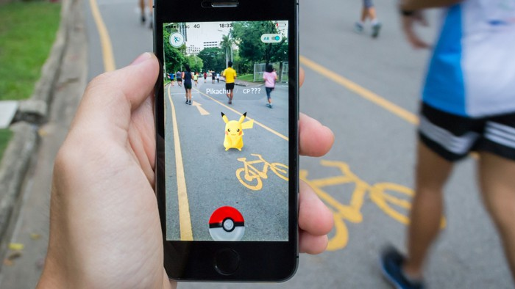
exploiting spawning algorithm <
a statistical approach
Notes:
In this project I tried to exploit the spawning algorithm behind the famous platform game Pokémon GO.
I guess that everybody knowns what Pokémon Go is,
in short, in this mobile game, the player should collect different monsters called Pokémon, and these Pokémon spawns in different places and condition.
So, more important, I had to explained that the spawning algorithm is the generative process that point out the features that the Pokémon that will spawn should have

Slide 2

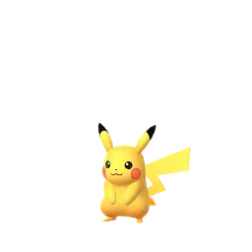


population density
type of terrain
temperature
wind speed
hour
season
problem <
Notes:
Basically, it takes in input many data from the real-world context like what’s the weather like or in which kind of neighborhood the player is located,
and it outputs the identification number of one of the hundreds Pokémon plus some variable attribute
This generative process should not be random neither deterministic. To be more precise,

Slide 3

goal <
Notes:
We don’t know
I would like do be straightforward, this presentation of results will be more like a presentation of fail rather than a presentation of success
due to the complexity of the dataset…
… so let’s have a look

Slide 4
Pokèmon ID [1:151]
fixed attribute (attack, defense, speed, ...)
variable attribute (weight, height, level, ...)
(Date, Time)
hour : (morning | afternoon | evening | night)
month : (spring | summer | fall | winter)
(Latitude, Longitude)
distance from fixed-position game spot (gym, villain, ...)
lakes, rivers, ...
population density : (urban | suburban | rural)
(Date, Time) + (Latitude, Longitude)
wind speed
pressure
clouds, fog
rain
sunset, sunrise
dataset <

Slide 5
151 pokémon
26 observable features (18 binary + 8 numeric)
principal component analysis
2 or 3 dimensions
clustering
5 or 6 group of pokémon
dimens-reduct <
Notes:
Dimensionality reduction idea

Slide 6
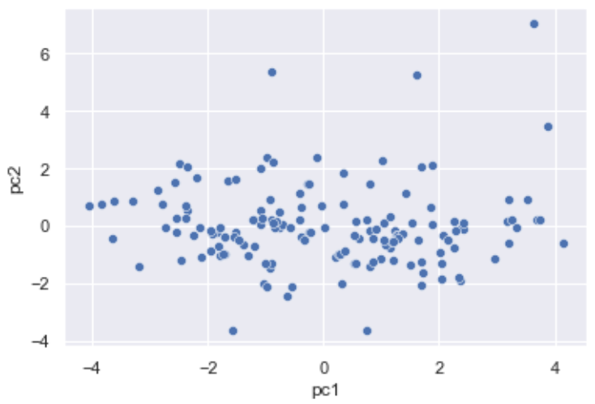
princ-comp <
Notes:
Dimensioanlity reduction results

Slide 7
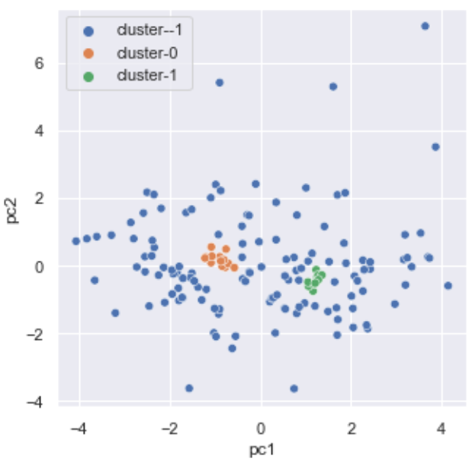
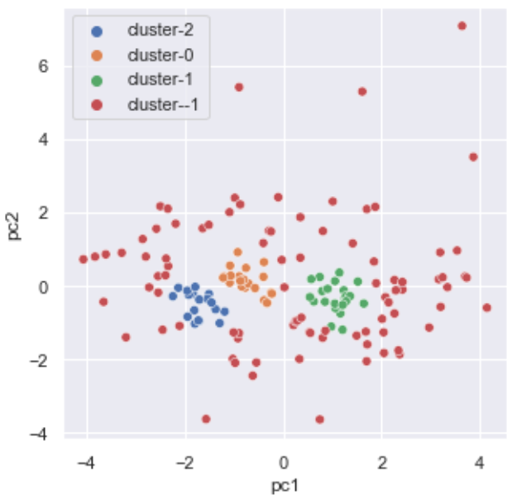
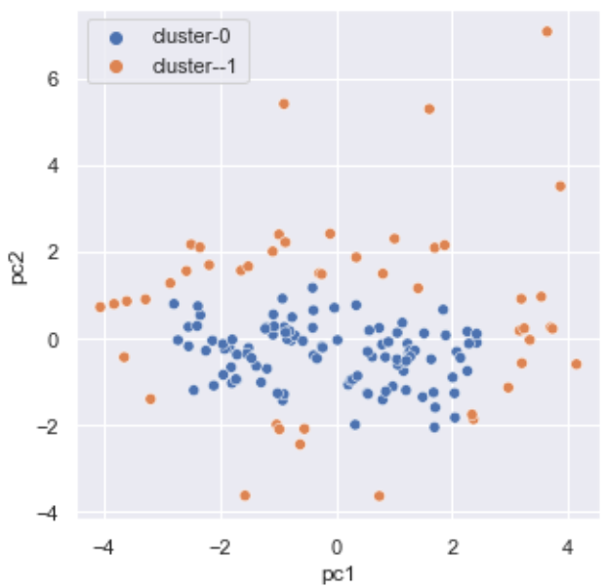
db-scan <

Slide 8
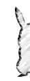
goal <
Notes:
Correspondence analysis idea

Slide 9


log-reg <

Slide 10
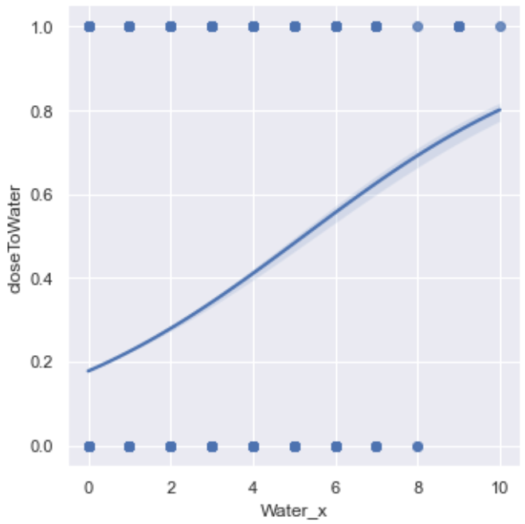
log-reg <

Slide 11
correspondence <
Notes:
Correspondence analysis idea

Slide 12
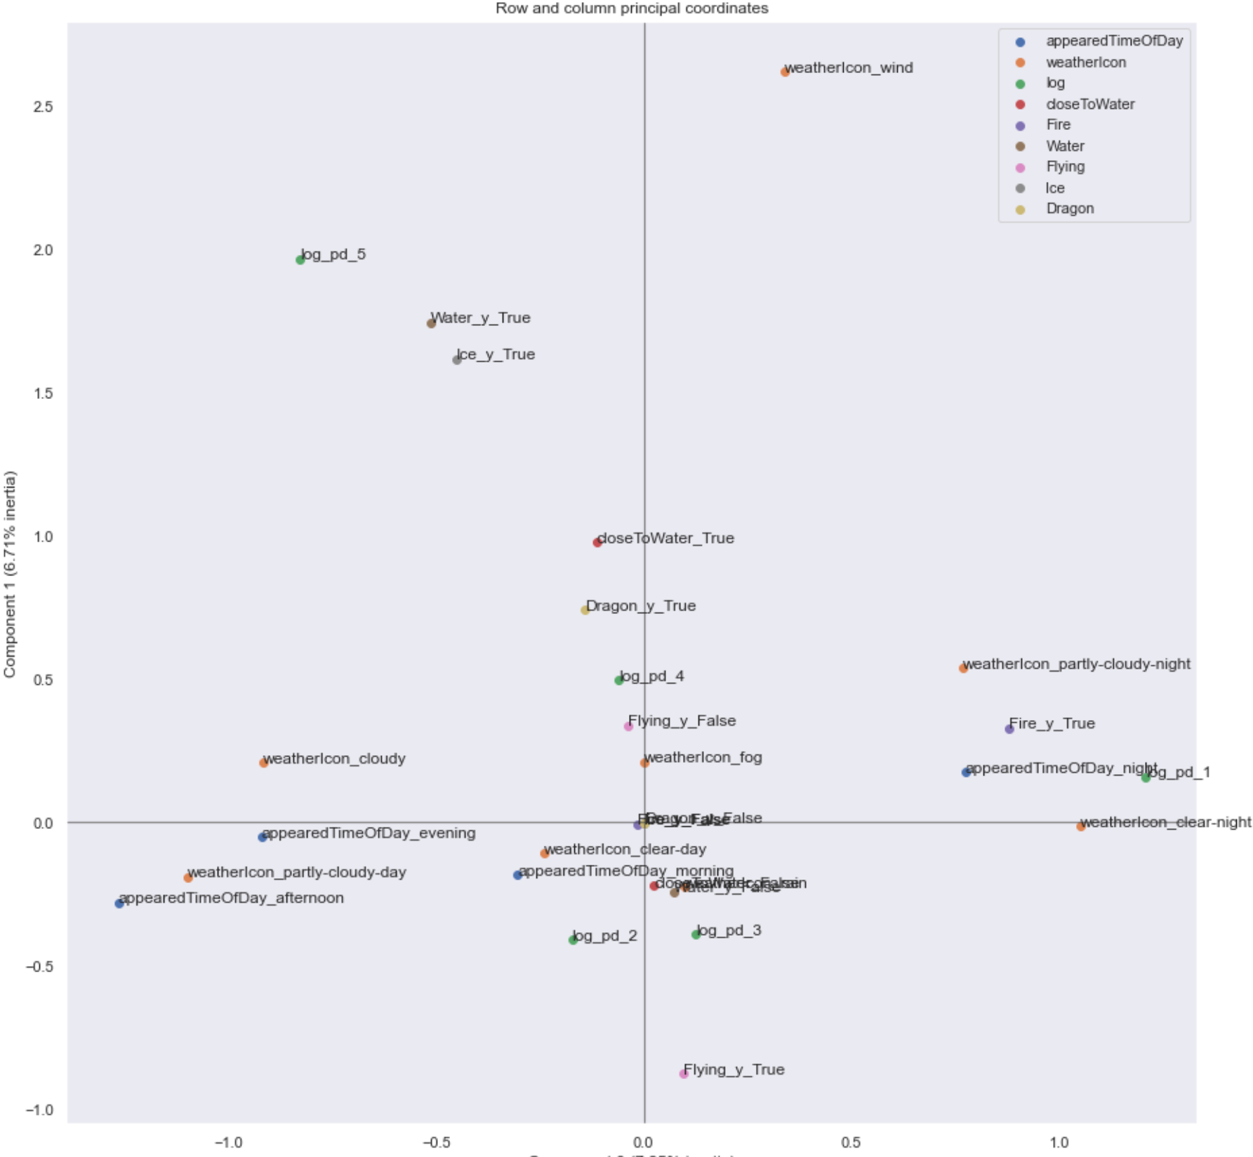
correspondence <
Notes:
categorical values
Mostly related to weather, density population was discetized

Slide 13
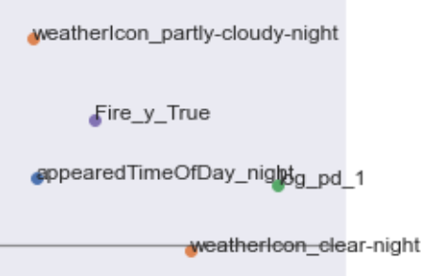
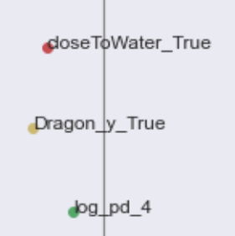


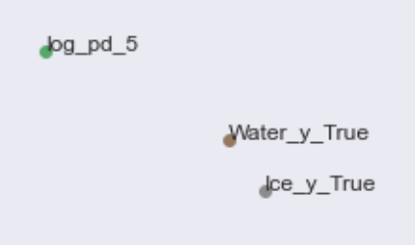

correspondence <
Notes:
Correspondence analysis results

Slide 14
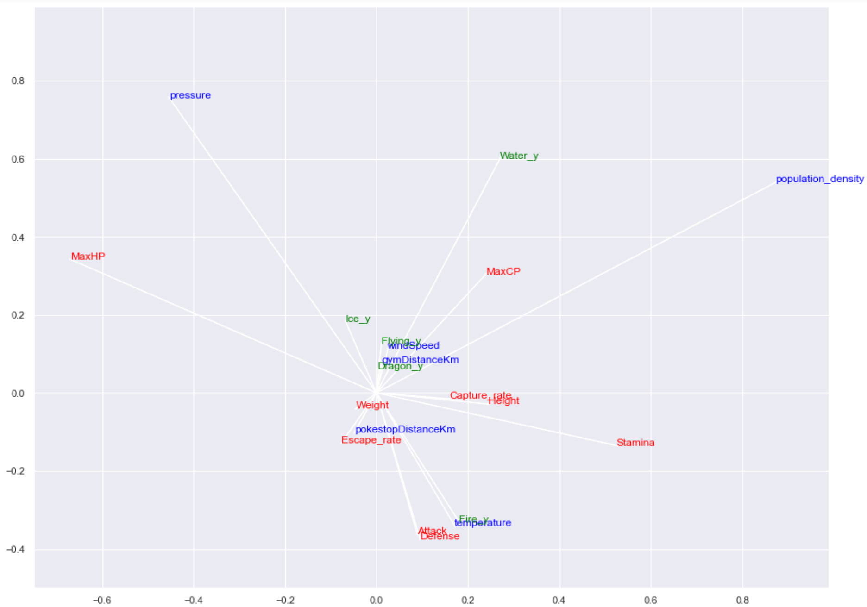
canonical-corr <
Notes:
Canonical correlation analisys

Slide 15
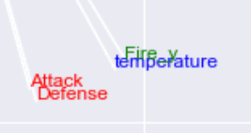
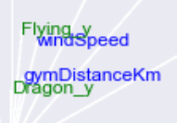

canonical-corr <
Notes:
Canonical correlation results

Slide 16

notebook github.com/ranieri-unimi/spawn-em-all-manzi-2022
dataset kaggle.com/semioniy/predictemall
end <

Slide 18
abstract <
In a game design context, generating objects (like enemies, items etc.) in an automatic but sensible way is a key factor. In this project we will model multiple analyses to exploit the generative process (the so-called spawn algorithm) behind a geolocation-aware game platform (Pokémon Go).
Since the spawn algorithm is kept secret but input like neighbourhood statistics, timeslot, weather parameters and fixed-object coordinates, and output (generated-object coordinates) are observable, we will provide a valid approximation of the generating mixture working on a sample dataset made up to 300.000 observation described by more than 200 features.

