Slide 1
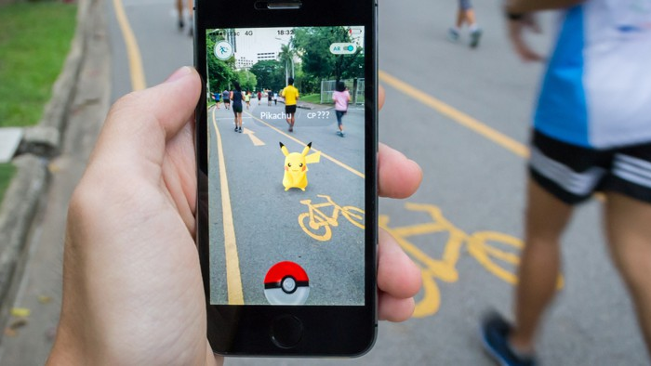
exploiting spawning algorithm <
a statistical approach
Notes:
In this project I tried to exploit the spawning algorithm behind the famous platform game Pokémon GO.
I guess that everybody knowns what Pokémon Go is,
in short, in this mobile game, the player should collect different monsters called Pokémon, and these Pokémon spawns in different places and condition.
First of all, generally, a spawning algorithm is the generative process that point out which kind of element should appear based on the context of the game.

Slide 2

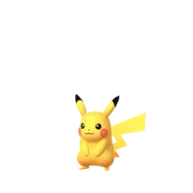


population density
type of terrain
temperature
wind speed
hour
season
problem <
Notes:
So, in our case the spawning algorithm will compute the features that the Pokémon that will spawn should have
Basically, the generative model inside Pokemon Go takes in input many data from the real-world context like what’s the weather like or in which kind of neighborhood the player is located,
and it outputs the identification number of one of the hundreds Pokémon, plus some not-fixed attribute that could vary in a certain range.
We don’t know how the generative model is, for sure it is very complex, but this project tried to provide an analysis of how should it work, trough statistical methods

Slide 3
Pokémon ID [1:151]
fixed attribute (attack, defense, speed, ...)
variable attribute (weight, height, level, ...)
(Latitude, Longitude)
distance from fixed-position game spot (gym, villain, ...)
lakes, rivers, ...
population density : (urban | suburban | rural)
(Date, Time)
hour : (morning | afternoon | evening | night)
month : (spring | summer | fall | winter)
(Date, Time) + (Latitude, Longitude)
wind speed
pressure
clouds, fog
rain
sunset, sunrise
dataset <
Notes:
The analyses were computed over a database of 300 of thousand of observation collected around the world during August 2016
The dataset has three main features:
the id of the extracted Pokémon
the geolocation, expressed with latitude and longitude, where the Pokémon spawn
And the local timestamp, so the hour and the day of the event
Thanks to this main features we can derive other features (..bro improvvisa..)

Slide 4
151 Pokémon
26 observable features (18 binary + 8 numeric)
principal component analysis
2 or 3 dimensions
clustering
5 or 6 group of Pokémon
dimens-reduct <
Notes:
Dimensionality reduction idea

Slide 5
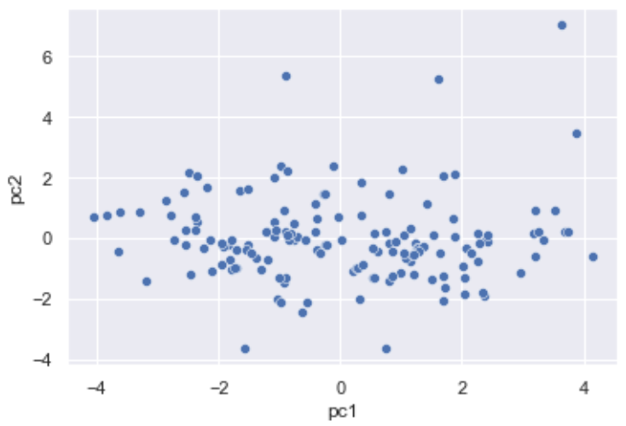
princ-comp <
Notes:
Dimensioanlity reduction results

Slide 6
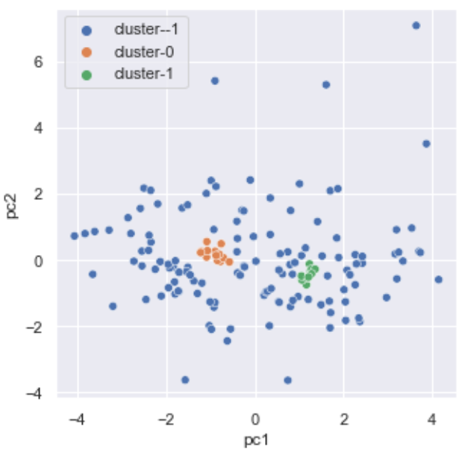
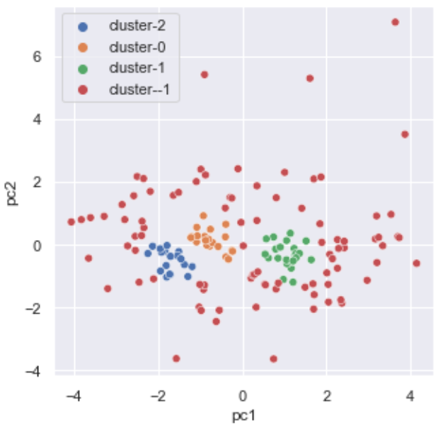
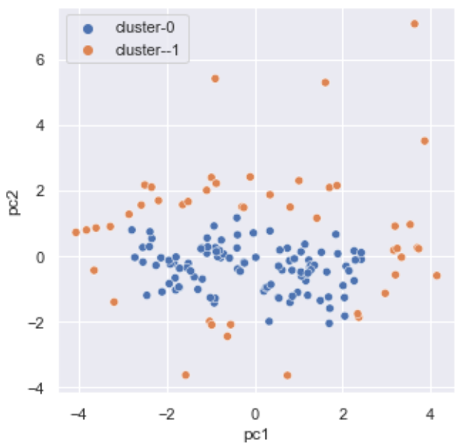
db-scan <

Slide 7


log-reg <

Slide 8
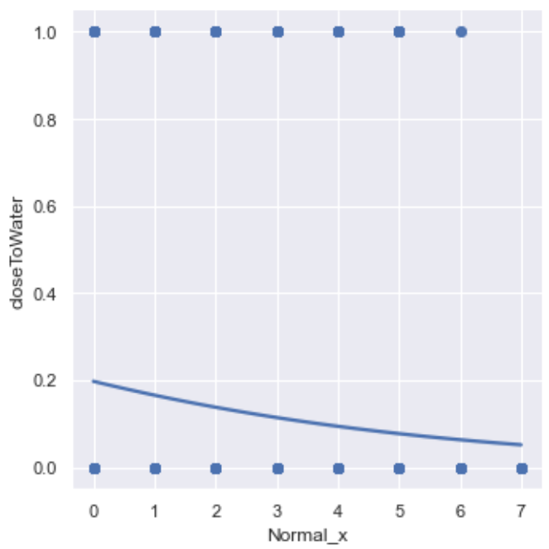
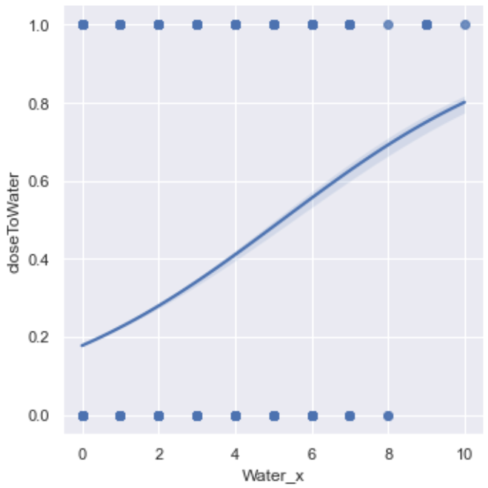
log-reg <
Notes:
An first experiment was made it
Bootstrapped
How about the other type of Pokémon?

Slide 9

correspondence <
Notes:
So measurige must be made by including as much features as possible without ending up to a multinomial of 17 variables,

Slide 10
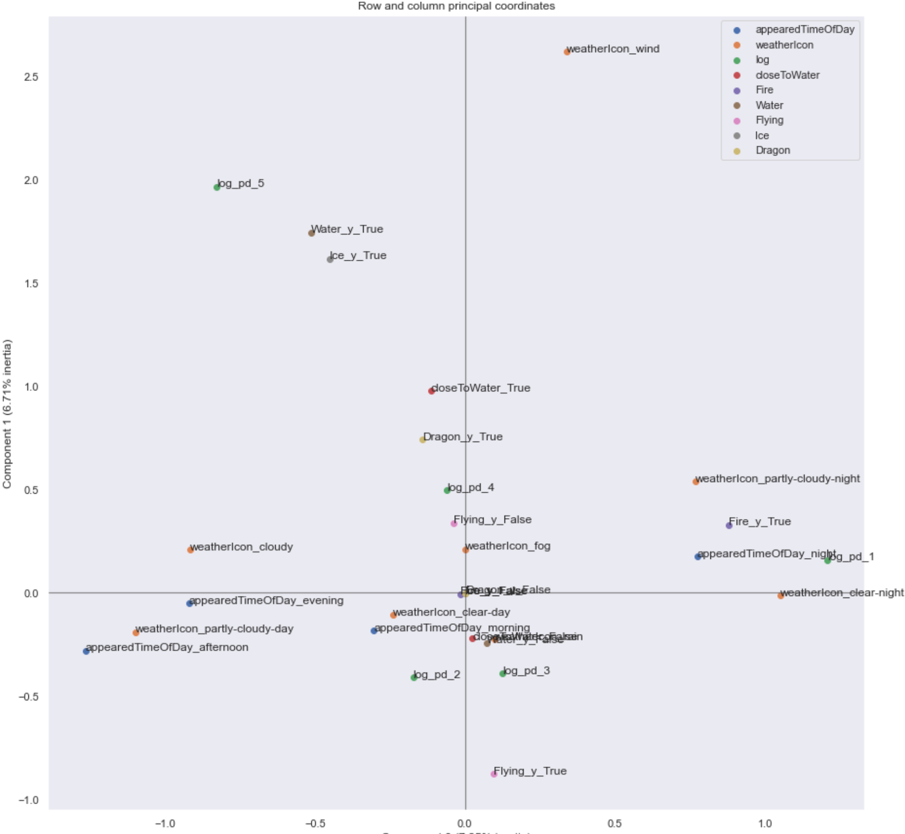
correspondence <
Notes:
categorical values
Mostly related to weather, density population was discetized

Slide 11
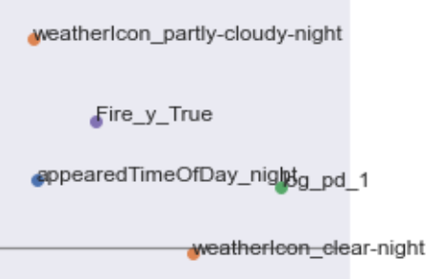
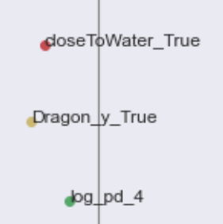


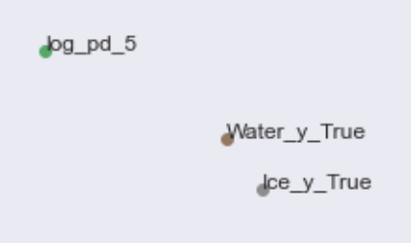

correspondence <
Notes:
Correspondence analysis results

Slide 12
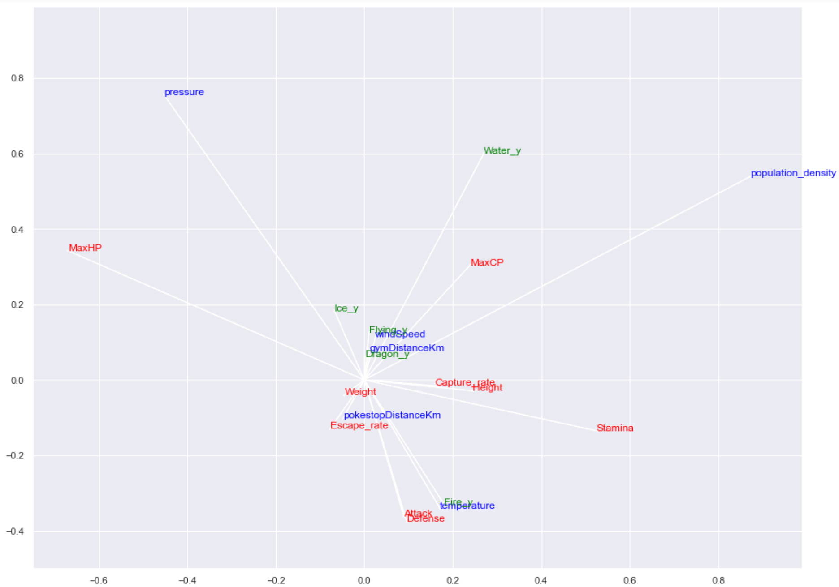
canonical-corr <
Notes:
Canonical correlation analisys

Slide 13
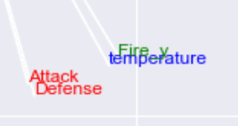
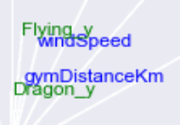

canonical-corr <
Notes:
Canonical correlation results

Slide 14

notebook github.com/ranieri-unimi/spawn-em-all-manzi-2022
dataset kaggle.com/semioniy/predictemall
end <

Slide 16
abstract <
In a game design context, generating objects (like enemies, items etc.) in an automatic but sensible way is a key factor. In this project we will model multiple analyses to exploit the generative process (the so-called spawn algorithm) behind a geolocation-aware game platform (Pokémon Go).
Since the spawn algorithm is kept secret but input like neighbourhood statistics, timeslot, weather parameters and fixed-object coordinates, and output (generated-object coordinates) are observable, we will provide a valid approximation of the generating mixture working on a sample dataset made up to 300.000 observation described by more than 200 features.

Slide 17
goal <

Slide 18
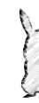
goal <
Notes:
Correspondence analysis idea

