Slide 1
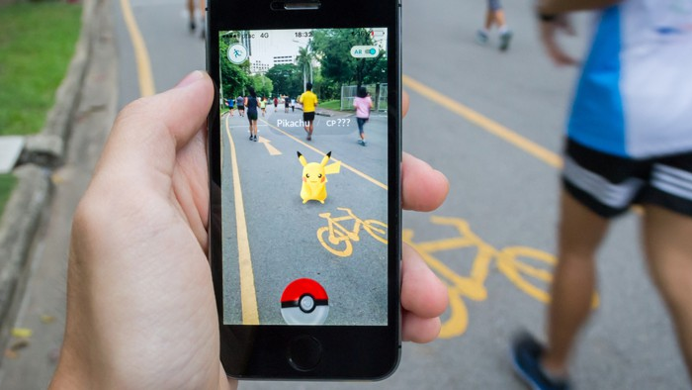
exploiting spawning algorithm <
a statistical approach
Notes:
In this project I tried to exploit the spawning algorithm behind the famous platform game, Pokémon GO.
I guess that everybody knowns what Pokémon Go is,
But in short, in this mobile game, the player should collect different monsters called Pokémon, and these Pokémon spawns in different places and at different condition.
Generally, a spawning algorithm is the generative process that point out which kind of element should appear, based on the context of the game.

Slide 2




population density
type of terrain
temperature
wind speed
hour
season
problem <
Notes:
So, in our case the spawning algorithm will compute the values that the Pokémon that will spawn should have.
Basically, the generative model, inside Pokémon Go, takes in input many data from the real-world context like,
what’s the weather like, or in which kind of neighbourhood the player is located,
and it outputs the identification number of one, of the hundreds Pokémon,
plus some not-fixed attribute that could vary in a certain range.
We don’t know how the generative model works, for sure it is very complex, but this project tried to provide some analyses of how it should work, trough statistical methods

Slide 3
Pokémon ID [1:151]
fixed attribute (attack, defense, speed, ...)
variable attribute (weight, height, level, ...)
(Latitude, Longitude)
distance from fixed-position game spot (gym, villain, ...)
lakes, rivers, ...
population density : (urban | suburban | rural)
(Date, Time)
hour : (morning | afternoon | evening | night)
month : (spring | summer | fall | winter)
(Date, Time) + (Latitude, Longitude)
wind speed
pressure
clouds, fog
rain
sunset, sunrise
dataset <
Notes:
The analyses were computed over a dataset of 3 hundred of thousand of observations collected around the world during August TwentySixTeen
The dataset has three main variables:
the id of the extracted Pokémon
the geolocation, expressed with latitude and longitude, where the Pokémon spawn
And the local timestamp, so the hour and the day of the event
Thanks to this three main information we can derive other variables,
those ones that are really used by the generative model
so we can retrieve weather conditions,
seasonal changes like the end of the day or of the night,
if the Pokémon is located in a rural or urban context, if there is a river or a lake near the player, … and all stuff like that
so, on the output side, the generative model will mix all the input,
to obtain a set of fixed and variable attributes,
that the Pokémon should have,
and it will choose a Pokémon that is likely to match those attributes

Slide 4
151 Pokémon
26 observable features (18 binary + 8 numeric)
principal component analysis
2 or 3 dimensions
clustering
5 or 6 group of Pokémon
dimens-reduct <
Notes:
So, a big issue is that, the Pokémon ID is obviously a nominal variable,
but with one hundred and fifty possible values
And if we consider the variable of each Pokémon like
a sort of coordinates in a multivariate space, things are not going to be easier.
Because each Pokémon is described by 8 numeric features and 18 dummy variables
Scinànighen(,) we can apply the principal component analysis to reduce the number of dimensions,
then, apply a clustering technique and so reduce 150 labels to a bunch of labels that represent few homogeneous groups

Slide 5
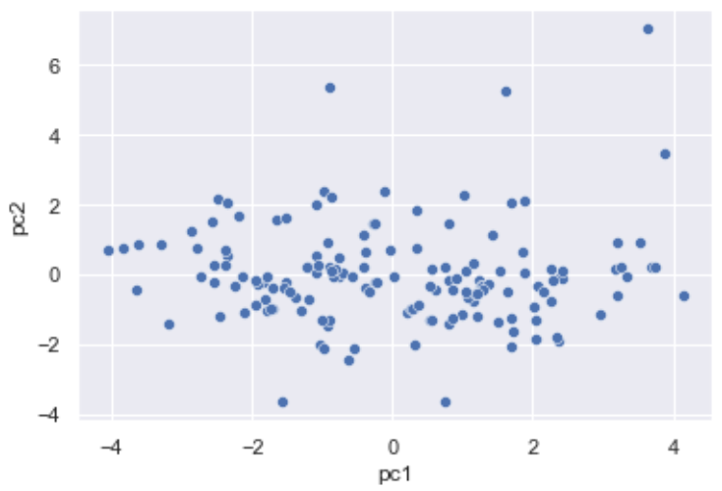
princ-comp <
Notes:
so, here we got the result of the PCA with two components, but not so much appealing,
(Kaiser was pretty low) (proportion of variance of the fists few component was not enough)
I also tried to keep 3 components, but the result did not change matter, moreover three-dimensional plot did not give a better clear view.

Slide 6
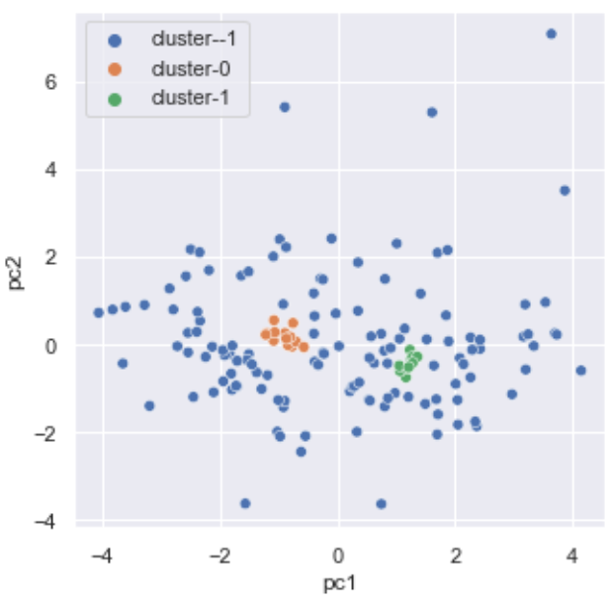
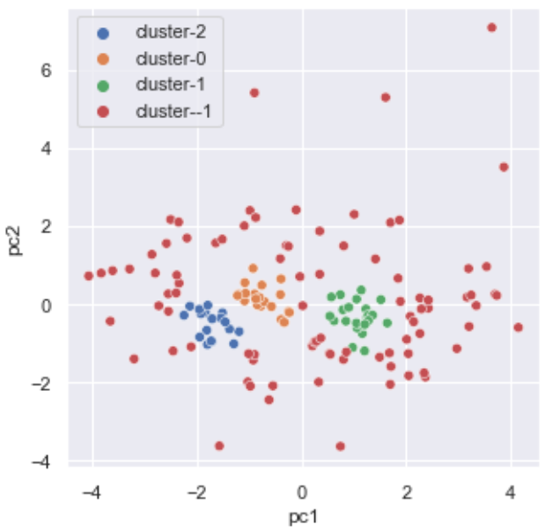
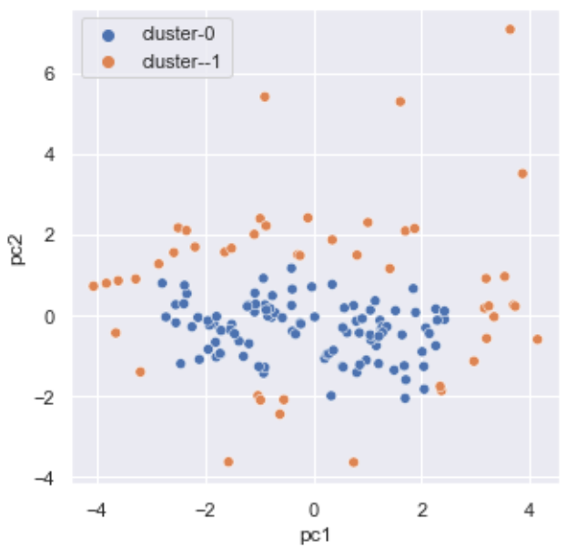
db-scan <
Notes:
For the sake of science I applied DB SCAN,
that’s because I was expecting that, most of the Pokémon, somehow, would form dense groups,
and instead, few of particular Pokémon would lies between those clusters.
I tried also to change dynamically the radius epsailon,
but in any case it did not lead to homogeneous clusters,
and the noise cluster,
, the one labelled with minus 1,
was always too large.

Slide 7


log-reg <
Notes:
So I tried a different approach:
maybe it’s easier to link some single real word variable to the spawn frequency, of a specific in-game variable.
Like, for example, I would expect to find near rivers and lakes more Pokémon related to water
,so, Pokémon based on fishes or frogs.
Aand, yeah,

Slide 8
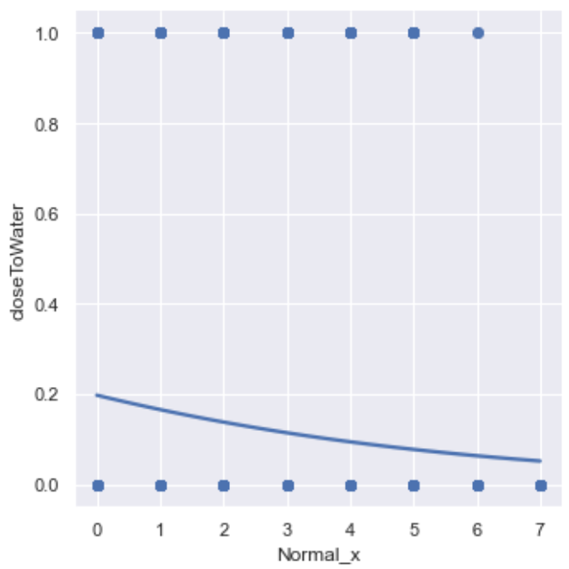
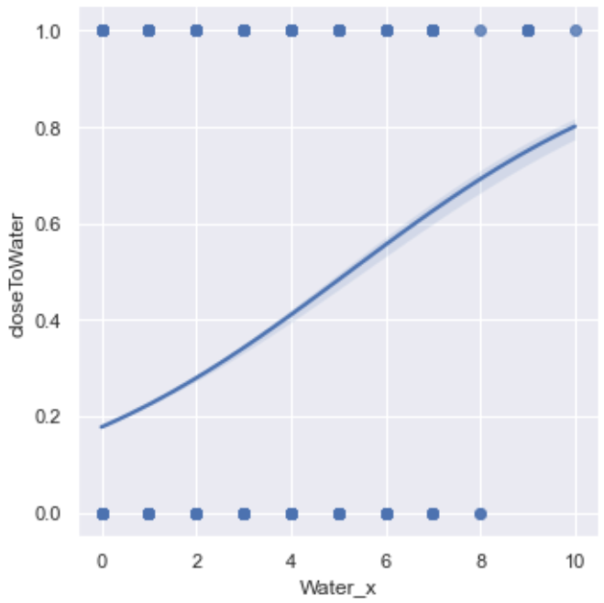
log-reg <
Notes:
, it could work,
I made a toy example with a bootstrapped logistic regression,
on the left normal Pokémon, and on the right water type Pokémon.
On the x we got the number of spawning Pokémon of the selected type,
And, as binary response, if the player was near or not to some kind of water venue,
in a range of one hundred meters.
So, the advantages of using a multiple logistic regression with multiple response variables are that we can push with no regards all the multivariate input,
and we can also compute the odds that a specific Pokémon will appear under certain condition.
But in the other hand, many variables should be dichotomized, and we will still end up in a very messy and heavy multinomial output.

Slide 9

correspondence <
Notes:
So at this checkpoint, it’s pretty insane to consider statistical analyses that do require tons of manual manipulation,
or that require a lot computational time, like Bayesian network
and on mind I still like the idea including not all, but at least as much features as possible, and disentangle relationship between them

Slide 10
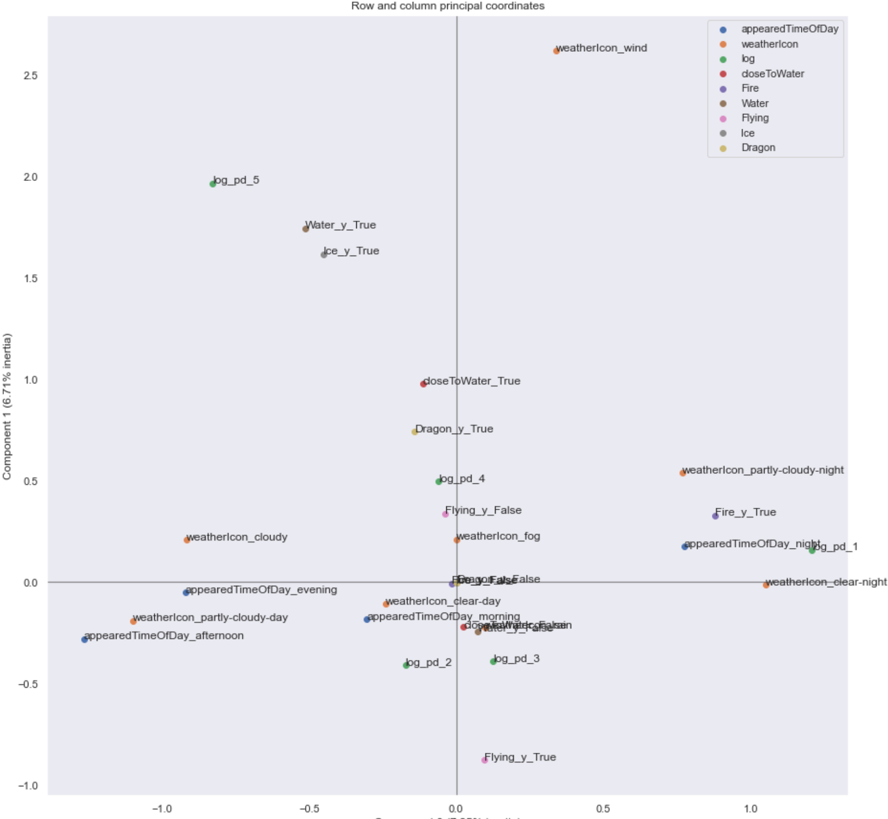
correspondence <
Notes:
So,multiple correspondence analysis could be our superhero,
at least for nominal features,
but that’s not a big deal,
for example, here,
density population was discretised and put together to the other features
so, let me zoom for you the most appealing cluster

Slide 11
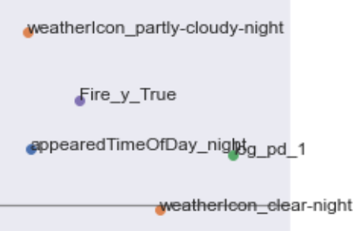
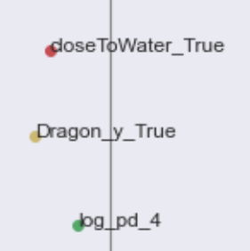


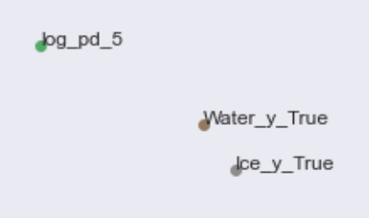

correspondence <
Notes:
as we can see (..ii..)
<<<<<<<<<<<<<<
We said that fire Pokémon are likely to spawn during the night
and we obviously known that night is typically cold,
same for rural areas

Slide 12
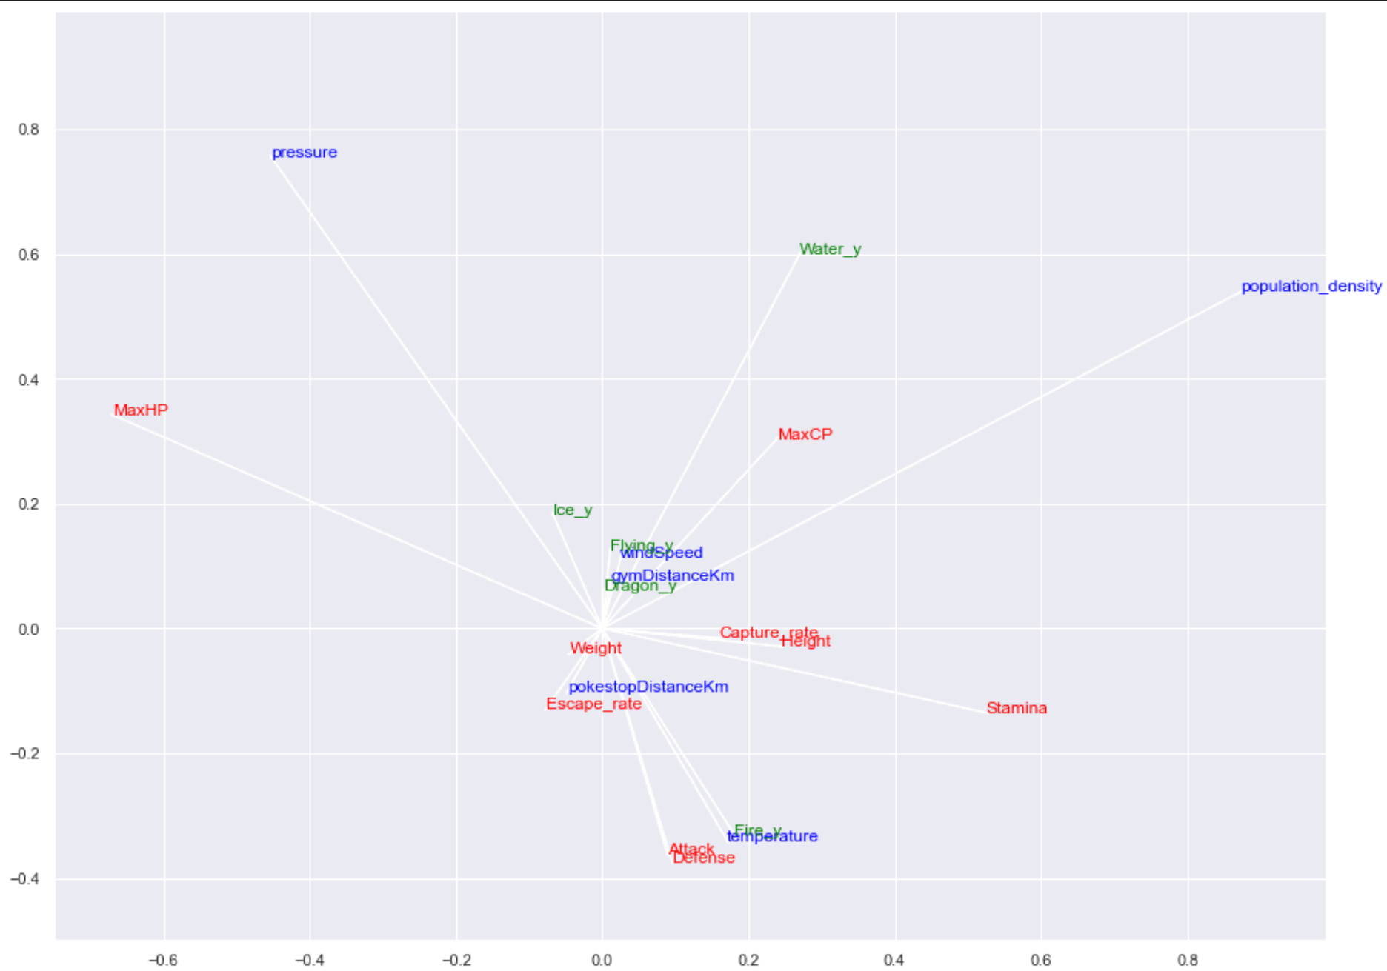
canonical-corr <
Notes:
last but not least,
I gave also a try to canonical correlation
to let continuous features shine their power
Let me zoom again

Slide 13
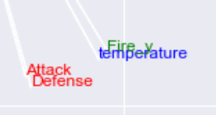
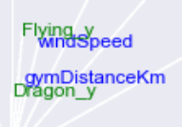

canonical-corr <
Notes:
so, I won’t trust at all these results because, for example, distances are not obviously normally distributed,
But they still look pretty nice,
for example,
gamers believe that fire Pokémon spawns to “heat up” the gamer when it’s cold,
and if you look at this fire–temperature correlation
this belief can be confirmed by looking at our correspondence analysis
wheeeere
<<<<<<<<<<<<

Slide 14

notebook github.com/ranieri-unimi/spawn-em-all-manzi-2022
dataset kaggle.com/semioniy/predictemall
end <
Notes:
so, that’s all
I hope you enjoyed this small adventure inside this
mix of analysis.
thanks

Slide 16
abstract <
In a game design context, generating objects (like enemies, items etc.) in an automatic but sensible way is a key factor. In this project we will model multiple analyses to exploit the generative process (the so-called spawn algorithm) behind a geolocation-aware game platform (Pokémon Go).
Since the spawn algorithm is kept secret but input like neighbourhood statistics, timeslot, weather parameters and fixed-object coordinates, and output (generated-object coordinates) are observable, we will provide a valid approximation of the generating mixture working on a sample dataset made up to 300.000 observation described by more than 200 features.

Slide 17
goal <

