Slide 1
Accident analysis and severity prediction of road accidents in the United States using machine learning algorithms
Group 7
Members: Sri Siddhartha Reddy Gudemupati,
Praneetha Kotikalapudi,
Yen Ling Chao
Professor: Dr. Ebrima Ceesay
Date: May 13th, 2022

Slide 2
Introduction
Around 37000 persons die in automobile accidents each year, with another 2.35 million wounded or incapacitated by car accidents.
Children under the age of 15 were responsible for 1600 deaths
While approximately 8000 persons between the ages of 16 and 20 were killed in automobile accidents.
As a result, vehicle accidents have become a societal hazard and one of the four leading causes of mortality in the metropolitan population.
We can take appropriate actions and better manage financial and human resources if we can identify the primary reasons for catastrophic accidents.

Slide 3
Problem Statement
The goal of this paper is to conduct a statistical analysis of the data
Investigate the states with the most accidents, investigate when accidents are most likely to occur and the weather conditions at the time of accidents
Discover the factors influencing the occurrence and severity of accident
The severity of the accident is predicted and evaluated.

Slide 4
Significance
This research studies the current state of road accidents in the United States which we are going to focus on Virginia State
Offers recommendations for reducing the number and severity of accidents based on several data parameters.
Examine the distribution of accidents in the United States based on geography.
The weather dimension is used to examine the diverse effects of various meteorological elements on severity.
To evaluate and comprehend if current accidents in the United States are rising or decreasing year by year
Which period is the peak period during which traffic accidents are most likely to occur.

Slide 5
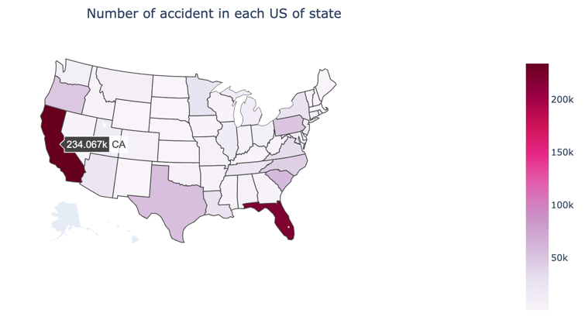
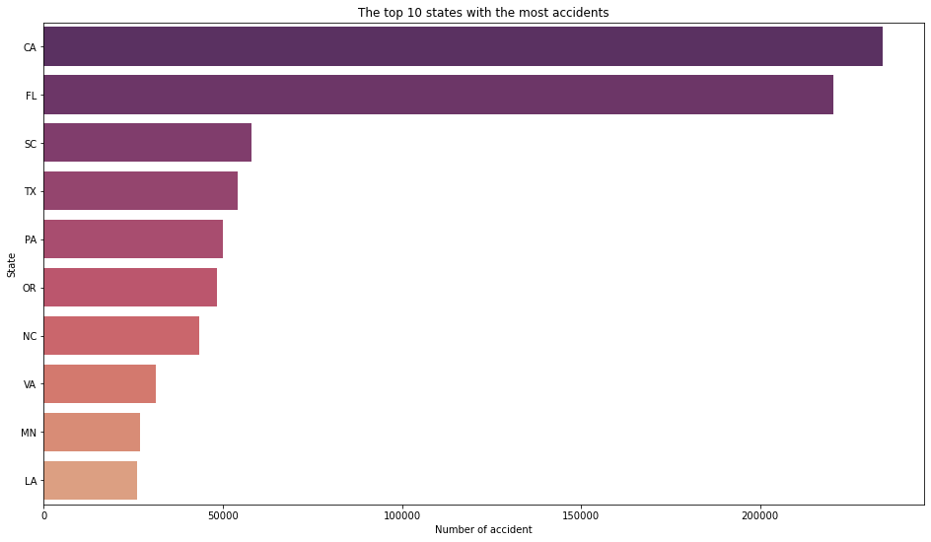
Visualization
From the map, we see that California is recorded to be the highest accident-prone state
The top ten states have the highest number of auto accidents.
The top three states with the most accidents are California, Florida, and South Carolina, all of which are at the top of the US in terms of population and GDP.
The expansion of traffic will be fueled by the economy's prosperity, and the likelihood of traffic accidents will rise as well.

Slide 6
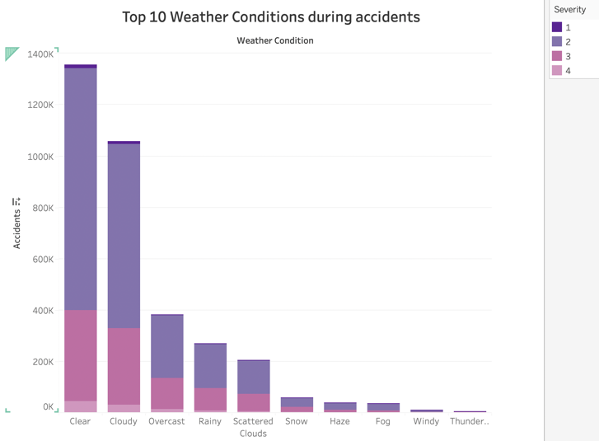
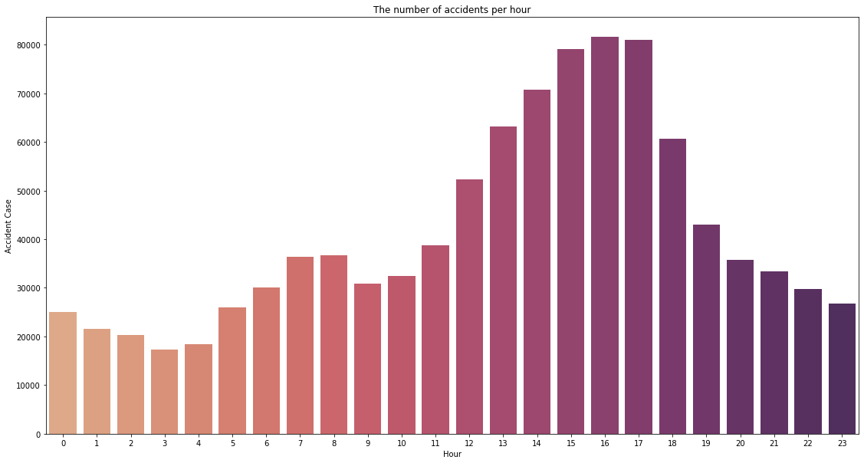
Visualization
The bar chart displayed the top ten weather conditions at the time of the accident.
We can observe that the majority of accidents have a severity of 2
The majority of accidents occur in "Clear" weather conditions, and that the total number of accidents exceeds 1,200,000.
The higher the number of accidents in the morning peak, the greater the traffic flow
The evening peak comes to an end, the serious accident rate continues to rise, reaching a peak at 17:00 and then gradually decreasing
It is speculated that this is due to fatigue driving after normal working hours.

Slide 7
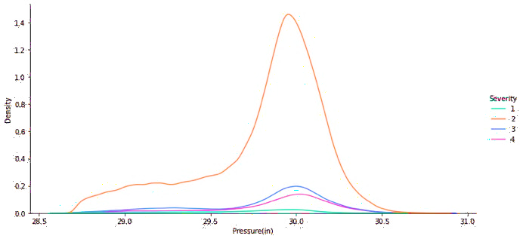
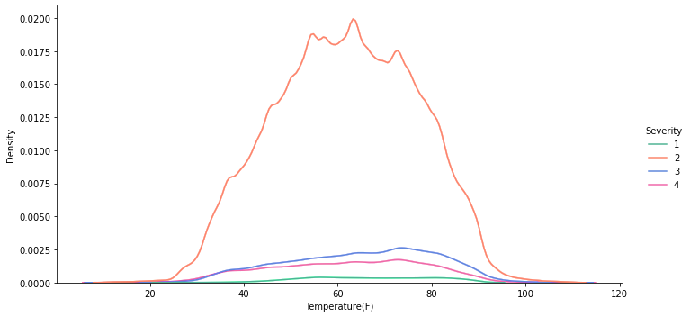
Visualization
Considering the climate conditions such as temperature and pressure
All the severity 2 is more when the pressure is between 29.5 and 30.5
Found that other severities are recorded to be more at that particular pressure point.
Considering temperature as a factor, severity 2 is highest when the temperature is recorded between 40F and 80F

Slide 8
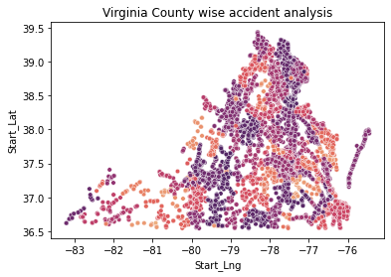
VA accident Analytics
There were 128,172 events in 2019, with 65,708 injuries and 827 fatalities. However, there were 105,600 accidents in 2020, resulting in 52,668 injuries and 847 fatalities.
However, the number of collisions on Virginia's roadways fell in 2020, while road deaths increased to the highest level in more than a decade.
There will be a 2.4 percent rise in accident deaths in 2020 compared to 2019, while speed-related fatalities would climb by 16.3 percent compared to last year.

Slide 9
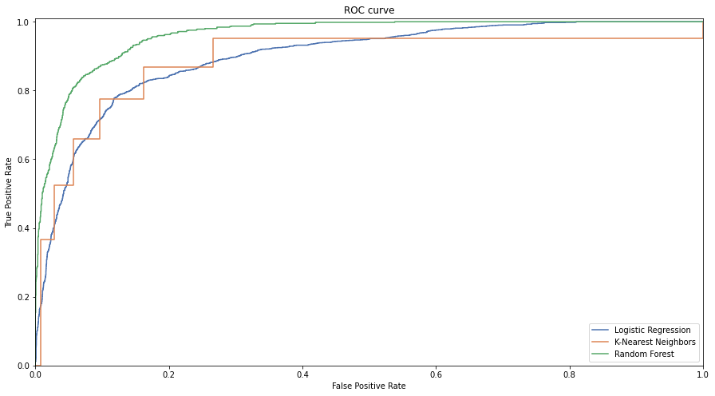
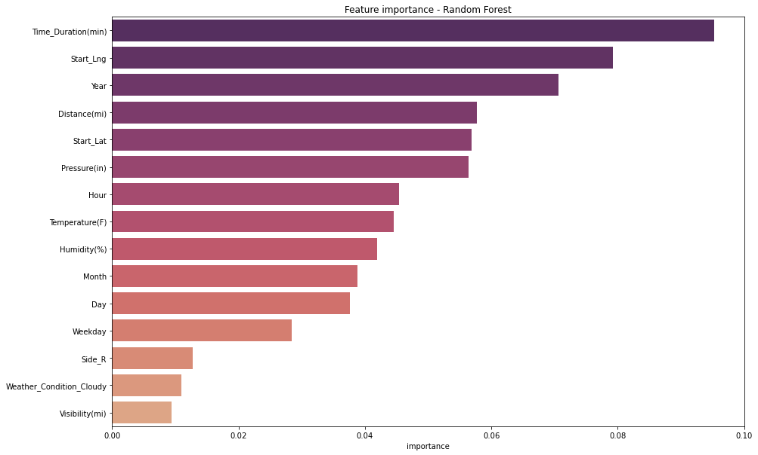
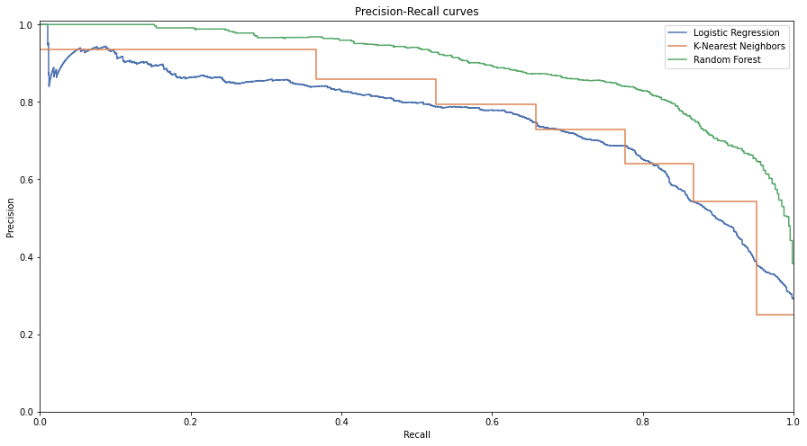
Model Result
By building a model using logistic regression, KNN, and random forests, and compare the results to see which model can predict the severity of a vehicle accident better.
We discovered that the random forest has the best outcomes after analyzing and comparing the results of the three models using the accuracy, ROC, and PR curves.
Model | Logistic Regression | KNN | Random Forest
Accuracy | 0.71 | 0.85 | 0.88
Precision | 0.29 | 0.59 | 0.88
Recall | 0.28 | 0.47 | 0.62
F1-score | 0.26 | 0.49 | 0.69

Slide 10
Conclusion And Future Work
Conclusion
The severity of road accidents may be predicted using the three types of traffic accident severity prediction models developed in this work.
Second, the data from traffic accidents includes many dimensions, and the random forest technique is well-suited to multi-dimensional data and can produce accurate predictions.
We can determine if these factors are influence by predicting the severity of traffic incidents. As a result, there is a useful measure for preventing or lessening the severity of road accidents.
These elements can be studied and planned for as much as feasible while developing traffic roadways in order to lessen the influence on traffic accidents.
Future Work
Predicting automobile accidents is a critical area for future study as a method of reducing accidents and only using three modeling, however, more algorithms can be investigated for verification in the future to improve prediction results.
To conduct more research and pay closer attention to the severity of automotive accidents in each state.SSsS

