Slide 1
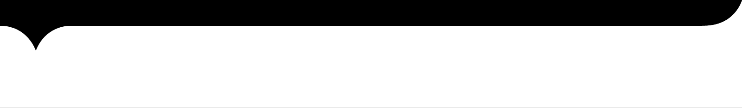

Airline Reservation System
IGATE is now a part of Capgemini

Slide 2
TEAM MEMBERS
Employee Id | Employee Name
150682 | B. Sri Vani
150701 | Ch. Anudeep
150702 | Ch. Lakshmi Kalyani
150683 | B. SreeLekha

Slide 3
CONTENTS
OVERVIEW
REQUIREMENT ITEMIZATION
USECASE
ACTORS
TESTCASE
APPLICATION LINK
DEFECTS
TEST CASE ADEQUACY
TEST CASE EFFECTIVENESS
PROJECT STATISTICS
TRACEABALITY MATRIX

Slide 4
OVERVIEW OF THE PROJECT
This project is aimed at developing an online Airline Reservation System (ARS) for customers. This is a web based application that can be accessed throughout the web. This system can be used to search flight details, reserve flight, and update/cancel any reservation. This is an integrated system that contains both the user component and the administration component. There are features like report generators etc in this system.

Slide 5
REQUIREMENT ITEMIZATION
Requirements validation is an iterative process which takes place throughout the lifecycle of the project.
During elicitation, analysis and specification you should constantly be questioning and clarifying the data given to you in order to check its validity.
This will ensure that the SRS that you produce is complete, consistent and ready for the formal validation process.
LINK: C:\Users\Mini\Desktop\project\RVFD.xlsx

Slide 6
Requirements Validation And Functional Decomposition
Termination
End process
File Handling
Storage of information
Invocation
Start process
Implicit
Efficiency
RVFD
System
Minimum specifications
Explicit
User specified
Query
improvements
Error Handling
consistency
Security
For confidentiality

Slide 7
USE CASES
A use case is a methodology used in system analysis to identify, clarify, and organize system requirements.
The use case is made up of a set of possible sequences of interactions between systems and users in a particular environment and related to a particular goal.
A use case can be thought of as a collection of possible scenarios related to a particular goal, indeed, the use case and goal are sometimes considered to be synonymous.

Slide 8
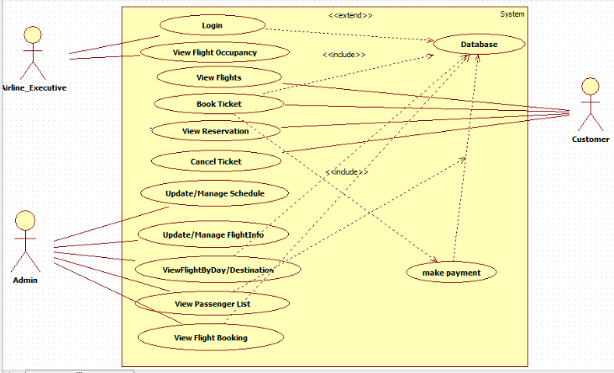
USE CASE DIAGRAM

Slide 9
ACTORS
Admin
Airline-Executive
User

Slide 10
TEST CASES
A test case is a set of conditions or variables under which a tester will determine whether a system under test satisfies requirements or works correctly.
The process of developing test cases can also help find problems in the requirements or design of an application.

Slide 11
Link : C:\Users\mini\Desktop\project\TESTCASE.xlsx
TEST CASES
LOGIN
User
View Flight Occupacy
Login
Executive
Admin
View Booking Info
Login
Update Flight Info
View flights
Book flight

Slide 12
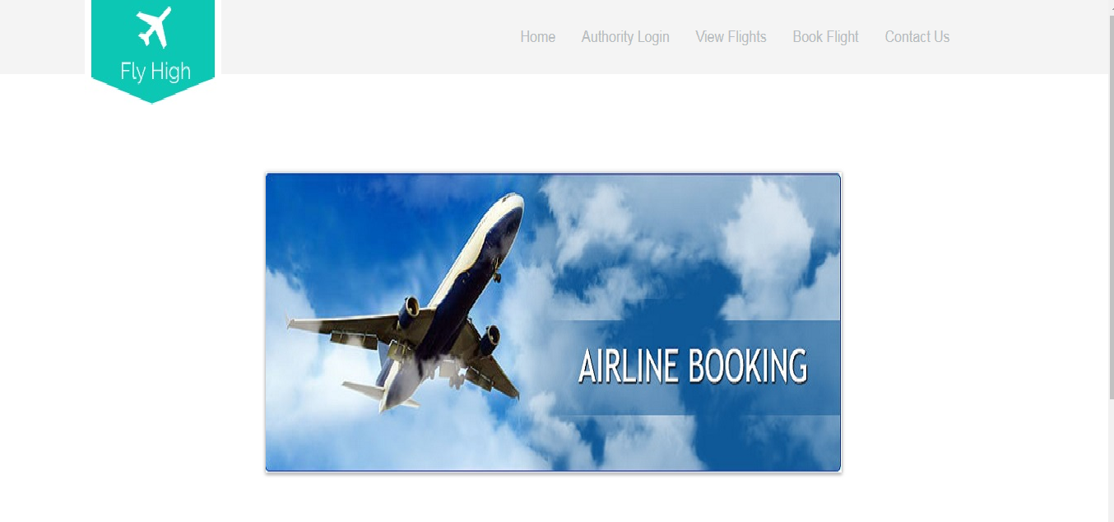
Application link
http://ndafile:8081/AirlineReservationSystem/

Slide 13
DFDR
A defect is an error or a bug, in the application that causes it to produce an incorrect or unexpected results.
A programmer while designing and building the software can make mistake or error.
These mistakes or errors mean that there are flaws in the software, these are called defects and the report written for logging these defects is called a defect report.
LINK: TechnoTM.pptx

Slide 14
DEFECTS FOUND
Admin cannot be able to login in to website.
The system does not display appropriate error message on entering invalid username and invalid password.
Admin cannot be able to view the flight schedule.
Admin cannot be able to update the Flight schedule.
Admin cannot be able to view the passenger list of specific Flight.
Admin

Slide 15
DEFECTS FOUND
Airline-Executive
Airline-Executive cannot be able to view the flight occupancy details.

Slide 16
DEFECTS FOUND
User cannot be able to view the reservation details.
User cannot be able to update the booking details.
User cannot be able to cancel the booking details.
User cannot be able to make payment through Net-Banking/Debit card.
Users are allowed to enter the numeric data in the name field.
Users are allowed to enter invalid mail Id.
User

Slide 17
Test Case Adequacy
This defines the number of actual test cases created vs estimated test cases at the end of test case preparation phase. It is calculated as
Test Case Adequacy = No. of actual Test cases*100/No. of estimated Test cases estimated
=(79*100)/89
=88.76

Slide 18
Test Case Effectiveness
This metrics defines the effectiveness of the test cases which is measured in terms of the number of defects found in testing with using the test cases.
Test Case Effectiveness = No. of defects detected using test cases*100)/total no of defects detected in testing
=(15*100)/18
=83.33

Slide 19
Project Statistics
Number of Test Cases = 79
Number of Test Cases Passed = 51
Number of Test Cases Failed = 28
Number of Defects Logged = 15
Number of Use Cases = 1

Slide 20
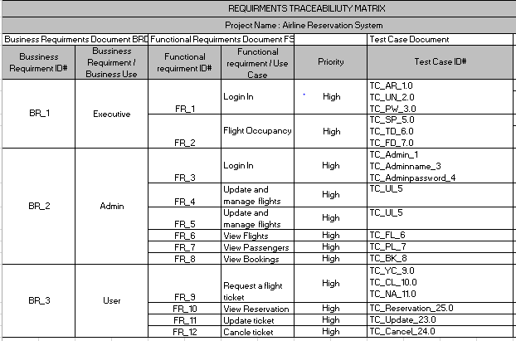
Traceability Matrix

Slide 21
USE CASE HYPERLINKS
Login:
http://ndafile:8081/AirlineReservationSystem/
http://ndafile:8081/AirlineReservationSystem/loginForm.obj
Functionalities:
http://ndafile:8081/AirlineReservationSystem/View.obj
http://ndafile:8081/AirlineReservationSystem/bookTicket.obj
http://ndafile:8081/AirlineReservationSystem/loginValidate.obj
http://ndafile:8081/AirlineReservationSystem/contact.jsp

Slide 22
THANK YOU

