Slide 1

Mastering Basic SQL Queries: A Guide for Excel Professionals
Unlock the power of databases with SQL. As Excel experts, learning SQL queries will enhance your data analysis capabilities. This guide will introduce you to essential SQL commands and their practical applications.
by Ranil Kr
RK

Slide 2

SELECT: Retrieving Data
1
Syntax
2
Purpose
SELECT column1, column2 FROM table_name;
Retrieves specific columns from a table, similar to filtering columns in Excel.
3
Example
4
Excel Parallel
SELECT first_name, last_name FROM employees;
Like choosing specific columns in a pivot table or VLOOKUP function.

Slide 3
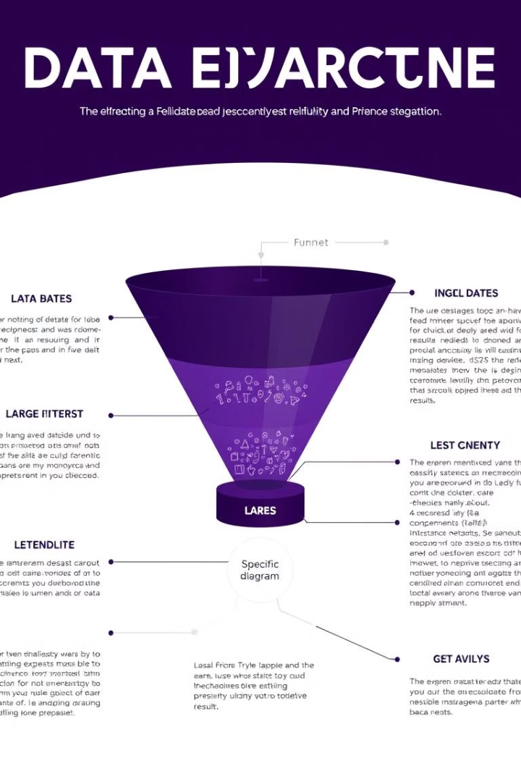
WHERE: Filtering Data
1
Syntax
SELECT column1, column2 FROM table_name WHERE condition;
2
Purpose
Filters rows based on specified conditions, similar to Excel's filter function.
3
Example
SELECT * FROM sales WHERE amount > 1000;
4
Excel Parallel
Comparable to using AutoFilter or advanced filter options in Excel.

Slide 4
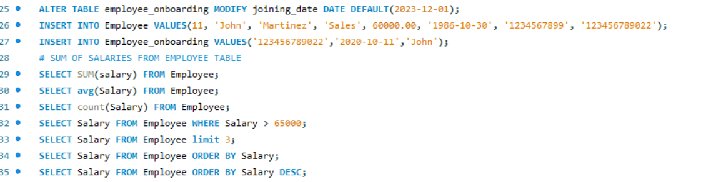
. Basic SQL queries
&
joining tables in MySQL

Slide 5
JOIN: Combining Data from Multiple Tables
INNER JOIN
LEFT JOIN
RIGHT JOIN
Retrieves matching rows from both tables. Similar to VLOOKUP with exact match.
Keeps all rows from left table, matching from right. Like VLOOKUP with #N/A results.
Keeps all rows from right table, matching from left. Reverse of LEFT JOIN.

Slide 6

Aggregate Functions: Summarizing Data
Function
Purpose
Excel Equivalent
COUNT()
Counts non-null values
COUNTA()
SUM()
Calculates total of values
SUM()
AVG()
Computes average of values
AVERAGE()
MAX()
Finds maximum value
MAX()
MIN()
Finds minimum value
MIN()

