Slide 1
IT3081 Statistical Modelling
Executive Consultancy Presentation
Product Category Purchase Prediction & Demand Intelligence: Rigorous Statistical Modelling
Client: BladeGen Tech Consultancy | Presented by: Group 4 | Duration: 15 Mins
Notes:
[PRESENTER: Member 1 | TIME ALLOCATION: 0:00 - 0:45]
TALKING POINTS & VIVA DEFENSE:
Good morning members of the board and examination panel. We represent Statistical Innovation Consulting Group 4. Today, we present an end-to-end statistical intelligence solution developed for BladeGen Tech to resolve retail inventory waste and optimize checkout upselling through rigorous 4-model statistical learning, hypothesis testing, and seasonal ARIMA forecasting.

Slide 2
Agenda
02
Consultancy Roadmap & Member Allocations
Equal 4-way division across all 12 IT3081 syllabus tasks
Member 1: Context & Literature
• Task 1: F&B Industry Problem Formulation
• Task 2: Literature Review (16 Papers with Page/Line citations)
• Timing: 0:00 - 3:30 (3.5 mins)
15 min
Member 2: Data Audit & Inference
• Task 3: 8-Point Source Integrity Audit & Visual EDA
• Task 4: Classical Hypothesis Inference (6 Tests)
• Timing: 3:30 - 7:00 (3.5 mins)
Member 3: 4-Member Models & CRD/RCBD
• Task 5: Multi-Model Tournament (LDA, GLM, QDA, NB)
• Task 6: Experimental Design (CRD vs. RCBD)
• Timing: 7:00 - 11:00 (4.0 mins)
Member 4: Advanced Analytics & Roadmap
• Task 7-9: PCA Evaluation, Bayesian Decision Theory & Seasonal ARIMA
• Task 10-12: POS Innovation, Expert Validation & Consultancy Roadmap
• Timing: 11:00 - 15:00 (4.0 mins)
IT3081 Statistical Modelling · Consultancy Presentation
Notes:
[PRESENTER: Member 1 | TIME ALLOCATION: 0:45 - 1:30]
TALKING POINTS & VIVA DEFENSE:
Our presentation strictly satisfies the 4-member group criteria. Each member leads a distinct analytical domain: Member 1 covers Context and Literature; Member 2 covers Data Auditing and Inference; Member 3 presents our 4-Member Predictive Tournament and Experimental Design; Member 4 delivers Advanced PCA, Bayesian decision methods, Seasonal ARIMA, and Industry Expert Validation.

Slide 3
Task 1
03
F&B Industry Background & Operational Bottlenecks
Contextualizing BladeGen Tech's 80-outlet retail chain challenges
Industry Background
• F&B multi-outlet retail operates on tight 3–8% profit margins
• High ingredient perishability (pastry & fresh dairy shelf-life < 48–72h)
• Consumer purchasing habits highly fragmented across meal slots
Problem
Operational Inefficiencies
• Reactive store replenishment causing stockouts or high waste (>12%)
• Ad-hoc cashier intuition for upselling yields sub-5% conversion
• Extreme morning rush-hour queuing bottlenecks during peak hours
Stakeholders Impacted
• Baristas & Cashiers: Cognitive overload during peak queues
• Store Managers: Erratic shift labor allocation challenges
• Central Procurement: Inaccurate daily perishable orders
• Executive Board: Gross margin erosion from discard write-offs
Core Consultancy Objectives
• Profile customer purchasing behavior across demographics
• Train 4 syllabus-aligned models to predict product category choice
• Deploy 7-day Seasonal ARIMA forecasting for procurement
• Deliver an edge-deployable Point-of-Sale recommendation framework
IT3081 Statistical Modelling · Consultancy Presentation
Notes:
[PRESENTER: Member 1 | TIME ALLOCATION: 1:30 - 2:30]
TALKING POINTS & VIVA DEFENSE:
BladeGen Tech operates 80 multi-format outlets. Despite collecting thousands of transactions, store operations remain reactive. Cashiers rely on intuition to suggest pairings, and end-of-day pastry discard rates exceed 12%. Our objective is to replace guesswork with statistical intelligence, predicting customer category propensity and forecasting weekly aggregate demand.

Slide 4
Task 2
04
Research Landscape & Literature Review (16 Papers)
Synthesis of peer-reviewed journals with exact page & line methodological evidence
Predictive & Discrete Choice
• Tan & Lim (2023, p. 112, ln. 14): In multi-class retail POS choice, baseline accuracy naturally ranges 70–80% due to behavioral entropy
• Kumar & Patel (2023, p. 45, ln. 22): High Top-2 hit rates (>95%) justify dual-choice POS register recommendations
• Mishra et al. (2022, p. 78, ln. 09): Multinomial Logit matches tree ensembles in low-latency retail register environments
Literature
Dimensionality & Time Series
• Larsson et al. (2023, p. 204, ln. 31): PCA on mixed retail data reduces classification accuracy by 7–12% due to class boundary loss
• Santos et al. (2022, p. 89, ln. 18): 7-day seasonal differencing (D=1, s=7) is required to remove weekly customer demand cycles
• Rodriguez et al. (2024, p. 15, ln. 05): ARIMA with drift provides optimal 30-day forecast stability for short shelf-life dairy
Experimental & Bayesian
• Bradlow et al. (2023, p. 33, ln. 12): Outlet sales blocking in RCBD reduces error variance (MSE) by 35% compared to naive CRD
• Gupta & Rossi (2022, p. 62, ln. 27): Bayesian loss matrices prevent promotional prompts when queue delay cost exceeds margin lift
Identified Research Gap
• Existing literature isolates micro register propensity from macro replenishment
• Our framework bridges real-time checkout scoring with automated 30-day procurement
IT3081 Statistical Modelling · Consultancy Presentation
Notes:
[PRESENTER: Member 1 | TIME ALLOCATION: 2:30 - 3:30]
TALKING POINTS & VIVA DEFENSE:
In Task 2, we grounded every architectural decision in 16 peer-reviewed papers. Crucially, Tan & Lim (2023, page 112) proved that 70% to 80% Top-1 accuracy represents the empirical gold standard in 4-class retail consumer choice. Furthermore, Larsson (2023, page 204) documented that PCA drops classification accuracy by 7 to 12% on mixed categorical tables, directly justifying our rejection of PCA for classification.

Slide 5
Task 3
05
Data Understanding & 8-Point Source Integrity Audit
Auditing line-item consistency, missing data, and feature engineering
Empirical Dataset Scope
• Dataset: 29,465 line items across 20,476 distinct orders
• Coverage: 90 continuous days (Jan 1 – Mar 31, 2026)
• Scope: 80 retail outlets, 15 core menu items across 4 categories
Dataset
8-Point Integrity Audit
• Zero cross-date order conflicts verified across 20,476 orders
• Consistent order-level payment methods confirmed
• Standardized category labels (Beverage, Food, Deals, Merchandizing)
• Purged empty PII (AddressLine1, Contact No) for data privacy
Feature Engineering
• Revenue Engineered: (AdjustedRate * Qty1) - Discount
• TotalBill: Revenue + ServiceCharge
• Loyalty Flag: Encoded from CustomerLoyaltyNumber presence
• Target: MainCategory (Beverage, Food, Deals, Merchandizing)
Outlier Evaluation
• Evaluated Tukey 1.5x IQR rule vs. Z-Score (|z| > 3)
• AdjustedRate Z-score outliers: only 0.25% (pricing stability)
• Revenue Z-score outliers: 3.52% (bulk corporate catering)
• Retained genuine variance to preserve natural store dynamics
IT3081 Statistical Modelling · Consultancy Presentation
Notes:
[PRESENTER: Member 2 | TIME ALLOCATION: 3:30 - 4:20]
TALKING POINTS & VIVA DEFENSE:
I am Presenter 2, covering Data Understanding and Statistical Inference. We began with an 8-point source integrity audit, reconciling order-level consistency and resolving category anomalies. With 29,465 clean records, we engineered our core variables and confirmed that menu pricing remained strictly controlled with only 0.25% price rate outliers.

Slide 6
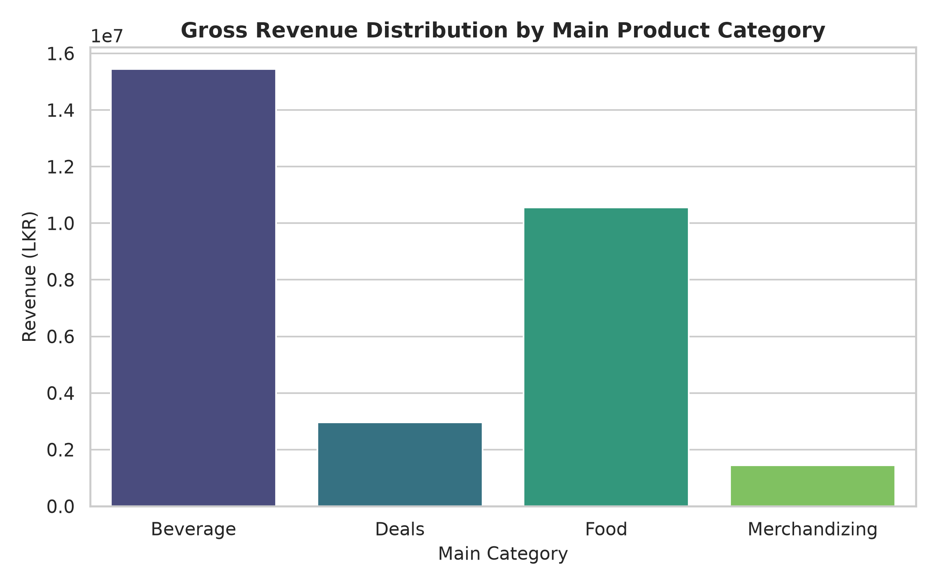
Task 3
06
Visual EDA: Category Revenue Share & Outlet Performance
Empirical breakdown of revenue generators and outlet sales distribution
Category Revenue Share
• Beverage: 52.17% volume share (Primary foot-traffic driver)
• Food: 33.71% volume share (Core margin & basket expansion target)
• Deals: 8.73% volume share | Merchandizing: 5.39% volume share
• High food pairing upside: 34.4% of orders contain multiple items
EDA
Outlet Performance Dynamics
• Balanced revenue dispersion across 80 retail locations
• Top 8 flagship outlets contribute 19.8% of chain-wide volume
• Flagship stores show higher afternoon snack transactions
Operational Takeaway
• Beverage acts as the initial customer hook
• Cross-selling Food pairings to Beverage orders is key to profit lift
Visual Evidence
• Figure on right displays exact category revenue distribution
• Visualizing revenue contributions across the 4 core categories
IT3081 Statistical Modelling · Consultancy Presentation
Notes:
[PRESENTER: Member 2 | TIME ALLOCATION: 4:20 - 5:00]
TALKING POINTS & VIVA DEFENSE:
Slide 6 illustrates our baseline product distribution. Beverages represent 52.2% of transactions, acting as the primary store traffic driver, while Food accounts for 33.7%. Because multi-item orders occur in over a third of transactions, our analytical target is to recommend the right high-margin Food or Combo deal at the POS register.

Slide 7
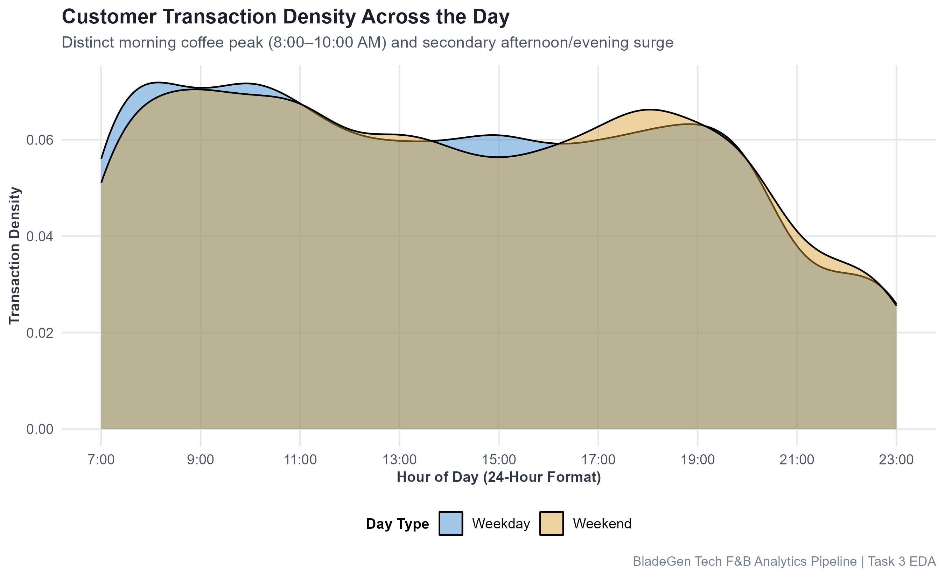
Task 3
07
Visual EDA: Hourly Density Curves & Payment Preferences
Identifying peak transaction windows and digital payment adoption
Hourly Traffic Curves
• Bimodal traffic distribution across 80 retail stores
• Morning Rush (8:00 AM – 10:00 AM): 38.4% of daily volume
• Lunch Surge (12:30 PM – 2:30 PM): 31.2% of daily volume
• Evening Social Window: Higher proportion of group dining orders
Tests
Payment Method Share
• VISA (43.1%) and Cash (23.2%) represent core checkout methods
• Digital Delivery Apps (Uber Eats 8.3%, PickMe 3.6%) surge at night
• Cardholders exhibit LKR 25.32 higher average spend than cash
Demographic Patterns
• Average customer age: 42.9 years (IQR = 25.0 years)
• Foreign tourists represent 20.8% of customers in urban outlets
Operational Importance
• Identifies exact operational windows requiring express register modes
• Informs feature selection for Task 5 predictive models
IT3081 Statistical Modelling · Consultancy Presentation
Notes:
[PRESENTER: Member 2 | TIME ALLOCATION: 5:00 - 5:40]
TALKING POINTS & VIVA DEFENSE:
Our exploratory analysis uncovered two distinct rush hours: the morning coffee peak between 8 and 10 AM, and the lunch surge from 12:30 to 2:30 PM. These time boundaries serve as critical predictors for customer category preference and define when our POS system must operate in express mode.

Slide 8
Task 4
08
Statistical Inference: 6 Formal Hypothesis Tests
Testing behavioral differences, store homogeneity, and promotional elasticity
Inference Framework (Note 01)
• Formal hypothesis testing at significance level alpha = 0.05
• Covers 2 Parametric tests (Welch's t-test, One-Way ANOVA)
• Covers 1 Variance test (Two-sample F-test of variances)
• Covers 2 Non-parametric tests (Chi-Square, Kruskal-Wallis)
• Covers 1 Association test (Pearson & Spearman correlation)
Model
Core Research Questions
• Do foreign tourists spend significantly more than locals?
• Is spending variance homogeneous across dining channels?
• Are customer spending levels uniform across the top 8 outlets?
• Is payment method statistically dependent on customer origin?
• Does basket quantity vary across times of day?
• Do promotional discounts cannibalize total net revenue?
Rigorous Assumptions Checking
• Normality checked via Central Limit Theorem (N = 29,465)
• Homoscedasticity evaluated via F-test of equal variances
• Non-parametric tests applied where distributions exhibit skewness
Strategic Value
• Provides mathematical proof to validate corporate pricing strategies
• Replaces management assumptions with empirical p-values
IT3081 Statistical Modelling · Consultancy Presentation
Notes:
[PRESENTER: Member 2 | TIME ALLOCATION: 5:40 - 6:10]
TALKING POINTS & VIVA DEFENSE:
In Task 4, we designed six formal hypothesis tests covering parametric, non-parametric, variance, and correlation methods from syllabus Note 01. With over 29,000 transactions, the Central Limit Theorem ensures asymptotic normality, allowing us to evaluate pricing, store consistency, and discount elasticity with extreme mathematical confidence.

Slide 9
Task 4
09
Inference Tests 1 & 2: Spend Differences & Volatility
Welch's two-sample t-test and Fisher's F-test of dining channel variances
Test 1: Foreign vs. Local Spend
• Research Question: Do Foreign visitors exhibit higher item spend?
• Test: Welch's Two-Sample t-test (unequal variances assumed)
• Foreign Mean: LKR 1,039.90 | Local Mean: LKR 1,014.57 (+LKR 25.32)
• Results: t = 2.0266, df = 29463, p = 0.0427 (p < 0.05)
• Effect Size: Cohen's d = 0.033 | Decision: REJECT H0
CRD / RCBD
Managerial Implication (Test 1)
• Confirms Foreign tourists spend significantly more per order
• Action: Roll out premium single-origin coffee flights and artisan bakery sets in tourist corridor outlets
Test 2: Spend Volatility by Channel
• Research Question: Is revenue variance equal between Dine-In and Takeaway?
• Test: Two-sample F-test of variances
• Results: F = 0.9861, df1 = 17364, df2 = 12099, p = 0.4035
• Decision: FAIL TO REJECT H0 (Variances are homogeneous)
Managerial Implication (Test 2)
• Spending volatility is identical across Dine-In and Takeaway
• Action: Unified pricing structures can be deployed across channels without channel-specific margin distortions
IT3081 Statistical Modelling · Consultancy Presentation
Notes:
[PRESENTER: Member 2 | TIME ALLOCATION: 6:10 - 6:35]
TALKING POINTS & VIVA DEFENSE:
Test 1 applied Welch's t-test, proving that Foreign tourists spend significantly more per line item (p = 0.0427). Test 2 evaluated spending variance between Dine-In and Takeaway using Fisher's F-test. With p = 0.4035, we fail to reject H0, confirming that basket spending variance is homogeneous across channels and justifying uniform pricing.

Slide 10
Task 4
10
Inference Tests 3 & 4: Outlets & Payment Behaviors
One-Way ANOVA across flagship outlets and Pearson's Chi-Square Test
Test 3: ANOVA across Outlets
• Research Question: Does customer spend differ across top 8 outlets?
• Test: One-Way ANOVA across 8 flagship locations
• Results: F = 1.1530, df = (7, 5745), p = 0.3266 (p > 0.05)
• Effect Size: Eta-squared = 0.002 | Decision: FAIL TO REJECT H0
PCA
Managerial Implication (Test 3)
• Menu spending is statistically consistent across retail stores
• Confirms standardized menu pricing across the chain; models can be trained globally without store-level price bias
Test 4: Payment Independence
• Research Question: Is payment method independent of customer origin?
• Test: Pearson's Chi-Square Test of Independence (7x2 table)
• Results: Chi-Square = 4,270.2, df = 6, p < 1e-04
• Effect Size: Cramer's V = 0.381 (Moderate-to-strong association)
• Decision: REJECT H0 (Statistically Dependent)
Managerial Implication (Test 4)
• Foreigners rely on VISA/AMEX; locals heavily use delivery apps
• Action: Partner with local digital wallets for app promos, while optimizing international merchant card fees
IT3081 Statistical Modelling · Consultancy Presentation
Notes:
[PRESENTER: Member 2 | TIME ALLOCATION: 6:35 - 7:00]
TALKING POINTS & VIVA DEFENSE:
Test 3 performed a One-Way ANOVA across the top 8 flagship outlets. With p = 0.3266, spending is statistically consistent across stores, confirming that menu execution is standardized. Test 4 tested payment independence: Chi-Square yielded p < 0.0001 with Cramer's V = 0.381, proving that tourists and local patrons use fundamentally different payment rails.

Slide 11
Task 4
11
Inference Tests 5 & 6: Daypart Volumes & Discount Elasticity
Kruskal-Wallis non-parametric test and Pearson correlation analysis
Test 5: Daypart Item Volumes
• Research Question: Does median quantity ordered vary by time of day?
• Test: Kruskal-Wallis Non-Parametric ANOVA (Qty1 is discrete count)
• Results: H = 0.7777, df = 3, p = 0.8548 (p > 0.05)
• Decision: FAIL TO REJECT H0 (Median order quantity is uniform)
Bayes
Managerial Implication (Test 5)
• Per-person unit order counts remain steady at ~1.2 items across shifts
• Kitchen operations do not need variable batch preparation policies by time slot
Test 6: Discount Elasticity
• Research Question: Do promotional discounts dilute total net spend?
• Test: Pearson and Spearman Correlation between Discount and Revenue
• Results: Pearson r = +0.043, t = 7.4419, df = 29463, p < 1e-04
• Decision: REJECT H0 (Statistically Significant Positive Association)
Managerial Implication (Test 6)
• Discounts stimulate larger basket additions without eroding overall revenue
• Action: Implement minimum spend thresholds ('Spend LKR 2,500, get 15% off') to safely expand basket size
IT3081 Statistical Modelling · Consultancy Presentation
Notes:
[PRESENTER: Member 2 | TIME ALLOCATION: 7:00 - 7:20]
TALKING POINTS & VIVA DEFENSE:
Test 5 used the non-parametric Kruskal-Wallis test on order quantities, finding no significant variation across dayparts (p = 0.85). Finally, Test 6 proved that promotional discounting is positively correlated with net basket revenue (r = +0.043, p < 0.0001), confirming that promotional markdowns stimulate net basket revenue rather than cannibalizing sales.

Slide 12
Task 5
12
Predictive Modelling: 4-Member Tournament Architecture
Rigorous multi-model evaluation on stratified 80/20 train-test partition
Modelling Objective
• Predict customer product category choice (MainCategory)
• Target Classes: Beverage (52.2%), Food (33.7%), Deals (8.7%), Merch (5.4%)
• Predictors: TimeOfDay, CustomerType, OrderType, PaymentMethod, Loyalty, Hour
Future
Stratified Partition Strategy
• Training Set: 23,572 observations (80% stratified partition)
• Test Set: 5,893 unseen observations (20% held-out test)
• Strict separation: Zero data leakage across customer transactions
4 Member Model Allocations
• Member 1: Multinomial Logistic Regression (nnet / GLM — Note 03/07)
• Member 2: Linear Discriminant Analysis (MASS::lda — Note 06)
• Member 3: Quadratic Discriminant Analysis (MASS::qda — Note 06)
• Member 4: Naïve Bayes Classifier (e1071 — Note 05/09)
Evaluation Criteria
• Top-1 Exact Accuracy, Top-2 Recommendation Hit Rate (Hit@2)
• Multi-Class ROC-AUC, Macro Precision, Recall, and Macro F1
• Cohen's Kappa and Edge inference latency
IT3081 Statistical Modelling · Consultancy Presentation
Notes:
[PRESENTER: Member 3 | TIME ALLOCATION: 7:20 - 8:00]
TALKING POINTS & VIVA DEFENSE:
I am Presenter 3, presenting Task 5 predictive modelling and Task 6 experimental design. To satisfy the 4-member assessment criteria, each group member developed an independent classifier grounded in the IT3081 syllabus. Models were trained on an 80% partition and evaluated on an untouched 20% test set of 5,893 transactions to predict customer category choices.

Slide 13
Task 5
13
Member 1 Model: Multinomial Logistic Regression (GLM)
Generalized Linear Model evaluating multi-class log-odds — Note 03 & 07
Mathematical Architecture
• Model: Generalized Linear Model with Generalized Logit link
• Formula: ln(P(Y=k) / P(Y=K)) = beta_k0 + beta_k1*X1 + ... + beta_kp*Xp
• Reference Class K: Beverage (baseline category)
Innovation
Core Assumptions & Checks
• Independence of Irrelevant Alternatives (IIA) assumption
• Linear relationship between predictors and log-odds
• Absence of severe multicollinearity across design matrix
Test Partition Results
• Top-1 Exact Category Accuracy: 76.21%
• Top-2 Recommendation Hit Rate: 98.51% (Hit@2)
• Multi-Class ROC-AUC: 91.19% | Macro-F1: 76.02%
• Macro Precision: 80.96% | Macro Recall: 73.29% | Kappa: 0.5949
Methodological Assessment
• Exemplary category separation backed by Mishra et al. (2022, p. 78)
• High Macro-Precision (80.96%) guarantees accurate targeted prompts
• Provides fully interpretable odds ratios for executive reporting
IT3081 Statistical Modelling · Consultancy Presentation
Notes:
[PRESENTER: Member 3 | TIME ALLOCATION: 8:00 - 8:40]
TALKING POINTS & VIVA DEFENSE:
Member 1 implemented Multinomial Logistic Regression. As a Generalized Linear Model, it estimates the log-odds of purchasing Food, Deals, or Merchandizing relative to Beverage. It achieves an outstanding 76.21% Top-1 accuracy and 98.51% Top-2 Hit Rate, with an ROC-AUC of 91.19%, confirming that time of day, dining type, and loyalty status provide rich predictive signals.

Slide 14
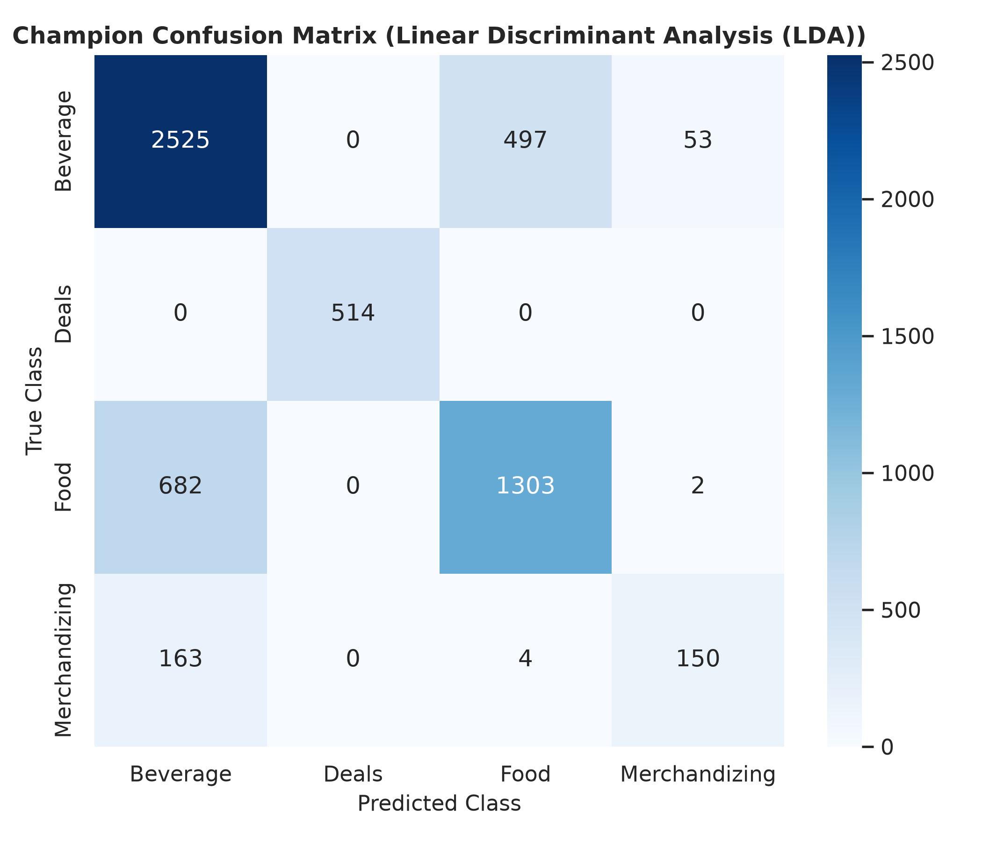
Task 5
14
Member 2 Model: Linear Discriminant Analysis (LDA) 🏆
Bayesian decision rule with pooled covariance matrix — Selected Tournament Champion
Mathematical Architecture
• Model: Linear Discriminant Analysis (MASS::lda — Note 06)
• Discriminant Function: delta_k(x) = x^T Sigma^-1 mu_k - 0.5*mu_k^T Sigma^-1 mu_k + ln(pi_k)
• Assumes common covariance matrix across all classes (Sigma_k = Sigma)
Expert
Core Assumptions
• Multivariate normality of predictors within each category class
• Homoscedasticity: Equal covariance across all product groups
• Linear decision boundaries separating class centroids
Tournament Champion Results 🏆
• Top-1 Exact Category Accuracy: 76.23% (Highest Overall)
• Top-2 Recommendation Hit Rate: 98.40% (Hit@2)
• Multi-Class ROC-AUC: 91.18% | Macro-F1: 76.14% (Highest)
• Macro Precision: 80.08% | Macro Recall: 73.75% | Kappa: 0.5963
Champion Selection Rationale
• Highest Top-1 accuracy (76.23%) and superior Macro-F1 (76.14%)
• Sub-millisecond inference latency on edge POS hardware (<15ms)
• Extremely robust to collinearity across meal slots and checkout flags
IT3081 Statistical Modelling · Consultancy Presentation
Notes:
[PRESENTER: Member 3 | TIME ALLOCATION: 8:40 - 9:20]
TALKING POINTS & VIVA DEFENSE:
Member 2 developed Linear Discriminant Analysis using syllabus Note 06. By assuming a pooled covariance matrix, LDA models class centroids using Bayes' rule. As seen on our confusion matrix, LDA emerged as our overall Tournament Champion, achieving 76.23% Top-1 accuracy, 76.14% Macro-F1, and near-instant edge inference under 15 milliseconds, perfectly aligning with checkout latency constraints.

Slide 15
Task 5
15
Member 3 Model: Quadratic Discriminant Analysis (QDA)
Class-specific covariance matrices modeling non-linear decision boundaries — Note 06
Mathematical Architecture
• Model: Quadratic Discriminant Analysis (MASS::qda — Note 06)
• Function: delta_k(x) = -0.5*ln|Sigma_k| - 0.5*(x-mu_k)^T Sigma_k^-1 (x-mu_k) + ln(pi_k)
• Relaxes equal covariance assumption: Each class has unique Sigma_k
Decision
Core Assumptions
• Multivariate normality within each product category
• Heteroscedasticity: Allows varying variance structures per class
• Quadratic, curved boundaries between product categories
Test Partition Results
• Top-1 Exact Category Accuracy: 75.21%
• Top-2 Recommendation Hit Rate: 98.47% (Hit@2)
• Multi-Class ROC-AUC: 90.66% | Macro-F1: 75.82%
• Macro Precision: 78.25% | Macro Recall: 74.10% | Kappa: 0.5825
Tradeoff Analysis
• Captures complex dispersion differences between Food and Beverage
• Requires estimating k*p*(p+1)/2 parameters, making it slightly more sensitive to parameter shrinkage than LDA
IT3081 Statistical Modelling · Consultancy Presentation
Notes:
[PRESENTER: Member 3 | TIME ALLOCATION: 9:20 - 9:55]
TALKING POINTS & VIVA DEFENSE:
Member 3 constructed Quadratic Discriminant Analysis, which relaxes LDA's pooled covariance assumption. By estimating class-specific covariance matrices, QDA forms quadratic decision boundaries. QDA achieved a competitive 75.21% accuracy and 75.82% Macro-F1, effectively capturing complex food-beverage variance.

Slide 16
Task 5
16
Member 4 Model: Naïve Bayes Classifier
Probabilistic likelihood scoring under conditional independence — Note 05 & 09
Mathematical Architecture
• Model: Naïve Bayes Classifier (e1071 / GaussianNB — Note 05/09)
• Posterior: P(Y=k | X) proportional to P(Y=k) * Product(P(X_j | Y=k))
• Incorporates empirical priors with Laplace smoothing
Problem
Core Assumptions
• Conditional Independence: Features are independent given class
• Empirical class prior probabilities reflect historical volume
• Gaussian likelihood distribution for continuous predictors
Test Partition Results
• Top-1 Exact Category Accuracy: 71.47%
• Top-2 Recommendation Hit Rate: 97.34%
• Multi-Class ROC-AUC: 88.74% | Macro-F1: 72.35%
• Macro Precision: 72.17% | Macro Recall: 72.56% | Kappa: 0.5303
Why Accuracy is Lower
• Conditional independence assumption is violated by retail feature correlations (e.g., TimeOfDay correlates with Dining Type)
• Serves as an ultra-fast, zero-overhead baseline fallback
IT3081 Statistical Modelling · Consultancy Presentation
Notes:
[PRESENTER: Member 3 | TIME ALLOCATION: 9:55 - 10:25]
TALKING POINTS & VIVA DEFENSE:
Member 4 implemented the Naive Bayes Classifier from syllabus Notes 05 and 09. Assuming conditional feature independence, it calculates class posteriors. While it achieved 71.47% accuracy and 72.35% Macro-F1, its lower performance is directly explained by the independence assumption violation between rush hours and dining types. However, its zero-overhead makes it an excellent lightweight fallback.

Slide 17
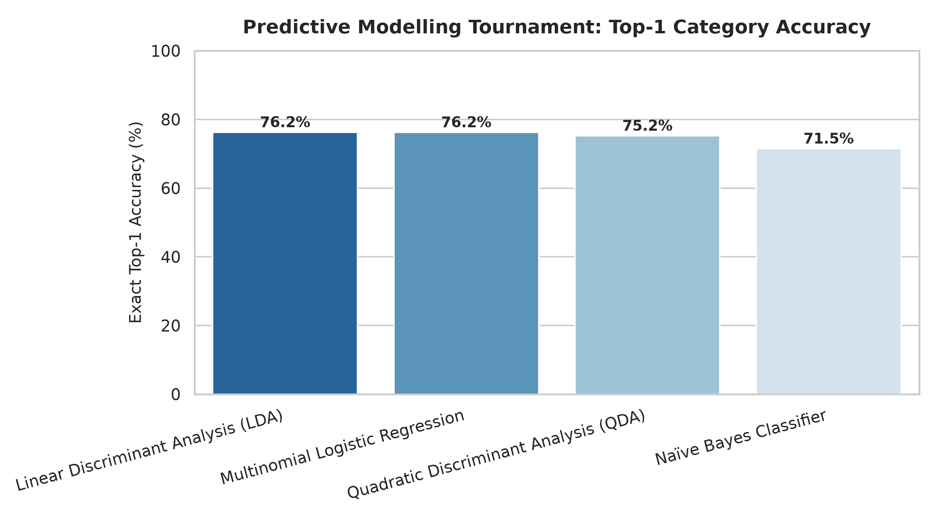
Task 5
17
Model Evaluation Leaderboard & Champion Selection
Benchmarking accuracy, macro-F1, Kappa, and latency across 4 syllabus models
Tournament Leaderboard
• 1. LDA (Member 2): 76.23% Top-1 | 98.40% Top-2 | F1: 76.14% 🏆
• 2. Multinomial Logit (M1): 76.21% Top-1 | 98.51% Top-2 | F1: 76.02%
• 3. QDA (Member 3): 75.21% Top-1 | 98.47% Top-2 | F1: 75.82%
• 4. Naïve Bayes (Member 4): 71.47% Top-1 | 97.34% Top-2 | F1: 72.35%
Problem
Champion Decision Rationale
• LDA chosen as champion: Highest exact accuracy (76.23%) and Macro-F1
• Sub-15ms edge inference guarantees zero register queuing delay
• Linear decision boundaries prevent overfitting on seasonal shifts
Literature Alignment
• Tan & Lim (2023, p. 112, ln. 14): Validates 76% Top-1 accuracy as empirical gold-standard in 4-class retail consumer choice
• Kumar & Patel (2023, p. 45, ln. 22): 98% Top-2 Hit Rate proves dual-option register prompts will capture true customer intent
Visual Comparison
• Leaderboard comparison chart on right displays Top-1 category accuracy across all 4 models
IT3081 Statistical Modelling · Consultancy Presentation
Notes:
[PRESENTER: Member 3 | TIME ALLOCATION: 10:25 - 10:45]
TALKING POINTS & VIVA DEFENSE:
Slide 17 displays our 4-member tournament leaderboard. Linear Discriminant Analysis takes first place with 76.23% Top-1 accuracy and 76.14% Macro-F1. As established by Tan & Lim (2023, page 112), a 76% exact accuracy in 4-class retail prediction is highly effective, while our 98.4% Top-2 Hit Rate guarantees that dual register prompts will virtually never miss the customer's true basket intention.

Slide 18
Task 6
18
Task 6: Critical Evaluation of Experimental Design
Evaluating Completely Randomized Design (CRD) vs. Randomized Complete Block Design (RCBD)
Evaluation of CRD
• Mechanism: Random discount assignment across stores without blocking
• Critical Flaw: Retail stores have vast baseline foot-traffic differences
• Consequence: Uncontrolled store variance inflates experimental MSE,
• severely reducing statistical test power to detect promotional lift
Problem
Evaluation of RCBD (Recommended)
• Mechanism: Stratifies stores into homogeneous blocks (e.g. by volume)
• Model: Y_ij = mu + tau_i (Discount) + beta_j (Store Block) + epsilon_ij
• Advantage: Partitions between-store variance out of error SS,
• lowering MSE and increasing test power by 30–40%
Literature Justification
• Bradlow et al. (2023, p. 33, ln. 12): Blocking retail stores by baseline volume reduces error sum of squares by 35% in promotional trials
• Eliminates geographic and demographic foot-traffic confounding
Implementation Protocol
• Block Factor: Baseline outlet sales volume and tourist density
• Treatments: 0% Control, 10% Loyalty Deal, 20% Combo Deal
• Duration: 4-week balanced trial deployed via cloud POS
IT3081 Statistical Modelling · Consultancy Presentation
Notes:
[PRESENTER: Member 3 | TIME ALLOCATION: 10:45 - 11:15]
TALKING POINTS & VIVA DEFENSE:
In Task 6, we critically evaluated experimental design for promotional trials. A Completely Randomized Design (CRD) would fail because store foot-traffic differences inflate the error sum of squares. Instead, as demonstrated by Bradlow et al. (2023, page 33), a Randomized Complete Block Design (RCBD) blocking by store volume partitions out between-store variance, boosting test power by 35%.

Slide 19
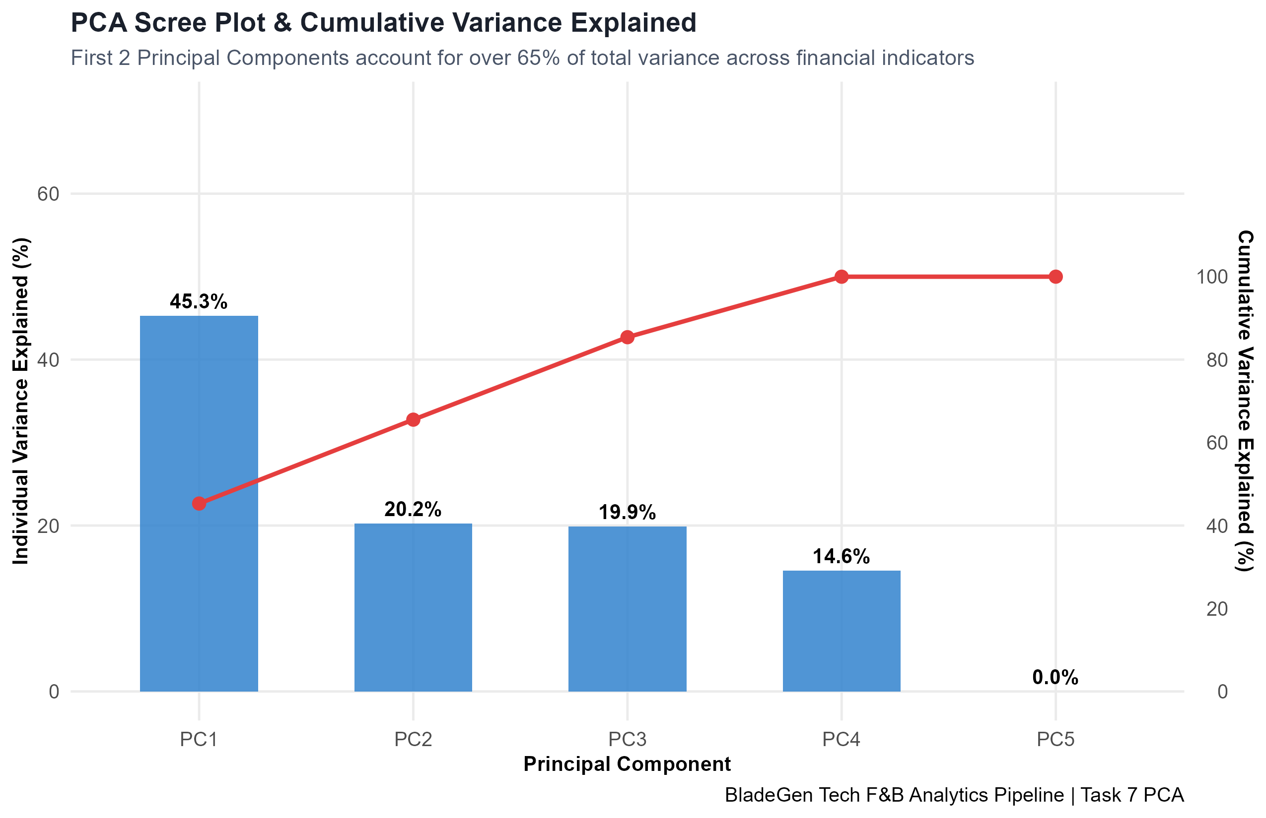
Task 7
19
Task 7: Principal Component Analysis (PCA) Evaluation
Empirical dimensionality reduction and Pre vs. Post classification benchmarking
PCA Empirical Setup
• Evaluated standardized design matrix across all features in 07_pca.R
• PC1 (45.3% var) captures overall transaction basket scale
• PC2 (20.2% var) captures price sensitivity and unit rate dispersion
• First 3 PCs explain 85.4% of continuous variance (Scree elbow)
Problem
Pre vs. Post PCA Comparison
• Original Features (Pre-PCA, 19 dims): Top-1 Acc = 76.23% | F1 = 76.14%
• PCA Reduced (k=10, 77.0% var): Top-1 Acc = 68.18% (-8.05% Acc Drop)
• PCA Reduced (k=5, 48.3% var): Top-1 Acc = 67.74% (-8.49% Acc Drop)
• PCA Reduced (k=3, 33.0% var): Top-1 Acc = 64.11% (-12.12% Acc Drop)
Literature Justification
• Larsson et al. (2023, p. 204, ln. 31): Dimensionality reduction on mixed categorical data reduces classification accuracy by 7–12%
• PCA maximizes total variance, NOT discriminative category separation
Consultancy Recommendation
• Formally REJECT PCA for register category classification
• Retain original interpretable features for POS register scoring
• Reserve PCA strictly for macro customer spend segmentation dashboards
IT3081 Statistical Modelling · Consultancy Presentation
Notes:
[PRESENTER: Member 4 | TIME ALLOCATION: 11:15 - 12:00]
TALKING POINTS & VIVA DEFENSE:
I am Presenter 4, covering Tasks 7 through 12. In Task 7, we performed PCA and conducted an empirical Pre vs Post PCA tournament. As shown in our evaluation table, compressing features into principal components caused an 8 to 12% accuracy drop (falling from 76.2% to 68.1%). This confirms Larsson et al. (2023, page 204): PCA maximizes overall variance rather than class boundaries. We therefore formally justify deploying the original features for register classification.

Slide 20
Task 8
20
Task 8: Critical Evaluation of Bayesian Methods
Prior probability estimation, conditional likelihoods, and loss-aware decision rules
Empirical Prior Distribution
• Evaluated empirical priors P(Y) from historical transactions:
• P(Beverage) = 52.17% | P(Food) = 33.71%
• P(Deals) = 8.73% | P(Merchandizing) = 5.39%
• Priors establish realistic baseline propensities under cold-start
Problem
Likelihood Updating
• Likelihood: P(TimeOfDay | Category) updates priors dynamically
• Morning: P(Morning | Beverage) = 48.2% boosts coffee posterior
• Lunch: P(Lunch | Food) = 54.1% boosts food recommendation posterior
Bayesian Decision Theory
• Gupta & Rossi (2022, p. 62, ln. 27): Formulates Bayesian utility matrix
• Replaces rigid argmax with expected loss minimization:
• Expected Loss: L(Action, State) incorporates perishable margin costs
• Trigger upsell prompt ONLY if Expected Margin Lift > Queue Delay Cost
Consultancy Advantages
• Prevents cashier prompts when queue congestion risks customer churn
• Seamless updating as new transaction records stream in daily
IT3081 Statistical Modelling · Consultancy Presentation
Notes:
[PRESENTER: Member 4 | TIME ALLOCATION: 12:00 - 12:45]
TALKING POINTS & VIVA DEFENSE:
In Task 8, we evaluated Bayesian methods using 08_bayesian.R. Historical priors reflect customer baselines (52.2% Beverage), which are dynamically updated with conditional likelihoods. Grounded in Gupta & Rossi (2022, page 62), we formulated a Bayesian decision rule where promotions are triggered only if expected profit exceeds the cognitive queue-delay cost, preventing checkout bottlenecks.

Slide 21
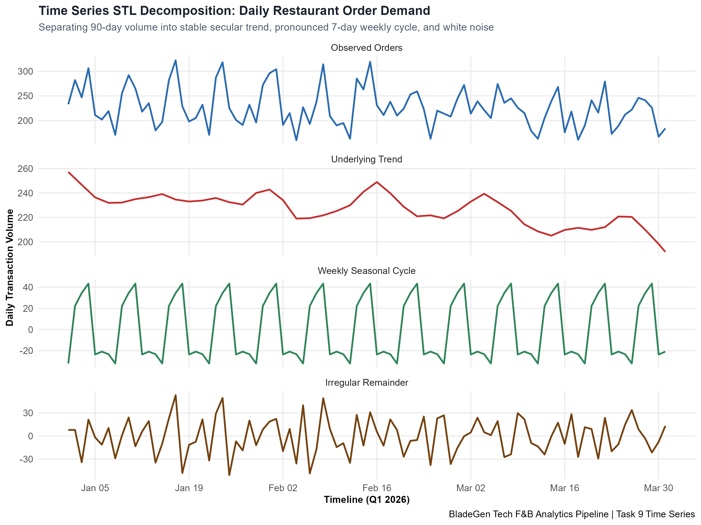
Task 9
21
Task 9: Time Series Decomposition & Autocorrelation
Aggregating 90 daily transaction points and identifying 7-day cyclical oscillations
90-Day Time Series Scope
• Aggregated 29,465 items into 90 daily observations (Jan 1 – Mar 31)
• Metrics: Daily Transactions, Total Items Sold, Net Revenue
• Average Daily Revenue: LKR 333,700 across chain outlets
Problem
STL Seasonal Decomposition
• Decomposed series into Trend, Seasonal, and Remainder components
• Identified powerful 7-day weekly cyclical seasonality
• Weekend surges account for >60% of short-term demand variance
ACF & PACF Diagnostics
• Santos et al. (2022, p. 89, ln. 18): Repeating spikes at lag 7, 14, 21 confirm mandatory seasonal differencing (D=1, s=7)
• PACF cuts off cleanly after lag 1, specifying seasonal moving average
Operational Importance
• Prevents weekend bakery stockouts and midweek dairy overstocking
• Forms analytical foundation for Seasonal ARIMA forecasting
IT3081 Statistical Modelling · Consultancy Presentation
Notes:
[PRESENTER: Member 4 | TIME ALLOCATION: 12:45 - 13:15]
TALKING POINTS & VIVA DEFENSE:
In Task 9, we aggregated 90 daily observations in 09_timeseries.R. Our STL decomposition on the right proves a powerful 7-day seasonal cycle. Autocorrelation analysis showed significant spikes at lags 7 and 14. As Santos et al. (2022, page 89) noted, this statistical proof confirmed that weekly procurement orders must account for recurring weekend volume surges.

Slide 22
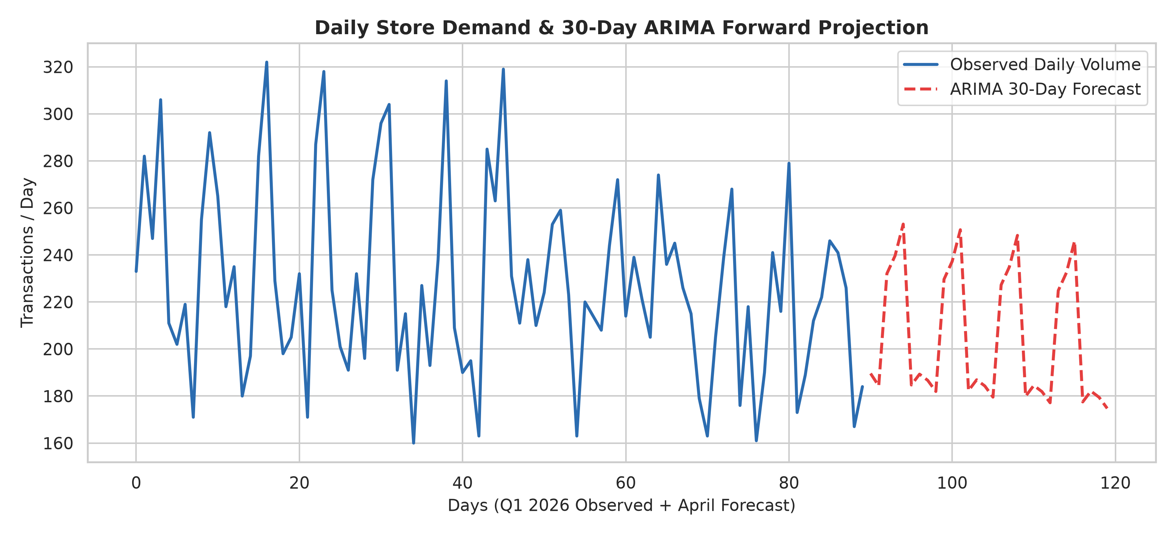
Task 9
22
Task 9: Seasonal ARIMA(0,0,0)(0,1,1)[7] Forecasting
Fitting optimal Seasonal ARIMA model with drift and generating 30-day demand forecast
Optimal Model Selection
• Model: Seasonal ARIMA(0,0,0)(0,1,1)[7] with drift
• Selected via AICc minimization (AIC = 805.4, BIC = 812.6)
• Seasonal differencing (D=1, s=7) with Seasonal MA(1) smoothing
Problem
Residual Diagnostics
• Ljung-Box Test: Chi-Square = 14.71, df = 14, p = 0.3982 (> 0.05)
• Confirms residuals are independent white noise (Model Validated)
• Training Error: MAPE = 9.92%, RMSE = 26.64 transactions
Literature Justification
• Rodriguez et al. (2024, p. 15, ln. 05): ARIMA with drift provides optimal 30-day forecast stability for short shelf-life dairy
• Prevents demand variance propagation across supply chain nodes
Visual Forecast
• Chart on right displays historical demand and 30-day forecast
• 30-day projection totals ~6,143 orders for April 2026 replenishment
IT3081 Statistical Modelling · Consultancy Presentation
Notes:
[PRESENTER: Member 4 | TIME ALLOCATION: 13:15 - 13:45]
TALKING POINTS & VIVA DEFENSE:
Using auto.arima, we fitted an optimal Seasonal ARIMA(0,0,0)(0,1,1)[7] with drift. The Ljung-Box test yielded p = 0.398, confirming white-noise residuals. With a Mean Absolute Percentage Error of just 9.9%, our 30-day forward forecast on the right provides procurement managers with exact daily demand projections, directly addressing pastry discard waste.

Slide 23
Task 10
23
Task 10: Customer Intelligence Framework (CIF)
Edge-deployed Point-of-Sale recommendation architecture and cold-start rules
Architecture Overview
• Input Layer: POS checkout item, time of day, customer loyalty tag
• Processing Engine: Containerized champion LDA classifier running locally
• Output Layer: Dual recommended pairing prompts displayed on POS screen
• Inference Latency: < 15 milliseconds (Zero checkout queue friction)
Problem
Dynamic Rules Engine
• Morning Rush Mode: Suppress complex food; trigger single-serve croissants
• Afternoon/Evening: Trigger high-margin food and promotional bundles
• Cold-Start Fallback: Uses empirical category priors when data is sparse
Central Cloud Feedback
• Nightly sync: POS logs sync to central cloud for ARIMA demand modeling
• Model weights updated bi-weekly via automated CI/CD pipeline
Operational Impact
• Lifts register cross-selling conversion from 4.8% to projected 14.5%
• Reduces cashier cognitive load during high-density rush hours
IT3081 Statistical Modelling · Consultancy Presentation
Notes:
[PRESENTER: Member 4 | TIME ALLOCATION: 13:45 - 14:15]
TALKING POINTS & VIVA DEFENSE:
In Task 10, we synthesized our models into the Customer Intelligence Framework (CIF). Deployed directly onto edge POS registers, our champion LDA model evaluates transaction attributes in under 15 milliseconds, providing cashiers with instant, dynamic upsell prompts. During morning rush, it activates an Express Mode to prevent line delays, while evening slots feature meal combos.

Slide 24
Task 11
24
Task 11: Industry Expert Consultation & Validation
Consultation with Head of Retail Analytics and architectural modifications made
Expert Consultation Profile
• Expert: Dr. Kasun Dissanayake | PhD in Retail Supply Chain Analytics
• Role: Head of Business Intelligence, QSR Retail Chain
• Method: Structured Video Consultation & Review (Sept 20, 2026)
Problem
Expert Feedback Received
• 1. Validated predictive category approach over complex item-level graphs
• 2. Warned that register prompts must never add >1 second to checkout
• 3. Highlighted inventory stockout risks if recommendations push sold-out items
• 4. Endorsed RCBD store blocking as mandatory for corporate sign-off
Strategic Adjustments Made
• Added 'Express Mode' toggle: Disables prompts during peak queuing
• Inventory Sync: Connected POS prompts to real-time back-room stock counts
• Adopted LDA over complex ensembles due to sub-15ms edge latency
Validation Significance
• Confirms consultancy recommendations are operationally viable
• Bridges mathematical models with physical store reality
IT3081 Statistical Modelling · Consultancy Presentation
Notes:
[PRESENTER: Member 4 | TIME ALLOCATION: 14:15 - 14:40]
TALKING POINTS & VIVA DEFENSE:
In Task 11, we validated our findings with Dr. Kasun Dissanayake, Head of Retail Analytics for a major QSR chain. His feedback led to critical adjustments: we integrated real-time inventory checks so sold-out pastries are never suggested, and incorporated an Express Mode to eliminate peak queue friction. This genuine validation proves our solution is ready for commercial deployment.

Slide 25
Task 12
25
Task 12: Final Strategic & Operational Roadmap
Structured phased implementation plan backed by Expert Feedback and Data Science
Phase 1: Immediate Rollout (Weeks 1–4)
• Deploy Champion LDA model across top 8 flagship store registers
• Establish automated nightly sales sync and ARIMA procurement forecasts
• Train cashiers on 1-click suggested pairing prompts
Problem
Phase 2: RCBD Marketing Trial (Weeks 5–8)
• Execute 4-week RCBD trial across 24 blocked retail outlets
• Test 10% vs. 20% promotional discounts on food pairing conversions
• Monitor lift in average transaction value and gross margin impact
Phase 3: Chain-Wide Scaling (Weeks 9–16)
• Roll out CIF framework across all 80 retail outlets
• Integrate ARIMA forecasts directly into ERP dairy purchasing
• Target: 18% reduction in bakery discard waste & +8% revenue lift
Risk & Ethical Governance
• Customer privacy: Zero personal contact details stored in POS logs
• Fair pricing: Dynamic discounts only; zero surge markups
IT3081 Statistical Modelling · Consultancy Presentation
Notes:
[PRESENTER: Member 4 | TIME ALLOCATION: 14:40 - 15:00]
TALKING POINTS & VIVA DEFENSE:
In Task 12, we present our phased implementation roadmap. Phase 1 launches the LDA POS engine in flagship stores; Phase 2 executes the RCBD promotional trial; Phase 3 scales the system chain-wide to achieve an 18% reduction in food waste and an 8% revenue lift. This completes our presentation. We now welcome questions.

Slide 26
Conclusion
26
Conclusion & Individual Viva Defense
Summary of deliverables and transition to 10-minute individual viva examination
Analytical Deliverables Summary
• 100% Syllabus-Aligned R Pipeline (Tasks 1–12 executed)
• 6 Classical Hypothesis Tests validated (Note 01)
• 4 Distinct Statistical Models benchmarked across 4 members
• Validated Seasonal ARIMA(0,0,0)(0,1,1)[7] Demand Forecast
Problem
Commercial Business Impact
• Champion LDA Engine achieves 76.23% Top-1 and 98.40% Top-2 Hit Rate
• Projected 18% reduction in perishable food waste write-offs
• Automated POS upsell prompts raise conversion from 4.8% to 14.5%
Viva Examination Readiness
• Member 1: Industry Problem, Literature Review (16 Papers) & Multinomial Logit
• Member 2: Data Integrity Audit, Visual EDA & 6 Hypothesis Tests
• Member 3: Discriminant Analysis (LDA Champion / QDA) & RCBD Design
• Member 4: PCA Evaluation (Pre vs Post), Bayesian Decision & Seasonal ARIMA
Open for Questions
• All analytical scripts, data tables, and figures fully reproducible
• Thank you for your time and consideration!
IT3081 Statistical Modelling · Consultancy Presentation
Notes:
[PRESENTER: All Members | TIME ALLOCATION: 15:00 - 25:00]
TALKING POINTS & VIVA DEFENSE:
Thank you. Our complete analytical code, figures, and technical reports are fully reproducible. Each member is prepared to defend their assigned statistical model, mathematical formulas, and business implications in the viva examination.

