Slide 1
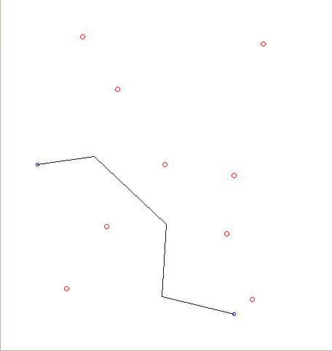
Robot Navigation Using Voronoi Diagrams
Rishabh Manoj, Anirudh Ravi, Penmetsa Murali Krishnam Raju, Samyak Upadhyay, Tadigadapa Abhiram and Nigel Steven Fernandez IIIT-B
Introduction
Our C project “Robot Navigation using Voronoi Diagrams” displays the safest and shortest path between two points in a plane filled with discrete obstacle points.
This path is then used by a robot to travel between the two points.
Results
The initial and final points are marked in blue, the obstacle points are marked in red and the safest, shortest path along the vertices of the Voronoi graph connecting its nodes is shown by the black line.
Conclusions and future work
Working with geometrical figures as obstacles instead of treating them as discrete point obstacles. This will require the computation of Voronoi diagrams for geometrical objects.
Accepting dynamic input of obstacles during the movement of the robot, thus computing the safest and shortest path on the fly.
Materials and methods
The first step is to input the co-ordinates of the initial point, final point and obstacle points.
After this, a Voronoi diagram is computed treating the obstacle points as generators. A Voronoi diagram is a way of dividing space into a number of regions where for each generator (obstacle point) there will be a corresponding region (Voronoi cells) consisting of all points closer to that point than to any other.
Having computed the Voronoi graph, the Dijkstra’s algorithm is employed to obtain the shortest path from the initial point along the nodes of the Voronoi graph to the final point.
The resulting path is the safest path as the edges of the Voronoi graph are at maximum distance from corresponding obstacles.
This path is used by the robot to move from the initial to final points
We made use of a Lego robot with a NXT controller and for generating the Delaunay triangulation we used the code written by Steven Fortune in 1986 in his paper "A sweepline algorithm for Voronoi diagrams”.
References
Steven Fortune’s implementation of his algorithm published in 1986 in his paper "A sweepline algorithm for Voronoi diagrams”.
For implementation ideas -http://www.cs.columbia.edu/~pblaer/projects/path_planner/
For making Voronoi diagrams fun – http://alexbeutel.com/webgl/voronoi.html
For a brief description of Voronoi diagrams - http://en.wikipedia.org/wiki/Voronoi_diagram#Illustration
Acknowledgments
Prof. S Sadagopan – for providing us with this enlightening opportunity
Prof. Madhav Rao – for being a guiding beacon and supporting us till the end
Prof G Srinivasaraghavan – for opening up the world of Voronoi diagrams to us
Notes:
Copyright Colin Purrington (http://colinpurrington.com/tips/academic/posterdesign).

