Slide 1
DIGITAL PORTFOLIO
STUDENT NAME: S.RANI
REGISTER NO AND NMID: 24131131802522013/asanm11324131131802522013
DEPARTMANT: B.SC COMPUTER SCIENCE
COLLEGE NAME AND UNIVERSITY: 113-VALLALAR ARTS AND SCIENCE COLLEGE,ANNAMALAI UNIVERSITY

Slide 2
PROJECT TITLE:
AI ENGINEER
PORTFOLIO

Slide 3
AGENDA:
1.Problem Statement
2.Project Overview
3.End Users
4.Tools and Technologies
5.Portfolio design and Layout
6.Features and Functionality
7.Results and Screenshots
8.Conclusion
9.Github Link

Slide 4
PROBLEM STATEMENT:
AI Engineers need a professional way to showcase their skills and projects beyond a traditional resume. A static CV cannot demonstrate interactive coding abilities. To solve this, a portfolio website using HTML, CSS, and JavaScript is developed to present skills, projects, and contact details effectively.

Slide 5
PROJECT OVER VIEW:
Designed a personal portfolio website for an AI Engineer using HTML, CSS, and JavaScript.
Showcases About Me, Skills, Projects, and Contact sections.
Includes interactive features like alert messages and project pop-ups.
Provides a professional platform to display achievements and links (GitHub, LinkedIn).
Helps recruiters and peers easily view skills and projects in one place.

Slide 6
END USERS:
Students who want to showcase their AI and coding skills.
Recruiters and hiring managers looking for AI Engineer talent.
Trainers and mentors reviewing student portfolios..

Slide 7
TOOLS AND TECHNIQUES:
HTML5 → for creating the structure of the portfolio.
CSS3 → for styling, layout, and responsive design.
JavaScript → for interactivity and alert messages.
Visual Studio Code → as the development environment.
GitHub → for hosting and sharing the project.

Slide 8
PORTFOLIO DESIGN AND LAYOUT:
Clean and modern dark-themed interface with contrasting text.
Header with navigation links to About, Skills, Projects, and Contact.
Card-style sections for skills and projects with icons and descriptions.
Interactive buttons for alerts and project pop-ups.

Slide 9
FEATURES AND FUNCTIONALITY:
Interactive navigation menu for smooth section access.
Alert messages to display project updates and user actions.
Contact form for collecting user details and messages.
Responsive design for viewing on desktop and mobile devices.

Slide 10
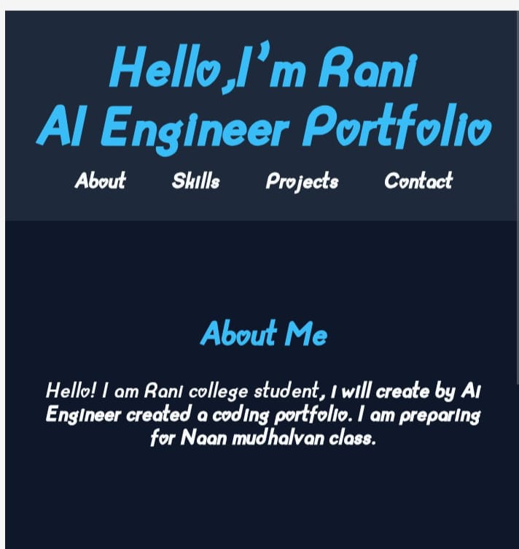
RESULTS AND SCREENSHORT:
Successfully created a responsive and interactive AI Engineer portfolio website.
Screenshots highlight About, Skills, Projects, and Contact sections with styled design.

Slide 11
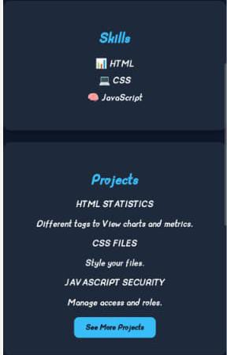
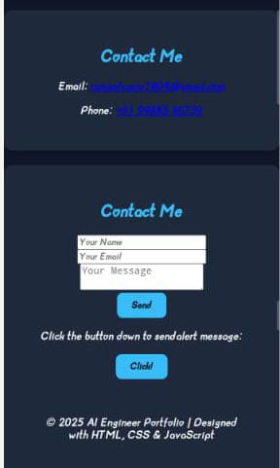

Slide 12
CONCLUSION:
The AI Engineer portfolio demonstrates technical skills using HTML, CSS, and JavaScript. It provides a professional platform to showcase projects, skills, and contact details effectively.

