Slide 1

Agenda
Differences with JIRA
Project/Prototype
Functionalities
Process/methodology

Slide 2
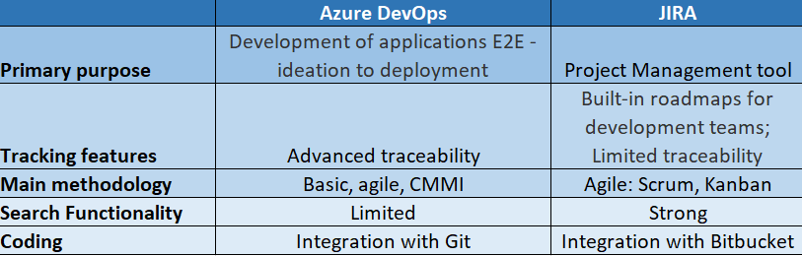
Azure DEVOPS vs. JIRA
Notes:
There’re packages to visualize geospatial data like folium etc.

Slide 3
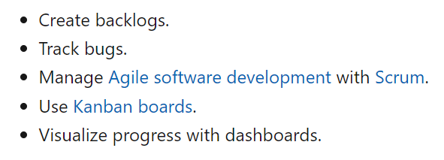
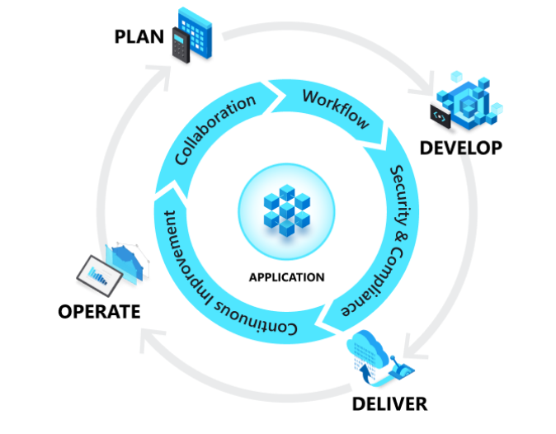
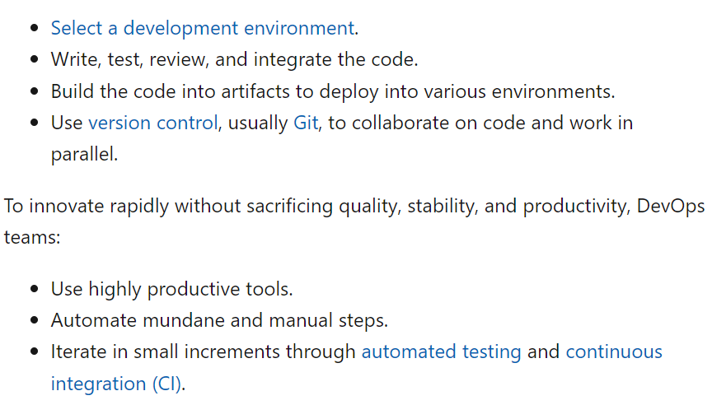
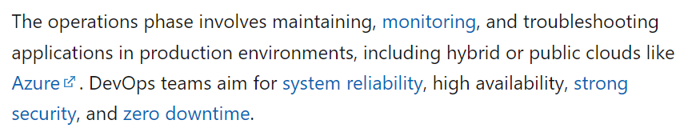
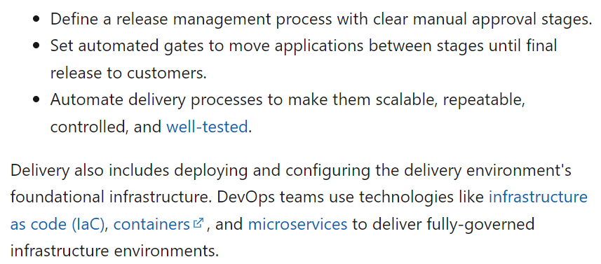
DevOps & APPLICATION LIFECYCLE

Slide 4
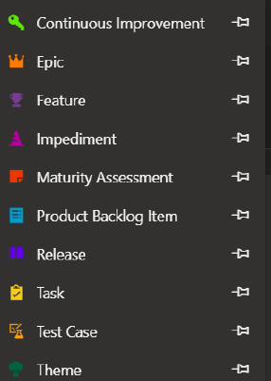
Project/prototype
Work items: There’s a hierarchy
Under a project/prototype, there is issue or bug
Notes:
There’re packages to visualize geospatial data like folium etc.

Slide 5
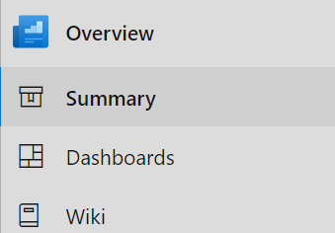
PROJECT/PROTOTYPE: Overview
In summary ‘About the project’, ‘Project Statistics’, ‘Number of members’ etc. appear
One can add all work item cards to dashboard
One may also create project wiki for team members and others

Slide 6
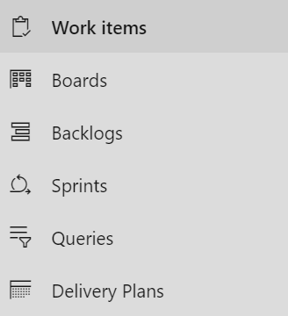
PROJECT/PROTOTYPE: BOARDS
In Boards, work item cards for 3 categories appear: ‘To Do’, ‘Doing’, ‘Done’ (one can create more categories)
One can have product backlog work items in sprints
One can create a delivery plan with work items (epic, bug etc.)

Slide 7
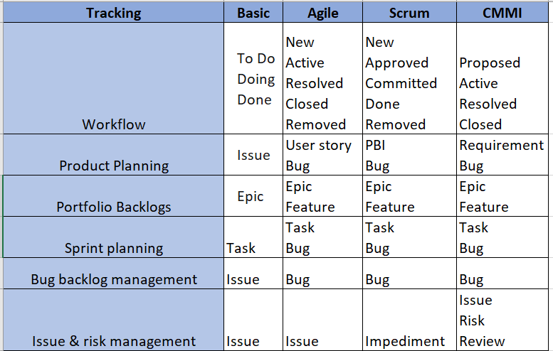
Process flow (Devops boards)
Choose a process for your Azure DevOps project - Azure Boards | Microsoft Learn
Understand how to use work items to track user stories & more - Azure Boards | Microsoft Learn

Slide 8
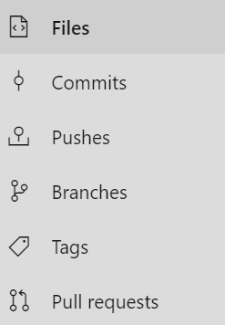
PROJECT/PROTOTYPE: REPOS
Create Git Repo, main/master branch for development
Create feature branches for team members to work on
Commits, pushes & pull requests to the main branch are visible
One may create tags for the repository

Slide 9
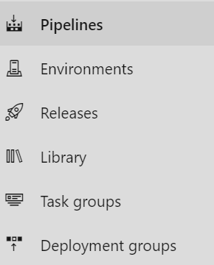
PROJECT/PROTOTYPE: PIPELINES
Code, build, test and deploy to production
Get E2E traceability by creating environments
Keep track of releases
Perform CI/CD through pipelines

Slide 10
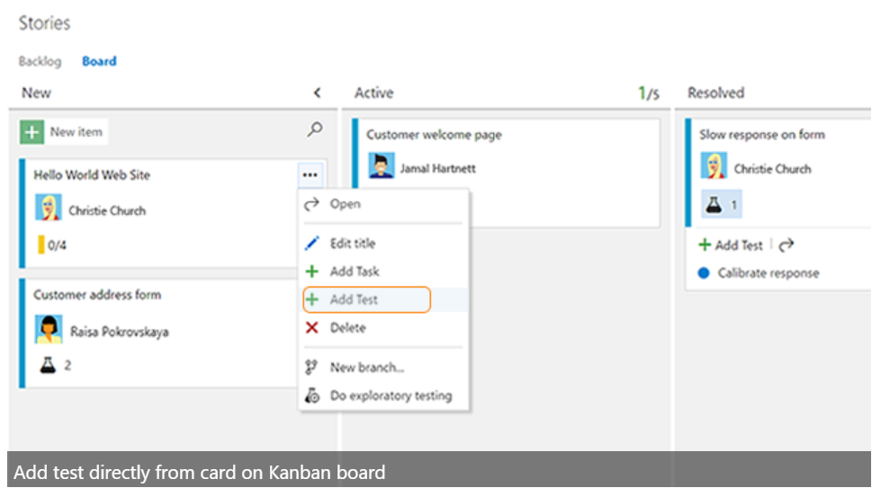
PROJECT/PROTOTYPE: TEST PLANS
One can create, run and track test for work item cards
There’s a progress report for every test run

Slide 11
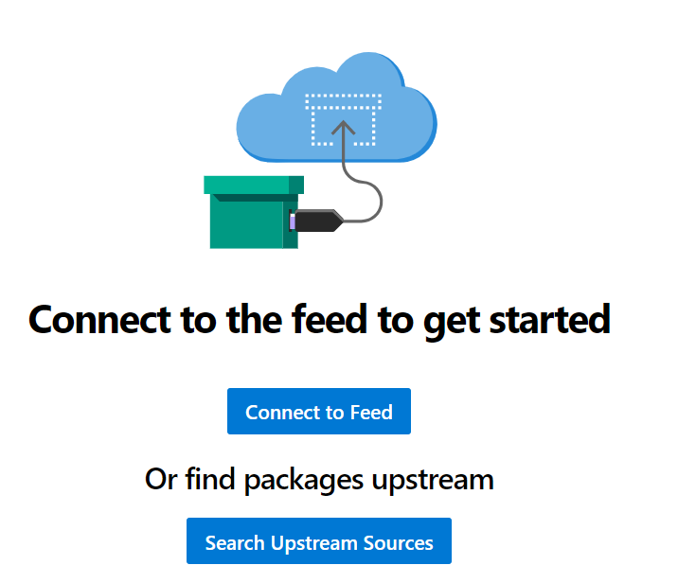
PROJECT/PROTOTYPE: ARTIFACTS
Azure Artifacts enables developers to share their code efficiently and manage all their packages from one place. With Azure Artifacts, developers can publish packages to their feeds and share it within the same team, across organizations, and even publicly.
Azure Artifacts documentation | Microsoft Learn

Slide 12
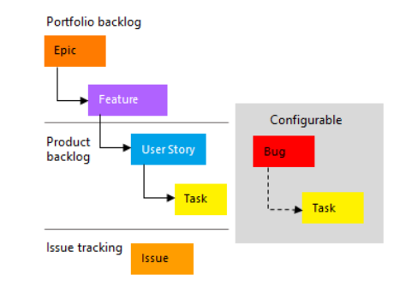
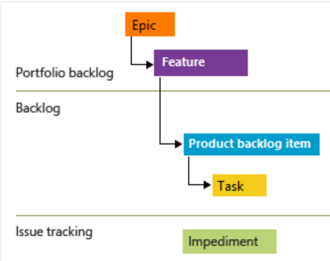

Process/Methodology
Add work items in accordance with the process you’re following.
Basic: Issue and task are used to track work, while epic is used to
group work under larger scenarios.
Agile: User story defines applications, requirements, elements that teams need to create.
Product owners typically define, and stack rank a user story. The team estimates the
effort and work to deliver the highest priority items.
Scrum: Agile methodology wherein PBIs are tracked
CMMI: Requirements are tracked

Slide 13
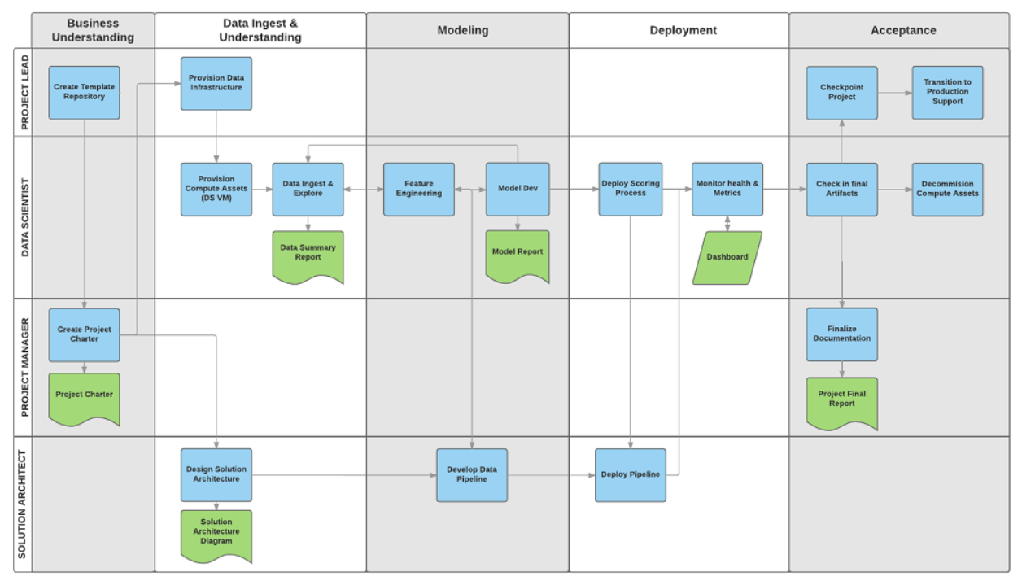
TEAM DATA SCIENCE Process (TDSP)
Notes:
There’re packages to visualize geospatial data like folium etc.

Slide 14
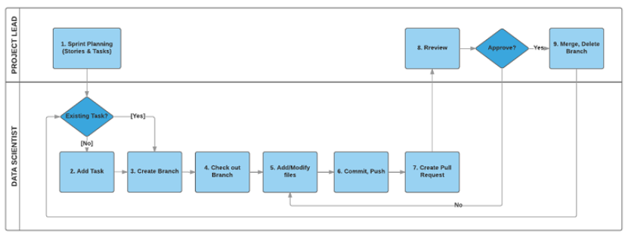
TDSP WORKFLOW
Notes:
There’re packages to visualize geospatial data like folium etc.

Slide 15
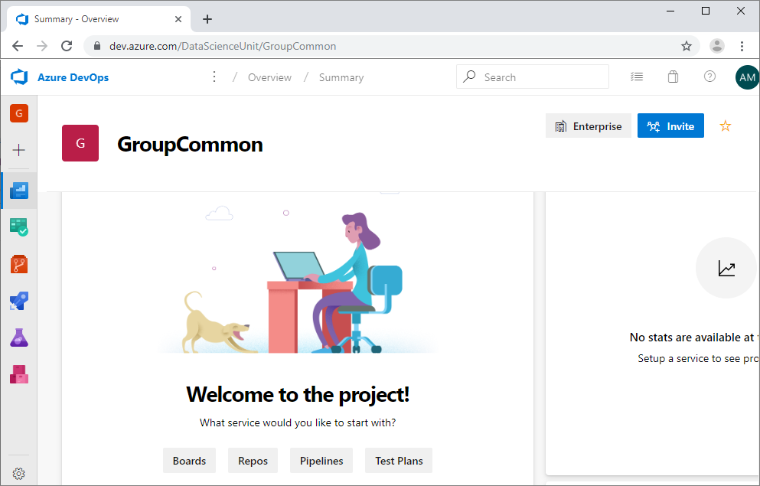
PROJECT STRUCTURE IN AZURE DEVOPS

Slide 16
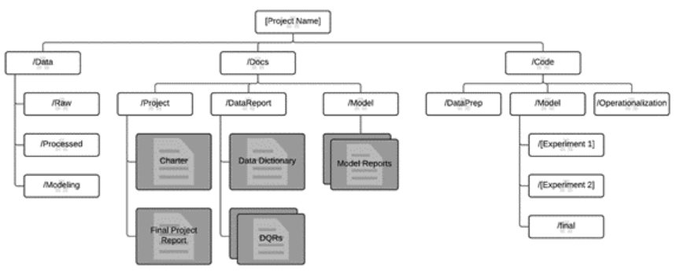
Repository structure (GIT)
GitHub - Azure/Azure-TDSP-ProjectTemplate: TDSP: Data science project template repository with standardized directory structure and document templates to support efficient project execution and collaboration.
Notes:
There’re packages to visualize geospatial data like folium etc.

Slide 17
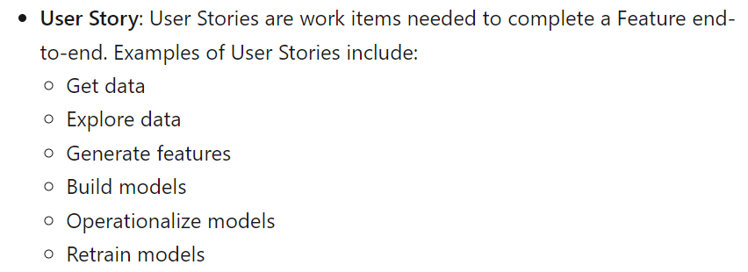
AGILE DEVELOPMENT of tdsp (DEVOPS BOARDS)
Add a feature to the backlog (Boards). Each feature corresponds to a TDSP stage or project phase
Business understanding
Data ingestion
Modeling
Deployment
Add a user-story to the feature
Add a task to the user-story
Agile development of data science projects - Azure Architecture Center | Microsoft Learn

