Slide 1
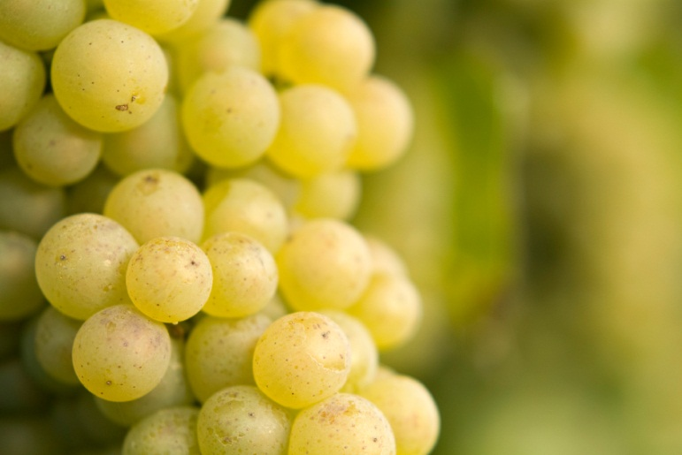
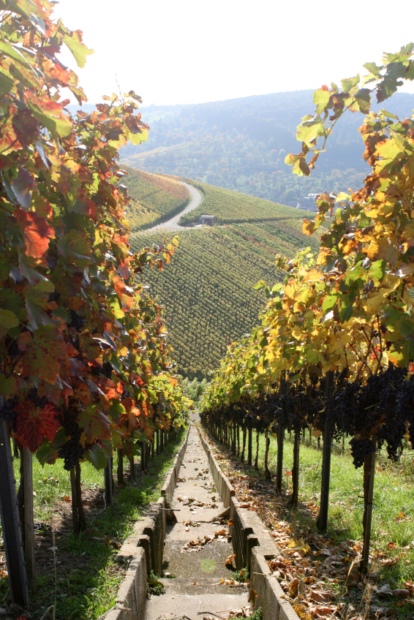
[Improvement in Wine Quality]
Prepared for Unicorn Winery
By Digitas Advanced Analytics
[20, April, 2018]

Slide 2

EDA to perceived quality of wines
Complication/Gap
Client does not have a data driven mechanism to under the improve quality of the wine.
Current Situation
Desired State
Client Unicorn Winery is a multinational beverage company
Company certain aspects of wine to improve the quality of wine .
Organization wants to understand the relationship between certain physicochemical properties to improve quality of wine.
Client will understand the aspect should be modified to make good quality wine which will help the company to have a positive impact on the consumers or the sales of the wine.
Key questions
What is happening in the current manufacturing process?
Which are the aspects impacting quality of wines in the production unit?
Which aspect should be modified to improve quality?

Slide 3
Introduction
Market Opportunity
Unicorn Challenges
Analytic Objectives
In 2014, $180 billion USD spent on wine (27 billion liters) worldwide
Steady growth predicted from 2015 to 2020
Understand wine production and marketing options for increasing consumer appeal and sales of our wines
Identify relationships between physiochemical properties of wine and perceptions of quality
Identify additional analyses to provide insights for wine production and marketing decisions

Slide 4
Analytic Approach
Dataset
Method(s)
6,497 samples of red and white Vinho Verde
Features include 1 sensory-based measure of quality and 11 physiochemical properties
Fixed acidity, volatile acidity, citric acid, pH, alcohol, residual sugar, chlorides, density, sulphates, free sulfur dioxide and total sulfur dioxide
No missing values
Exploratory Data Analysis is required such as :
Univariate Analysis
Bivariate Analysis
Multivariate Analysis

Slide 5
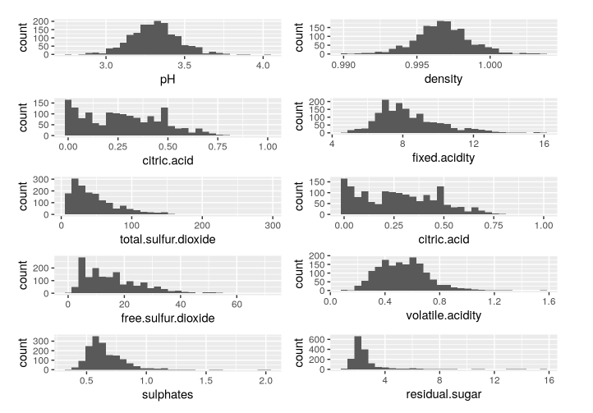
Univariate Analysis Plot

Slide 6
Univariate Analysis Results
Most of the wines in the data are average quality wines
A number of factors might be taken into account. The data is specific to only red wines of 1599 samples
The quality parameters are also mid ranged. Though a further analysis is required to understand that the concentration of input paramters is normally skewed with few outliers at the positive and negative ends
A quick look on the histogram plots suggests that the data may be nomally dictributed and the impact would be certain based on the quantity of the input content. In particular, the residual sugar, sulphates, volatile acidity, density and pH are uniformly skewed in its initial analysis.
The sulphate content might suggest to have some outliers and the distribution of the data needs to be explored further

Slide 7
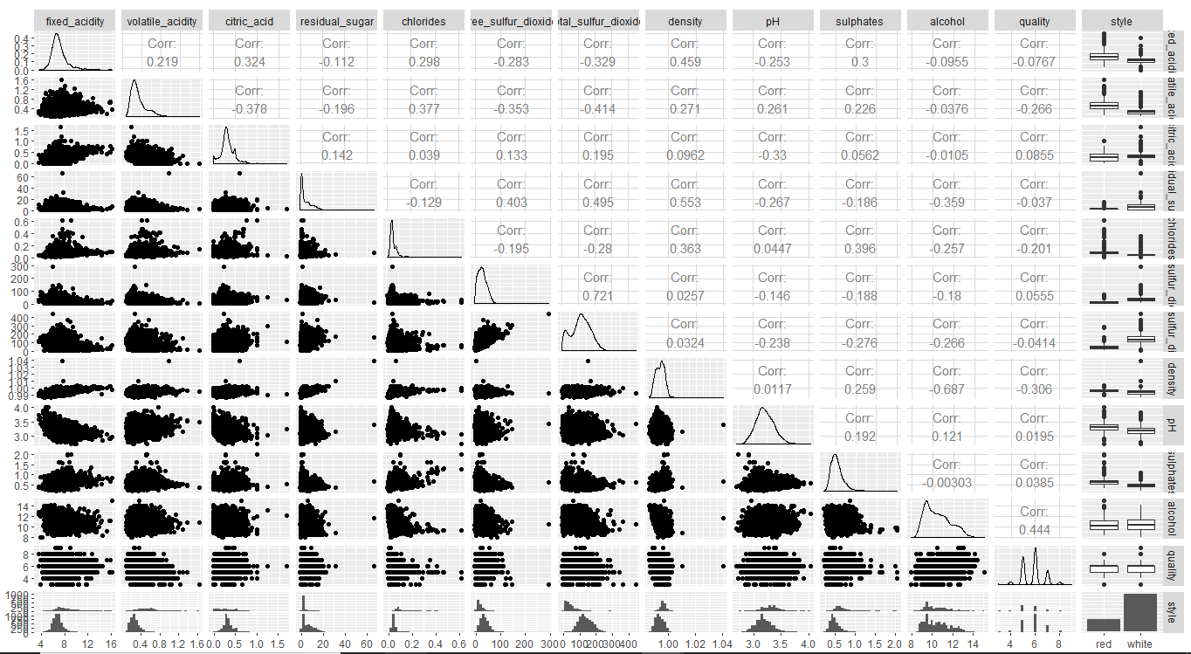
Bivariate analysis plot

Slide 8
Bivariate Analysis Results
pH has a mild effect on the alcohol content, higher pH, lower the alcohol quality
Fixed acidity does not have any impact
Volatile acidity has a negative impact
Citric Acid content has a positive impact
Other parameters such as chlorides, residual sugar are weakly correlated and does not provide much of the details
The Sulphur and the density concentration seem to have a good correlation between the quality of the wine. The concentration of the quality seem to have a direct impact on the quality of wine. Lets do some multivariate and correlation analysis to understand this a bit more

Slide 9
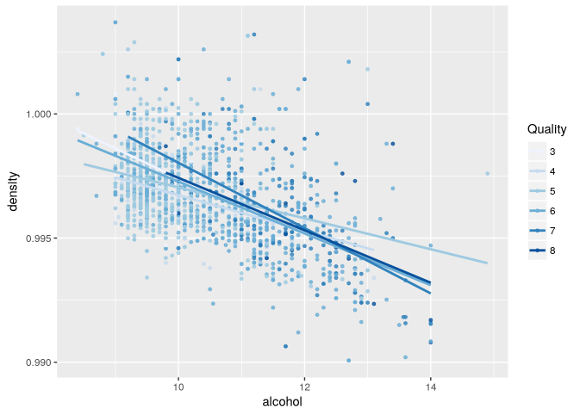
Multivariate Analysis Plots

Slide 10
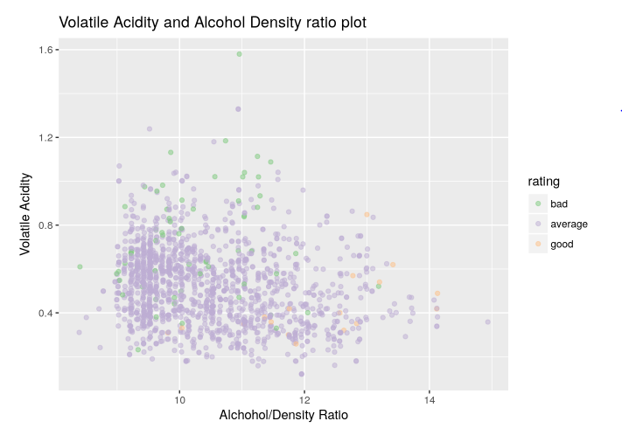

Slide 11
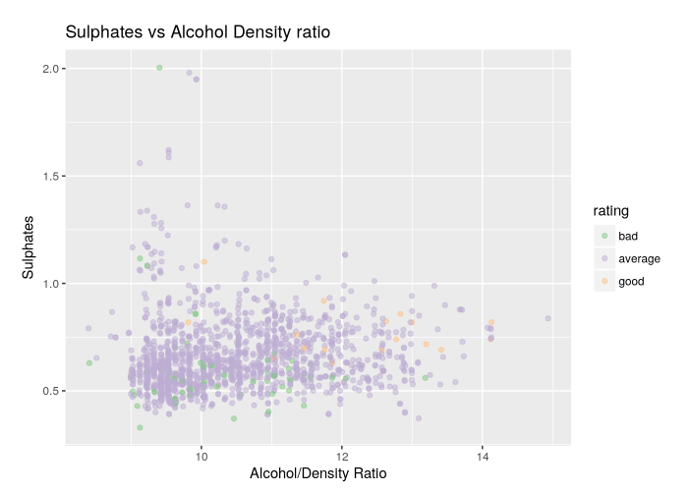

Slide 12
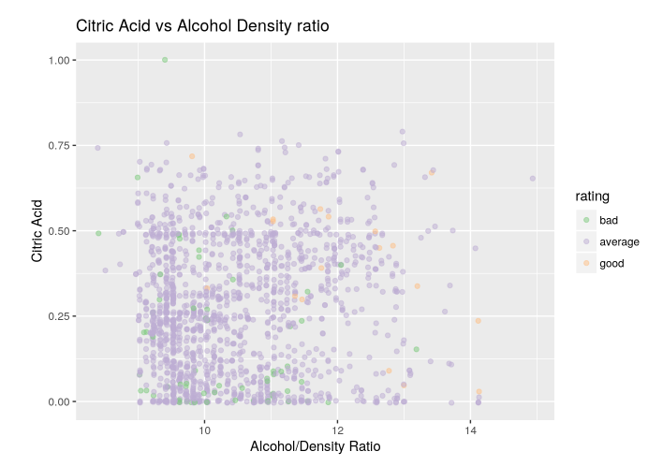

Slide 13
Multivariate Analysis Summary
There finally comes an end to an interesting analysis on the red wine quality based on various chemical combinations and quality being conformed based on the samples.
The dataset contained mostly average quality wines with only few samples of bad and good quality wines. This can be a starter point for any further analysis on the wine quality and suggestion can be to include more quality on the extremes of good and bad quality in future for deeper analysis

Slide 14
The analysis started with understanding individual characteristics and distribution of the input parameters to determine the quality of wine. I started with qplots to determine the individual parameters then proceeded to compare it with the quality and then ratio of density and alcohol content
The bivariate plots showed that acidic properties and effect of sulphates in the samples were direct. Alcohol content and density effect were more similar and we used the alcohol/density ratio to plot against the acidic properties of the wine. All the results on the multivariate plot again suggest to have a direct correlation on the quality of the data, as detailed on the induvial analysis of the plots

Slide 15
Future Support to Business
This dataset can be extended to have time parameters on which these samples were taken and also the cost of the wines involved to further extend on the quality of the wines, as I believe this could have more impact on the quality of the wines. It would also be better to know the number of wine tasters and the sample quantity consumed in order to further probe on the data

