Slide 1

Multi-Junction Solar Cell
Presentation by:
Ranjan Yadav
EVD17I009
under the guidance of:
Dr. Vivek Kumar
Photovoltaic Science & Engineering
PHY-507T
Department of ECE
Indian Institute of Information Technology
Design and Manufacturing Kancheepuram, Tamil Nadu, 600-127

Slide 2
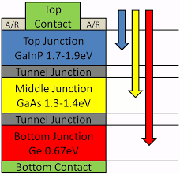
What is Solar Cell?
A solar cell, or photovoltaic cell, is an electrical device that converts the energy of light directly into electricity by the photovoltaic effect, which is a physical and chemical phenomenon. It is a form of photoelectric cell, defined as a device whose electrical characteristics, such as current, voltage, or resistance, vary when exposed to light. Individual solar cell devices can be combined to form modules, otherwise known as solar panels.
Fig-1 Solar Cell Working
Multi-junction solar cell:
Multi-junction (MJ) solar cells are solar cells with multiple p–n junctions made of different semiconductor materials. Each material's p-n junction will produce electric current in response to different wavelengths of light. The use of multiple semiconducting materials allows the absorbance of a broader range of wavelengths, improving the cell's sunlight to electrical energy conversion efficiency.
Image Sources: Google Images
Fig-2 MJ Solar Cell

Slide 3
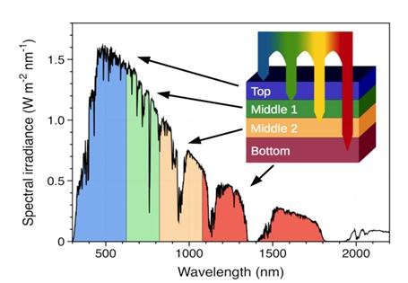
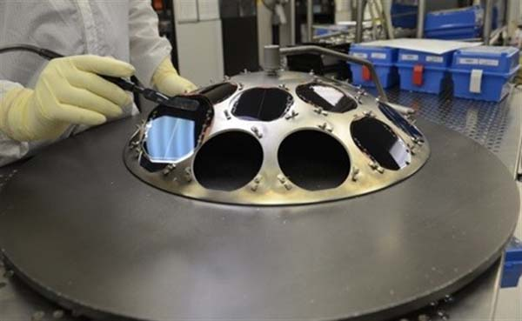
Ideation:
Cells made from multiple materials layers can have multiple bandgaps and will therefore respond to multiple light wavelengths, capturing and converting some of the energy that would otherwise be lost to relaxation as we know.
For instance, if one had a cell with two bandgaps in it, one tuned to red light and the other to green, then the extra energy in green, cyan and blue light would be lost only to the bandgap of the green-sensitive material, while the energy of the red, yellow and orange would be lost only to the bandgap of the red-sensitive material.
Conveniently, light of a particular wavelength does not interact strongly with materials that are of bigger bandgap. This means that you can make a multi-junction cell by layering the different materials on top of each other, shortest wavelengths (biggest band-gap) on the "top" and increasing through the body of the cell. As the photons have to pass through the cell to reach the proper layer to be absorbed, transparent conductors need to be used to collect the electrons being generated at each layer.
Fig-2 : Spectrum Utilization
Fig-3 : Inverted Metamorphic Multi-Junction Solar Cells (Credit: SolAero Technologies)
Image Sources: Google Images

Slide 4
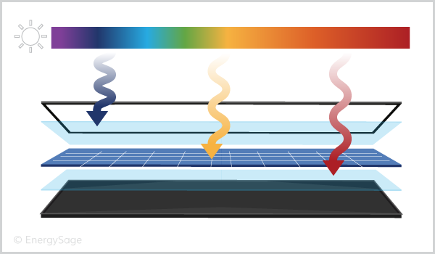

Comparing multi-junction and single-junction solar cells:
Efficiency:
A solar cell efficiency is a measure of what percentage of incoming light that hits the cell can be converted to electricity.
In terms of theoretical efficiency, multi-junction solar cells have the potential to significantly outperform traditional single-junction solar cells.
According to the Department of Energy, multi-junction solar cells with three junctions have theoretical efficiencies over 45 percent, while single-junction cells top out at about 33.5 percent. Adding more junctions (potentially up to 5 or 6 junctions) could boost efficiency over 70 percent. For reference, the most efficient solar panels available today have efficiencies around 22 percent.
Materials:
Single-junction solar cells are typically made using silicon as a semiconductor, while multi-junction solar cells commonly use three separate semiconductors: gallium indium phosphide (GaInP), indium gallium arsenide (InGaAs), and germanium (Ge).
Pricing:
One thing is for sure: multi-junction solar cell production is a more complicated and difficult process using more expensive materials, so they’ll likely cost more than single-junction cells when they hit the mass market.
There aren’t commercially-available multi-junction solar cells yet, which means that pricing is mostly speculation.
Fig-4 Efficiency enhancement
Fig-5 Cost of Fabrication is high due to higher precision at junctions
Image Sources: Google Images

Slide 5
Past Notable Research Work:
“Numerical Study of InGaN based photovoltaic by SCAPs Simulation”
By: L. Boudaoud, S. Khelifi, M. Mostefaoui, A.K. Rouabhia & N. Sahaoune
From: Centre de Développement des Énergies Renouvelables, Algeria
Conclusion: They conducted experiment for photovoltaic performance of p-GaN/ n-InGaN solar cells and investigated for Voc, Isc, Conversion efficiency, and also on composition of Indium which enhances Isc. Also they achieved max efficiency around 27.8%.
“Simulation studies of CZT(S,Se) single and tandem junction solar cells towards possibilities for higher efficiency upto 22%”
By: Goutam Kumar Gupta & Ambesh Dixit
From: IIT -Jodhpur
Conclusion: DST/INT/Mexico/P-02/2016 project which showed the optimal efficiency upto 22% for Tandem CZTS,Se structures. Also to enhance efficiency by introducing Wider bandgap chalcogenide such as CZGS in tandem geometries.
“Effect of temperature on GaInP/GaAs Tandem solar cells performance”
By & From : Mahfoud (Algeria) , Md. Fathi (Malaysia) & Farid Djahli(Algeria)
Conclusion: Electrical Properties of the Tandem SC are studied for a varying temp. From 25 to 80 degree celsius, showed increasing the temp causes the reduction of the Voc, Isc and conversion efficiency.
“Analysis of Enhancement of Quantum Efficiency For Multijunction Solar Cell”
By: Jatin Kr. Chaudhary[i], Rajiv Kanth[ii], Pekka[iii] & Heikkonen[iii]
From: NIT Surat[i], University of AS Finland[ii], University of Turku Finland[iii].
Conclusion: Simulated 5 layered, 4 junction Solar Junction whose Fill Factor and Quantum Efficiency was
increased by 9.86% & 37.198% from there benchmark which were taken from State-of-the-art research in Solar
Cell efficiencies.

Slide 6
Abstract:
To simulate the high efficiency CIGS(Cu(In,Ga)Se2) based Solar Cell using SCAPs 1D tool and analyze the influence of buffer layer on the CIGS-based Solar cell. Also PV parameters are calculated for different buffer layer (CdS,ZnS,ZnSe) and find the alternative of CdS.
Introduction:
CIGS is important material for terrestrial based solar cells applications because of their high efficiency, long-term stable performance and potential for low-cost production. Thin film solar-cells with polycrystalline Cu(In,Ga)Se2 (CIGS ) absorber layers provide a good alternative to wafer based crystalline silicon solar cells, which currently constitute the major share of photovoltaics installed and used worldwide. The CIGS based solar cells exhibit excellent outdoor stability, radiation hardness and highest efficiencies (19.2%)[3-6].
These compounds are direct bandgap semiconductors which minimize the requirement for long minority carrier diffusion lengths.
Such p-type semiconductors with high absorption coefficient are the promising absorbing materials for thin film photovoltaic technology.
Buffer layer is an intermediate layer film between the absorber and window layers with two main objectives,
A. to provide structural stability to the device &
B. to fix the electrostatic conditions inside the absorber layer.
Cadmium sulphide (CdS) is a prominent candidate to be used a buffer layer in Cu(In,Ga)Se2 based solar cell.
Note that Cadmium (Cd) is a metal that can cause severe toxicity in humans and the environment.
ZnO{n type}
Buffer layer(ZnS/CdS/ZnSe){n type}
CIGS(Absorber layer){p type}
Table shows layer arrangement

Slide 7
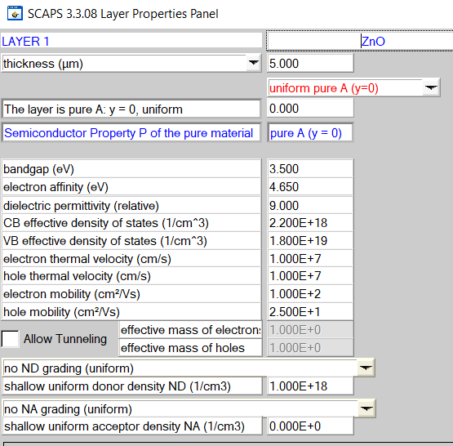
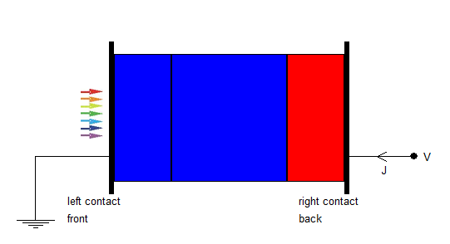
Properties:
Fig-6 Diagram for MJ Simulated Solar Cell, First layer is ZnO, then Buffer layer(ZnS/CdS/ZnSe) then CIGS layer(moving from left to right)
Fig-7 : Properties of ZnO layer . N-type surface. Also, this layer will have direct light contact

Slide 8
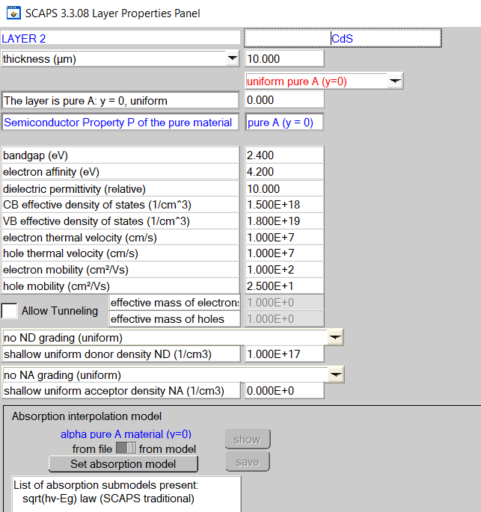
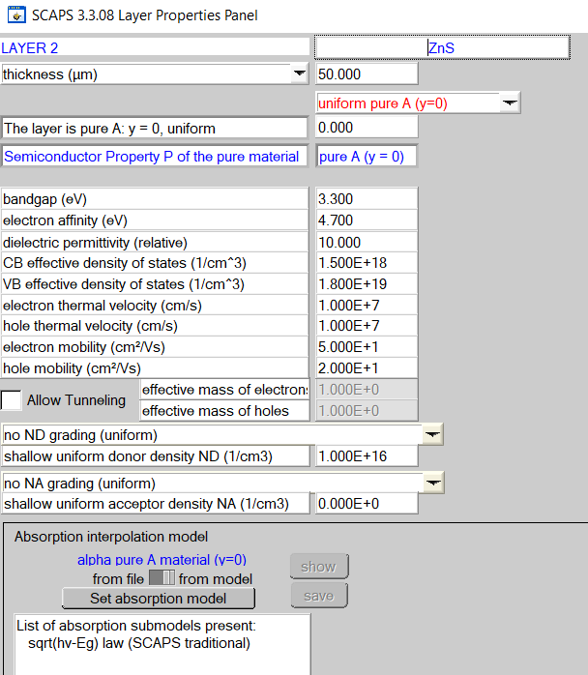
Fig-8 : Properties of CdS layer . N-type surface. This layer is called as buffer layer
Fig-9 : Properties of ZnS layer . N-type surface. This layer is called as buffer layer

Slide 9
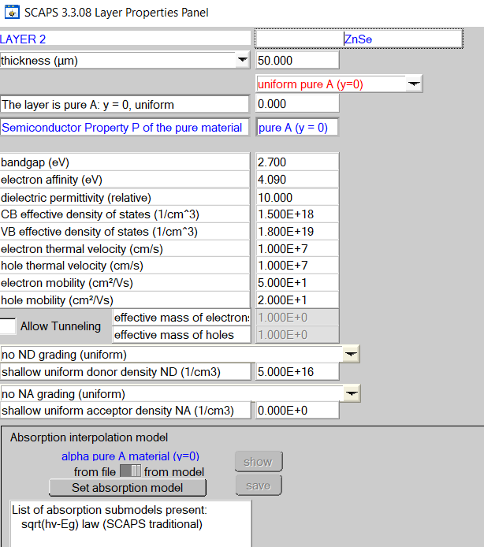
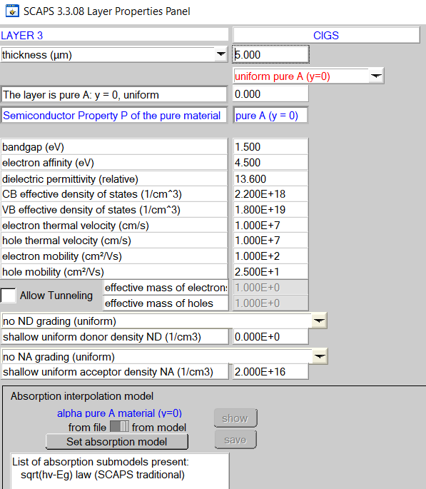
Fig-10 : Properties of ZnSe layer . N-type surface.
This layer is called as buffer layer.
Fig-11 : Properties of CIGS layer . N-type surface.
This layer is called as absorber layer.

Slide 10
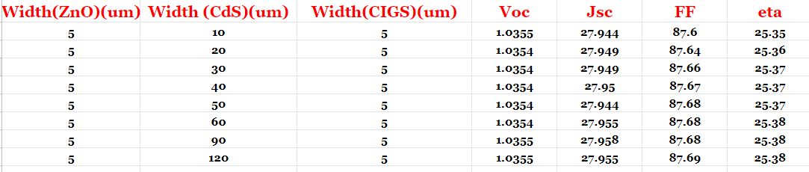
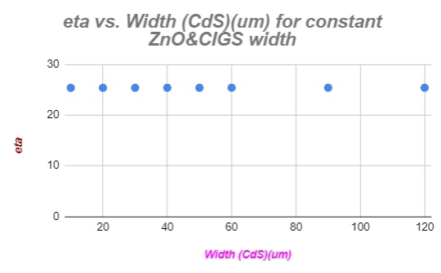
Experimental Results:
Varying CdS( buffer layer) width:
Fig-12 : Experimental result on eta vs width of CdS. shows that eta is almost constant. However cost analysis shows that fabricating around 50um is cost optimum(practical).

Slide 11
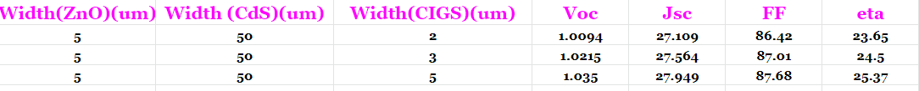
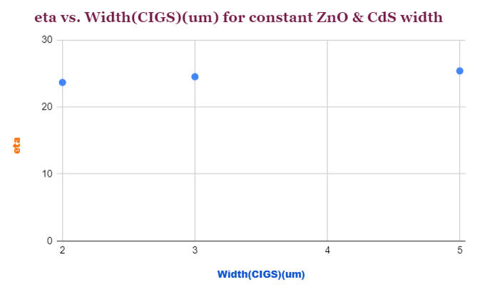
2. Varying CIGS Width
Fig-13 : Experimental result on eta vs width of CIGS. shows that eta is almost constant. Increase in eta is observable however it is not drastic.

Slide 12
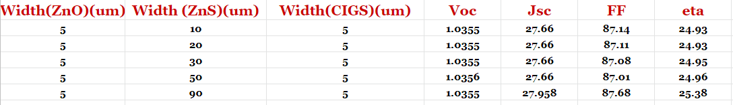
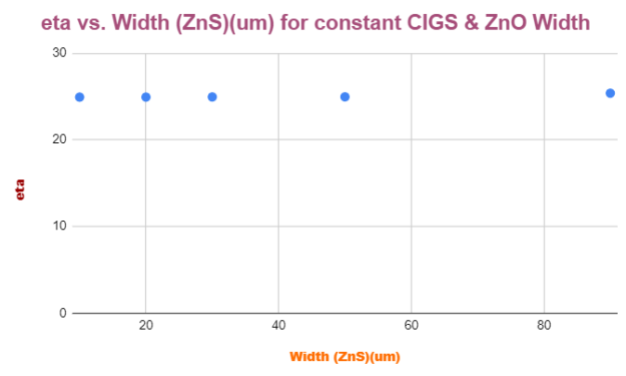
3. ZnS as buffer layer:
Fig-14 : Experimental result on eta vs width of ZnS. shows that eta is almost constant. Eta practical value is around that of CdS. Hence it is good substituting material for CdS. Note: Cd is highly toxic in nature for human as well as environment.

Slide 13
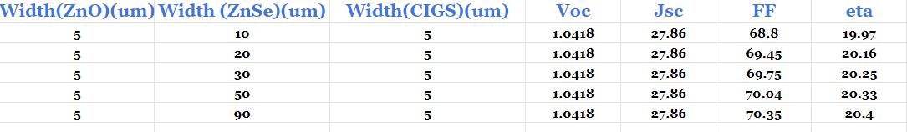
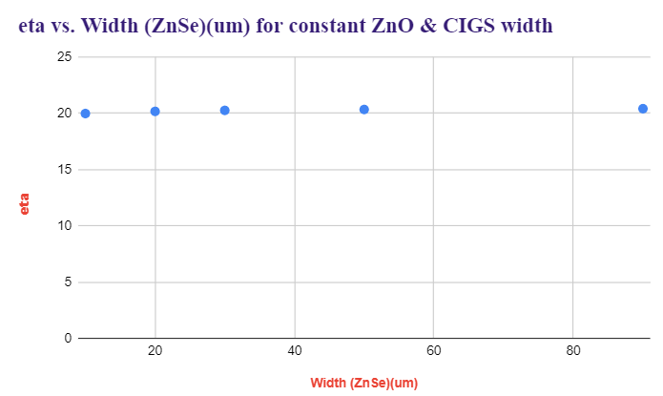
4. ZnSe as Buffer layer
Fig-14 : Experimental result on eta vs width of ZnSe. shows that eta is almost constant. Eta practical value is much less than that of CdS (less<6% around) . Hence it is not a good substituting material for CdS in terms of installation in place of CdS.

Slide 14
Result: Simulated the 3 layer MJ Solar cell and plotted the efficiency vs Width for various cases. I chose CdS as buffer layer initially and wanted to find substituting material for CdS due to its toxic nature without compensating the efficiency, Hence found the material ZnS which is good material for environment , easy to manufacture and non-toxic in nature as well with almost same efficiency.
Conclusion:
In this investigation, I studied the performance of the CIGS-based solar cells. The CdS buffer layer is replaced by other materials like Zinc Sulphide (ZnS) and Zinc Selenide (ZnSe). We concluded that ZnS can be used as alternative material to CdS.
I have also demonstrated in this study, that the variation in the thickness of the absorber layer (and buffer layer) and analyzed that buffer layer width variation have almost constant relation with eta, however increasing the width of absorber layer increases the eta, 5um is good for absorber layer.
The photovoltaic parameters (Jsc, eta , Voc and FF) have been calculated and it was found that optimized value of the cell thickness is 5 μm for p-CIGS layer and 90nm for n-ZnS layer. (Size is little bulky than CdS to attain the exactly same max. efficiency).
Multi junction Solar cells , if properly fabricated along with optimum design and best material selection without causing any ill effect on environment can serve potential source of renewable energies, with better efficiency rates.

Slide 15
References:
https://en.wikipedia.org/wiki/Multi-junction_solar_cell
https://openei.org/wiki/Definition:Solar_cell
Repins I, Contreras M, Egaas B, DeHart C, Scharf J, Perkins C, To B, Noufi R. 19.9%-efficient ZnO/CdS/CuInGaSe Solar cell with 81.2% fill factor. Prog Photovolt Res Appl, 2008, p 235–239.
J.Lindahl , U.Zimmermann , P.Szaniawski , T.Törndahl , A.Hultqvist , P.Salomé , C.Platzer-Björkman and M.Edoff , Inline Cu(In,Ga)Se2 Co-evaporation for high efficiency solar cells and modules IEEE J.Photovolt , 2013, p1100–1105.
M.Powalla , P.Jackson , W.Witte , D.Hariskos , SPaetzle , C.Tschamber and W.Wischmann , High-efficiency Cu(In,Ga)Se2 cells and modules Solar Energy Mater. Solar Cells,2013, p 51–58.
A.Chirila et al , Highly efficient Cu(In,Ga)Se2 solar cells grown on flexible polymer films , Nature Mater, 2011, p 857–861.
Thank You
For your support

