Slide 1
SHA-256
DSTTD lab
1. Introduction 2. Algorithm
3. Output 4. Code Coverage
5. Assertions 6. Conclusion
Ranjan Yadav
Roll No: EVD17I009
Digital System Testing and Testable Design Practice
ELE548P
Department of Electronics & Communication Engineering Indian Institute of Information Technology
Design and Manufacturing, Chennai, Tamil-Nadu-600127, India
November 4, 2020
SHA-256

Slide 2



Presentation Outline
1. Introduction 2. Algorithm
3. Output 4. Code Coverage
5. Assertions 6. Conclusion
Introduction Overview
Algorithm
1. Notations
2. Pre and post processing
Outputs
Code Coverage
Assertions
Conclusion
SHA-256

Slide 3
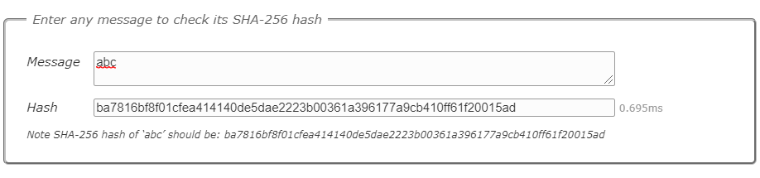
1. Introduction 2. Algorithm
3. Output 4. Code Coverage
5. Assertions 6. Conclusion
Introduction
Introduction:
SHA-2 (Secure Hash Algorithm 2) is a set of cryptographic hash functions designed by the United States National Security Agency(NSA) and first published in 2001.
A cryptographic hash (sometimes called ‘digest’) is a kind of ‘signature’ for a text or a data file. SHA-256 generates an almost-unique 256-bit (32-byte) signature for a text. SHA-256 is one of the successor hash functions to SHA-1 (collectively referred to as SHA-2), and is one of the strongest hash functions available. SHA-256 is not much more complex to code than SHA-1, and has not yet been compromised in any way. The 256-bit key makes it a good partner-function for AES. It is defined in the NIST (National Institute of Standards and Technology) standard ‘FIPS 180-4’. NIST also provide a number of test vectors to verify correctness of implementation.
Figure 1:Evaluation of SHA-256 for abc
using https://www.movable-type.co.uk/scripts/sha256.html
SHA-256

Slide 4
1. Introduction 2. Algorithm
3. Output 4. Code Coverage
5. Assertions 6. Conclusion
Introduction
Introduction:
Basic Description of SHA-256
The SHA-256 compression function works on a 512-bit message block and a 256-bit intermediate hash value. It is essentially a 256-bit block cipher algorithm which encrypts the intermediate hash value using the message block as key.
It consist of two major blocks:
Compression Function
Message schedule. SHA-256 is a 256-bit hash and is meant to provide 128 bits of security against collision attacks.
Collision attack: Finding any two messages which hash to the same value should require work equivalent to about 2^{(n/2)} hash computations. Find two different messages m1 and m2 such that hash(m1) = hash(m2).
Overview:
The message to be hashed is follows the following two steps: (1) padded with its length in such away that the result is a multiple of 512 bits long, and then (2) parsed into 512-bit message blocks M⁽¹⁾ ; M⁽²⁾ ;...............;M^{(N)} .
The message blocks are processed one at a time:
Beginning with a fixed initial hash value H⁽⁰⁾ , sequentially compute H^{(i)} = H^{(i-1)} + C_{M}^{(i)} (H^{(i-1)}) ;
where C is the SHA-256 compression function
and + means word-wise mod 2³² addition. H^{(N)} is the hash of is the hash of M
SHA-256

Slide 5
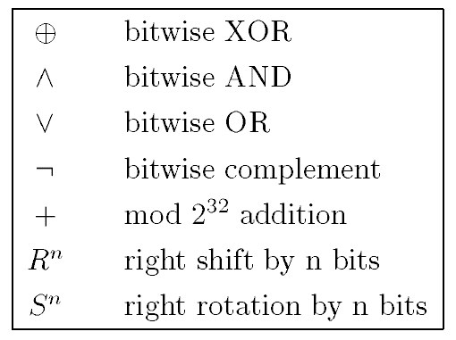
1. Introduction 2. Algorithm
3. Output 4. Code Coverage
5. Assertions 6. Conclusion
Algorithm
Algorithm:
Notation and initial values:
The initial hash value H⁽⁰⁾ is the following sequence of 32-bit words.
H⁽⁰⁾ 1 = 6a09e667
H⁽⁰⁾ 2 = bb67ae85
H⁽⁰⁾ 3 = 3c6ef372
H⁽⁰⁾ 4 = a54ff53a
H⁽⁰⁾ 5 = 510e527f
H⁽⁰⁾ 6 = 9b05688c
H⁽⁰⁾ 7 = 1f83d9ab
H⁽⁰⁾ 8 = 5be0cd19
Figure 2:Notations.
SHA-256

Slide 6
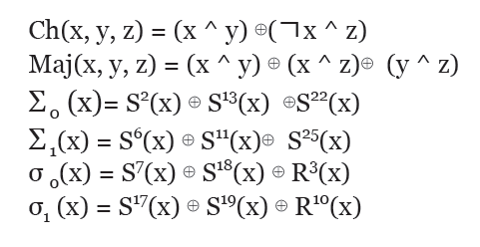
1. Introduction 2. Algorithm
3. Output 4. Code Coverage
5. Assertions 6. Conclusion
Algorithm
Algorithm:
Pre-Processing:
Computation of the hash of a message begins by preparing the message:
Pad the message in the usual way: Suppose the length of the message M, in bits, is l . Append the bit “1" to the end of the message, and then k zero bits, where k is the smallest non-negative solution to the equation
l +1+k ≡ 448 mod 512.
2. Parse the message into N 512-bit blocks M⁽¹⁾; M⁽²⁾ ;...........;M^{(N)} . The first 32 bits of message block i are denoted M^{(i)} ₀ , the next 32 bits are M^{(i)} ₁ , and so on up to M^{(i)} ₁₅ .
We use the big-endian convention throughout, so within each 32-bit word, the leftmost bit is stored in the most significant bit position
Functions involved:
Six logical functions are used in SHA-256. Each of these functions operates on 32-bit words and produces a 32-bit word as output. Each function is defined as follows:
Figure 3:
Functions
SHA-256

Slide 7
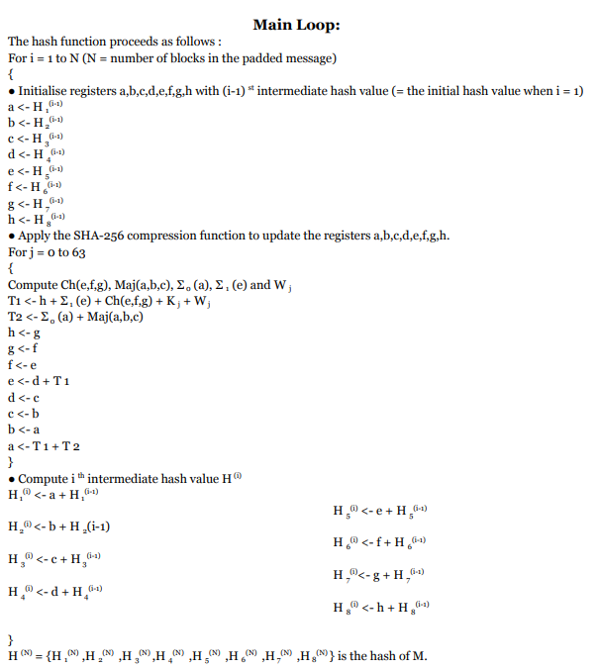
1. Introduction 2. Algorithm
3. Output 4. Code Coverage
5. Assertions 6. Conclusion
Algorithm
Algorithm:
Figure 4:
Algorithm
SHA-256

Slide 8
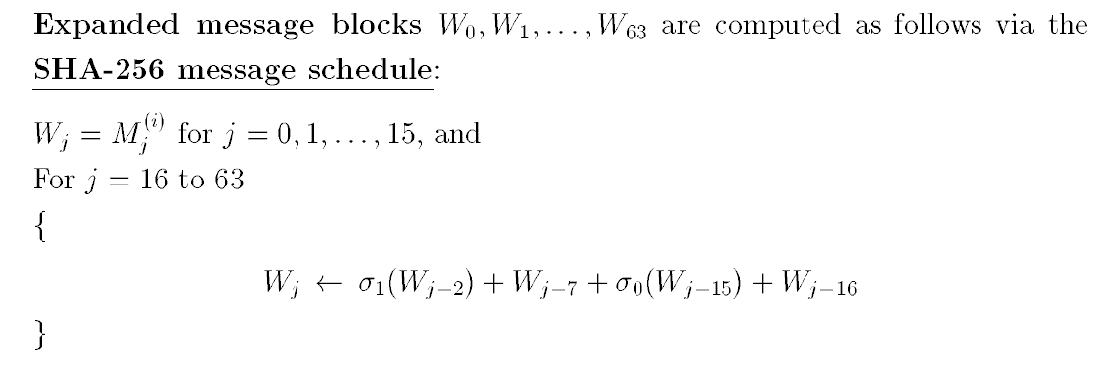
1. Introduction 2. Algorithm
3. Output 4. Code Coverage
5. Assertions 6. Conclusion
Algorithm
Algorithm:
What is W?
Figure 5:
Expanded message block
What is K?
A sequence of constant words, K₀,......,K_{63 ;} is used in SHA-256. In hex, these are given by
428a2f98 71374491 b5c0fbcf e9b5dba5 3956c25b 59f111f1 923f82a4 ab1c5ed5
d807aa98 12835b01 243185be 550c7dc3 72be5d74 80deb1fe 9bdc06a7 c19bf174
e49b69c1 efbe4786 0fc19dc6 240ca1cc 2de92c6f 4a7484aa 5cb0a9dc 76f988da
983e5152 a831c66d b00327c8 bf597fc7 c6e00bf3 d5a79147 06ca6351 14292967
27b70a85 2e1b2138 4d2c6dfc 53380d13 650a7354 766a0abb 81c2c92e 92722c85
a2bfe8a1 a81a664b c24b8b70 c76c51a3 d192e819 d6990624 f40e3585 106aa070
19a4c116 1e376c08 2748774c 34b0bcb5 391c0cb3 4ed8aa4a 5b9cca4f 682e6ff3
748f82ee 78a5636f 84c87814 8cc70208 90befffa a4506ceb bef9a3f7 c67178f2
These are the first thirty-two bits of the fractional parts of the cube roots of the first sixty-four primes.
SHA-256

Slide 9
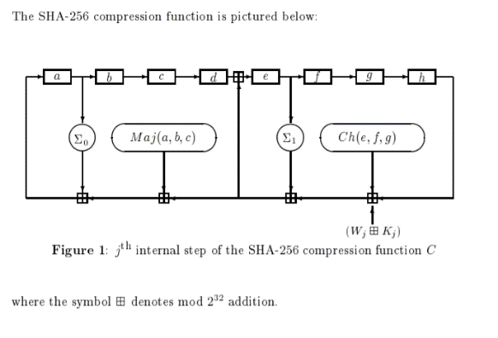
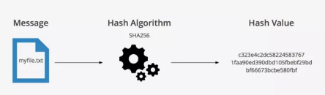
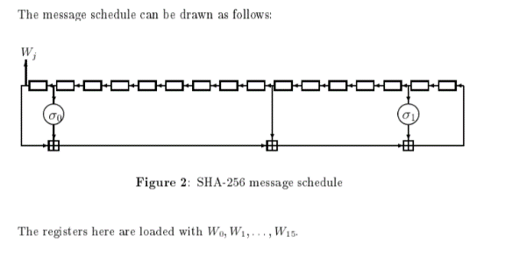
1. Introduction 2. Algorithm
3. Output 4. Code Coverage
5. Assertions 6. Conclusion
Algorithm
Algorithm:
Block Diagrams:
Figure 6: Overlook
Figure 7:
Figure 8:
SHA-256

Slide 10
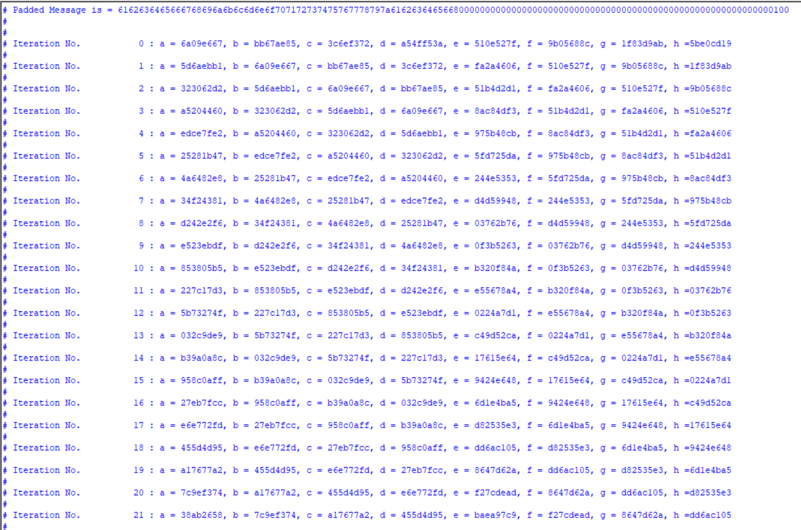
1. Introduction 2. Algorithm
3. Output 4. Code Coverage
5. Assertions 6. Conclusion
Outputs
Outputs:
Reset=1, and with input of 256 bit binary of “abcdefghijklmnopqrstuvwxyzabcdef”
SHA-256

Slide 11
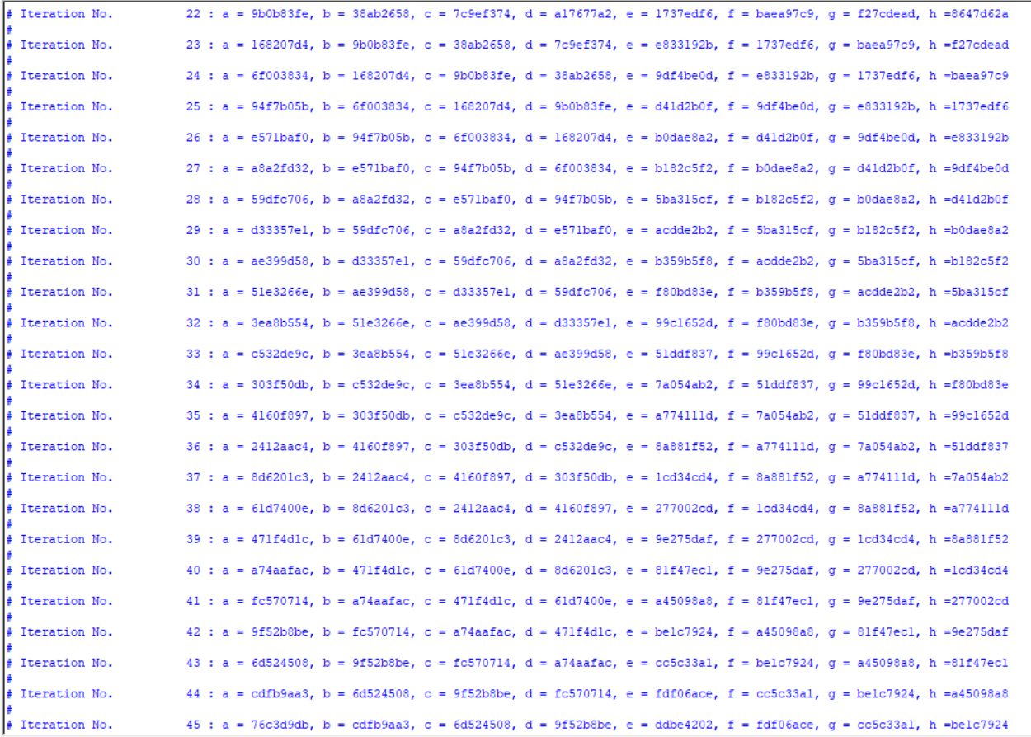
1. Introduction 2. Algorithm
3. Output 4. Code Coverage
5. Assertions 6. Conclusion
Outputs
Outputs:
SHA-256

Slide 12
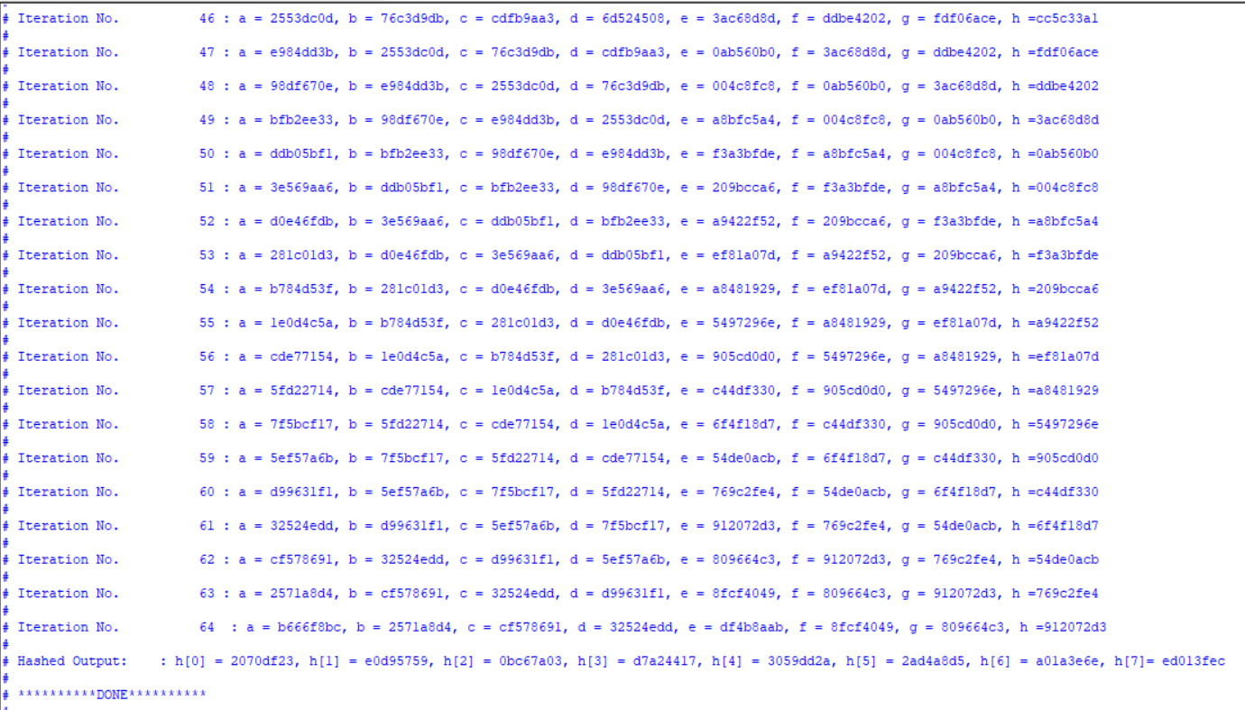
1. Introduction 2. Algorithm
3. Output 4. Code Coverage
5. Assertions 6. Conclusion
Outputs
Outputs:
The output hash function for given input is shown as h[0] to h[7]:
Hashed Output: : h[0] = 2070df23, h[1] = e0d95759, h[2] = 0bc67a03, h[3] = d7a24417,
h[4] = 3059dd2a, h[5] = 2ad4a8d5, h[6] = a01a3e6e, h[7]= ed013fec
SHA-256

Slide 13
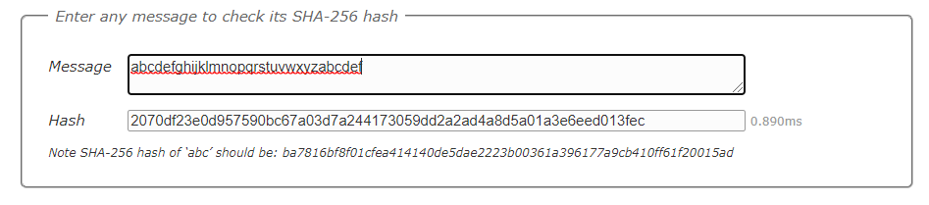
1. Introduction 2. Algorithm
3. Output 4. Code Coverage
5. Assertions 6. Conclusion
Outputs
Outputs:
Now using e-tool: source: https://www.movabletype.co.uk/scripts/sha256.html
Figure 8: Output using e-tool
SHA-256

Slide 14
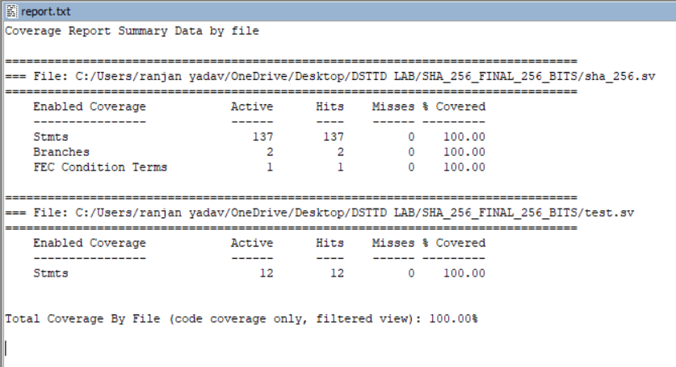
1. Introduction 2. Algorithm
3. Output 4. Code Coverage
5. Assertions 6. Conclusion
Code Coverage
Code Coverage:
Coverage Report Summary Data by file
Figure 9: Code Coverage Report
SHA-256

Slide 15
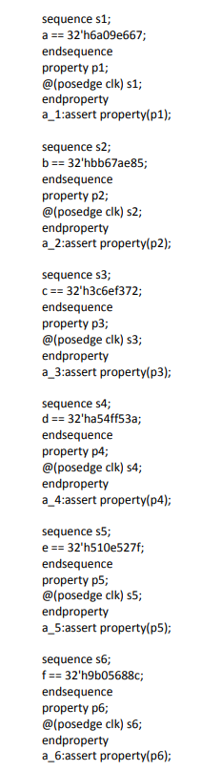
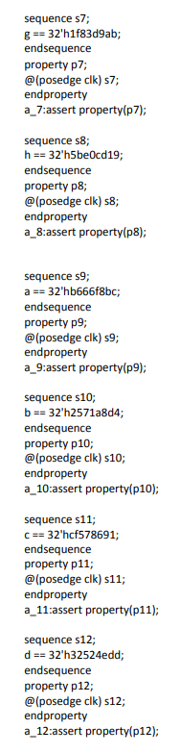
1. Introduction 2. Algorithm
3. Output 4. Code Coverage
5. Assertions 6. Conclusion
Assertions
Assertions:
Figure 9: Implementation of Assertions.
Assertions to verify the values in registers
Assertions to verify various functions
SHA-256

Slide 16
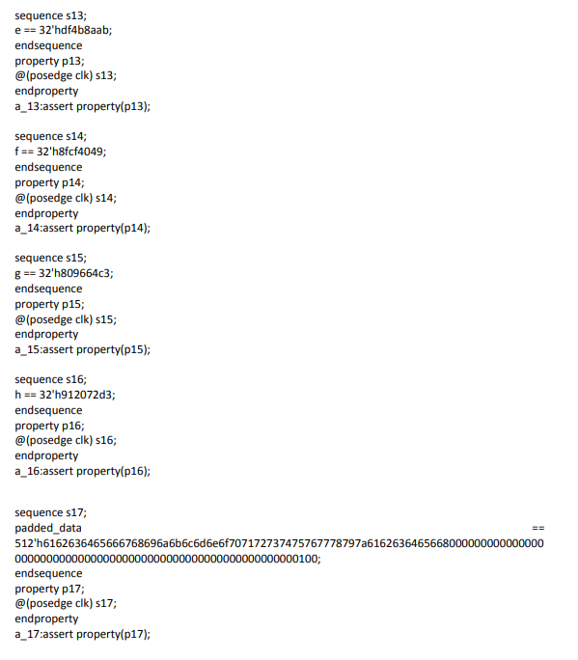
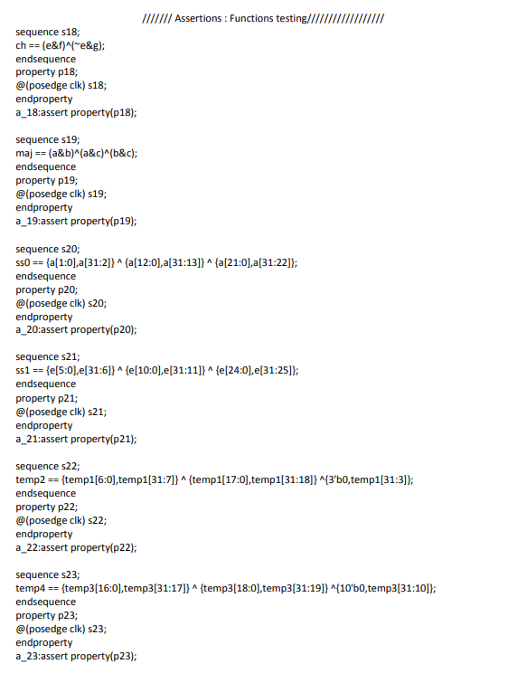
1. Introduction 2. Algorithm
3. Output 4. Code Coverage
5. Assertions 6. Conclusion
Assertions
Assertions:
SHA-256

Slide 17
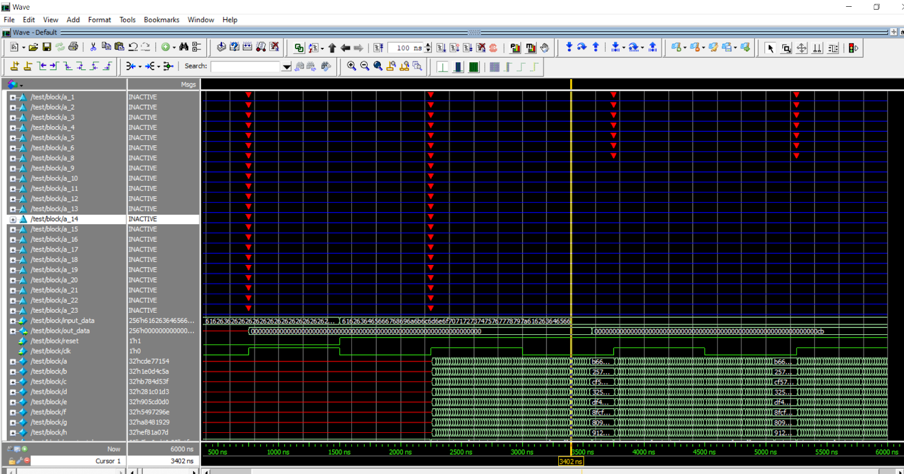
1. Introduction 2. Algorithm
3. Output 4. Code Coverage
5. Assertions 6. Conclusion
Assertions
Assertions:
SHA-256

Slide 18
1. Introduction 2. Algorithm
3. Output 4. Code Coverage
5. Assertions 6. Conclusion
Conclusion
Conclusion:
The SHA-256 hashing algorithm is currently one of the most widely used hashing algorithms as it hasn’t been cracked yet and the hashes are calculated quickly in comparison to the other secure hashes like the SHA-512. It is very well established but the industry is trying to slowly move towards the SHA-512 which is more secure as experts claim SHA-256 might be vulnerable very soon.
SHA-256 is implemented using System Verilog. Also code coverage and assertions checks are performed for various input cases and output has been verified every time as shown in previous slides.
SHA-256

Slide 19
1. Introduction 2. Algorithm
3. Output 4. Code Coverage
5. Assertions 6. Conclusion
References
References:
1. Basic Definition and Introduction from Wikipedia.(Slide-3)
https://en.wikipedia.org/wiki/SHA-2
Example output in slide-3 is taken from https://www.movabletype.co.uk/scripts/sha256.html
Remaining algorithm and pictures from (Other important slides)
http://www.iwar.org.uk/comsec/resources/cipher/sha256-384-512.pdf
Thank You
SHA-256

