Slide 1
Serial Communication Protocols – I2C & SPI
DSTTD lab
1. Introduction 2. Algorithm
3. Output 4. Code Coverage
5. Inference 6. Conclusion
Ranjan Yadav
Roll No: EVD17I009
Digital System Testing and Testable Design Practice
ELE548P
Department of Electronics & Communication Engineering Indian Institute of Information Technology
Design and Manufacturing, Chennai, Tamil-Nadu-600127, India
November 4, 2020
Serial Communication protocols – I2C & SPI

Slide 2



Presentation Outline
1. Introduction 2. Algorithm
3. Output 4. Code Coverage
5. Inference 6. Conclusion
The same outline is followed for both I2C & SPI protocol
Introduction Overview
Algorithm
Outputs
Code Coverage
Inference
Conclusion
Serial Communication protocols – I2C & SPI

Slide 3
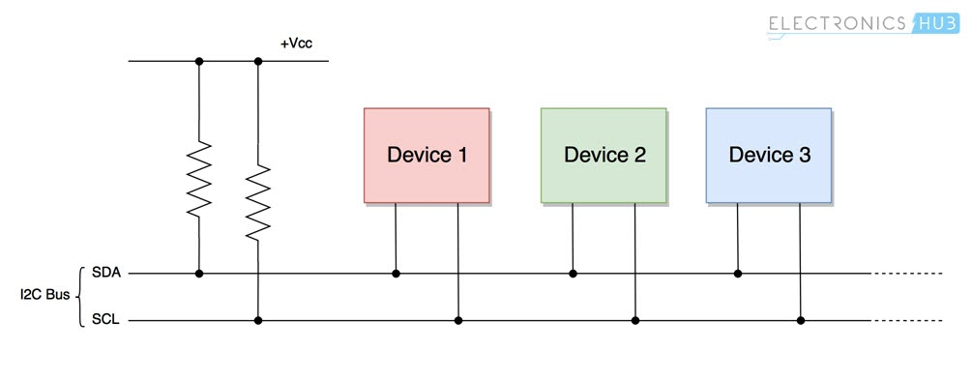
1. Introduction 2. Algorithm
3. Output 4. Code Coverage
5. Inference 6. Conclusion
Introduction
Introduction for I2C Protocol:
I²C (Inter-Integrated Circuit), pronounced I-squared-C, is a synchronous, multi-master, multi-slave, packet switched, single-ended, serial communication bus invented in 1982 by Philips Semiconductor (now NXP Semiconductors). It is widely used for attaching lower-speed peripheral ICs to processors and microcontrollers in short-distance, intra-board communication. Alternatively, I²C is spelled I2C (pronounced I-two-C) or IIC (pronounced I-I-C).
I2C at the Hardware Level:
Each I2C bus consists of two signals: SCL and SDA. SCL is the clock signal, and SDA is the data signal. The clock signal is always generated by the current bus master. The data to be transferred is sent through the SDA wire and is synchronized with the clock signal from SCL. All the devices/ICs on the I2C network are connected to the same SCL and SDA lines as shown below:
Figure1: Both the I2C bus lines (SDA, SCL) are operated as open drain drivers. It means that any device/IC on the I2C network can drive SDA and SCL low, but they cannot drive them high. So, a pull up resistor is used for each bus line, to keep them high (at positive voltage) by default.
I2C-Protocol

Slide 4
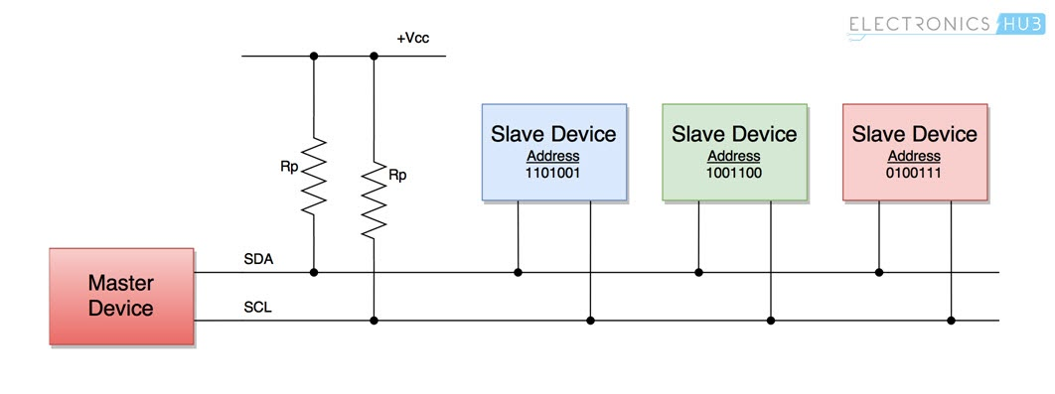
1. Introduction 2. Algorithm
3. Output 4. Code Coverage
5. Inference 6. Conclusion
Introduction
Configuration:
Master and Slave Devices
The devices connected to the I2C bus are categorized as either masters or slaves. At any instant of time only a single master stays active on the I2C bus. It controls the SCL clock line and decides what operation is to be done on the SDA data line.
All the devices that respond to instructions from this master device are slaves. For differentiating between multiple slave devices connected to the same I2C bus, each slave device is physically assigned a permanent 7-bit address.
When a master device wants to transfer data to or from a slave device, it specifies this particular slave device address on the SDA line and then proceeds with the transfer. So effectively communication takes place between the master device and a particular slave device. All the other slave devices don't respond unless their address is specified by the master device on the SDA line.
I2C-Protocol

Slide 5
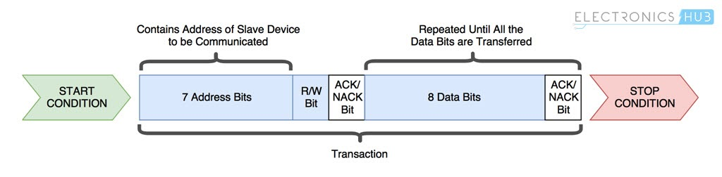
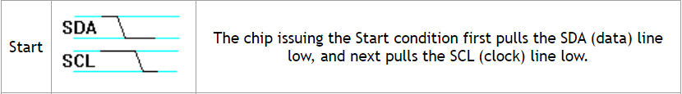
1. Introduction 2. Algorithm
3. Output 4. Code Coverage
5. Inference 6. Conclusion
Introduction
Rules:
Data Transfer Protocol
The following protocol (set of rules) is followed by master device and slave devices for the transfer of data between them.
Data is transferred between the master device and slave devices through a single SDA data line, via patterned sequences of 0’s and 1’s (bits). Each sequence of 0’s and 1’s is termed as a transaction and the data in each transaction is structured as below:
Start Condition
Whenever a master device/IC decides to start a transaction, it switches the SDA line from high voltage level to a low voltage level before the SCL line switches from high to low.
Once a start condition is sent by the master device, all the slave devices get active even if they are in sleep mode, and wait for the address bits.
I2C-Protocol

Slide 6
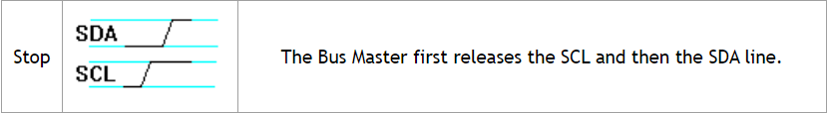
1. Introduction 2. Algorithm
3. Output 4. Code Coverage
5. Inference 6. Conclusion
Introduction
Rules:
Address Block: It comprises 7 bits and is filled with the address of the slave device to/from which the master device needs send/receive data. All the slave devices on the I2C bus compare these address bits with their address.
Read/Write Bit: This bit specifies the direction of data transfer. If the master device/IC needs to send data to a slave device, this bit is set to ‘1’. If the master IC needs to receive data from the slave device, it is set to ‘0’.
ACK/NACK Bit: It stands for Acknowledged/Not-Acknowledged bit. If the physical address of any slave device coincides with the address broadcasted by the master device, the value of this bit is set to ‘1’ by the slave device. Otherwise it remains at logic ‘0’ (default).
Data Block: It comprises 8 bits(can be adjusted) and they are set by the sender, with the data bits it needs to transfer to the receiver. This block is followed by an ACK/NACK bit and is set to ‘1’ by the receiver if it successfully receives data. Otherwise it stays at logic ‘0’.
This combination of data blocks followed by ACK/NACK bit is repeated until the data is completely transferred.
Stop Condition: After required data blocks are transferred through the SDA line, the master device switches the SDA line from low voltage level to high voltage level before the SCL line switches from high to low.
NOTE: Logic ‘0’ or setting a bit to ‘0’ is equivalent to applying low voltage on the SDA line and vice versa.
I2C-Protocol

Slide 7
1. Introduction 2. Algorithm
3. Output 4. Code Coverage
5. Inference 6. Conclusion
Algorithm
Working/Design:
Code Explanation/Algorithm Overview for my work:
It has a master which guides slaves with two wires namely i2c_scl and i2c_sda which are clock and data address lines which are kept at high(Vcc) unless data transmission start from master which pulls down the i2c_sda and then after i2c_scl will start tracing clock(external) and then make data transfer between master and slaves synchronous.
Output1, 2, 3 & 4 are output terminals of slaves which trace the data given by master if it has been addressed by master.
When i2c_sda is pull down , then start bit of transmission starts and after a clock pulse next 7 bit address will be sent and then if address will be matched with any slave then acknowledgement bit will be received and shown on i2c_sda and read enable will be sent to slave and then after 32-bit data transfer will happen and again an acknowledgement bit will be sent to i2c_sda line to show data has been received and then stop bit will start and then it finishes . All this happens when only reset=0 and start =1 is given as input and all these have been coded using FSM.
Similarly four slave configurations have been set using FSM again to send ack and receive data if address matches otherwise ack will not be sent . However slave has only control over i2c_sda for acknowledgement only otherwise i2c_sda is always handled by master.
I2C-Protocol

Slide 8
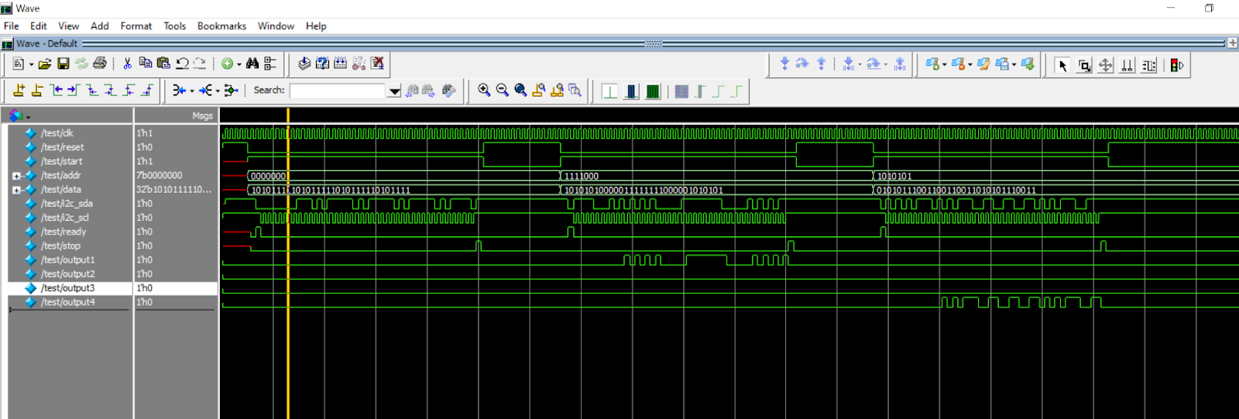
1. Introduction 2. Algorithm
3. Output 4. Code Coverage
5. Inference 6. Conclusion
Output
Output:
Output for 32-bit data transfer and 7-bit address transfer on I2C Protocol for 1-Master and 4-slaves.
I2C-Protocol

Slide 9
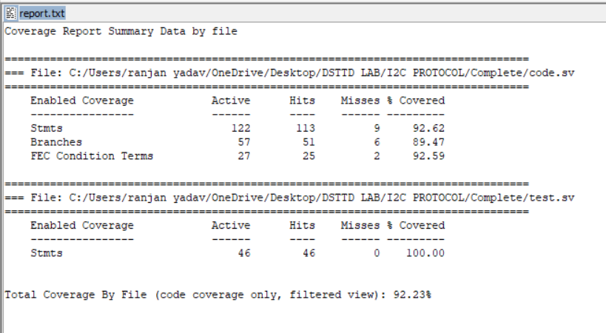
1. Introduction 2. Algorithm
3. Output 4. Code Coverage
5. Inference 6. Conclusion
Code Coverage
Code Coverage:
The above screenshots shows the code coverage for I2C Protocol: Almost 92% code coverage achieved as it is a communication protocol with many conditions based approaches and giving test conditions manually is little hectic job manually. 2 Fsm are used in codes and giving input in test bench to satisfy is bit tedious.
I2C-Protocol

Slide 10
1. Introduction 2. Algorithm
3. Output 4. Code Coverage
5. Inference 6. Conclusion
Introduction
Introduction to SPI Protocol:
The Serial Peripheral Interface (SPI) is a synchronous serial communication interface specification used for short-distance communication, primarily in embedded systems. The interface was developed by Motorola in the mid-1980s.
SPI devices communicate in full duplex mode using a master-slave architecture with a single master. The master device originates the frame for reading and writing. Multiple slave-devices are supported through selection with individual slave select (SS), sometimes called chip select (CS), lines.
To begin communication, the bus master configures the clock, using a frequency supported by the slave device, typically up to a few MHz. The master then selects the slave device with a logic level 0 on the select line. If a waiting period is required, such as for an analog-to-digital conversion, the master must wait for at least that period of time before issuing clock cycles.
During each SPI clock cycle, a full-duplex data transmission occurs. The master sends a bit on the MOSI line and the slave reads it, while the slave sends a bit on the MISO line and the master reads it. This sequence is maintained even when only one-directional data transfer is intended.
SPI-Protocol

Slide 11
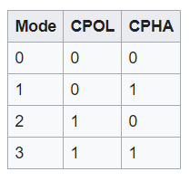
1. Introduction 2. Algorithm
3. Output 4. Code Coverage
5. Inference 6. Conclusion
Introduction
Terminology:
Transmissions normally involve two shift registers of some given word-size, such as eight bits, one in the master and one in the slave; they are connected in a virtual ring topology. Data is usually shifted out with the most significant bit first. On the clock edge, both master and slave shift out a bit and output it on the transmission line to the counterpart. On the next clock edge, at each receiver the bit is sampled from the transmission line and set as a new least-significant bit of the shift register. After the register bits have been shifted out and in, the master and slave have exchanged register values. If more data needs to be exchanged, the shift registers are reloaded and the process repeats. Transmission may continue for any number of clock cycles. When complete, the master stops toggling the clock signal, and typically deselects the slave.
Transmissions often consist of eight-bit words. However, other word-sizes are also common, for example, sixteen-bit words for touch-screen controllers or audio codecs, such as the TSC2101 by Texas Instruments, or twelve-bit words for many digital-to-analog or analog-to-digital converters.
Every slave on the bus that has not been activated using its chip select line must disregard the input clock and MOSI signals and should not drive MISO (I.E. must have a tristate output) although some devices need external tristate buffers to implement this.
SPI Terminology:
CPOL: Clock Polarity
CPOL=0 means clock idles at 0, leading edge is rising edge.
CPOL=1 means clock idles at 1, leading edge is falling edge.
CPHA: Clock Phase
CPHA=0 means the "out" side changes the data on trailing edge of clock & the "in" side captures data on leading edge of clock
CPHA=1 means the "out" side changes the data on leading edge of clock & the "in" side captures data on the trailing edge of clock
SPI-Protocol

Slide 12
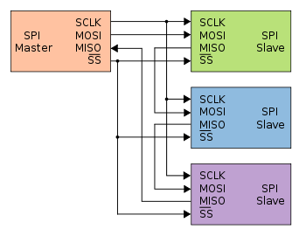
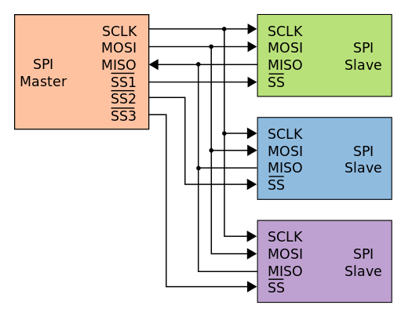
1. Introduction 2. Algorithm
3. Output 4. Code Coverage
5. Inference 6. Conclusion
Introduction
Configuration Examples:
Daisy-chained SPI bus: master and cooperative slaves
Typical SPI bus: master and three independent slaves
SPI-Protocol

Slide 13
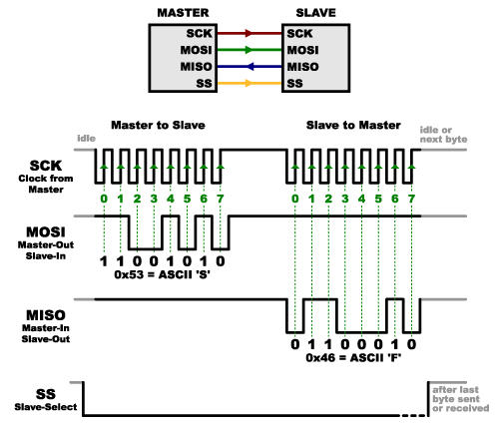
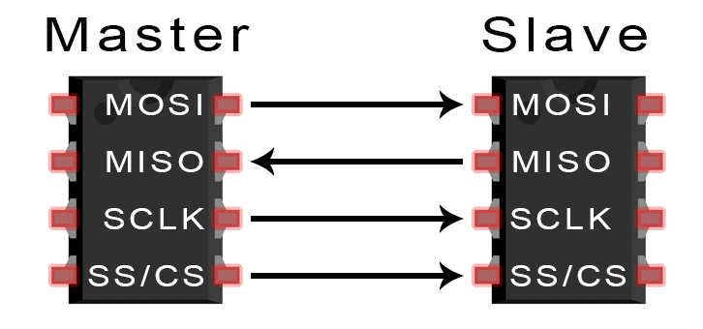
1. Introduction 2. Algorithm
3. Output 4. Code Coverage
5. Inference 6. Conclusion
Algorithm
Working/Design:
Code explanation : I have implemented the SPI protocol with chip select or slave select for 1-master-slave configuration, it means it has one slave only and master has access to control over the data transfer to slave but at the same time slave can also send 8-bit data to master, hence it is full duplex communication. I also tried to implement the CPHA & CPOL and the output for MODE =1 & 3 is coming fine but for 0 & 2 last bit is missing in serial communication due to precision at timing waveform, even though the code is running fine for 2-Modes which makes it complete for data transfer as only 1 mode out of 4 should be present in hardware and 2 are working for me , hence it is achieved.
SPI-Protocol

Slide 14
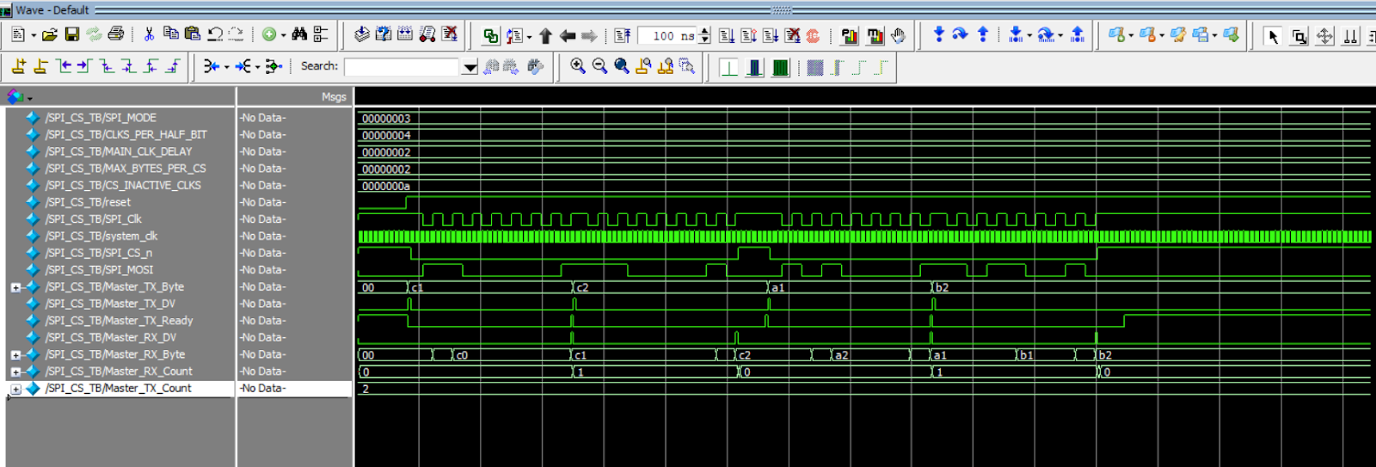
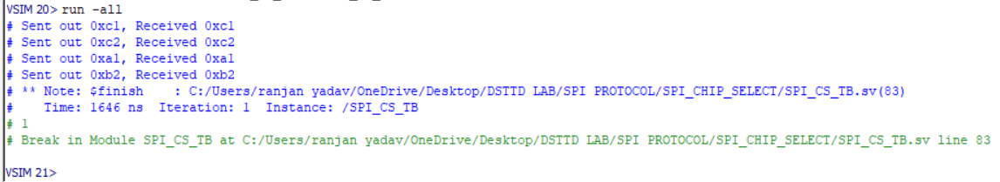
1. Introduction 2. Algorithm
3. Output 4. Code Coverage
5. Inference 6. Conclusion
Outputs
Outputs:
This is output when MOSI & MISO are shorted(above)
SPI-Protocol

Slide 15
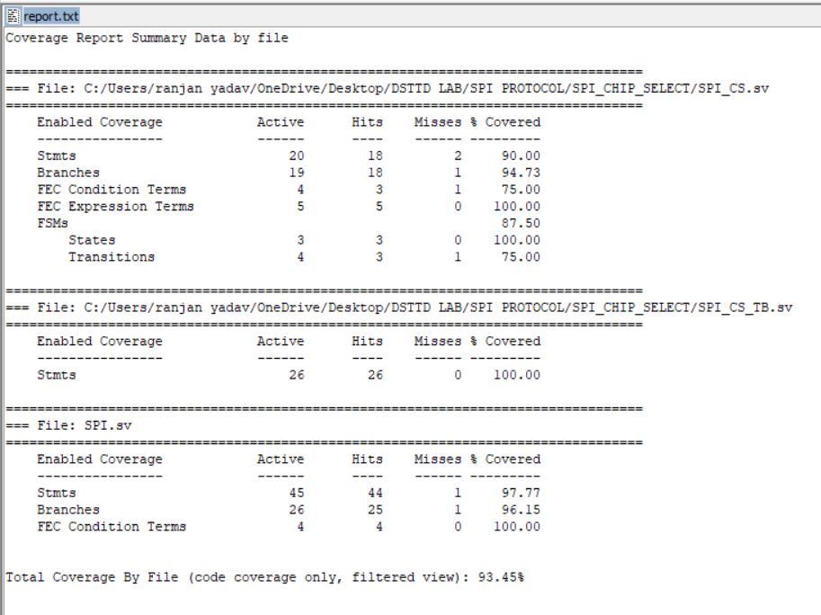
1. Introduction 2. Algorithm
3. Output 4. Code Coverage
5. Inference 6. Conclusion
Code Coverage
Code Coverage:
SPI-Protocol

Slide 16
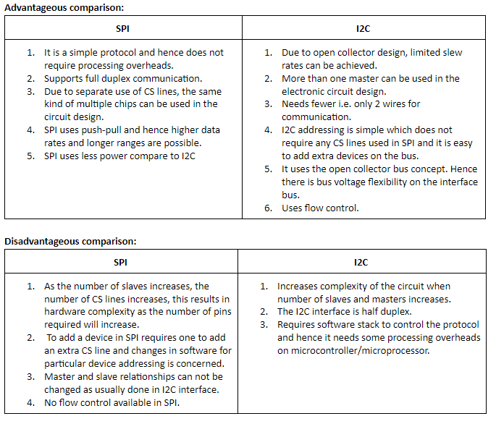
1. Introduction 2. Algorithm
3. Output 4. Code Coverage
5. Inference 6. Conclusion
Inference
Inference:
I
N
F
E
R
E
N
C
E
Serial Communication protocols – I2C & SPI

Slide 17
1. Introduction 2. Algorithm
3. Output 4. Code Coverage
5. Inference 6. Conclusion
References
References:
https://www.circuitbasics.com/basics-of-the-i2c-communication-protocol/
2. https://en.wikipedia.org/wiki/I%C2%B2C
3. https://www.electronicshub.org/basics-i2c-communication/
4. https://www.nxp.com/docs/en/user-guide/UM10204.pdf
5.https://en.wikipedia.org/wiki/Serial_Peripheral_Interface
Thank You
Serial Communication protocols – I2C & SPI

