Slide 1
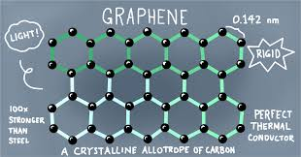
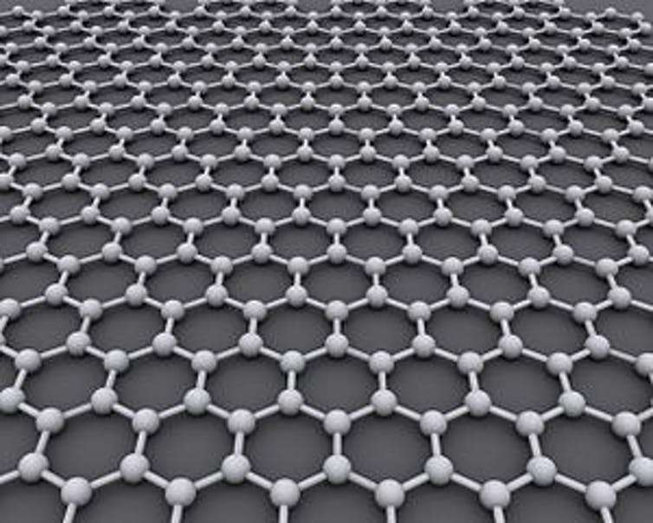
RANJAN YADAV EVD17I009 Harder than diamond, stronger than steel, super conductor … graphene’s unreal.
Graphene: the world's first 2D material. A material that is just one atom thick, 200 times stronger than steel, harder than diamond, conductor of heat and electricity and super-flexible to use. It is the basic structuralal unit of other allotropes, including graphite, charcoal, carbon nanotubes and fullerenes.
"Graphene" is a combination of word "graphite" and the suffix -ene, named by Hanns Peter Boehm , who described single-layer carbon foils in 1962. Graphene is a new structural form of carbon – one of the most versatile elements in the universe. It was discovered in 2004 by Russian-born physicists Andre Geim and Konstantin Novoselov, who jointly received the 2010 Nobel Prize in Physics for their remarkable achievement.
Graphene is the thinnest and lightest material known. A 1-square-meter sheet of graphene weighs a mere 0.0077 grams, yet is capable of supporting up to four kilograms of weight, a tremendous profitable technology for future generation .
Simply it is miracle material as it can help in eradicating nuclear waste , bio compatible,
Can be use in every sphere of engineering . Thus this material is boon for engineering.

Slide 2

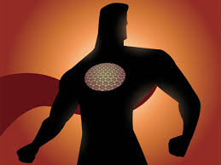

GRAPHENE???
Graphene is just a single layer of graphite, the material found in pencil “lead”. When you draw on paper with a pencil, weakly bound graphene sheets in the graphite spread over your paper.
But because graphene is so thin – the thickness of a single carbon atom – it is extremely difficult to see. This makes researchers to find it very difficult . Again this is even a property of GRAPHENE.
Graphene is an excellent conductor of electricity. Electrons flow through graphene with almost zero electrical resistance. This unusual property, and the fact graphene is nearly invisible, makes it an ideal material for the transparent electrodes can be used in computer displays and solar cells. Graphene has many unusual properties. It is about 200 times stronger than the strongest steel. It conducts heat and electricity and is nearly transparent. Graphene shows a large and nonlinear diamagnetism , greater than graphite.
(7facts):GRAPHENE POWER:
(1)Graphene is so strong that you can take an elephant , put
the elephant on a pencil , put the pencil on graphene and
Graphene will not break !
(2)It is one million times smaller than the diameter of a single human hair.
(3) Graphene is also the most conductive material in the world.
(4) It is the world’s first 2D material.
(5) Graphene could be used to treat cancer.
(6) It is amazingly transparent, it absobs just 2.3 percent of light that lands on it.
(7) Graphene is also the most impermeable material ever discovered, Even helium atoms cannot squeeze through

Slide 3
#Properties: (1)Melting point:
Earlier it was assumed that its melting point to be around 4125k but recently scientists claimed that its melting point is in the range of 5000-6000k. Thus its high melting property can be used in space aircrafts. (2)Mechanical properties:
GRAPHENE is strongest material ever tested . ITS tensile strength found to be 130.5 Gpa and young’s modulus to be 1 Tpa.
ITS 1sq. M layer can lift 4 kg cat which itself equals the weigth of largest hair of cat.
(3)Fracture toughness:
GRAPHENE IS RELATIVE BRITTLE MATERIAL TO A FRACTURE TOUGHNESS. IT IS LIKELY TO CRACK IN A BRITTLE MANNER AS LIKE A CERAMIC MATERIAL.
ONE MORE PROPERTY THAT IT CAN DISTRIBUTE THE FORCE FASTLY OVER ITSELF FROM A IMPACT THAN ANY KNOWN MATERIAL
(4)BIO Compatible material:
Graphene is even a bio compatible material . It can be used as biochemical inducers . GRAPHENES electodes in the body stays significantly more stable than the electrodes of tungsten or silicon because of its high flexibility, conductivity and compatibility. (5)Conductivity:
One of the most useful properties of graphene is that it is a zero-overlap semimetal (with both holes and electrons as charge carriers) with very high electrical conductivity. The conductivity of graphene is tremendous , thus a gift for electrical and electronics engineering.

Slide 4
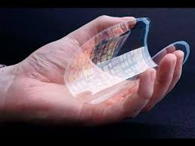
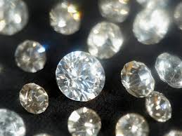
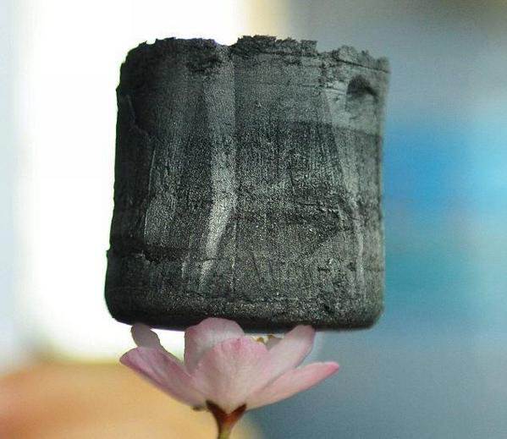
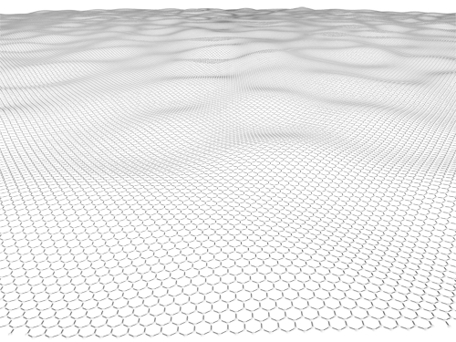
<GRAPHENE VS DIAMOND >
Graphene is stronger tha diamond . Graphene is superior to diamond in all respects like thermal stability, bond length ,ionization energy and young’s modulus and etc.
In graphene c-c bond length is 0.142nm while diamond have a bond length of 0.154 nm, creates a impact in young’s modulus . As young modulus of graphene is around 1TPa while young modulus of diamond is only 1200 Gpa. Thus graphene have high strength and stronger than the diamond.
Another reason for this superior tensile strength is the hybridization pattern in graphene and diamond. As we know, C atoms are sp3 hybridized in diamond forming a tetrahedral structure but in graphene, C atoms are sp2 hybridized forming a hexagonal structure with each atom 120 deg apart in the x-y plane. Hence, the nearest neighbour sp2 bonds in graphene are greater than the nearest neighbour sp3 bonds in diamond leading to higher tensile strength Hence, graphene is stronger than diamond.
ANOTHER PHYSICAL PROPERTIES OF GRAPHENE
*DENSITY= 0.77 mg/m^2
*BREAKING STRESS=42N/m
*CONDUCTIVITY=0.96X10^6 (OHM)^-1/cm
*THERMAL CONDUCTIVITY : 10X GREATER THAN COPPER

Slide 5
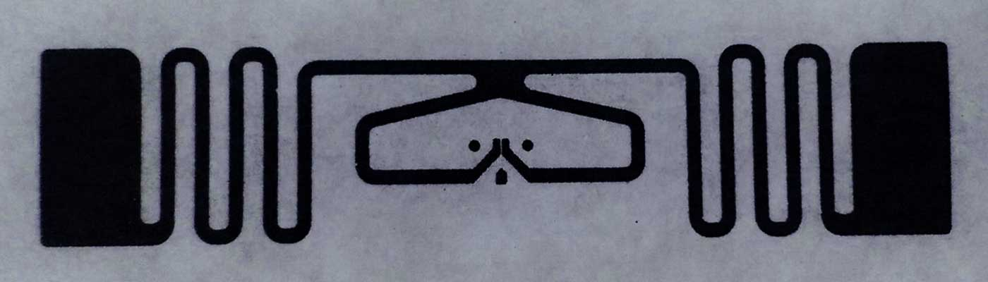
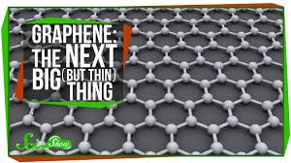
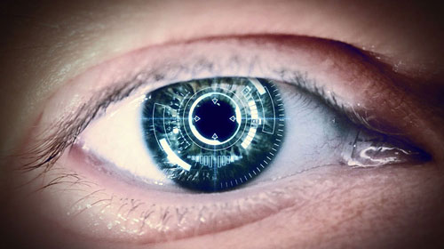
Current applications
Right now in world graphene is used in various applications for its outstanding properties in Electronics, Sensors ,Biomedical, Coatings, Membranes, Composites etc.
THIS IS ONLY THE START. THESE ARE ONLY THE FIRST STEPS.
Future technology
So where will graphene take us? How will it change our world? What benefits will it bring to mankind? What applications will we see in the near future and decades to come?
It can be used for purification , many developed countries are putting their efforts in technologies for purification of WATER . Moreover it can be used in semi transparent mobile phones . It can be used in wearable clothing that can help in communication as it is highly flexible and durable.
These are future technologies which can be possible because of this highly useful MATERIAL ,in the coming FUTURE. Now nothing is impossible with graphene. Simply it is ALL IN ONE material.

