Slide 1

FINAL PROJECT
ADVANCED ANALYTIC: GROUP II
ABHIJIT DATTA
AMJAD JALALUDEEN
NIPUN BHALLA
RANJAN

Slide 2
TABLE OF CONTENT
1) | INTRODUCTION…………………………………………………………………………………. | 3
2) | DATASET……………………………………………………….…………………………………. | 4
3) | GOALS…………………………………………………………………………………………….. | 5
4) | METHODOLOGY………………………………………………………………………………… | 6
5) | PREDICTIVE-MODELLING………………………………….…………………………………. | 7
6) | BUSINESS-PROBLEM……………………………………….…………………………………. | 9
7) | SOLUTION……………………………………………………..…………………………………. | 10
8) | APPENDIX I………………………………………………………………………………………. | 14
9) | APPENDIX II…………………………………………………..………………………………….. | 25
10) | APPENDIX III………………………………………………….………………………………….. | 29
11) | APPENDIX IV…………………………………………………………………………………….. | 37
12) | APPENDIX V……………………………………………………………………………………… | 40
13) | APPENDIX VI……………………………………………………………………………………. | 42

Slide 3
INTRODUCTION
Marketing campaign is one of the most important skills which any organization can hone. Having a good marketing campaign is one of the keys, in determining the success of an organization.
Machine Learning (ML) algorithms helps us create more advanced customer interactions. Companies have been expanding their customer service and other consumer conversation tools in recent years with ML.
ML helps to make the marketing experience more targeted and personalized to the consumers, ensuring that the right products and services are advertised to the right people.
Introduction
Dataset
Goals
Methodology
Predictive-Modelling
Business-Problem
Solution
Appendix I
Appendix II
Appendix III
Appendix IV
Appendix V
Appendix VI

Slide 4
DATASET
Introduction
Dataset
Goals
Methodology
Predictive-Modelling
Business-Problem
Solution
Appendix I
Appendix II
Appendix III
Appendix IV
Appendix V
Appendix VI
The data is related with direct marketing campaigns (phone calls) of a Portuguese banking institution. The bank conducted a marketing campaign on their customers to encourage them to subscribe the term deposit service.
The source of our dataset is from Kaggle:
Dataset Link

Slide 5
GOALS
Our aim is to utilize machine learning concepts and enhance the marketing campaign. We will ensure this by:
Predicting if the customer will / will-not subscribe to a term deposit, by building multiple ML models.
Providing key outcomes along with actionable recommendations for future marketing campaigns.
Introduction
Dataset
Goals
Methodology
Predictive-Modelling
Business-Problem
Solution
Appendix I
Appendix II
Appendix III
Appendix IV
Appendix V
Appendix VI

Slide 6
METHODOLOGY
In order to enhance the marketing campaigns, we will have to take the following steps:
Data Collection.
Exploratory Data Analysis (EDA) / Visualization.
Data Wrangling.
Predictive Modelling.
Key outcomes & recommendations
Introduction
Dataset
Goals
Methodology
Predictive-Modelling
Business-Problem
Solution
Appendix I
Appendix II
Appendix III
Appendix IV
Appendix V
Appendix VI

Slide 7
PREDICTIVE-MODELLING
Summary of ML models used:
ML MODELS | ACCURACY
Logistic Regression | 0.834303
GridSearchCV | 0.801164
Decision Tree | 0.799820
Random Forest | 0.862068
Ada Boost | 0.816838
Voting Classifier | 0.841916
Introduction
Dataset
Goals
Methodology
Predictive-Modelling
Business-Problem
Solution
Appendix I
Appendix II
Appendix III
Appendix IV
Appendix V
Appendix VI
CONCLUSION 1: ML MODEL SELECTION
Our final ML model is based on high Accuracy Score values. As seen above in our case the Random Forest model has the best Accuracy Score value of 0.862068.
Therefore, to determine the Business Solution we will use Random Forest as our final ML model.

Slide 8
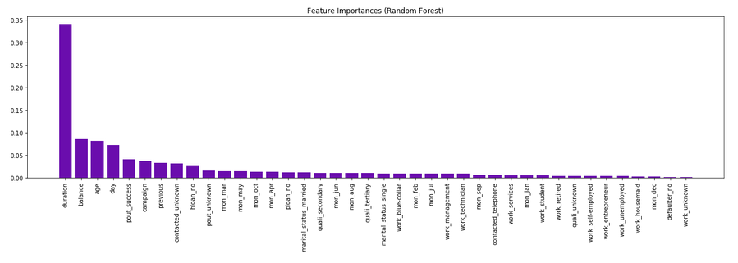
CONTINUED…
In order to make any actionable recommendations, we must look upon the feature importance's based on our selected model i.e. Random Forest model.
Duration
Balance
Introduction
Dataset
Goals
Methodology
Predictive-Modelling
Business-Problem
Solution
Appendix I
Appendix II
Appendix III
Appendix IV
Appendix V
Appendix VI
Age
Day
As we can see from the above shown bar plot representing the feature importance’s. The top 4 important features are:
Duration : Last contact duration in seconds made with the customer.
Balance : Customer Balance Amount with the bank.
Age : Age of the customer.
Day : Last contacted day of the week

Slide 9
BUSINESS-PROBLEM DEFINITION
In order to provide specific actionable recommendations, lets answer the following questions:
Q1. The duration of time a customer should be contacted for?
Q2. The account balance of a customer who should be contacted?
Q3. The age range of a customer who should be contacted?
Q4. The day of the month a customer should be approached?
Introduction
Dataset
Goals
Methodology
Predictive-Modelling
Business-Problem
Solution
Appendix I
Appendix II
Appendix III
Appendix IV
Appendix V
Appendix VI

Slide 10
SOLUTION
Q1. The duration of time a customer should be contacted for?
A1. The average duration of time (in seconds) a customer should be contacted for must lie between 255 to 324 seconds(4-6 mins). Hence the campaign should have a sales pitch which does not exceed these limits.
Introduction
Dataset
Goals
Methodology
Predictive-Modelling
Business-Problem
Solution
Appendix I
Appendix II
Appendix III
Appendix IV
Appendix V
Appendix VI
Q2. The account balance of a customer who should be contacted?
A2. The customers having account balance of $935 & above should be the primary focus of the marketing campaign. These customers are more likely to go for a term deposit.

Slide 11
SOLUTION
Q3. The age range of a customer who should be contacted?
A3. The average age of a customer to be approached for should be less than 31 or higher than 53. These customers are more likely to go for a term deposit.
The marketing campaign should avoid focusing on age groups between 31 & 53.
Introduction
Dataset
Goals
Methodology
Predictive-Modelling
Business-Problem
Solution
Appendix I
Appendix II
Appendix III
Appendix IV
Appendix V
Appendix VI
Q4. The day of the month a customer should be approached?
A4. If the customer is approached, before the 8th of the month or after the 23rd of the month, the likelihood for a term deposit are high.
The marketing campaign should avoid focusing between 9th & 22nd of the month.

Slide 12
THANK YOU
Continue for Appendices

Slide 13
APPENDICES
Appendix I : EDA / Visualization
Appendix II : Data Wrangling
Appendix III : Predictive Modelling
Appendix IV : Model Comparison
Appendix V : Business Solution
Appendix VI : Conclusion & Recommendations

Slide 14
APPENDIX I: EDA / VISUALIZATION
Appendix I : EDA / Visualization
Appendix II : Data Wrangling
Appendix III : Predictive Modelling
Appendix IV : Model Comparison
Appendix V : Business Solution
Appendix VI : Conclusion & Recommendations

Slide 15
APPENDIX I: EDA / VISUALIZATION
Understanding our data
Customer Attributes:
Age : Age of the customer.
Job : Type of Job the customer is in.
Marital : Marital Status of the customer.
Education : Education Level of the customer.
Default : Did the customer defaulted any loan repayment.
Balance : Customer Balance Amount with the bank.
Housing : Do the customer has housing loan?
Loan : Do the customer has personal loan?
Introduction
Dataset
Goals
Methodology
Predictive-Modelling
Business-Problem
Solution
Appendix I
Appendix II
Appendix III
Appendix IV
Appendix V
Appendix VI

Slide 16
CONTINUED…
Understanding our data
Campaign Attributes:
Contact : Mode of communication made with the customer.
Day : Last contacted day of the month made with the customer.
Month : Last contacted month of the year made with the customer.
Duration : Last contact duration in seconds made with the customer.
Campaign : Number of contacts performed during this campaign and for this customer.
Deposit : Has the customer subscribed to the Fixed Deposit.
Introduction
Dataset
Goals
Methodology
Predictive-Modelling
Business-Problem
Solution
Appendix I
Appendix II
Appendix III
Appendix IV
Appendix V
Appendix VI

Slide 17
CONTINUED…
Understanding our data
Previous Contacts/Campaign Attributes:
Pdays : Number of days that passed by after the customer was last contacted from a previous campaign
Previous : Number of contacts performed before this campaign and for this customer.
Poutcome : Outcome of the previous marketing campaign.
Introduction
Dataset
Goals
Methodology
Predictive-Modelling
Business-Problem
Solution
Appendix I
Appendix II
Appendix III
Appendix IV
Appendix V
Appendix VI

Slide 18
CONTINUED…
Understanding our data
S.No. | Column Name | Column Type
9 | Contact | Categorical
10 | Day | Numerical
11 | Month | Categorical
12 | Duration | Numerical
13 | Campaign | Numerical
14 | Pdays | Numerical
15 | Previous | Numerical
16 | Poutcome | Categorical
17 | Deposit | Categorical
S.No. | Column Name | Column Type
1 | Age | Numerical
2 | Job | Categorical
3 | Marital | Categorical
4 | Education | Categorical
5 | Default | Categorical
6 | Balance | Numerical
7 | Housing | Categorical
8 | Loan | Categorical
Introduction
Dataset
Goals
Methodology
Predictive-Modelling
Business-Problem
Solution
Appendix I
Appendix II
Appendix III
Appendix IV
Appendix V
Appendix VI
Total Number of Observations = 11162
Total Number of Predictors = 16
Total Number of Response variable = 1 (Deposit)

Slide 19
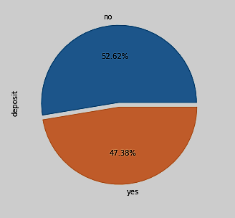
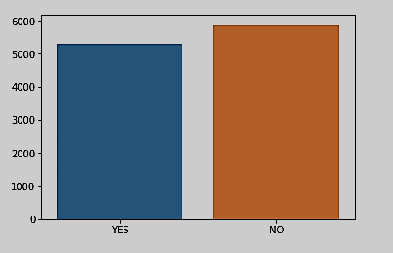
CONTINUED…
Understanding our data
NUMBER OF DEPOSITS:
Introduction
Dataset
Goals
Methodology
Predictive-Modelling
Business-Problem
Solution
Appendix I
Appendix II
Appendix III
Appendix IV
Appendix V
Appendix VI
YES NO
5289 5873

Slide 20
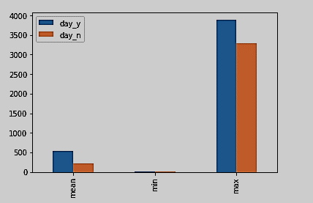
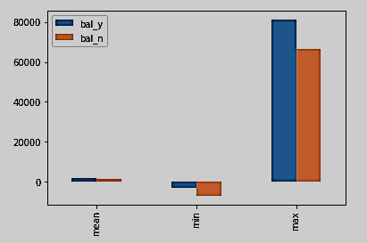
CONTINUED…
Understanding our data : Deposit vs top 4 predictors
DEPOSIT vs DURATION DEPOSIT VS BALANCE
Introduction
Dataset
Goals
Methodology
Predictive-Modelling
Business-Problem
Solution
Appendix I
Appendix II
Appendix III
Appendix IV
Appendix V
Appendix VI
Chances of successfully locking a customer for a term deposit substantially increase with higher duration of conversation
Customers with greater bank balance are more inclined towards a term deposit.

Slide 21
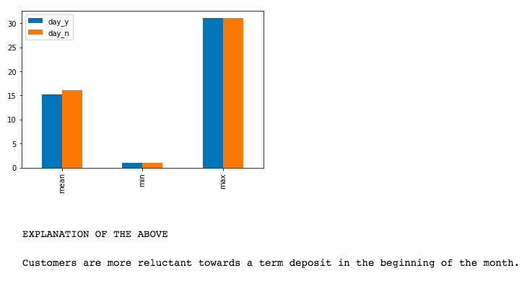
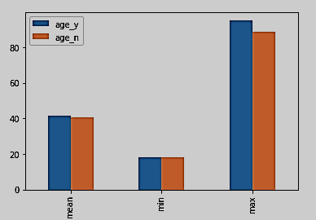
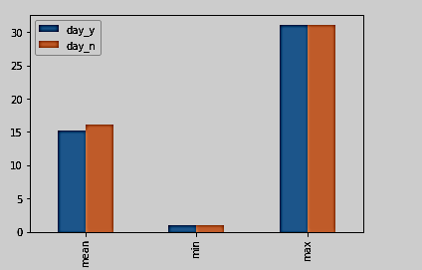
CONTINUED…
Understanding our data : Deposit vs top 4 predictors
DEPOSIT vs AGE DEPOSIT VS DAY
Introduction
Dataset
Goals
Methodology
Predictive-Modelling
Business-Problem
Solution
Appendix I
Appendix II
Appendix III
Appendix IV
Appendix V
Appendix VI
Customers with higher age group are more inclined towards a term deposit
Customers are more reluctant towards a term deposit in the middle of the month.

Slide 22
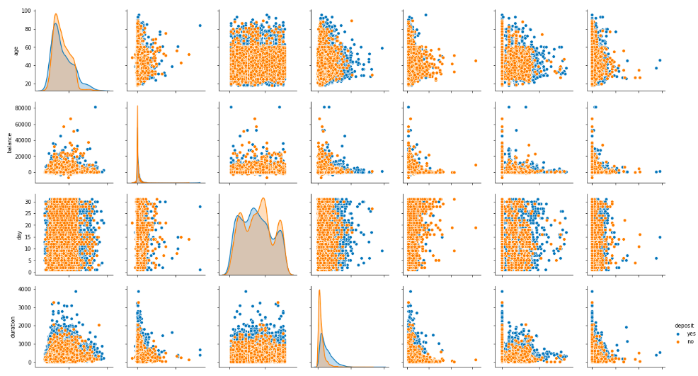
CONTINUED…
Understanding our data : Pair plot
Introduction
Dataset
Goals
Methodology
Predictive-Modelling
Business-Problem
Solution
Appendix I
Appendix II
Appendix III
Appendix IV
Appendix V
Appendix VI

Slide 23
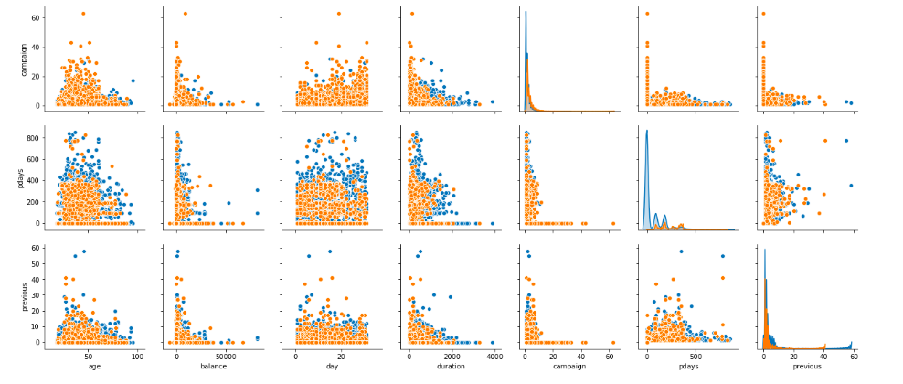
CONTINUED…
Understanding our data : Pair plot
Introduction
Dataset
Goals
Methodology
Predictive-Modelling
Business-Problem
Solution
Appendix I
Appendix II
Appendix III
Appendix IV
Appendix V
Appendix VI

Slide 24
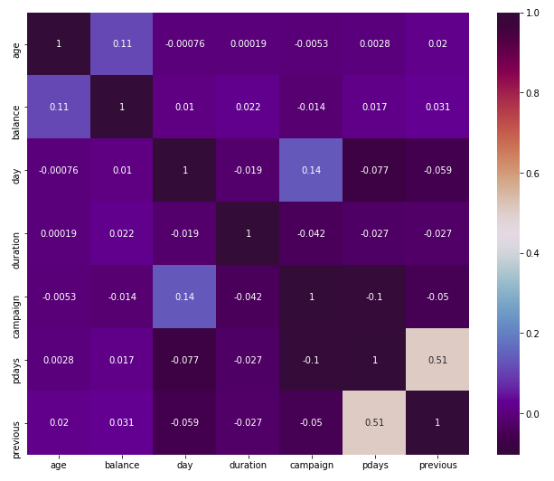
CONTINUED…
Understanding our data : Correlation Matrix
As we can clearly observe that features are not much correlated. Therefore we continued with all the features
Introduction
Dataset
Goals
Methodology
Predictive-Modelling
Business-Problem
Solution
Appendix I
Appendix II
Appendix III
Appendix IV
Appendix V
Appendix VI

Slide 25
APPENDIX II: DATA WRANGLING
Appendix I : EDA / Visualization
Appendix II : Data Wrangling
Appendix III : Predictive Modelling
Appendix IV : Model Comparison
Appendix V : Business Solution
Appendix VI : Conclusion & Recommendations

Slide 26
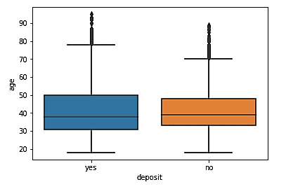
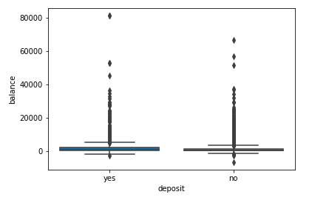
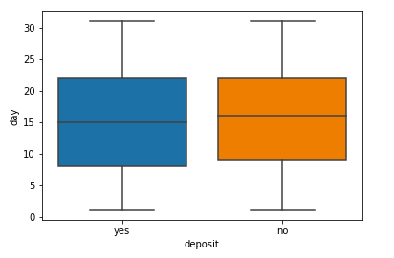
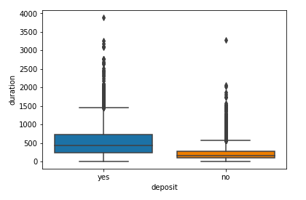
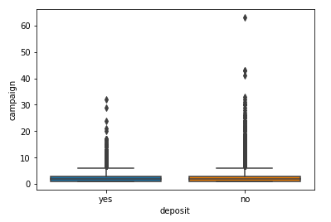
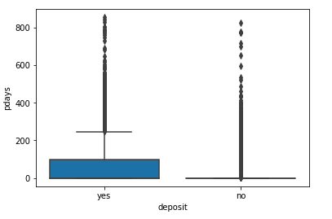
CONTINUED…
Data preparation : Detecting the Outliers
DEPOSIT vs AGE
DEPOSIT vs BALANCE
DEPOSIT vs DAY
Introduction
Dataset
Goals
Methodology
Predictive-Modelling
Business-Problem
Solution
Appendix I
Appendix II
Appendix III
Appendix IV
Appendix V
Appendix VI
DEPOSIT vs DURATION
DEPOSIT vs CAMPAIGN
DEPOSIT vs PDAYS

Slide 27
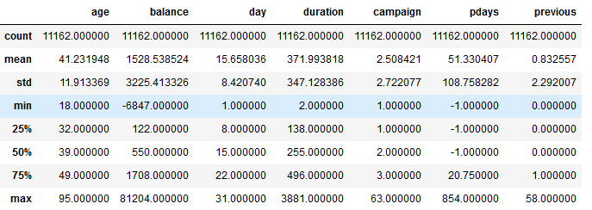
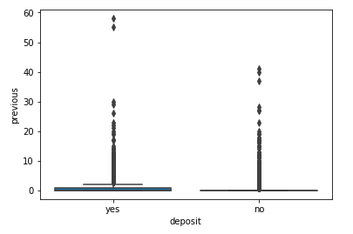
CONTINUED…
Data preparation : Detecting the Outliers
DEPOSIT vs PREVIOUS
Introduction
Dataset
Goals
Methodology
Predictive-Modelling
Business-Problem
Solution
Appendix I
Appendix II
Appendix III
Appendix IV
Appendix V
Appendix VI
Based on the above shown Box-Plots we can clearly see that except 'day' feature all other features have some anomalies, so we will investigate these attributes further.
OUTLIERS are defined as 1.5xQ3 value (75%).
From the above we can clearly figure out that we have outliers in all the attributes except 'day’. As max values are > 1.5xQ3 (1.5 * 75%).
But these outliers are within an acceptable range, {Age can be 95(max), Balance can be 81204(max) or -6847(min)}, therefore we will continue with this dataset as it is.
We can also observe that in the column 'pdays' has -1(min) value, which seems unlikely. We will further continue with our investigation.

Slide 28
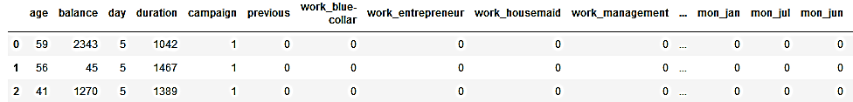
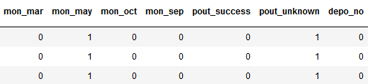
CONTINUED…
Data preparation : Detecting the Outliers
As 'pdays' has value of -1 more then 74% of this column. Therefore we recommend to drop this column. We will continue with the rest of the columns for building the ML Models
Converting categorical features into dummy variables & dropping irrelevant columns
Introduction
Dataset
Goals
Methodology
Predictive-Modelling
Business-Problem
Solution
Appendix I
Appendix II
Appendix III
Appendix IV
Appendix V
Appendix VI
This is our final dataset which we are used to build relevant ML Models

Slide 29
APPENDIX III: Predictive Modelling
Appendix I : EDA / Visualization
Appendix II : Data Wrangling
Appendix III : Predictive Modelling
Appendix IV : Model Comparison
Appendix V : Business Solution
Appendix VI : Conclusion & Recommendations

Slide 30
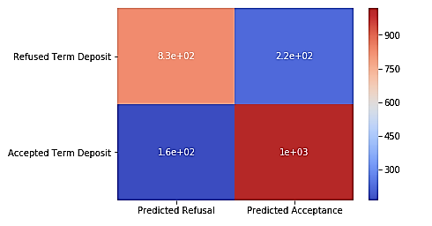
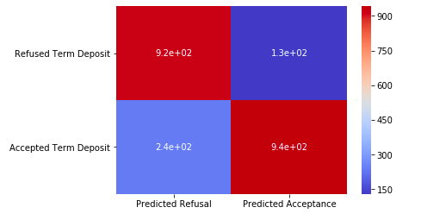
CONTINUED…
Logistic Regression
Optimal Threshold : 0.61020
Before Optimal Threshold |  | After Optimal Threshold
Accuracy score | 0.82803 | Accuracy score | 0.834303
Number of correctly classified observations | 1849 | Number of correctly classified observations | 1863
Number of incorrectly classified observations | 384 | Number of incorrectly classified observations | 370
Log loss | 5.93957 | Log loss | 5.72299
Introduction
Dataset
Goals
Methodology
Predictive-Modelling
Business-Problem
Solution
Appendix I
Appendix II
Appendix III
Appendix IV
Appendix V
Appendix VI

Slide 31
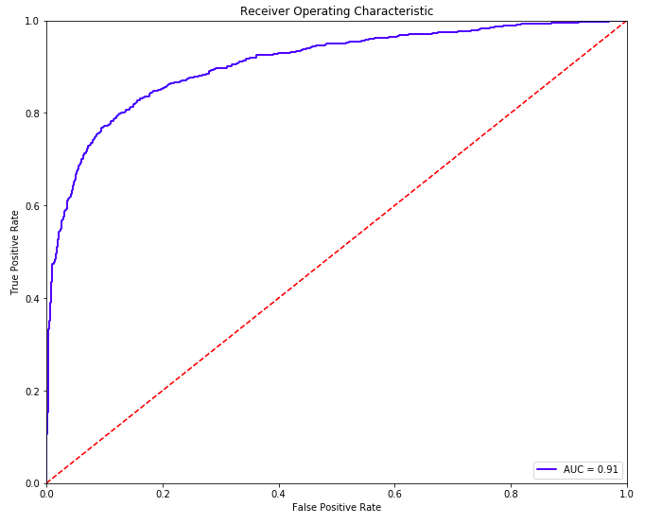
CONTINUED…
Logistic Regression
Optimal Threshold : 0.61020
Before Optimal Threshold
 | Predicted Refusal | Predicted Acceptance
Refused Term Deposit | 831 | 221
Accepted Term Deposit | 163 | 1018
Introduction
Dataset
Goals
Methodology
Predictive-Modelling
Business-Problem
Solution
Appendix I
Appendix II
Appendix III
Appendix IV
Appendix V
Appendix VI
After Optimal Threshold
 | Predicted Refusal | Predicted Acceptance
Refused Term Deposit | 922 | 130
Accepted Term Deposit | 240 | 941
AUC Score | 0.90681
F1 Score | 0.84132

Slide 32
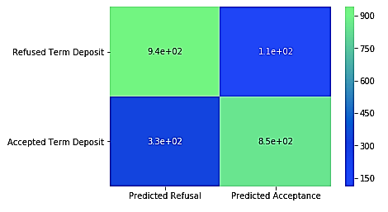
CONTINUED…
GridSearchCV
Optimal Threshold : 0.61020
Confusion Matrix
 | Predicted Refusal | Predicted Acceptance
Refused Term Deposit | 941 | 111
Accepted Term Deposit | 333 | 848
Introduction
Dataset
Goals
Methodology
Predictive-Modelling
Business-Problem
Solution
Appendix I
Appendix II
Appendix III
Appendix IV
Appendix V
Appendix VI
Accuracy Score | 0.801164
Hyperparameters
Max Depth | 3
Max Features | None

Slide 33
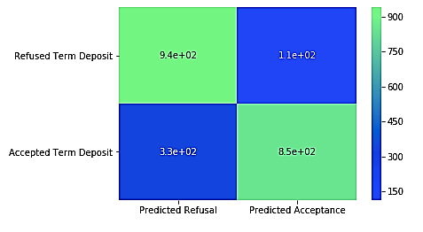
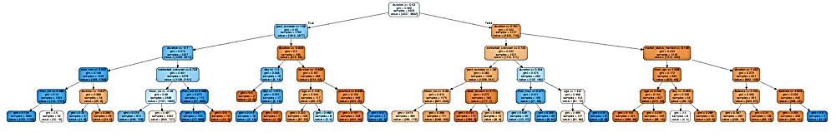
CONTINUED…
Decision Tree
Confusion Matrix
 | Predicted Refusal | Predicted Acceptance
Refused Term Deposit | 939 | 113
Accepted Term Deposit | 334 | 847
Introduction
Dataset
Goals
Methodology
Predictive-Modelling
Business-Problem
Solution
Appendix I
Appendix II
Appendix III
Appendix IV
Appendix V
Appendix VI
Accuracy Score | 0.799820

Slide 34
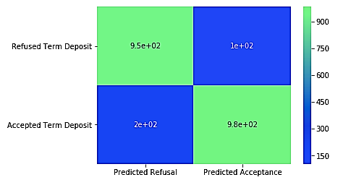
CONTINUED…
Random Forest
Confusion Matrix
 | Predicted Refusal | Predicted Acceptance
Refused Term Deposit | 943 | 109
Accepted Term Deposit | 199 | 982
Introduction
Dataset
Goals
Methodology
Predictive-Modelling
Business-Problem
Solution
Appendix I
Appendix II
Appendix III
Appendix IV
Appendix V
Appendix VI
Accuracy Score | 0.862068

Slide 35
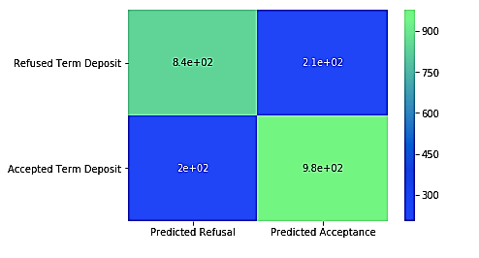
CONTINUED…
Ada Boost
Confusion Matrix
 | Predicted Refusal | Predicted Acceptance
Refused Term Deposit | 847 | 205
Accepted Term Deposit | 204 | 977
Introduction
Dataset
Goals
Methodology
Predictive-Modelling
Business-Problem
Solution
Appendix I
Appendix II
Appendix III
Appendix IV
Appendix V
Appendix VI
Accuracy Score | 0.816838

Slide 36
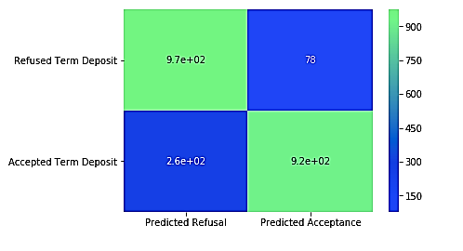
CONTINUED…
Voting Classifier
Confusion Matrix
 | Predicted Refusal | Predicted Acceptance
Refused Term Deposit | 970 | 82
Accepted Term Deposit | 271 | 910
Introduction
Dataset
Goals
Methodology
Predictive-Modelling
Business-Problem
Solution
Appendix I
Appendix II
Appendix III
Appendix IV
Appendix V
Appendix VI
Accuracy Score | 0.841916

Slide 37
APPENDIX IV: Model Comparison
Appendix I : EDA / Visualization
Appendix II : Data Wrangling
Appendix III : Predictive Modelling
Appendix IV : Model Comparison
Appendix V : Business Solution
Appendix VI : Conclusion & Recommendations

Slide 38
CONTINUED…
Model Comparison : Based on Confusion Matrix
Logistic Regression
 | Predicted Refusal | Predicted Acceptance
Refused Term Deposit | 922 | 130
Accepted Term Deposit | 240 | 941
Random Forest
 | Predicted Refusal | Predicted Acceptance
Refused Term Deposit | 943 | 109
Accepted Term Deposit | 199 | 982
Introduction
Dataset
Goals
Methodology
Predictive-Modelling
Business-Problem
Solution
Appendix I
Appendix II
Appendix III
Appendix IV
Appendix V
Appendix VI
GridSearchCV
 | Predicted Refusal | Predicted Acceptance
Refused Term Deposit | 941 | 111
Accepted Term Deposit | 333 | 848
Ada Boost
 | Predicted Refusal | Predicted Acceptance
Refused Term Deposit | 847 | 205
Accepted Term Deposit | 204 | 977
Decision Tree
 | Predicted Refusal | Predicted Acceptance
Refused Term Deposit | 939 | 113
Accepted Term Deposit | 334 | 847
Voting Classifier
 | Predicted Refusal | Predicted Acceptance
Refused Term Deposit | 970 | 82
Accepted Term Deposit | 271 | 910
Based on Confusion Matrix we can conclude that the Random Forest model was the best model as it is having the least number of misclassified observations from test set. Only 308 observation were misclassified.

Slide 39
CONTINUED…
Model Comparison : Based on Accuracy Scores
Model | Accuracy Score
Random Forest | 0.862068
Voting Classifier | 0.841916
Logistic Regression | 0.834303
Ada Boost | 0.816838
GridSearchCV | 0.801164
Decision Tree | 0.799820
Introduction
Dataset
Goals
Methodology
Predictive-Modelling
Business-Problem
Solution
Appendix I
Appendix II
Appendix III
Appendix IV
Appendix V
Appendix VI
Based on accuracy score values we can conclude that the Random Forest model was the best model as it is having the best accuracy score value of 0.8620689655172413

Slide 40
APPENDIX V: Business Solution
Appendix I : EDA / Visualization
Appendix II : Data Wrangling
Appendix III : Predictive Modelling
Appendix IV : Model Comparison
Appendix V : Business Solution
Appendix VI : Conclusion & Recommendations

Slide 41
CONTINUED…
Business Solution : Feature Importance'
We have selected our final ML model based on the Accuracy Score values. As seen earlier in our case the Random Forest model has the best Accuracy Score value of 0.8620689655172413. Therefore, to determine our Business Solution we will use Random Forest as our final ML model.
In order to make any actionable recommendations, we are looking upon the feature’s importance based on our selected model i.e. Random Forest model.
Introduction
Dataset
Goals
Methodology
Predictive-Modelling
Business-Problem
Solution
Appendix I
Appendix II
Appendix III
Appendix IV
Appendix V
Appendix VI
Duration
Balance
Age
Day

Slide 42
APPENDIX VI: Conclusion & Recommendations
Appendix I : EDA / Visualization
Appendix II : Data Wrangling
Appendix III : Predictive Modelling
Appendix IV : Model Comparison
Appendix V : Business Solution
Appendix VI : Conclusion & Recommendations

Slide 43
CONTINUED…
Business Solution : Feature Importance'
Introduction
Dataset
Goals
Methodology
Predictive-Modelling
Business-Problem
Solution
Appendix I
Appendix II
Appendix III
Appendix IV
Appendix V
Appendix VI
Key outcomes of the analysis are the recommendations for future marketing campaigns:
Sales pitch of the campaign should be 4mins to 6 mins long.
Customers having account balance north of $935 should be the focus group.
Customers having age groups between 31 & 53 shouldn't be the focus group.
Customers are more willing to invest either before 8th or after 23rd of the month.

Slide 44
THE END

