Slide 1
Value at Risk
By,
Ranjan Mondal

Slide 2
DEFINITION:
A statistical technique used to measure and quantify the level of financial risk within a stock or investment portfolio over a specific time frame.
The three variables:
The amount of potential loss
The probability of that amount of loss(Confidence level)
The time frame

Slide 3
Example
http://economictimes.indiatimes.com/state-bank-of-india/stocks/companyid-11984.cms

Slide 4
Techniques(Value at Risk)
Nonparametric (Historical simulation)
        Historical data with in a given time period
Parametric simulation
        Mean
        Varience

Slide 5
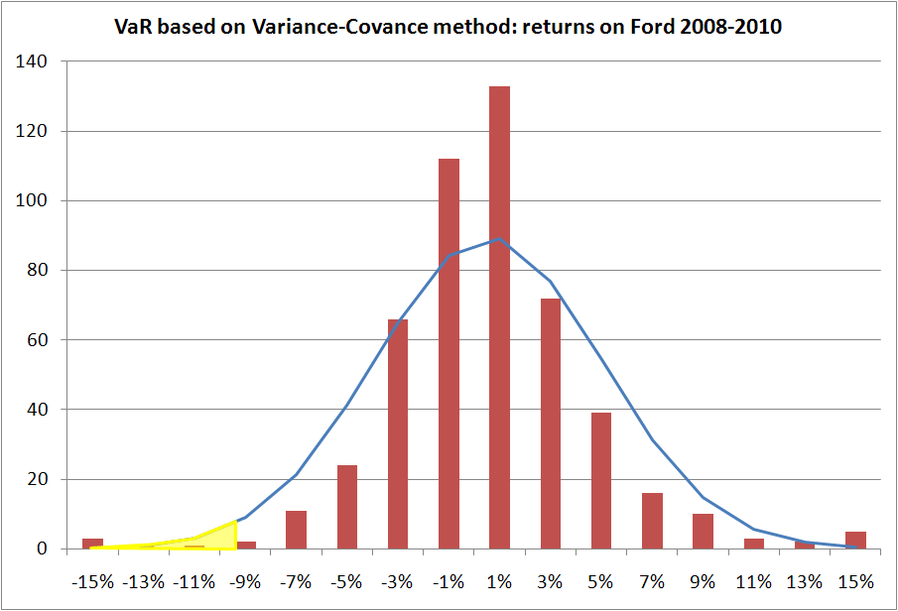
Nonparametric simulation

Slide 6
        Parametric simulation
PARAMETER:
1.Mean
2.Varience or Standrad daviation

Slide 7
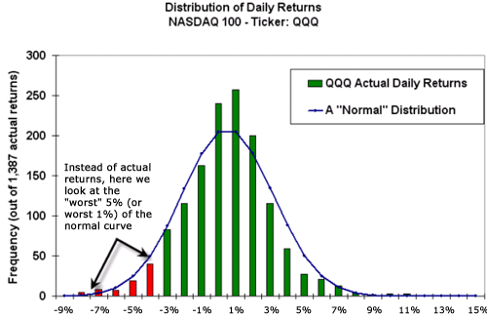
        Parametric simulation

