Slide 1
Voice Controlled Home Automation
Submitted by :
Ranjan Kumar A Saikiran K
USN : 01JST18CS104 USN : 01JST18CS111
Roll no. : 40 Roll no. : 43

Slide 2
Introduction
The smart home automation system using voice control helps to control electrical appliances by using voice commands.
The system works by interfacing the on/off switches of electrical appliance or loads by using relay or solid state replay.
The voice command is sent using an app, a built-in microphone and voice recognition system.

Slide 3
Components required :
Arduino UNO Board
2 Channel Relay Module
Bluetooth Module HC-05
Breadboard
Jumper Wires

Slide 4
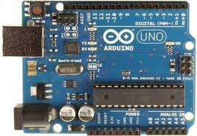
Arduino UNO Board
The Arduino UNO is an open-source microcontroller board based on the Microchip Atmega328P microcontroller.
The board is equipped with sets of digital and analog input/output pins that may be interfaced to various expansion boards and circuits.

Slide 5
2 Channel Relay Module
2 channel 5V relay module is a relay interface board.
It uses a low level triggered control signal(3.3-5VDC) to control the relay.
It is an automatic switch to control a high-current circuit with a low-current signal.
Triggering the relay operates the normally open or normally closed contacts.

Slide 6
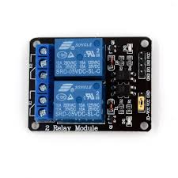
2 Channel Relay Module
It is frequently used in an automatic control circuit.
It can be controlled directly by a wide range of microcontrollers such as Arduino, AVR, PIC, ARM etc.

Slide 7
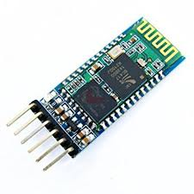
Bluetooth Module HC-05
It is designed for wireless communication.
It uses serial communication to communicate with devices.
HC – 05 has red LED which indicates connection status, whether Bluetooth is connected or not.

Slide 8
Proposed system
The system consists of a computer server with internet connection, an IoT Ethernet shield used to connect the server to the external network.
An Arduino microcontroller with a hardwired application is connected to the system.
The IoT based home automation system focuses on controlling home electronic devices from inside or outside the home.

Slide 9
Flow diagram
User
Voice recognition app
Bluetooth module HC-05
Load
2 channel relay module
Arduino UNO board

Slide 10
Theory
The IoT project utilizes relay to switch electrical appliances on and off when the Bluetooth module triggers it to switch.
A microcontroller is a sensitive piece of hardware that cannot handle 220 volts. So we cannot just control our home appliances directly with the microcontroller and relay is the perfect solution for that.
A relay is basically just a switch which is triggered with a small electrical signal.
It consists of a lever and a core with a copper wire wrapped around it, known as the armature.

Slide 11
Theory
There are two states in a relay, Normally Closed(NC) and Normally Opened(NO).
The appliances are connected between NO and Grounds as the relay is initially in the NC state.
When the microcontroller provides the trigger function, the armature becomes an electromagnet and pulls the lever to NO closing the circuit as a result.

Slide 12
Theory
As the relay used in our project has 2 channels, we can control two appliances with it.
The command is given in the form of string which is passed wirelessly using the Bluetooth module HC-05.

Slide 13
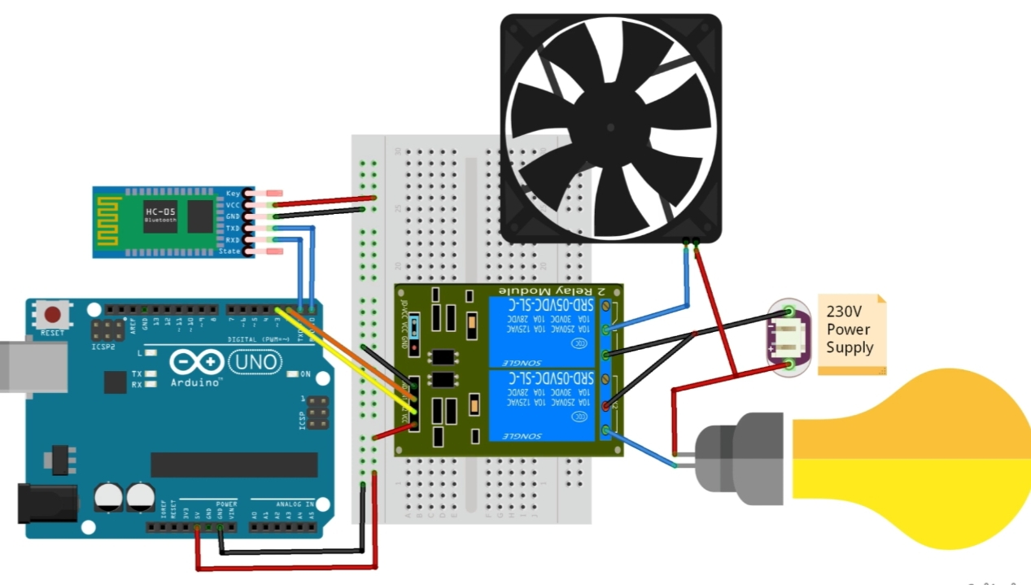
Block Diagram

Slide 14
Implementation
The setup is connected to an active power supply source.
The number of channels in the relay module should be equal to number of devices that are going to be controlled.
We have used 2 channel relay module since we are connecting two appliances in our project.

Slide 15
Implementation
Arduino UNO is a hardware which has a programmable IC Atmega328P and programmed using Arduino IDE.
It has multiple input and output pins for controlling multiple unit of sensors.

Slide 16
Implementation
The relay uses electromechanical coil to open and close the circuit.
When small amount of current passes through the coil, it excites the coil and generates magnetic field and either pulls the bar or releases the bar which is used for opening and closing the circuit.

Slide 17
Implementation
The user gives the command to microcontroller by using speech recognition system of smartphone.
The command is transferred as a String via the Bluetooth module to the Arduino UNO board.
The input string is processed by the program which is uploaded to the Arduino UNO.
The function digitalWrite is used to set the switch on or off in the relay.

Slide 18
Advantages
The voice controlled home automation system is portable, user-friendly and economical.
It can be easily implemented in a real house to allow real-time monitoring of home conditions and control of home appliances.
The system can increase the safety, security, intelligence and comfort of users.

Slide 19
Advantages
It is most beneficial for handicap or aged people.
The system solves the problem of switching on/off electrical appliances since user just have to give voice command to control the appliances.

Slide 20
Conclusion
From this project, it can be concluded that the usage of the voice is capable to be one of the method to control electrical devices provided a suitable system is used.
It is flexible and can be customized for individual requirements.
The system may be employed in many places like banks, hospitals etc.

Slide 21
Thank you

