Slide 1

Prepared for Steven Williams, CEO and Jaime Cauldfield,CFO of Frito-Lay
By- Ranjan Karki
DDSAnalytics

Slide 2
Data
870 Employees
36 Variables
- Employee Job Level, Job Role, Employee Satisfaction, Monthly Salary, etc
No missing Values

Slide 3
Objective
Identify current attrition rate
Factors contributing attrition
Where is attrition happening?
Top 3 factors
Building model to predict employee attrition and salary.
How well the model will perform for future prospective Employee?

Slide 4
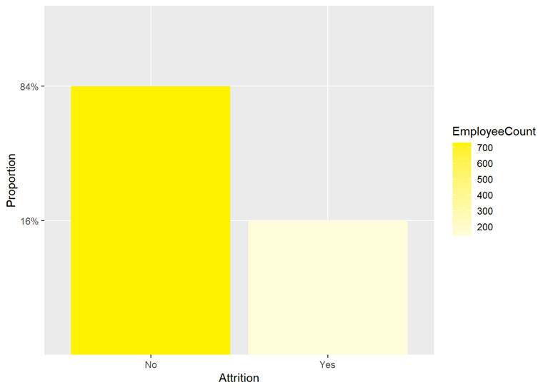
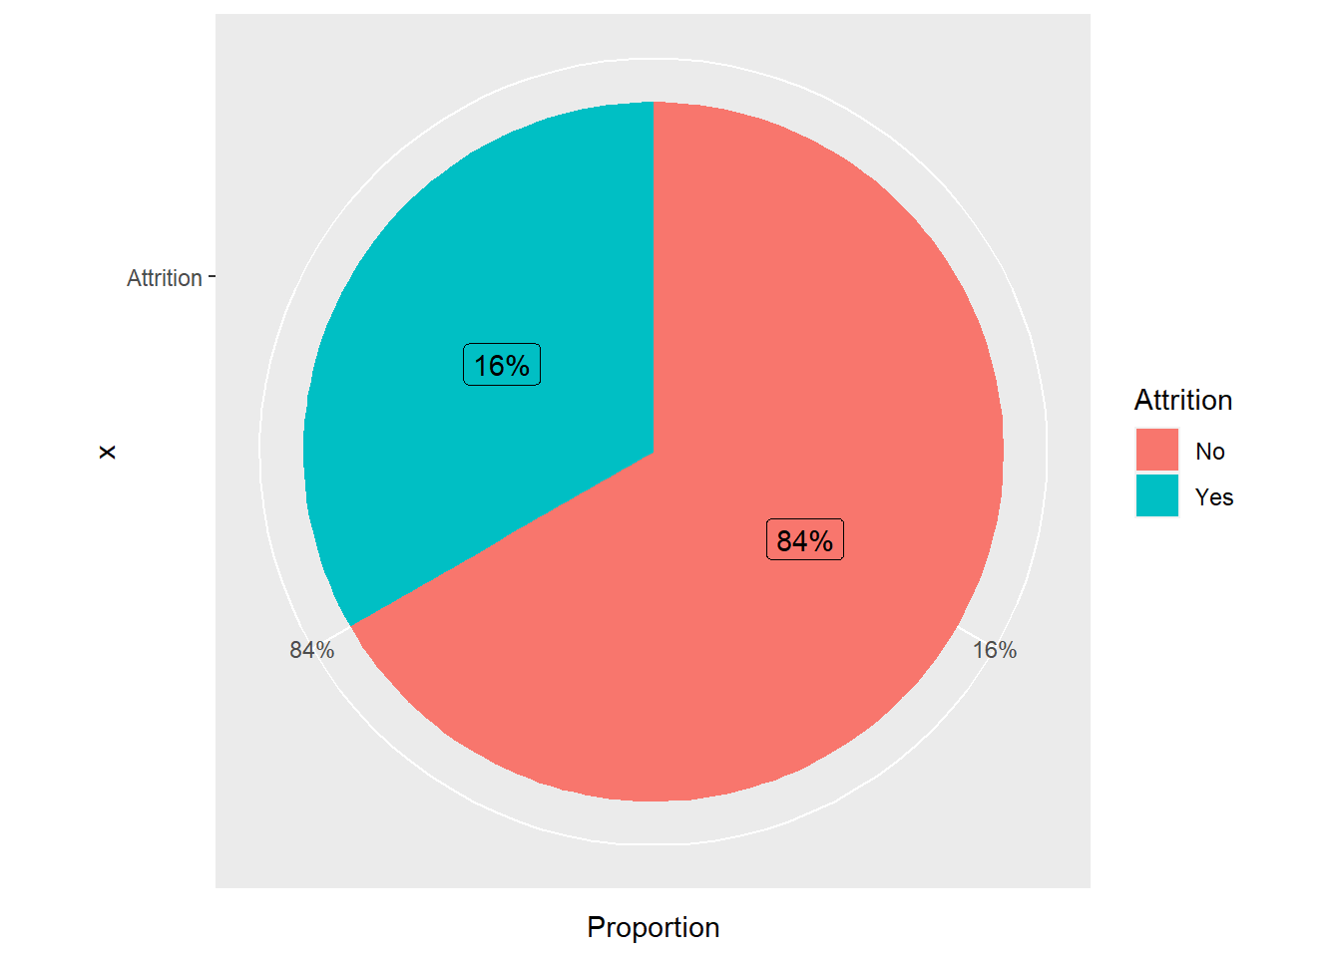
Attrition Rate

Slide 5
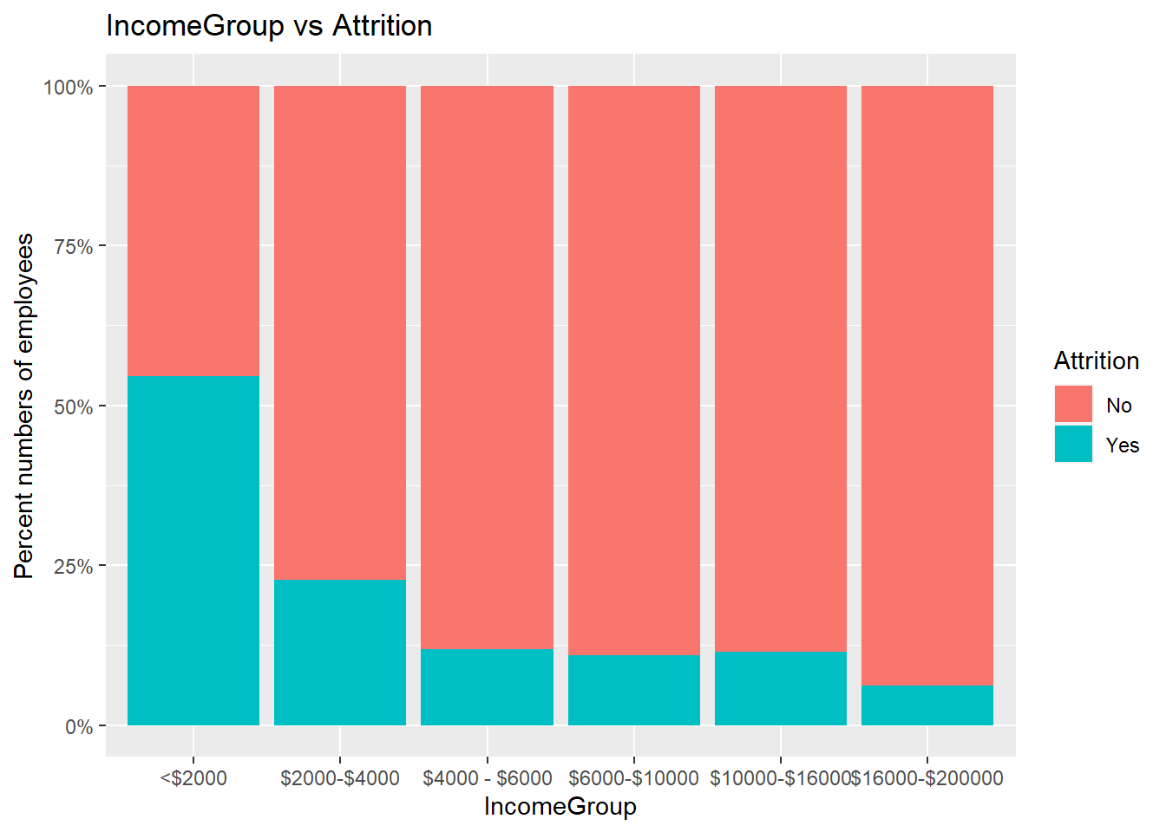
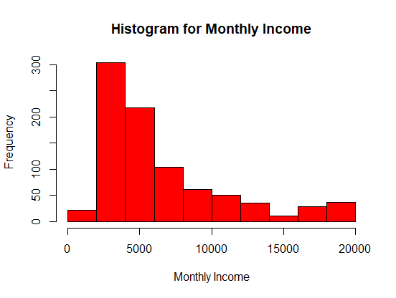
Income Group

Slide 6
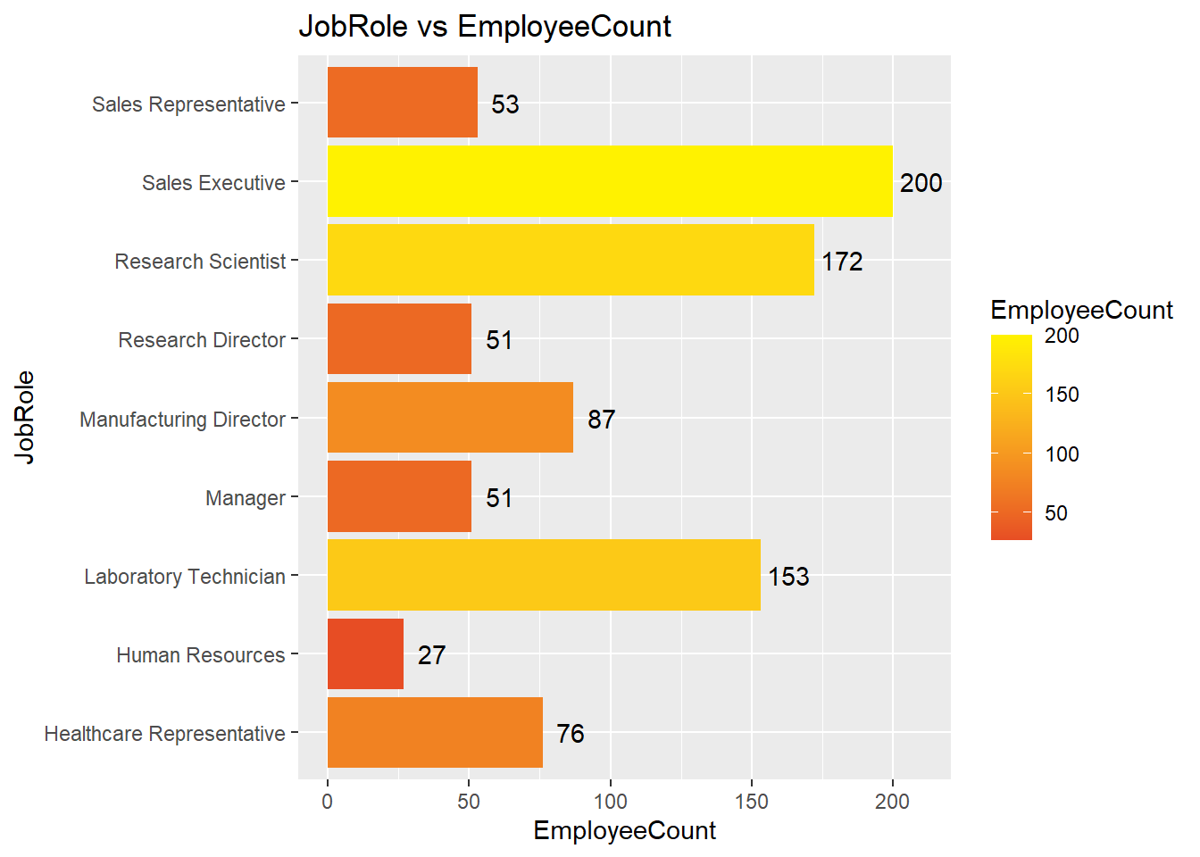
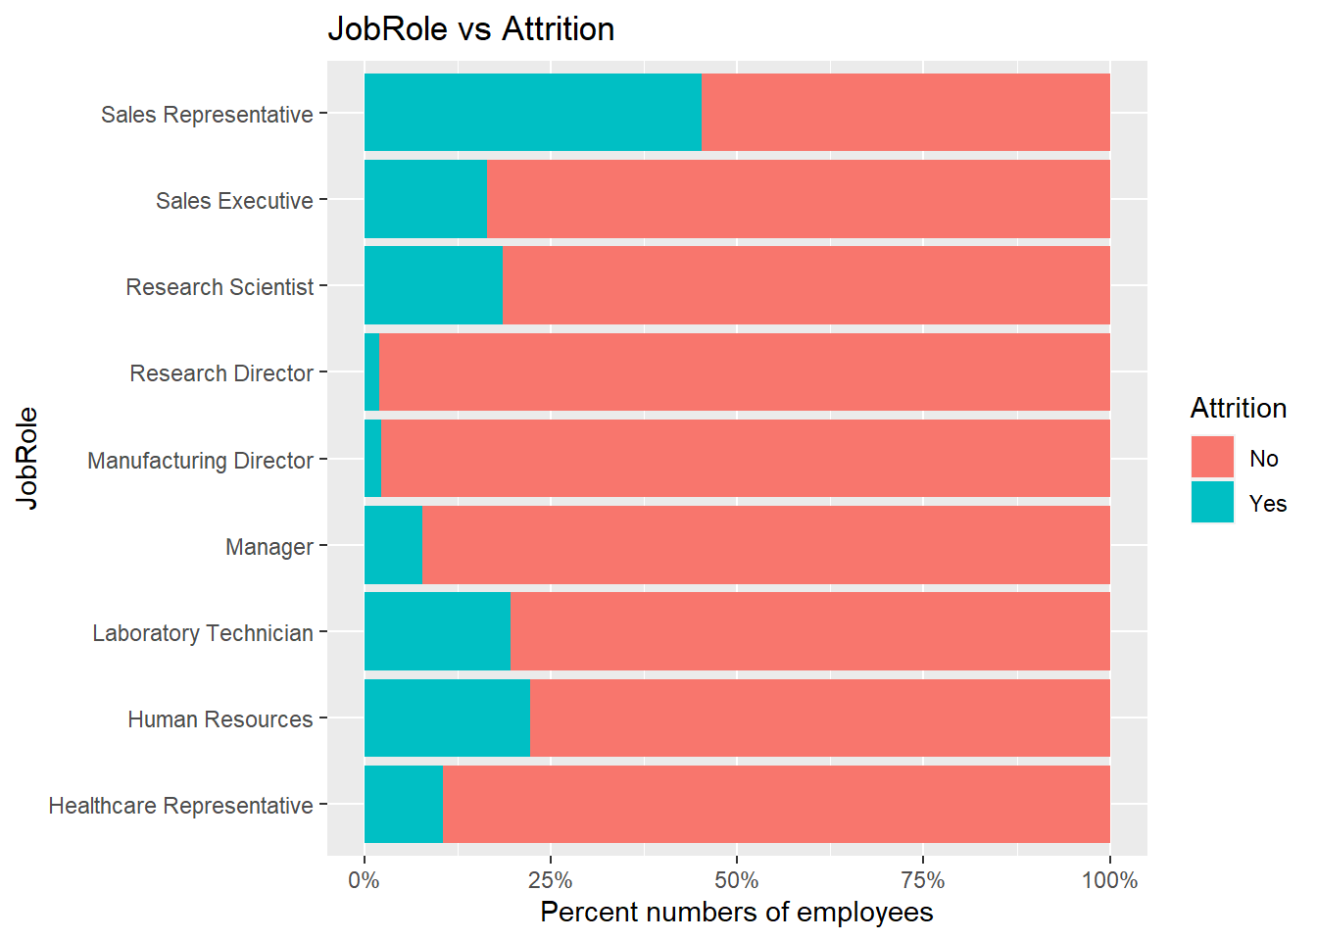
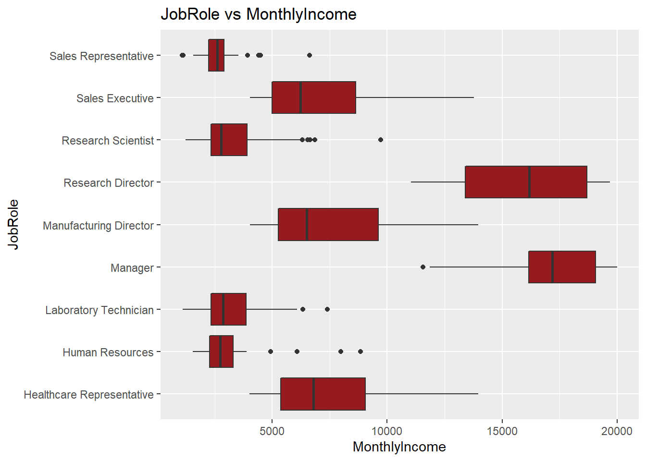
Job Role

Slide 7
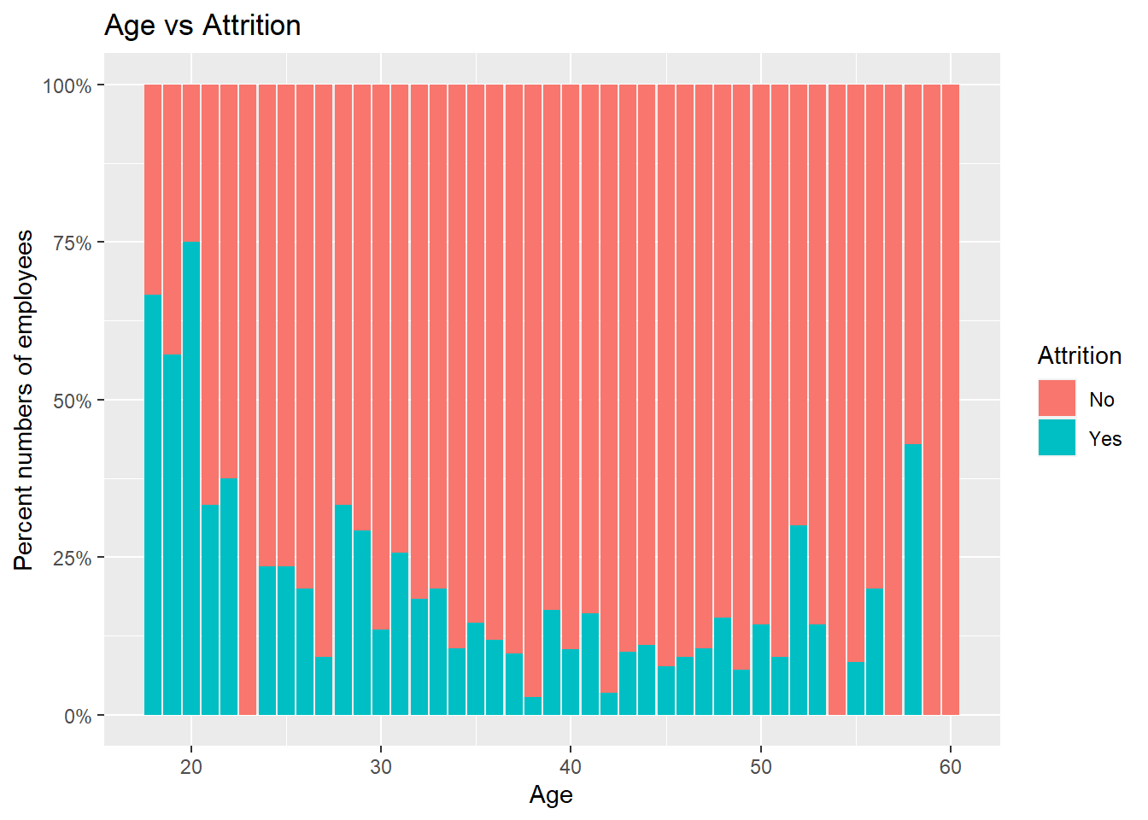
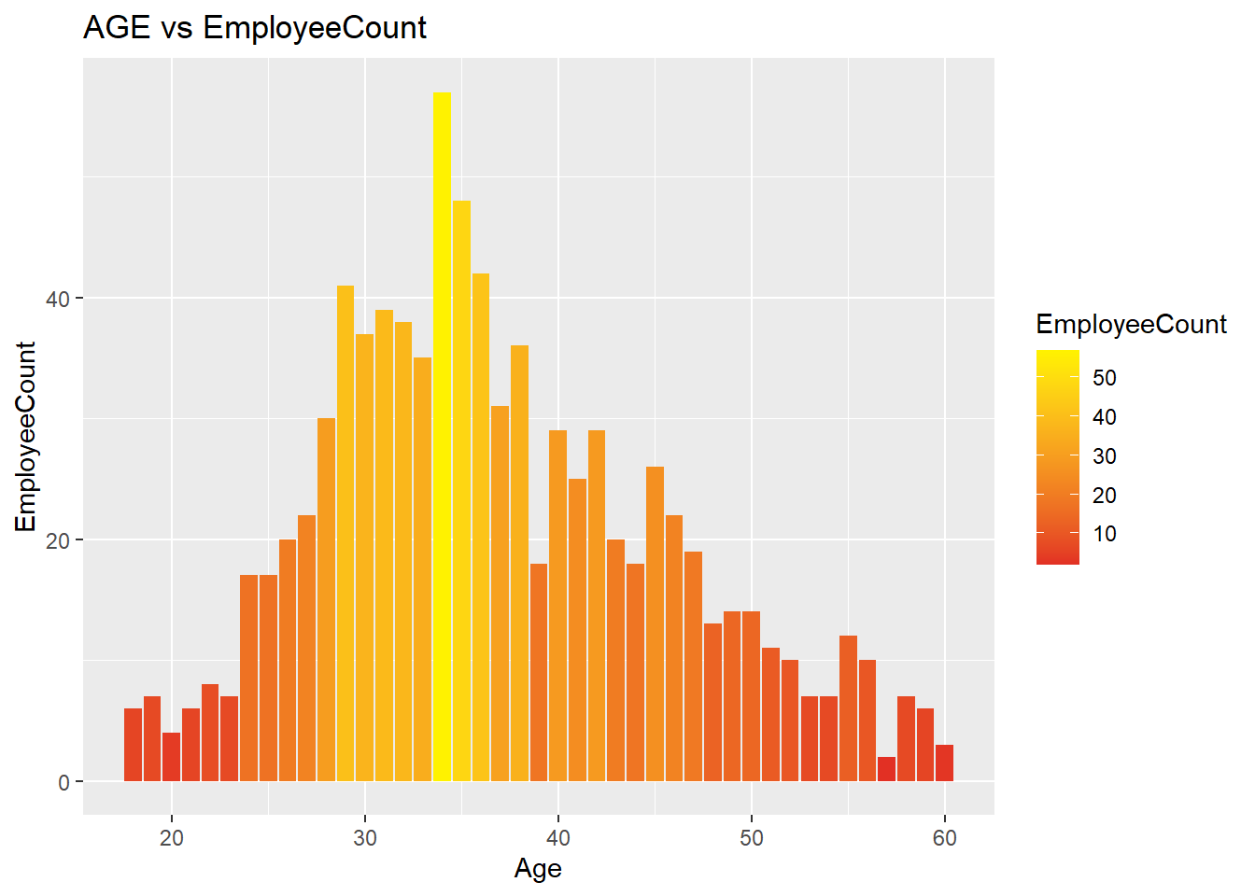
AGE

Slide 8
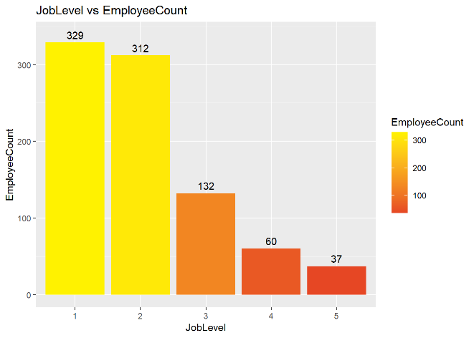
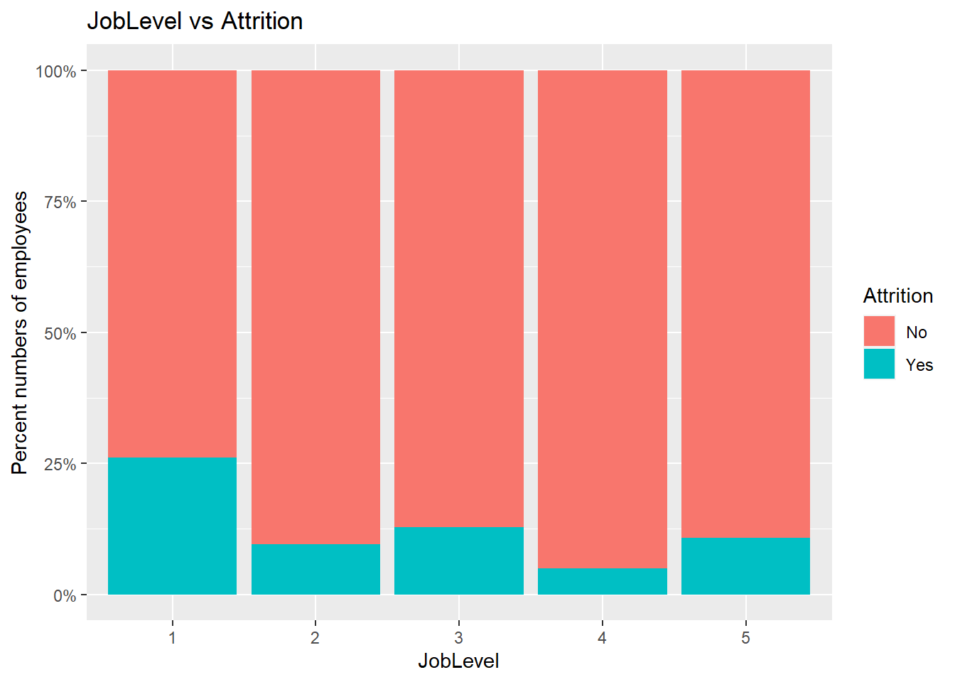
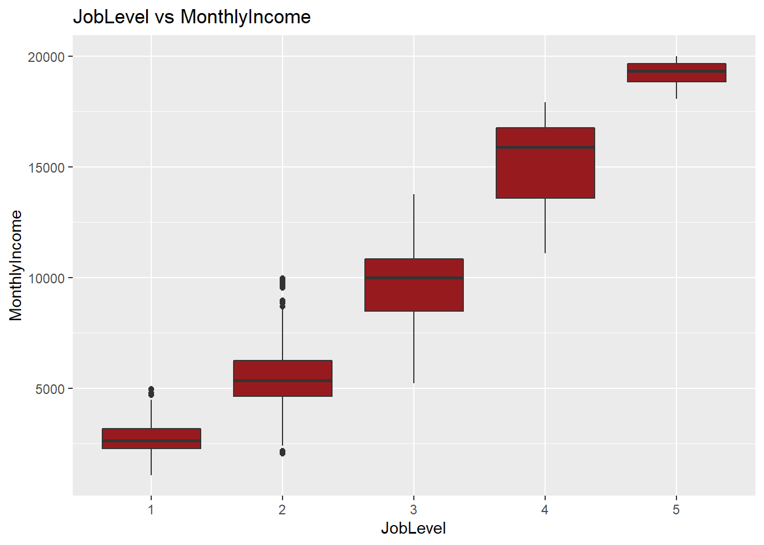
JobLevel

Slide 9
Top 3 predictors
Used Multivariate Regression Analysis
Over-Time
Years with Current Manager
Stock Option Level

Slide 10
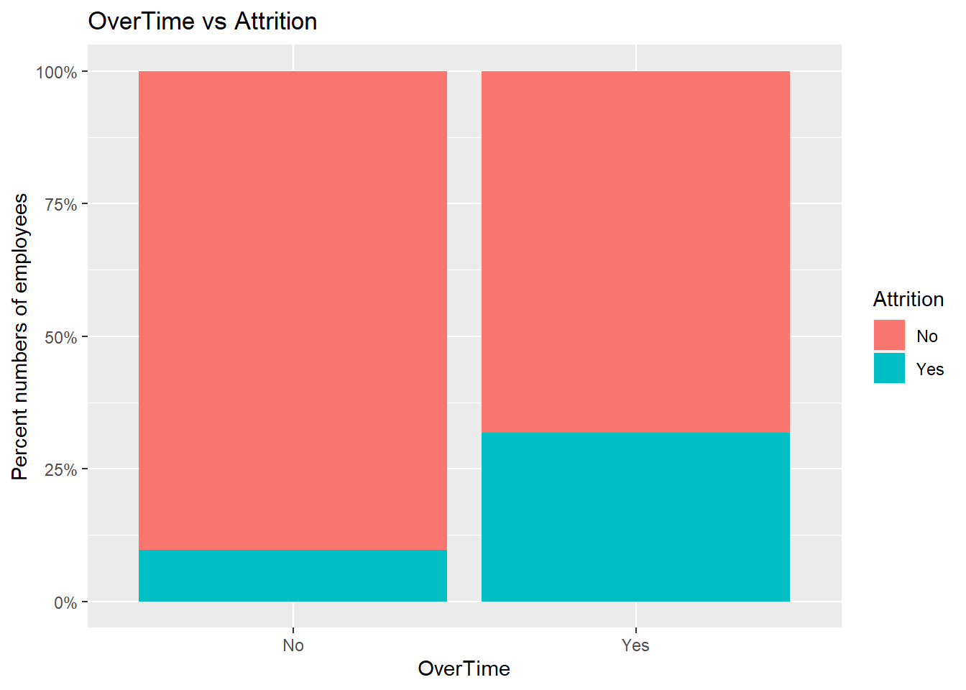
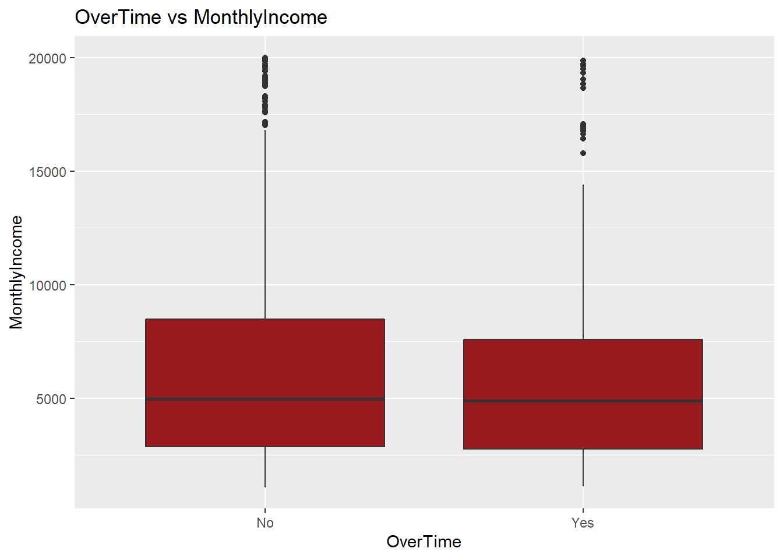
EDA for Top Factors Over-Time

Slide 11
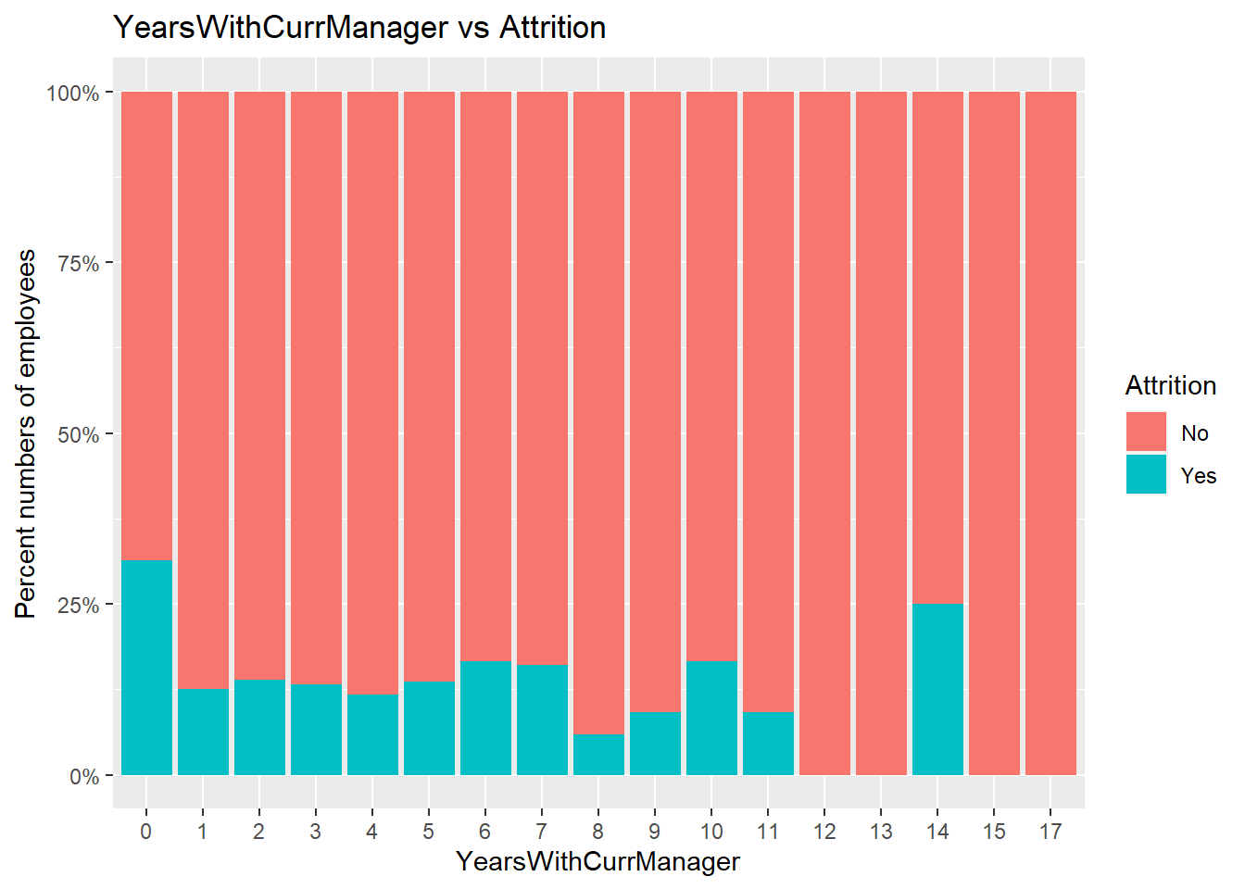
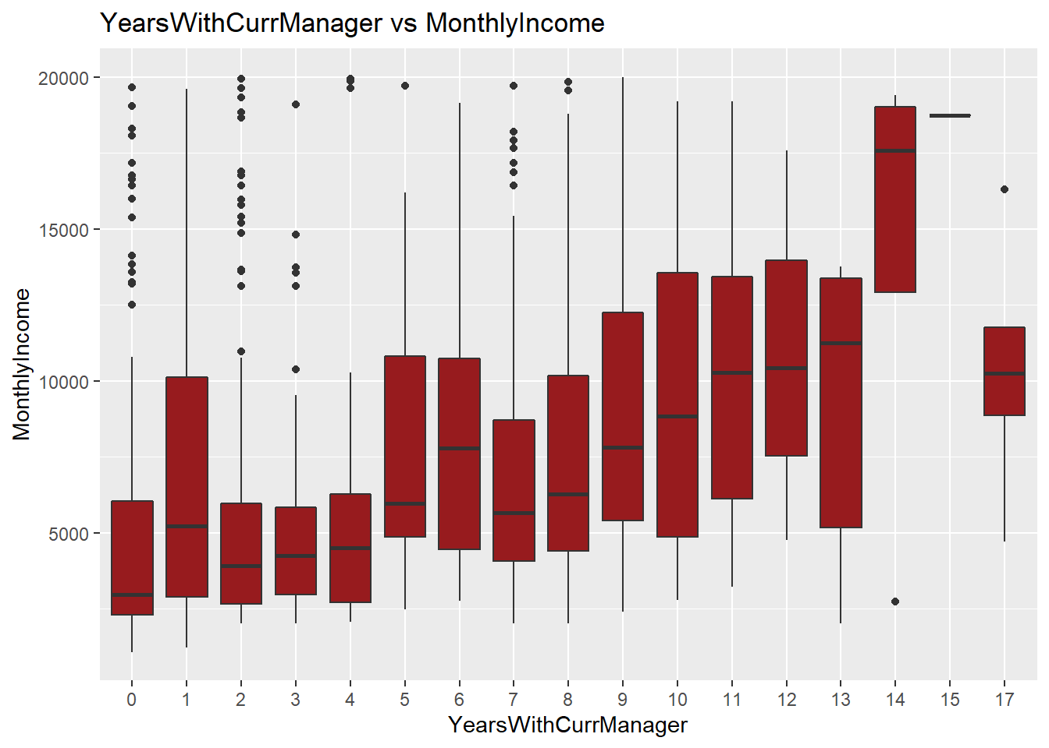
Years with Current Manager

Slide 12
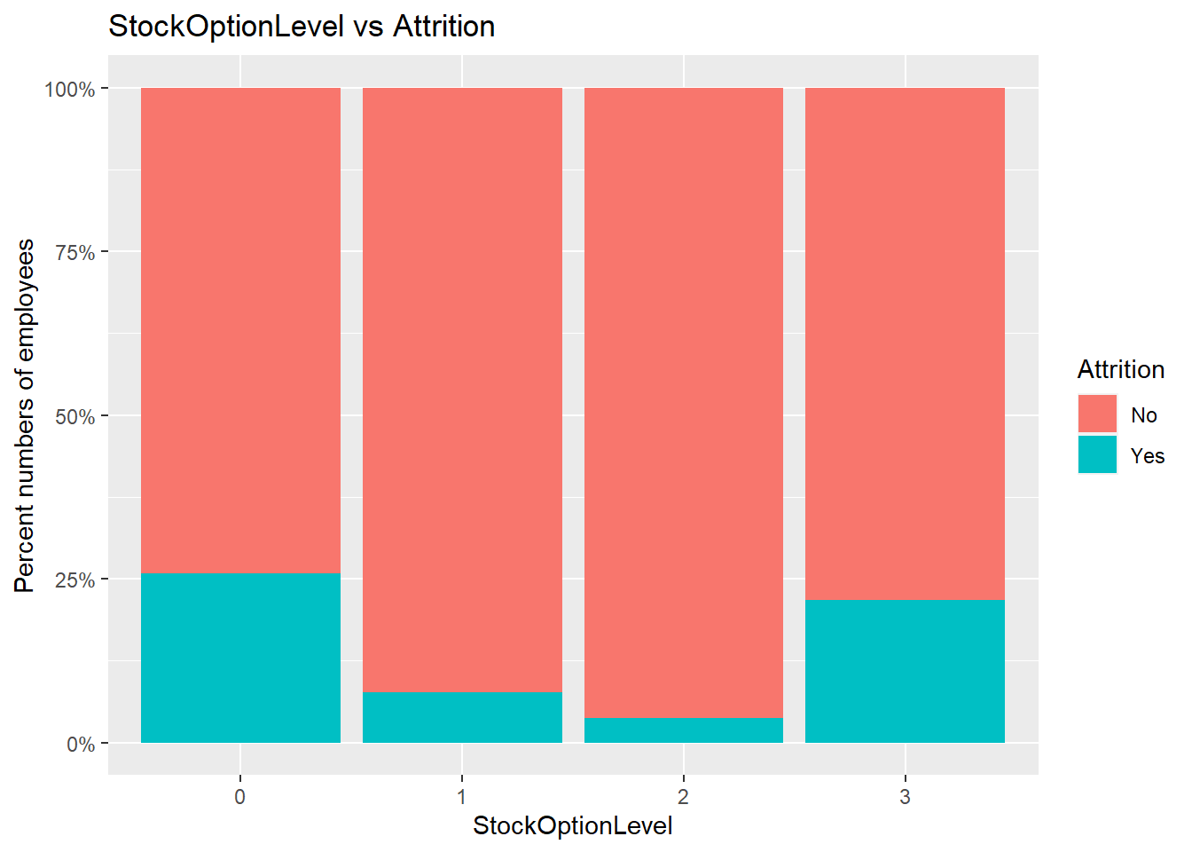
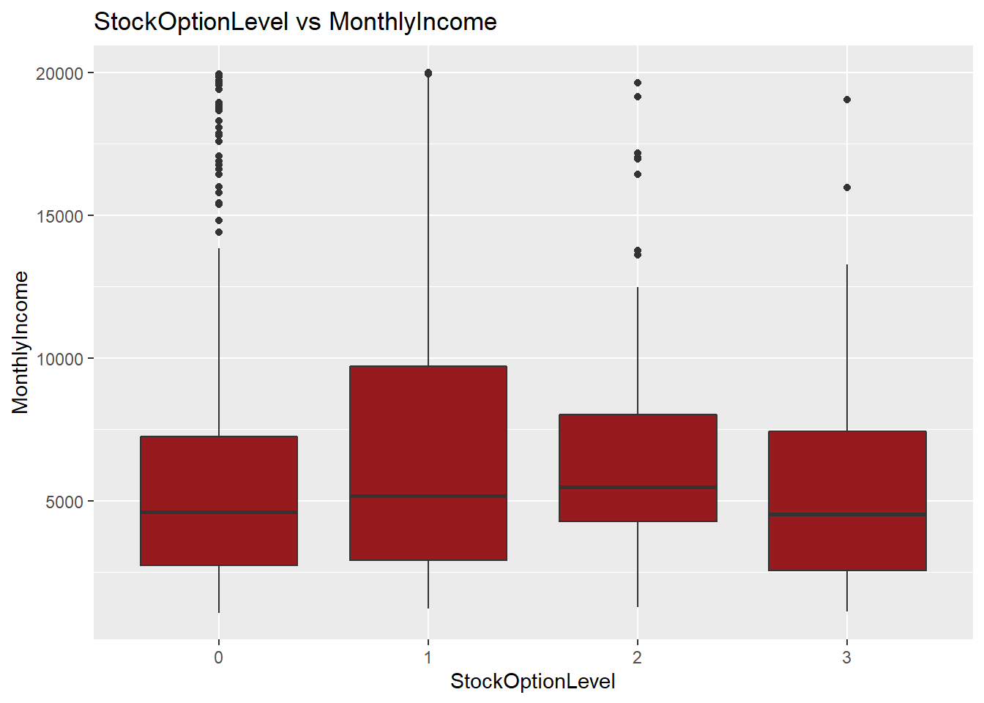
Stock Option Level

Slide 13
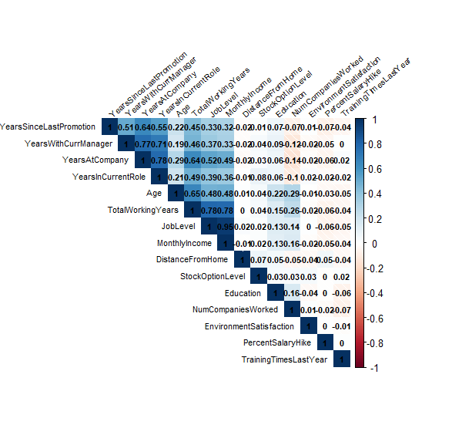
Numeric Variables

Slide 14
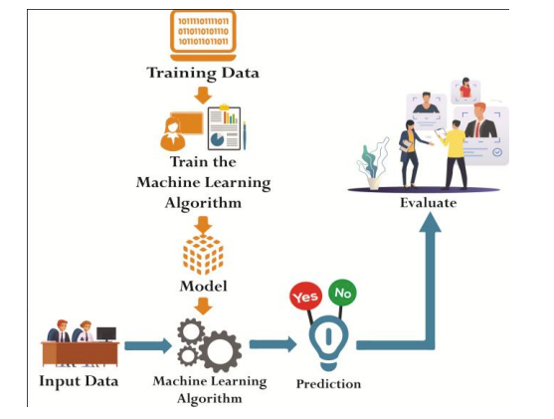
Model
Used Multiple Regression Model
Variables used – Monthly Income related to Age, Attrition, Business Travel, Department, Education, Job Level, Job Role, Number of Companies Worked, Total Working Years, Years At Company, Years In Current Role, Years Since Last Promotion, Years With Current Manager , Stock Option Level
RMSE : $1034.676
Predicted Salary.

Slide 15
Model
Naïve Bayes –
Attrition, Age, Department, Environment Satisfaction, Job Involvement, Job Level, Job Role, Job Satisfaction, Marital Status, Monthly Income, Number of Companies Worked, Over Time, Stock Option Level, Total Working Years, Work Life Balance, Years At Company, Years In Current Role, Years With Current Manager
Accuracy- 82 %
Sensitivity - 85.8 % (True Positive Rate)
Specificity – 61.5 % (True Negative Rate)
Predicted Attrition.

Slide 16
Conclusion
Model can be used to prevent future employee attrition.
Attrition can be reduced by retaining skilled and experienced employees.
To control attrition- Motivate employees, expose employees to newer role, offer competitive salary.
And most importantly perform exit interview with departing employee.

Slide 17
Thank You

