Slide 1
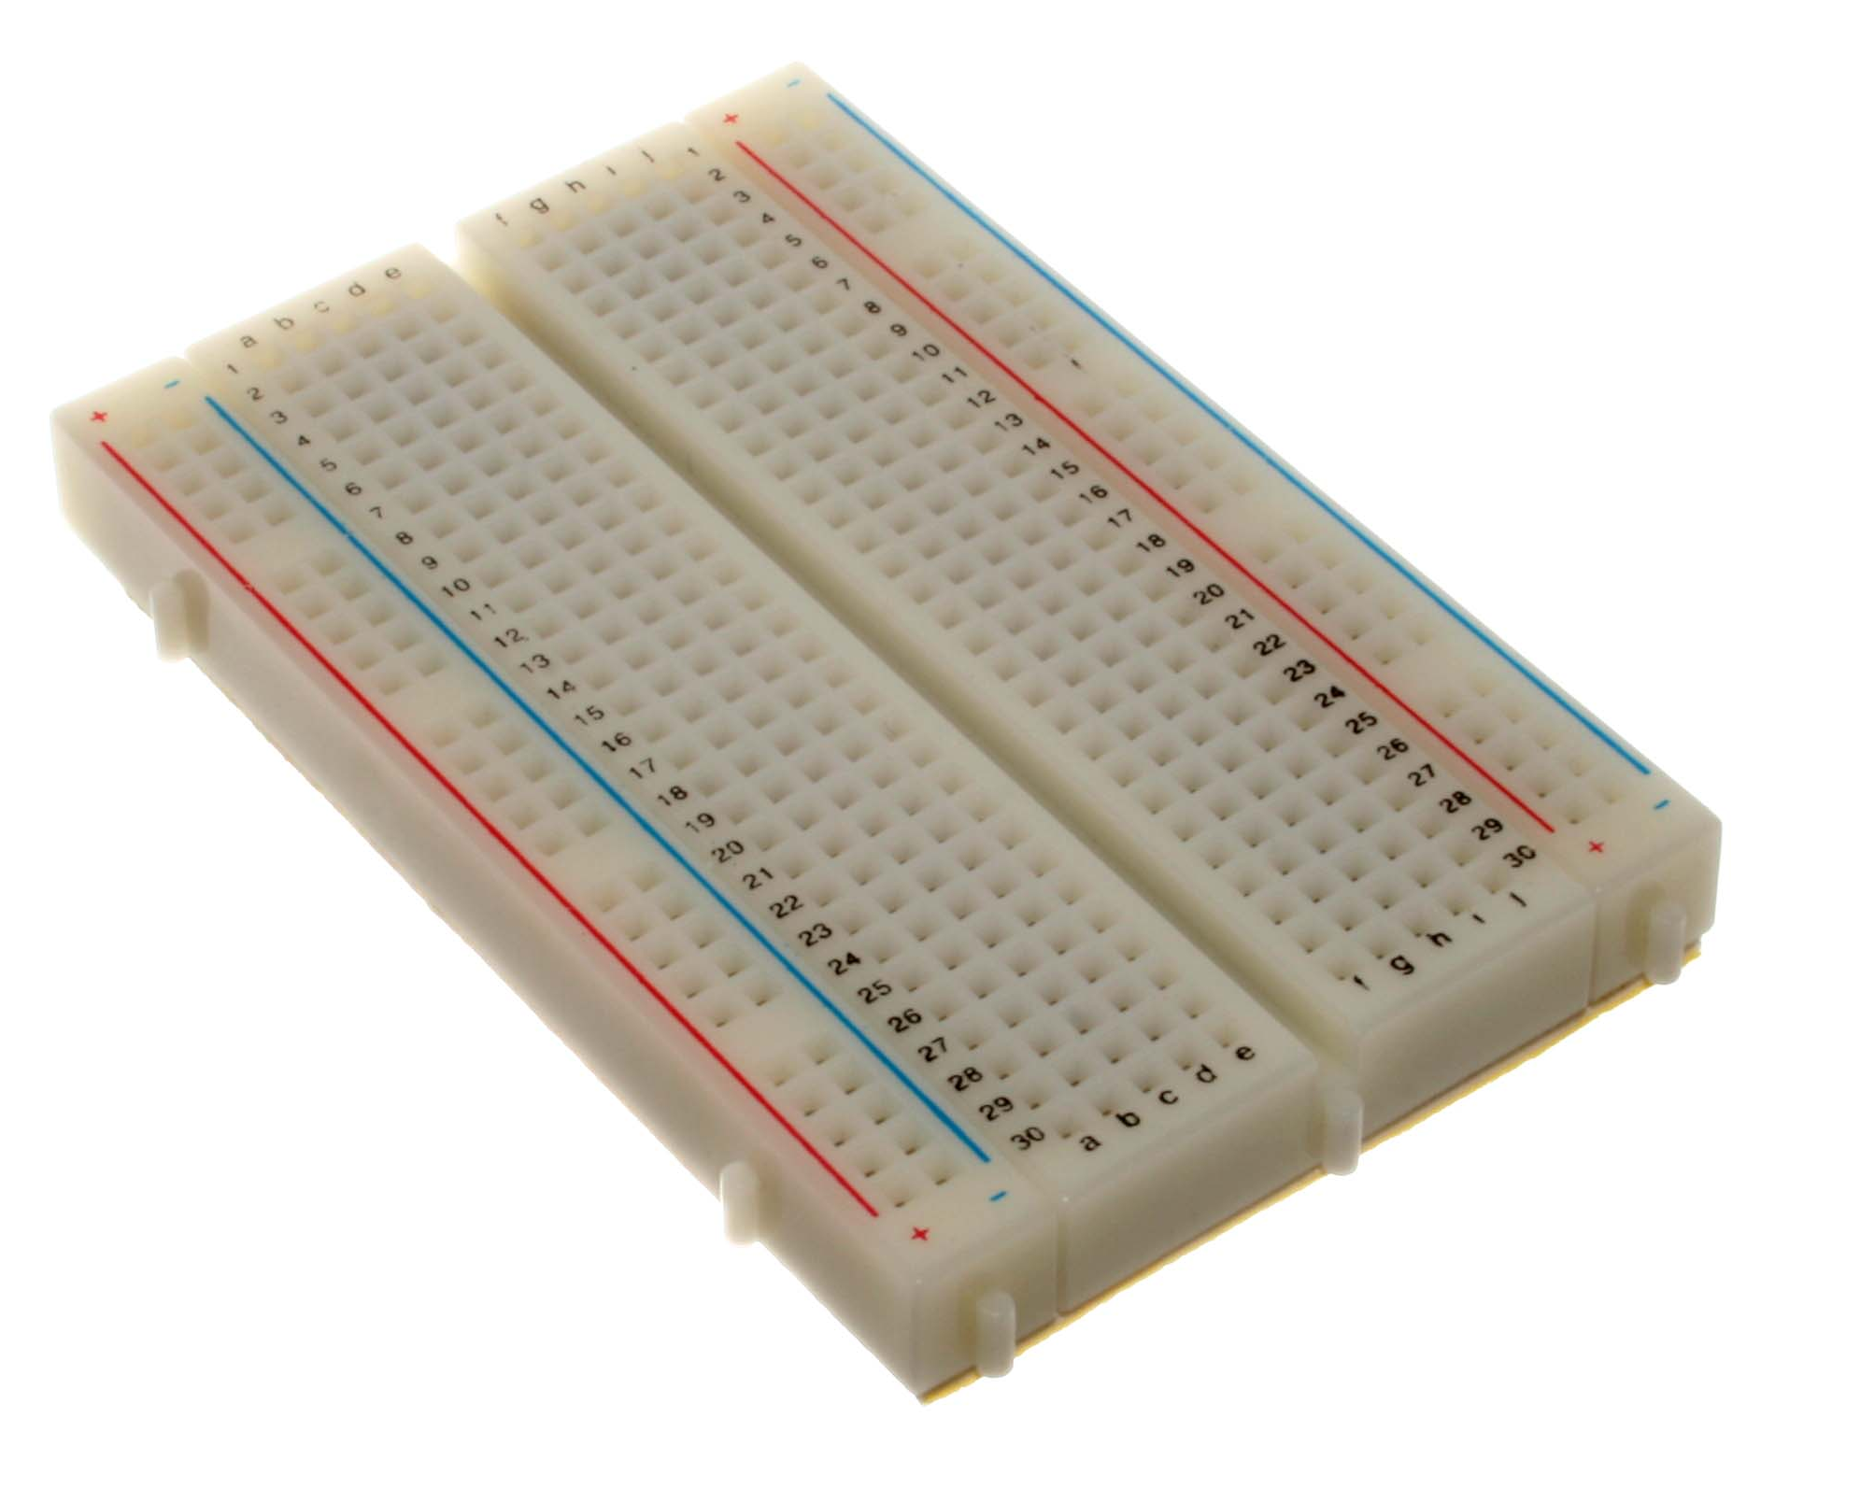
Breadboard
Introduction , Variations & Use

Slide 2
Introduction
The breadboard is a construction base for prototyping of electronic circuits.
The breadboard most commonly used today is usually made of white plastic and is a pluggable breadboard.
It was designed by Ronald J. Portugal of EI Instruments Inc. in 1971.
Because the solder less breadboard does not require soldering it is reusable.
This makes it easy to use for creating temporary prototypes and experimenting with circuit design.

Slide 3
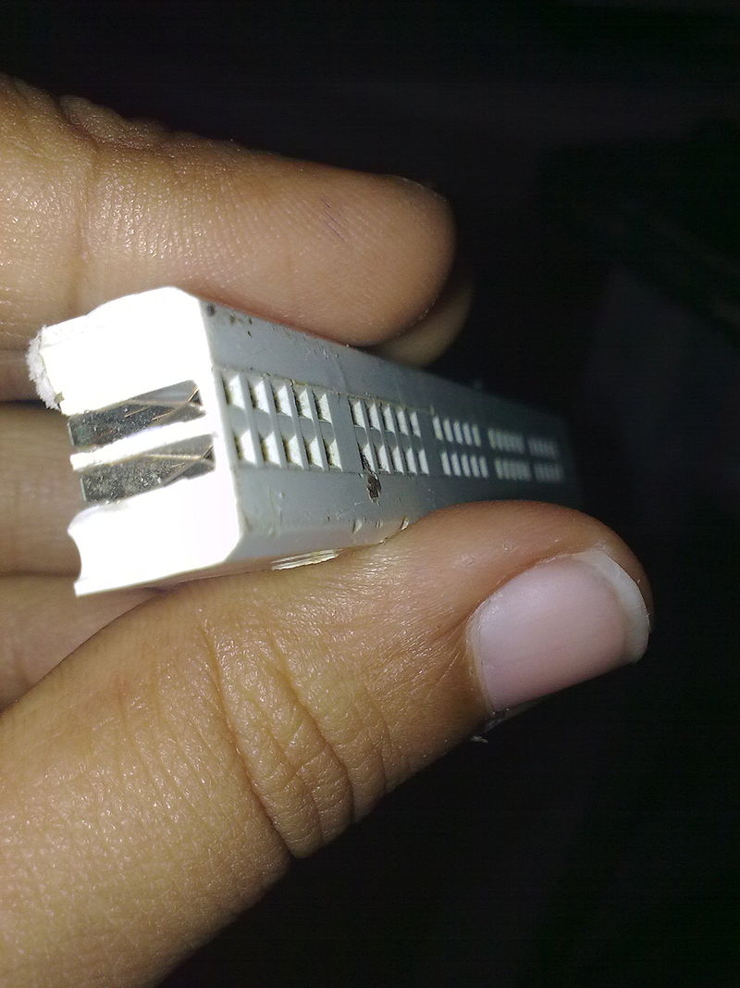
Construction
A modern solder less breadboard consists of a perforated block of plastic with numerous tin plated, phosphor bronze or Nickel Silver alloy spring clips under the perforations.
The clips are often called tie points or contact points. The number of tie points is often given in the specification of the breadboard.
The spacing between the clips (lead pitch) is typically 0.1 in (2.54 mm).
Typically the spring clips are rated for 1A at 5V and 0.333 amperes at 15 volts (5W).

Slide 4
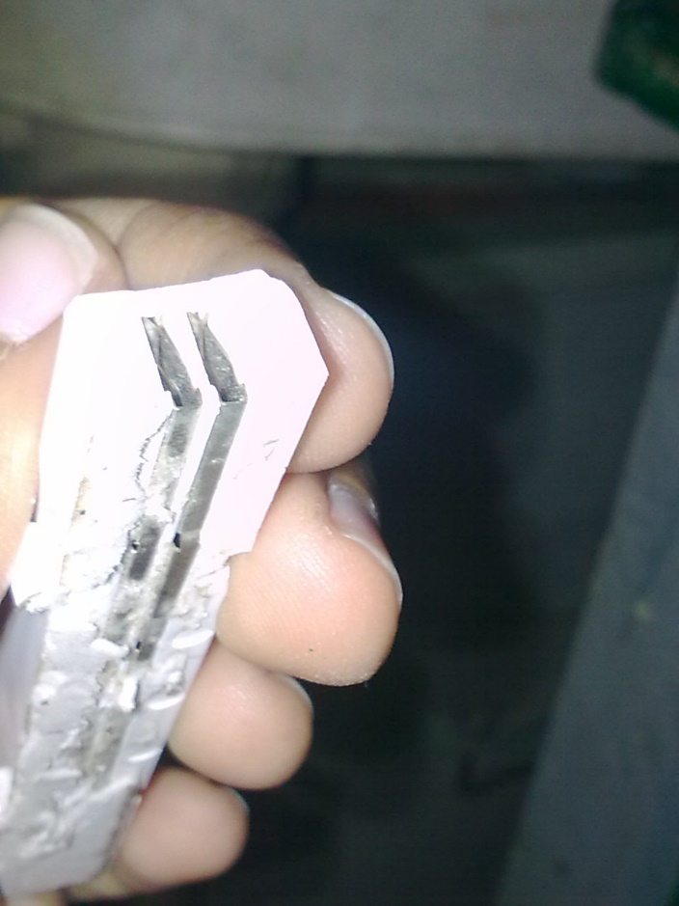
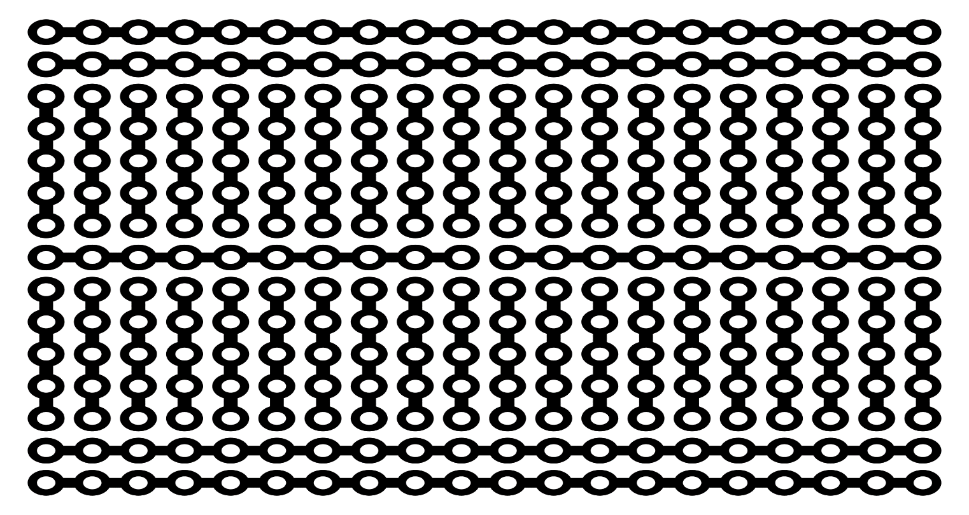
The hole pattern for a typical etched prototyping PCB (printed circuit board) is similar to the node pattern of the solder less breadboards shown here.
The five clip columns on the left of the notch are often marked as A, B, C, D, and E, while the ones on the right are marked F, G, H, I and J.
A bus strip usually contains two columns: one for ground and one for a supply voltage.

Slide 5
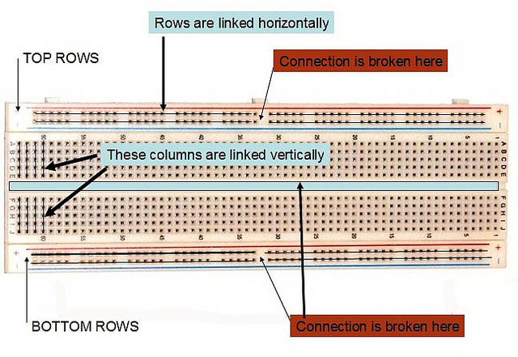

Slide 6
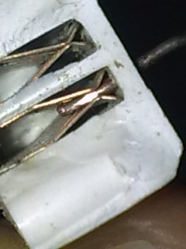
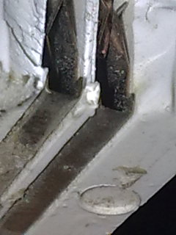
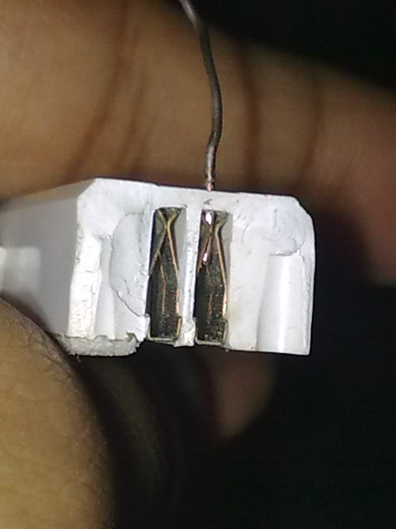
Due to stray capacitance the breadboard limits applications under 10MHz.
Solder less breadboards are further limited by their voltage and current ratings.
Solder less breadboards usually cannot accommodate surface mount devices (SMDs) or components with grid spacing other than 0.1 in (2.54 mm)

Slide 7
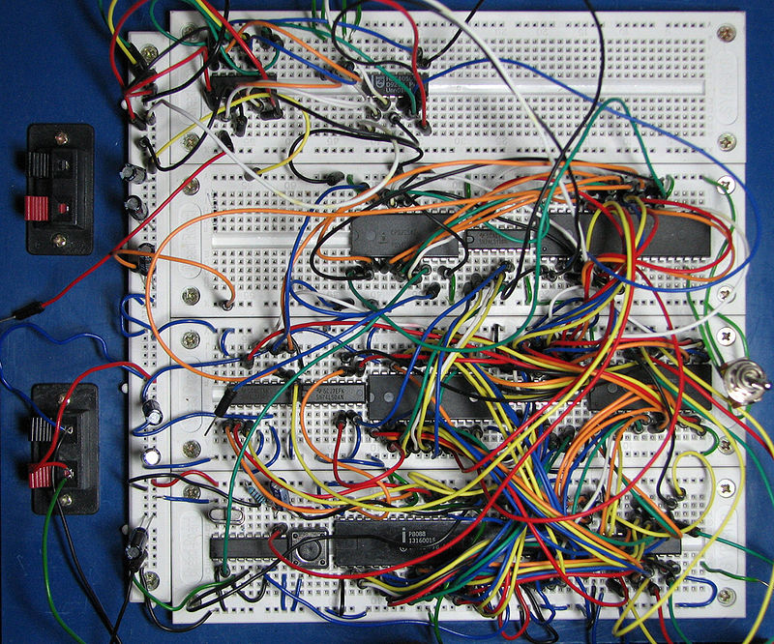
Very complex circuits can become unmanageable on a solder less breadboard due to the large amount of wiring required.
The very convenience of easy plugging and unplugging of connections also makes it too easy to accidentally disturb a connection, and the system becomes unreliable.

Slide 8
Variations
Vero board is a brand of strip board, a pre-formed circuit board material of copper strips on an insulating board which was originated and developed in the early 1960s by the Electronics Department of VPE.
One variant is called a Tri Pad board. This is similar to strip board, except that the conductive tracks do not run continuously along the board but are broken into sections, each of which spans three holes.
Perfboard is a material for prototyping electronic circuits (also called DOT PCB).

Slide 9
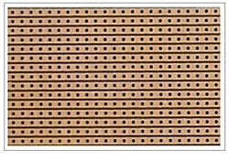
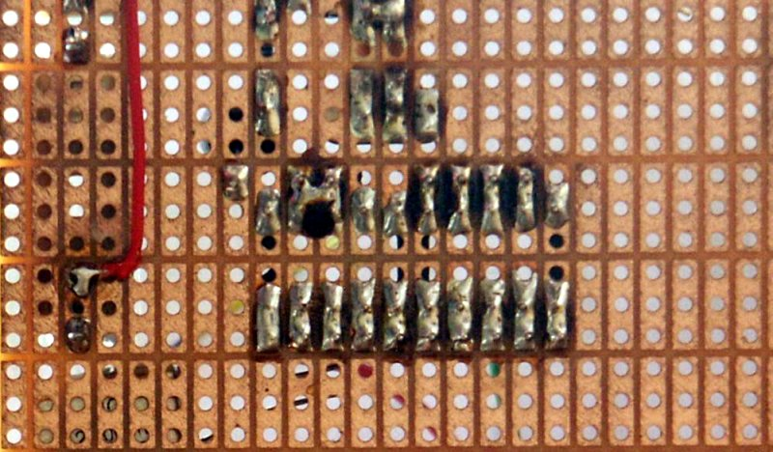
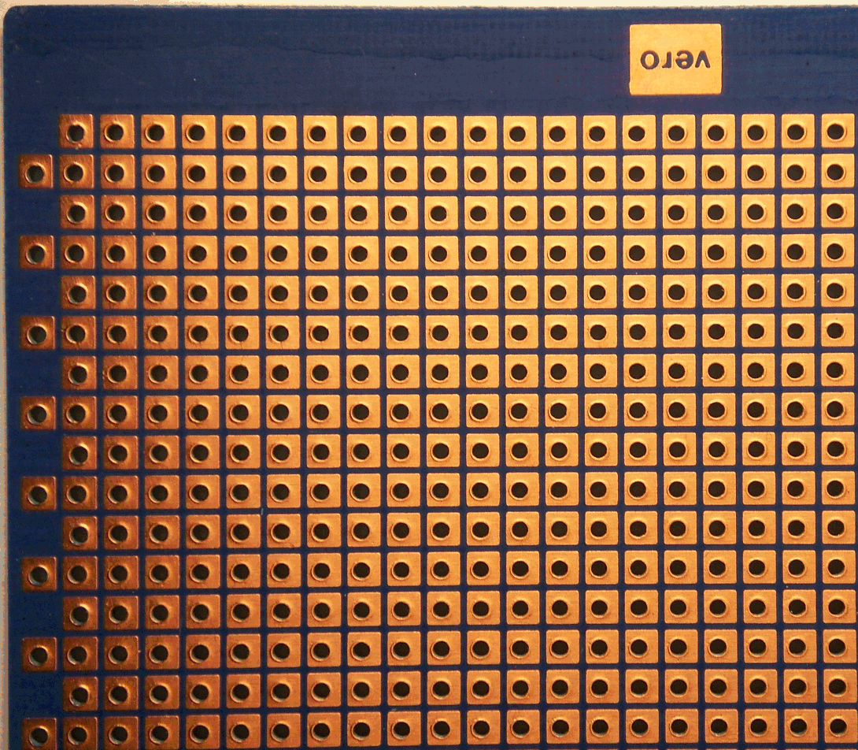
Vero Board
Tri Pad
Perf Board

Slide 10

THE END

