Slide 1

Data-Science-Capstone-RETAIL MARKETING ANAYLATICS
CUSTOMER SEGGREGATION AND TARGETING

Slide 2
Problem Statement
Business Understanding
An amusement park company offers different services within the park- rides, restaurants across price categories (from 2 star to 4 star), pet friendly activities, kid friendly activities and events, and overnight stays.
They have collected data on their customers at a household level and want to use it to target them with customized marketing activities and promotions.
Goal/ Business Objectives
Find the groups of customers using the data.
Come up with a marketing strategy for each of the groups based on the group behavior.
Data download
DATA SOURCE:https://raw.githubusercontent.com/vkoul/data/main/misc/household_data.csv
GITHUB LINK: HTTPs://github.com/ranjanapriya21/Machine-learning

Slide 3
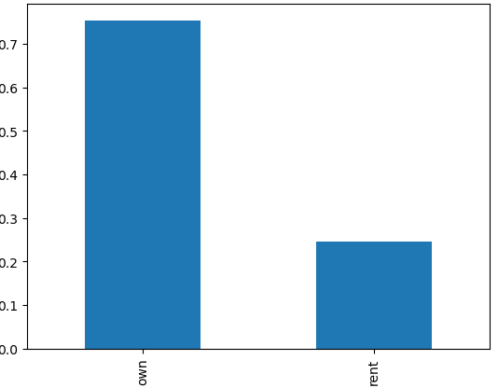
Steps to accomplish data analysis.
1)Perform descriptive analysis. Understand the variables and their corresponding values.
2) Data Exploration
Create scatter charts between the pair of variables to understand the relationships. Describe your findings. Check the balance of the data by plotting the count of outcomes by their value. Describe your findings and plan future course of action.
Perform correlation analysis. Visually explore it using a heat map.

Slide 4
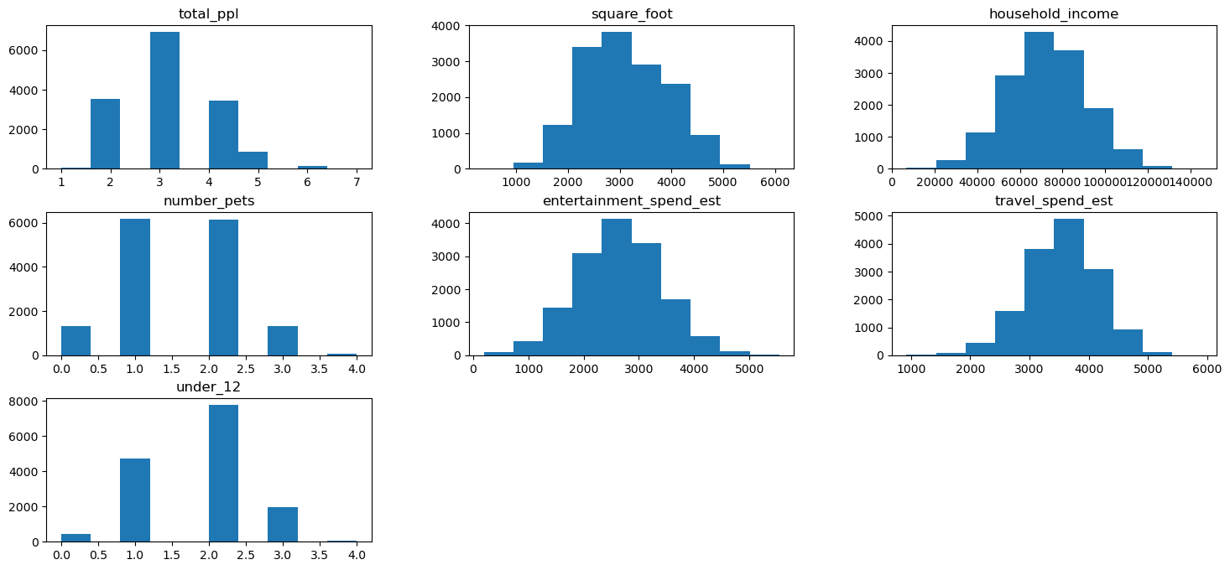
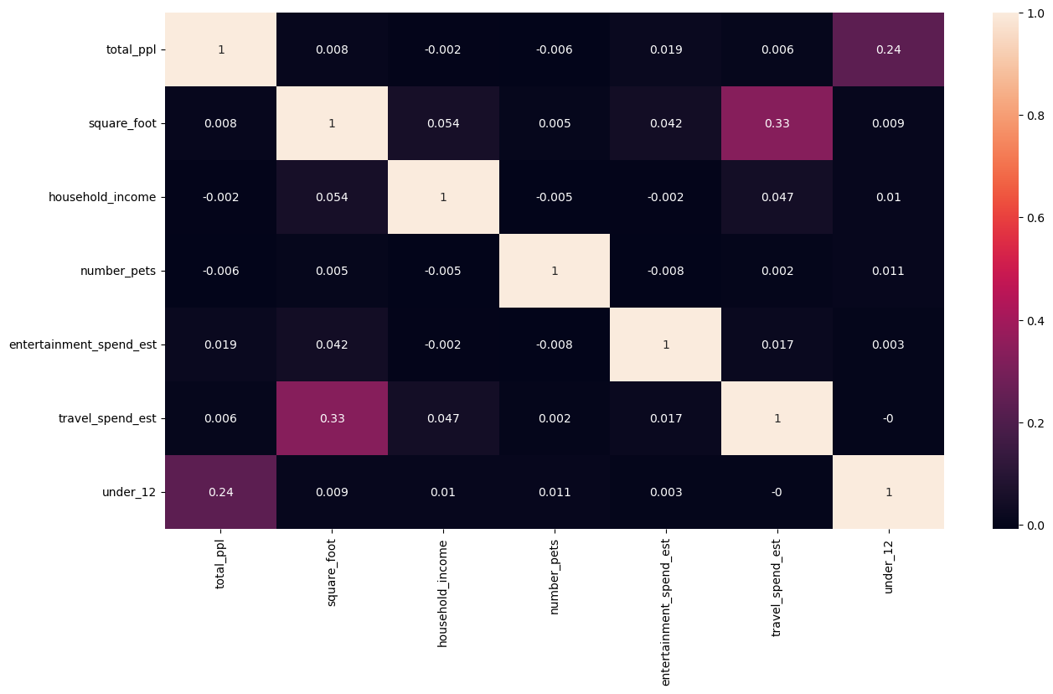
DATA VISUALIZATION

Slide 5
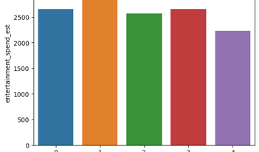
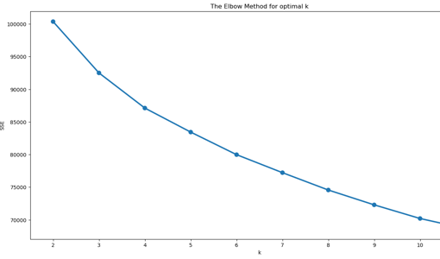
Data Modeling
Devise strategies for model building. It is important to decide the right validation framework. Express your thought process.
Apply an appropriate classification algorithm to build a model. Compare various models with the results from K means clustering algorithm
Create a classification report by analyzing sensitivity, specificity, AUC (ROC curve), etc. Please be descriptive to explain what values of these parameter you have used.
Create Cluster Level Analysis.
Analyze different class labels against the number of clusters for each data points

Slide 6
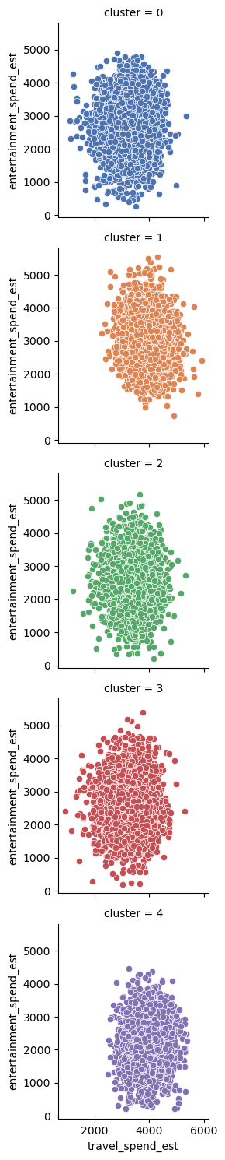
Scatter charts between relevant variables to analyze the relationships
These results would allow us to know the different groups into which our customers are divided. Thus, we could carry out specific actions on them, such as personalized advertising campaigns, offers aimed at specific groups example the cluster with mean of highest household income will be offered premium membership to encourage to spend more nights in park.
The cluster with mean of highest kids in a family will be offered more kid friendly activities so without K means cluster to segregate with 15,000 customers it had been a difficult task for marketing team to target their loyal customers.

Slide 7

THANK YOU
FEEDBACK AND MORE INSIGHTS IF NEEDED

