Slide 1

DR B R AMBEDKAR NATIONAL INSTITUTE OF TECHNOLOGY, JALANDHAR (144011)
MINOR PROJECT
Fake News Detection System
MENTORED BY: SUBMITTED BY:
Dr. Shveta Mahajan Priyanshi (20103112)
Assitant Professor Ranjan Kumar(20103120)
Department of CSE

Slide 2


Contents
Introduction
Literature Survey
Problem Statement
Solution approach
Methodology
Implementation
Result and Conclusion
Future Scope
References

Slide 3

Introduction
The spread of fake news has become a major concern for individuals, organizations, and governments worldwide. With the advent of social media and the ease of sharing information, it has become effortless to spread false information and sensationalized stories. The consequences of fake news can be severe, leading to misunderstandings, anxiety, fear, and even violent incidents. It can also affect the reputation and credibility of individuals and institutions. Fake news detection systems have been developed to tackle this issue.

Slide 4



Literature Review
Shu, K., Mahudeswaran, D., Wang, S., Lee, J., & Liu, H. (2017). Fake News Detection on Social Media: A Data Mining Perspective. Explorations Newsletter, 19(1), 22-36.
This study proposes a fake news detection system that uses a combination of machine learning algorithms, natural language processing techniques, and social network analysis to identify fake news on social media platforms. The authors discuss the importance of identifying the source of fake news and the role of social media in its spread. They also highlight the challenges in detecting fake news, including the use of clickbait headlines and sensationalized language.

Slide 5


Literature Review (contd.)
A Survey on Fake News: Fundamental Insights and Challenges. ACM Transactions on Information Systems (TOIS), 37(3), 1-38.
This survey provides an overview of the various approaches to detecting fake news and identifies the challenges in developing effective systems. The authors discuss the limitations of existing systems and highlight the need for more comprehensive approaches that consider the social and political context of fake news. They also explore the ethical implications of fake news detection and the potential for bias in automated systems.

Slide 6
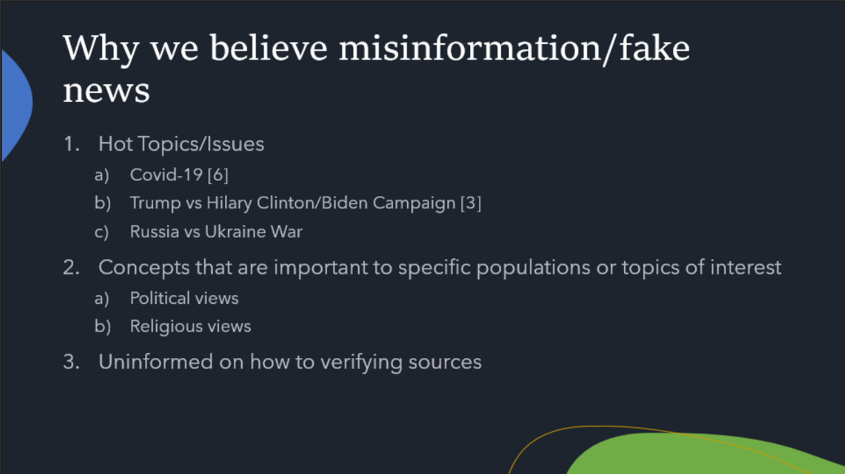
What we plant in the soil of contemplation , we shall reap in the harvest of action .
-Meister Eckhart

Slide 7


Problem Statement
●Proliferation of fake news and misinformation
●Difficulty in distinguishing between factual and fabricated content
●Inability of existing fact-checking initiatives
●Sophisticated techniques employed by malicious actors
●Real-time processing of vast amounts of information.
● To keep social balance between different community.
● No app is available for image based fakenewsdetector

Slide 8
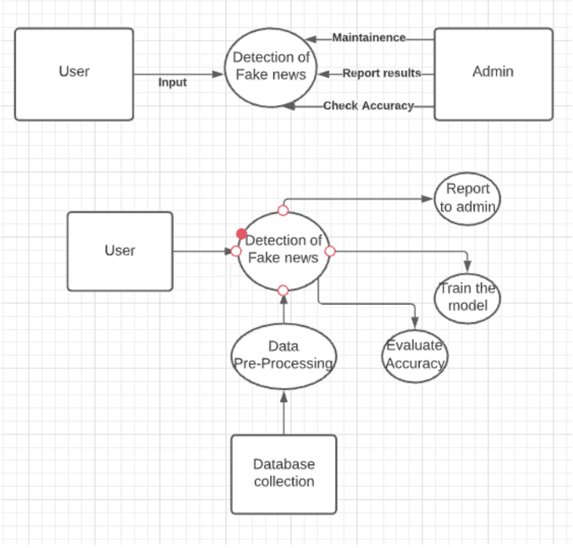
SOLUTION APPROACH
Firstly we will build a Machine Learning Model which will tell us the news is Fake or Real .
After the machine learning model is build we will integrate it with a web App using streamlit and python.
User will give the input in the form of image or text and it will tell us whether the news is fake or real.
Data pre-processing
Generating vectors for the text data
Test train splits
Training the model
Prediction on test set
Combination of results
Web app

Slide 9
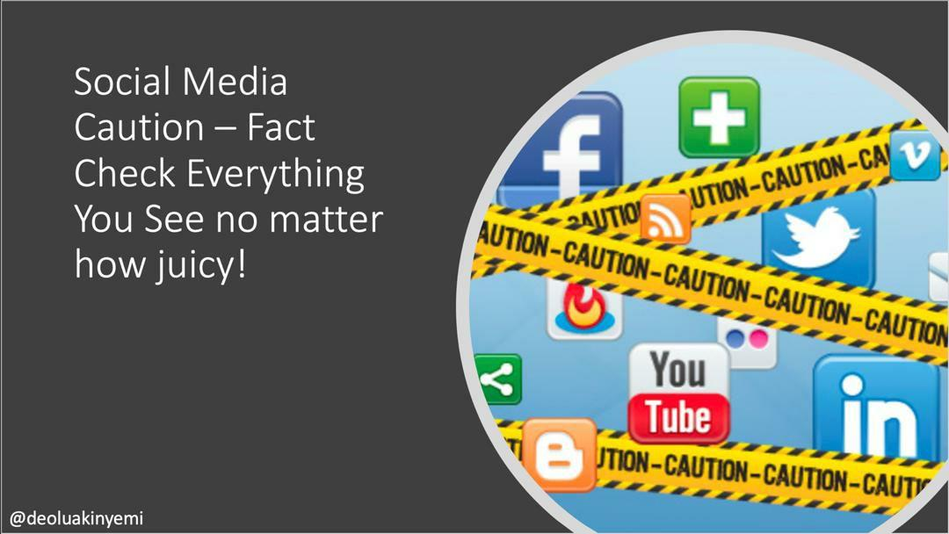
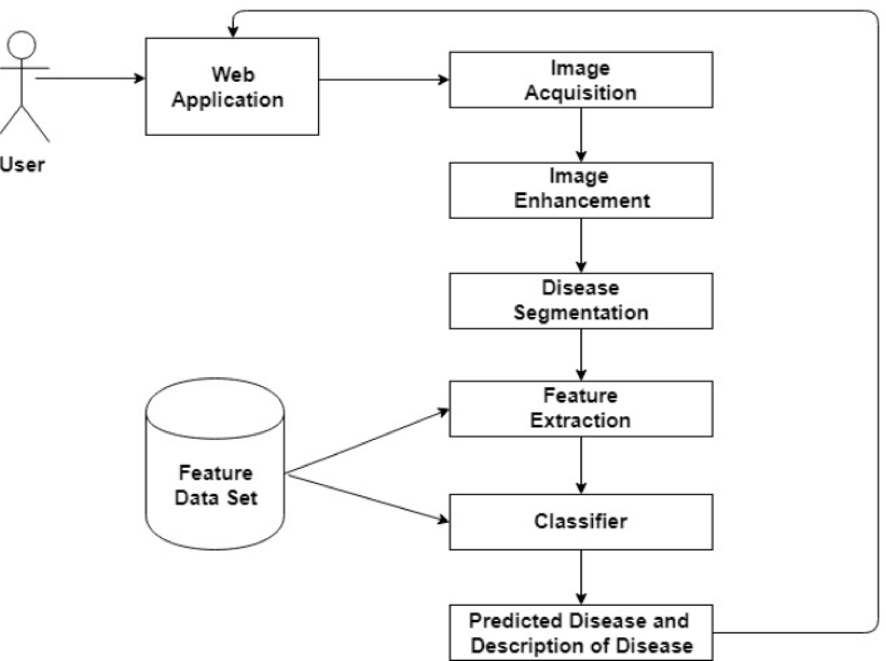



System Architectural Flow

Slide 10
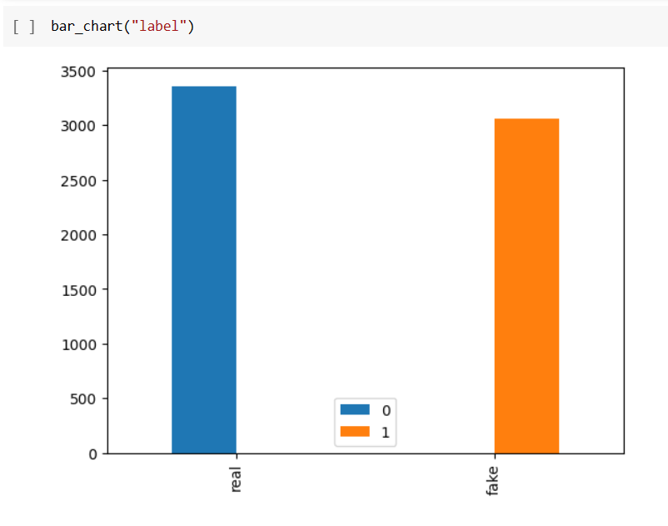
Methodology
Preprocessing and Training the model :
The dataset is simple. It contains the titles of the news, the body text and a label field, which, if the news is authentic, shows REAL and if inauthentic, shows FAKE.
Vectorization is needed for determining the frequency of the words present in a passage. This is needed to determine which words are used often.
Here, in our model we have used 5 types of classifiers: logistic regression, soft margin estimate via support vector machine, decision tree classifier, random forest ensemble and adaboost technique.
The model is built through the train and test of the dataset, by ensuring that the training is done for 90% of the dataset and testing is done in the rest of the 10% of the dataset.

Slide 11





Tech Used
ML
Python
Streamlit
Html
Css

Slide 12
Implementation
Reading the dataset into dataframe and visualization of the dataset
Data preprocessing: Removal of unnecessary columns is important for reducing redundant columns, etc.
The next part is the extraction for words. . It defines a list of stopwords, which are common words to be filtered out. The filtered words of each tweet are stored in a list.
Partitioning the data into training and testing parts
5. Application of different types of classifiers
Logistic regression
KNN Classifier
Decision tree classifier
Random Forest Ensemble
Adaboost Classifier
6. Combined result of 5 different models using pipelining.
7. Input a text or an image. Text is extracted from the image and translated to English, which is further given as an input to the stacked classifier.

Slide 13
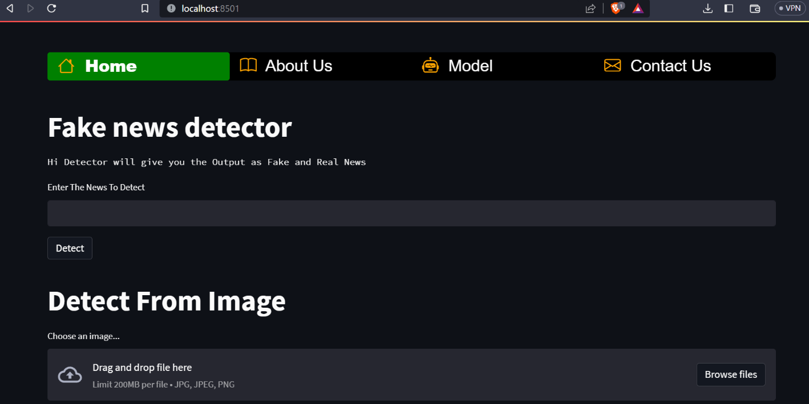
Home Page

Slide 14
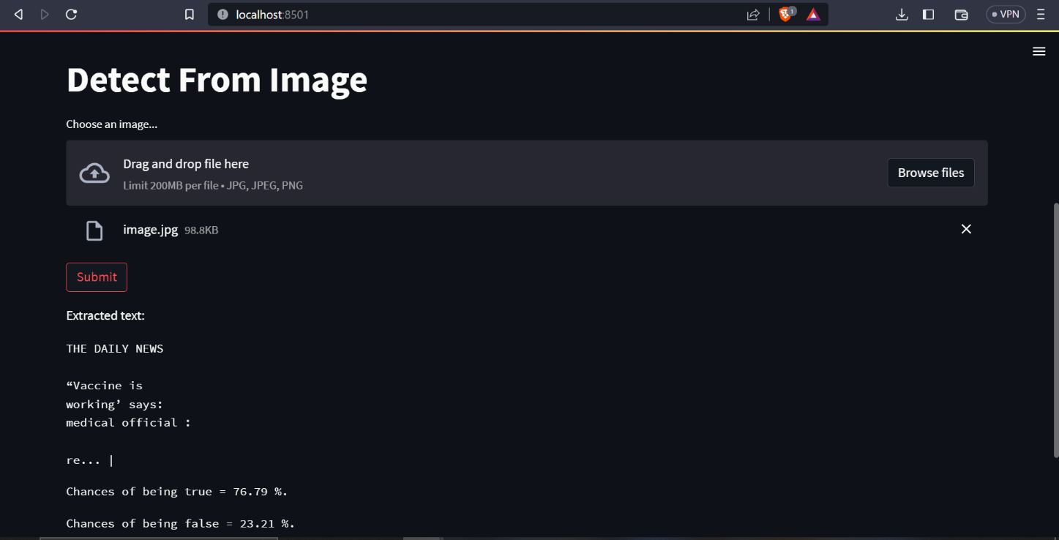
Detection using Image recognition

Slide 15

Conclusion
In this study, we employed several popular machine learning algorithms, including logistic regression, K-nearest neighbors (KNN), decision tree, random forest, and AdaBoost, as classifiers to detect fake news. The findings of this study emphasize the importance of leveraging diverse machine learning algorithms and their ensemble techniques to tackle the multifaceted nature of fake news detection. Such an approach provides a more nuanced understanding of news authenticity, enabling users to make more informed decisions about the information they consume and share.

Slide 16
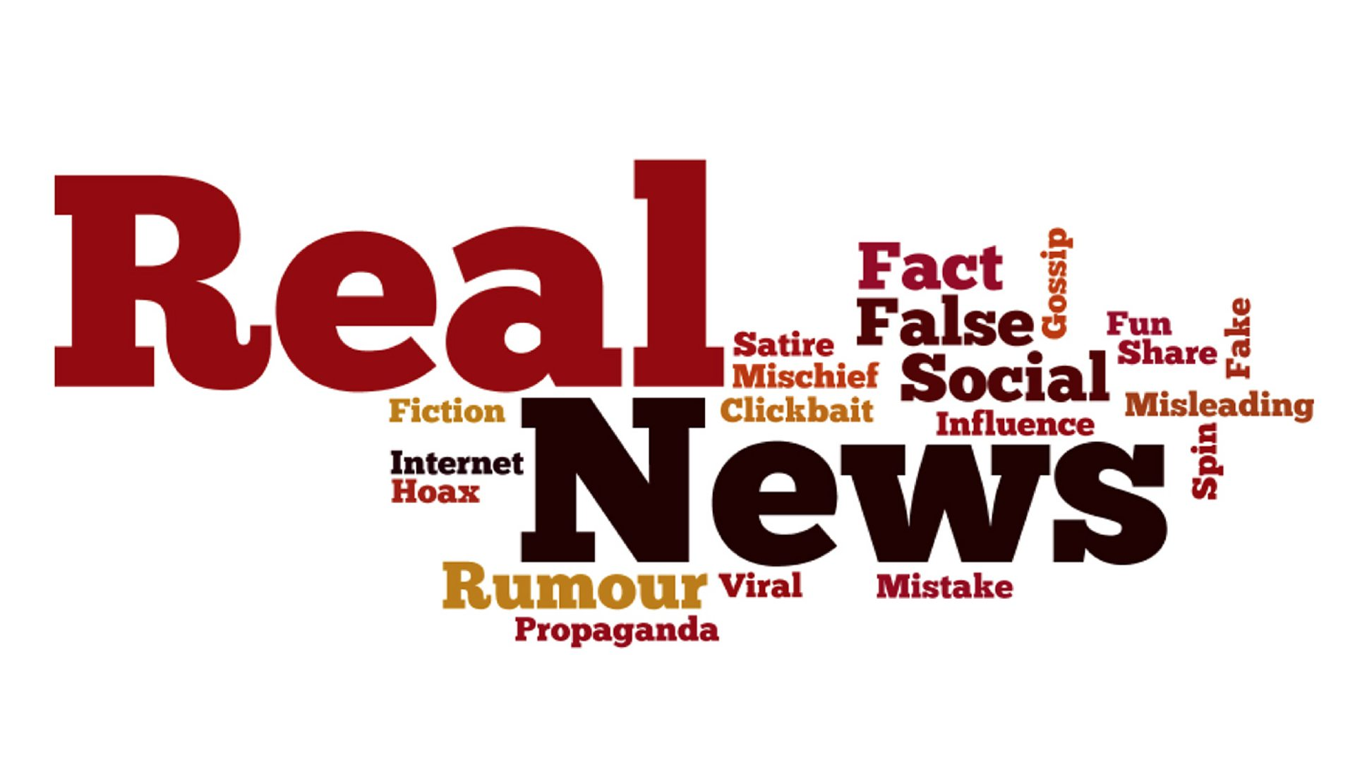

Future Scope
Multi-domain fake news detection
Despite the powerful ability of deep learning models to capture various news features, the algorithms still struggle when it comes to detecting fake news on emerging events. The model trained on past events may not perform satisfactorily due to the domain shift in news events, so new information from emergent events is required to supplement fake news detection models.
Multi-lingual fake news detection
The majority of studies to date have focused on detecting fake news in a particular language. However, a lot of the information is disseminated not just among native English speakers but also among speakers of other languages who come from other cultures.

Slide 17
References
Whitten, Bentley, and Dittman . 2004. System Analysis and Design Methods (5th ed). McGraw-Hill .
Inmei Hu , Siqi Wei , Ziwang Zhao , Bin Wu (2023), Deep learning for fake news detection: A comprehensive survey, published by sciencedirect.com.
Shu, K. , Mahudeswaran , D., Wang, S., Lee, D. H., & Liu, H. (2019). Fake News Detection on Social Media: A Data Mining Perspective. ACM Computing Surveys, 52(5), Article No. 96.
Pulido, C. M., Redondo-Sama, G. , Sordé - Martí , T. , & Flecha , R. (2020). Fake News Detection on Social Media: A Systematic Review. Telematics and Informatics, 55, Article No. 101444.
Machine learning and deep learning: Udemy, Tutorials Point.
Google Colaboratory python library features and documentation
Wikipedia For Basic Introduction of Technology and Diagrams

Slide 18
Thank You
.

