Slide 1
Detecting machine-generated code
SemEval-2026 Task 13 - same idea, honest evaluation
preset `local_real`, seed 42

Slide 2
What GPAD actually computes
CodeBERT encoder -> 1 extra block -> MLP head
Bias on pre-softmax attention scores: score_qk += sign . alpha . sigma(mean(H) - H_k)
  H_k = entropy of a LEARNED softmax over key self-similarity (not predictive entropy)
  at sign=+1 this boosts LOW-entropy keys - the opposite of the original write-up
Gated fusion of 16 z-scored stylometric features
True predictive entropy / NLL from a frozen code LM is a separate, named feature set

Slide 3
Audit of my own project, and the fixes
'Entropy' meant three different things -> one name per mechanism
No control for the extra block -> parameter-matched capacity control
Tables compared 349 vs 17,226 rows -> identical rows by id, n printed
Task B accuracy 0.64 / macro-F1 0.29 -> majority-class illusion, class-aware loss
'Entropy-only is best' from single runs -> paired bootstrap + McNemar, ties called ties
Python-only stylometry acted as a language detector -> language-agnostic features

Slide 4
Task A - human vs machine (macro-F1, 95% bootstrap CI)
model | in-distribution | official val set | unseen language
Style features + gradient boosting | 0.957 [0.933, 0.977] | 0.960 [0.936, 0.980] | 0.754 [0.703, 0.798]
Stacked ensemble | 0.963 [0.943, 0.983] | 0.957 [0.930, 0.977] | 0.747 [0.700, 0.793]
Length + whitespace only (shortcut probe) | 0.903 [0.869, 0.936] | 0.889 [0.848, 0.925] | 0.513 [0.456, 0.569]
CodeBERT fine-tune | 0.943 [0.917, 0.967] | 0.930 [0.899, 0.957] | 0.509 [0.452, 0.566]
GPAD (entropy bias + style) | 0.950 [0.923, 0.973] | 0.933 [0.903, 0.960] | 0.477 [0.421, 0.531]
GPAD with the bias switched off (control) | 0.947 [0.920, 0.970] | 0.926 [0.895, 0.953] | 0.475 [0.419, 0.527]
Majority class (floor) | 0.344 [0.320, 0.367] | 0.344 [0.320, 0.368] | 0.344 [0.320, 0.368]
Character n-grams + logistic regression | 0.840 [0.797, 0.877] | 0.846 [0.806, 0.886] | 0.341 [0.317, 0.364]
Same rows for every model. Overlapping intervals mean 'tie', not 'better'.

Slide 5
Task B - which LLM family (macro-F1, 95% bootstrap CI)
model | in-distribution | official val set | unseen generator
Stacked ensemble | 0.148 [0.093, 0.201] | 0.156 [0.108, 0.199] | 0.151 [0.094, 0.190]
Character n-grams + logistic regression | 0.144 [0.091, 0.202] | 0.096 [0.068, 0.130] | 0.125 [0.088, 0.159]
Majority class (floor) | 0.085 [0.083, 0.087] | 0.085 [0.084, 0.087] | 0.087 [0.086, 0.089]
GPAD, entropy only | 0.099 [0.085, 0.115] | 0.089 [0.080, 0.102] | 0.085 [0.082, 0.086]
CodeBERT, class-weighted loss | 0.092 [0.082, 0.104] | 0.087 [0.078, 0.098] | 0.082 [0.080, 0.085]
Same rows for every model. Overlapping intervals mean 'tie', not 'better'.

Slide 6
Controlled ablation: does the mechanism beat its own control?
comparison | split | n | macro-F1 diff [95% CI] | verdict
gpad - control | in-distribution | 300 | +0.003 [+0.000, +0.010] | tie
gpad - control | official val set | 300 | +0.007 [+0.000, +0.017] | tie
gpad - control | unseen language | 300 | +0.002 [-0.013, +0.020] | tie
gpad - codebert | in-distribution | 300 | +0.007 [-0.007, +0.020] | tie
gpad - codebert | official val set | 300 | +0.003 [+0.000, +0.010] | tie
gpad - codebert | unseen language | 300 | -0.032 [-0.065, -0.000] | significant
tfidf_lr - length_only | in-distribution | 300 | -0.063 [-0.113, -0.018] | significant
tfidf_lr - length_only | official val set | 300 | -0.043 [-0.089, +0.004] | tie
tfidf_lr - length_only | unseen language | 300 | -0.172 [-0.221, -0.117] | significant
Decision rule: GPAD - control CI must exclude 0 on an OOD split. Outcome: no_gain_beyond_capacity.

Slide 7
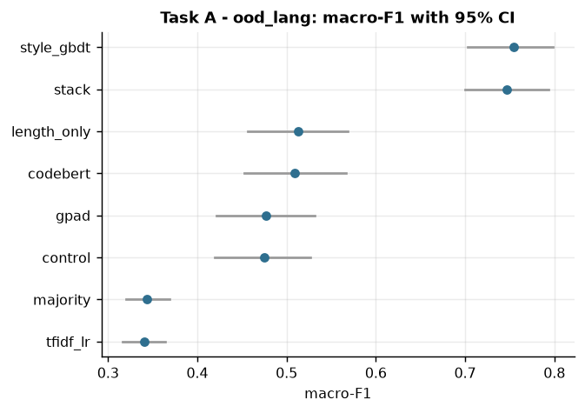
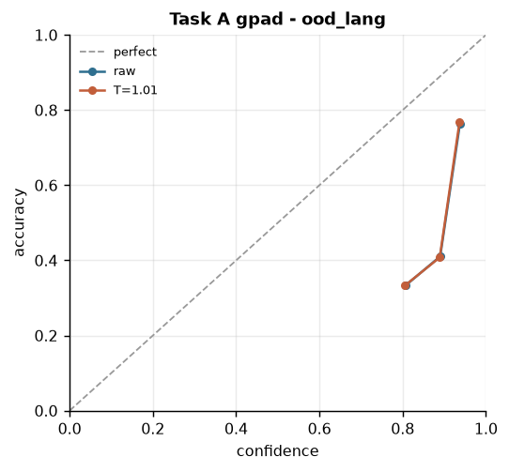
Shortcut learning and calibration under shift
A length/whitespace-only regression scores 0.903 in-distribution and 0.513 on the held-out language. The gap to the transformer is how much of the task is about authorship rather than formatting.

Slide 8
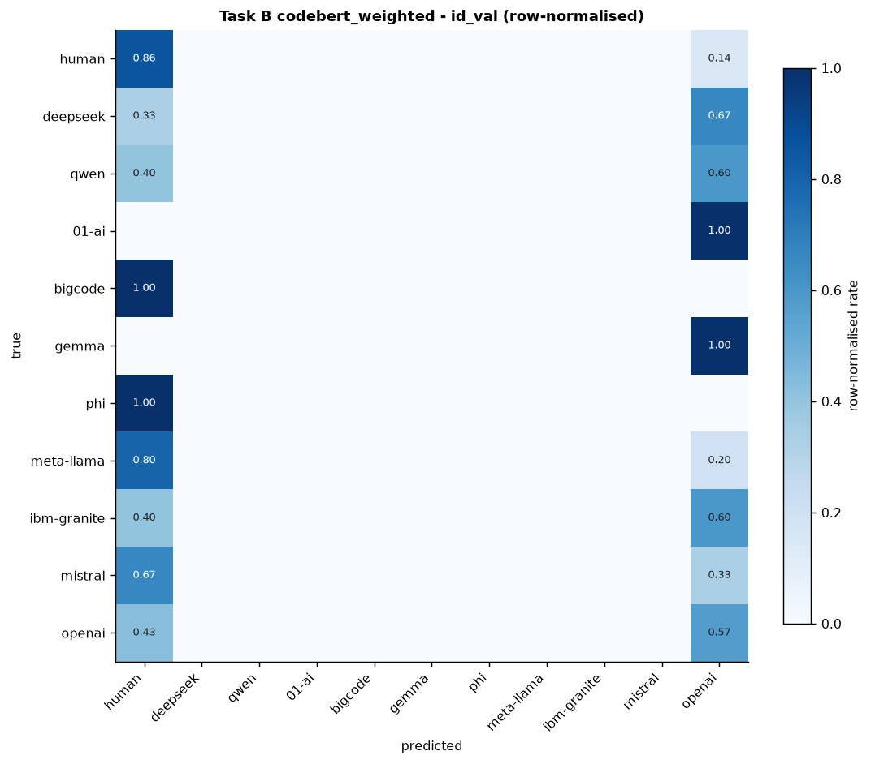
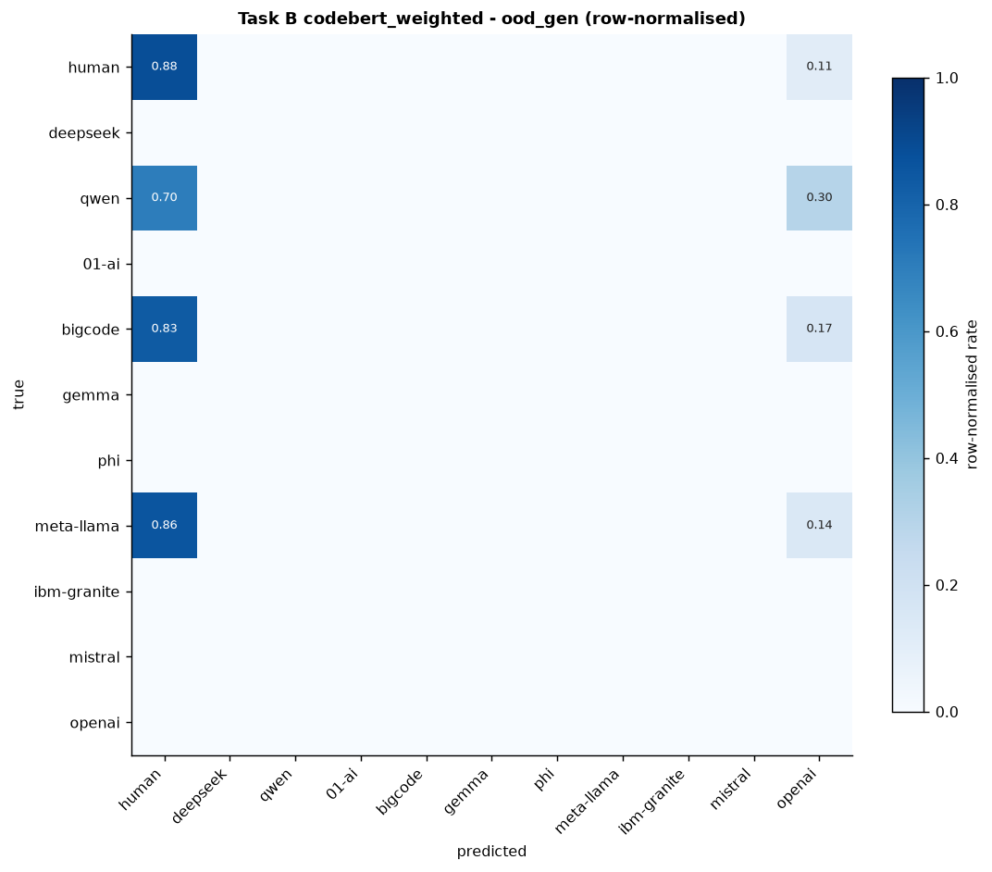
Task B is an imbalance problem
Macro-F1 next to accuracy; the majority-class baseline is on the results slide.

Slide 9
Serving cost
model | params total/trainable | device/precision | p50 ms | p95 ms
CodeBERT fine-tune | 83.7M / 83.7M | cpu/fp32 | 357.3 | 554.8
CodeBERT fine-tune | 83.7M / 83.7M | cpu/int8_dynamic | 138.2 | 331.8
GPAD with the bias switched off (control) | 90.8M / 90.8M | cpu/fp32 | 333.1 | 408.8
GPAD with the bias switched off (control) | 90.8M / 90.8M | cpu/int8_dynamic | 168.1 | 284.0
GPAD (entropy bias + style) | 91.4M / 91.4M | cpu/fp32 | 327.6 | 661.7
GPAD (entropy bias + style) | 91.4M / 91.4M | cpu/int8_dynamic | 169.2 | 394.5
CodeBERT + LoRA | 83.8M / 0.4M | cpu/fp32 | 466.7 | 617.1

Slide 10
Original competition-time results (not re-validated)
Task A macro-F1 reported in 2025: 0.9731 baseline -> 0.9957 GPAD-2 (seen/seen)
  unseen language 0.5676 -> 0.7268; unseen/unseen 0.5606 -> 0.6538
Task B macro-F1: 0.29 baseline, 0.34 entropy-only, 0.20 style-only
Measured before the fixes on the audit slide: different row counts, no control, no CIs
Kept here for honesty, not comparison - see docs/dev/ORIGINAL_RESULTS.md

Slide 11
What I would do next
Full data, multiple seeds, the lite preset on a GPU session
Larger code LM for the entropy features; the true Binoculars ratio with a second model
Domain-adversarial training against the language shortcut
Open-set rejection for Task B so an unseen generator can answer 'unknown'
Distillation + ONNX export, and re-measurement whenever a new model family ships

