Slide 1

BUILDING A WEBRTC VIDEO CHAT APPLICATION
Presented to:
Dr. Narendra Kumar
SOC-IT
Presented by:
Ranjan Kumar
Aman Bhardwaj

Slide 2





Proposed Work
To establish browser to browser video
and audio communication using
WebRTC and Implement this
in android application.

Slide 3





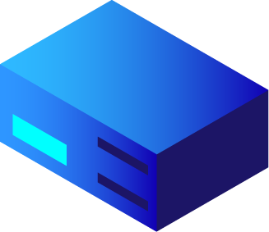



Requirements
Systems with web browser supporting WebRTC
Internet connection
Platform for executing Node.js and JavaScript codes.
4 GB of RAM
At least 50 GB of free hard disk space
64-bit Intel processor with two CPU cores
Android Studio
Firebase

Slide 4
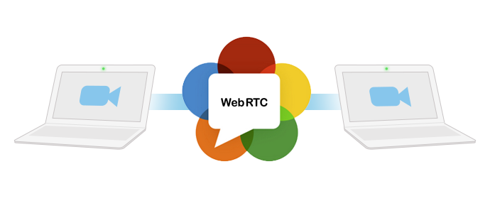
What is WebRTC?
With Web Real-Time Communication (WebRTC), modern web applications can easily stream audio and video content to millions of people. WebRTC is a powerful tool that can be used to infuse Real-Time Communications (RTC) capabilities into browsers and mobile applications.
We use WebRTC to set up peer-to-peer connections to other web browsers quickly and easily.

Slide 5
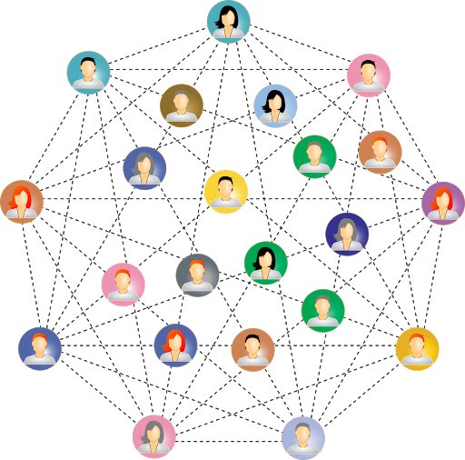
Peer to Peer Communication
Stands for "Peer to Peer." In a P2P network, the "peers" are computer systems which are connected to each other via the Internet. Files can be shared directly between systems on the network without the need of a central server. In other words, each computer on a P2P network becomes a file server as well as a client.
The only requirements for a computer to join a peer-to-peer network are an Internet connection and P2P software.

Slide 6
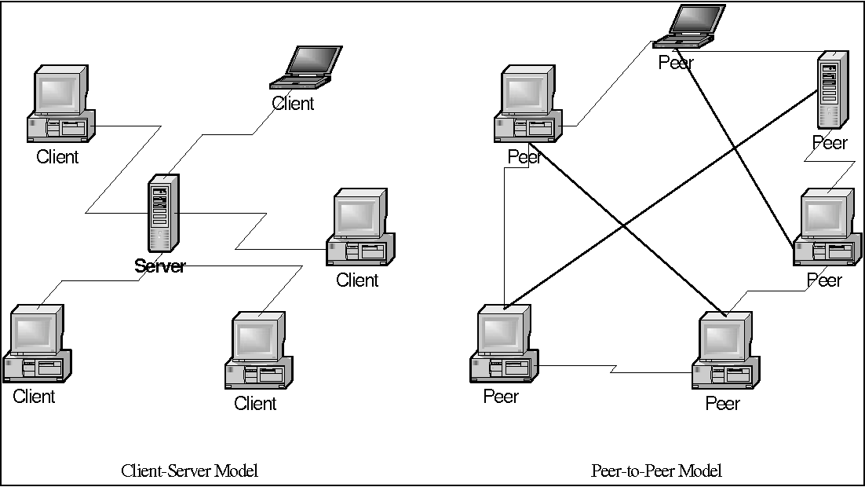

Slide 7
Advantages of WebRTC
It's free
Platform and device independence
Secure voice and video
Advanced voice and video quality
Reliable session establishment
Multiple media streams
Adaptive to network conditions
Rapid application development

Slide 8
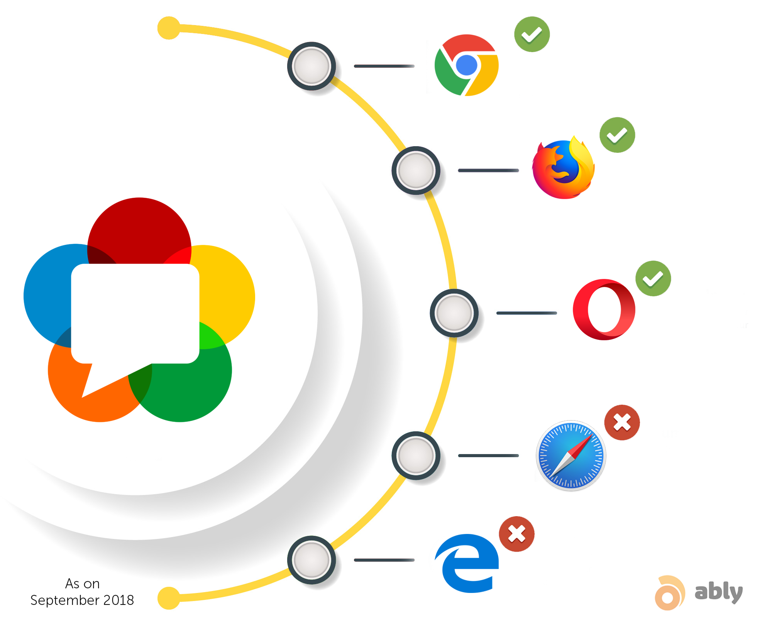
Browsers supporting webRTC

Slide 9
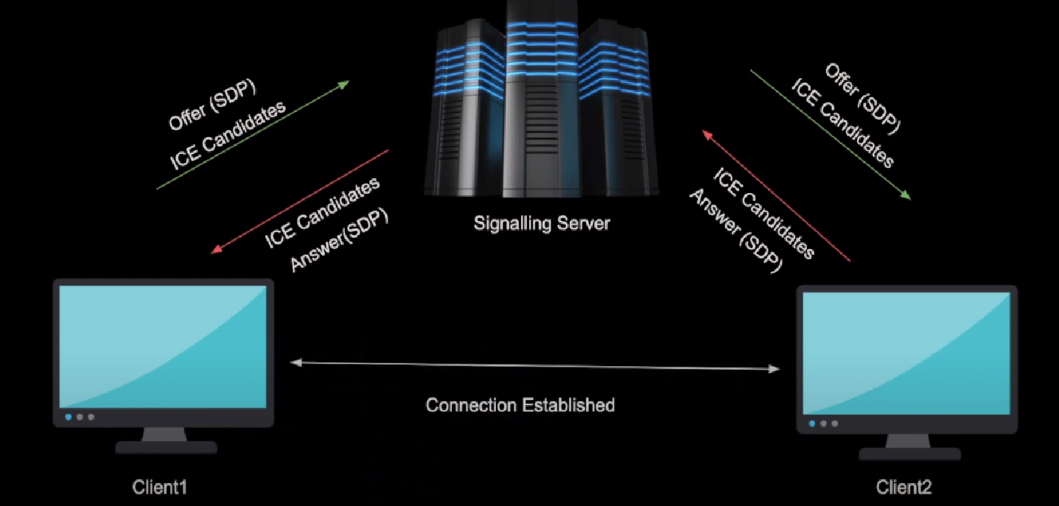
How WebRTC Works ?

Slide 10
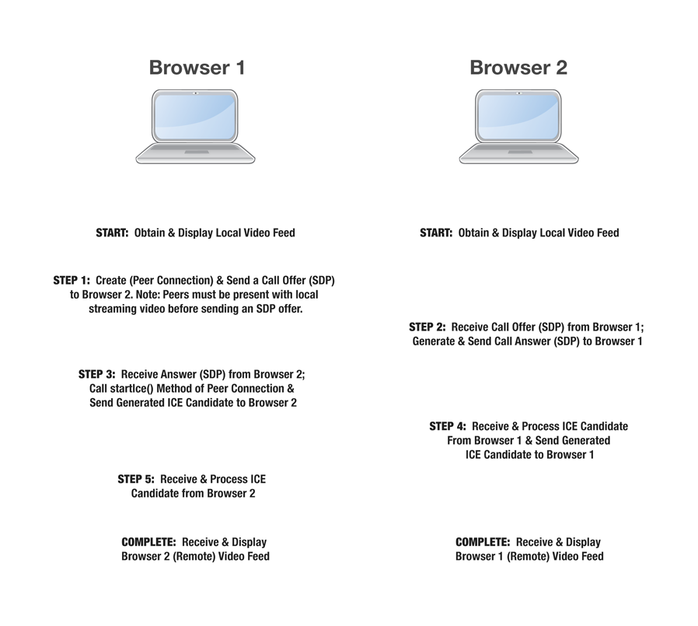

Slide 11
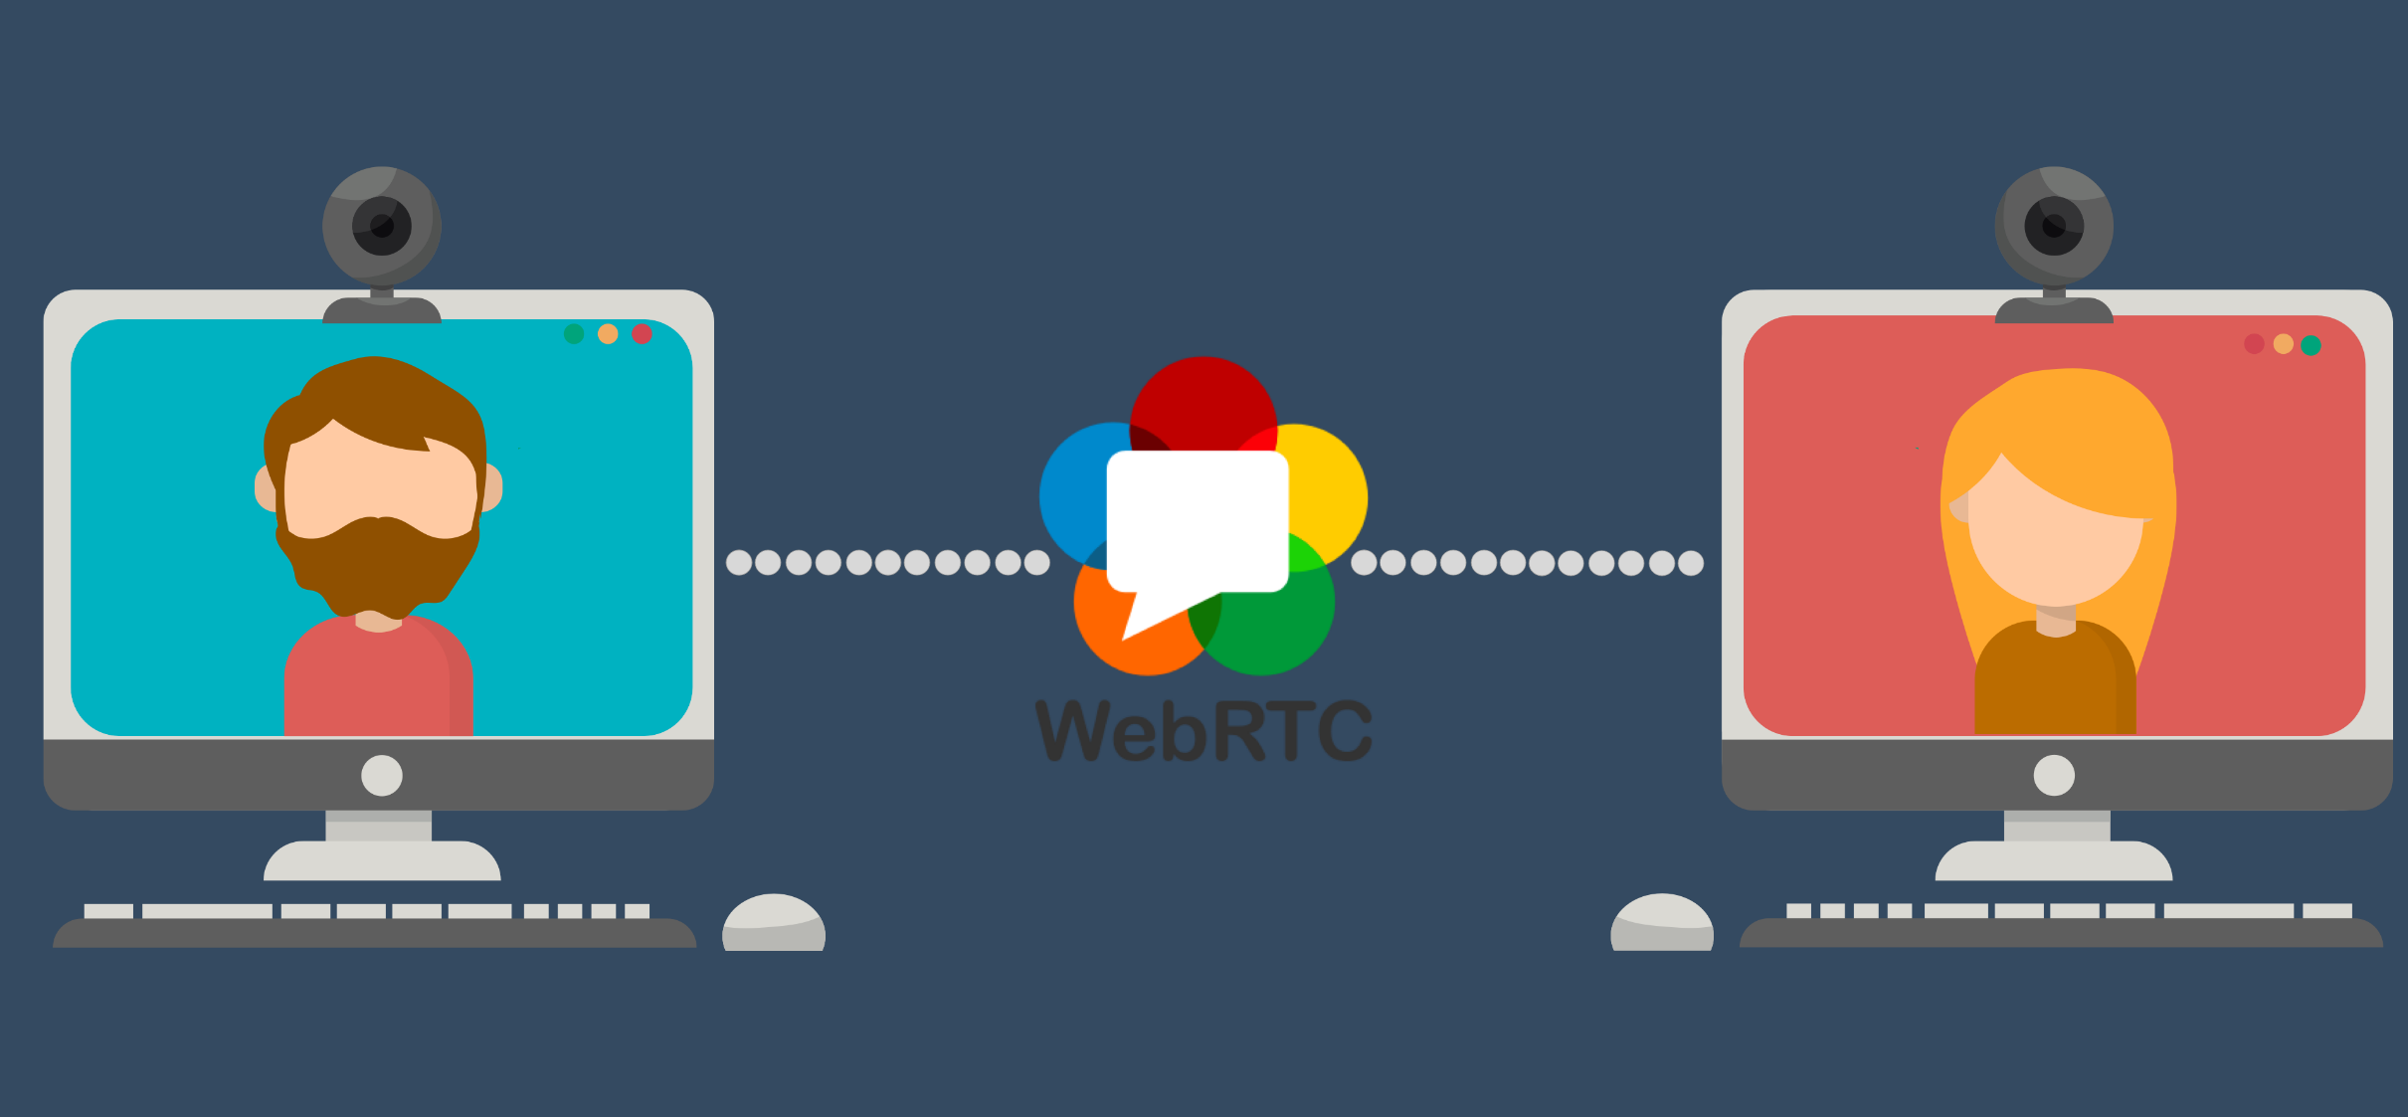
Expected Result
We expect to be able establish video calling feature from browser to browser over internet without using a third-party application.

Slide 12

Some applications using WebRTC
1. Google Meet and Google Hangouts
2. Facebook Messenger
3. Discord
4. Zoom
5. Microsoft Teams

Slide 13
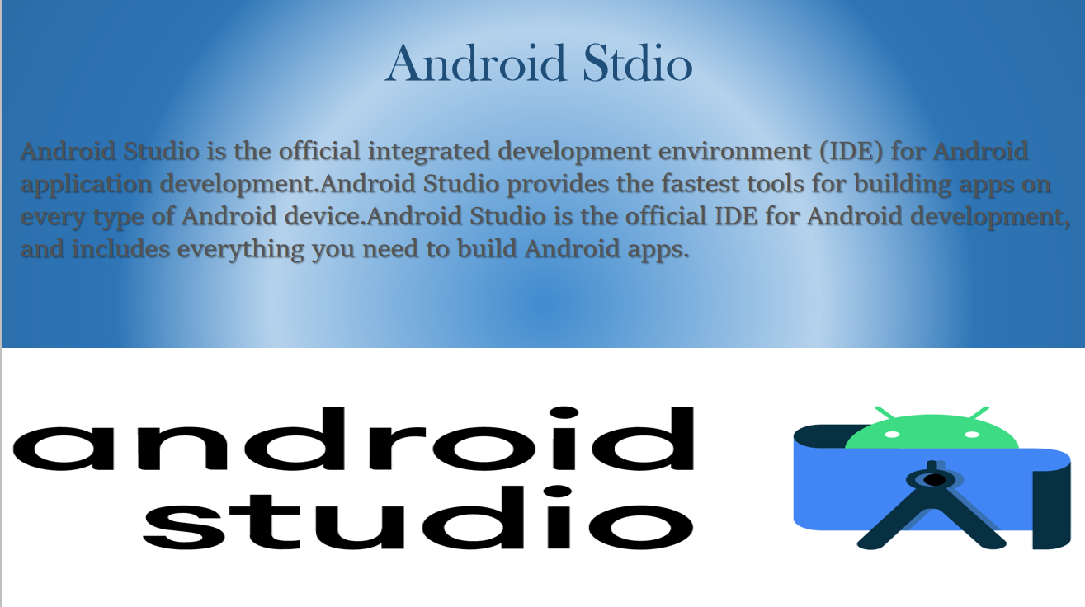

Slide 14
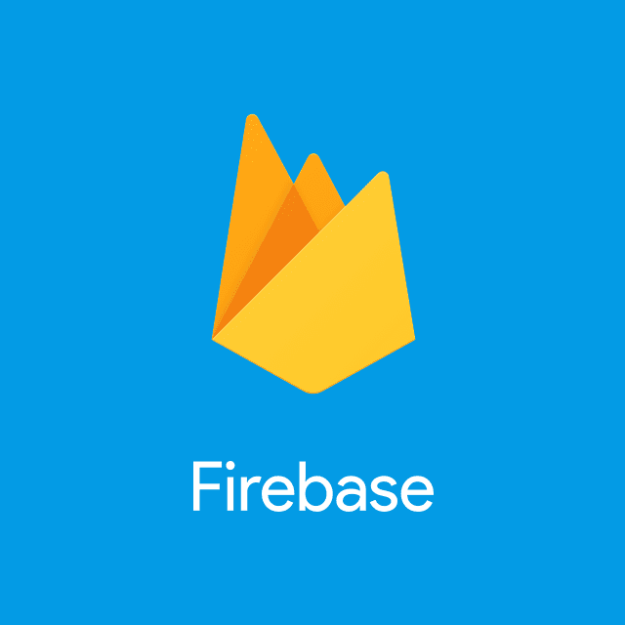
Firebase
Firebase is a Backend-as-a-Service (Baas).
It provides developers with a variety of tools and services to help them develop quality apps, grow their user base, and earn profit.
It is built on Google's infrastructure. Firebase is categorized as a NoSQL database program, which stores data in JSON-like documents.

Slide 15

create android stdio project

Slide 16
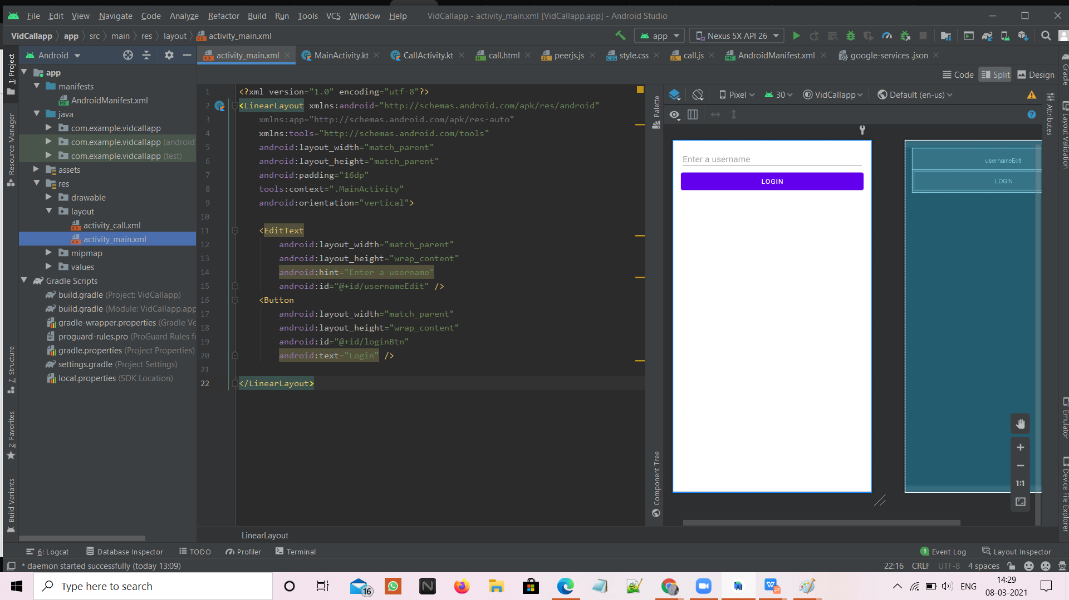
Login Page

Slide 17
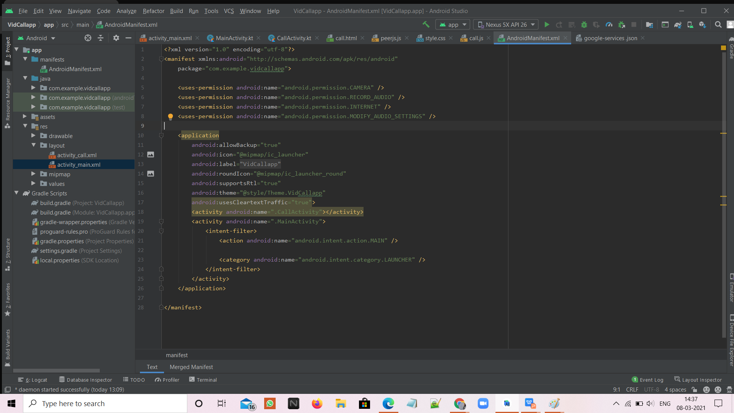
Permissions Required

Slide 18
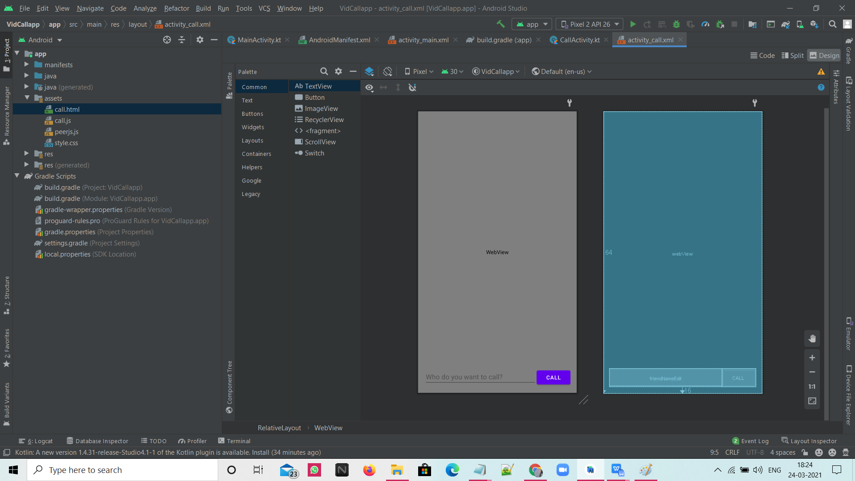
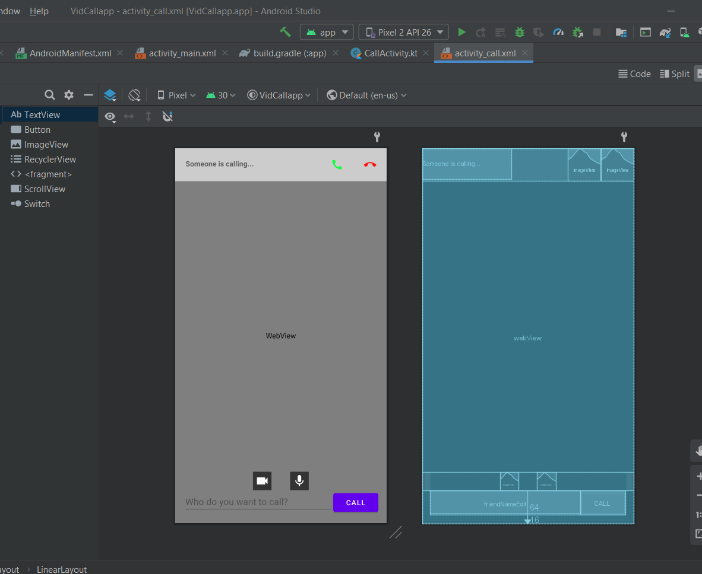
After Login Page

Slide 19

Thank you!
Suggestions and feedbacks are welcomed.

