Slide 1
TIOR GAMES CASE STUDY
The objective is to analyze the accessible data and propose strategies for Tior Gaming to enhance both player and spectator experiences
UP2301022
Masters in Artificial Intelligence & Machine Learning (MSc AI&ML)
Part Time, 2024-2025
M33878 BUSINESS INTELLIGENCE (BI) Coursework Item 1

Slide 2
Question 1
Compose and execute six T-SQL queries. In the slide presentation, include the code for each query
Video Link - https://drive.google.com/file/d/1kZfyjG0G9W-J0LxmBpzeANcdIgsbjAct/view?usp=drive_link

Slide 3
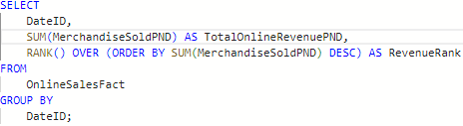
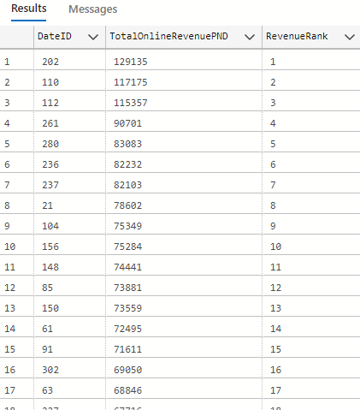
Query 1 Top Revenue Generating Games This Year
Business Rationale:
Identifies peak online sales dates to guide future marketing and logistics planning. Helps in determining optimal promotional periods and ensuring adequate server infrastructure and stock during those times.

Slide 4
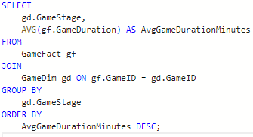
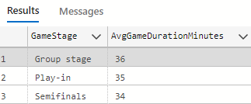
Query 2 Longest Average Game Duration by Game Stage (AVG + GROUP BY)
Business Rationale:
Helps developers optimize pacing by understanding how game stages affect duration. This aids in designing engaging and balanced gameplay that aligns with user expectations and attention spans.

Slide 5
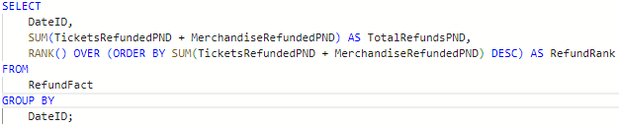
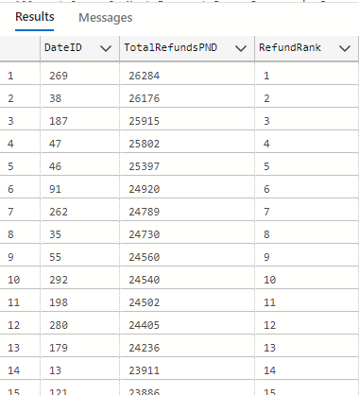
Query 3 Top Dates by Refund Volume (SUM + RANK)
Business Rationale:
Pinpoints dates with high refund volume to investigate causes and mitigate future loss. Helps identify operational, customer service, or quality issues linked to specific campaigns or events.

Slide 6
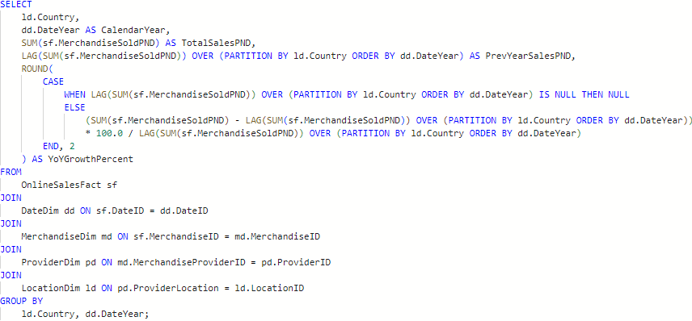
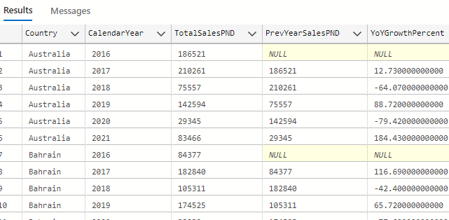
Query 4 Year-over-Year (YoY) Growth in Online Merchandise Sales by Country
Business Rationale:
Measure country-wise year-over-year (YoY) growth in online merchandise sales.

Slide 7
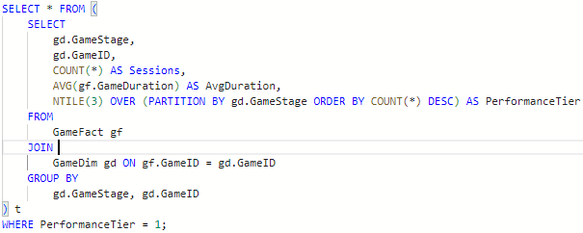
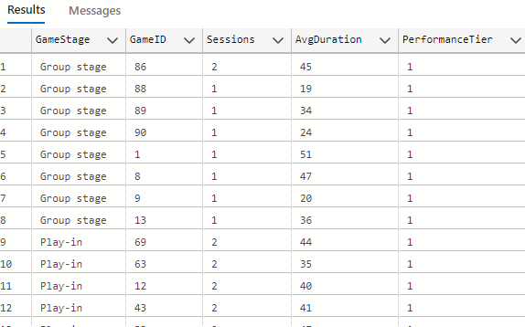
Query 5 Top-performing games within each game stage
Business Rationale:
Identifies the top-performing games within each game stage based on the number of sessions. It also provides the average duration of gameplay for each title.

Slide 8
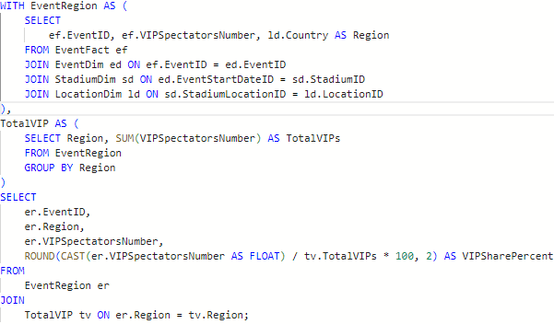
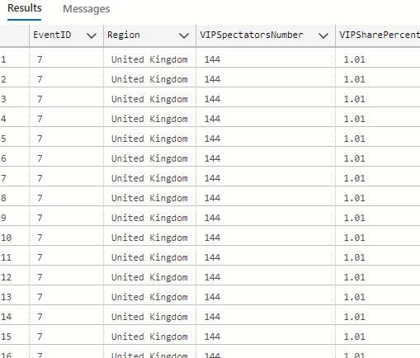
Query 6 VIP Attendance Share by Event Region
Business Rationale:
Calculate VIP engagement as a percentage by region. Enhance elite gamer/event targeting strategies. OLAP ratio calculation. Regional grouping via LocationDim.

Slide 9
Question 2
Revise the given schema and propose a minimum of two additional dimensions that would yield valuable insights.

Slide 10
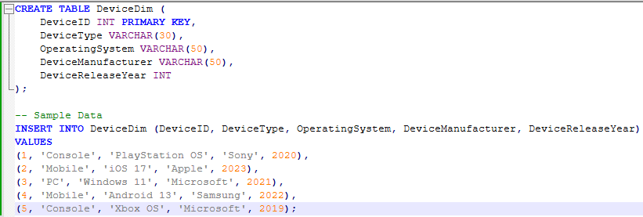
Dimension 1: DeviceDim
Justification:
Understanding player behavior by device type helps optimize game performance, user experience, and targeted promotions.

Slide 11
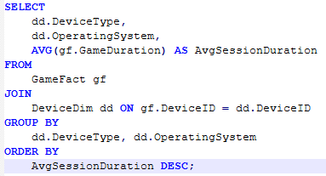
Query Average Game Duration by Device Type
Business Rationale:
Helps Tior Games understand which devices lead to longer gameplay sessions. This can inform optimization for specific platforms (e.g., PC vs. Mobile vs. Console)..

Slide 12
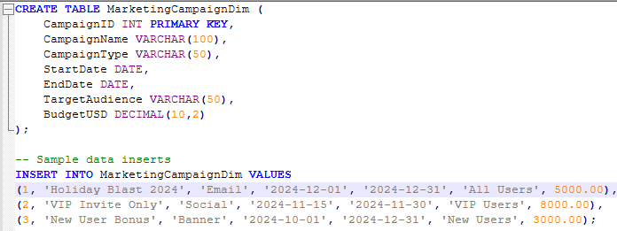
Dimension 2: DemographicsDim
Justification:
Enables segmentation and targeted engagement by analyzing player demographics such as age and region..

Slide 13
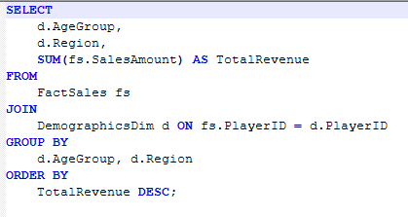
Query Revenue by Age Group and Region
Business Rationale:
Allows marketing and monetization teams to identify the most lucrative demographic segments for targeted campaigns and region-specific strategies.

Slide 14
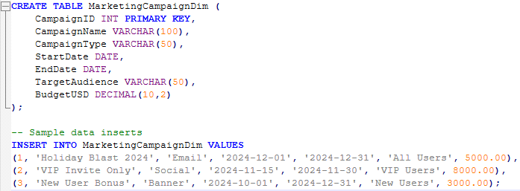
Dimension 3: MarketingCampaignDim
Justification:
Tracking the impact of different marketing campaigns enables Tior Games to measure campaign ROI, adjust budgets dynamically, and personalize promotions based on successful patterns.

Slide 15
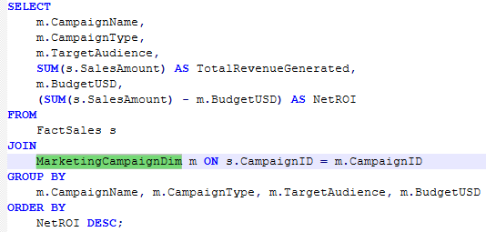
Query Revenue Performance by Campaign
Business Rationale:
Shows which campaigns drove the highest net returns, enabling smarter marketing spend and customer targeting.

Slide 16
Question 3
Utilize the provided data warehouse to formulate ONE T-SQL query answering the following questions:
a. Determine the online item that experienced the most unexpected sales in Japan and identify the corresponding year.
b. Identify the online item with the least unexpected sales when considering all countries and years. Specify the country and exact year for this occurrence

Slide 17
Based on the provided data dictionary, we can assume that unexpected sales can be interpreted as sales that significantly deviate from the stocked amount. A practical approach is to consider the absolute difference between the number of items stocked and sold as a proxy for unexpectedness.
Logical Interpretation:
Unexpected Sales = ABS(MerchandiseSold - MerchandiseStocked)
The most unexpected is the maximum value of this absolute difference.
The least unexpected is the minimum value.
We'll use the OnlineSalesFact, MerchandiseDim, and LocationDim (via ProviderDim) tables to identify:
The merchandise item (MerchandiseID)
The country (Country from LocationDim)
The year (DateYear from DateDim)

Slide 18
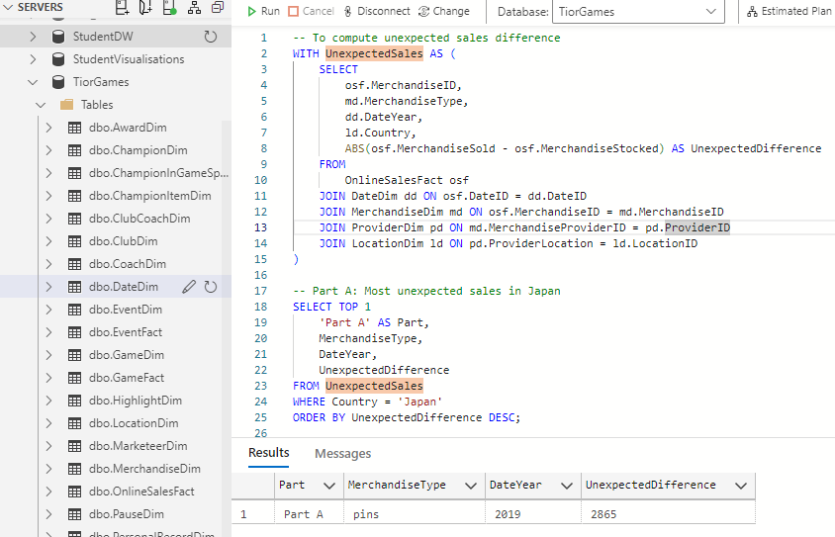
Part A: Most unexpected sales in Japan

Slide 19
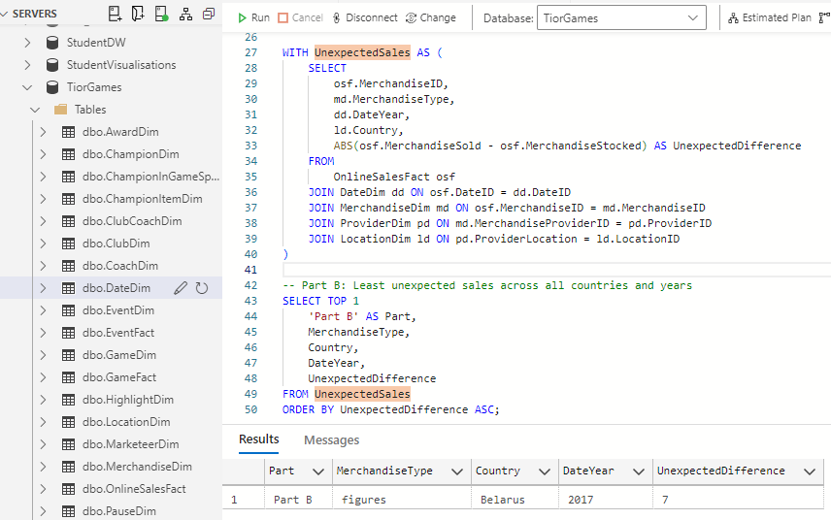
Part B: Least unexpected sales across all countries and years

Slide 20
Question 4
External dataset integration.
Based on the data warehouse provided. You are tasked to identify and describe the rationale of an external dataset or identify a real company that their data would be able to complement Tior Games data warehouse.

Slide 21
Enhancing Tior Games data Warehouse With Streaming Platform Integration
Executive Summary
Objective: Augment Tior Games' analytics capabilities by integrating data from external streaming platforms (e.g. taken, YouTube Gaming).
Why it matters: Streaming platforms directly influence gamer trends, in-game purchases, and event popularity.
Key Outcome: Improved decision-making in marketing, product development, and event planning.

Slide 22
To enhance insights into player behavior and marketing effectiveness, we propose integrating streaming engagement data from platforms like YouTube Gaming.
Proposed External Dataset – YouTube Gaming (by Google)
Current Data Warehouse Strengths
In-game transactions, player behaviours, merchandise, and event metrics captured.
Comprehensive dimensional model: PlayerDim, ChampionDim, DateDim, PromotionDim, etc.
Supports operational and strategic insights.

Slide 23
Rationale for Selection / Benefits of Integration / Relevance to Tior Games
Tior Games Area | Streaming Data Adds Value / Benefits
Champion/Item Popularity | Track which items/champions are trending via streams
Promotion Effectiveness | Correlate in-game promo periods with viewer spikes.
Event Planning | Use peak engagement metrics to schedule and hype events.
Regional Analysis | Map viewer origins to match LocationDim trends.
Iinfluencer ROI | Evaluate which streamers drive actual in-game actions.

Slide 24
New Schema Elements / Dimensions / Integrations
Table Name | Type | Description
StreamingMetricsFact | Fact Table | Contains measurable, quantitative streaming data (e.g., views, watch time, revenue).
StreamingEventDim | Dimension | Contains metadata about the streaming event (e.g., event name, type, location).
DateDim | Dimension | Calendar information (e.g., date, month, year, week number).
ChampionDim | Dimension | Details about the champion(s) featured in the stream (e.g., name, rank, nationality).
PromotionDim | Dimension | Metadata on promotions or marketing tied to the event (e.g., campaign name, discount rate).

Slide 25
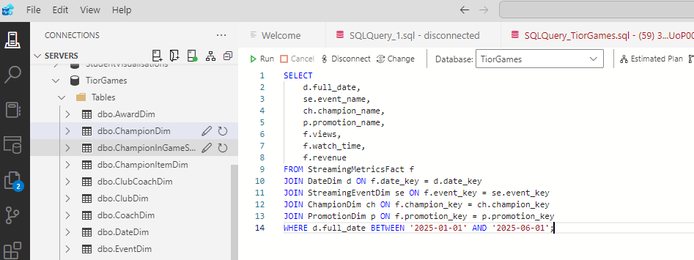
This query retrieves performance metrics for streaming events, enriched with descriptive details about event, date, champion, and promotion, but only for events that occurred between January 1, 2025, and June 1, 2025.
+--------------+ +--------------------+ +---------------+
| Streaming | | StreamingMetrics | | Champion |
| EventDim |<--->| Fact Table |<--->| Dim |
| (event_key) | | (FKs + measures) | | (champion_key)|
+--------------+ +--------------------+ +---------------+
^ ^
| |
+-----------+-----------+
| |
+---------+ +--------------+
| DateDim | | PromotionDim |
| (date_ | | (promotion_ |
| key) | | key) |
+---------+ +--------------+

Slide 26
Challenges & Mitigation
Challenge | Solution
Data Format | Use ETL pipelines to transform JSON to SQL
Naming Inconsistencies | Champion alias mapping table
API Rate Limits | Schedule batch fetches, implement retries
Data Volume | Use incremental loads & cloud storage
Conclusion
Integrating streaming platform data positions Tior Games for more data-driven, real-time decision-making.
Boosts marketing ROI, enhances player engagement strategies, and strengthens competitive edge.

Slide 27

Thank you for listening
Questions ?

