Slide 1


Personal Space
Where worlds collide

Slide 2
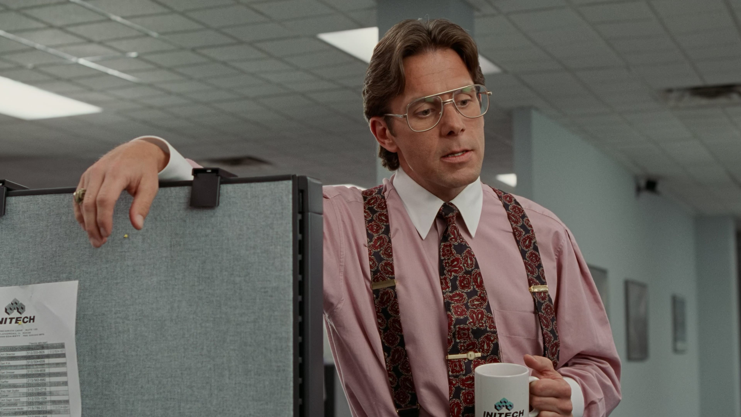
Your manager
You’re not visible enough.
But I’m full-time billable at a client!
That’s what I said, you’re never here

Slide 3






Bringing worlds together
Sales Decks
Client Space
Capgemini Space
Our App
MS Teams
MS Teams
Your Space

