Slide 1
AgentOllama
Enterprise Agentic & RAG Use Cases

Slide 2
Benefits of Agentic & RAG in Business Applications
Boost User Productivity
Assist users in accomplishing tasks faster and more efficiently.
Automate Repetitive Work
Eliminate manual, tedious tasks to reduce workload.
Enable Intelligent Assistance
Provide contextual recommendations and proactive support.
Enhance Decision-Making
Use real-time data insights to drive better business outcomes.
Optimize Workflows
Streamline operations by integrating AI-driven automation.
Foster Innovation
Free up time for users to focus on creative and strategic initiatives

Slide 3
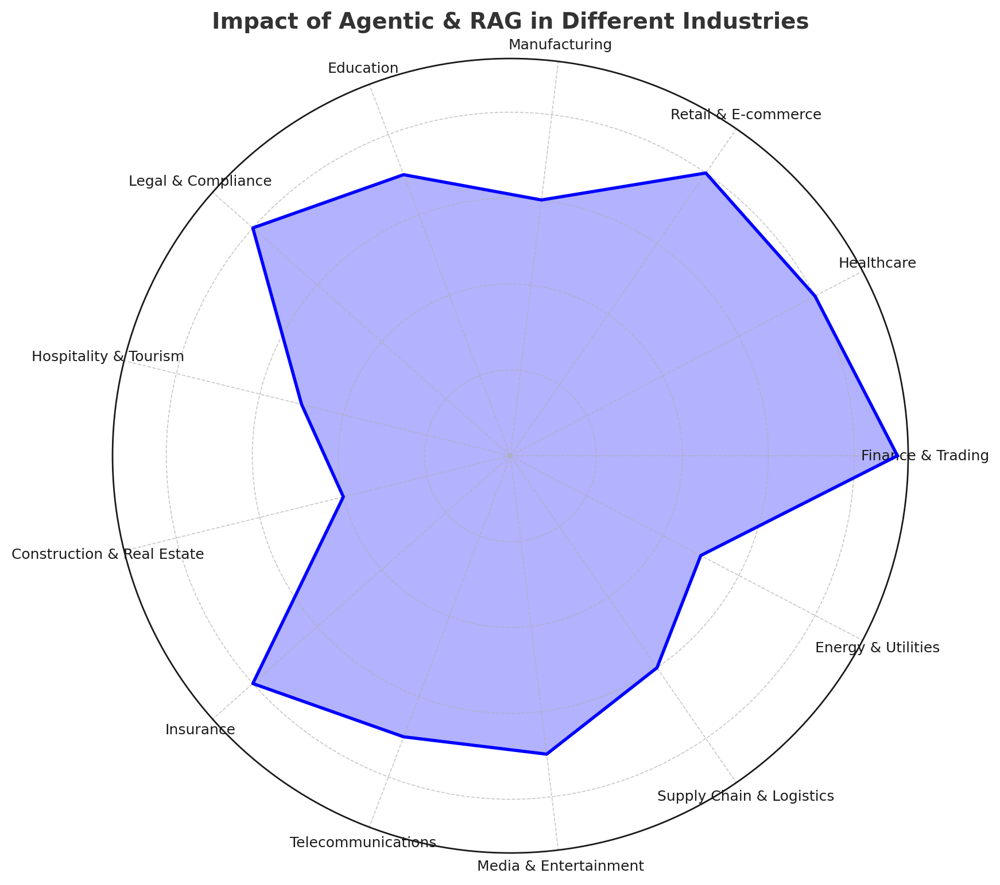
Industry Impact of Agentic & RAG Application
High-Impact Sectors
Finance, Insurance, Healthcare, and Legal industries benefit the most due to AI-driven automation, risk analysis, and decision support.
Retail & E-commerce leverage AI for personalized recommendations and customer engagement.
Moderate-Impact Sectors
Manufacturing & Supply Chain optimize processes using AI-powered predictive analytics.
Education & Telecommunications improve learning experiences and customer interactions.
Lower-Impact Sectors
Construction, Hospitality & Energy

Slide 4
Agentic Application Architecture & Integration
Client Business Application
Reusable Agentic/RAG/Tool Service App
AI/LLM Opensource Private Models
App
Agent
Model
App
App
Agent
Agent
Model
Model

Slide 5
Use case – Assisting Health Insurance Claim Process
POC on Assisting Health Insurance Claim Processing
Extracts and verifies claim details from medical documents.
Reduces manual effort and speeds up approvals.
Detects fraudulent claims using AI-powered anomaly detection.
Retrieves relevant policies and guidelines for quick reference.
Provides real-time claim status updates to customers.
Ensures compliance with insurance regulations and reduces disputes.
Integrates with existing claim management systems for seamless processing.
Accelerates verification, reducing settlement time.

Slide 6
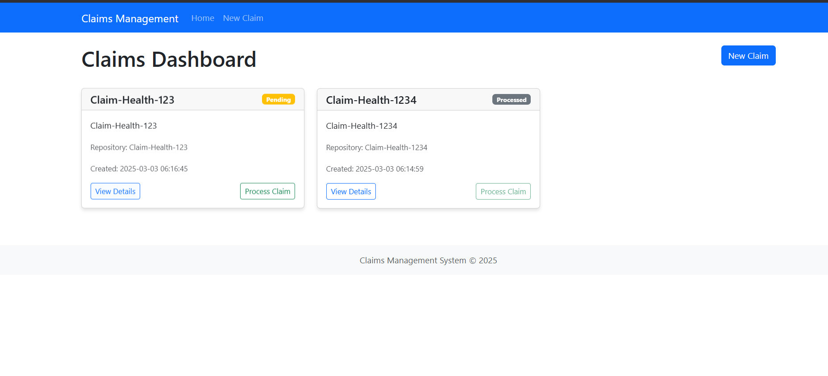
Client App – Landing Page with Healthcare Insurance Claims
Use case – Assisting Health Insurance Claim Process(Cont)

Slide 7
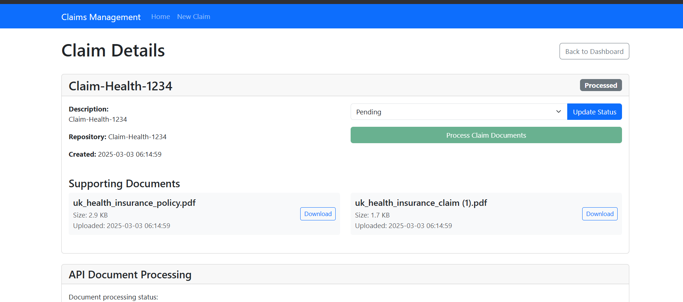
Client App – Claim documents being processed by AI
Use case – Assisting Health Insurance Claim Process(Cont)

Slide 8
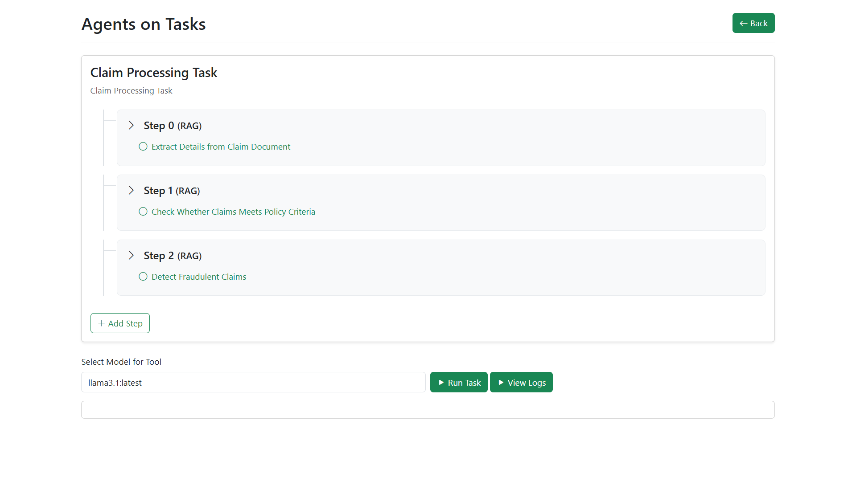
Agentic/RAG Service App – Triggered by Client Application, having multiple AI steps
Use case – Assisting Health Insurance Claim Process(Cont)

Slide 9
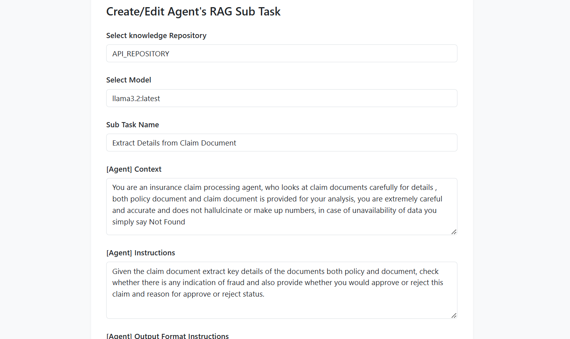
Agentic/RAG Service App – Configure Prompts for each step within a task
Use case – Assisting Health Insurance Claim Process(Cont)

Slide 10
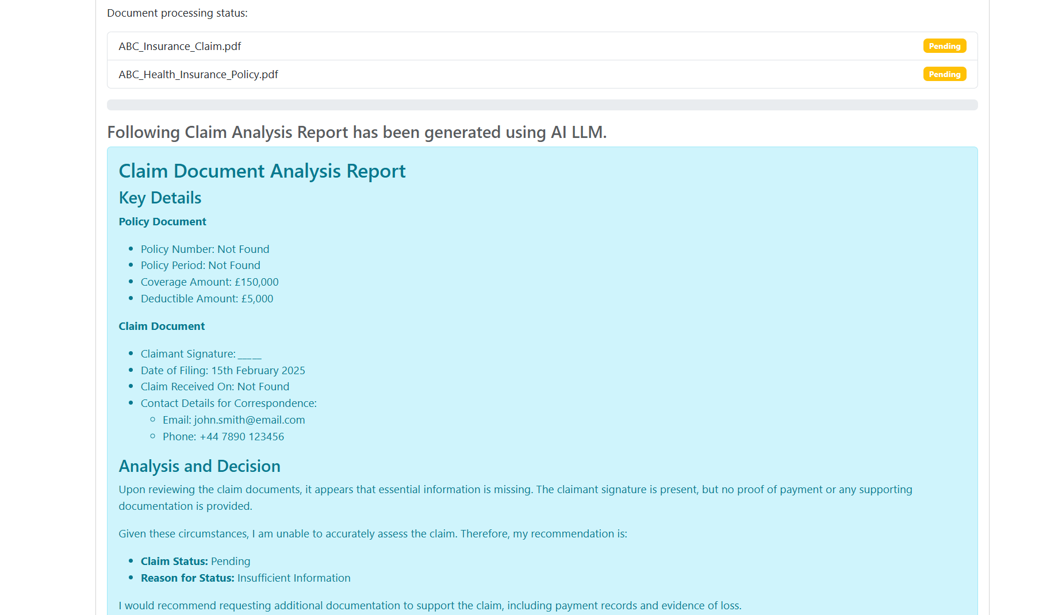
Client App – AI Generated Claim Analysis Report for quicker decision making
Use case – Assisting Health Insurance Claim Process(Cont)

Slide 11
More Use Cases
More use cases can be built in these high impact sectors, showcasing AI LLM Capabilities.
Insurance
Finance
E-Commerce/Retail
Health
Insurance is ideal for Agentic & RAG use cases due to its document-heavy, complex decision-making processes, need for fraud detection, regulatory compliance, and high demand for automation to enhance efficiency and customer experience
Finance is ideal for Agentic & RAG use cases due to its high-volume transactions, real-time risk analysis, fraud detection needs, regulatory compliance requirements, and demand for automation in trading, loan approvals, and customer service.
E-commerce & Retail are ideal for Agentic & RAG use cases due to their need for personalized recommendations, dynamic pricing, inventory optimization, fraud detection, automated customer support, and efficient order fulfillment.
Healthcare is ideal for Agentic & RAG use cases due to its need for automated medical record analysis, diagnosis assistance, personalized treatment plans, insurance claim processing, regulatory compliance, and patient support.

