Slide 1

Final project presentation on
An Adaptive Overcurrent Protection Scheme for
Dual-Setting Directional Recloser and Fuse Coordination
in Unbalanced Distribution Networks With Distributed Generation
Jhala Nath Kafle
Master’s Degree in Power System Engineering
Pulchowk Campus, Institute of Engineering
October 2026
▲
Department of Electrical Engineering
Pulchowk Campus, Institute of Engineering
Tribhuvan University
●
1/30
Notes:
Good afternoon. I am Jhala Nath Kafle, roll number 081MSPSE009. My project is an adaptive overcurrent protection scheme for dual-setting directional recloser and fuse coordination in distribution networks with distributed generation, implemented on the IEEE 13-node feeder in DIgSILENT PowerFactory.

Slide 2
Presentation Outline
1. Introduction
Background and problem
2. Objectives
General and specific
3. Scope
What the study covers
4. Methodology
Method, model and settings
5. Results
Coordination, time domain, DG penetration
6. Conclusions
Findings and future work
7. References
Sources used
8. Appendix
Comparison with the reference paper
2/30
Notes:
I will cover the introduction, objectives, scope, methodology, results, conclusions and references. The comparison with the reference paper is in the appendix.

Slide 3
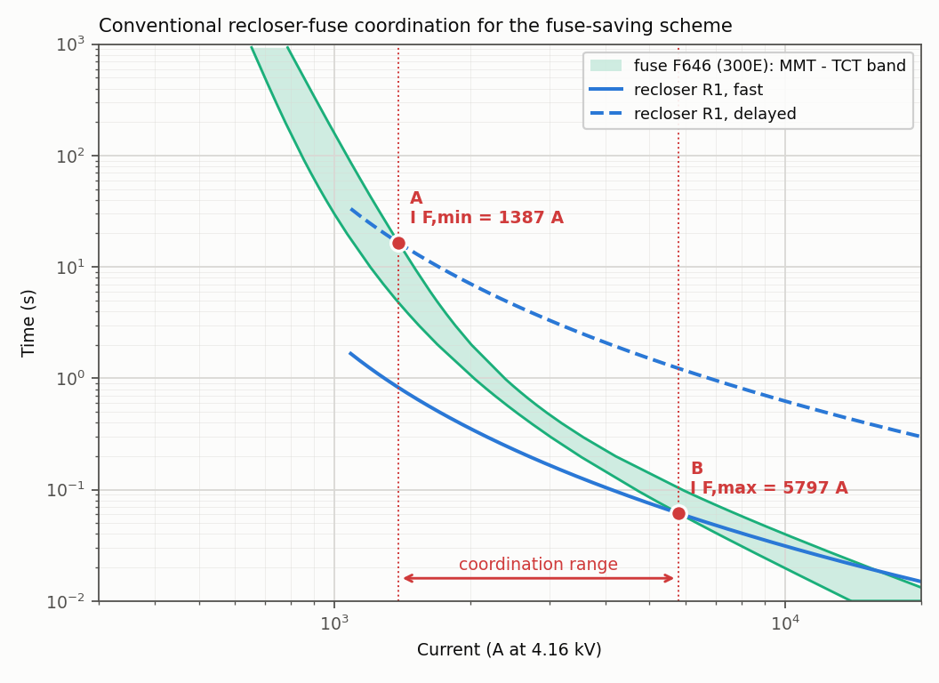
1. Introduction: Recloser–Fuse Coordination
Fuse saving: the recloser's fast trip clears a temporary fault before the lateral fuse melts; its delayed trip lets the fuse clear a permanent fault.
Fast curve below the fuse's melting curve, delayed curve above its clearing curve.
Coordination is guaranteed only while the recloser and the fuse carry the same current.
A distributed generator (DG) changes the magnitude and the direction of the fault current.
Conventional recloser–fuse coordination (R1 and fuse F646)
3/30
Notes:
In a fuse-saving scheme the recloser trips first on its fast curve, so a temporary fault clears and the fuse is saved; for a permanent fault the delayed curve lets the fuse clear its lateral. This works only while the recloser and the fuse carry the same current, and a DG changes both the size and the direction of the fault current.

Slide 4
1. Introduction: Problem Statement
Without DG
Fault current flows from the substation to the fault; recloser and fuse see the same current.
With DG
The fuse carries grid + DG current; the recloser only the grid share. A mid-line recloser sees reverse current.
Consequence
The fuse can melt before the fast trip: fuse saving is lost.
Problem: loss of recloser–fuse coordination when a DG is connected; a single fixed setting does not suit both the forward (grid) and the reverse (DG) fault current.
Proposed solution: a Dual-Setting Directional Recloser (DSDR) – the mid-line recloser R2 gets independent forward and reverse settings, selected by the direction of the current.
This project: implements and tests the DSDR method on the IEEE 13-node feeder in DIgSILENT PowerFactory with the real characteristics of commercial relays and fuses.
4/30
Notes:
With a DG the fuse carries grid plus DG current, while the recloser sees only the grid part, and a mid-line recloser can even see reverse current. The fuse may then melt before the fast trip. The solution studied is the dual-setting directional recloser, or DSDR: R2 gets separate forward and reverse settings, chosen by the current direction.

Slide 5
2. Objectives
General Objective
To build and validate a DIgSILENT PowerFactory implementation of the dual-setting directional recloser (DSDR) coordination method on the IEEE 13-node feeder, with and without distributed generation.
Specific Objectives
1. Build and verify the IEEE 13-node feeder with its recloser and fuse protection.
2. Perform unbalanced load-flow and short-circuit studies for LG, LL, LLG and LLL faults.
3. Calculate the recloser pickups, time dials and fuse coefficients.
4. Establish the coordination without DG, then with a 4.05 MVA synchronous DG at node 692.
5. Design the forward and reverse settings of R2 as a DSDR and check the coordination again.
6. Verify the reclosing sequence in the time domain (EMT simulation).
7. Study the effect of DG penetration from 0 to 100 %.
5/30
Notes:
The general objective was to build and validate a PowerFactory implementation of the DSDR method on the IEEE 13-node feeder, with and without DG. To reach it there are seven specific objectives: the model, load flow and short circuit, the settings, coordination without and with the DG, the dual setting of R2, a time-domain check, and the effect of DG penetration.

Slide 6
3. Scope and Limitations
Scope
Limitations
IEEE 13-node feeder, 4.16 kV, unbalanced.
LG, LL, LLG and LLL faults at 12 locations: 39 node/fault-type cells.
Pickup, time-dial and fuse coordination calculations.
DSDR forward and reverse settings; coordination with and without the DSDR.
One EMT simulation of the reclosing sequence; DG penetration 0–100 %.
R2 settings, fuse sizes and fault type of each operating-time case are not published; they were chosen and documented.
The CDG34 library relay is not directional: two relay units, direction from the fault location.
Zero-margin criterion (fuse must not start to melt before the fast trip).
One DG location (692); IEEE 34-node feeder not modelled.
6/30
Notes:
The study covers four fault types at twelve locations, which gives 39 node and fault-type cells, plus one EMT simulation and a penetration study. The limitations: some settings are not published and were chosen and documented; the CDG34 relay model is not directional, so two relay units are used; a zero margin is used; and only one DG location is studied.

Slide 7
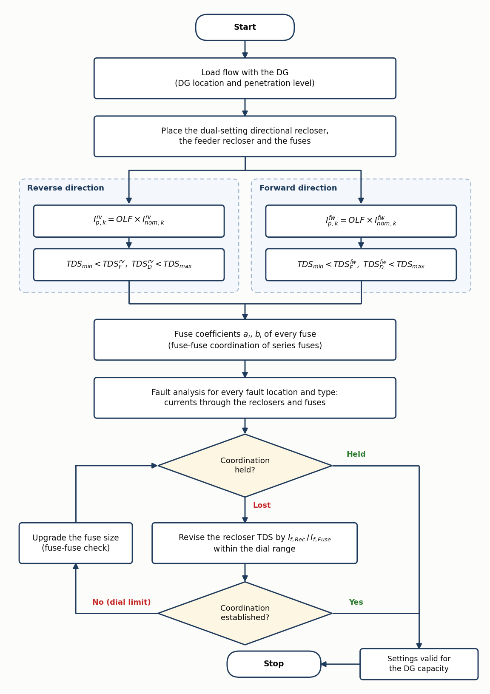
4. Methodology: Coordination Method
A. Conventional scheme without DG: pickups by I_p = OLF × I_nom (OLF = 1.25), fuses sized and checked.
B. Same settings with the DG connected: classification of all 39 cells.
C. R2 as a DSDR: reverse pickup from the reverse load current, forward and reverse dials.
If coordination is lost: revise the time dial; at the dial limit, upgrade the fuse size.
Check: fuse melting time must exceed the recloser fast time, fuse clearing time below the delayed time.
7/30
Notes:
The method has three stages: A, the conventional design without DG, with pickup equal to 1.25 times the rated current; B, the same settings with the DG; and C, R2 as a DSDR. If coordination is lost, the time dial is revised first, and at the dial limit the fuse is made larger. The fuse must not melt before the fast trip, and must clear before the delayed trip.

Slide 8
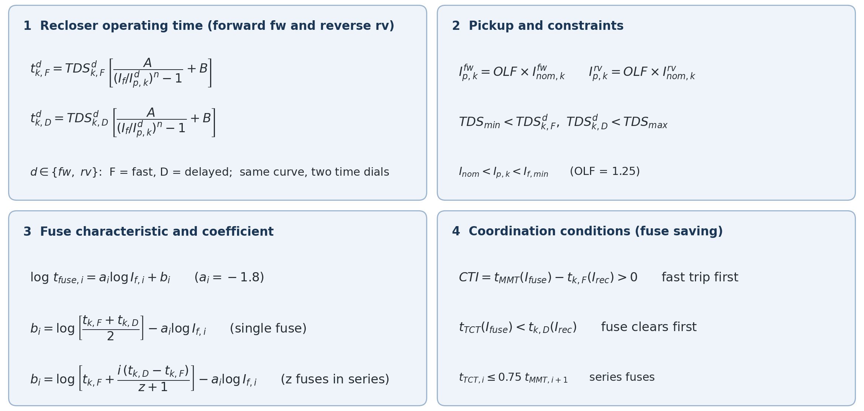
4. Methodology: Mathematical Formulation
8/30
Notes:
These are the equations of the method. Each recloser has the same inverse-time curve with a fast and a delayed time dial, in the forward and, for the DSDR, the reverse direction. The pickup is 1.25 times the load current in that direction and must stay below the smallest fault current. Each fuse follows a straight line on log-log axes with slope minus 1.8; its coefficient b places it between the fast and delayed recloser times. Coordination holds when the fuse melts after the fast trip and clears before the delayed trip.

Slide 9
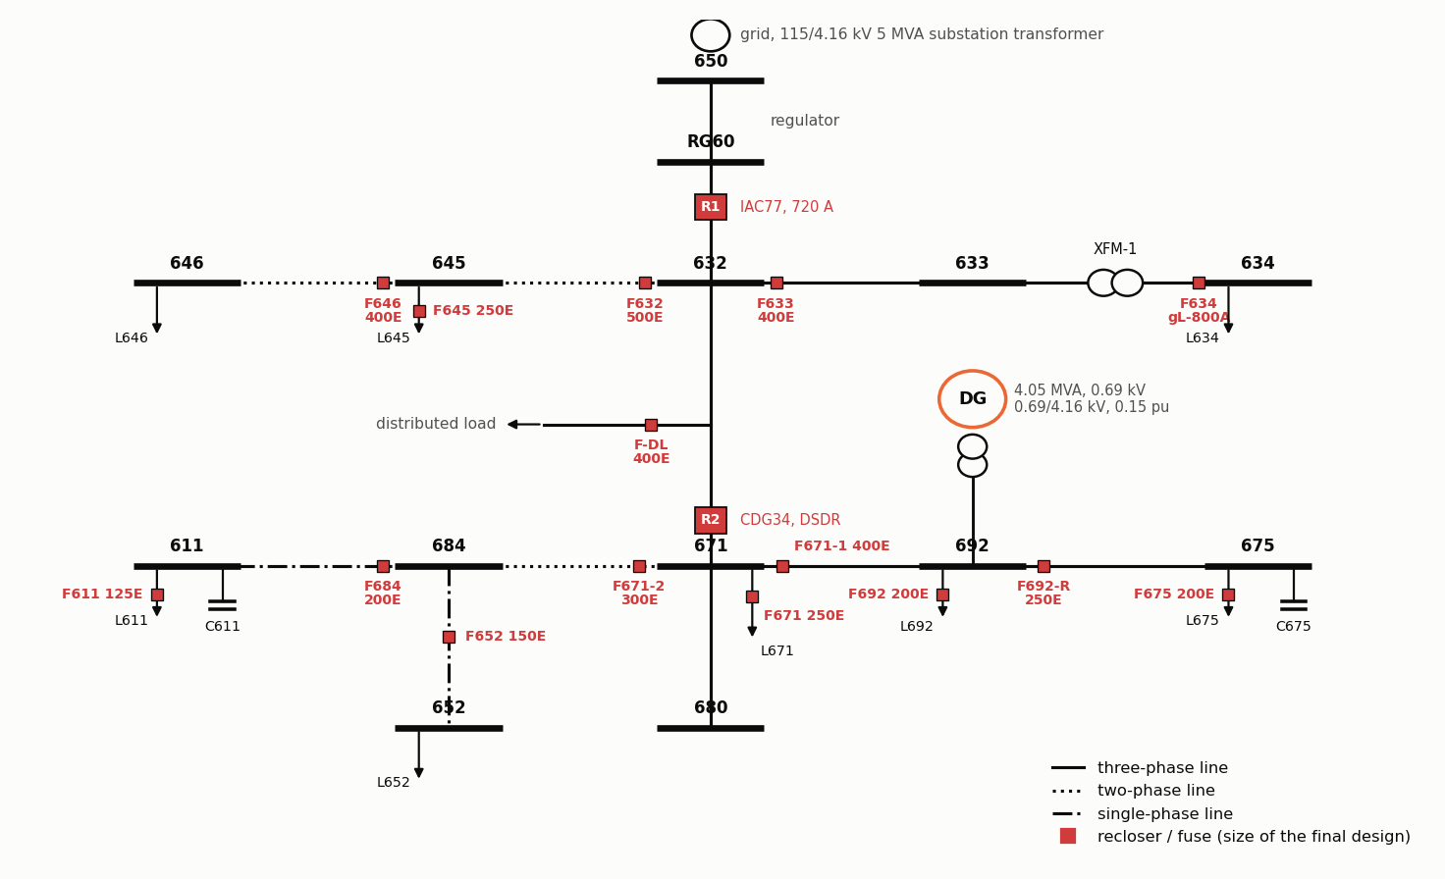
4. Methodology: Test System in PowerFactory
IEEE 13-node feeder, 4.16 kV, 115 kV grid via 5 MVA transformer.
DG: 4.05 MVA synchronous machine at node 692, 0.69/4.16 kV transformer.
R1: GE IAC77B801A at the feeder head (RG60–632).
R2: CDG34 on line 632–671 (the DSDR).
Fuses: A055C (E-rated) on the laterals.
Unbalanced load flow, short-circuit and EMT studies in DIgSILENT PowerFactory 2021.
9/30
Notes:
This is the PowerFactory model: a 4.16 kV feeder fed from a 115 kV grid, a 4.05 MVA synchronous generator at node 692, R1 a GE IAC77 relay at the feeder head, R2 a CDG34 relay on line 632 to 671, and A055C fuses on the laterals.

Slide 10
4. Methodology: Parameters of the Synchronous DG
Parameter | Symbol | Value
Leakage reactance | Xl | 0.05 pu
Stator resistance | Ra | 0.0014 pu
d-axis synchronous reactance | Xd | 1.4 pu
d-axis transient reactance | X'd | 0.231 pu
d-axis subtransient reactance | X''d | 0.118 pu
d-axis transient OC time const. | T'd0 | 5.5 s
d-axis subtransient OC time const. | T''d0 | 0.05 s
q-axis synchronous reactance | Xq | 1.372 pu
q-axis transient reactance | X'q | 0.8 pu
Parameter | Symbol | Value
q-axis subtransient reactance | X''q | 0.118 pu
q-axis transient OC time const. | T'q0 | 1.25 s
q-axis subtransient OC time const. | T''q0 | 0.19 s
Mechanical starting time | M = 2H | 1.5 s
DG rating | Sn | 4.05 MVA
DG voltage | Un | 0.69 kV
Step-up transformer |  | 0.69 / 4.16 kV
Transformer leakage reactance | xT | 0.15 pu
Connection node |  | 692
Dynamic synchronous machine in PowerFactory, operating point 3.24 MW, voltage control at 1.0 pu
10/30
Notes:
These are the parameters of the synchronous DG used in the model, 4.05 MVA at 0.69 kilovolts, connected at node 692 through a 0.69 to 4.16 kilovolt transformer.

Slide 11
4. Methodology: Protection Settings
Device | Characteristic | Pickup / plug (fast / delayed) | Dial (fast / delayed)
R1 (feeder head) | GE IAC extremely inverse | 720 A | TDS 0.5 / 10
R2 forward (grid current) | CDG34 | 300 / 600 A | TMS 0.1 / 1.0
R2 reverse (DG current) | CDG34, CT 500/5 | 150 / 300 A | TMS 0.1 / 1.0
Reverse load current of R2 with the DG: 252 A → reverse pickup 315 A (OLF = 1.25).
Dial revision could not help: R1 and R2 are already at the ends of their dial ranges.
Fuse revision (step 9 of the method): F632 → 500E; F633, F646, F-DL, F671-1 → 400E; F692-R → 250E.
11/30
Notes:
R1 has a pickup of 720 amperes and dials 0.5 and 10. R2 forward uses plugs of 300 and 600 amperes, the new reverse group 150 and 300 amperes. With the DG, the load current through R2 reverses to 252 amperes, giving a reverse pickup of about 315 amperes. The dials were already at their limits, so the fuse sizes were revised as shown.

Slide 12
5. Results: Branch Currents and Fault Levels (DG out)
Branch | Rated current Inom (A) | If,min (kA) LG 3 Ω, farthest node | If,max (kA) bolted, nearest node
RG60–632 | 587.7 | 1.07 | 4.73
632–633 | 81.0 | 0.76 | 4.1
632–645 | 143.1 | 0.73 | 3.42
632–671 | 470.0 | 0.88 | 3.39
XFM-1 HV side | 81.0 | 0.08 | 1.81
XFM-1 LV side | 706.4 | 0.71 | 15.67
645–646 | 66.1 | 0.73 | 3.11
671–692 | 229.7 | 0.74 | 3.39
671–684 | 71.1 | 0.66 | 2.66
671–680 | 0.0 | 0.64 | 2.93
692–675 | 205.9 | 0.74 | 3.15
684–611 | 71.1 | 0.68 | 1.86
684–652 | 63.0 | 0.66 | 1.87
Unbalanced load flow (largest phase) and short circuit, complete method; XFM-1 LV side at 0.48 kV
12/30
Notes:
The first result is the base case without DG: the rated current of each protected branch from the load flow, the minimum fault current, an LG fault through 3 ohm at the farthest node, and the maximum, a bolted fault at the nearest node. The feeder head sees 4.73 kiloamperes.

Slide 13
5. Results: Fuse Coefficients (eq. 9, a = −1.8)
Fuse | If (A) | i / z | t fast (s) | t delayed (s) | t fuse (s) | b i | Installed fuse | t MMT (s)
F632 | 3418 | 2/2 | 0.133 | 2.670 | 1.824 | 6.62 | 400E | 0.512
F633 | 4102 | 1/1 | 0.100 | 2.008 | 1.054 | 6.53 | 250E | 0.102
F634 | 15671 | 1/2 | 0.439 | 8.772 | 3.217 | 8.06 | gL-800A | 0.021
F645 | 3418 | 1/2 | 0.133 | 2.670 | 0.979 | 6.35 | 250E | 0.158
F646 | 3112 | 1/2 | 0.156 | 3.115 | 1.142 | 6.35 | 300E | 0.273
F-DL | 3946 | 1/1 | 0.106 | 2.130 | 1.118 | 6.52 | 250E | 0.112
F671 | 3390 | 1/1 | 0.054 | 1.601 | 0.827 | 6.27 | 250E | 0.161
F671-1 | 3390 | 3/3 | 0.054 | 1.601 | 1.214 | 6.44 | 300E | 0.218
F692 | 3390 | 1/2 | 0.054 | 1.601 | 0.569 | 6.11 | 200E | 0.094
F692-R | 3151 | 2/3 | 0.057 | 1.829 | 0.943 | 6.27 | 200E | 0.112
F675 | 3151 | 1/3 | 0.057 | 1.829 | 0.500 | 6.0 | 200E | 0.112
F671-2 | 2655 | 3/3 | 0.069 | 2.572 | 1.946 | 6.45 | 300E | 0.428
F684 | 1857 | 2/3 | 0.113 | 5.778 | 2.946 | 6.35 | 200E | 0.465
F611 | 1857 | 1/3 | 0.113 | 5.778 | 1.530 | 6.07 | 125E | 0.120
F652 | 1874 | 1/2 | 0.112 | 5.660 | 1.961 | 6.18 | 150E | 0.207
If: largest fault current below the fuse, DG out. i / z: position in a series of z fuses (1 = closest to the fault)
13/30
Notes:
With the method's fuse equation, slope a equal to minus 1.8, the coefficient b of every fuse follows from the recloser times at the largest fault current below that fuse. The last columns give the installed fuse and its melting time.

Slide 14
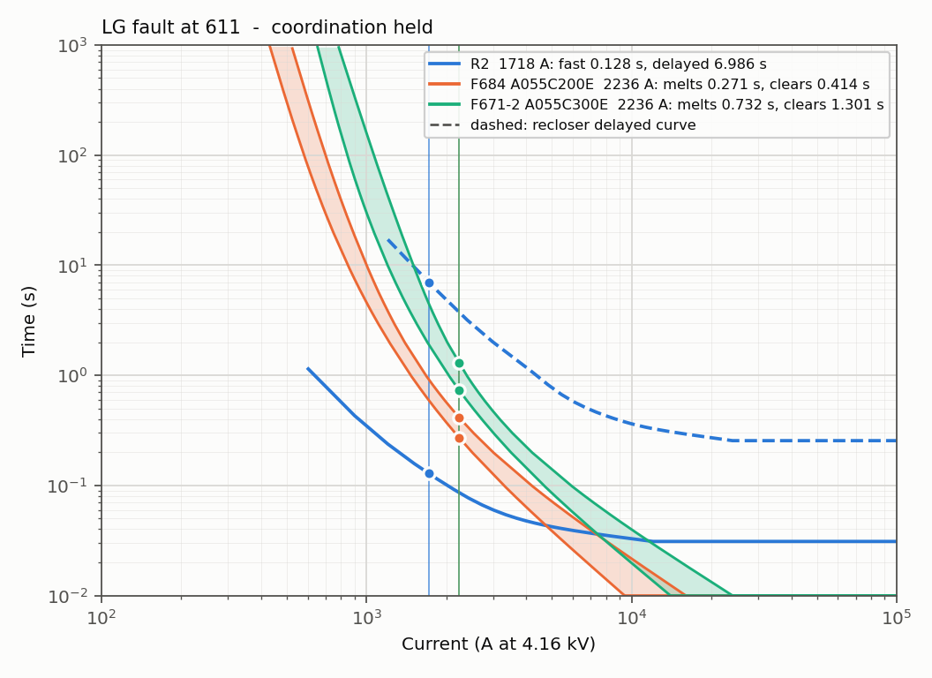
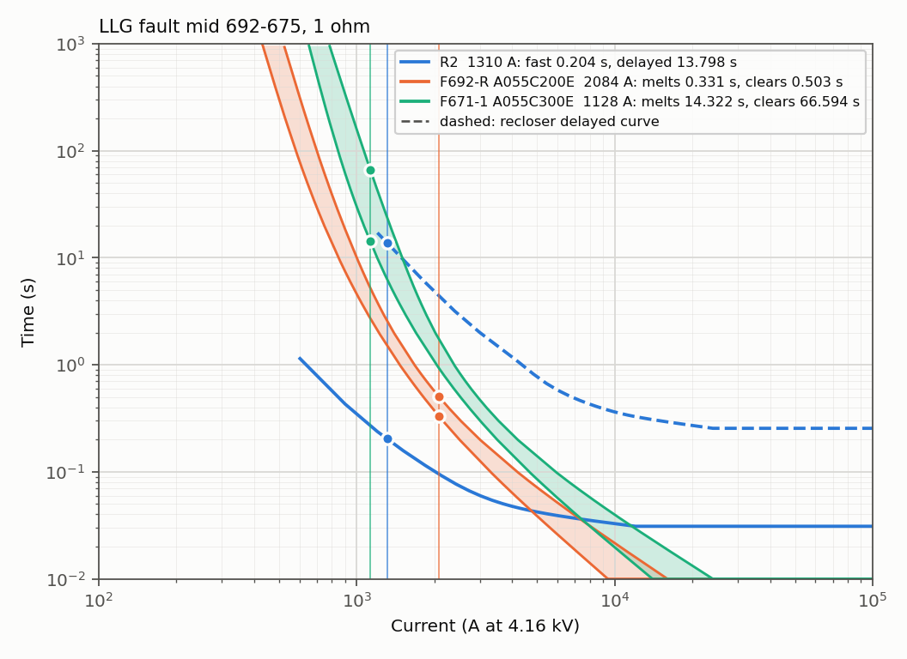
5. Results: Coordination Without DG
LG fault at 611: R2 fast 0.128 s < F684 melts 0.271 s – held
LLG fault mid 692–675, 1 Ω: R2 fast 0.204 s < F692-R melts 0.331 s – held
Fault levels within about 2 % of the IEEE benchmark. 35 of 39 cells held with the starting fuses, 39 of 39 after F692-R → 200E. R2 fast below the fuses, delayed above them.
14/30
Notes:
Without DG, 35 of 39 cells were coordinated, and all 39 after one fuse change. In both examples, an LG fault at 611 and an LLG fault between 692 and 675, R2's fast curve is below the fuses and its delayed curve above them.

Slide 15
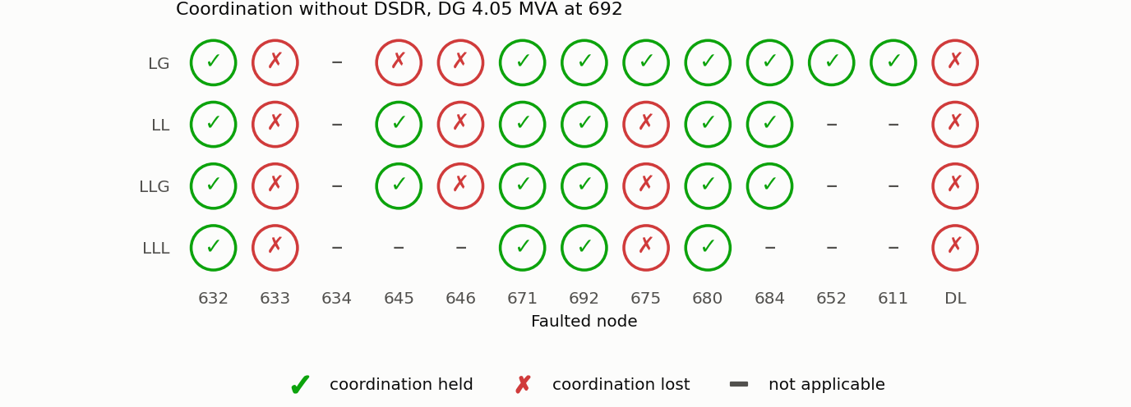
5. Results: DG Connected, Conventional R2
Coordination held in 24 of 39 cells.
Lost at 633, 645, 646, DL and 675.
The fuse carries grid + DG current and melts before the fast trip.
For some LG faults the single-setting R2 does not pick up the reverse DG current at all.
15/30
Notes:
With the DG and unchanged settings, coordination holds in only 24 of 39 cells. Losses are at 633, 645, 646, the distributed load and 675: the fuse melts before the fast trip, and for some LG faults R2 does not even pick up the reverse current.

Slide 16
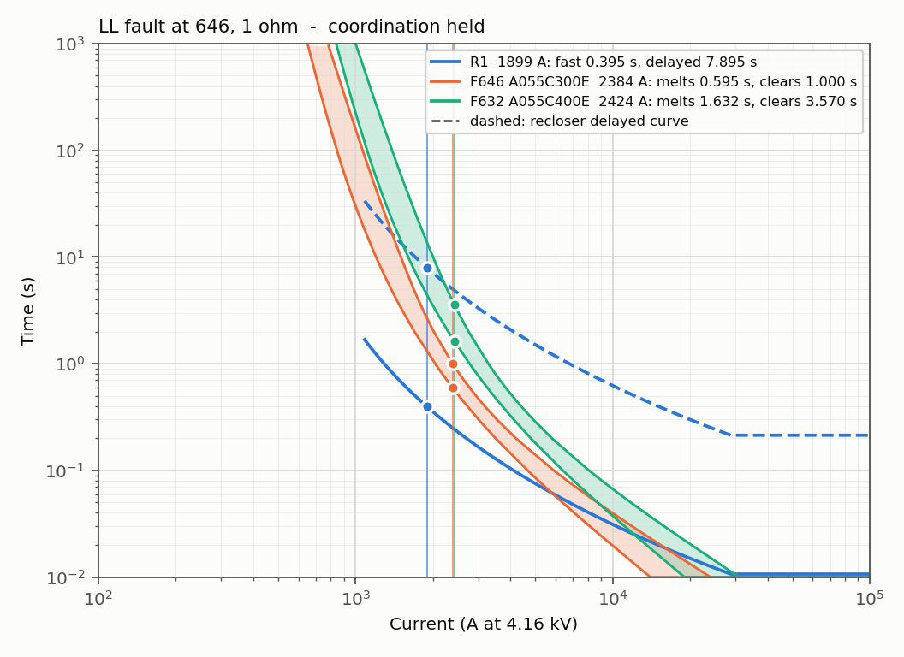
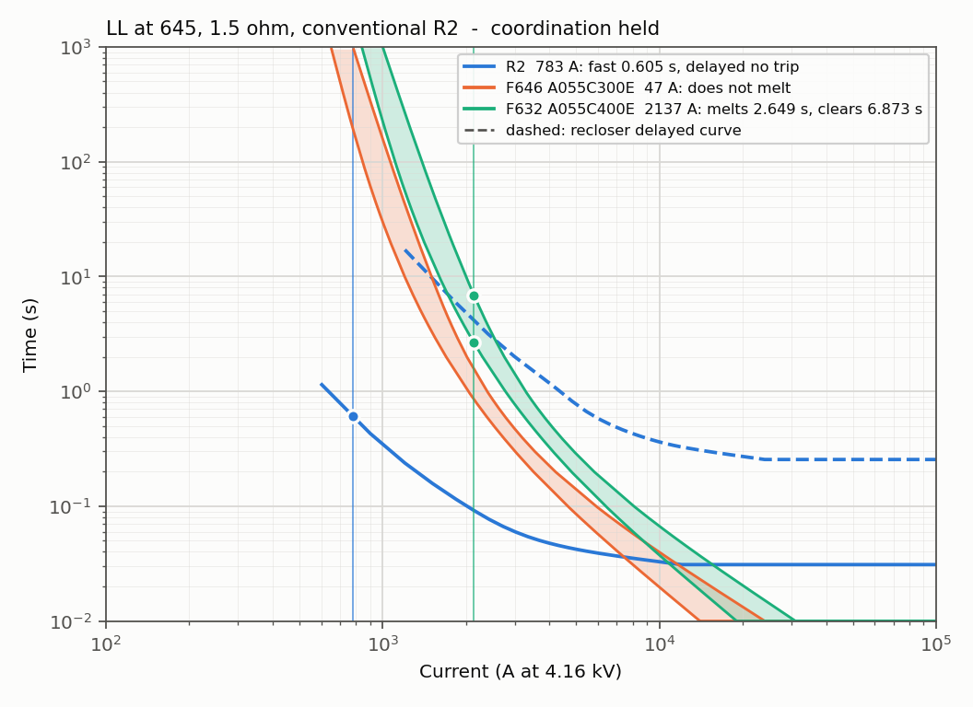
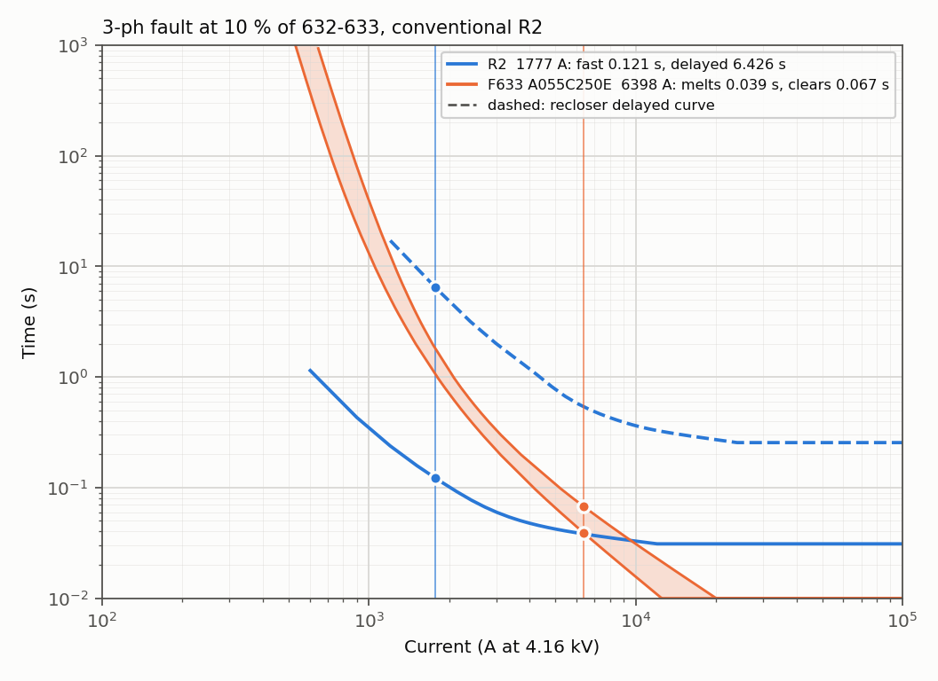
5. Results: Conventional R2 with DG – Three Faults
LL fault at 646, 1 Ω
R1 1899 A: fast 0.395 s
F646 300E melts 0.595 s
R1 trips first
coordination HELD
LL fault at 645, 1.5 Ω
R2 783 A (reverse): fast 0.605 s
F632 400E melts 2.649 s
R2 trips first
coordination HELD
3-phase fault at 10 % of 632–633
R2 1777 A (reverse): fast 0.121 s
F633 250E melts 0.039 s
the fuse melts first
coordination LOST
16/30
Notes:
Three faults with the DG and the conventional settings. At 646 and 645 through a fault impedance the recloser still trips first. For the three-phase fault close to 632, R2 carries 1777 amperes in reverse and trips in 0.121 seconds, but fuse F633 melts in 0.039 seconds: coordination is lost.

Slide 17
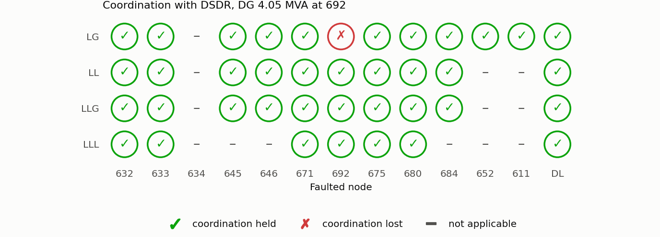
5. Results: With the DSDR
Coordination held in 38 of 39 cells.
Same fuses with a single-setting R2: 31 cells.
The dual setting restores 7 cells: all faults at 633 and the LG faults at 645, 646 and DL.
Still lost: LG fault at 692 – the 400E fuse F671-1 clears after R2's delayed trip (7.6 s vs 4.0 s); the delayed dial is already at its maximum.
17/30
Notes:
With R2 as a DSDR and revised fuses, 38 of 39 cells are held. With the same fuses and a single setting only 31, so the dual setting itself restores seven cells, at 633, 645, 646 and the distributed load. Only the LG fault at 692 stays lost, at the limit of R2's dial range.

Slide 18
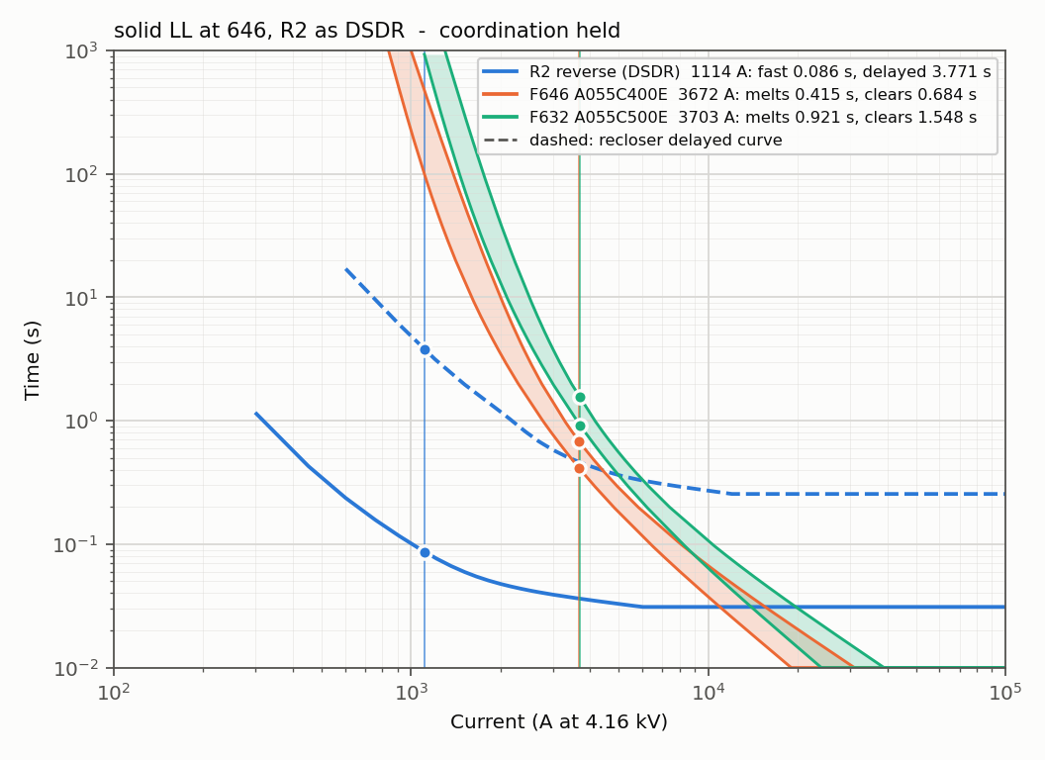
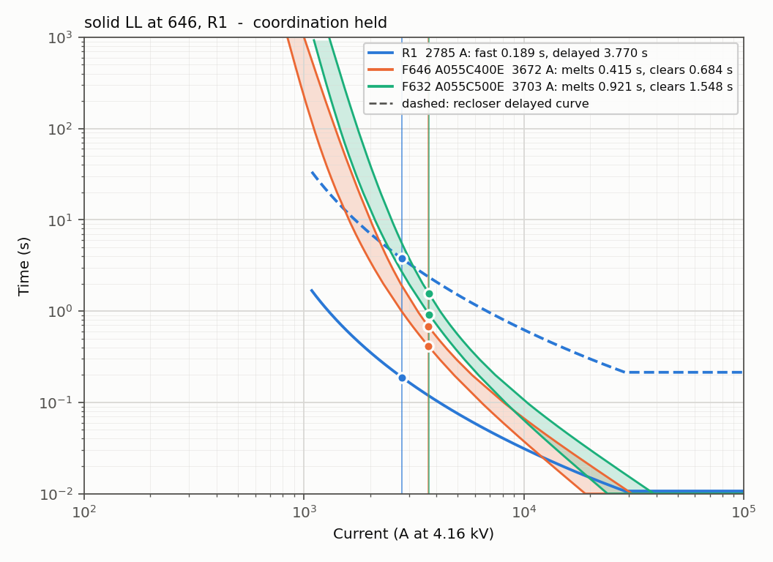
5. Results: Bolted LL Fault at 646 with the DSDR
R2 reverse (DG share, 1114 A): fast 0.086 s
R1 (grid share, 2785 A): fast 0.189 s
The fuses carry 3.67 kA (grid + DG). Both reclosers trip before F646 (400E) starts to melt at 0.415 s: R2 removes the DG share, R1 the grid share – fuse saved.
18/30
Notes:
A bolted line-to-line fault at 646 with the DSDR. The fuses carry 3.67 kiloamperes. R2 sees the DG share, 1114 amperes in reverse, and its reverse group trips in 0.086 seconds; R1 sees the grid share and trips in 0.189 seconds. Both are before F646 starts to melt at 0.415 seconds, so the fuse is saved.

Slide 19
5. Results: Operating Times with the DSDR (DG in)
Node | Fault | I R1 (A) | R1 fast / delayed (s) | I R2 (A) | R2 fast / delayed (s) | Fuse | I fuse (A) | Fuse MMT / TCT (s)
632 | LLL | 4734 | 0.081 / 1.627 | 1813 rev | 0.051 / 1.416 | – | – | –
633 | LLL | 3970 | 0.106 / 2.111 | 1500 rev | 0.060 / 2.001 | F633 | 5426 | 0.149 / 0.235
645 | LL | 3124 | 0.155 / 3.095 | 1232 rev | 0.075 / 3.002 | F632 | 4191 | 0.613 / 0.970
646 | LL | 2785 | 0.189 / 3.770 | 1114 rev | 0.086 / 3.771 | F646 | 3672 | 0.415 / 0.684
DL | LLL | 3954 | 0.106 / 2.123 | 1972 rev | 0.048 / 1.213 | F-DL | 5902 | 0.121 / 0.193
671 | LLL | 3412 | 0.134 / 2.677 | 3391 fwd | 0.054 / 1.600 | – | – | –
692 | LLL | 3412 | 0.134 / 2.677 | 3391 fwd | 0.054 / 1.600 | F671-1 | 3391 | 0.525 / 0.891
675 | LLL | 3090 | 0.158 / 3.152 | 3050 fwd | 0.059 / 1.941 | F692-R | 5022 | 0.065 / 0.106
684 | LL | 2543 | 0.222 / 4.437 | 2543 fwd | 0.072 / 2.813 | F671-2 | 3963 | 0.148 / 0.230
680 | LLL | 2789 | 0.188 / 3.761 | 2757 fwd | 0.066 / 2.381 | – | – | –
611 | LG | 1814 | 0.435 / 8.709 | 1718 fwd | 0.128 / 6.986 | F684 | 2236 | 0.271 / 0.414
652 | LG | 1795 | 0.446 / 8.919 | 1761 fwd | 0.123 / 6.570 | F652 | 2239 | 0.138 / 0.193
Bolted LLL (LL at two-phase, LG at one-phase nodes). Every fuse starts to melt after the last fast trip; smallest margins 6 ms (675) and 15 ms (DL)
19/30
Notes:
This table gives the operating times with the DSDR and the DG connected. R2 works in reverse for the nodes above it and forward for those below. In every row the fuse starts to melt after the last fast trip; the smallest margins are 6 milliseconds at 675 and 15 at the distributed load.

Slide 20
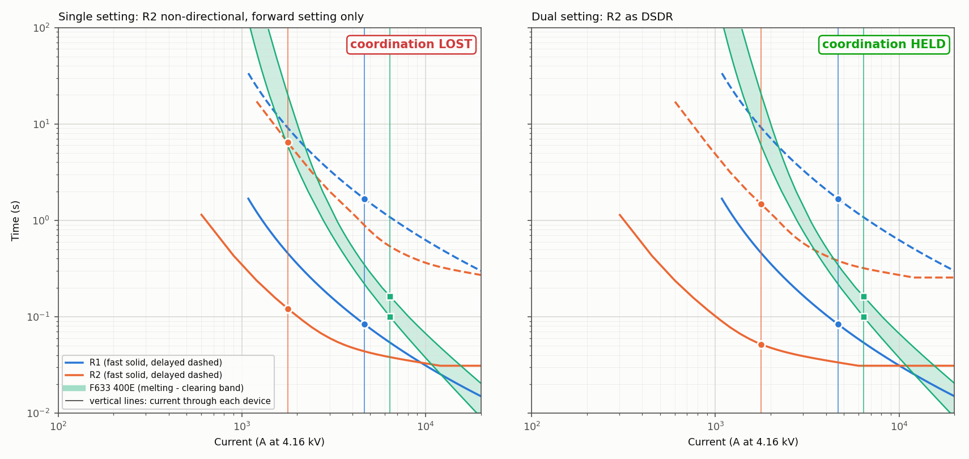
5. Results: Single vs Dual Setting (3-phase fault near 632)
Quantity | Single setting | Dual setting (DSDR)
Current through R2 | 1777 A, reverse (DG contribution) | 1777 A, reverse
R2 setting used | Forward: plug 300/600 A | Reverse: plug 150/300 A
R2 fast trip | 0.121 s | 0.052 s
F633 (400E) starts to melt | 0.100 s | 0.100 s
Fuse saving | LOST | HELD
20/30
Notes:
One case in detail: a three-phase fault near 632, with 1777 amperes in reverse through R2. With the single setting R2 trips in 0.121 seconds but the fuse starts melting at 0.100 seconds: lost. With the reverse group R2 trips in 0.052 seconds: held. Only the setting group changed.

Slide 21
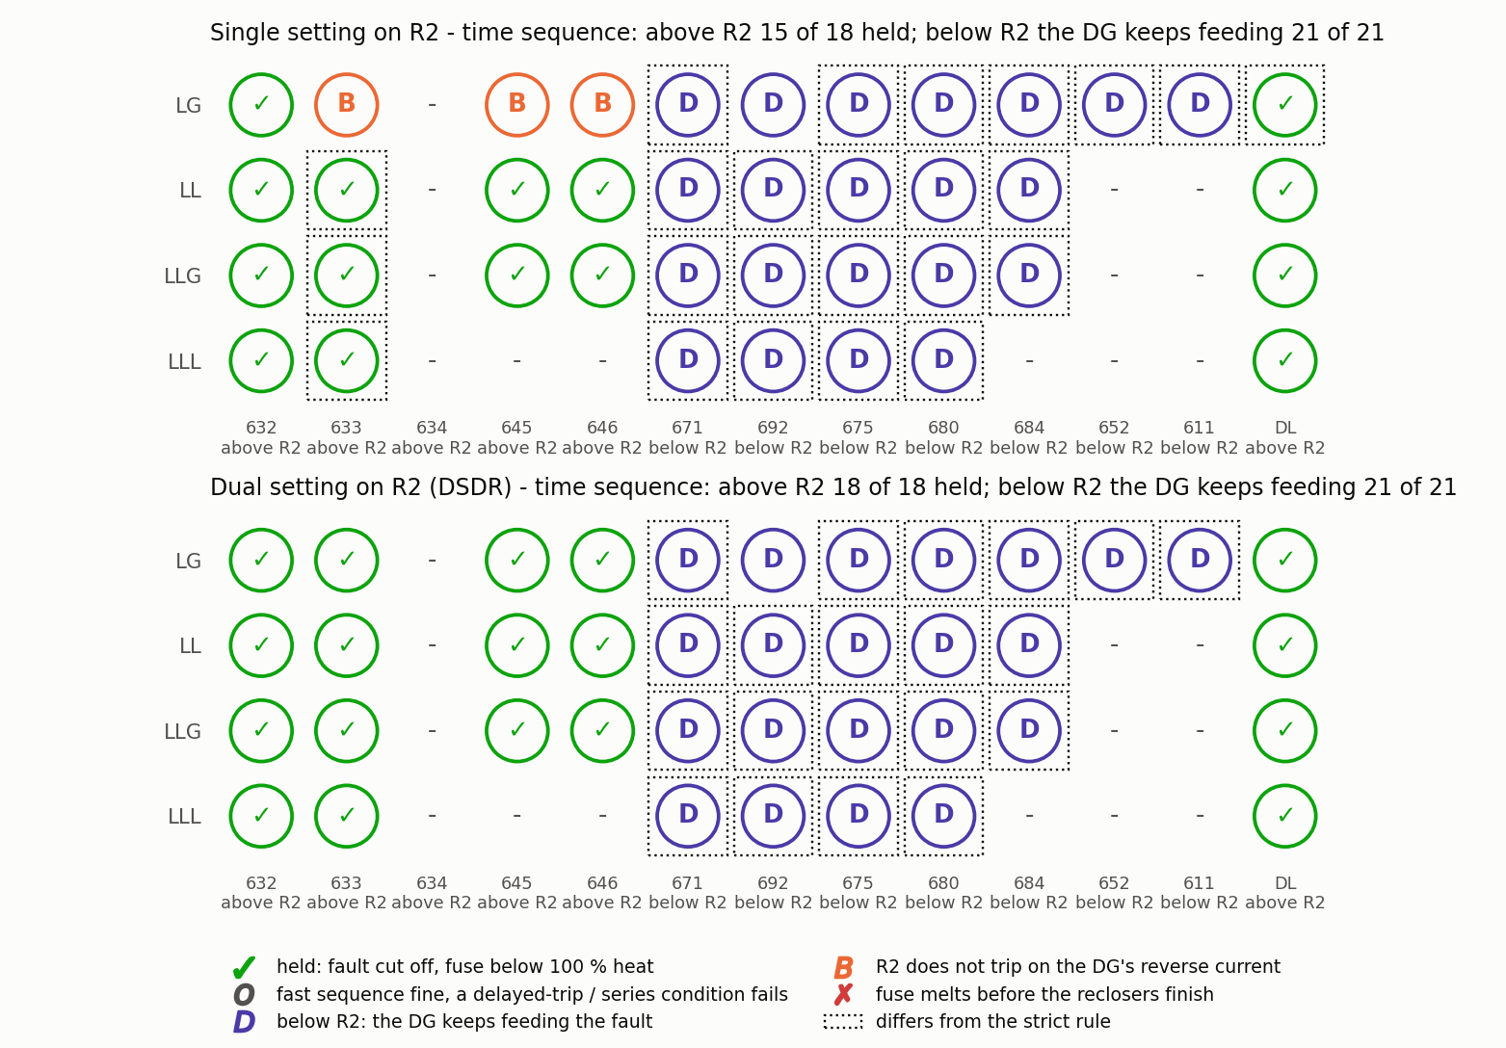
5. Results: Time-Sequence Check of All Faults
Each fault followed in time: the fuse heats while current flows after each recloser opens.
Above R2: 15 of 18 held with a single setting, 18 of 18 with the DSDR.
Restored: LG faults at 633, 645 and 646.
Below R2 the DG feeds the fault directly: the setting of R2 makes no difference.
21/30
Notes:
As a second check I followed every fault in time. Above R2 the single setting holds 15 of 18 cells and the DSDR all 18; the restored cells are the LG faults at 633, 645 and 646. Below R2 the DG feeds the fault directly, so the setting of R2 makes no difference.

Slide 22
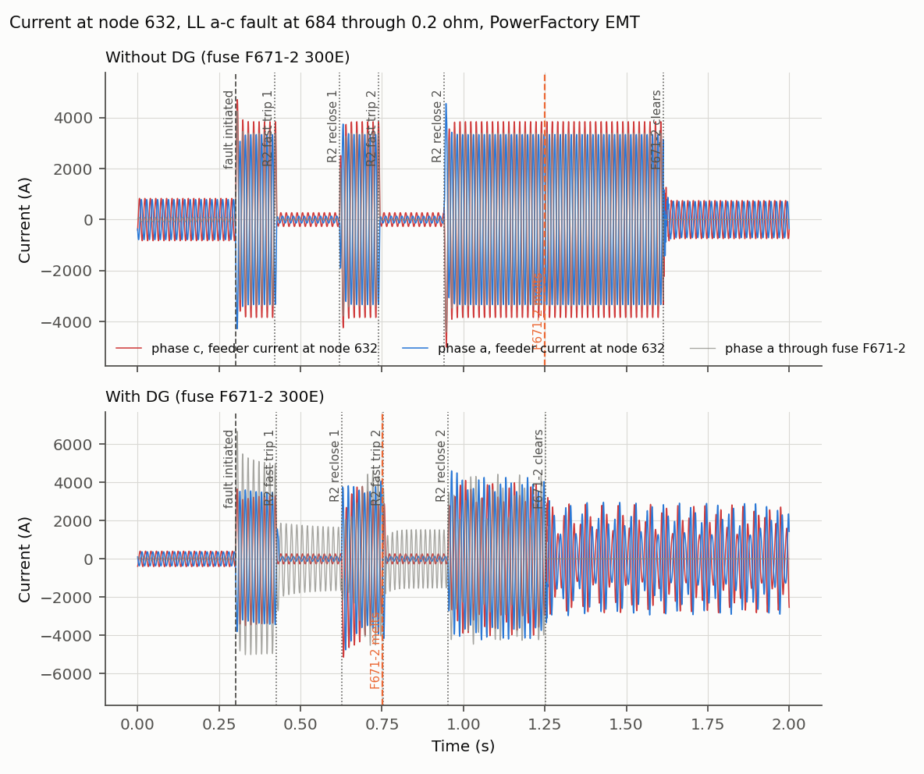
5. Results: Time-Domain (EMT) Verification
Event | Without DG | With DG
F671-2 melts | 1.248 s | 0.752 s
F671-2 clears | 1.613 s | 1.253 s
LL fault (a–c) at 684 through 0.2 Ω, conventional settings.
Without DG the two fast shots use 45 % of the fuse's melting heat; the fuse then clears the permanent fault.
With DG the fuse melts during the second fast shot: the DG keeps feeding the fault while R2 is open.
22/30
Notes:
This EMT simulation is a line-to-line fault at 684 with conventional settings. Without DG the two fast shots use only 45 percent of the fuse's melting heat, and the fuse then clears the permanent fault. With the DG, current keeps flowing while R2 is open, and the fuse melts at 0.75 seconds, during the second fast shot.

Slide 23
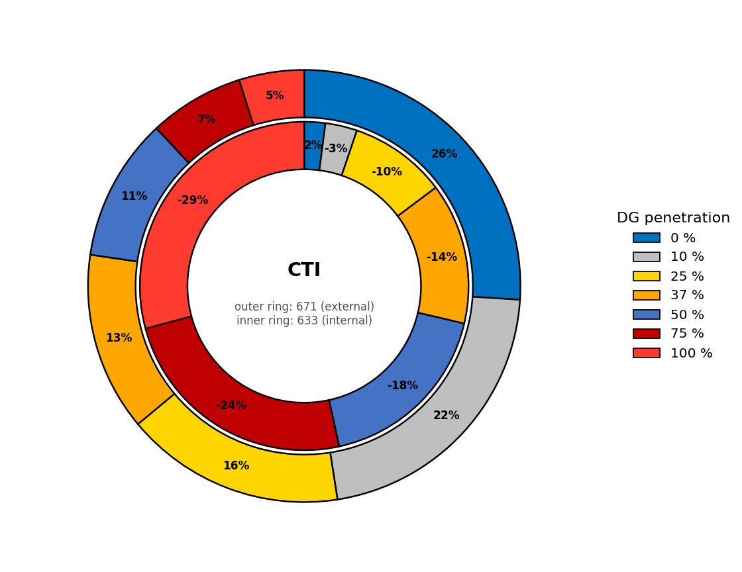
5. Results: Effect of the DG Penetration Level
Seven PowerFactory models: DG 0, 10, 25, 37, 50, 75, 100 % of 4.05 MVA; settings of the design without DG kept.
CTI = t_MMT(fuse) − t_fast(recloser):
node 633: +4 ms → −51 ms
node 671: +403 ms → +75 ms
The fuse carries grid + DG current, the recloser only the grid share: the CTI falls as the DG grows.
Fault level rises by up to 64 %; R2 stops detecting its weakest fault above about 50 %.
23/30
Notes:
Seven models with the DG from 0 to 100 percent and fixed settings show the CTI, the fuse melting time minus the recloser fast time, falling: at 633 from plus 4 to minus 51 milliseconds, at 671 from 403 to 75 milliseconds. The fuse carries grid plus DG current, the recloser only the grid share, so the fuse speeds up much faster.

Slide 24
5. Results: Summary and Verification
Stage | Cells held (of 39)
No DG, starting fuse sizes | 35
No DG, after the fuse revision | 39
DG connected, conventional R2 | 24
DG connected, no-DG fuses, R2 as DSDR | 25
DG connected, revised fuses, conventional R2 | 31
DG connected, revised fuses, R2 as DSDR | 38
PowerFactory's own relay and fuse models reproduce the calculated operating times within 1.22 % (1896 operating times).
With a breaker time of 3 cycles: 31 cells held; with a fuse safety margin as well: 26.
24/30
Notes:
In summary: 39 cells without DG, 24 with the DG, and 38 with the DSDR. PowerFactory's own relay and fuse models reproduced all 1896 operating times within 1.22 percent.

Slide 25
6. Conclusions and Future Work
The DSDR method was implemented on the IEEE 13-node feeder in DIgSILENT PowerFactory with real relay and fuse characteristics; the model meets the IEEE benchmark within about 2 %.
The DG breaks coordination: 39 → 24 of 39 cells with a conventional R2.
R2 as a DSDR with the fuse revision restores it: 38 of 39 cells (31 with a single setting).
The DSDR works in the zone between the grid and the DG; it needs the fuse revision, and faults below R2 (fed directly by the DG) remain a limit.
With fixed settings the CTI falls steadily as the DG penetration rises.
Future work
IEEE 34-node feeder; explicit directional element for R2; practical margins; setting-group change triggered by the DG state; inverter-based DG; hardware-in-the-loop tests.
25/30
Notes:
To conclude: the DG reduces coordination from 39 to 24 cells, and a dual-setting R2 with the fuse revision restores it to 38. The DSDR works in the zone between the grid and the DG, but needs the fuse revision, and faults below R2 remain a limit. Future work includes the 34-node feeder, a true directional element, practical margins and inverter-based DG.

Slide 26
7. References
[1] M. Yousaf, A. Jalilian, K. M. Muttaqi, D. Sutanto, "An adaptive overcurrent protection scheme for dual-setting directional recloser and fuse coordination in unbalanced distribution networks with distributed generation," IEEE Trans. Ind. Appl., vol. 58, no. 2, pp. 1831–1842, 2022.
[2] W. H. Kersting, "Radial distribution test feeders," IEEE Trans. Power Syst., vol. 6, no. 3, pp. 975–985, 1991.
[3] G. Benmouyal et al., "IEEE standard inverse-time characteristic equations for overcurrent relays," IEEE Trans. Power Del., vol. 14, no. 3, pp. 868–872, 1999.
[4] A. Naiem et al., "A classification technique for recloser-fuse coordination in distribution systems with distributed generation," IEEE Trans. Power Del., vol. 27, no. 1, pp. 176–185, 2012.
[5] M. Yousaf, K. M. Muttaqi, D. Sutanto, "Overcurrent protection scheme for the IEEE 13-node benchmark test feeder with improved selectivity," IEEE PES General Meeting, 2020.
[6] W. H. Kersting, G. Shirek, "Short circuit analysis of IEEE test feeders," IEEE PES T&D, 2012.
[7] DIgSILENT GmbH, PowerFactory 2021 User Manual, 2021.
[8] GE Multilin, 735/737 Feeder Protection Relay – Instruction Manual (GEK-106291F), 2010.
26/30
Notes:
These are the main references; the method is from Yousaf and co-authors, 2022.

Slide 27
Appendix: Comparison with the Reference Paper
Aspect | This project | Reference paper [1] | Assessment
Rated branch currents | within 2 % | Table II | Very good
Fault levels | IEEE benchmark, 4.73 kA at head | 5.41 kA, some branches higher | Lower
R1 worked example (4219 A) | 0.096 / 1.926 s | 0.097 / 1.932 s | Very good
Coordination with DG, conventional R2 | 24 of 39 held | 30 of 39 (Fig. 14) | Good (29 cells agree)
Coordination with the DSDR | 38 of 39 held | 39 of 39 (Fig. 17) | Good; one cell at dial limit
Fuse current, LL at 646 | 3.67 kA | 3.64 kA (Fig. 15) | Very good
R2 reverse current, LL at 646 | 1.11 kA | 1.54 kA | Lower
EMT: fuse operation | melts 1.25 s, clears 1.61 s | 1.21 s (Fig. 10) | Close
DG model | Dynamic synchronous machine | Synchronous machine | Same
27/30
Notes:
Compared with the reference paper, load currents agree within 2 percent and the R1 worked example almost exactly. My fault levels are lower because I validated against the IEEE benchmark. The paper reports 30 and 39 coordinated cells, I obtained 24 and 38. The main finding is reproduced.

Slide 28
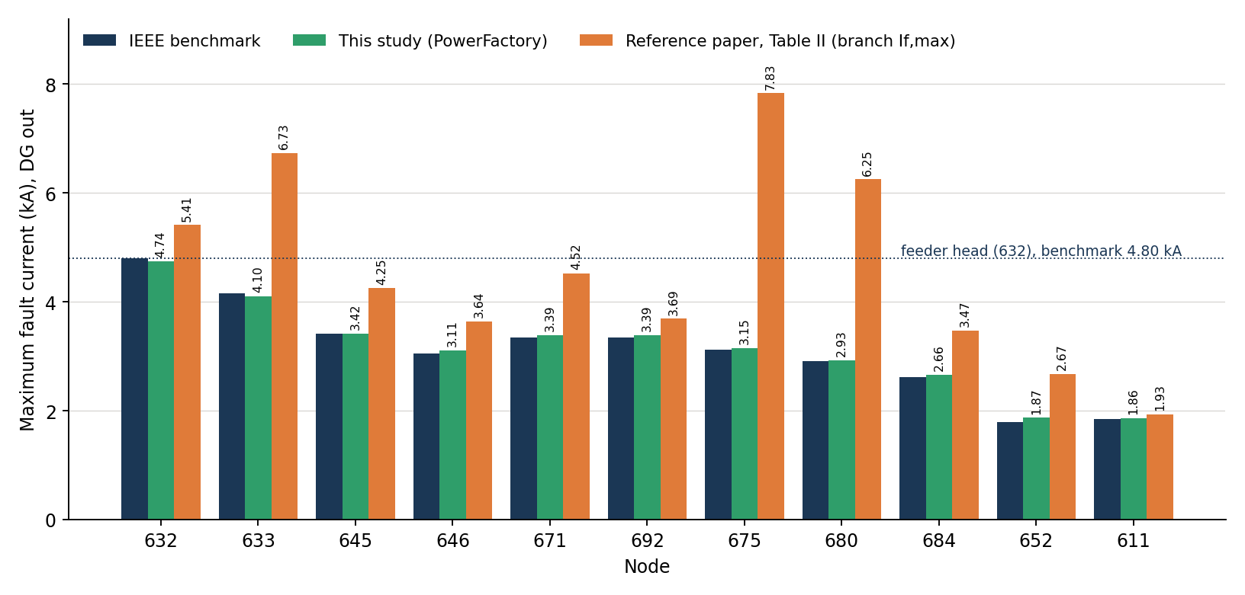
Appendix: Fault Levels – IEEE Benchmark, This Study and the Paper
This study vs IEEE benchmark: within 2 % at 10 of 11 nodes; largest difference 4.7 % (652, LG).
Paper vs benchmark: 4 % to 151 % higher.
The paper's 6.73 kA (632–633) and 7.83 kA (692–675) exceed its own 5.41 kA at the feeder head – not possible in a radial feeder without DG.
So the model was validated against the benchmark, not tuned to the paper's Table II.
Maximum fault current, DG out. Benchmark: Kersting & Shirek [6], values as quoted in [5]
28/30
Notes:
My fault levels are lower than the paper's, so I checked them against the IEEE short-circuit benchmark, the source the same authors used in their 2020 paper. My model agrees within 2 percent at ten of eleven nodes. The paper's values are up to 151 percent higher, and two of them exceed its own feeder-head value of 5.41 kiloamperes, which is not possible in a radial feeder without DG.

Slide 29
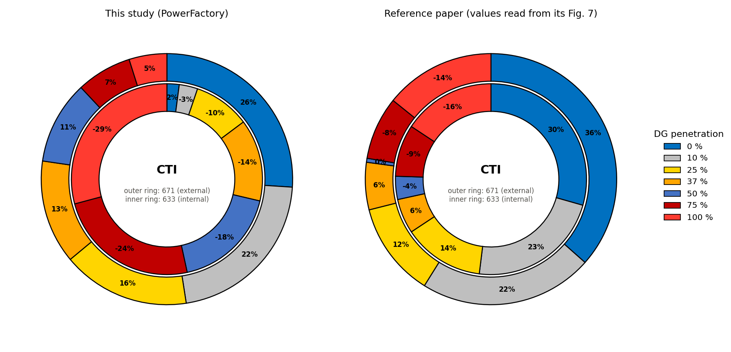
Appendix: CTI with DG Penetration – Study and Paper
Both show the CTI decreasing as the DG penetration rises.
The paper's values are read from its Fig. 7.
Where the sign changes depends on the starting margin, i.e. on fuse sizes and settings that the paper does not publish.
Central finding reproduced: the DSDR restores coordination between the grid and the DG.
29/30
Notes:
Both studies show the margin decreasing with DG penetration; where it turns negative depends on settings the paper does not publish.

Slide 30
Thank You
Questions and Discussion
30/30
Notes:
Thank you for your attention. I am happy to take your questions.

