Slide 1
Github Analytics
Harishma Parthiban
Ranjan Ravi
Sumitha Babu
Varsha Umed Dugar

Slide 2
Problem Statement
GitHub Analysis
Industry Focused
Human Resources
Profile Improvement

Slide 3


Why Github Analytics?
Showcase your Work
Ease Recruitment Process

Slide 4
Data Collection
PyGithub APIs
Custom Scoring
User profile popularity
Repo popularity
Contributions
Languages
Categorizing the scores

Slide 5







Data Characteristics
IVs
DV
Followers
Following
Repos
Stars
Forks
Language Count

Slide 6
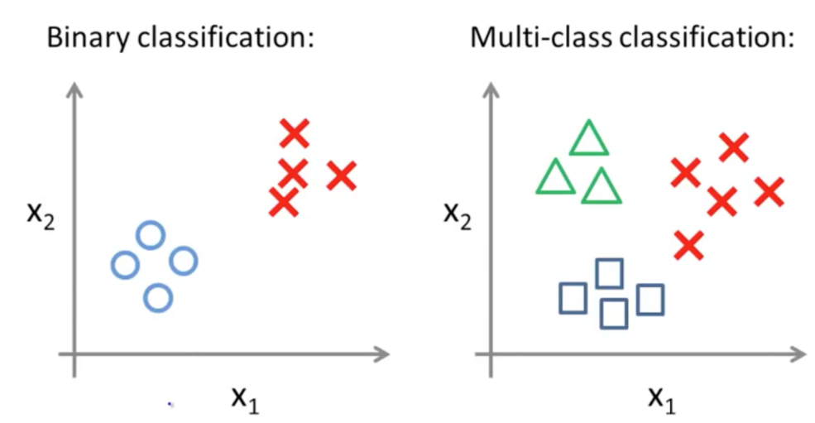
Model Justification
Multiple Classes: Good, Average and Low
Models Used: MultiClass Decision Jungle, MultiClass Neural Network and MultiClass Logistic Regression Classification

Slide 7
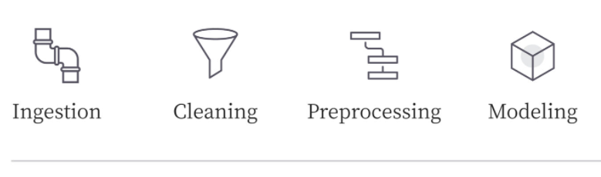
Model Construction
GitHub API
Data Normalization
Dimensionality Reduction
Classifier

Slide 8
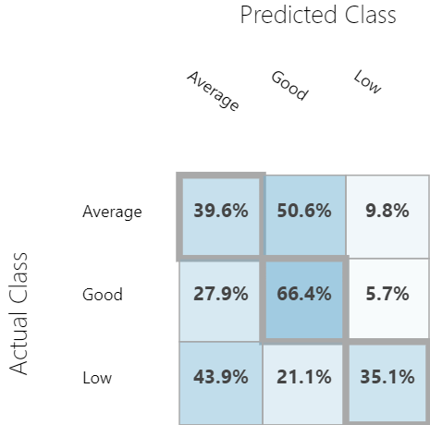
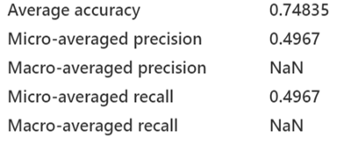
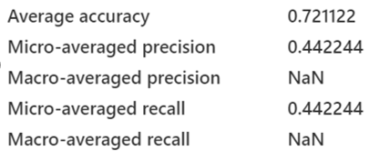
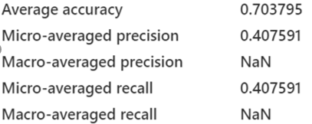
Model Evaluation
Decision Jungle
Neural Network
Logistic Regression

Slide 9


Business Model - Benefit Analysis

Slide 10
Link to Microsoft Azure ML Studio
https://gallery.azure.ai/Experiment/GithubAnalysis

