Slide 1
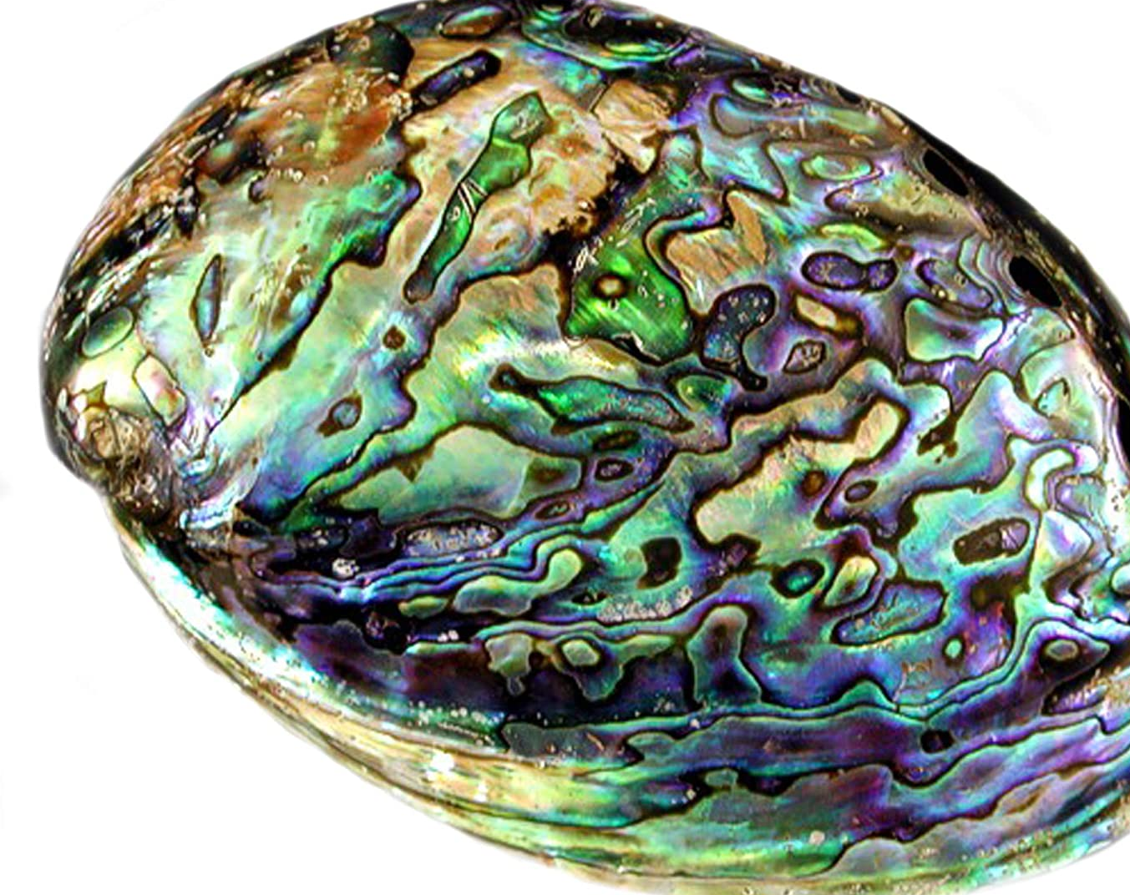
Prediction of Abalone(Shell) Age

Slide 2
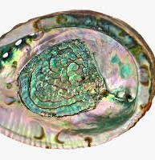
Introduction
Abalones are marine snails.
The flesh of abalones is widely considered to be a desirable food, and is consumed raw or cooked by a variety of cultures.
The age of abalone is determined by cutting the shell through the cone, staining it, and counting the number of rings through a microscope.
The economic value of abalone is positively correlated with its age. Therefore, to detect the age of abalone accurately is important for both farmers and customers to determine its price.
The case study considers a report collected from various parameters of the abalones like their sex, length, diameter, height, weight, etc.

Slide 3
Problem Statement
Predicting the age of abalone without cone and staining is very important.
This can be done by predicting a number of rings by its various other parameters like sex, length, diameters, height and weight.
In a data science role I have been hired to analyse and create a model which can predict rings in abalone.
Adding rings with 1.5 will give approx age of abalone and thus provide an appropriate price.
This would be a leading step to helping the farmers and customers.

Slide 4
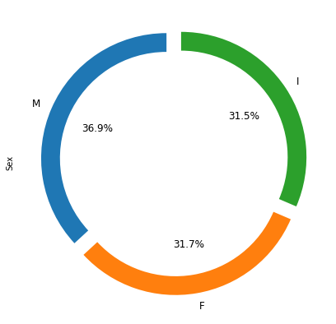
Q: What is the percentage ratio of different sex of Abalone?
Observations:
We have a total of 40% Male, 31.5% Infant and 31.7 % Female.
Data is almost equally distributed among sex.
We will not get a biased problem.

Slide 5
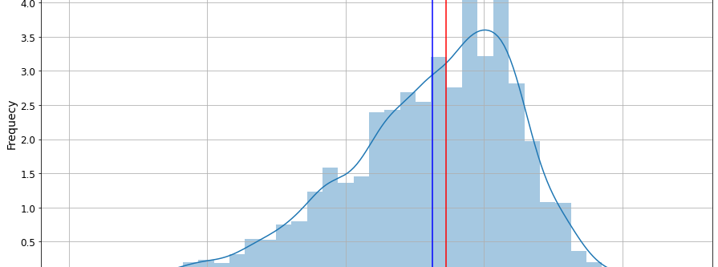
Q: What is a frequency distribution of length in abalone?
Observations:
The length of the abalone is right-skewed.
There is a 0.019 mm difference between the mean and median.
Most of the data is in between the 0.5 mm to 0.7 mm range.

Slide 6
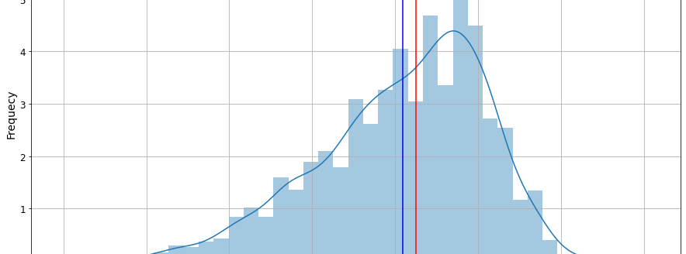
Q: What is the frequency distribution of diameter in abalone?
Observations:
The diameter of the abalone is right-skewed.
There is a 0.016 mm difference between the mean and median.
Most of the data is in between the 0.4 mm to 0.5 mm range.

Slide 7
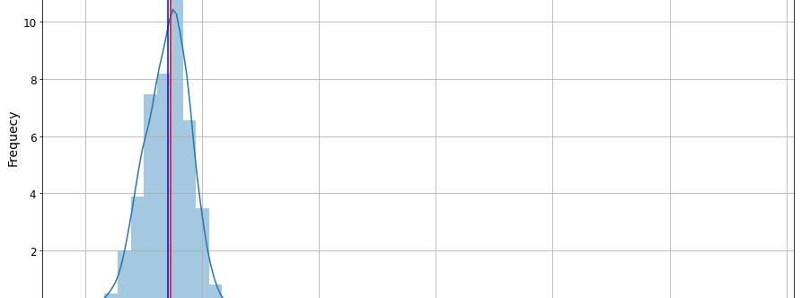
Q: What is the frequency distribution of height in abalone?
Observations:
Height is normally distributed.
There are very few abalones whose height is between 0.3 to 1.13.
It is very negligible.

Slide 8
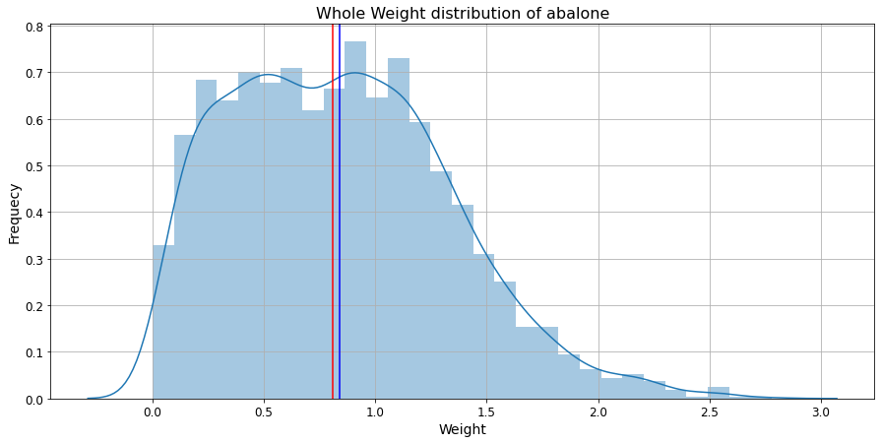
Q: What is the frequency distribution of weight in abalone?
Observations:
Weight is normally distributed.
There are many abalones whose height is between 0.1 to 1.4.

Slide 9
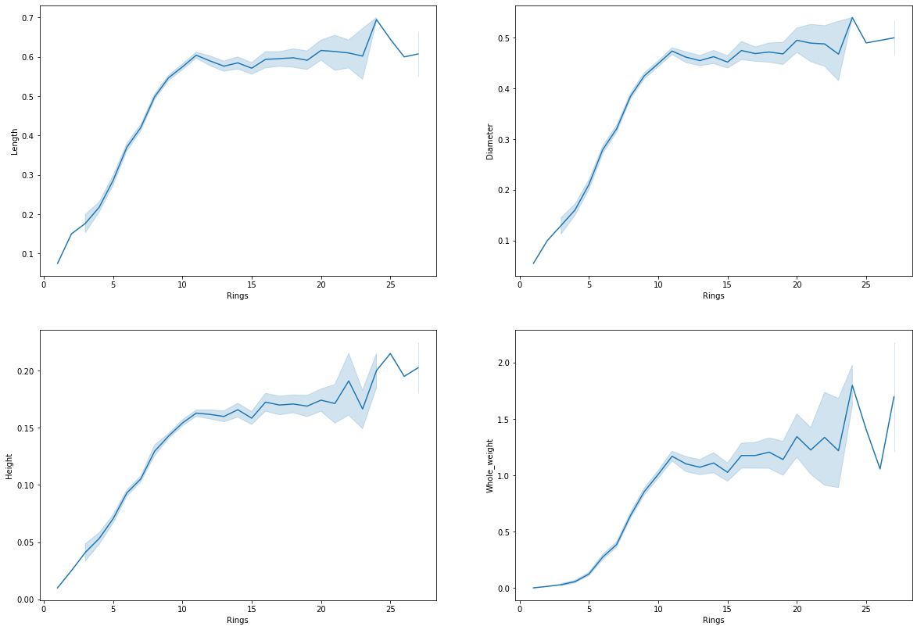
Observations:
Number of rings increases with an increase in length, diameter, height and weight of abalone.
But after 10 rings length, diameter, height and weight are almost constant.
There is a small deflection after 20 rings.

Slide 10
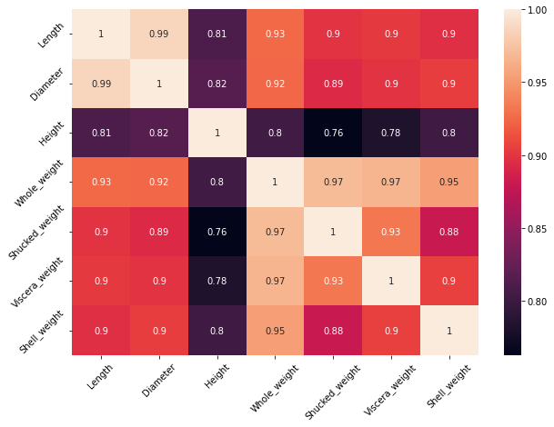
Q: Correlation matrix?
Observations:
Length and diameters are highly correlated.
All types of weight are highly correlated with each other.
There is a small deflection after 20 rings.

Slide 11
Model No. | Criteria of hyperparameter | RMSE | R2
Linear Regression | Default hyper tuning | 2.20 | 0.53
Decision Tree Regressor | {max_depth=5, min_samples_split=6, max_leaf_nodes=10} | 2.36 | 0.45
GridSearchCV | {"criterion": ["mse", "mae","poisson"], "min_samples_split": [10, 20, 40], "max_depth": [6, 7, 8, 10, 12], "min_samples_leaf": [10,15, 18, 20, 22, 25], "max_leaf_nodes": [15, 18, 20, 22, 25, 30], "random_state": [4, 5, 6, 7], } | 2.23 | 0.51
Model Evaluation with RMSE
Based on various parameters I will choose best estimator from GridSearchCV.

Slide 12
Conclusion
Farmers will get benefit from this model.
It will reduce the time to get the best quality of abalone in the market.
As the time is reduced while calculating rings and age of abalone price will also be reduced as it is reducing human efforts.

