Slide 1
Predicting person will have heart disease using classifier model

Slide 2
Heart is an essential organ of living things.
It is a kind of motor of the body which helps in transporting oxygenated/deoxygenated blood, hormones other vital substances, body waste, and maintaining blood pressure.
Keeping the heart healthy is one of the most priority things in life.
The case study considers a report collected from various people about their health and if they have heart conditions.
Introduction

Slide 3
Keeping the heart healthy should be the most priority thing in life.
Because of the tight schedule and hectic life, people are neglecting this.
In a data science role I have been hired to analyse and create a model which can predict person will have heart disease or not.
With help of this analysis person can be cautious and plan his routine health checkup.
This would be a leading step to help the user to get their health right.
Problem Statement

Slide 4
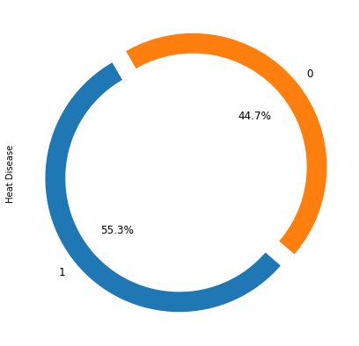
Q: What is the ratio of person having heard disease or not?
Observations:
It is a balanced dataset.
Around 55% of people have heart disease.

Slide 5
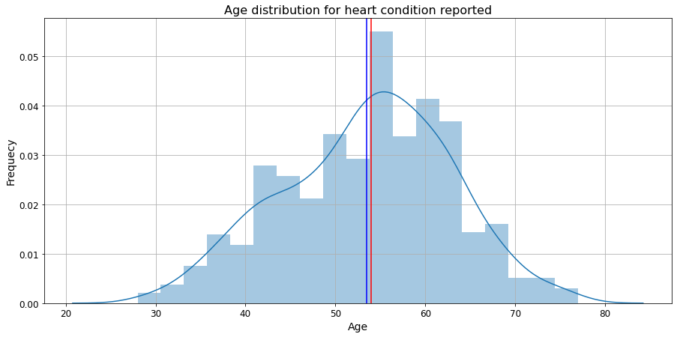
Q: Age distribution in recorded data?
Observations:
Between ages 50 to 65 most people have reported about their health.
The mean and median are close to each other.
Dataset is normally distributed.

Slide 6
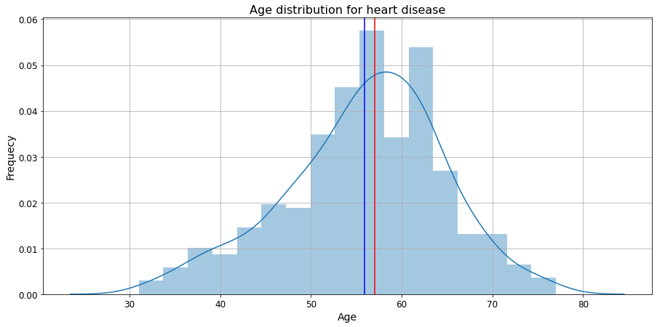
Q: Age distribution in a person having heart disease?
Observations:
Between the ages of 50 and 65, most people have heart disease.
The mean and median are almost close to each other.
There is a very small right-skewed.

Slide 7
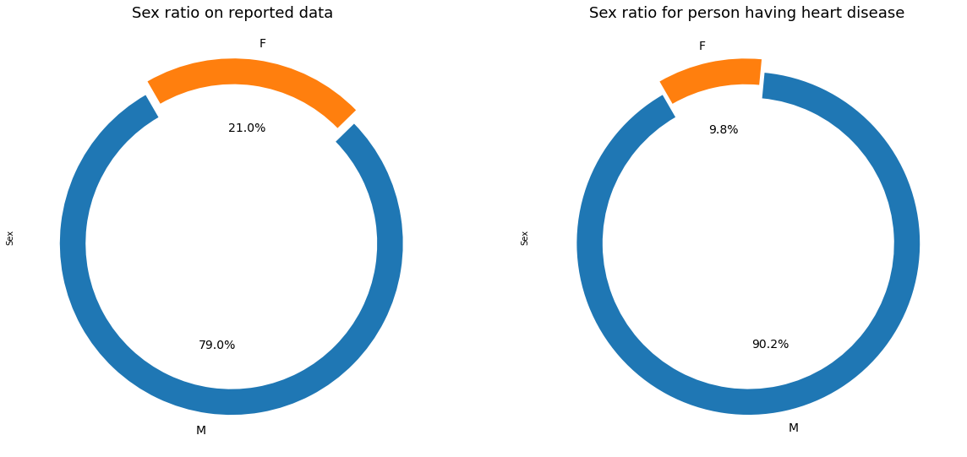
Q: Sex ratio for total reported cases and person have heart disease?
Observations:
70% of reported cases are male.
The ratio is not balanced.
People who have heart diseases have 90% male category.
It might be the case that many females who are suffering from heart disease are not reporting it.

Slide 8
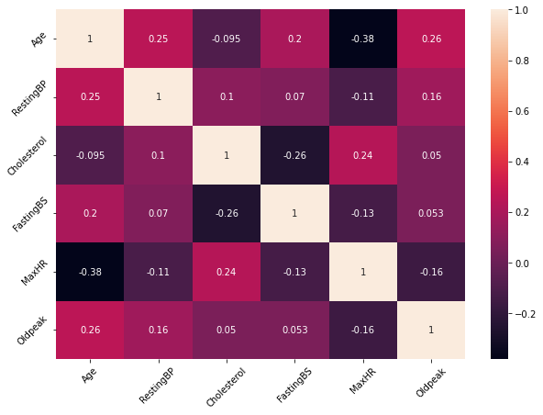
Observations:
All features are not highly correlated.
Some of features are negative correlated.

Slide 9
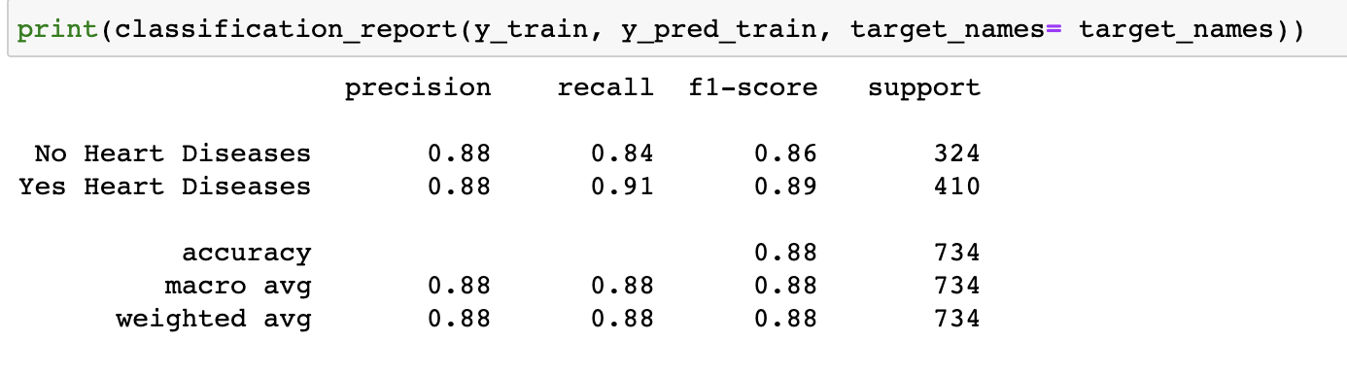
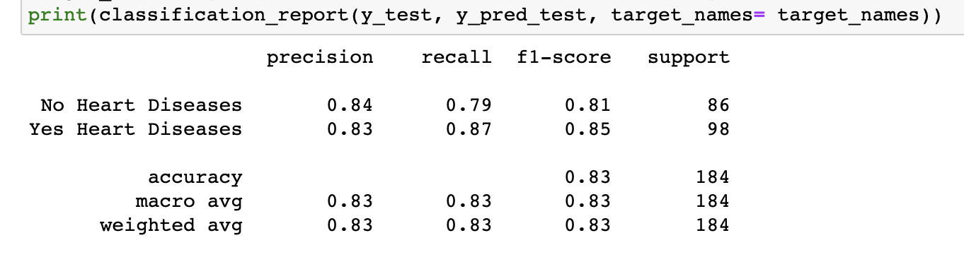
Logistic Regression Report
Model Development & Evaluation

Slide 10
Logistic Regression Report
Model Development & Evaluation
As per the problem statement reducing False negatives is more important hence improving recall.
Accuracy of train and test data are 88% and 83%.
Model is towards overfitting and will try to improve.
Recall of train and test is 91% and 87%.
We definitely need to improve our model.

Slide 11
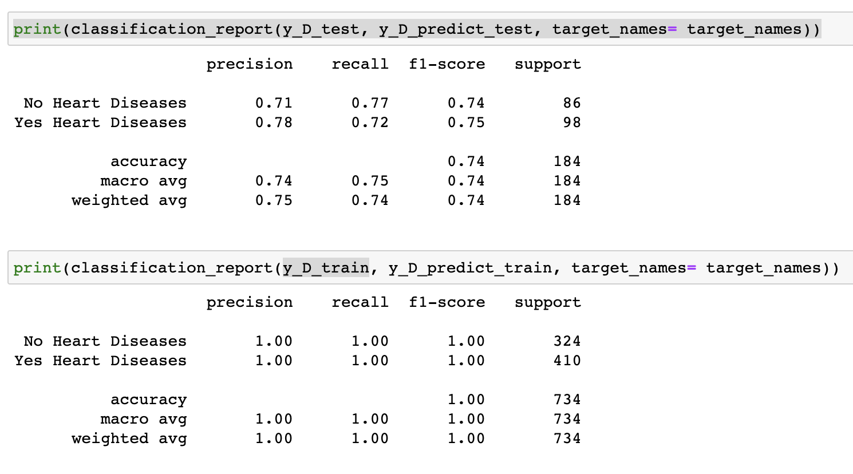
Decision Tree Classifier Report
Model Development & Evaluation

Slide 12
Decision Tree Classifier Report
Model Development & Evaluation
Model is working very well in train data.
Model is not working very well on test data.
It is a very much overfitted model.
We will select the LogisticRegression model.
We will use other model techniques in future terms to increase the performance of the model.

Slide 13
Conclusion
DecisionTreeClassifier is known for overfitting, which is very evident in this dataset.
Logistic regression have better result in dataset, but there is scope of improvement.
We will use another model or hyperparameter to increase the performance of the model.

