Slide 1
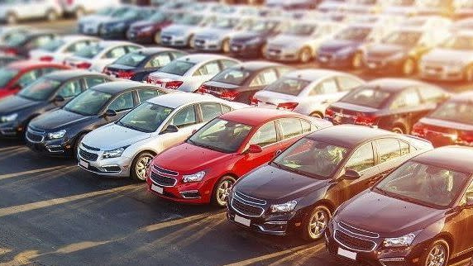
Selling price prediction of Cars secondhand market using Linear Regression

Slide 2
Introduction
Even as new car sales have slowed down in the recent past, the pre-owned car market has continued to grow over the past year and is larger than the new car market now.
Experts said a slowdown in new car sales could mean the demand is shifting towards the pre-owned market. In fact, some car sellers replace their old cars with pre-owned cars instead of buying new ones.
In the increasingly competitive environment, enterprises have to create a decision-making model for precision marketing on provide right value to particular brand.
The case study considers a marketing problem of find right value and good condition pre-owned car.
This case study demonstrates that our proposed decisions and insights are capable of providing a good precision marketing strategy.
The real-world data from a Car Dekho were collected and used in this case study to illustrate how to implement EDA.

Slide 3
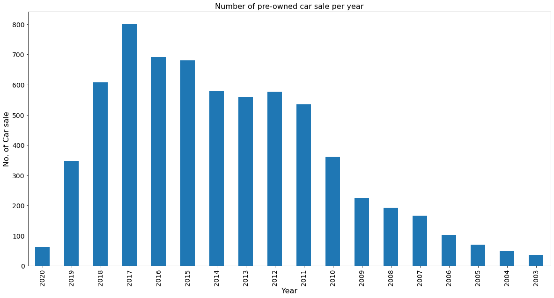
Q: What is the sale of car across each year?
Observations:
In 2017 we had the highest number of sales of pre-owned cars.
There is an increase in sales from 2003 to 2017.

Slide 4
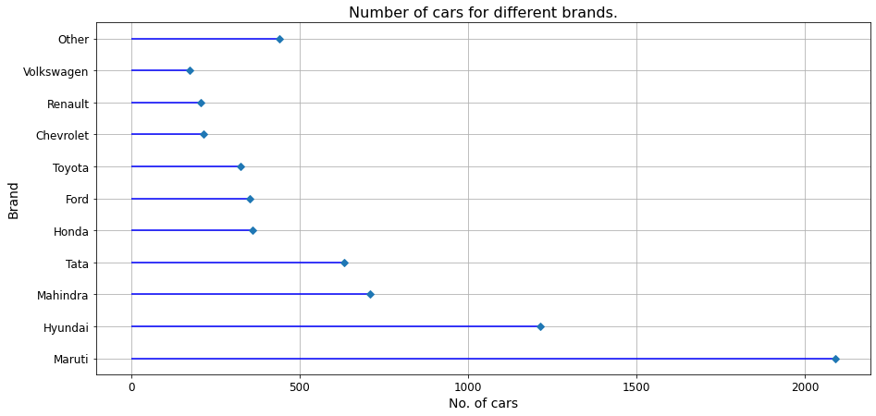
Q: Which brand is more popular in market?
Observations:
Maruti, Hyundai, Mahindra and Tata hold most of the cars in the market.
Out of which Maruti is almost double from second top Hyundai.

Slide 5
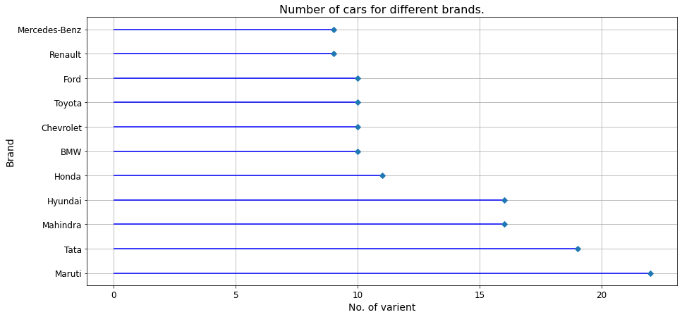
Q: Which brand have most variety of cars in the market?
Observations:
Maruti, Tata, Mahindra, Hundai have most number of varient in market.

Slide 6
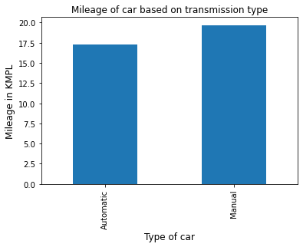
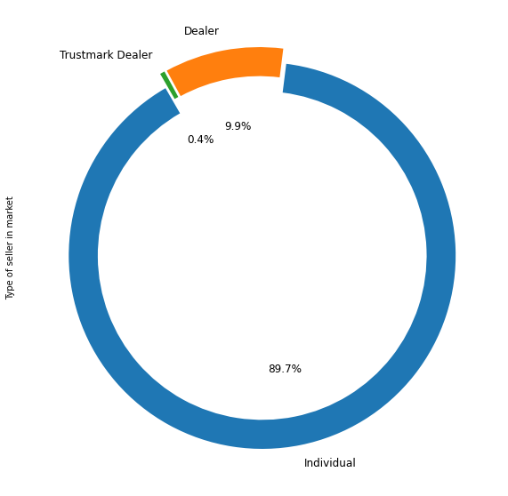
Q: What kind of sellers are there in the market?
Observations:
People prefer selling cars by themself.
Dealers are in market but very few of them are trusted delaer.
Q: Which type of car has a better average?
Observations:
Manual cars have better average.

Slide 7
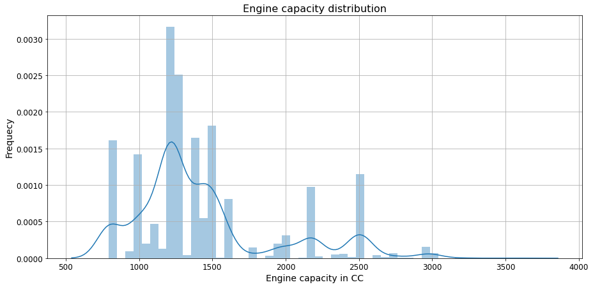
Q: Range of CC common in most of cars
Observations:
Engine CC with a range of 1000 to 1500 is more common in cars.
There are few cars of 2000 and 2500 CC in the market.

Slide 8
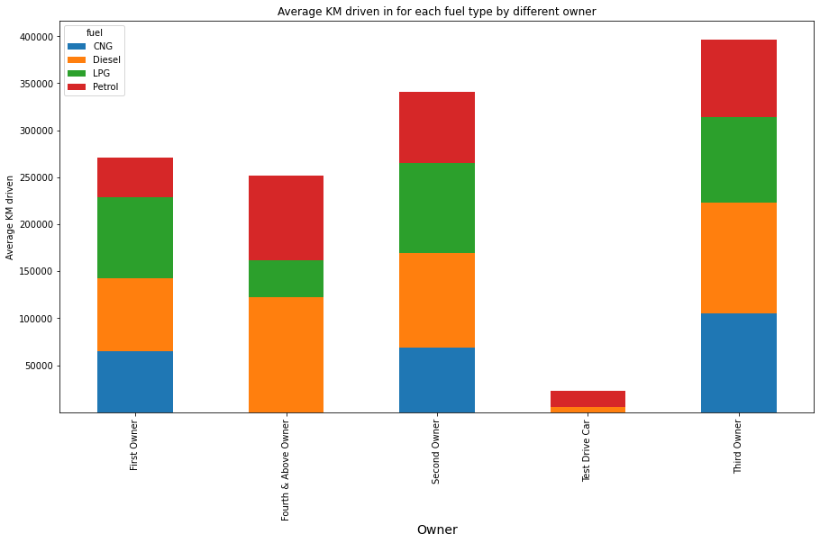
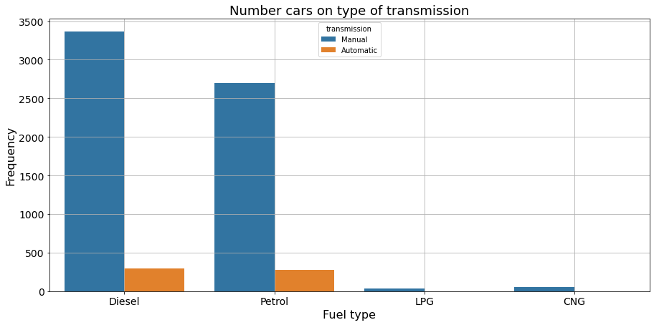
Q: Which fuel type has more demand among owners?
Q: Which fuel type of car has better selling price?
Observations:
Test drives are mostly done on petrol variant
Diesel cars are used most out of all variant
Observations:
Automatic diesel has better resale value.
The resale of the Manual variant is almost similar to all fuel types.
LPG and CNG are not much popular in Automatic.

Slide 9
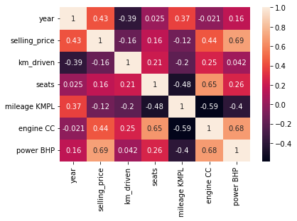
Observations:
The selling price is increasing with an increase in Engine CC and Power.
Mileage doesn't have much impact on the selling price of the car.

Slide 10
Linear regression model
We will develop Linear Regression model
We will made different linear model by changing test size and it’s randomness
Then we will analyze the results obtained and make our observations.
For evaluation purpose we will focus on RMSE, R2 and Adjusted R2 scores.
We will conclude if our model have is right fitted, overfitted or underfitted.

Slide 11
Model No. | Criteria | R2 | Adjusted R2
Model 1 | Random State: 1, Split 20% | 0.71 | 0.76
Model 2 | Random State: 2, Split 25% | 0.67 | 0.66
Model 3 | Random State: 3, Split 30% | 0.73 | 0.72
Model Evaluation
Model 1 is not so good. Different between train and test id 5%
Model 2 is an under-fitted model.
Model 3 is little better that model 1. But we will work on finding some better model.

Slide 12
Conclusion
Diesel cars are more popular in the market.
2011 to 2018 may people opted for pre-owned cars
Maruti, Hyundai, Mahindra and Tata are top-selling cars.
Most cars of range of 1000 to 1500 CC
Automatic transmission cards are getting popularity, instead of little advantage in mileage in manual cars.
We didn’t get good model to predict car price.
We try to leverage other model techniques to improve R2 and Adjusted R2

