Slide 1
ADPG
Adaptive Demotion Policy with Global fluctuations of Priority Values
Piyush Deshpande
Ranjan Raut
Rohan Hulsure
Vatsal Vador

Slide 2
Outline
ADPG Recap
Environment setup
Benchmark Results
Analysis
Conclusion
References

Slide 3
What is ADP-G ? Recap

Slide 4
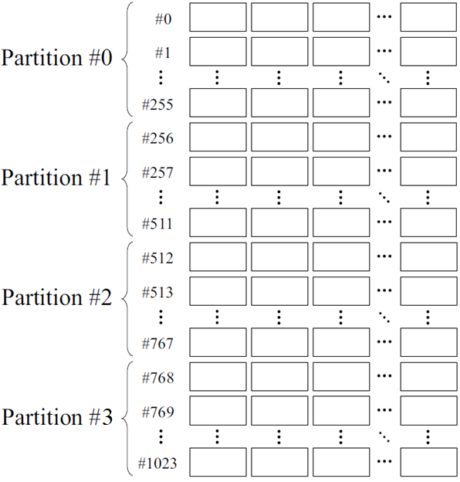
1 way
2 way
3 way
n way
Notes:
Explain partitioning and why its important for ADPG

Slide 5
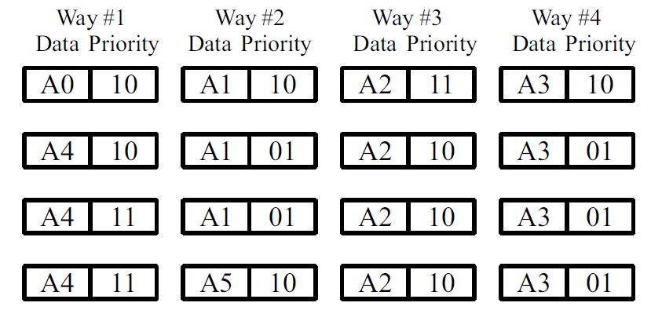
Priority Value to each Cache Block
Notes:
Zoomed version of previous slide section

Slide 6
IPDS Policies
Insertion
I0
I1
I2
I3
Promotion
Hit Priority
Frequently Priority
Demotion
Half Of Average
Average
Selection
Left-side
Random
Notes:
Talk about IDPS in detail according to time we have

Slide 7
Why do we need Partitions ?
Notes:
OBJECTIVE : Large, Fast and Cheap memory

Slide 8
How it helps capture locality in application ?
Notes:
program access a relatively small portion of address space at any instant of time,
temporal (time) locality is something which is referenced has high probability to be referenced again soon,
spatial (space) locality is something which is referenced, its close address are having high probability to referenced soon,
and that is the key for hardware to rely on speed for last couple of years.
Cache are like hash table but the difference is that in hash table we can keep inserting keys so eventually it will grow big but here we have to replace those old keys with new one
so we need some sort of mechanism which will map big address range to small cache memory that we have so we come up with the concept of set associativity or we can say that we
partitions the cache. It helps in locality.

Slide 9
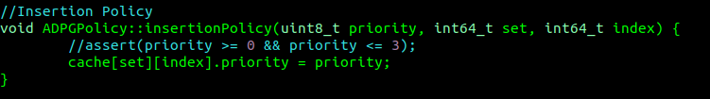
Insertion Policy
Decides incoming priority of incoming block
Ex: I0 policy sets initial priority as 00,
I1 policy sets initial priority as 01,
I2 policy sets initial priority as 10,
I3 policy sets initial priority as 11.
Code Snippet:
Notes:
Things to consider that when there is incoming block with lower priority value then already present in set then that incoming block won’t be referred and instead without re-reference it get evicted.
Where are in situation like initial propriety of incoming block is higher than already present in the group then it supports temporal locality.

Slide 10
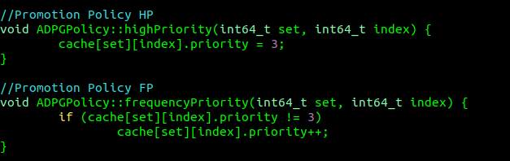
Promotion Policy
It cares to improve the priority of hit block when we get hot.
Possible policies are Highest Priority in which it will be set to highest priority in block where for Frequently Priority it will increase the priority by one value.
Code Snippet:

Slide 11
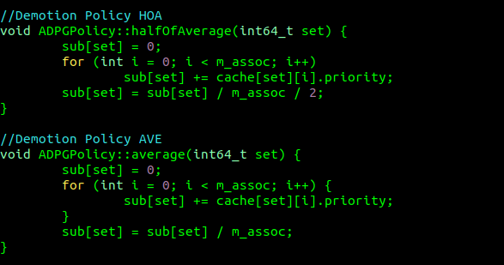
Demotion Policy
It decides how to reduce the priority of the blocks when the cache is accessed .
Possible demotion policies we have are Half Of Average (HOA) and Average Policy for same where HOA will decrease the priority of all blocks by half of average of all priority values in set. And average policy will decrease priority values by average of all blocks in set.

Slide 12
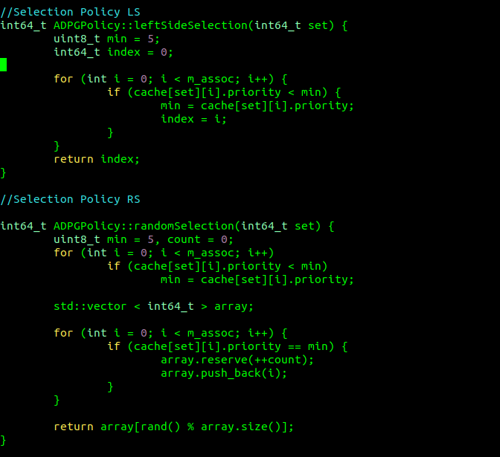
Selection Policy
This policy helps to select victim by selecting the block which has the smallest priority value.
If multiple blocks have same minimum priority then either Left-side Selection Policy in which leftmost candidate or Random Selection Policy in which random candidate is selected is applicable.

Slide 13
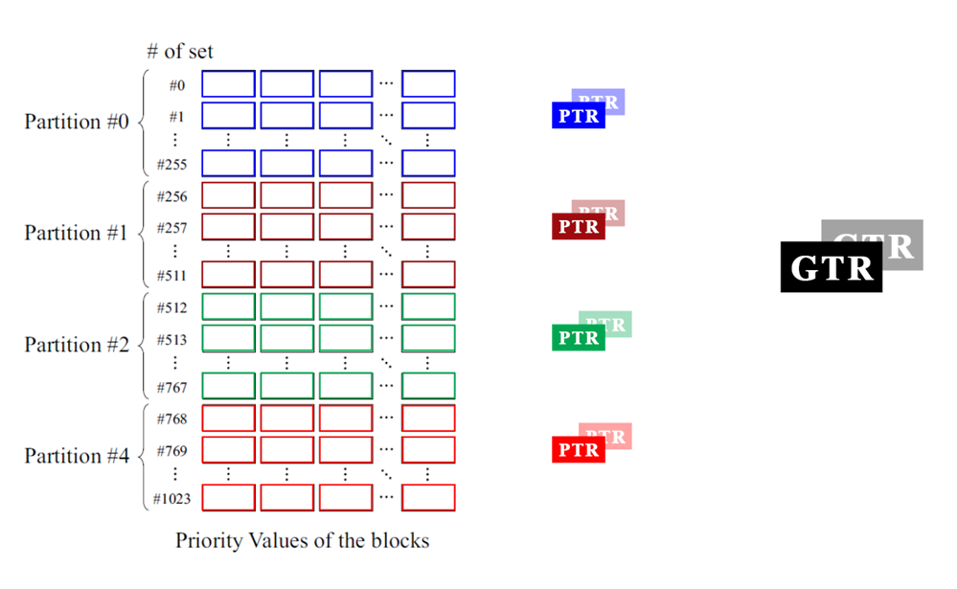
Mapping GTR & PTR
Notes:
Explain about register mappings

Slide 14
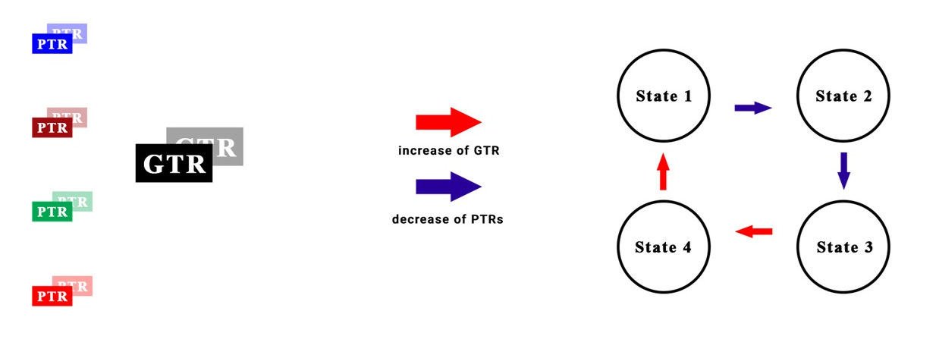
Global Fluctuations
State 1
State 2
State 4
State 3
Notes:
Show global fluctuations

Slide 15
Implementation

Slide 16
Environment Setup
GEM5 provides system-level architecture. Simulation helps to analyse real-time performance.
RUBY memory module used.
Protocol used: MESI_THREE_LEVEL.
Architecture : X86
Output Dir : gem5/m5out/stats.txt
Integrated Spec CPU 2017 with GEM5 for benchmarking.

Slide 17
Environment Setup: Config
Cache Parameters Used
Cache Level | Size | Assoc.
L1I | 32Kb | 8
L1D | 32Kb | 8
L2 | 256Kb | 8
L3 | 2MB | 16
Main Memory | 4GB | -
Table 1: Cache Parameters

Slide 18
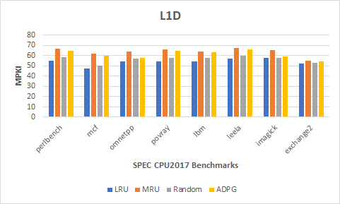
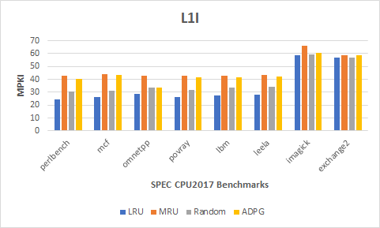
Benchmark Results

Slide 19
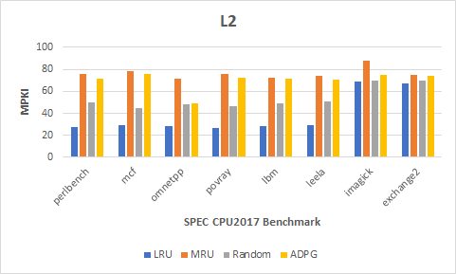
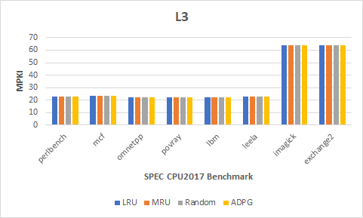
Benchmark Results

Slide 20
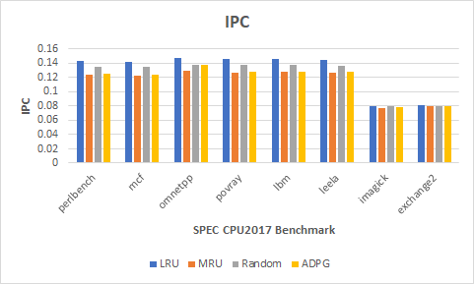
Benchmark Results

Slide 21
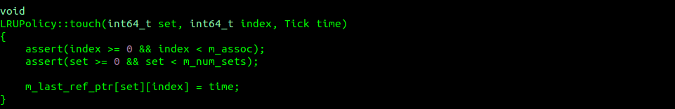
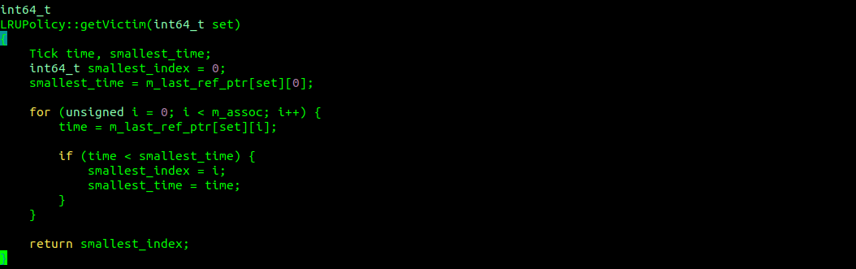
Analysis : LRU

Slide 22
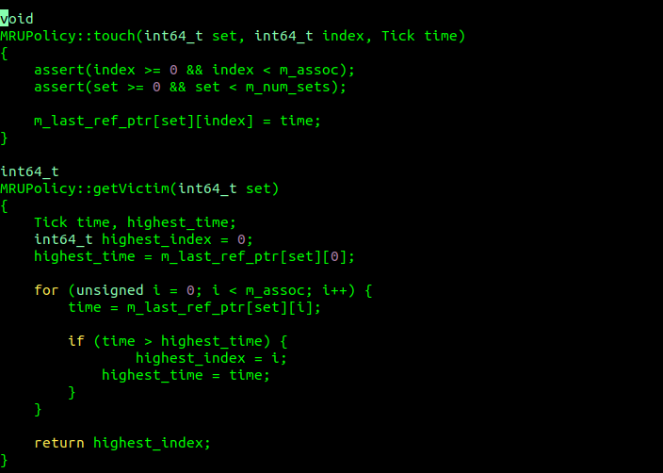
Analysis : MRU

Slide 23

Analysis : Random

Slide 24
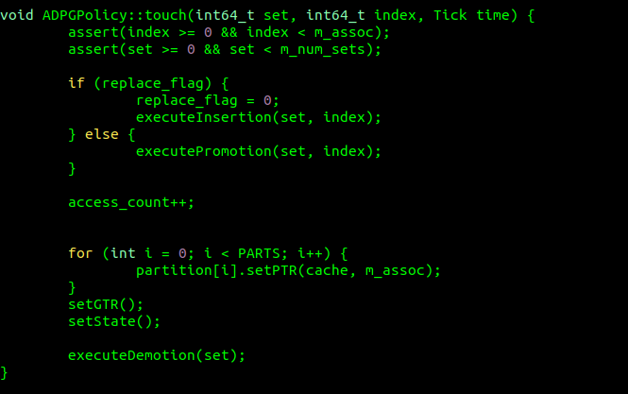
Analysis : ADP-G Hit

Slide 25

Analysis : ADP-G Hit

Slide 26
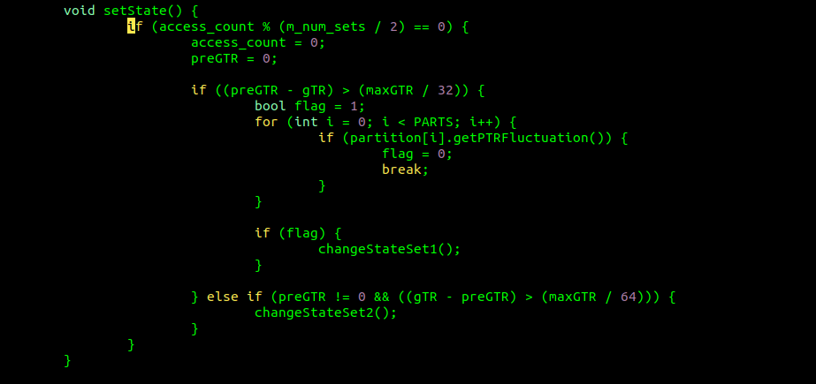
Analysis : ADP-G HIT Check State

Slide 27
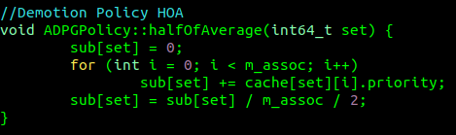
Analysis : ADP-G HIT

Slide 28
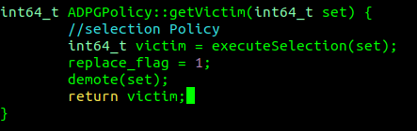
Analysis : ADP-G Miss

Slide 29
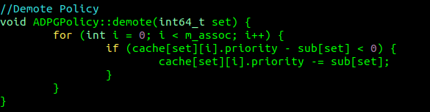
Analysis : ADP-G Miss

Slide 30
Analysis – What went wrong !
Many Data Elements for this Algorithm:
Priority[set][assoc]
Partitions[n]
PTR, prePTR, startSet, endSet
SubtractionValue[set]
GTR, prePTR

Slide 31
Analysis : ADP-G HIT
Check whether hit is after Miss
Yes, then use insertion policy (according to current state)
No, then use promotion Policy (according to current state)
Set Values for PTRs, prePTRs, GTR, preGTR
Check interval, whether to look for state change
Yes, then check threshold for difference between GTR and preGTR
Check difference between PTR and prePTR across all partitions
If yes, then change state
Calculate Subtraction Value (according to current State)

Slide 32
Analysis : MISS
Use selection policy to find eviction block (according to current state)
Check minimum priority from all blocks in a set
Calculate total occurrences of minimum priority
If found more than one, then select either Leftmost or Random
Demote all block priority values by subtraction value in a set

Slide 33

Analysis : Too many computations !

Slide 34
Conclusion
We started with a need for a dynamic policy which will change policies according to the behavior of the application
We were able to achieve dynamic selections of the policies.
But, this has large overhead for computations and state changes
Among the experimented policies LRU out-performed others.

Slide 35
References
Jubee Tada, “A Cache Replacement Policy with Considering Global Fluctuations of Priority Values” in 2018 Sixth International Symposium on Computing and Networking Workshops (CANDARW).
J. Tada, et al., ”An Adaptive Demotion Policy for High-Associativity Caches,” in Proceedings of international symposium on Highly Efficient Accelerators and Reconfigurable Technologies (HEART2017) , 2017.

Slide 36
Questions?

