Slide 1

Deciphering Infant Distress: Unveiling the Hidden Patterns Behind Baby Cries Using Machine Learning Techniques

Slide 2

Introduction
Infant cry signals are complex and multifaceted, often containing subtle variations that convey important information about the baby's needs and emotional state. Analyzing these signals requires a nuanced understanding of signal processing techniques and machine learning algorithms.
In this study, we explore the use of advanced methods to decode the rich information embedded within infant cry signals, with the aim of improving our ability to understand and respond to the needs of infants

Slide 3

Research Objective
Develop a machine learning model for automated cry analysis.
01
Assist caregivers in identifying infant needs more effectively.
02
Classify different types of infant cries accurately.
03

Slide 4
Methodology
Data Collection
Data Preprocessing
Feature Extraction
Model Training
Testing
Final Model Selection
Model Evaluation

Slide 5
Dataset Overview
Dataset source : Donate-a-cry campaign
Classes:
Hungry (hu)
Needs to burp (bu)
Belly pain (bp)
Discomfort (dc)
Tired (ti)
Lonely (lo)
Cold/hot (ch)
Scared (sc)
Don’t know (un)

Slide 6
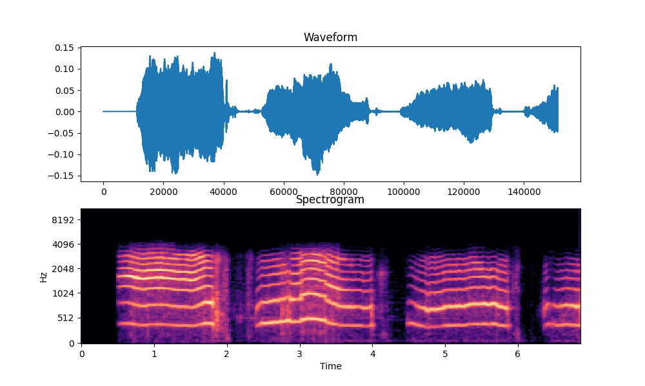
Signal Analysis
Analyze the acoustic properties of infant cry signals to extract relevant features for classification.
Methods:
Waveform Visualization: Visualize the amplitude of cry signals over time to understand their temporal characteristics.
Spectrogram Analysis: Convert cry signals into spectrograms to examine their frequency content and variations.

Slide 7
Feature Extraction
Mel-frequency cepstral coefficients (MFCCs) in speech and audio processing tasks, including cry classification.
MFCCs: MFCCs represent the short-term power spectrum of a sound signal in a compact manner, capturing both frequency and temporal information.
Significance: capture relevant acoustic characteristics

Slide 8
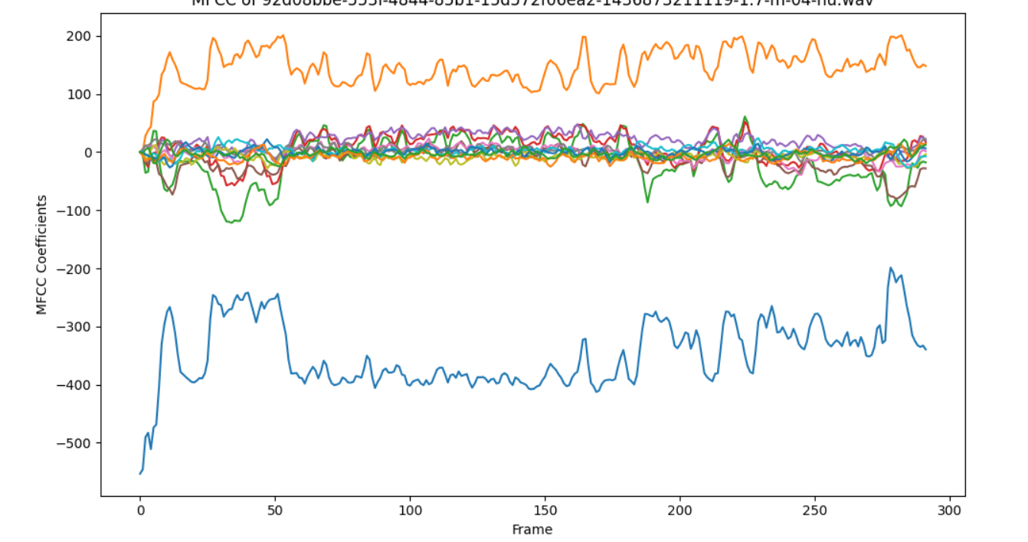
MFCC
Pre-emphasis: Enhances high-frequency components to improve signal-to-noise ratio.
Framing: Divides the signal into short frames (typically 20-40 ms) with overlap.
Windowing: Applies a window function (e.g., Hamming window) to each frame to reduce spectral leakage.
Fast Fourier Transform (FFT): Computes the power spectrum of each frame.
Mel Filterbank: Applies a set of triangular filters spaced in the mel-frequency scale to the power spectrum.
Logarithm: Takes the logarithm of the filterbank energies.
Discrete Cosine Transform (DCT): Computes the DCT of the log filterbank energies to obtain the MFCCs.
Features: MFCCs capture both spectral and temporal characteristics of the audio signal
Significance: MFCCs provide a compact and informative representation of the acoustic features

Slide 9
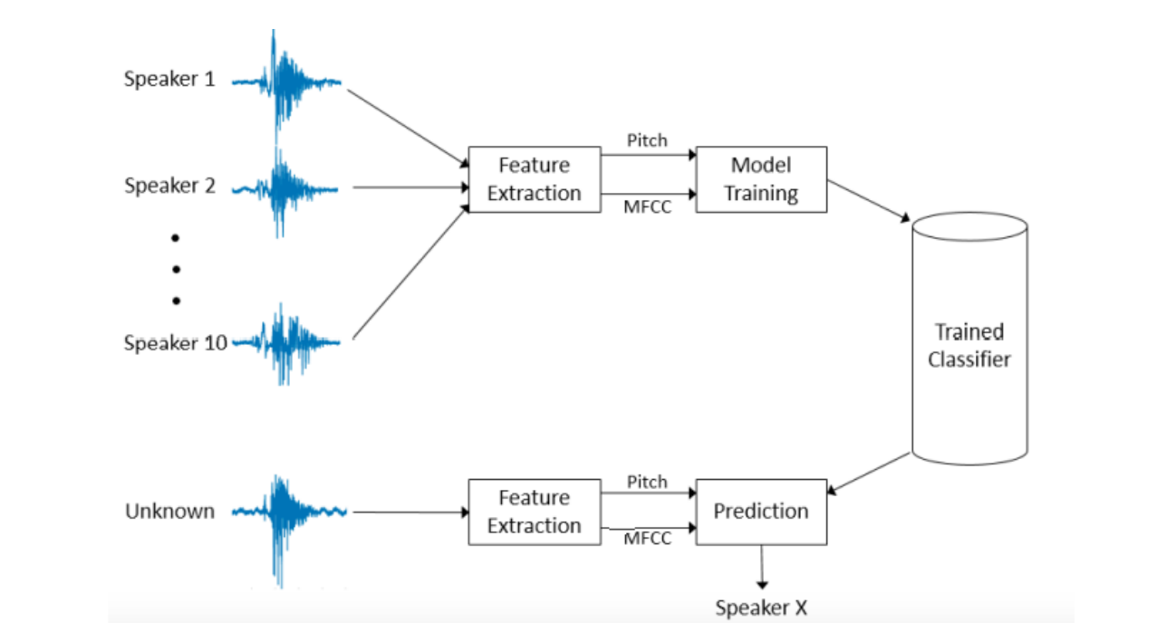
System Architecture

Slide 10
Cry Detection Algorithm
SVM
Logistic Regression
Feature Extraction
Decision Tree
Random Forest

Slide 11
Model Evaluation (SVM)
Accuracy
62%
Precision
75%
Recall
61%

Slide 12
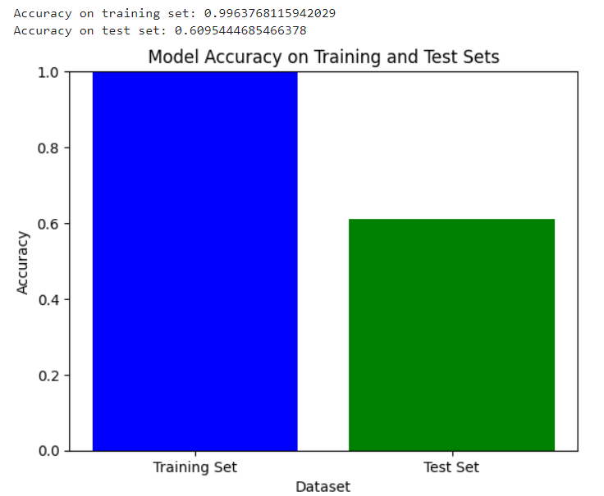
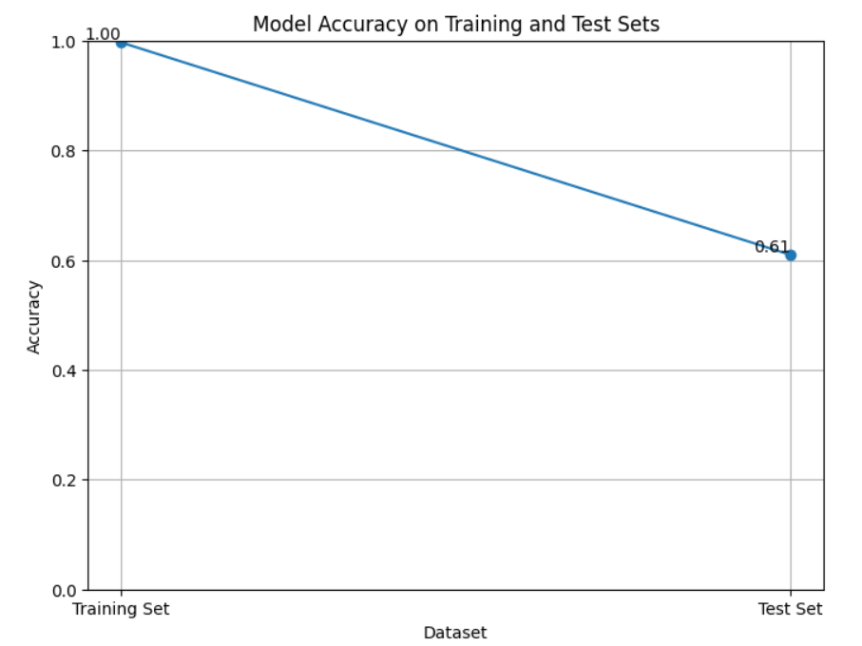
Model Performance

Slide 13
Challenges and Limitations
Limited Dataset Size
Class Imbalance
Variability in Cry Patterns
Factors such as background noise, environmental conditions, and variations in recording equipment could affect the algorithm's performance in practical applications.
Inadequate feature representation or selection may lead to suboptimal performance

Slide 14
Future Directions
Dataset Expansion
Feature Engineering:
Exploring advanced feature extraction methods and signal processing techniques
Convolutional neural networks (CNNs) and recurrent neural networks (RNNs), for automatic feature learning from raw cry audio data.
Real-World Deployment:
Conducting extensive testing and validation of the cry detection algorithm in real-world settings, including healthcare facilities, childcare centers, and home environments.
Collaborating with domain experts, healthcare professionals, and caregivers to gather feedback and iteratively improve the algorithm's performance and usability.
Integration with Assistive Technologies:
Integrating the cry detection algorithm into assistive technologies, such as smart baby monitors, mobile applications, and wearable devices, to provide real-time monitoring and early detection of infant distress signals.
Exploring potential applications in telehealth and remote monitoring systems for supporting caregivers and healthcare providers in infant care.
Collect data from different sources.
Experimental data

Slide 15
Real-World Applications
Healthcare Settings:
Early detection of infant distress signals, such as hunger, pain, or discomfort, can aid healthcare professionals in timely intervention and treatment.
Integration of cry detection technology into neonatal intensive care units (NICUs) and pediatric clinics can assist medical staff in monitoring infant health and development.
Childcare Assistance:
Smart baby monitors equipped with cry detection algorithms can provide real-time alerts to parents or caregivers when the infant exhibits signs of distress.
Remote monitoring systems enable caregivers to respond promptly to the infant's needs, even when they are not in close proximity.
Parental Support:
Mobile applications and wearable devices equipped with cry detection technology offer parents valuable insights into their infant's behavior and well-being.
By understanding the meaning behind different cry types, parents can better respond to their infant's needs and strengthen the parent-child bond.
Telehealth and Remote Monitoring:
Telehealth platforms leverage cry detection technology to enable remote consultations between healthcare providers and parents/caregivers.
Remote monitoring systems offer scalable solutions for population-wide screening and early detection of developmental delays or health concerns in infants, particularly in underserved or rural communities.

Slide 16

Conclusion
Successfully developed and implemented cry detection algorithms for infant.
Demonstrated the efficacy of signal processing techniques and machine learning models in classifying different types of infant cries.
Explored the potential of cry detection technology in real-world applications, including healthcare settings, childcare assistance, and parental support.
Highlighted the significance of cry detection technology in early detection of infant distress signals and timely intervention.
Summarized the project's contributions to the field of infant health monitoring and care.

Slide 17
Thank You

