Slide 1

Analysis of Online Poker Network
Ranjan Kumar Singha (2023EET2192)
Sagar Karar (2023EET2755)
Supervisor: Dr. Sougata Mukherjea
Computer Technology
Electrical Engineering Department
IIT Delhi

Slide 2
Contents
Introduction & Motivation
Problem Statement
Related Work
Approach & Methodology
Results
Conclusion & Future Work

Slide 3
Introduction & Motivation
Online poker is a lucrative business for hosting sites and a passion for many enthusiasts. We are interested in understanding the dynamics of how the elite players (i.e. the professionals) interact with others in the network, including how they select which opponents to play with and where their winnings come from Also a major focus is been on the result of the gameplay between two players who have never played against each other and predict the outcome.

Slide 4
Problem Statement
To determine if any concrete differences exist between how poker players of different skill levels and styles connect to the graph. Also, determine key summary statistics that predict how money will flow on the network of players and which types of players they fare better or worse against.

Slide 5
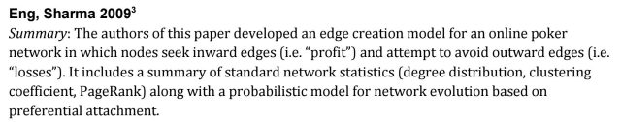
Related Work

Slide 6
Dataset
Dataset Overview:
Kaggle dataset of online poker network
Link - https://www.kaggle.com/datasets/sagarkarar/onlinepokerdataset

Slide 7
Approach and Methodology
We will create an edge creation model for an online poker network in which nodes seek inward edges (i.e. "profit") and attempt to avoid outward edges (i.e. "losses”). It includes a summary of standard network statistics (degree distribution, clustering coefficient, PageRank) along with a probabilistic model for network evolution based on preferential attachment.
Steps for creation of the model:
Step 1: Extract the dataset of poker network and connect the nodes with weighted edges given in the data set . The inward direction of the edge represents profit for a node and outward edge represents loss for a node.
Step2: The player interaction network can be build based on the above criteria and the player interaction graph can be formed which is shown below :

Slide 8
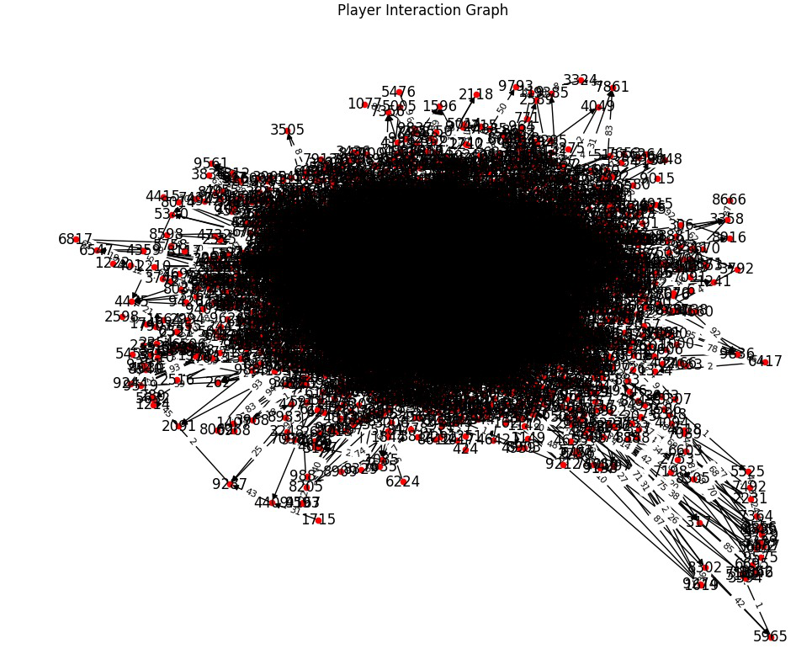

Slide 9
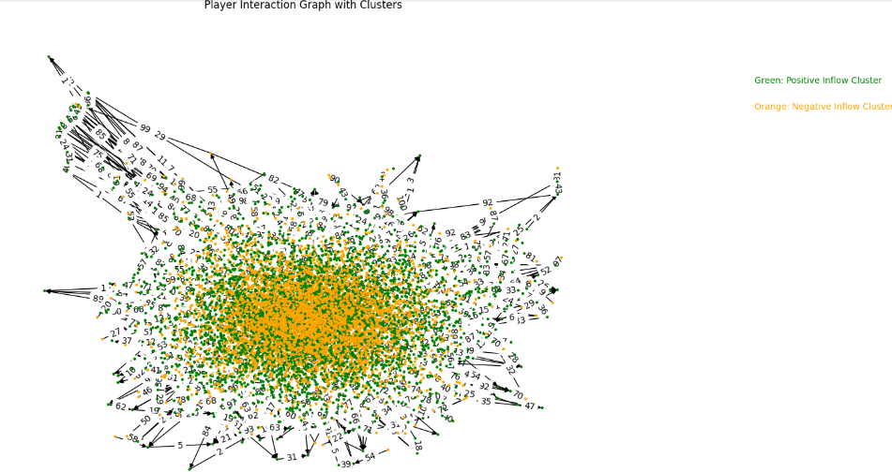
Step 3: Calculating the net flow of each player and form clusters based on the
positive and negative outflows . The clusters have been represented below:

Slide 10
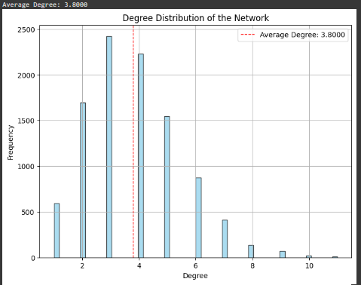
Step 4 : To calculate The average degree of a player/node which corresponds to whether a player is a regular player in the graph or an irregular player. The degree distribution graph is shown below:

Slide 11
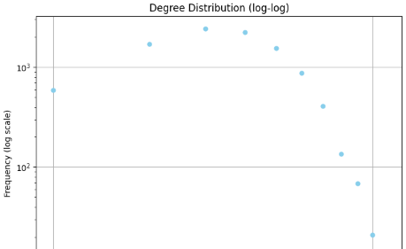
The degree distribution of the network based on the log-log scale which follows power law. The graph is shown below:

Slide 12
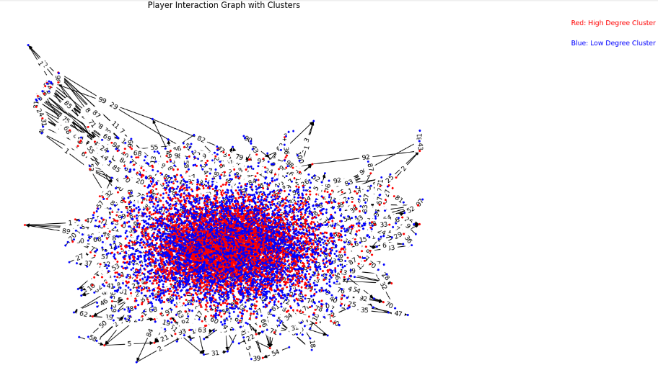
The Clusters of players termed as high degree and low degree cluster of the players determine the regularity of the graph

Slide 13
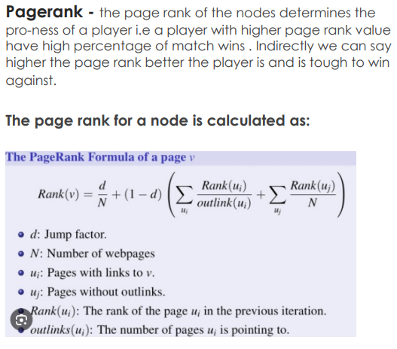

Slide 14
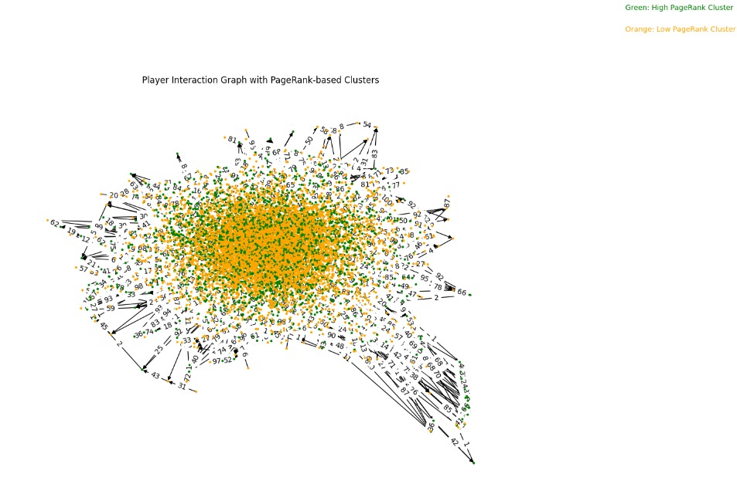
Step 5: To calculate the page rank of the nodes which determine the pro-ness of a player i.e a player with higher page rank value have high percentage of match wins . Indirectly we can say higher the page rank better the player is and is tough to win against. The page rank based cluster is shown below:

Slide 15
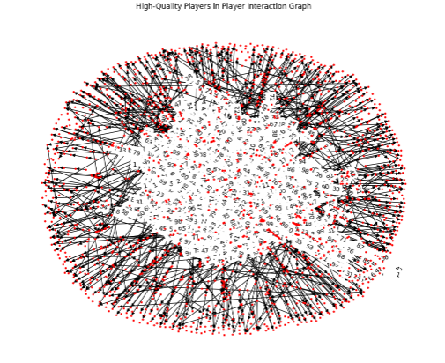
Step 6: Determine the high quality players in the graph by taking intersection of the high degree cluster, high page rank cluster and positive outflow cluster . This cluster shown below denotes the Hub of the network.

Slide 16
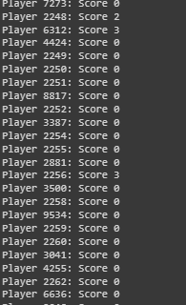
Step 7 : calculate the authority score of each node . The authority score of a node denotes the number of players a player has beaten from the hub of high quality players.

Slide 17
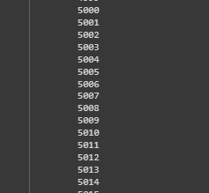
Step 8 : Analyse a particular node/player in the graph to determine which whom the player has not played against in the graph. In the figure shown below the player node analysed in node -6

Slide 18
Step 9: calculate the likelihood of a player to win against a player whom he has not played with beforehand.
The Likelihood of a player to win depend on the 4 parameters discussed previously :
--- PageRank of a node
--- NetFlow of a node
--- Degree of a node
--- Authority score of a node.
The results have been shown in the next page.

Slide 19


Results

Slide 20
Conclusions and Future Work
Transactional Interactions: Understanding the flow of funds between players sheds light on the network's financial dynamics and player behavior.
Network Structure: Identification of influential players, hubs, and patterns within the network contributes to comprehending its topology and potential vulnerabilities.
Future Scope : Implement machine learning algorithms for predictive analysis, anomaly detection

Slide 21
Reference
CS 322: Social and Information Network Analysis Professor Jure Leskovec, Autumn 2009
Analysis of Online Poker Network : Graham Yennie, Michael Jermann, Kartik Trasi, Stanford University, December 11, 2016
J. Saramaki, M. Kivela, J.-P. Onnela, K. Kaski, and J. Kertesz. Generalizations of the clustering coefficient to weighted complex networks. Physical Review, 2007.
Zhang and S. Horvath. A general framework for weighted gene co-expression network analysis.

Slide 22
Thank You.

