Slide 1

CUSTOMER BEHAVIOR
ANALYSIS REPORT
A Data-Driven Study of Shopping Patterns, Revenue Drivers,
and Strategic Customer Insights
Tools: SQL | Python | Power BI
Portfolio Project — Data Analyst
By: Chittaranjan Mohapatra
Data Analytics Portfolio | 2026

Slide 2
EXECUTIVE SUMMARY
Data Stack
Dataset
Python (Pandas) for data wrangling, MySQL for EDA, and Power BI for interactive dashboards — a complete modern analytics pipeline.
3,900 customer records across 18 features including demographics, purchase history, behavior, and shipping preferences.
Objective
Outcome
Identify strategic opportunities for revenue growth by analyzing shopping patterns, subscription behavior, and product performance.
Clear roadmap to optimize marketing, refine subscriptions, improve cross-selling, and drive acquisition of new customer segments.
1

Slide 3
DATASET OVERVIEW
3,900
18
37
Customer Records
Feature Columns
Imputed Values
Demographics
Purchase Details
Shopping Behavior
Age · Gender · Location · Subscription Status
Item · Category · Amount · Season · Size · Color
Discounts · Promo Codes · Frequency · Reviews · Shipping

Slide 4
METHODOLOGY & DATA ENGINEERING
Data Imputation
Feature Engineering
Missing review ratings algorithmically imputed using median rating per product category. Ensuring statistical integrity across 37 null values.
Age groups segmented into Young-Adult, Adult, Middle-Aged, Seniors. Purchase frequency strings mapped to numeric day intervals for time-series evaluation.
01
02
Database Integration
Exploratory Analysis
Column names standardized to snake_case. Refined dataset pushed to MySQL via SQLAlchemy for agile, efficient querying.
10 targeted SQL queries crafted to answer strategic business questions around revenue, customers, products, and subscriptions.
03
04

Slide 5
SQL ANALYSIS: REVENUE BY GENDER
$157,890
Male Revenue
67.8% of total revenue
$75,191
Female Revenue
32.2% of total revenue
🔑 Revenue gap of $82,699 — untapped female market

Slide 6
PRODUCT RATINGS & DISCOUNT-DEPENDENT ITEMS
Discount-Dependent Products
Hat
50.00%
Sneakers
49.66%
Coat
49.07%
Sweater
48.17%
Pants
47.37%
⚡ Nearly 50% of purchases on these items use discounts — margin risk

Slide 7
SUBSCRIPTION MODEL ANALYSIS
7.3%
Subscription Rate
Only 1,053 of 3,900 customers
$59.49
Avg Spend – Subscribers
Per transaction average
$59.87
Avg Spend – Non-Subscribers
No significant spend difference
Null hypothesis confirmed: subscribers do NOT spend more

Slide 8
CUSTOMER SEGMENTATION & AGE GROUP REVENUE
🏆 80% of customers are Loyal (11+ purchases) | Young Adults lead revenue at $62,143 | Only 83 new customers — acquisition gap!

Slide 9
CATEGORY PERFORMANCE & SHIPPING ANALYSIS
Express Shipping
$60.48 avg purchase
Higher-value customers prefer express
Standard Shipping
$58.46 avg purchase
Marginal difference vs express
Top Products Per Category
Accessories
Clothing
Footwear
Outerwear
Jewelry · Sunglasses · Belt
Blouse · Pants · Shirt
Sandals · Shoes · Sneakers
Jacket · Coat

Slide 10
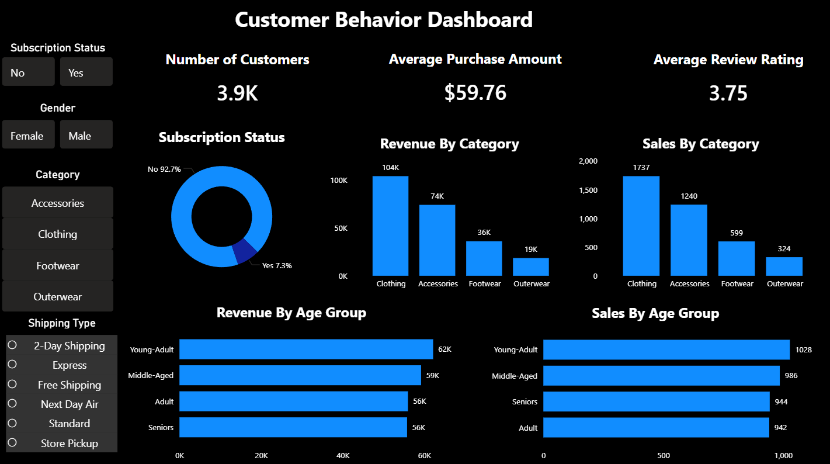
POWER BI DASHBOARD — KEY METRICS
3.9K
$59.76
3.75
7.3%
Total Customers
Avg Purchase
Avg Rating /5
Subscription Rate
Dashboard Findings
Clothing generates ~$104K — highest revenue category
Young Adults lead both revenue ($62K) and sales volume (1,028)
Non-subscribers generate $170,436 vs subscribers' $62,645
No female customers are enrolled in subscriptions
Average review rating of 3.75/5 shows room for improvement
Interactive Power BI Dashboard provides on-demand
insights for stakeholders

Slide 11
BUSINESS INSIGHT: THE FEMALE SUBSCRIBER GAP
Critical Finding
Female-Dominated Products Bought by Males:
0 female customers are enrolled in subscriptions
Blouse
Skirt
Category | Female | Male
Accessories | 392 | 848
Clothing | 556 | 1,181
Footwear | 199 | 400
Outerwear | 101 | 223
Jewelry
Scarf
Dress
Handbag
Key Hypothesis
Males purchase female-oriented items as gifts. The company captures the buyer but misses the end user — a missed acquisition and subscription opportunity.

Slide 12
STRATEGIC RECOMMENDATIONS
1
Gift Shopping Program
2
Recipient Profiling
3
Referral-Based Acquisition
Launch 'Gifts for Her', 'Birthday Collection', 'Valentine's Collection' to drive higher cart value and improve conversion rates by 5-10%.
Add checkout option: 'Is this for Myself / Wife / Girlfriend / Daughter / Mother?' to identify actual end users for targeted marketing.
'Share this gift and get 20% off her first subscription.' Convert male buyers into brand ambassadors who introduce female end users.
4
Family Fashion Membership
5
Women's Premium Club
6
Subscription Growth Target
Shared reward points, couple discounts, birthday rewards, and early access sales for a strong multi-user retention strategy.
Free express shipping, exclusive launches, early access, fashion recommendations, loyalty rewards, and influencer perks.
Convert 5+ purchase non-subscribers via free shipping, cashback offers. Goal: grow from 7.3% to 15% within 6 months.

Slide 13
REVENUE GROWTH ROADMAP
Phase 1 · Month 1-2
Phase 2 · Month 2-4
Phase 3 · Month 4-6
Data-Driven Quick Wins
Acquisition & Onboarding
Subscription & Retention
Promote Gloves, Sandals & Boots as quality-certified
Optimize discount strategy for Hat, Sneakers, Coat
Bundle top-rated items with avg-rated for cart uplift
Launch social ads targeting Young Adults & Middle-Aged
Offer 15% first-purchase incentive for new customers
Add recipient profiling at checkout for gift buyers
Launch Women's Premium Club subscription tier
Referral program: male buyers introduce female users
Target 5+ purchase non-subscribers with perks
Target: Grow subscription rate from 7.3% → 15% | Increase female subscriber base from 0% → 20% | 5-10% AOV uplift via bundles

Slide 14
TECHNICAL SKILLS DEMONSTRATED
Python / Pandas
MySQL / SQL
Power BI
Data cleaning & imputation (37 missing values)
10 strategic business queries
Interactive multi-filter dashboard
Feature engineering (age cohorts, frequency mapping)
CTEs, subqueries, window functions (DENSE_RANK, ROW_NUMBER)
KPI cards, donut charts, bar charts
Cross-tabulations & gender-product analysis
Revenue aggregations, segmentation logic
Cross-report filtering by gender, category, shipping
Exploratory statistical analysis
CASE WHEN, GROUP BY, ORDER BY, LIMIT
Stakeholder-ready visual storytelling

Slide 15
CONCLUSION & KEY TAKEAWAYS
💡 Strong Loyalty Base
⚠️ Subscription Gap
80% loyal customers (11+ purchases) — proven foundation for premium subscription tiers and retention campaigns.
7.3% subscription rate with zero female subscribers — massive untapped revenue potential requiring targeted intervention.
🛍️ Category Power
🎯 Discount Risk
Clothing dominates at ~$104K revenue — increase inventory investment and targeted promotions in this category.
~50% discount usage on Hat, Sneakers, Coat — requires profitability analysis to protect margins.
🚀 Acquisition Opportunity
📈 Full-Cycle Analytics
Only 83 new customers — invest in digital acquisition (social ads, referrals) targeting Young Adult and Middle-Aged segments.
End-to-end pipeline from raw data → Python → MySQL → Power BI demonstrates production-ready data analyst capabilities.
Chittaranjan Mohapatra · Data Analyst Portfolio · Tools: SQL | Python | Power BI

