Slide 1

Notes:
Introduce ourselves. Every rig writes a daily report, lost time hides inside it, and our team of AI agents finds it, checks it and hands it to an engineer to approve.

Slide 2
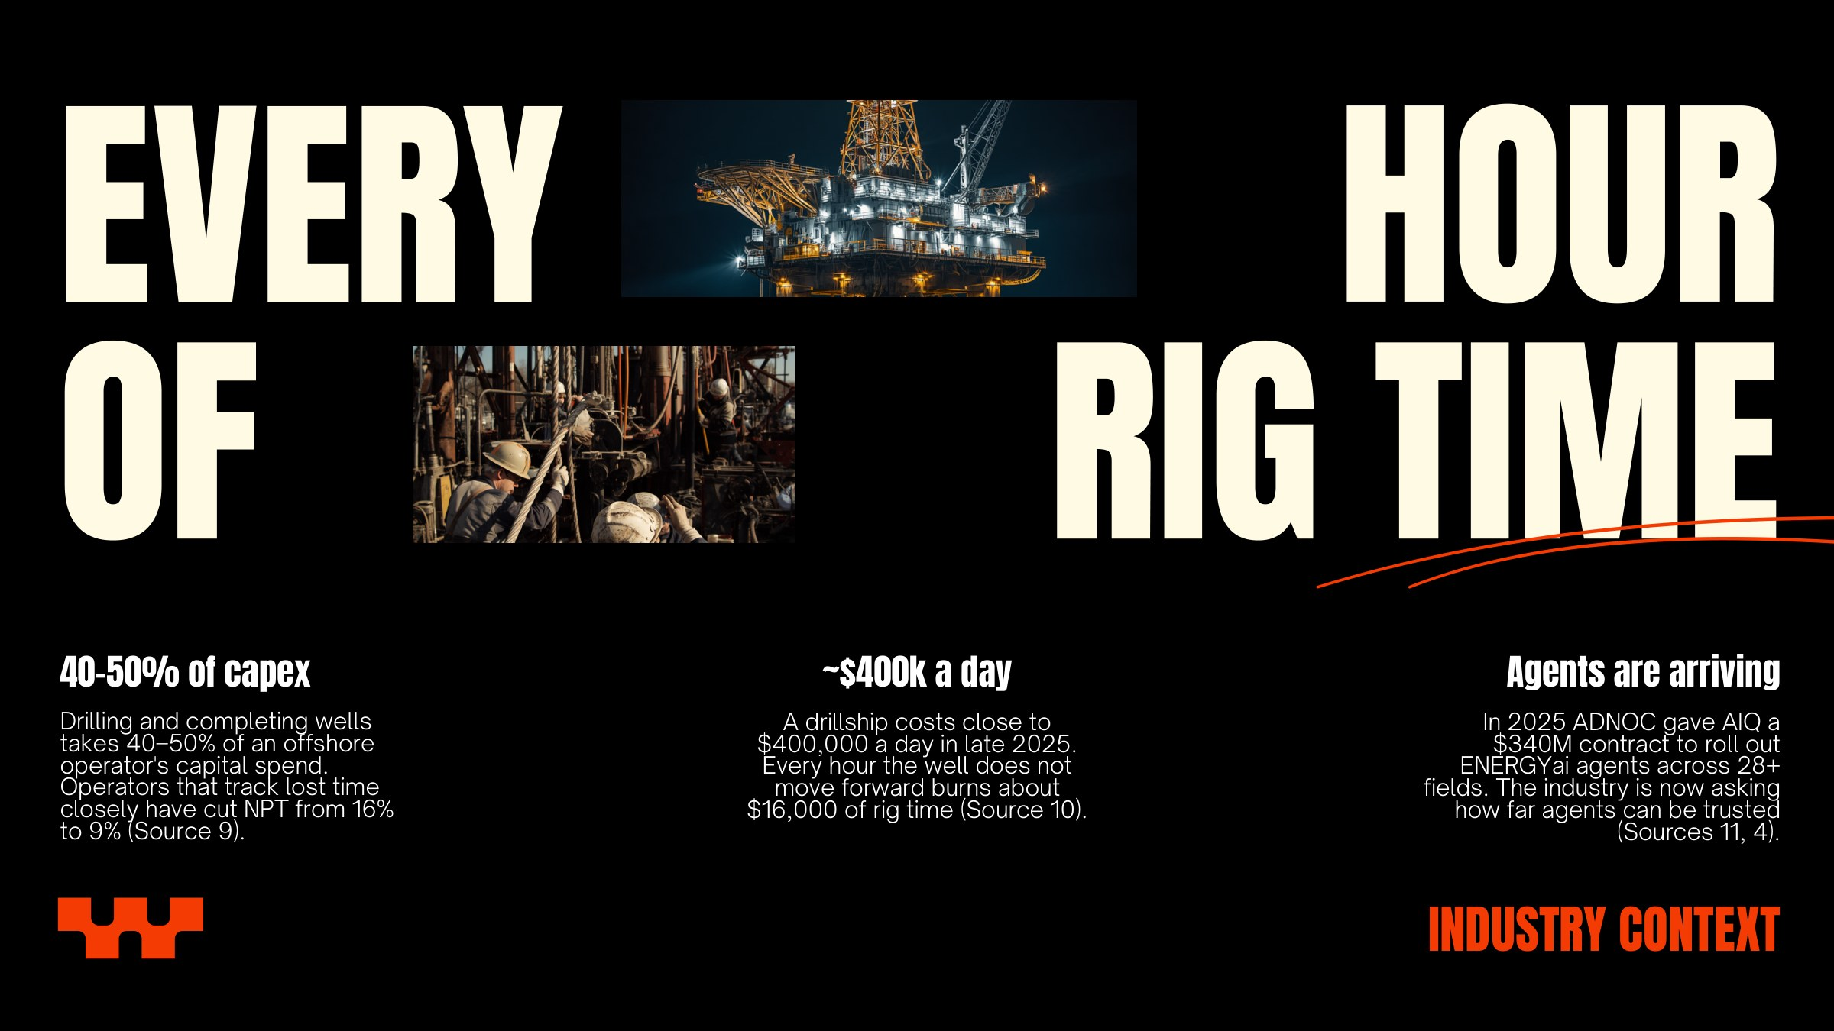
Notes:
Set the scene with money: one lost hour is about $16,000 of rig time. Operators that track NPT closely cut it a lot, and big players already pay for agentic AI.

Slide 3
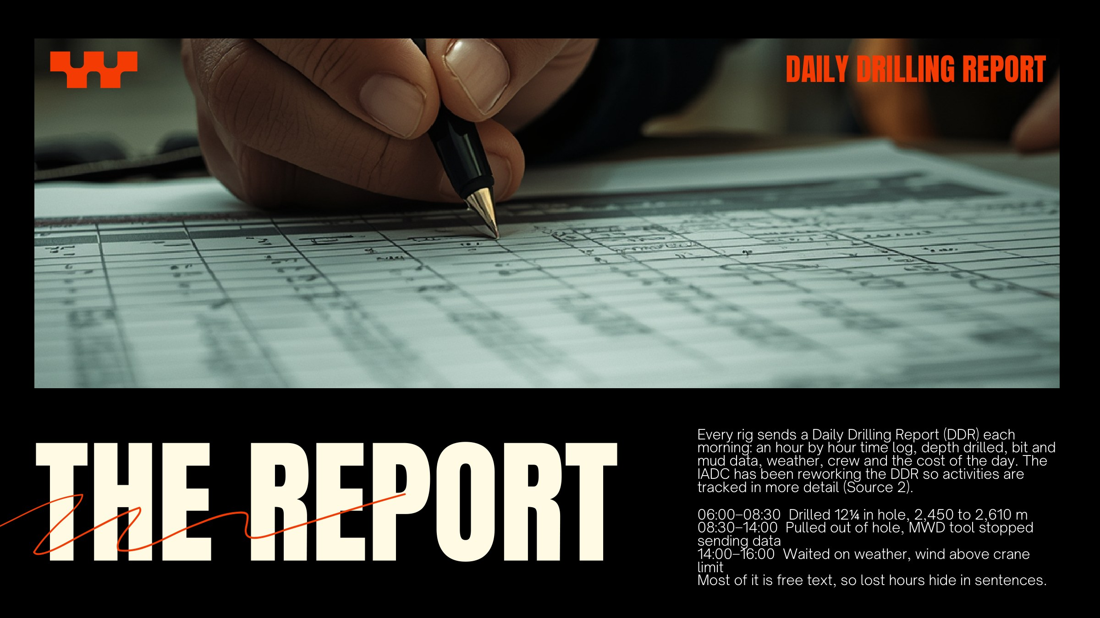
Notes:
Read the three lines. Lines two and three are lost time, but nothing in the report adds them up.

Slide 4
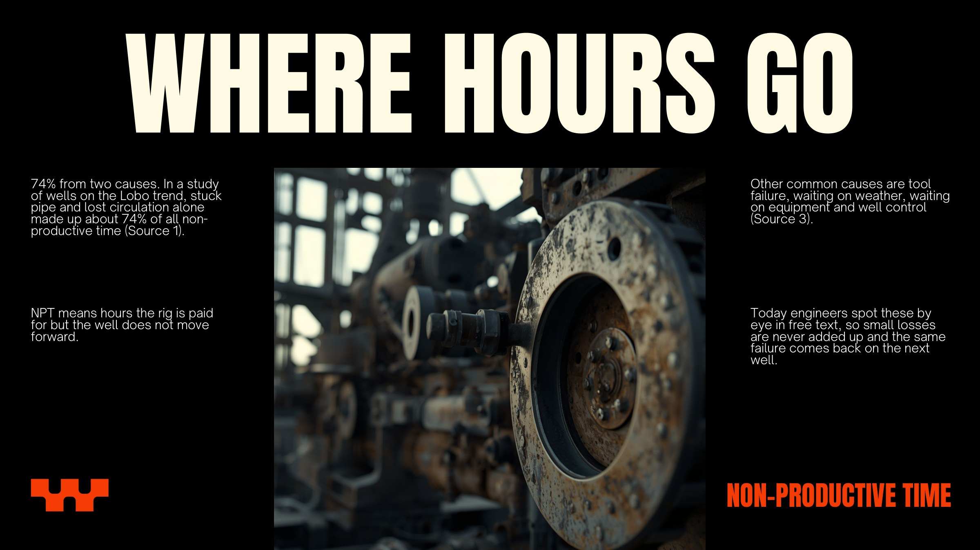
Notes:
NPT has patterns. Today nobody adds it up consistently, so the same failure comes back on the next well.

Slide 5
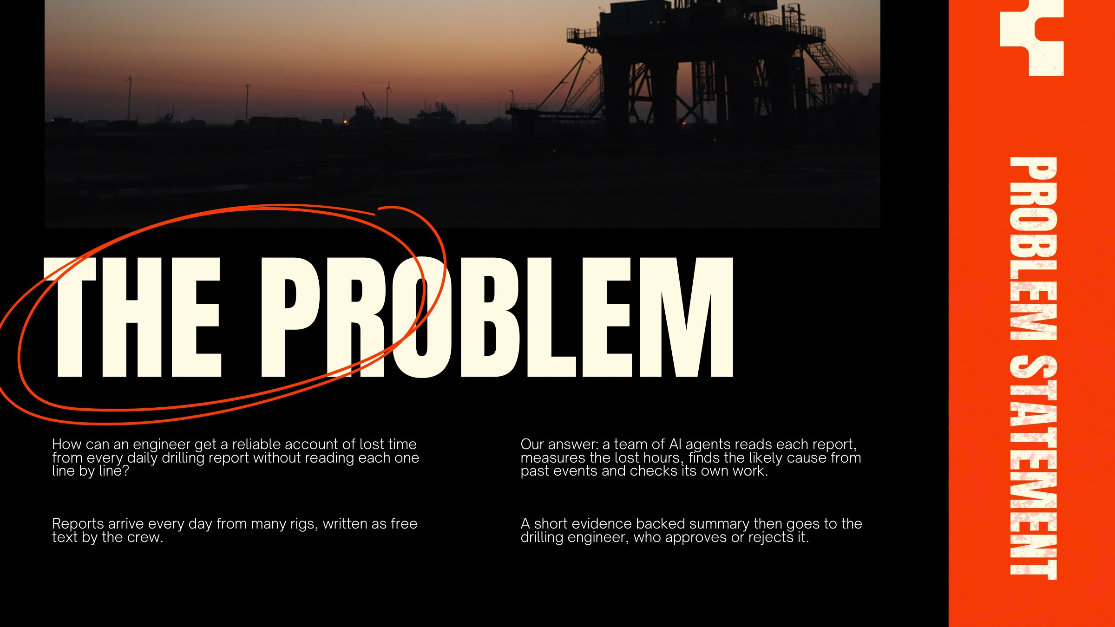
Notes:
This is the one question the whole project answers.

Slide 6
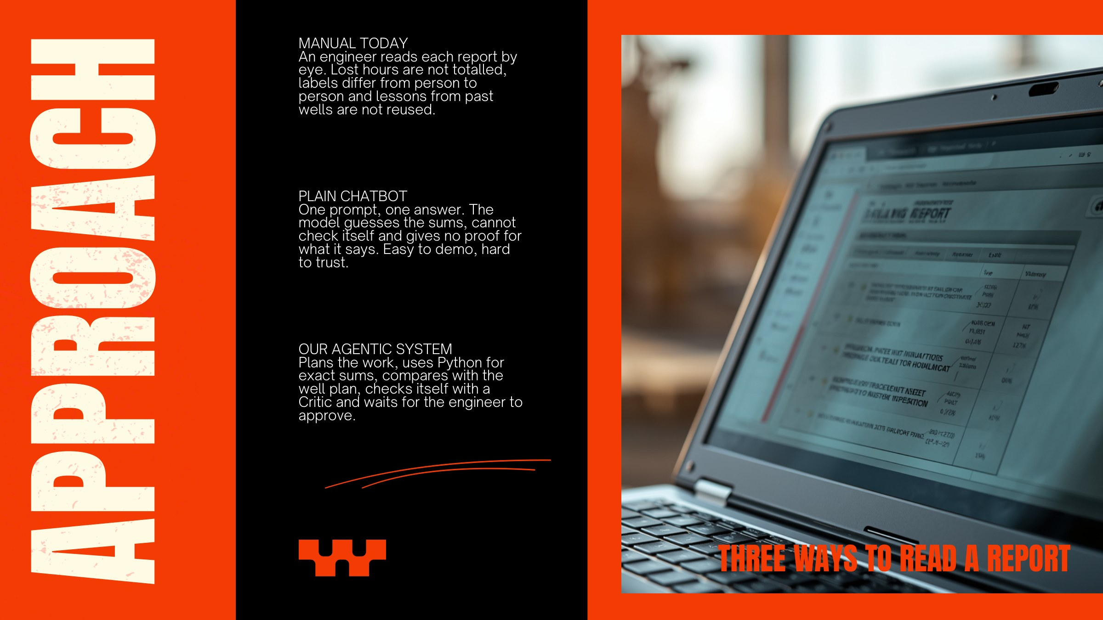
Notes:
Why not ChatGPT? A chatbot gives one answer with no checking and guesses numbers. We split the job, use code for the maths and check before a human signs off.

Slide 7

Notes:
Six roles, one shared state. Agents never talk directly; the Orchestrator decides who works next.

Slide 8
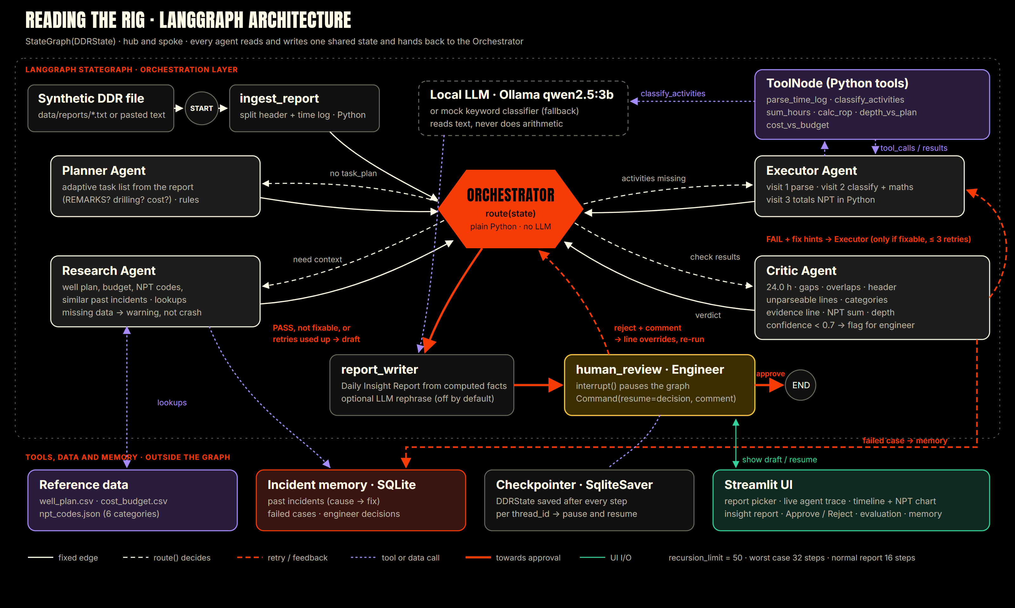
Notes:
Hub and spoke. The Orchestrator in the middle is plain Python: route() reads the shared DDRState and sends work to the Planner, Research, Executor and Critic. The Executor calls six Python tools through a ToolNode; only classify_activities uses the language model. A Critic FAIL with a fixable problem goes back to the Executor with structured fix hints, at most 3 times. Then report_writer drafts, and human_review pauses the graph with interrupt() until the engineer approves or rejects. recursion_limit is 50; worst case is 32 steps.

Slide 9
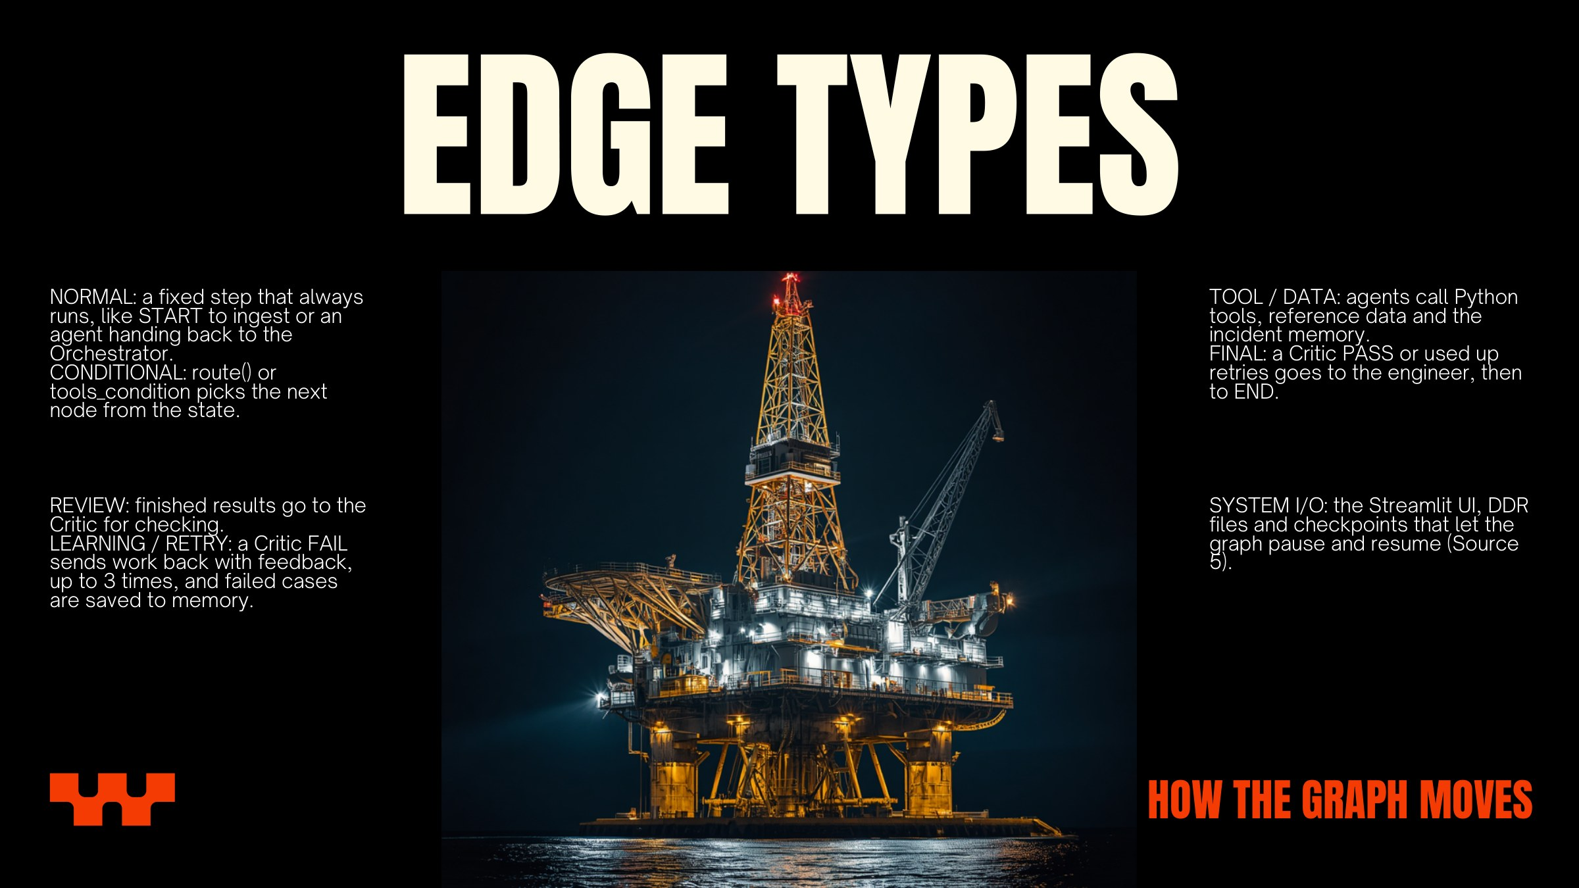
Notes:
Normal edges are fixed add_edge calls. Conditional edges come from route() or tools_condition. The red retry loop is what makes it agentic.

Slide 10
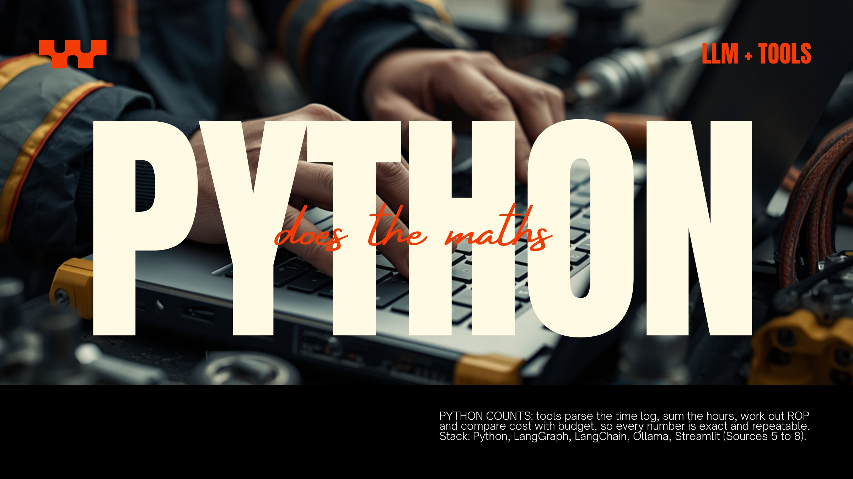
THE MODEL READS: a local Ollama model (qwen2.5:3b) only labels each log line with an NPT category and a confidence score. It does not write the numbers: in testing it swapped which hours belonged to which category. A mock classifier is the fallback and is always shown as mock.
Notes:
Small local models are fine at labelling a sentence but bad at arithmetic. Every number comes from Python, so the Critic can check it exactly. We tried letting the model rephrase the summary; it kept the numbers but attached them to the wrong categories, so the summary is a template by default. No paid API.

Slide 11

1 PLAN AND RESEARCH Well W-02, Day 14. The Planner makes 9 tasks. Research finds 2,650 m planned against 2,610 m actual and two past MWD failures on this field.
2 EXECUTE AND CHECK Tools label 5.5 h of tool failure. The Critic sees 23.5 h, names the 20:30-21:00 gap and sends it back. The retry finds it in REMARKS: 24.0 h, PASS.
3 ENGINEER DECIDES The model also called 'slip and cut' (3 h) NPT. The engineer rejects with 'line 7 is planned', the graph re-runs: 8.0 h NPT, approved.
Notes:
This is a real run with qwen2.5:3b. The key moment is the Critic catching 23.5 h and naming the exact gap. Then the engineer catches what the Critic cannot: a confident mislabel. Both loops are part of the graph.

Slide 12
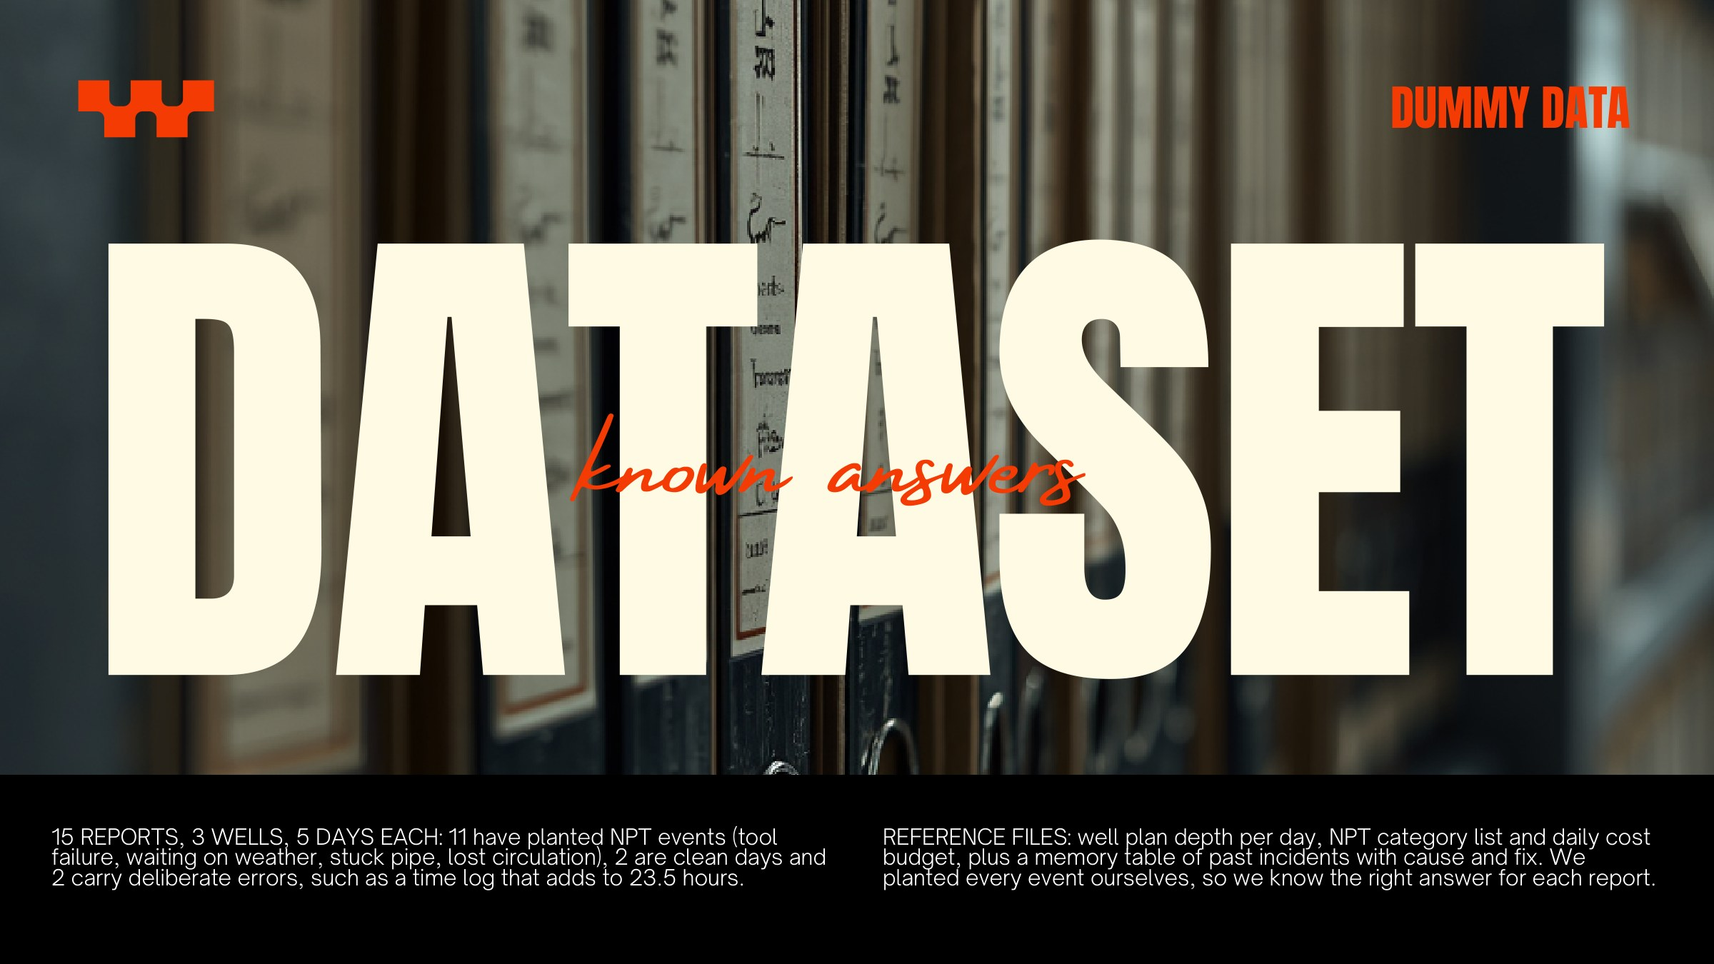
Notes:
All synthetic, as the brief asks. We planted every event, so each report has a known answer. One trap: 'waited on cement' is planned work, not NPT.

Slide 13

Notes:
Clean day: zero NPT. Tool failure day: right hours and category. W-02 Day 14: the Critic catches the 23.5 h log. If the live demo does not fit, use the next slide.

Slide 14

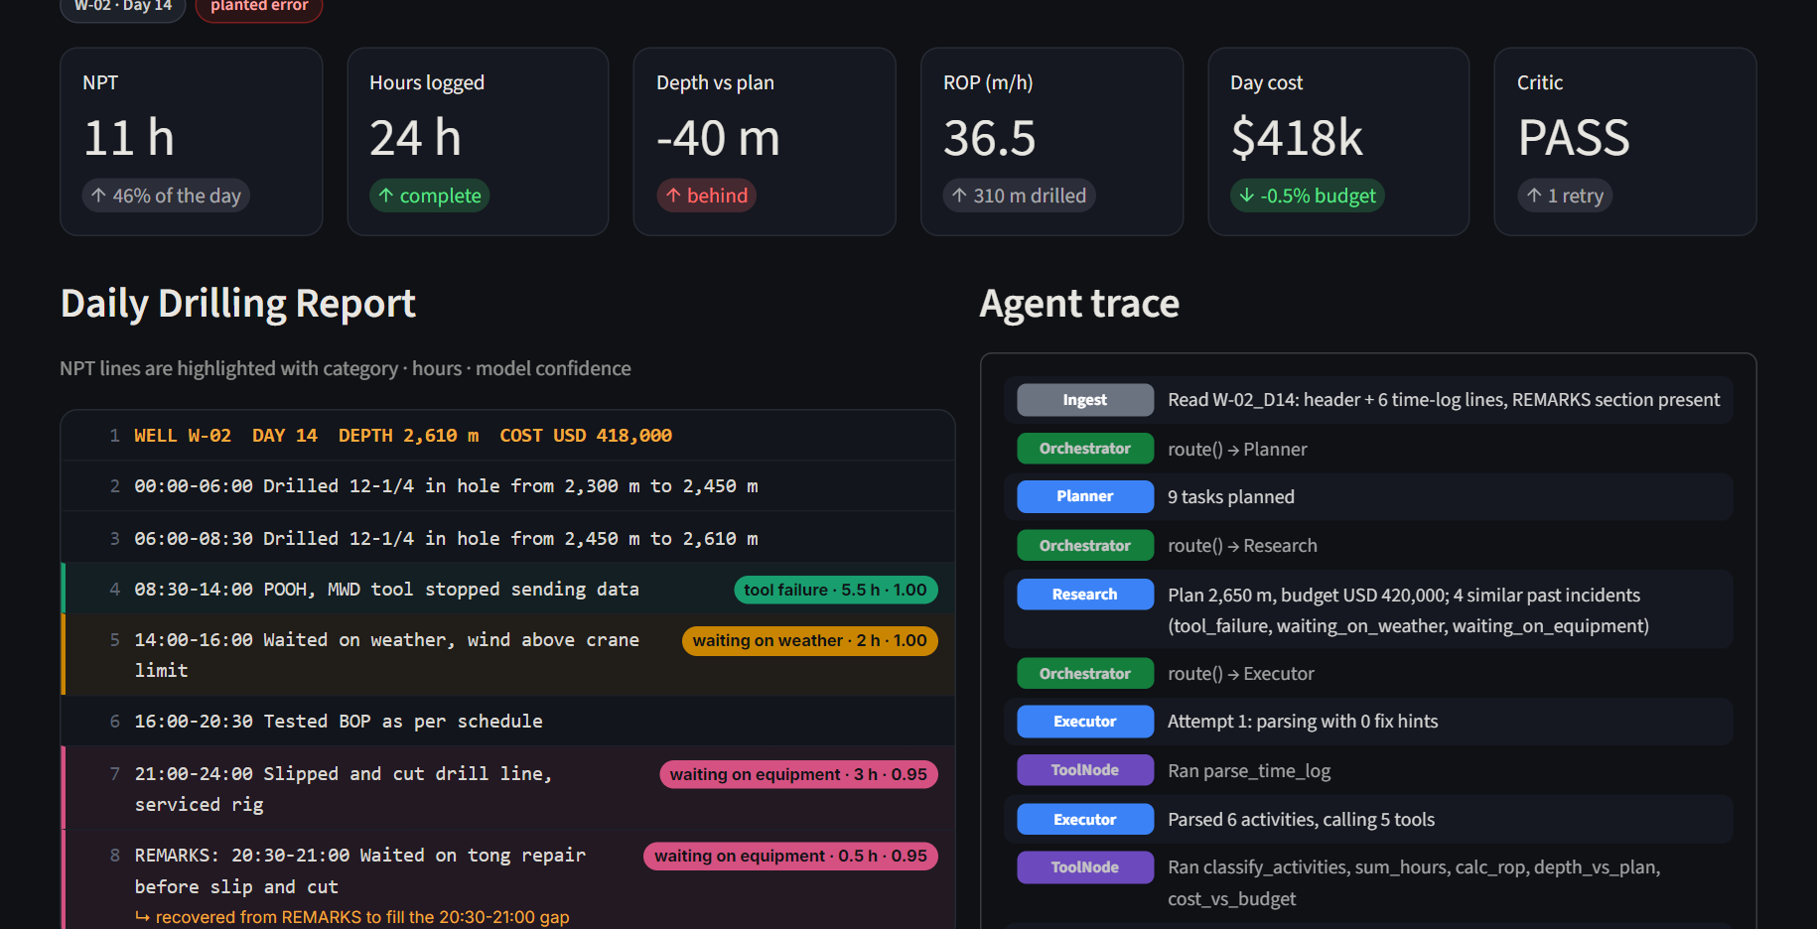
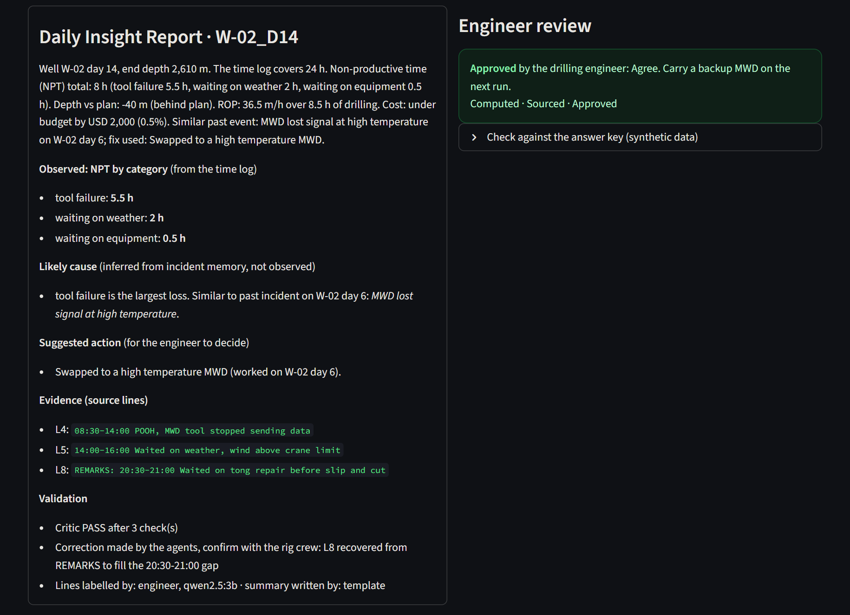
THE APP, LIVE
W-02 · DAY 14, REAL RUN
Run: each NPT line labelled with category · hours · model confidence; the 20:30-21:00 line recovered from REMARKS after the Critic's FAIL; the live agent trace.
After review: the engineer rejected one mislabel (line 7, slip and cut), the graph re-ran: 8.0 h NPT, approved.
Notes:
Backup for the live demo. Left is the run: the Critic fails the first pass at 23.5 h and the retry recovers the missing half hour. Right is the final report after the engineer rejected one mislabel and approved.

Slide 15
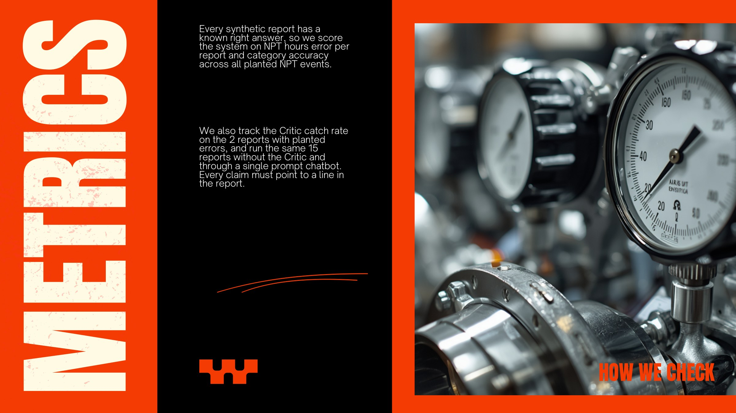
RESULTS (qwen2.5:3b, 15 reports): NPT error 0.47 h per report for our graph vs 3.83 h for a chatbot on the same model. Next slide.
Notes:
Every synthetic report has a known answer, so we can score instead of saying 'it looks good'. Same 15 reports, same model, three configurations.

Slide 16
RESULTS
SAME MODEL, 15 REPORTS
 | With Critic | No Critic | Chatbot
Category accuracy | 100% | 96.6% | 76%
Critic catch rate | 2 / 2 | n/a | n/a
Logs adding to 24 h | 15/15 | 13/15 | 1/15
Reports exactly right | 13/15 | 13/15 | 4/15
Evidence rate | 100% | 100% | 96%
What it shows: on the same model, splitting the job and letting Python count cuts the NPT error from 3.83 h to 0.47 h per report. The chatbot cannot even add the log up to 24 h. The Critic caught both planted errors before any human saw them.
Read it honestly: 'No Critic' has a slightly lower error (0.43 h) only because two mistakes cancel on W-02 Day 14. Our two remaining errors are planned work the model labels NPT with high confidence (slip and cut, waiting on cement): the engineer fixes each with one reject comment. Chatbot: latest run; separate runs on other days gave 3.77 h and 4.43 h. Mock fallback: 0.27 h. 48 automated tests pass.
Notes:
Same model for all three runs, so the comparison is fair. Point at the chatbot bar first, then ours. Then be honest about the no-Critic number and the two confident mislabels: that is why the engineer approves every report.

Slide 17
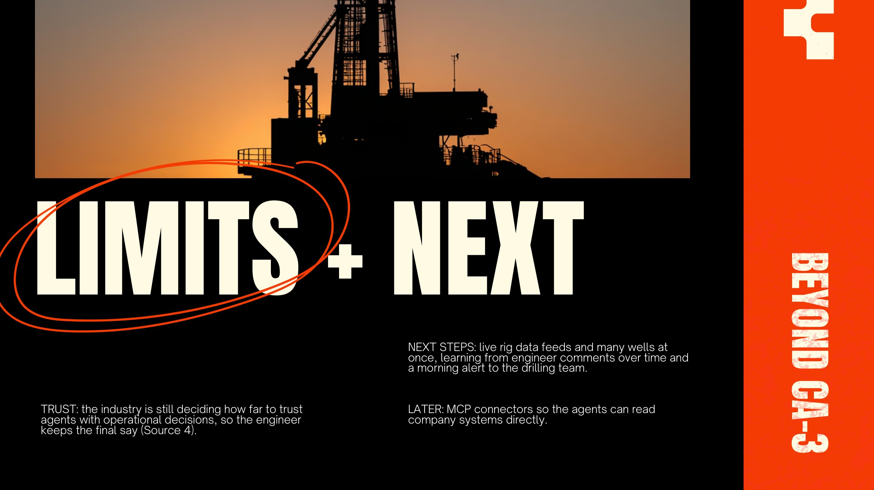
LIMITS: synthetic data, six NPT categories, one report format. The 3B model labels some planned work as NPT with high confidence. Not a certified engineering or safety tool.
Notes:
Be honest about limits. It is a PoC on synthetic data. The human stays in the loop because the model makes confident mistakes and the industry has not settled how much to trust agents.

Slide 18
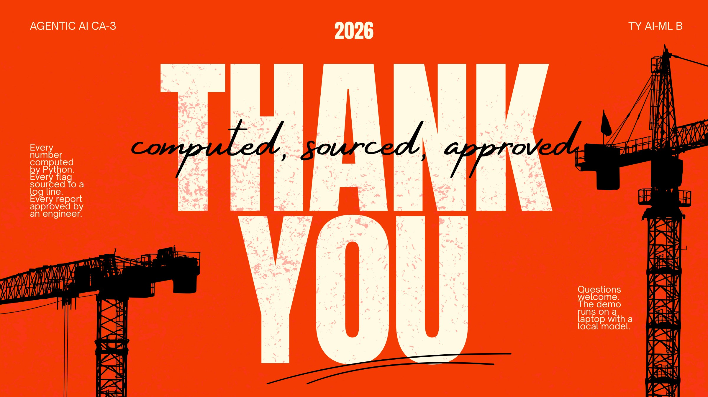
Notes:
Every number computed, every flag sourced, every report approved by a person. Questions.

Slide 19
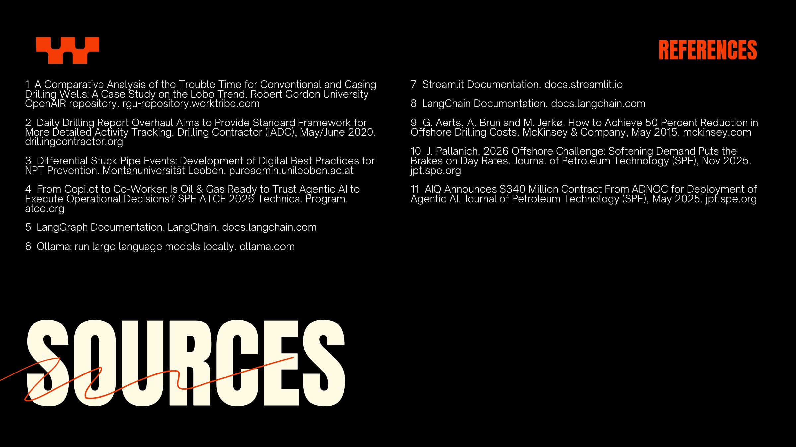
Notes:
All 11 sources. Source numbers match the small (Source N) tags on the slides.

