Slide 1
GOVERNMENT OF INDIA
Ministry of Home Affairs | Land Port Authority of India
AI Integration in Land Port Authority of India
LPAI Nexus — Smart Border Command Platform
Internship Technical Presentation
Himanshu | AI & Software Engineering Intern, LPAI
June 2026
Land Port Authority of India | Ministry of Home Affairs | Government of India
Notes:
Introduce yourself and the internship context. Emphasize that LPAI Nexus is a fully working prototype built during the internship — not a concept or proposal document. This presentation covers the platform built, the problem it solves, and recommended next steps.

Slide 2
LPAI Nexus — Smart Border Command Platform
Ministry of Home Affairs | Government of India
India's Land Borders — The Scale of the Challenge
15,200 KM
7 Countries
Operational ICPs Across Land Borders
●
Attari–Wagah
●
Agartala
International Land Border
Afghanistan · Bangladesh · Bhutan China · Myanmar · Nepal · Pakistan
Punjab — Pakistan Border
Tripura — Bangladesh
●
Petrapole
●
Jogbani
West Bengal — Bangladesh
Bihar — Nepal Border
12 ICPs
23 Sanctioned
●
Raxaul
●
Rupaidiha
Bihar — Nepal Border
Uttar Pradesh — Nepal
Operational Integrated Check Posts
Total Land Ports Approved
●
Moreh
●
Hili
Manipur — Myanmar Border
West Bengal — Bangladesh
●
Dawki
◌
Mahendragarh
Meghalaya — Bangladesh
Uttarakhand — Nepal
FY 2023-24 Highlights
●
Sutarkhandi
◌
Sabroom
₹70,952 Crore trade facilitated · 30.46 Lakh passengers processed · ₹62.17 Crore revenue collected — 15-fold trade increase from 2014-15
Assam — Bangladesh
Tripura — Bangladesh
* Commissioning phase
RESTRICTED — For Internal Use Only
India's Land Borders — The Scale of the Challenge
2 / 23
Notes:
Establish the extraordinary scale of India's land border challenge. The 15-fold trade increase is the most powerful number here — it shows that LPAI is managing explosive growth with infrastructure and processes designed for a fraction of current volumes. The case for AI is not theoretical; it is operational necessity.

Slide 3
LPAI Nexus — Smart Border Command Platform
Ministry of Home Affairs | Government of India
LPAI's Digital Transformation — Strong Foundations
LPMS
PIFS
Suvidha Portal
Land Port Management System
Passenger Integrated Facilitation System
Trader Self-Service Platform
Single window for all port operations
Aadhaar + passport digital registration
Slot booking live at Bangladesh ICPs
ANPR cameras + VAHAN vehicle integration
Facial recognition at entry/exit points
Petrapole export: 110 hrs → 14 hrs
Slot booking deployed for trucks
Pilot at Petrapole — successful rollout
80% reduction in truck waiting time
Significant reduction in wait times
Real-time queue visibility enabled
Proven model — replicable across ICPs
LPAI is already building the right infrastructure.
LPAI Nexus adds the AI intelligence and unified command layer on top.
RESTRICTED — For Internal Use Only
LPAI's Digital Transformation — Strong Foundations
3 / 23
Notes:
Acknowledge LPAI's strong existing digital foundation — LPMS, PIFS, and Suvidha are real achievements. Frame LPAI Nexus not as replacing these systems but as building the AI intelligence and unified command layer that connects and enhances them. This avoids any perception that the work dismisses existing investments.

Slide 4
LPAI Nexus — Smart Border Command Platform
Ministry of Home Affairs | Government of India
The Gap — Where Manual Processes Still Dominate
31 Hours
47 Docs
Passive CCTV
No Unified View
Manual ANPR
Average import clearance time at land ports
Per consignment — 21 export + 26 import
No AI threat detection Officers watch manually
LPAI HQ: no real-time picture of all 12 ICPs
Plate reading in pilot phase only Blacklist check is manual
CBIC Time Release Study 2023
Per stakeholder consultation
Security gap at all ICPs
Next-day Excel MIS only
Critical coverage gap
RESTRICTED — For Internal Use Only
The Gap — Where Manual Processes Still Dominate
4 / 23
Notes:
Each card represents a real operational gap documented in LPAI's own reports and CBIC studies. The 31-hour import clearance time is the most striking — contrast it with Singapore's 4.5-hour average. Do not dwell here; acknowledge the gaps and pivot to the solution LPAI Nexus provides.

Slide 5
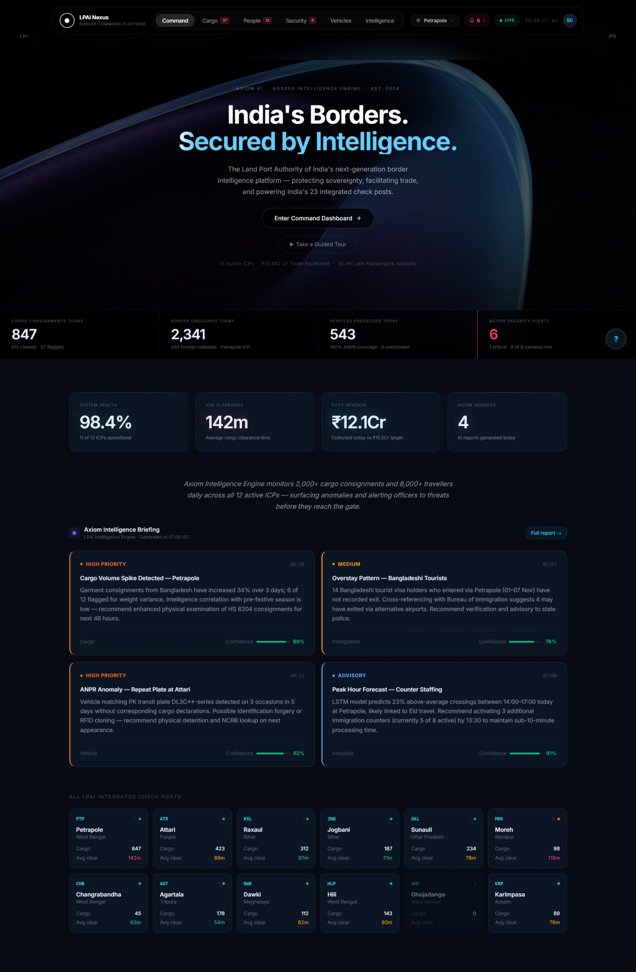
LPAI Nexus — Smart Border Command Platform
Ministry of Home Affairs | Government of India
LPAI Nexus — The Unified Command Platform
Built during Internship at LPAI, MHA
June 2026
React 18
Vite 5
Recharts
Tailwind CSS
Full Working Prototype
6 Modules
12 ICPs
Powered by Axiom AI
RESTRICTED — For Internal Use Only
LPAI Nexus — The Unified Command Platform
5 / 23
Notes:
This is the first time the audience sees the actual platform. Let the screenshot speak for itself — pause for 10-15 seconds. Then point out the ICP selector (top), the Axiom briefing (center), and the module tabs (left nav). Emphasize that everything shown is fully functional and demonstrable right now.

Slide 6
LPAI Nexus — Smart Border Command Platform
Ministry of Home Affairs | Government of India
Axiom — The AI Intelligence Engine
⚡
Cargo Document Processing
▶
2 min vs 45 min manual — 95% faster
👤
Watchlist Face Matching
▶
AXIOM
Under 1 second per passenger
📹
Camera Feed Monitoring
AI Intelligence Engine
▶
All feeds simultaneously, 24/7 — zero gaps
v1.0 — LPAI Nexus
🚛
Number Plate Recognition
▶
2 seconds + instant VAHAN + blacklist lookup
📊
Queue Size Prediction
▶
6 hours ahead — time-series model
📄
Daily Intelligence Briefing
▶
"Axiom does not replace officers — it ensures nothing is missed."
Auto-generated at 06:00 every morning
RESTRICTED — For Internal Use Only
Axiom — The AI Intelligence Engine
6 / 23
Notes:
Axiom is the differentiator between a data dashboard and an intelligence platform. Emphasize the 95% faster cargo processing figure — this is not aspirational, it reflects the speed difference between AI-assisted OCR and manual document review. The quote at the bottom is important for any officer in the room concerned about job displacement.

Slide 7
LPAI Nexus — Smart Border Command Platform
Ministry of Home Affairs | Government of India
Command Overview — All 12 ICPs on One Screen
✓
Real-time KPIs
Cargo, crossings, alerts, vehicles — all at a glance
✓
Axiom AI Briefing
Contextual intelligence summary with confidence scores
✓
All 12 ICPs Live
ICP grid with status, throughput and risk flags
Replaces: Next-day Excel MIS reports
Benefit: Instant situational awareness for LPAI HQ
RESTRICTED — For Internal Use Only
Command Overview — All 12 ICPs on One Screen
7 / 23
Notes:
This is the home screen every LPAI officer will see when they log in. Point out that the ICP selector (top right) instantly switches the entire dashboard to any of the 12 ICPs. The Axiom briefing at center replaces the morning MIS report — it synthesises overnight data into 4-5 actionable sentences.

Slide 8
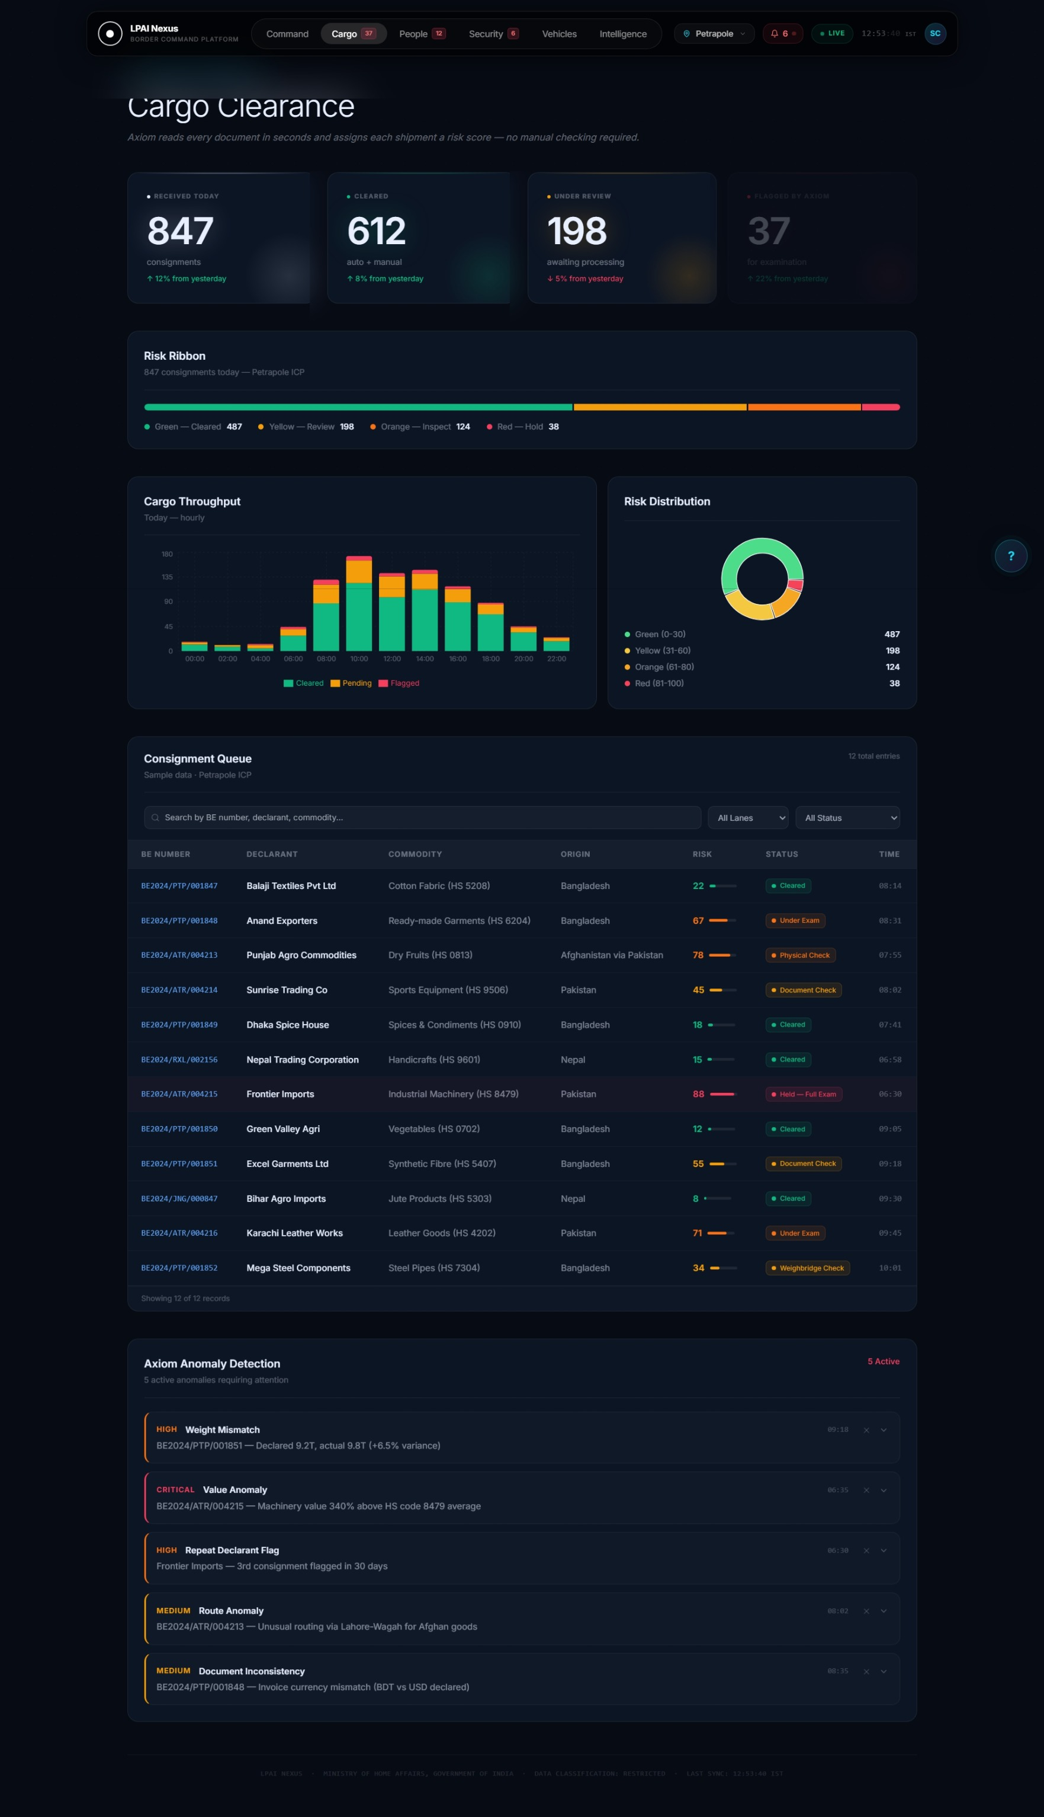
LPAI Nexus — Smart Border Command Platform
Ministry of Home Affairs | Government of India
Cargo Clearance — AI Risk Scoring for Every Consignment
The Four-Lane Risk System
GREEN LANE
Auto-cleared by Axiom AI
Score 0–35
YELLOW LANE
Document verification required
Score 36–65
ORANGE LANE
Physical examination ordered
Score 66–80
RED LANE
Full hold — officer decision required
Score 81–100
Processed Today
Auto-cleared
Flagged for Review
847 consignments
612 by Axiom AI
37 consignments
RESTRICTED — For Internal Use Only
Cargo Clearance — AI Risk Scoring for Every Consignment
8 / 23
Notes:
Axiom assigns a risk score to every consignment automatically — the officer does not need to review all 847, only the 37 flagged. This is the operational transformation: attention directed by AI, not wasted on low-risk cargo. The four-lane system mirrors the established WCO risk management framework.

Slide 9
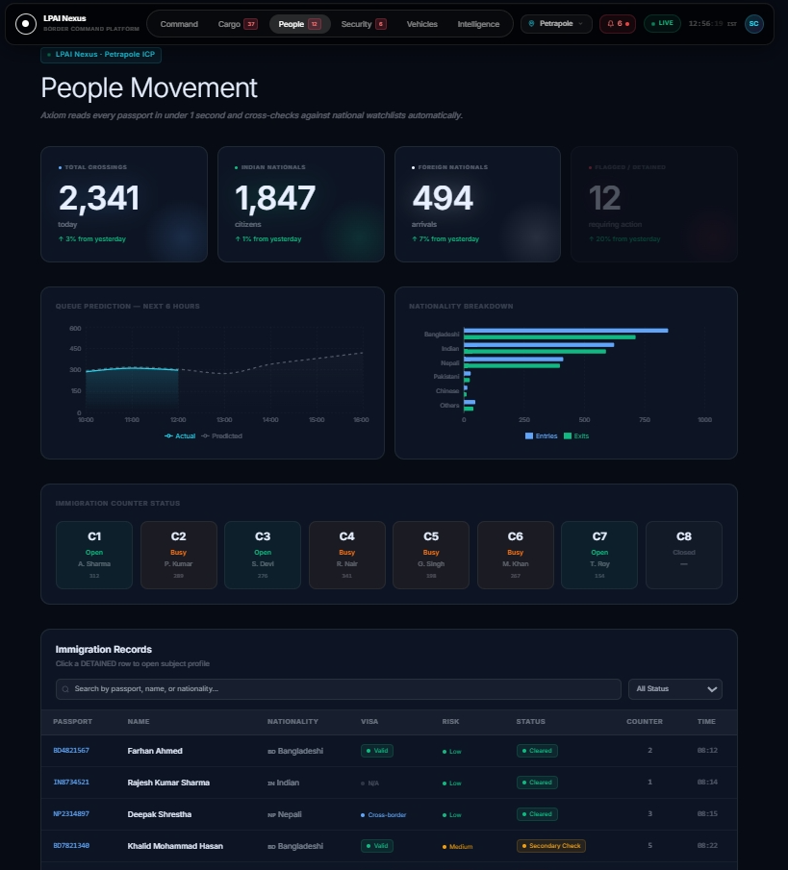
LPAI Nexus — Smart Border Command Platform
Ministry of Home Affairs | Government of India
People Movement — Predictive Queue Management
Axiom Queue Intelligence
Predicts queue sizes 6 hours ahead. ICP Commanders open counters before queues build — not after.
2,341
Crossings Today
494
Foreign Nationals
12
Flagged / Detained
Watchlist check: <1 second vs 2-3 min manual lookup
RESTRICTED — For Internal Use Only
People Movement — Predictive Queue Management
9 / 23
Notes:
The queue prediction capability is the most impactful for passenger flow. Emphasize that Axiom analyses historical patterns, current arrival rates, and staffing to forecast 6 hours ahead. The ICP Commander can pre-deploy counters at 8am knowing that peak will hit at 2pm — currently this decision is reactive and too late.

Slide 10
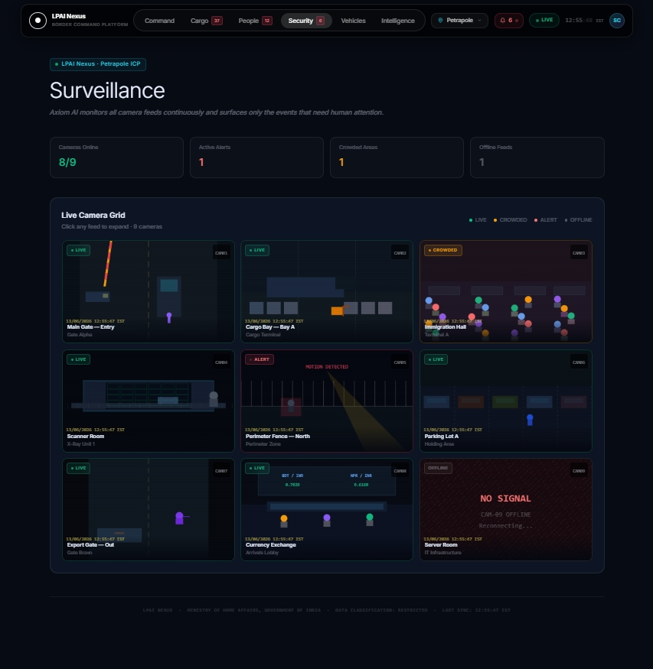
LPAI Nexus — Smart Border Command Platform
Ministry of Home Affairs | Government of India
Security & Surveillance — AI That Never Blinks
What Axiom Detects:
🚫
Restricted zone intrusions
📦
Unattended objects > 5 minutes
👥
Crowd density threshold breach
🎯
Watchlist face matches in real time
🚗
Vehicle anomalies and wrong-lane entry
Human officers: Can monitor 4–6 screens
Axiom: Monitors ALL feeds simultaneously, 24/7
RESTRICTED — For Internal Use Only
Security & Surveillance — AI That Never Blinks
10 / 23
Notes:
The surveillance gap is a genuine security risk — ICP perimeters are large and camera networks are expanding faster than officer rosters. Axiom does not make fatigue-related errors. The five detection types listed are based on standard computer vision capabilities deployable on Jetson Orin edge devices at remote ICPs with low connectivity.

Slide 11
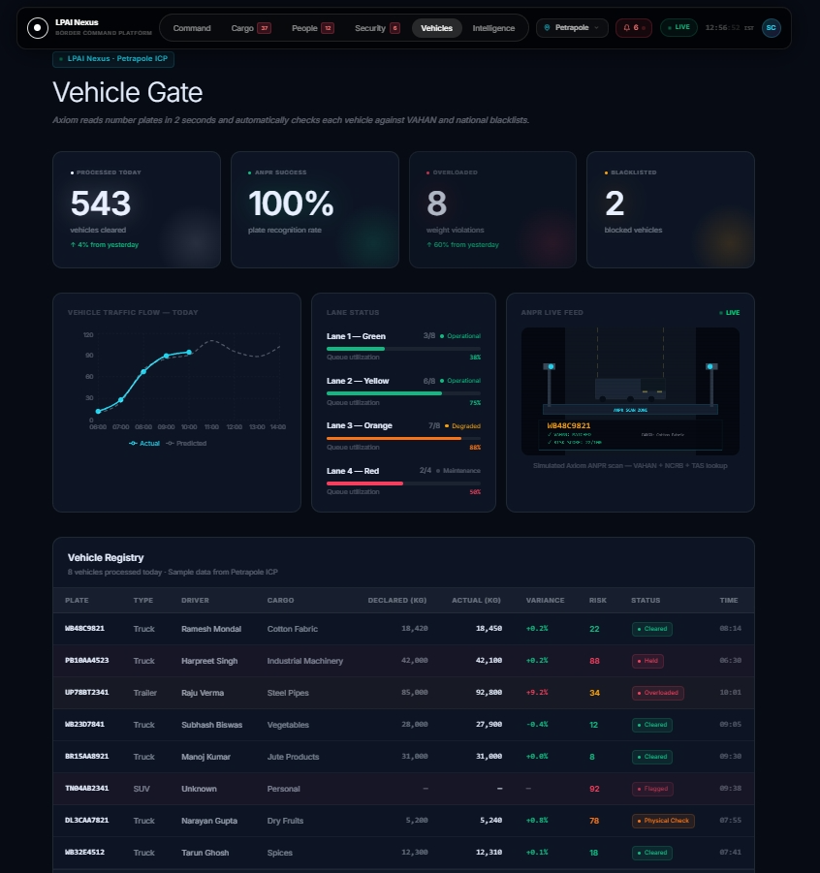
LPAI Nexus — Smart Border Command Platform
Ministry of Home Affairs | Government of India
Vehicle Gate — ANPR + Weighbridge Intelligence
Processing Flow:
1
Vehicle approaches → ANPR reads plate
2
Simultaneous: VAHAN + TAS + Blacklist check
3
Weighbridge → auto weight variance detection
4
Risk score assigned → lane directed by Axiom
543
100%
8
Vehicles processed today
ANPR plate coverage
Overloaded — auto-detected
RESTRICTED — For Internal Use Only
Vehicle Gate — ANPR + Weighbridge Intelligence
11 / 23
Notes:
The ANPR + VAHAN integration is the key capability here. Every vehicle entering the ICP is cross-checked against the VAHAN database and the blacklist in under 2 seconds — something that currently takes an officer 3-5 minutes per vehicle with manual checks. The weighbridge integration prevents the common fraud of mis-declaring cargo weight.

Slide 12
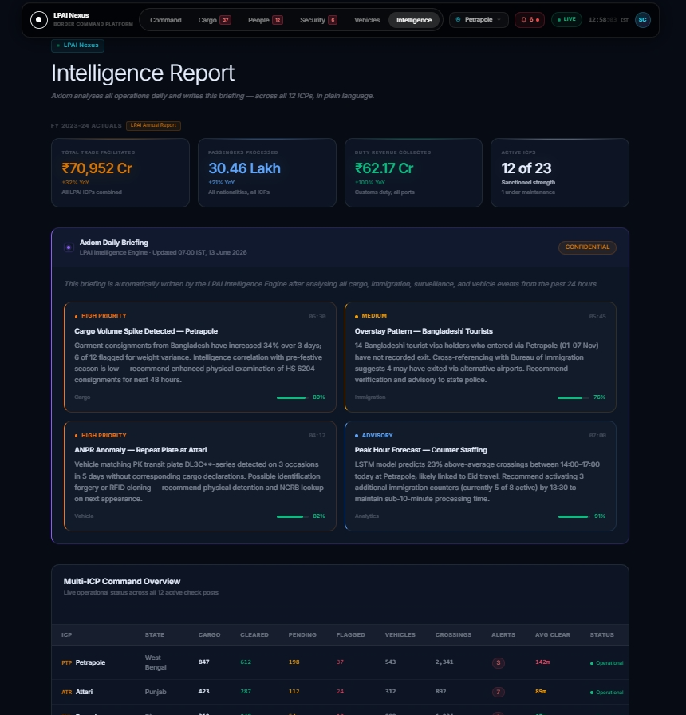
LPAI Nexus — Smart Border Command Platform
Ministry of Home Affairs | Government of India
Intelligence & Analytics — Data-Driven Border Management
FY 2023-24 Actuals (Real LPAI Data):
₹70,952 Cr
30.46 Lakh
Total Trade Facilitated
Passengers Processed
₹62.17 Cr
12 / 23
Duty Revenue Collected
Operational ICPs (of 23 sanctioned)
All 12 ICPs benchmarked side-by-side in real time No more waiting for consolidated monthly reports
RESTRICTED — For Internal Use Only
Intelligence & Analytics — Data-Driven Border Management
12 / 23
Notes:
The numbers shown are from LPAI's own Annual Report 2023-24 — real operational data, not estimates. Point out that currently this data is only available after month-end consolidation. LPAI Nexus makes it available in real time, letting senior officials make decisions on current performance rather than last month's data.

Slide 13
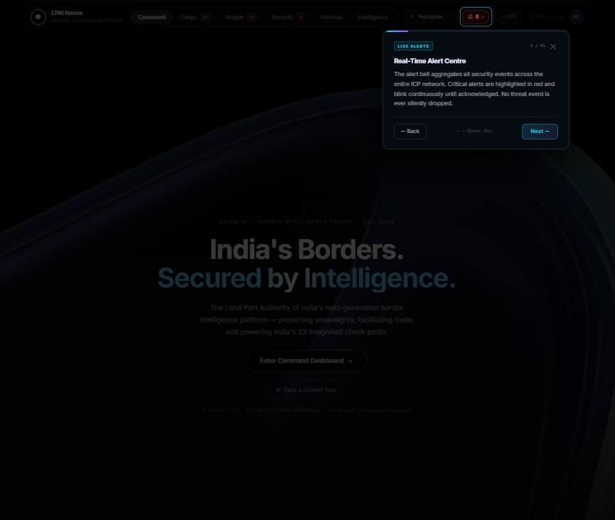
LPAI Nexus — Smart Border Command Platform
Ministry of Home Affairs | Government of India
Built-In Officer Onboarding — 45-Step Guided Tour
The Challenge:
Senior officers unfamiliar with new systems will not read a manual — they need guidance built into the software.
The Solution:
Press "Start Tour" — system guides you through every feature in plain language, step by step, module by module.
▶
45 steps across all 6 modules
▶
Written for IAS-level audiences
▶
Keyboard navigation + mobile support
▶
Persists completion — never shown twice
▶
Works on any government laptop / tablet
RESTRICTED — For Internal Use Only
Built-In Officer Onboarding — 45-Step Guided Tour
13 / 23
Notes:
The walkthrough system is often the most impressive feature for non-technical audiences. The spotlight overlay and step-by-step guidance means any officer — even a Secretary who has never used a dashboard before — can self-onboard in 8 minutes. This directly addresses the change management risk in any government technology deployment.

Slide 14
LPAI Nexus — Smart Border Command Platform
Ministry of Home Affairs | Government of India
System Architecture — Built for Government Scale
PRESENTATION LAYER
React 18 SPA · 6 Functional Modules · Shared Component Library · Responsive — Works on Government Laptops & Tablets
AXIOM INTELLIGENCE LAYER
Document OCR · Face Recognition · Camera Analysis · Queue Prediction · Cargo Risk Scoring · NLP Briefing Engine
DATA INTEGRATION LAYER
ICEGATE API · VAHAN API · Bureau of Immigration API · NDAP · LPMS · PIFS · CCTV Streams
DATA SOURCES
Customs Records · Vehicle Registry · Passport Database · CCTV Cameras · Weighbridge Sensors · Intelligence Feeds
◉ Current Status: Layer 1 complete · Layer 2 concept-implemented · Layers 3–4 planned Phase 2 (data sharing agreements required)
RESTRICTED — For Internal Use Only
System Architecture — Built for Government Scale
14 / 23
Notes:
Be transparent about what is built vs what is planned. Layer 1 (the full platform) is working today. Layer 2 (Axiom) is implemented as a concept engine in the prototype. Layers 3-4 (live API integrations) require inter-agency data agreements and are Phase 2 work. This transparency builds credibility with a senior government audience.

Slide 15
LPAI Nexus — Smart Border Command Platform
Ministry of Home Affairs | Government of India
The Impact — Process Transformation at Every Stage
Process | Before LPAI Nexus | After LPAI Nexus | Improvement
Cargo document check | 45 min — manual officer review | 2 min — Axiom AI OCR | 95% faster
Export clearance (avg) | 110+ hours at Petrapole | Target: 12–18 hours | ~85% reduction
Import clearance (avg) | 31 hours (CBIC 2023) | Target: 12–18 hours | ~50% reduction
Watchlist check | 2–3 min — manual database lookup | <1 second — AI matching | 99% faster
CCTV monitoring | Human-limited, 4–6 screens | AI-powered, all feeds 24/7 | Continuous
MIS / HQ reporting | Next-day Excel — 12-48 hr delay | Real-time dashboard | Instant
RESTRICTED — For Internal Use Only
The Impact — Process Transformation at Every Stage
15 / 23
Notes:
Use the CBIC Time Release Study 2023 figure (31 hours import clearance) as the anchor. These are real numbers from real government studies — LPAI Nexus targets represent international best-practice benchmarks. The improvements are conservative estimates based on comparable implementations at Singapore and EU smart border programs.

Slide 16
LPAI Nexus — Smart Border Command Platform
Ministry of Home Affairs | Government of India
Three-Phase Implementation Plan
Phase 1: Prototype
Phase 2: Pilot Deployment
Phase 3: National Rollout
Internship 2026 — Done
Months 4–9 post approval
Months 10–24
COMPLETED
PROPOSED
FUTURE
✓ 6 fully functional modules
• Petrapole + Attari ICPs
• All 12 operational ICPs
✓ 45-step guided walkthrough
• LPMS backend integration
• 1 ICP per month rollout cadence
▶
▶
✓ Full technical report + PRD
• Bureau of Immigration API
• Central command at LPAI HQ
✓ Axiom AI engine integrated
• Officer training programme
• AI model training on real data
✓ This presentation
• Performance benchmarking
• NATGRID + CCTNS integration
RESTRICTED — For Internal Use Only
Three-Phase Implementation Plan
16 / 23
Notes:
Phase 1 is complete — the prototype exists and works. The ask to this audience is approval to proceed to Phase 2. Petrapole and Attari are the right pilot ICPs because they are the highest-volume ICPs on the Bangladesh and Pakistan borders respectively — success there validates the model for all 12. Phase 2 requires MOU agreements with CBIC and BoI.

Slide 17
LPAI Nexus — Smart Border Command Platform
Ministry of Home Affairs | Government of India
LPAI Nexus — Aligned with National Priorities
🇮🇳 Viksit Bharat 2047
📋 NTFAP 2020-23 Action #44
💻 Digital India Mission
Digital governance as the foundation for a developed India. AI-powered border management directly supports the vision of a modern, efficient state.
The National Trade Facilitation Action Plan mandates a Land Port Community System for paperless, coordinated border clearance.
Paperless, faceless, contactless government services across all citizen touchpoints — including India's 12 ICPs.
LPAI Nexus: Real-time AI governance at every land border crossing by 2030.
LPAI Nexus: Directly implements this mandate with a unified AI intelligence layer.
LPAI Nexus: Automated clearance, digital audit trail, contactless AI-assisted processing.
LPAI Annual Report 2023-24 explicitly calls for AI/ML integration in LPMS and AI-based security at all ICPs. LPAI Nexus directly implements this stated vision.
RESTRICTED — For Internal Use Only
LPAI Nexus — Aligned with National Priorities
17 / 23
Notes:
This slide is important for a Secretary-level audience — it shows LPAI Nexus is not a student project but aligns with the highest levels of national policy direction. Cite the LPAI Annual Report line directly if asked: it explicitly calls for AI/ML integration in LPMS. LPAI Nexus is the prototype implementation of that stated vision.

Slide 18
LPAI Nexus — Smart Border Command Platform
Ministry of Home Affairs | Government of India
Where India Stands — Global Smart Border Benchmarks
Country / Port | System | Key Achievement | India Comparison
Singapore Ports | Portnet PCS | Full port community system Saves $80M+ over 3 years | Planned via LPMS — LPAI Nexus adds AI layer
US–Mexico Border | CBP One + FIRST | Real-time cargo tracking Joint inspection modules | LPAI Nexus proposes equivalent for land borders
European Union | EES + ETIAS | Automated entry/exit system Biometric at all crossings | LPAI Nexus addresses India's land border gap
Bangladesh (BSSB) | Digital Clearance | Slot booking + digital forms Reduced wait times 60% | India ahead via Suvidha Portal + LPAI Nexus
LPAI Nexus positions India's land border management at international best-practice level
RESTRICTED — For Internal Use Only
Where India Stands — Global Smart Border Benchmarks
18 / 23
Notes:
Global benchmarks anchor LPAI Nexus in an international context. Singapore's Portnet is the gold standard — it required $200M+ investment over 5 years. LPAI Nexus proposes an AI-first approach that can reach equivalent outcomes faster by building on LPAI's existing LPMS infrastructure. Bangladesh's success with digital clearance is particularly relevant — it demonstrates the model works in the South Asian operational context.

Slide 19
LPAI Nexus — Smart Border Command Platform
Ministry of Home Affairs | Government of India
Challenges — And How to Address Them
⚠ Connectivity at Remote ICPs
⚠ Training Data for AI Models
⚠ Officer Change Management
Moreh ICP (Manipur–Myanmar): 8 Mbps average connectivity. Cloud-dependent AI would fail during peak traffic.
Axiom requires historical Bill of Entry data, footfall logs, and watchlist access to train accurate models for Indian border conditions.
Government officers accustomed to established manual workflows may be resistant to AI-assisted decision-making.
Solution:
Solution:
Solution:
Edge AI deployment — AI models run locally on NVIDIA Jetson Orin devices. No cloud dependency for real-time processing.
Initiate inter-agency data agreements now (CBIC, VAHAN, BoI). Lead time: 12–18 months — begin immediately.
45-step guided walkthrough built-in. Designed specifically for non-technical government users. Plus structured training programme in Phase 2.
RESTRICTED — For Internal Use Only
Challenges — And How to Address Them
19 / 23
Notes:
Proactively addressing challenges signals technical credibility. The connectivity issue is real — do not dismiss it. Edge AI on Jetson Orin devices is a proven solution used by NVidia and Indian Railways. The data agreement lead time is the most critical challenge — it must begin before Phase 2 starts, not after.

Slide 20
LPAI Nexus — Smart Border Command Platform
Ministry of Home Affairs | Government of India
Recommendations to LPAI Leadership
1
INITIATE PHASE 2 PILOT AT PETRAPOLE AND ATTARI
Approve a 6-month pilot integrating LPAI Nexus with the LPMS backend at India's two busiest ICPs. The prototype is ready. The pilot will validate AI performance on real operational data and establish officer training protocols for all ICP grades.
2
ESTABLISH A TECHNOLOGY DIVISION AT LPAI HEADQUARTERS
Create a dedicated internal team of 8–10 professionals (engineers, data scientists, cybersecurity) to own LPAI Nexus long-term. External vendor dependency for core border management technology creates operational risk and limits institutional knowledge.
3
INITIATE DATA SHARING AGREEMENTS WITH CBIC, VAHAN, AND BUREAU OF IMMIGRATION
Axiom's full capability requires historical data from these three agencies. Agreements take 12–18 months to formalise. Starting now ensures AI training data is available when Phase 2 deployment begins — any delay cascades into Phase 3.
RESTRICTED — For Internal Use Only
Recommendations to LPAI Leadership
20 / 23
Notes:
These three recommendations are sequenced intentionally: Recommendation 1 is the immediate ask. Recommendation 2 is the structural ask for long-term success. Recommendation 3 is the parallel track that must start now regardless of the timeline for 1 and 2. Present them as a package — all three are needed for LPAI Nexus to reach its full potential.

Slide 21
LPAI Nexus — Smart Border Command Platform
Ministry of Home Affairs | Government of India
LPAI Nexus — The Opportunity in Numbers
95% Faster
~85% Reduction
< 1 Second
Cargo document processing
Export clearance time target
Watchlist face match check
24/7 Coverage
12 ICPs
₹70,952 Cr
All camera feeds monitored by AI
Unified in one command view
Annual trade — all visible in real time
LPAI Nexus is not a concept. It is a working prototype — ready for pilot deployment today.
A live demonstration can be arranged at any time for senior leadership.
RESTRICTED — For Internal Use Only
LPAI Nexus — The Opportunity in Numbers
21 / 23
Notes:
This is the closing impact slide before the conclusion — let the numbers land. Pause on '95% faster' and explain: 45 minutes becomes 2 minutes, for every single consignment, every day. The final banner is a call to action — offer the live demo explicitly. Senior officials are more likely to approve what they have seen working.

Slide 22
LPAI Nexus — Smart Border Command Platform
Ministry of Home Affairs | Government of India
Conclusion
"India manages 15,200 km of international land border across 7 countries.
In FY 2023-24, ₹70,952 crore in trade and 30.46 lakh passenger crossings were processed — a 15-fold increase from a decade ago.
LPAI Nexus demonstrates that the next 15-fold improvement will come not from more infrastructure, but from intelligence."
Delivered during this internship:
6 Fully Functional Modules
45-Step Guided Walkthrough
Technical Report + PRD Document
RESTRICTED — For Internal Use Only
Conclusion
22 / 23
Notes:
End with the central argument of this presentation: the next leap in LPAI's effectiveness will come from intelligence, not more concrete. The three deliverable boxes show tangible output from the internship — not just ideas. Leave the audience with a clear mental model: prototype built, pilot ready, your approval needed.

Slide 23
LPAI Nexus
Smart Border Command Platform
Presented by:
Himanshu
AI & Software Engineering Intern | LPAI, MHA | 2026
Under the guidance of:
[Reporting Officer Name]
Senior Officer (Administration), Land Port Authority of India
Land Port Authority of India | Ministry of Home Affairs | Government of India 1st Floor, Lok Nayak Bhawan, Khan Market, New Delhi - 110003
Notes:
Close by offering a live demonstration of the platform. Have a browser tab open with the LPAI Nexus prototype ready — offer to walk through any module in detail. Leave the room knowing the three recommendations: pilot approval, technology division, and data sharing agreements. Thank the audience for their time and LPAI for the internship opportunity.

