Slide 1

Optimization Model for
Operating Battery Systems in Multi-Level Electricity Markets
Ranjeet Kumar
Department of Chemical and Biological Engineering
University of Wisconsin-Madison

Slide 2
Problem Statement
Aim: To operate a battery system in a multi-level electricity market to maximize the daily revenues
Battery systems can be integrated in a power grid to provide energy and regulation services
Two components of revenues considered:
Energy sale: Battery provides net power to the grid and the grid pays the battery for the amount of energy sold
Providing regulation capacity or “band”: Grid pays the battery for providing a “band” around mean power within which grid can regulate net power output from battery
Energy sale is organized in a three level market while regulation market has two levels
Net battery power can be negative when the battery is drawing power from grid to recharge
Problem is formulated as a deterministic linear program
A comparison of monthly yearly revenues will be made by solving the optimization problem with two approaches:
Rolling horizon of 1 day
Solving complete optimization problem for 1 month year

Slide 3
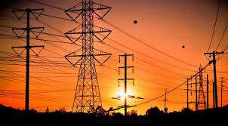
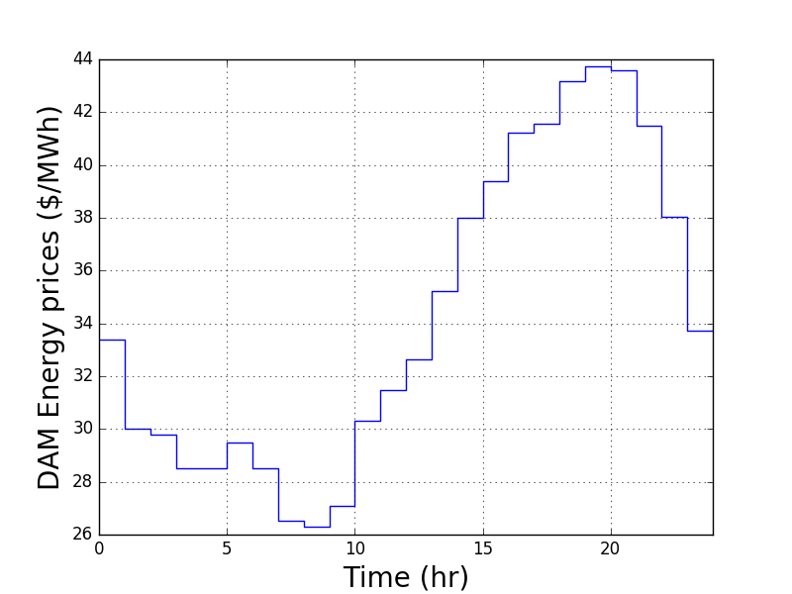
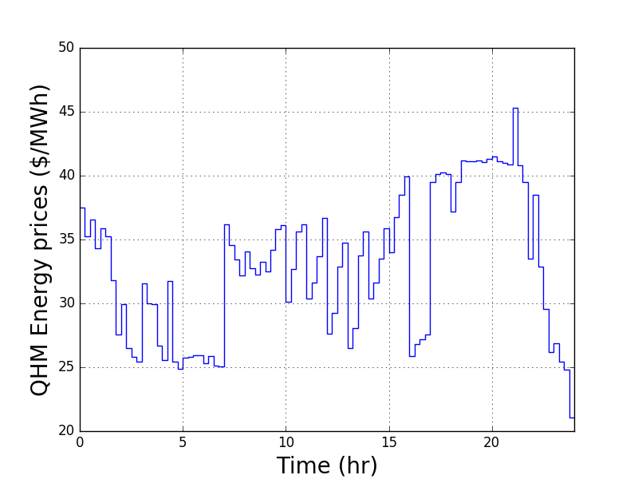
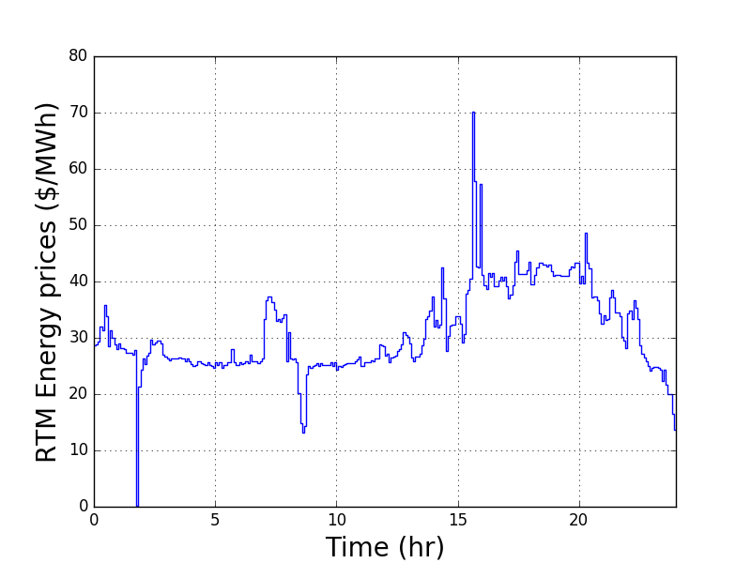
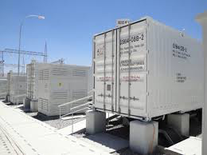
Battery Operation Model
Energy Prices:
Day-ahead market (Time scale: 1 hour)
Quarter-hourly market (Time scale: 15 min)
Real-time market
(Time scale: 5 min)
Regulation Prices:
Day-ahead market (Time scale: 1 hour)
Quarter-hourly market (Time scale: 15 min)
Example for day-ahead market:
P_max
Regulation up
Regulation down
Regulation up
Power (MW)
Regulation down
1
2
3
Time (hr)
Max Regulation
Regulation up
Max Regulation
Regulation down
-P_max

Slide 4
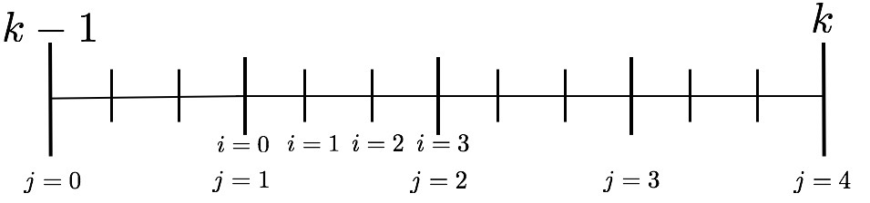
Optimization Model for one day: Constraints and Objective Function
where,
Energy balance equations for the battery at each subinterval:
Revenue from energy market:
Energy regulation at each subinterval:
Revenue from regulation market:
Bounds on variables:
Objective:

Slide 5
Results: Solving Complete Optimization Problem for 1 year
Approach:
A single optimization problem formulated to maximize revenues of the whole year
Problem size:
911041 linear constraints
1103761 variables
Computation time (Solved in Julia using Gurobi solver)
~ 20 seconds
Total annual revenues: $293,125
Revenues from energy sale: $201,281
Revenues from regulation: $91,844

Slide 6
Results: Simultaneously Solving Complete Optimization Problem for 1 year
Energy trading profile in a day:
Day-ahead market
Quarter-hourly market
Real-time market
State of charge of battery

Slide 7
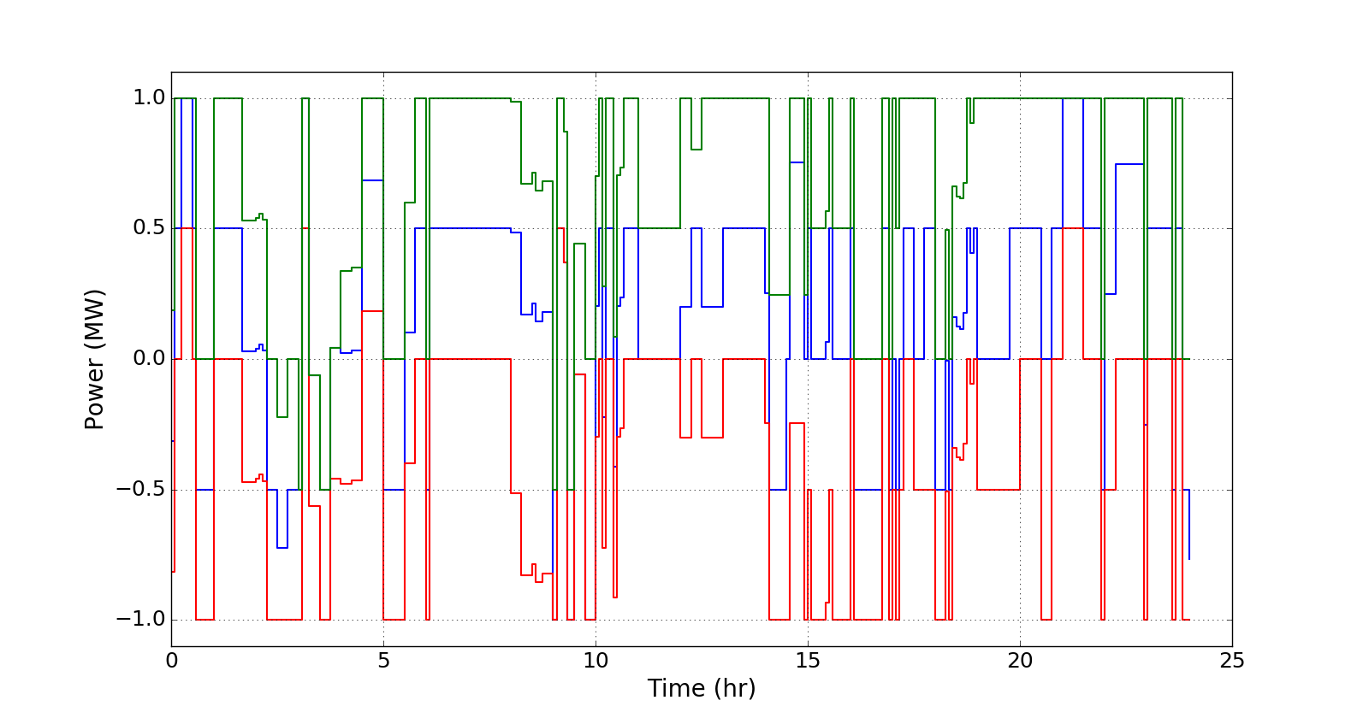
Results: Simultaneously Solving Complete Optimization Problem for 1 year
Regulation trading profile in a day:
Day-ahead market
Quarter-hourly market
Power and regulation band

Slide 8
Results: Solving Complete Optimization Problem for 1 year
Cumulative revenues in a year:
Revenues from energy sale
Revenues from regulation
Total revenues

Slide 9
Results: Solving with Rolling Horizon of 1 Day
Approach:
An optimization problem formulated to maximize revenues of each day sequentially
Takes the solution of the end of previous day as the initial point for the present day
Problem size for each day:
2497 linear constraints
3025 variables
Computation time (Solved in Julia using Gurobi solver)
0.01-0.02 seconds for each day
5-10 seconds for whole year
Total annual revenues: $296,985
Revenues from energy sale: $205,835
Revenues from regulation: $91,150

Slide 10
Results: Solving with Rolling Horizon of 1 Day
Energy trading profile in a day:
Day-ahead market
Quarter-hourly market
Real-time market
State of charge of battery

Slide 11
Results: Solving with Rolling Horizon of 1 Day
Regulation trading profile in a day:
Day-ahead market
Quarter-hourly market
Power and regulation band

Slide 12
Results: Solving with Rolling Horizon of 1 Day
Cumulative revenues in a year:
Revenues from energy sale
Revenues from regulation
Total revenues

Slide 13
Comparison
Simultaneously solving
Rolling horizon
Problem size:
911041 linear constraints
1103761 variables
Computation time
~ 20 seconds
Total annual revenues: $293,125
Revenues from energy sale: $201,281
Revenues from regulation: $91,844
Problem size for each day:
2497 linear constraints
3025 variables
Computation time
0.01-0.02 seconds for each day
~ 5-10 seconds for whole year
Total annual revenues: $296,985
Revenues from energy sale: $205,835
Revenues from regulation: $91,150

Slide 14
Conclusions
Rolling horizon approach is much computationally faster than the simultaneous approach
Although trends of the solutions are similar, rolling horizon approach results in slightly higher annual revenues than the simultaneous approach
Expect the rolling horizon approach to perform much better than the simultaneous approach to solve stochastic model for this problem
A real-time optimal controller can be designed to operate the battery in an optimal way with rolling horizon approach

Slide 15
Thank you!

