Slide 1

Musically Yours
DEMO Presentation
Project By
Ranjeeta Bhattacharya

Slide 2
Deliverables
These are the list of deliverables as part of this project:
Python Scripts (.py): There are two scripts delivered as part of this project. The core script is ‘main_program.py’ which internally refers to user defined module ‘dataset_research.py’.
Input CSV File: Input file referred is ‘MusicDataset_input.csv’ which contains ~10,000 records.
3) A video presentation(.mp4) file which will walkthrough the entire program. This file will also be embedded in this presentation.
Pre-Requisites
The following set of standard libraries should be installed before running the scripts:
1) Pandas
2) Matplotlib
3) Seaborn
Limitations
1) The input CSV file may have some encoding issues while processing. This may
generate some warnings/errors.
2) It is recommended to use Jupyter notebook for properly visualizing graphs, plots.

Slide 3
Introduction: Every musicians dream is to create something which would appeal to the listeners. Ultimate dream of an artist is to get recognized and earn appreciation for the work of art he/she creates. How to make a song popular remains a constant endeavor for all artists. Are there certain characteristics/traits/patterns which ensures a song’s success, and can we predict how popular a particular song will be based going through historical data? Music industry is booming now with global music sales nearly reaching $15 billion dollars. Predicting how popular a song requires extensive insights into the available data. Here I will present a script which will identify and make comparisons between some key features of a song and explore relationships between them (if any).
Background: In 2017, the music industry generated $8.72 billion in the United
States alone. The industry continues to flourish massively via the online streaming
services (Spotify, Apple Music, etc.). The top 10 artists in 2017 generated a
combined $363 million in revenue[Link]. Currently lot of research is ongoing
trying to predict popularity of a song with varying degree of success. Music
industry exploded with the rise of online streaming services. In 2010, music
streaming revenues amounted to roughly 500 million US dollars and by end
of 2017, that figure grew to approximately 5.7 billion US dollars [Link]. There
is currently ongoing research regarding song popularity predictor with
varying degree of success. A range of characteristics pertaining to a song
(lyrics, duration, artist information, temp, beat, loudness, chord)
can be analyzed to extract patterns.

Slide 4
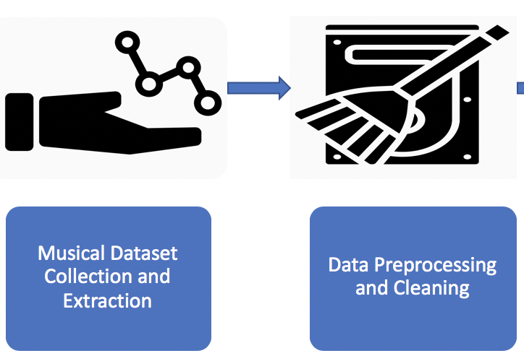
Data collection and Pre-Processing:
Acquiring the Data: The input dataset chosen for the script is a subset of ~10,000 records of the “Million Songs Dataset” provided by Columbia University and pulled from the Echo Nest [LINK]. The dataset has been generated at random (1.8% of the million dataset). Original dataset contained around 41 features categorized by audio analysis, artist information, and song related features. For my evaluation purpose, I’ve selected a subset of 22 features to carry out analysis. They are as follows:
“ artist_familiarity, artist_hotness, artist_id, artist_latitude, artist_location, artist_longitude, artist_name, duration,
end_of_fade_in, key, key_confidence, loudness, mode, mode_confidence, release,
song_hotness, start_of_fade_out, tempo, time_signature, time_signature_confidence, title, year “
Cleaning the Data Set: Many fields in the original million records dataset were unusable
due to old and deprecated data. In the revised subset, we replaced all null values with
some default value applicable for that attribute. The file was also encoded in UTF-8
format to enable smooth processing.

Slide 5
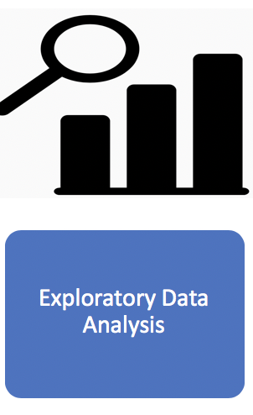
Exploratory Data Analysis (EDA):
Data Exploration: Using pandas dataframe, statistical analysis of entire dataset and correlation between some of its attributes were carried out:
 | artist_familiarity | song_hotness
artist_familiarity | 1.000000 | 0.405713
song_hotness | 0.405713 | 1.000000
 | artist_longitude | song_hotness
artist_longitude | 1.000000 | -0.009246
song_hotness | -0.009246 | 1.000000
 | loudness | song_hotness
loudness | 1.000000 | 0.186758
song_hotness | 0.186758 | 1.000000
 | artist_hotness | song_hotness
artist_hotness | 1.000000 | 0.372219
song_hotness | 0.372219 | 1.000000
 | artist_familiarity | song_hotness
artist_familiarity | 1.000000 | 0.811735
song_hotness | 0.811735 | 1.000000
Field | Count | Mean | Std (Standard Deviation) | Min | Max
artist_familiarity | 10001 | 0.5652510441393802 | 0.1605343552868329 | 0.0 | 1.1
artist_hotness | 10001 | 0.3855710736008436 | 0.14365251245032 | 0.0 | 1.082502557
duration | 10001 | 238.5116887651235 | 114.13256853435487 | 1.04444 | 1819.76771
Loudness | 10001 | -10.484950604939524 | 5.399995499735154 | -51.643 | 0.5660000000000001
tempo | 10001 | 122.9204771522855 | 35.18624609935969 | 0.0 | 262.828

Slide 6
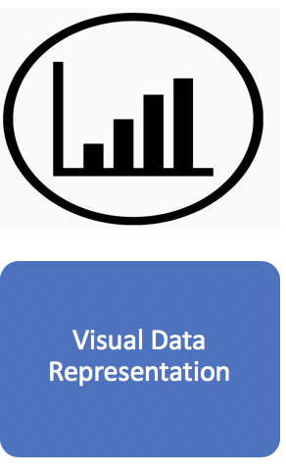
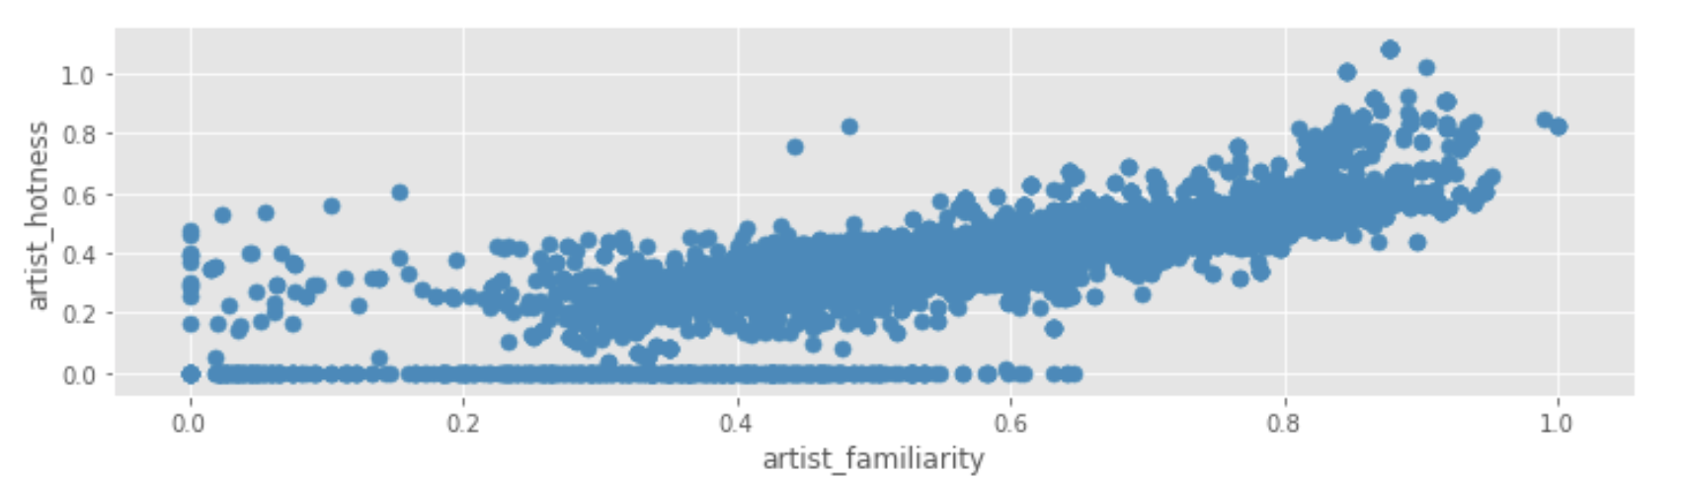
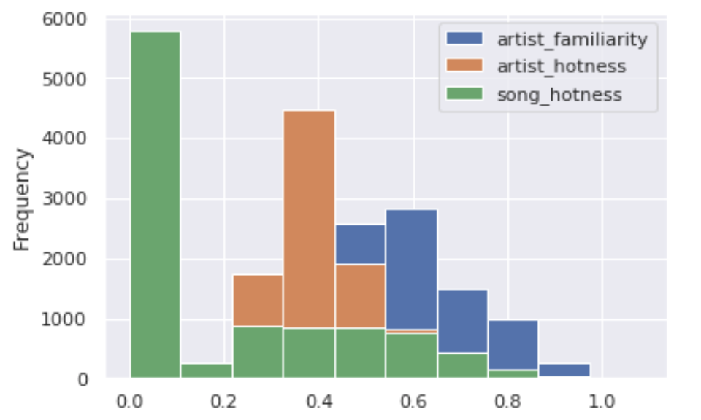
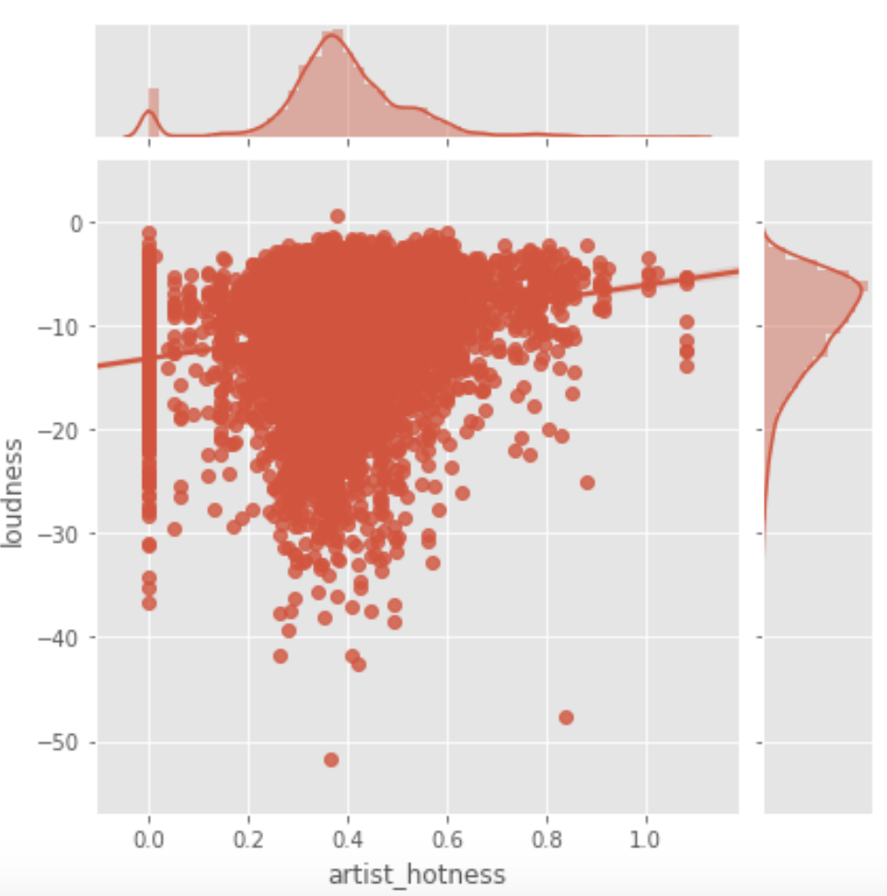
Data Visualization: Some basic plots were generated using matplotlib and seaborn data
visualization libraries as depicted below:
PANDAS SCATTER PLOT
PANDAS HISTOGRAM SEABORN JOINT PLOT

Slide 7
CONCLUSION & RECOMMENDATION
The process of data exploration was done by examining the dataset in aggregate and computing basic statistics (count, mean, standard deviation, min, max) for some important dataset features.
Strong positive correlations were identified between key attribute pair “artist_familiarity, song_hotness”.
Negative correlation was exhibited by attribute pair “artist_longitude, song_hotness”.
More insights can be derived if analysis is carried out with a larger dataset.
By using different machine learning techniques in the future, there remains a possibility of
of predicting if a particular song will be hit or not.

Slide 8
References
https://labrosa.ee.columbia.edu/millionsong/
https://pandas.pydata.org/pandas-docs/stable/
https://seaborn.pydata.org

