Slide 1
HACKATHON ANALYTICS SUBMISSION
VoltRelay Energy
Network Performance, Service Reliability
& Rider Experience Analysis
3.87M swap events • 6 cities • 8 datasets • Jan 2024 – Jun 2025
Bengaluru • Delhi NCR
Jan 2024 –
₹17.58 → ₹36.32
Hyderabad • Pune • Mumbai • Jaipur
Jun 2025 coverage
contribution margin / swap

Slide 2
EXECUTIVE SUMMARY
A Scaling Network With a Pinpointed Reliability Gap
VoltRelay's battery-swap network for 2W/3W gig and logistics riders grew rapidly across six cities through 2024–25. Unit economics improved steadily, but service reliability was not uniform — sharp, recurring failure spikes hit specific cities and older charging infrastructure each April–June, and battery availability shows up as both the leading operational failure mode and the #1 customer complaint.
12.27%
Peak monthly failure rate (May 2024) vs ~4.4% baseline
16.5% vs 6.8%
Gen1 vs Gen2 charger failure rate during the spike
₹17.58 → ₹36.32
What this analysis covers
Contribution margin proxy per completed swap, Jan’24–Jun’25
Network growth • city & station failure patterns • Gen1 vs Gen2 chargers • vehicle-class reliability • battery supplier health • pricing & contribution margin • support-ticket signals
44,000
Support tickets analyzed — battery availability is #1 complaint
2 / 10

Slide 3
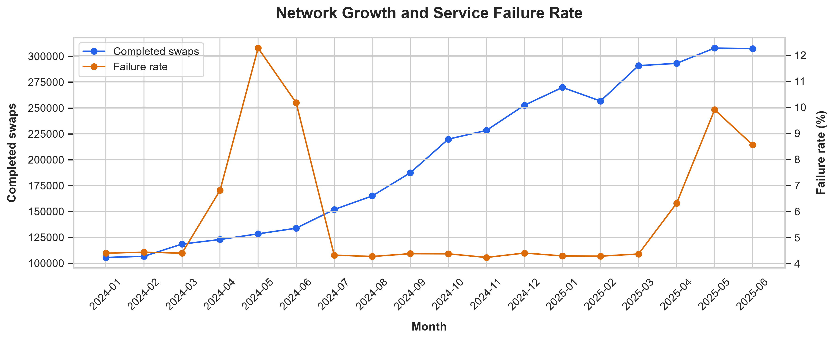
NETWORK GROWTH
The Network Scaled Fast — With Recurring Reliability Dips
₹6.32M → ₹16.34M
Monthly revenue growth, Jan–Dec 2024
12.27%
Peak failure rate, May 2024 vs ~4.4% baseline
A recurring pattern
The April–June disruption reappeared in 2025, though smaller in magnitude — a seasonal, city-specific pattern rather than a one-off event.
Completed swaps climbed from ~105K to ~310K+ a month, while failure rate spiked sharply each April–June (2024 and 2025) before settling back near ~4.2–4.5%.
3 / 10

Slide 4
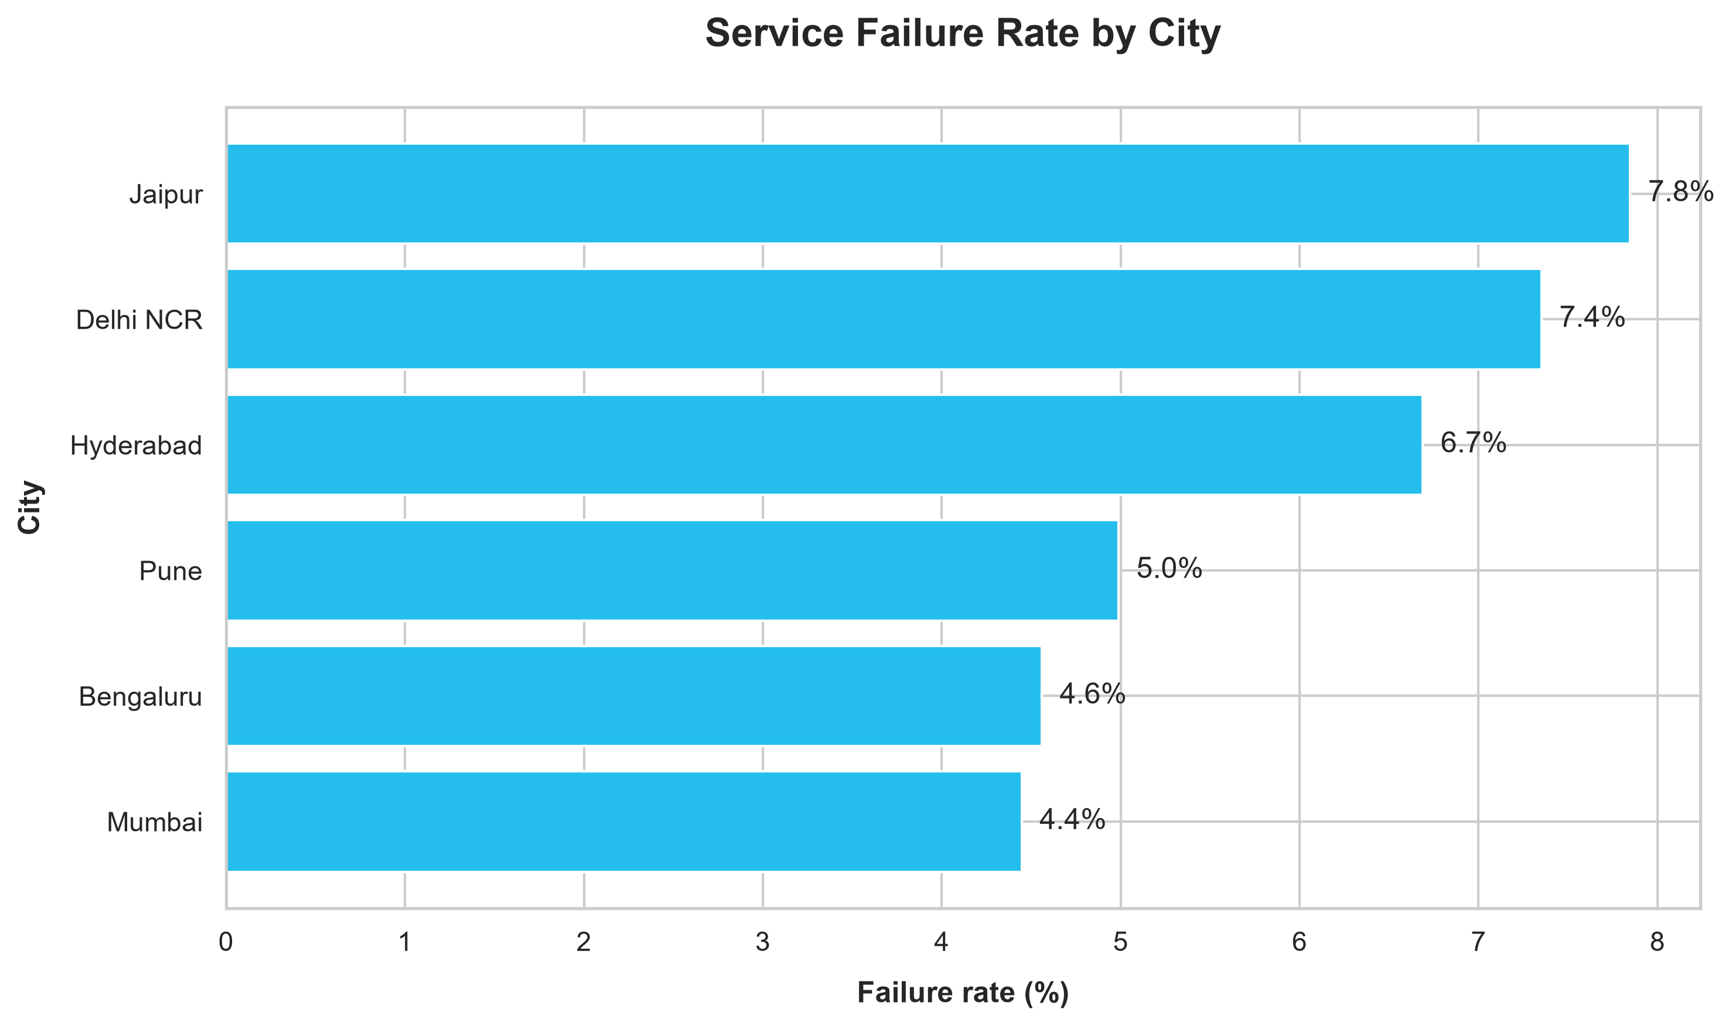
GEOGRAPHIC PATTERNS
Reliability Varies by City — With a Sharp May 2024 Spike
May 2024 spike, by city
Jaipur
19.77%
Hyderabad
17.72%
Delhi NCR
16.96%
Pune
9.81%
Bengaluru
6.44%
Mumbai
4.58%
By July 2024
All six cities returned to approximately 4.1–4.5% failure rate. A similar, smaller-magnitude pattern reappeared in April–June 2025 — these are recurring, city-specific windows worth pre-empting.
4 / 10

Slide 5
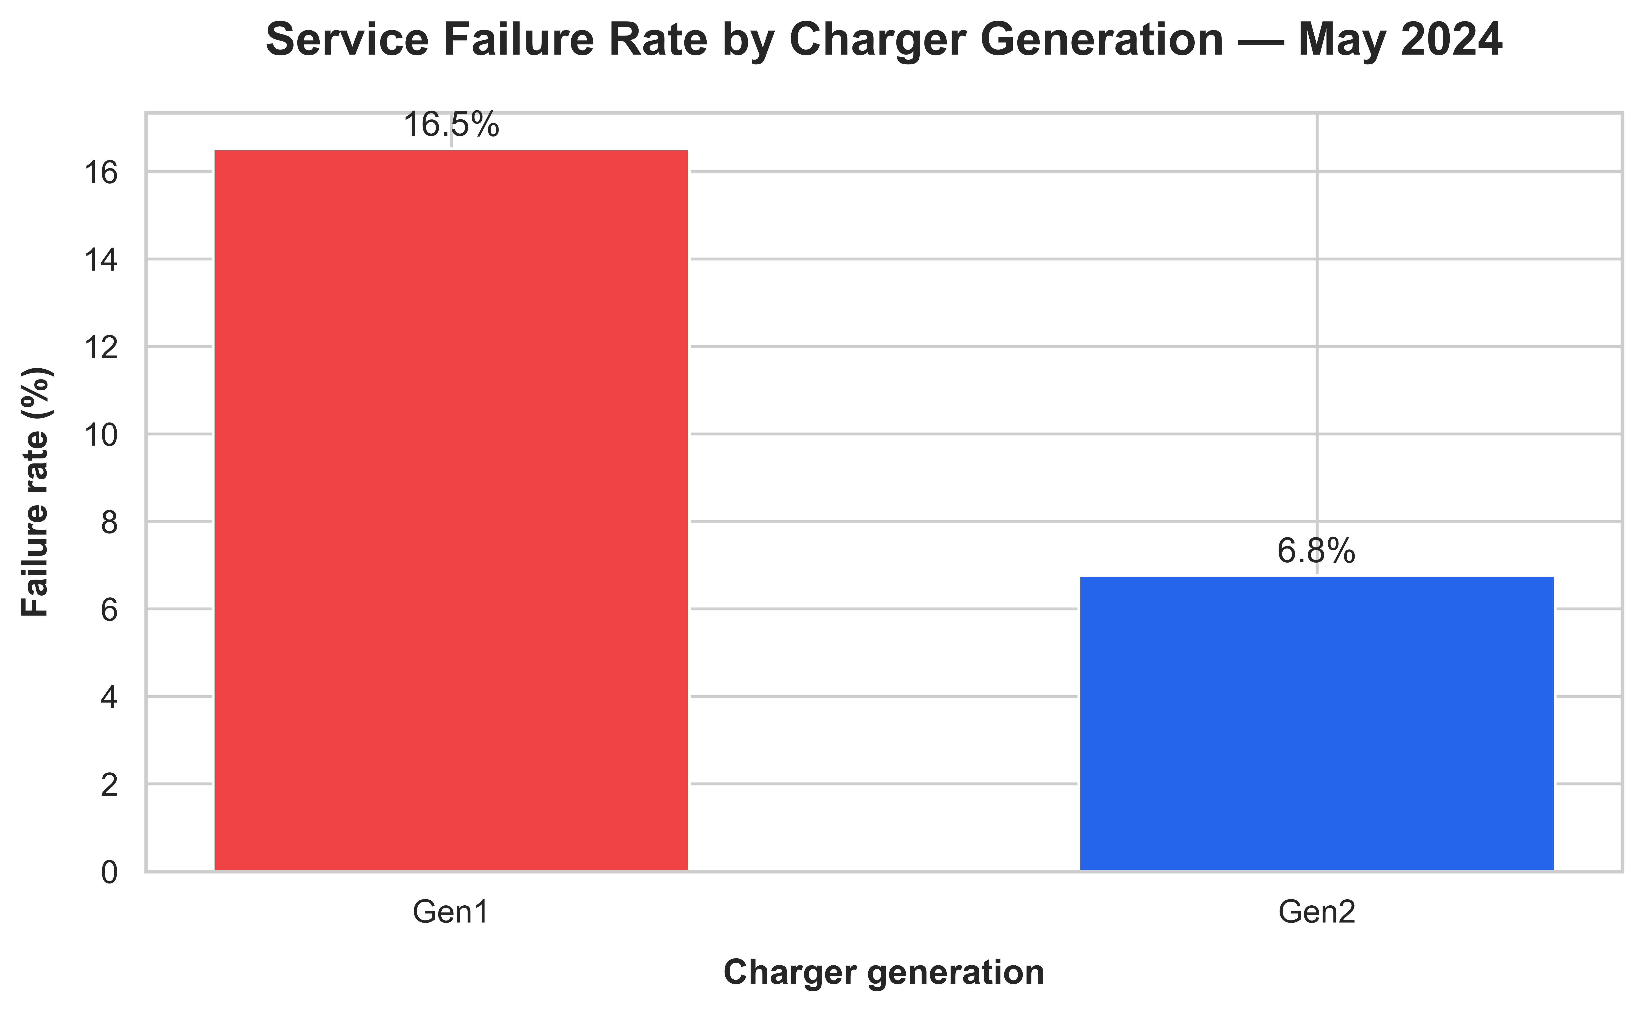
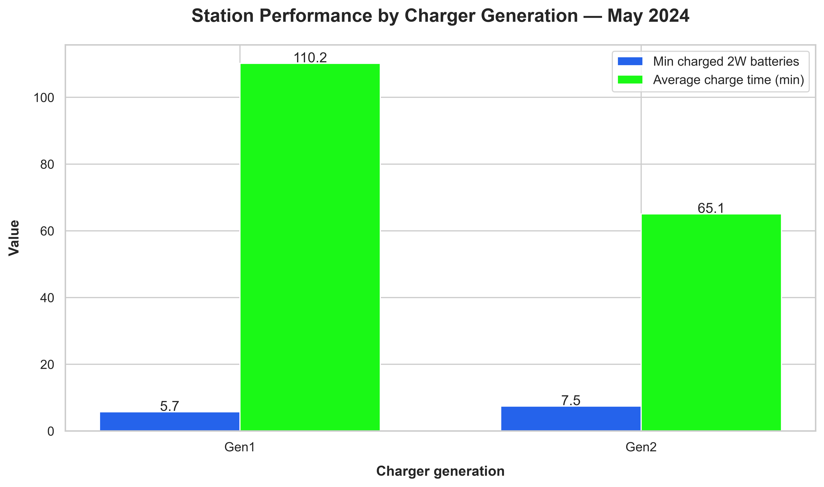
INFRASTRUCTURE
Gen1 Chargers Drove the May 2024 Failure Spike
Overall failure rate, May 2024
Station telemetry, May 2024
Gen1 had more chargers online (15.5 vs 14.1) yet performed worse — charger count alone doesn’t explain reliability. The gap held within every city too: Delhi NCR 19.6% vs 10.1%, Hyderabad 19.4% vs 10.2%, Pune 14.2% vs 7.9%, Bengaluru 7.4% vs 5.7%, Mumbai 5.2% vs 4.5% (Gen1 vs Gen2).
5 / 10

Slide 6
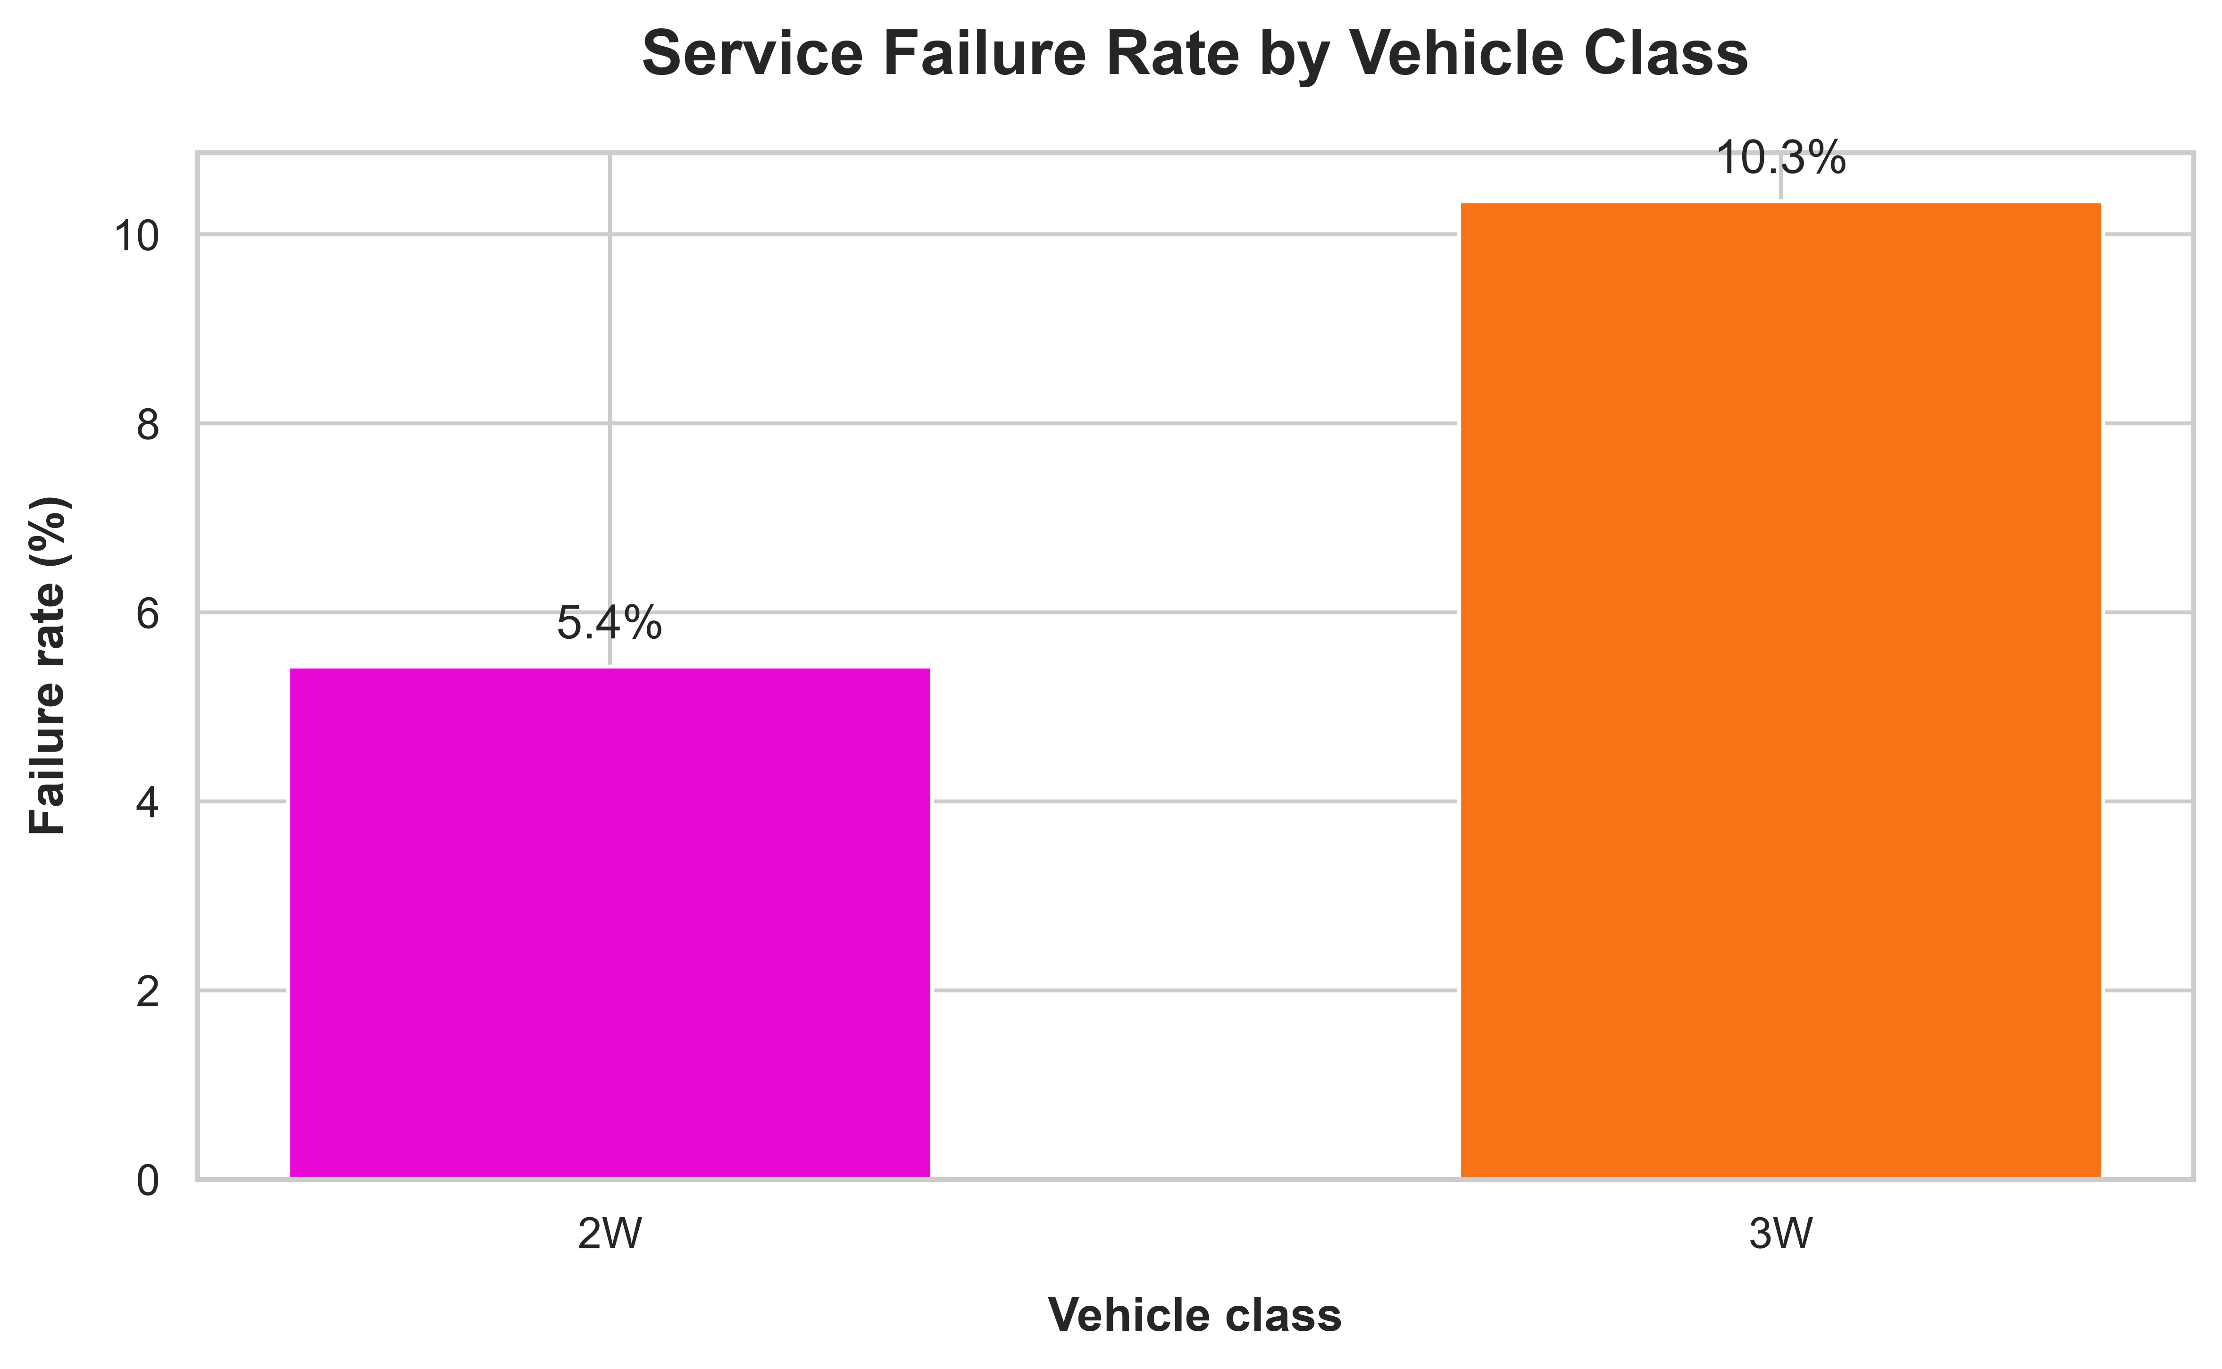
FAILURE MECHANISMS
No-Charged-Battery Events Drove Failures — 3W Hit Hardest
Avg. queue wait is ~243 seconds for both classes — the gap isn’t explained by wait time alone.
System-error events were comparatively minor — the story is battery inventory, not software.
6 / 10

Slide 7
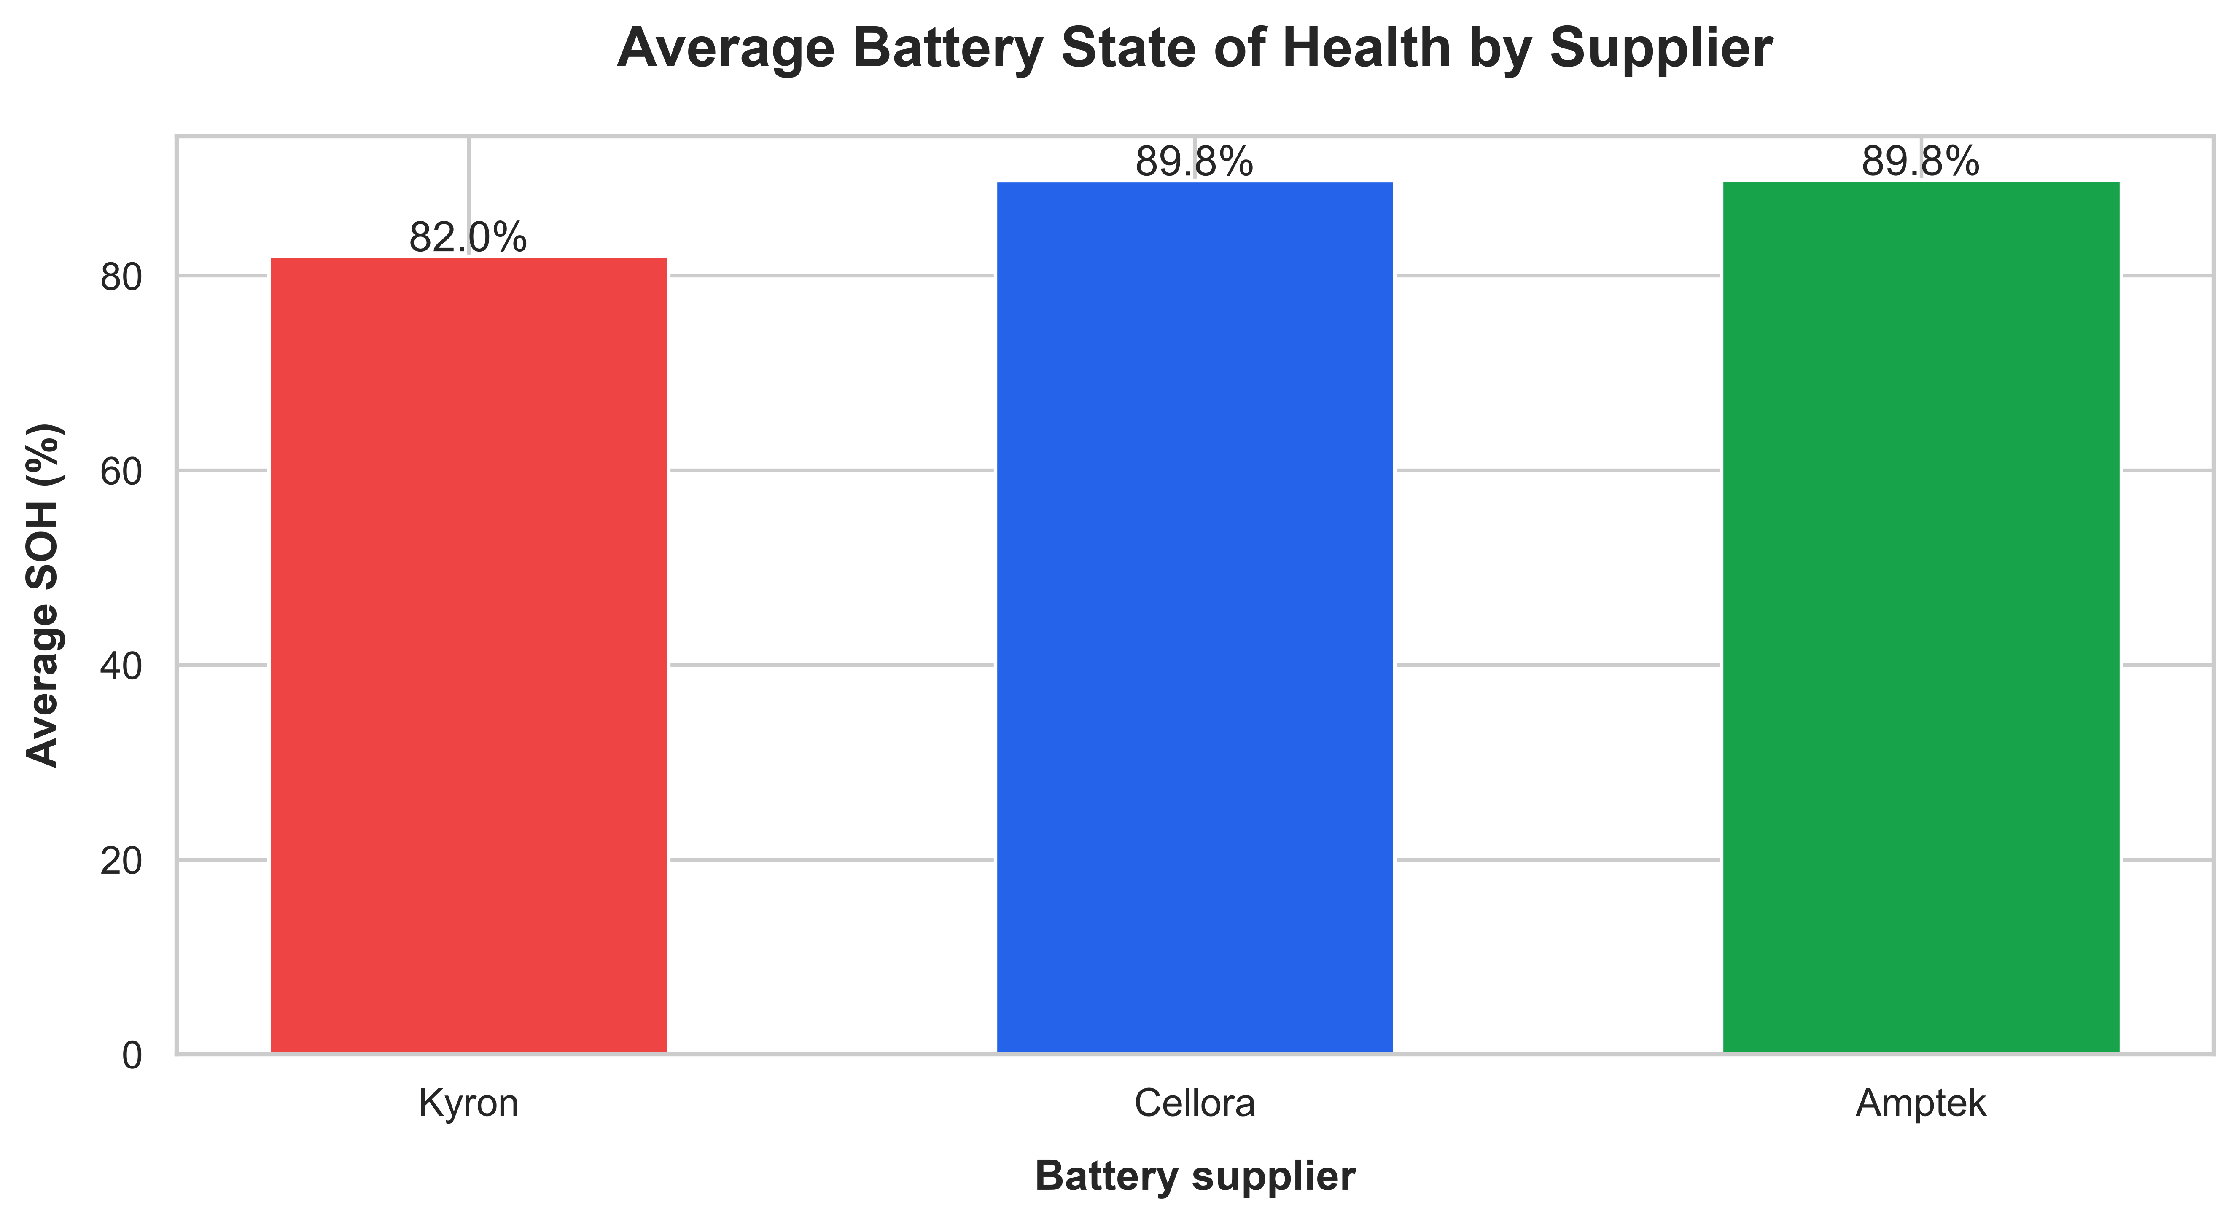
BATTERY HEALTH
Kyron Batteries Show Materially Lower State of Health
Supplier snapshot
Kyron
82.0% → 63.7% current SOH
657,648 swaps • 56.8 km avg. since last swap
Cellora
89.8% → 80.6% current SOH
2,188,677 swaps • 63.1 km avg. since last swap
Amptek
89.8% → 80.6% current SOH
799,484 swaps • 63.3 km avg. since last swap
Association only — age, deployment pattern, and manufacturing lot may also contribute.
7 / 10

Slide 8
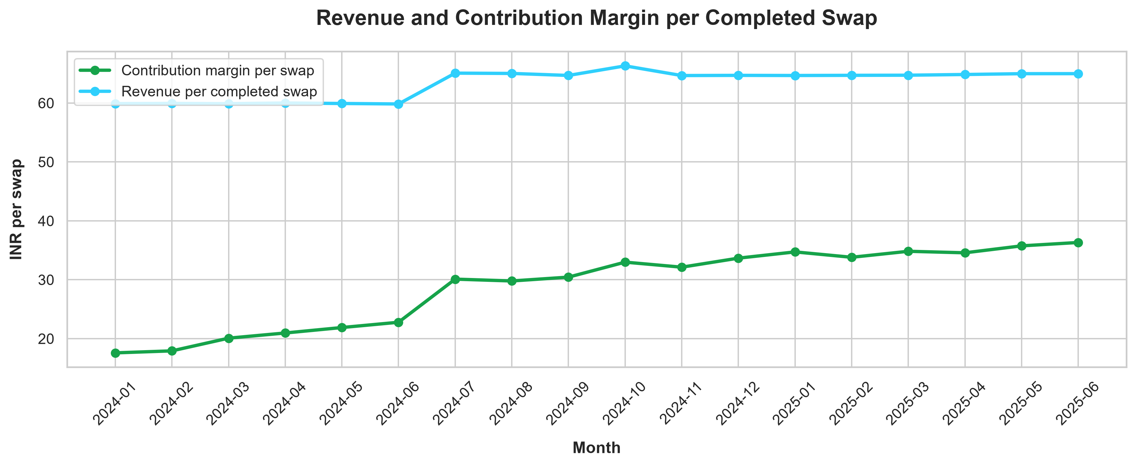
UNIT ECONOMICS
Contribution Margin per Swap More Than Doubled
₹1.12 Cr
Estimated June 2025 monthly contribution margin (~₹11.16M)
₹62–63 → ₹67–71
Standard/partner list price increase from July 2024
Peak/off-peak tariffs appeared from October 2024. Margin growth tracks pricing changes, but volume and partner mix moved at the same time — so pricing alone isn’t the sole driver.
8 / 10

Slide 9
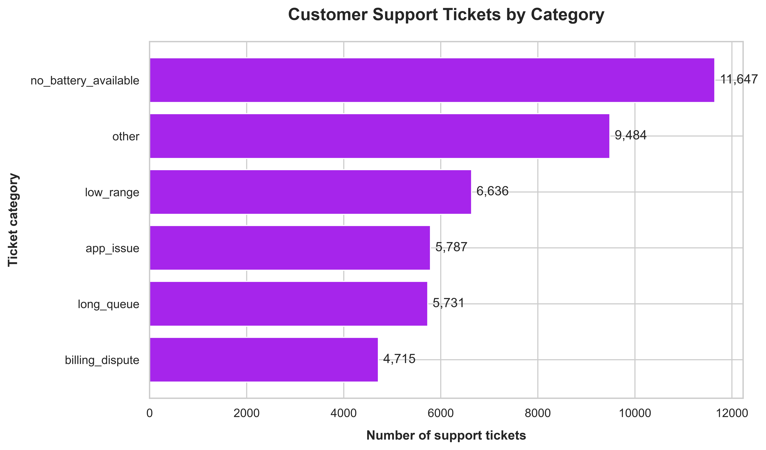
RIDER EXPERIENCE
Battery Availability Is the #1 Rider Complaint
~16 hrs
Average resolution time — consistent across categories
~3.5 / 5
Average CSAT across support categories
No-battery-available, low-range, and long-queue complaints together point to the same root cause as the operational data: charged-battery availability and station capacity.
9 / 10

Slide 10
CONCLUSION
Key Takeaways & Recommendations
What we found
What we recommend
Network scaled from ~105K to ~310K+ monthly completed swaps
Prioritize Gen1 stations for inspection & phased replacement
Failure rate spikes to ~12% each April–June, concentrated in Jaipur, Delhi NCR & Hyderabad
Track charged-battery availability as a leading station KPI
Gen1 chargers failed at ~2.4× the Gen2 rate, with longer charging & more outages
Build city-specific playbooks for the recurring Apr–Jun window
3W failure rate (10.3%) is nearly double 2W (5.4%), despite equal queue waits
Plan 3W capacity and inventory separately from 2W
Kyron batteries show lower SOH; margin per swap improved from ₹17.58 to ₹36.32
Investigate Kyron SOH by battery age, lot & deployment; monitor support tickets as an early-warning signal
Analysis based on organizer-provided datasets • AI tools used for structuring & visualization support
10 / 10

