Slide 1
Agile

Slide 2
Introduction to Agile
The Agile Manifesto
The Agile Principles
The Agile Team
Early and Frequent Feedback
Agile events (Sprint Planning,Review,Retro etc)
Roles of Agile team

Slide 3
Agile Manifesto
We are uncovering better ways of developing software by doing it and helping others do it. Through this work we have come to value:
Individuals and interactions over processes and tools
Working software over comprehensive documentation
Customer collaboration over contract negotiation
Responding to change over following a plan
That is, while there is value in the items on the right, we value the items on the left more.
“Agile” is not a process – it’s a value system

Slide 4
The Agile Principles
Our highest priority is to satisfy the customer through early and continuous delivery of valuable software.
Welcome changing requirements, even late in development. Agile processes harness change for the customer's competitive advantage.
Deliver working software frequently, from a couple of weeks to a couple of months, with a preference to the shorter timescale.
Business people and developers must work together daily throughout the project.
Build projects around motivated individuals. Give them the environment and support they need, and trust them to get the job done.
The most efficient and effective method of conveying information to and within a development team is face-to-face conversation.

Slide 5
The Agile Principles
Working software is the primary measure of progress.
Agile processes promote sustainable development. The sponsors, developers, and users should be able to maintain a constant pace indefinitely.
Continuous attention to technical excellence and good design enhances agility.
Simplicity--the art of maximizing the amount of work not done--is essential.
The best architectures, requirements, and designs emerge from self-organizing teams.
At regular intervals, the team reflects on how to become more effective, then tunes and adjusts its behavior accordingly.

Slide 6
Agile Implementations
Scrum
Extreme Programming
Iterative development
Kanban
And many others

Slide 7
Case Study: Building the team
Relates to these principles:
Business people and developers must work together daily throughout the project.
Build projects around motivated individuals. Give them the environment and support they need, and trust them to get the job done.
The most efficient and effective method of conveying information to and within a development team is face-to-face conversation.
At regular intervals, the team reflects on how to become more effective, then tunes and adjusts its behavior accordingly.

Slide 8
It takes many roles to build a K-12 analytics system…
Researchers
Data Modelers
Business
Analysts
System Architects
Trainers
Interface Designers
Interface Developers
Support Analysts
QA Testers
ETL Developers
Managers
Education World
Technology World

Slide 9
It takes many roles to build a K-12 analytics system…
We hired experienced private-sector technologists, who showed adaptability to different industries, to provide world- class technical skills.
Researchers
Data Modelers
Business
Analysts
System Architects
Trainers
Interface Designers
Interface Developers
Support Analysts
QA Testers
ETL Developers
Managers
Education World
Technology World

Slide 10
It takes many roles to build a K-12 analytics system…
We hired experienced, tech-savvy educators to provide domain expertise as researchers, analysts, trainers, testers, and support specialists
Researchers
Data Modelers
Teachers
Business
Analysts
System Architects
Trainers
Interface Designers
Interface Developers
Administrators
Support Analysts
QA Testers
ETL Developers
Data Specialists
Managers
Education World
Technology World

Slide 11
Key Characteristics
Have the “agile” mindset
  Self-driven to quality and doing things right despite schedule pressures
  Able to work today’s tasks while considering the big picture
  Not phased by change and adaptation
  Can reliably execute a test-driven process
  Proactive continuous improvement
  Thrive in a collaborative environment
Critical thinking skills to deal with deep data and business rule semantics
Experienced and expert in the underlying technologies
Deep experience in education data and applications

Slide 12
Early and Frequent Feedback
Early and frequent feedback in agile is a core practice that involves delivering working software in short, iterative cycles to continuously get input from stakeholders and the team.
This process allows teams to adapt to changes, prioritize high-value features, and catch misunderstandings or quality issues early when they are less expensive to fix

Slide 13
How it works
Short iterations: Instead of a long development period, agile teams work in short cycles (sprints), typically two to four weeks.
Working increments: At the end of each iteration, a usable, working piece of the product is delivered.
Stakeholder reviews: The delivery is showcased to stakeholders, who provide feedback on the functionality and alignment with business needs.
Actionable adjustments: This feedback is used to update the product backlog, which is then prioritized for future iterations.
Team reflection: The team also holds a retrospective to reflect on the process itself, identify what went well and what can be improved.

Slide 14
Key benefits
Higher customer satisfaction: The product evolves to better reflect the customer's true needs because they see and interact with it early and often.
Reduced costs: Issues and misunderstandings are found and fixed early in the development cycle, which is much less costly than fixing them at the end.
Focus on value: Teams can focus on delivering the highest-value features first, reducing project risk.
Adaptability: The team can easily incorporate changes and pivot direction as needed, rather than being locked into a plan from the beginning.
Continuous improvement: The feedback loop applies not only to the product but also to the team's workflow and processes, leading to continuous improvement.

Slide 15
Examples of feedback mechanisms
Sprint Review: A meeting at the end of each sprint to demonstrate the working software to stakeholders.
Daily Standup: A quick, daily meeting where team members share progress and identify blockers.
Automated testing: Automated tests provide immediate feedback on code quality throughout the development process.
Continuous Integration (CI): A practice that integrates code changes from multiple developers into a shared repository frequently, providing rapid feedback on integration issues.
Backlog Refinement: An ongoing process where the team discusses and clarifies future work items.

Slide 16
Roles of Agile team
The three core roles in an Agile team are the Product Owner, who manages the product backlog and prioritizes work based on business value;
the Scrum Master, who acts as a servant leader to facilitate the process and remove impediments; and the Development Team, which is a self-organizing, cross-functional group that builds the product.
These roles work together to deliver value through iterative cycles and continuous improvement.

Slide 17
Roles of Agile team
Product Owner
Defines and prioritizes the product backlog based on business value.
Gathers and refines customer requirements.
Collaborates with stakeholders to set goals and ensures the team is aligned with business objectives.
Acts as the voice of the customer to the team.

Slide 18
Roles of Agile team
Scrum Master
Facilitates Agile ceremonies and helps the team adhere to its principles.
Removes obstacles and impediments that block the team's progress.
Coaches the team in self-organization and cross-functionality.
Protects the team from external distractions and interferences.
Acts as a servant leader, empowering the team rather than commanding them.

Slide 19
Roles of Agile team
Development Team
A self-organizing, cross-functional group of individuals who perform the actual work of developing the product.
Collaborates to produce high-quality work during each iteration (sprint).
Works together to create and deliver the product increment.
Members may include developers, testers, designers, writers, and other specialists as needed.

Slide 20

Reveal Team Building
Upon joining the project, an excellent multi-functional team had already been assembled
But existing project management and team-building practices were ineffective, and there were many divisive influences affecting the team
We addressed the divisive influences. However, there was still an “us vs. them” problem between the educators and technologists. We needed a way to manage the project that promoted teamwork.

Slide 21
Agile Results on Reveal
We turned to Agile principles and Scrum to help solve the problem.
Cross-functional teams were formed.
The teams were given a goal and timeframe in regular intervals.
They were self-organizing - no pre-defined leader or roles.
We abandoned detailed specifications in favor of face-to-face collaboration and communication. (Documentation was done after the fact, and reflected the software as-built.)
We kept the focus on the end user, and educational outcomes.
They reflected on their progress and opportunities at regular intervals.
Soon, the teams began to understand the challenges they each faced, and how they could better collaborate to build great software quickly and effectively.
A high-functioning team was born!

Slide 22
Case Study: Managing the team
Relates to these principles:
Deliver working software frequently, from a couple of weeks to a couple of months, with a preference to the shorter timescale.
Working software is the primary measure of progress.
Welcome changing requirements, even late in development. Agile processes harness change for the customer's competitive advantage.
The most efficient and effective method of conveying information to and within a development team is face-to-face conversation.

Slide 23
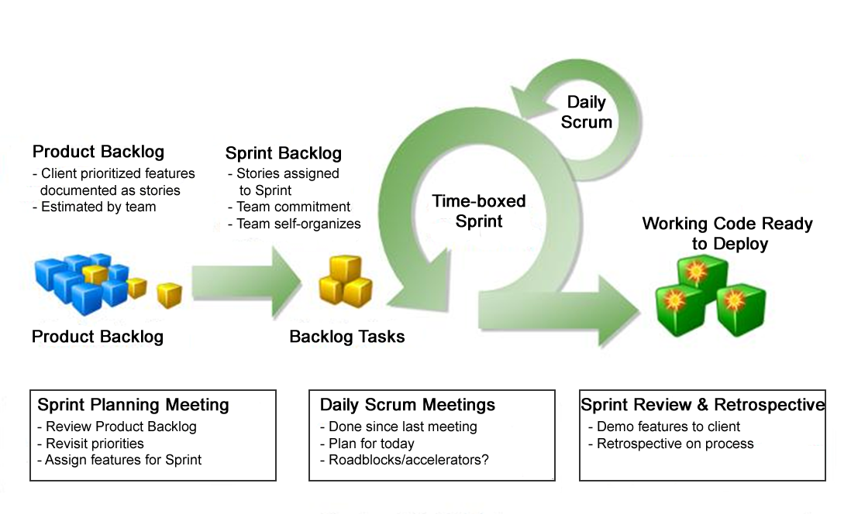
Scrum is the most popular agile process

Slide 24
Kanban + Scrum =“Scrum-ban”
Kanban
Scrum
Specialized functional groups
Track process steps
Continuous process with periodic release cycles
Able to expedite stories
Limits for work in process to identify bottlenecks
Goal is to minimize story completion time
Multi-faceted, self-organizing teams
Backlog | In process | Done
Time-boxed sprints, each potentially releasable
Stories frozen during a sprint
Unfinished stories placed on backlog
Goal is to increase team velocity

Slide 25
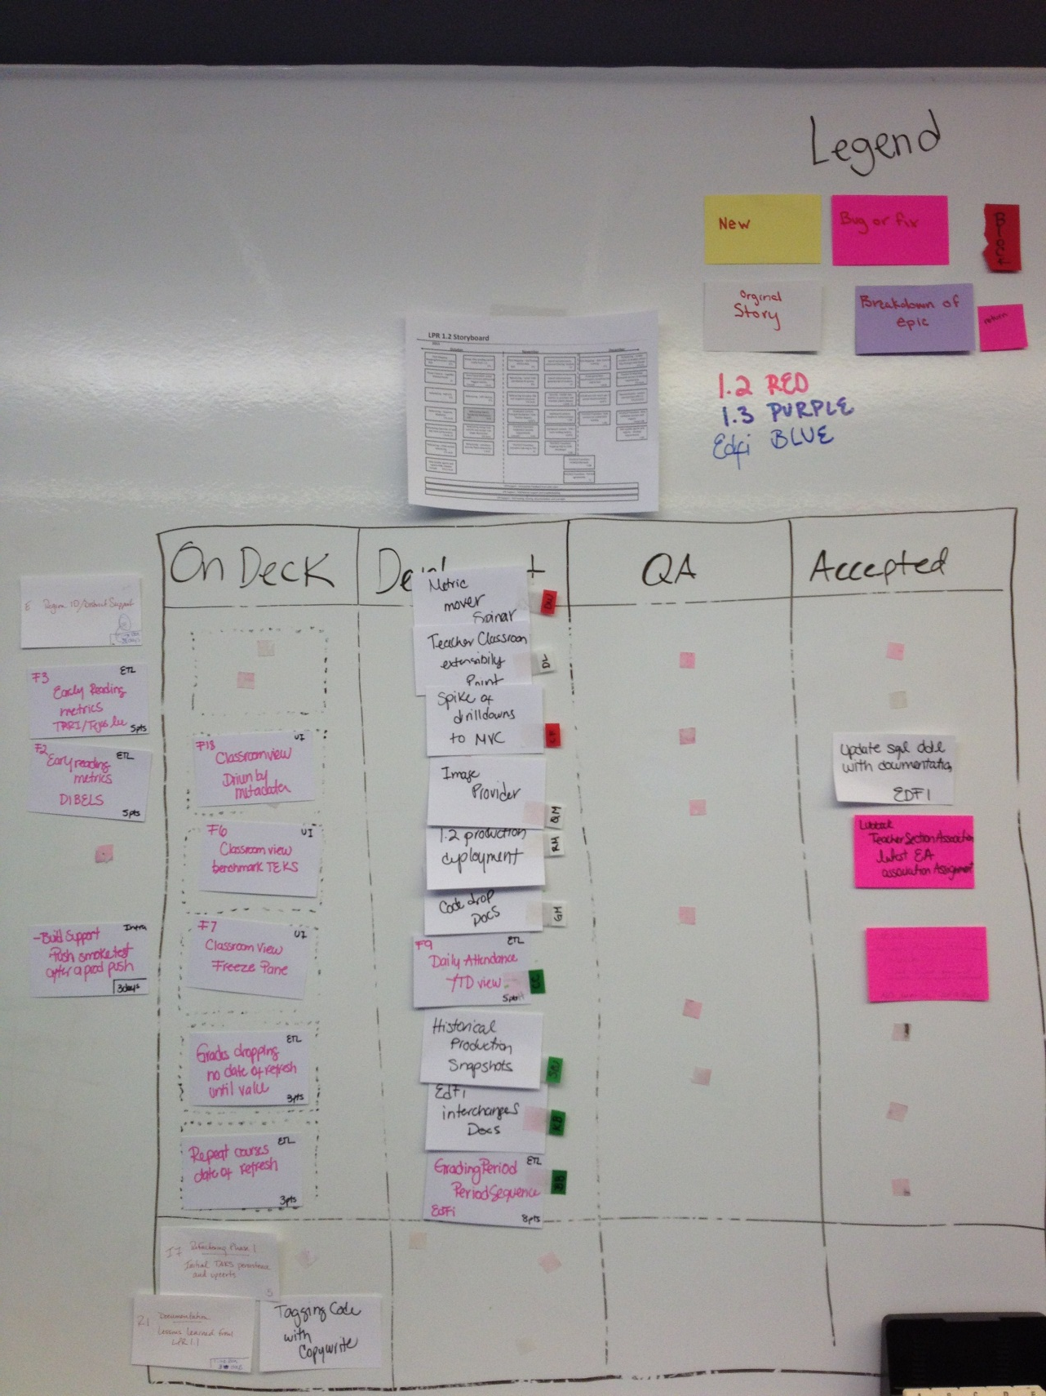
Kanban Board
New Bug or Fix
Original Breakdown
Story of Epic
Roadmap
Major Process Steps
On Deck
Stories in process
Stories that are done, done, done

Slide 26
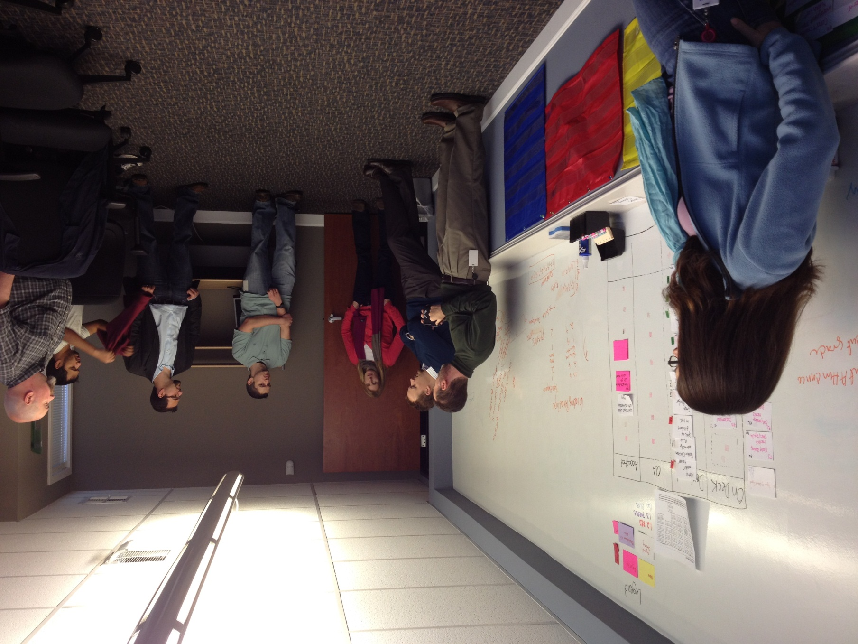
Scrum time at the Kanban Board
DLP photo. Release for web use of photo on file.

Slide 27
Collaborative development
High level of user input and collaboration
  Users – extensive stakeholder engagements at the start, monthly follow-up focus groups, demos, etc.
  Customer/sponsor – weekly meetings plus participation in JAD sessions
  Business analysts – the internal “voice of the users” with deep knowledge of education data
Experienced development team physically in the same room
  Architecture and leads with experience with education data and applications
  ETL developers, most with deep knowledge of education data
  UI/application developers
Support and deployment plugged in to the development team
  Provided remotely by Education Service Center Region 10
  Multiple touch points planned for each week
  Common issue tracker across districts, Region 10, and development

Slide 28
Other techniques contributing to being “agile”
Joint Application Development (JAD) sessions
  Bring users and developers together on specialized issues where features and implementations are closely intertwined
Test driven development
  ETL test harness
  Automated unit testing
Continuous integration with automated build and testing
Architecture focus on loose coupling and extensibility
Code refactoring
Capture requirements and knowledge in shared online tools
  Metrics database, wiki, code plus docs in subversion
Final QA accomplished by the business analysts with deep knowledge of education data
  “Done-done-done”

Slide 29
Agile results on TSDS
Year 1: Iterate and perfect different features
Year 2: Build out the features, productize and scale
Rapid iterations with users and customers
  UI look and feel
  Metric definitions
  Data anomalies
  Key features and drilldowns
Evolved and proved the process, the architecture, and factory for development
Incrementally delivered a significant dashboard application
Several refactoring passes
Incrementally on-boarded new LPR districts
Integrated user support into the development process
Consistently met all major milestones under budget
Exceeded the expectations of our customer
Received high praises from users for usability

Slide 30
How can this be applied to an
SEA implementation?
Get the “agile” mindset – will require a change in values
  Manage to a prioritized roadmap, not to a specification
“Wrap” an agile process in a more conventional project management structure
Focus on building the right team
  Agile works best with small teams of highly competent, highly motivated individuals
  If an internal team without agile experience, invest in some training
  If selecting a vendor, make sure they have deep experience with agile – and check their references
Staff for a highly collaborative process
  Full-time attention will be required
  Critical to involve end-users through the process

Slide 31
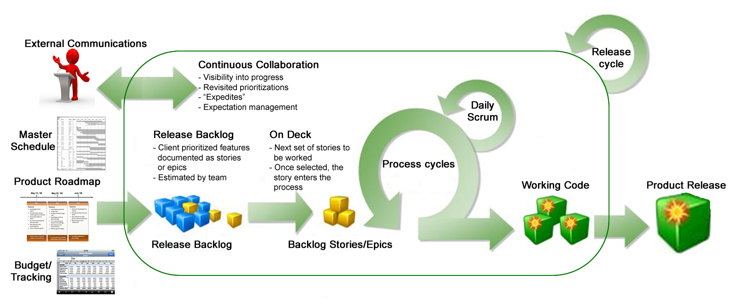
Wrap an agile process in a conventional project/product management process
Requires continuous collaboration
Healthy “tension” between the project/product manager and the development leads

Slide 32
Difference between Agile and SDLC
Aspect | AGILE | SDLC
Definition | Agile is a methodology following an iterative approach used for project management purposes. | SDLC is a process of design and development of a product or service.
Ease of Use | It is easier to use and implement. | Software Development Life Cycle is easy to understand and needs little systematic approach for implementation.
Origin and History | It came out in 2001 and it was made by a joint collaboration of 17 software developers. | Software Development Life Cycle was found in 1960.
Structure | Agile constitutes of different phases. | SDLC constitutes of different stages
Approach Speed | Agile has a faster approach comparatively. | SDLC has a systematic approach.
Project Suitability | Agile is more suited for small scale projects. | SDLC can be used for any sized projects
Flexibility | Agile allows dynamic changes in requirements. | SDLC doesn't allow changes after initial stage.
Process Flow | It follows a continuous cycle. | It follows a sequential stages.
Stakeholder Involvement | It requires close customer involvement. | It requires close project manager involvement.

Slide 33
Key Agile Metrics
Velocity: Amount of work (story points) a team completes per sprint, helps with future planning.
Cycle Time/Lead Time: Time from task start to finish, revealing efficiency.
Throughput/Work Items Completed: Number of items finished in a timeframe (Kanban focus).
Sprint Burndown/Burnup: Tracks work remaining/completed in a sprint.
Cumulative Flow Diagram (CFD): Visualizes work in different states (To Do, In Progress, Done) to spot bottlenecks.
Defect Escape Rate/Escaped Defects: Bugs found after release, indicating quality issues.
Time-to-Market: How long it takes to deliver new features or updates.
Technical Debt: Measures effort spent on maintenance vs. new features, affecting long-term agility.

Slide 34
Purpose of Agile Reporting
Improvement: Identify areas for process refinement (e.g., bottlenecks, skill gaps).
Predictability: Forecast delivery with greater accuracy using historical data.
Transparency & Alignment: Provide stakeholders with clear progress and value demonstration.
Data-Driven Decisions: Support teams in making informed choices about their work.
Reporting Best Practices
Focus on Value: Measure outcomes (customer satisfaction, value delivered) over just output (features built).
Team-Centric: Metrics should help the team improve, not be used for punishment or micromanagement.
Contextualize Data: Use metrics to ask the right questions and guide conversations, not just report numbers.
Combine Metrics: Use various metrics (productivity, quality, flow) for a holistic vie

Slide 35
Software support and maintenance
Software support and maintenance are crucial, ongoing services ensuring software remains functional, secure, and efficient post-deployment, combining reactive support (fixing user-reported issues like bugs) and proactive maintenance (updates, performance tuning, new features) to extend lifespan, prevent downtime, and adapt to new tech, making them essential for business continuity and user satisfaction.

Slide 36
Software support and maintenance
Software Support (Reactive)
Focus: Immediate, user-facing assistance for unexpected problems.
Activities: Troubleshooting crashes, resolving errors, helping users navigate features, ensuring quick fixes for disruptions.
Goal: Minimize downtime, improve user experience, build confidence.
Software Maintenance (Proactive)
Focus: Planned, ongoing improvements and preventative measures.
Types:
Corrective: Fixing bugs not found during testing.
Adaptive: Updating software to work with new OS, hardware, or environments.
Perfective: Enhancing features and performance based on feedback.
Preventive: Mitigating future risks to improve reliability.

Slide 37
Software support and maintenance
Goal: Extend software's life, maintain security, ensure compatibility, and add value.
Why They Are Essential
Reliability & Stability: Keeps systems running smoothly.
Security: Patches vulnerabilities against threats.
Cost-Effectiveness: Prevents major failures, which are more expensive.
User Satisfaction: Happy users stay loyal.
Adaptability: Ensures software evolves with technology.
In essence, support is about fixing what's broken now, while maintenance is about preventing future problems and improving overall quality.

Slide 38
More Info on Agile
en.wikipedia.org/wiki/Agile_software_development
www.infoq.com/agile - lots of articles, case studies, free e-books, including Henrik Kniberg’s excellent e-books:
  Scrum and XP from the Trenches (2007)
  Kanban and Scrum – making the most of both (2009)
Other books:
  Agile Software Development with Scrum (2001), Ken Schwaber and Mike Beedle
  Scrum in Action (2011), Andrew Pham
These slides available for download at http://www.schoolviz.org/reveal
adam.warner@region10.org
ed@doublelinepartners.com
sharon@doublelinepartners.com

