Slide 1





Rev
Hire
Tech Stack
Backend
Connecting Talent with Opportunity
Java Spring Boot 3.x
Full-Stack Job Portal
Frontend
Angular 17+
Application
Database
A Naukri.com-inspired platform enabling
seamless job discovery, applications,
and recruitment management.
MySQL
Security
JWT + Spring Security
1 / 8

Slide 2
Table of Contents
What we'll cover in this presentation
01
Introduction & Objective
04
Findings & Observations
Project overview, goals, and scope
Key features, screenshots, and results
02
System Architecture
05
Challenges & Key Learnings
Technical design and component structure
Problems faced and lessons learned
03
Methodology
06
Conclusion
Development approach and tools used
Summary and future enhancements
2 / 8

Slide 3



Introduction & Objective
What RevHire is and what it aims to solve
About RevHire
Key Objectives
RevHire is a full-stack monolithic web application modeled after Naukri.com — India's leading job portal. It bridges the gap between job seekers and employers through a unified, role-based digital platform.
Build a production-grade job portal with real-world features
Implement role-based access control for Seekers & Employers
Enable textual resume builder + PDF/DOCX file upload (max 2MB)
Job Seekers
Create profiles, upload resumes, search & apply for jobs, track applications
Provide advanced job search with 7+ filter parameters
Track application lifecycle: Applied → Shortlisted → Rejected
Employers
Deliver real-time in-app notifications for status updates
Post jobs, manage applicants, shortlist candidates, view dashboard analytics
Ensure secure authentication using JWT + Spring Security
3 / 8

Slide 4
JOB SEEKER FEATURES — PART 1
Empowering Job Seekers at Every Step
01
Registration & Account
02
Secure Login
Create account with personal details: name, email, phone, location, current employment status
Login using email and password with secure authentication
03
Resume Builder
04
Resume Upload
Create textual resume with structured sections: objective, education, experience, skills, projects, certifications
Upload formatted resume in PDF/DOCX format, max 2MB file size limit
05
Advanced Job Search
06
One-Click Apply
Filter by role, location, experience, company, salary range, job type, and date posted
Apply with saved resume and optional cover letter — unlimited applications

Slide 5
JOB SEEKER FEATURES — PART 2
Track, Manage & Stay Informed
07
Application Tracking
08
Withdraw Applications
View all applications with job details and status: Applied, Under Review, Shortlisted, Rejected, Withdrawn
Withdraw applications with confirmation dialog and optional reason for withdrawal
09
Profile Management
10
In-App Notifications
Manage education, work experience, skills, and certifications in one place
Receive real-time notifications for application status updates and job recommendations
11
Save Favourites
12
Job & Company Details
Save jobs to a favourites list for later review and application
View detailed job descriptions and full company profiles before applying

Slide 6
EMPLOYER FEATURES
Complete Employer Toolkit
Company Registration
Job Posting
Register with name, industry, size, description, website, location
Create postings with title, description, skills, experience, salary, type, deadline, openings
Post Management
Applicant Review
View, edit, close/reopen, delete, mark as filled, view statistics per job
View profile, textual/uploaded resume, cover letter, and application date
Shortlist & Reject
Search Applicants
Bulk actions with optional comments and status updates for applicants
Filter by experience, skills, education, application date, and status
Company Profile
Dashboard & Analytics
Manage and update company information and branding
Stats: total jobs, active jobs, total applications, pending reviews
Application Notes
Secure Login
Add internal notes to applications for team tracking
Authenticated access using registered employer credentials

Slide 7






System Architecture
Three-tier monolithic architecture with REST API integration
Presentation Layer
Business Logic Layer
Data Layer
Angular 17+ (Standalone Components)
Spring Boot 3.x (REST API)
MySQL Database
Components
Controllers
Entities (JPA)
⇄
⇄
Services
Services
Repositories
Guards
JWT Security
Schema
Interceptors
DTOs
Relations
Cross-Cutting Concerns:
JWT Auth Filter
CORS Config
Global Exception Handler
Role-Based Guards
HTTP Interceptors
4 / 8

Slide 8
Methodology
Development approach, tools, and workflow adopted for RevHire
1
2
3
4
Requirements Analysis
Backend Development
Frontend Development
Integration & Testing
Studied Naukri.com features
Spring Boot REST APIs
Angular 17 standalone
API integration
Defined user stories
JWT Security layer
Reactive forms
Unit tests (JUnit)
Designed ERD & schema
Service & Repository layers
Role-based routing
End-to-end testing
Tools & Technologies Used
5 / 8
Spring Boot 3.x
Angular 17+
MySQL 8
Maven

Slide 9
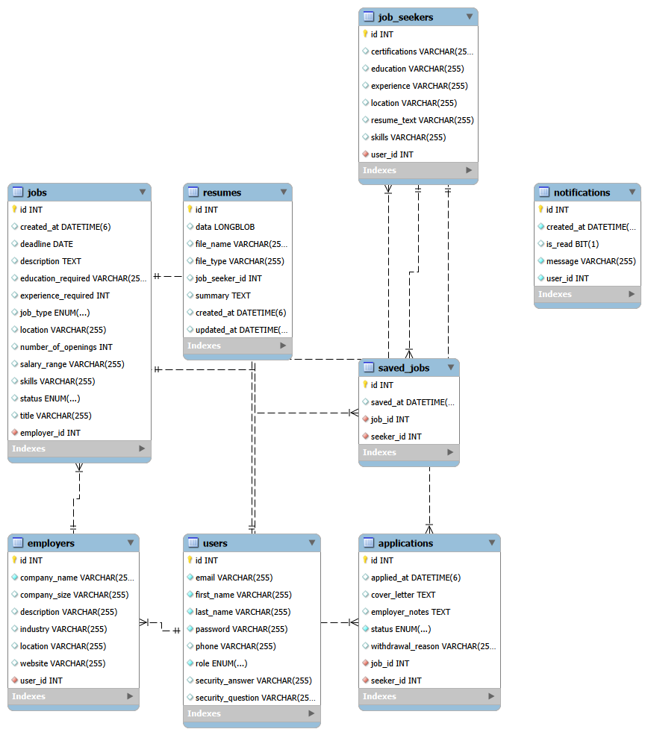
ER Diagram

Slide 10






Findings & Observations
Key features implemented and functional outcomes
Advanced Job Search
Dual Resume System
Application Tracking
7+ filters: keyword, location, salary, experience, job type, work mode, date posted
Textual builder (objective, education, experience, skills, projects, certs) + PDF/DOCX upload (max 2MB)
Full lifecycle: Applied → Under Review → Shortlisted → Rejected / Withdrawn with reason
Employer Dashboard
In-App Notifications
JWT Role-Based Auth
Stats: total jobs, active jobs, total applications, pending reviews + bulk actions
Real-time alerts for status updates and job recommendations with unread badge counter
Secure login for Job Seeker, Employer & Admin roles with route guards and interceptors
12+ Seeker Features
10+ Employer Features
7 Search Filters
5 Application Statuses
6 / 8

Slide 11



Challenges Faced & Key Learnings
Obstacles encountered and insights gained during development
Challenges Faced
Key Learnings
!
JWT Integration
Spring Security Architecture
Configuring Spring Security filter chain with stateless JWT and proper role extraction was complex
Gained in-depth understanding of filter chains, authentication providers, and JWT lifecycle management
!
CORS Configuration
RESTful API Design
Handling preflight OPTIONS requests between Spring Boot (8080) and Angular (4200) required careful header setup
Learned to design consistent, versioned REST APIs with proper HTTP methods, status codes, and DTOs
!
Dynamic Job Filters
Angular Reactive Programming
Building JPA Specifications for 7+ optional query parameters with proper AND/OR logic was non-trivial
Mastered RxJS Observables, BehaviorSubjects, and HttpInterceptors for clean async data flows
!
File Upload Validation
Role-Based Access Control
Enforcing 2MB limit and PDF/DOCX-only constraint on both client and server required layered validation
Implemented multi-role authorization at API and UI levels using guards and Spring Security annotations
!
Angular Standalone
Full-Stack Integration
Migrating to Angular 17 standalone components changed module imports and guard registration patterns
Understood end-to-end data flow from Angular forms → REST API → JPA entities → MySQL database
7 / 8

Slide 12



Conclusion
Project Summary
RevHire successfully delivers a feature-complete, production-grade job portal that mirrors the core functionality of Naukri.com. The application demonstrates mastery of full-stack development with secure role-based access, real-time features, and a responsive Angular UI — all backed by a robust Spring Boot REST API.
Thank You!
22+
2
100%
JWT
REST API Endpoints
User Roles
Requirements Met
Secure Auth
RevHire — Connecting
Talent with Opportunity
Future Enhancements
Email notifications via JavaMailSender (SMTP)
Resume parsing with AI skill extraction
Company rating & review system
Mobile app (Android/iOS) with push notifications
RevHire
8 / 8

