Slide 1
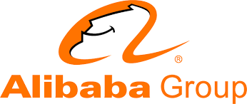
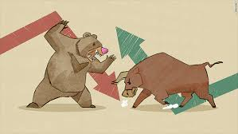
To make it easy to do business anywhere…
PRESENTED BY:
ARUNDHATHI T (XBBNLC1)
SAI AKHIL G (XBBNLDU)
PRIYANKA R (XBBNLD5)
SWEATHAA R (XBBNLD1)
RANJEETH B C (XBBNLDW)

Slide 2
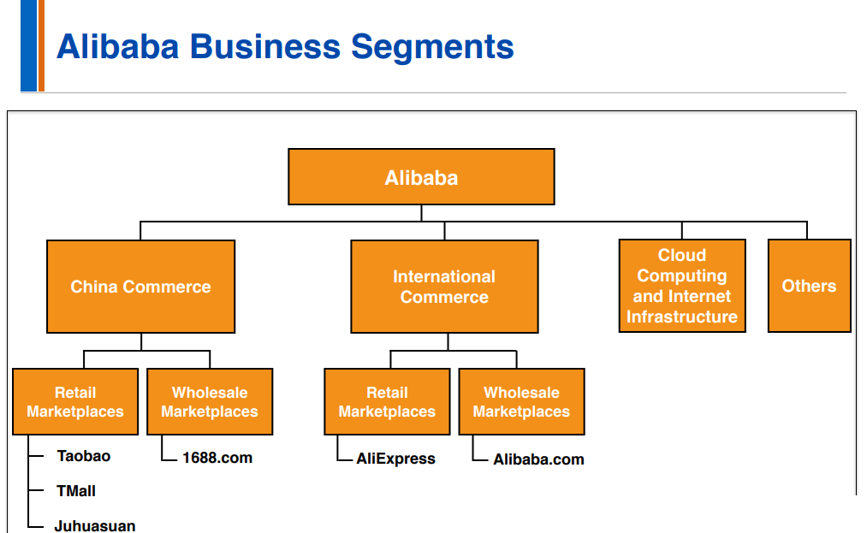
ALIBABA BUISNESS SEGMENTS

Slide 3
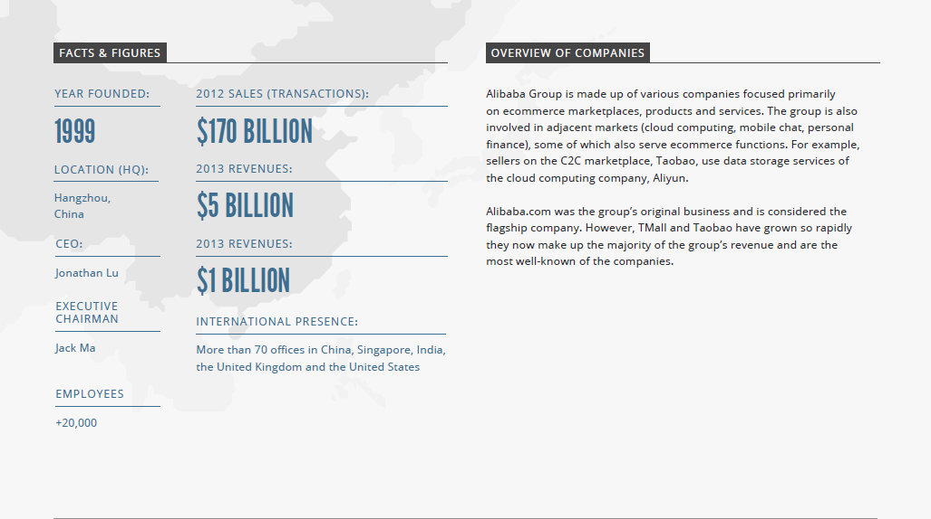
INTRODUCTION:
Alibaba group was founded in 1999 by 18 people led by Jack Ma, a former English teacher from China.
Alibaba has more than 40 million users.
It also reaches buyers and sellers in more than 240 countries around the world.
Alibaba specializes in trade between buyers and sellers.
Alibaba group revenue 158.3 billion CNY.

Slide 4
Alibaba Group launched a China marketplace ,currently known as 1688.com, for domestic wholesale trade.
Alibaba Group raises US$5 million from a consortium of investors.
1999
Alibaba Group raises US$20 million.
Alibaba.com surpasses 1 million registered users.
Alibaba Group raises US$82 million from several first-tier investors in the largest private equity commitment.
2000-
2004
Alibaba Group takes over the operations of China Yahoo!.
Alibaba.com completes its initial public offering(IPO) on the Main Board of the Hong Kong Stock Exchange.
Alibaba Group goes public on the New York Stock Exchange.
2005-2014
Alibaba Group and Ant Financial Services Group announce they will set up a joint venture, named Koubei, to capture opportunities within China’s local services market.
2015
Alibaba Group exceeds RMB3 trillion in FY2016 gross merchandise volume (GMV) on its China retail marketplaces and subsequently becomes the largest retail economy in the world.
2016

Slide 5
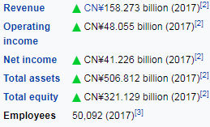
CURRENT STAT:

Slide 6
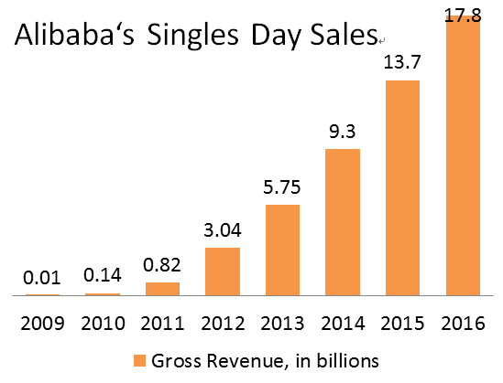
Singles’ Day has become not just the largest e-commerce shopping day in China but the largest in the world. Singles’ Day sales have grown from around $100 million in 2009 to $17.8 billion in 2016, according to research firm IDC.

Slide 7
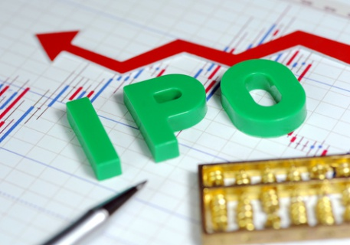
On 5 September 2014, the group—in a regulatory filing with the US Securities and Exchange Commission—set a US$60- to $66- per-share price range for its scheduled initial public offering (IPO).
On 18 September 2014, Alibaba's IPO priced at US$68, raising US$21.8 billion for the company and investors. Alibaba was the biggest US IPO in history.
On 19 September 2014, Alibaba's shares (BABA) began trading on the NYSE at an opening price of $92.70 at 11:55 am EST.
On 22 September 2014, Alibaba's underwriters announced their confirmation that they had exercised a greenshoe option to sell 15% more shares than originally planned, boosting the total amount of the IPO to $25 billion.
At present Alibaba outstanding shares are 2.53B.

Slide 8
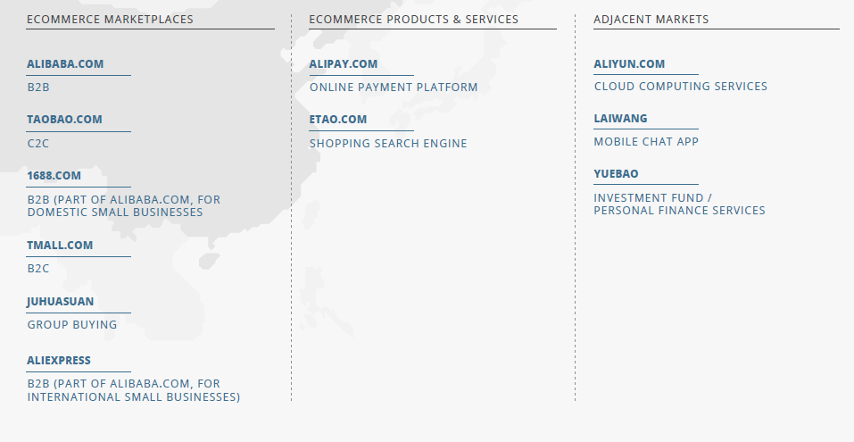
ALIBABA GROUP

Slide 9

“E-commerce is global so we needed a name that was globally recognized,"
"Alibaba brings to mind 'open sesame,' representing that our platforms open a doorway to fortune for small businesses."
Alibaba opens sesame for small to Medium sized companies.

Slide 10
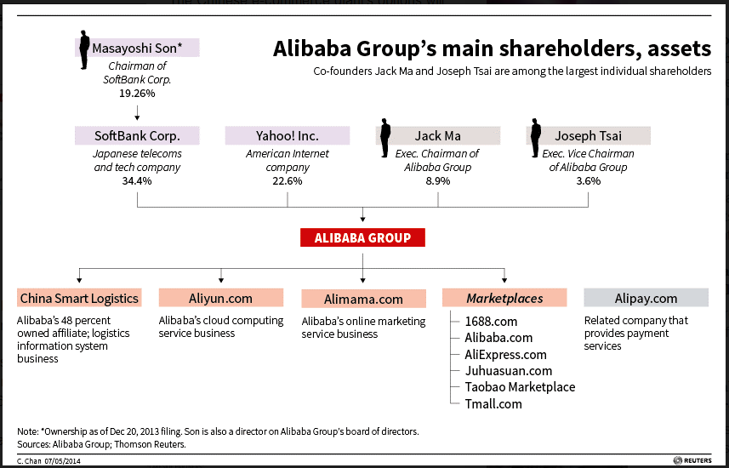

Slide 11
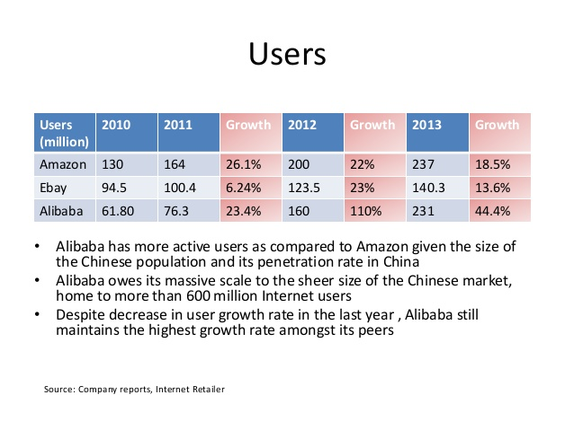

Slide 12
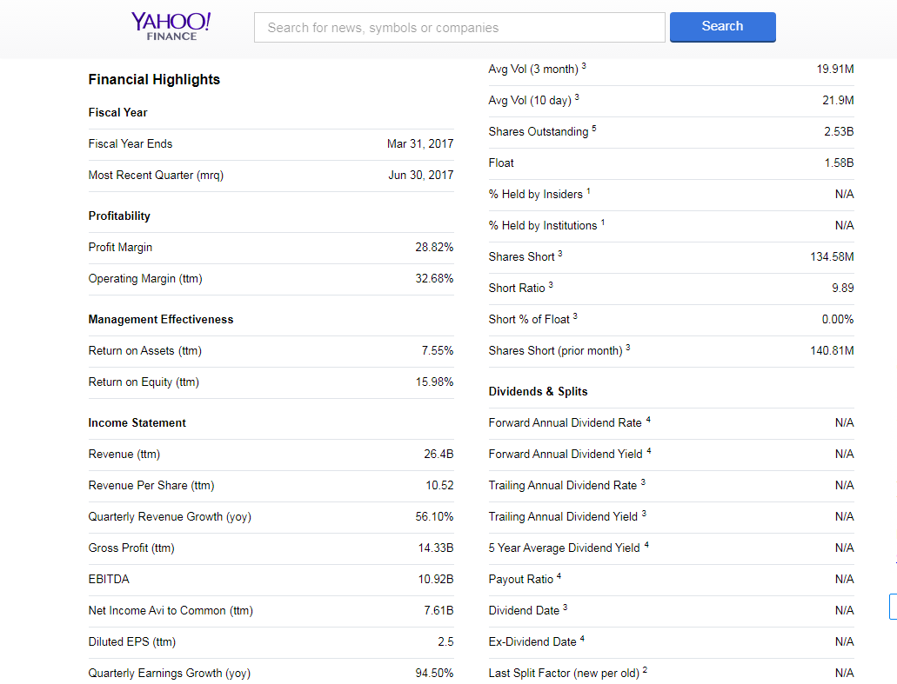

Slide 13

Key Partner
Alimama (advertising and marketing partner)
Alipay (Payment System)
FedEx, DHL
Seller/Retailer
Long Term Strategic Goal
Serve 2,000,000,000
consumers served around the world
support 10,000,000
businesses to operate profitably.

Slide 14
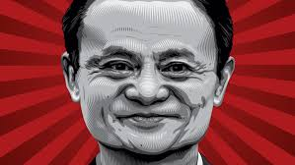


Slide 15
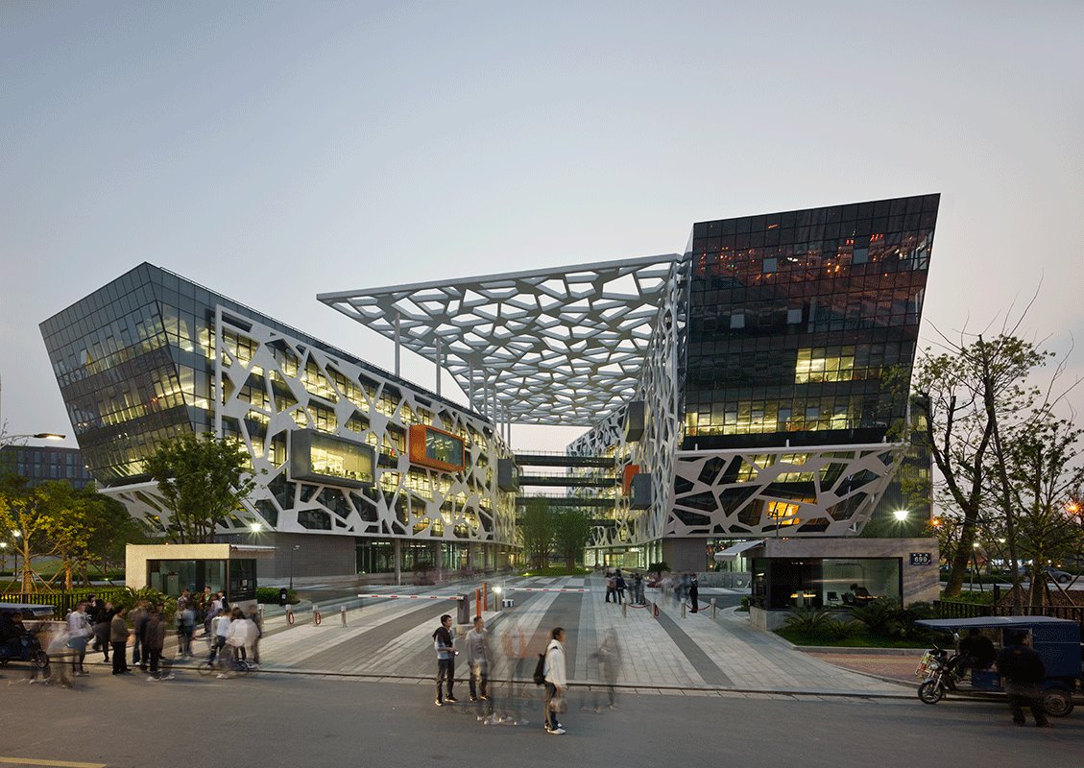
Questions?

Slide 16
THANK YOU
Notes:
I am excited to show you how Alibaba accomplish so many achievement by several special marketing strategies.

