Slide 1

AtliQo Telecom Analysis
Codebasics November Month Challenge
Ranjeev Pandey

Slide 2
Introduction
AtliQo is one of the leading telecom providers in India and launched it’s 5G plans in May 2022 along with other telecom providers.
However, the management noticed a decline in their active users and revenue growth post 5G launch in May 2022.

Slide 3
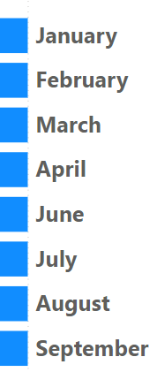
Details of Data
Before 5G
May – 5G Implementation – No data
After 5G

Slide 4
Main KPIs
ARPU – Average Revenue Per User
Revenue – Revenue for all the plans
Active users – Number of Persons who are using the network
Unsubscribed users – Number of Persons who left the network

Slide 5
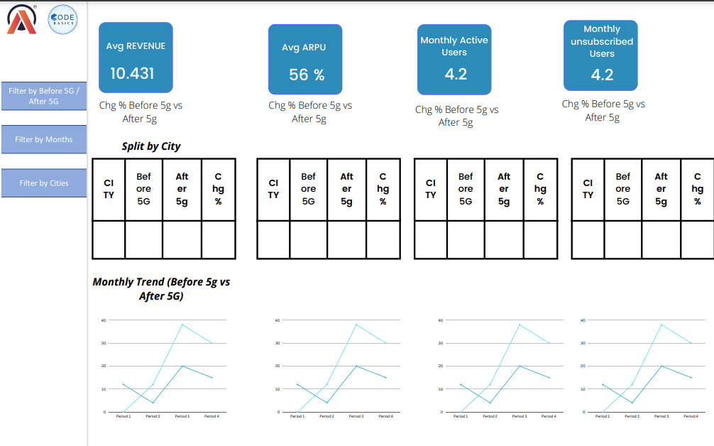
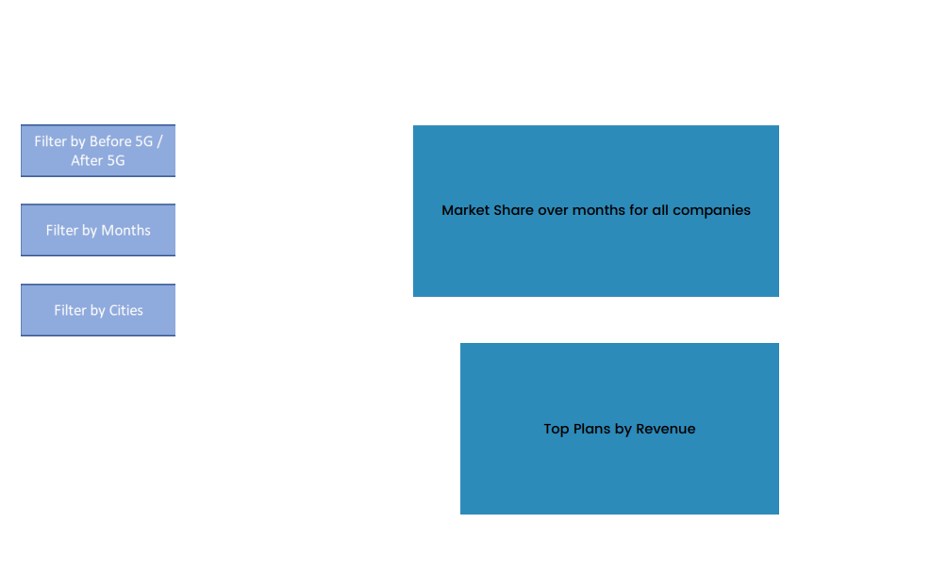
Mock – up Dashboard

Slide 6
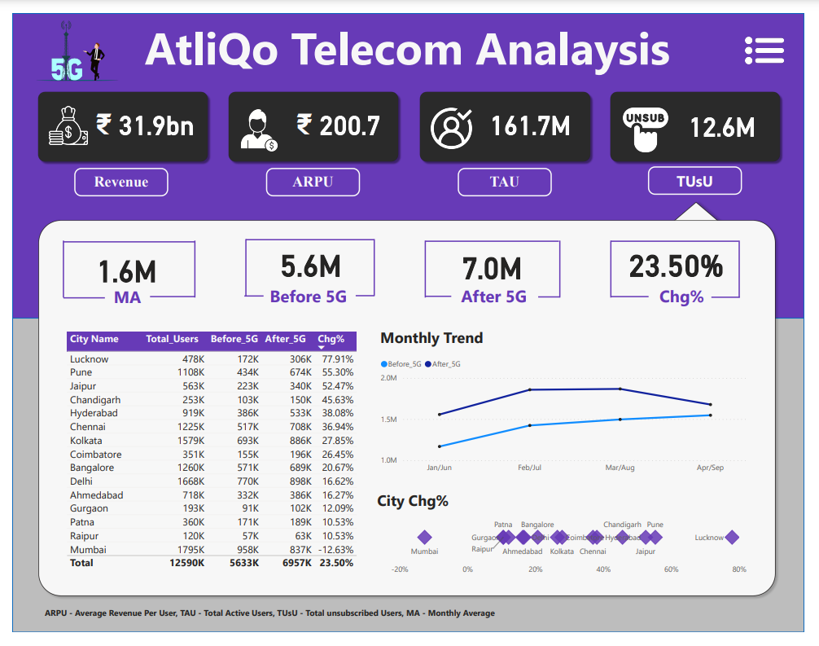
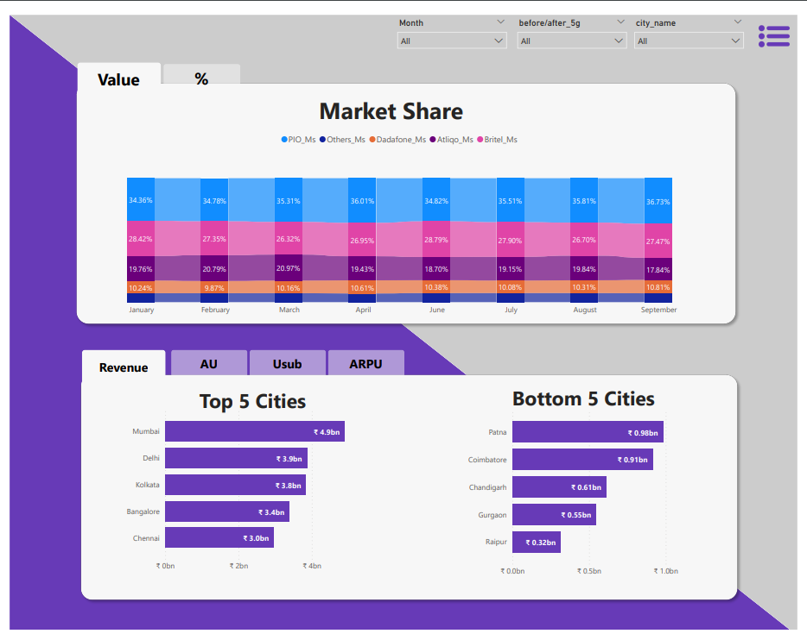
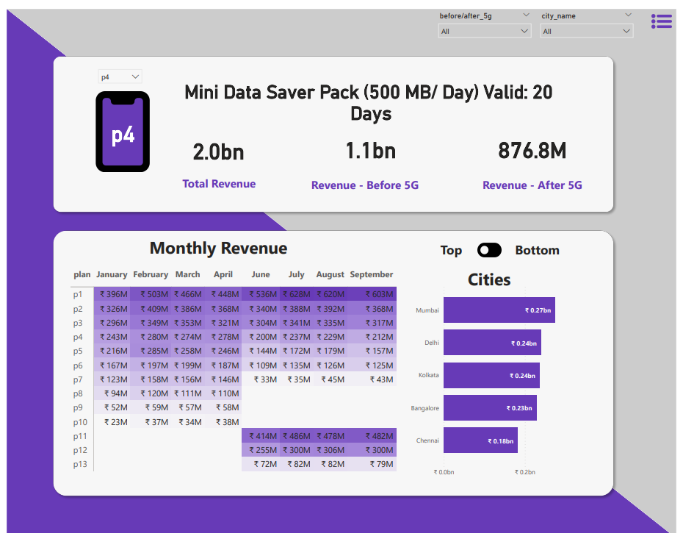
My Design

Slide 7
Thank you
By:Ranjeev Pandey

