Slide 1



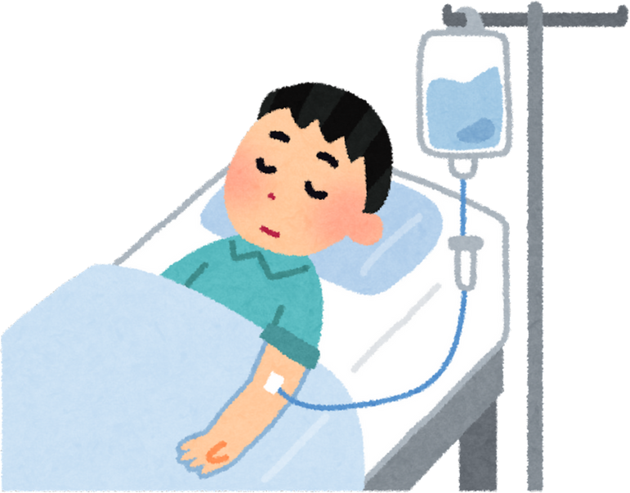

Smart bed for pressure ulcers (Bedsores) prevention
(Group 7: Avishkaar)
Mid-Semester Evaluation (HT508)
Sharvani Pokala, Ranjith K S, Sudheshna Ch, Rushikesh Khot

Slide 2

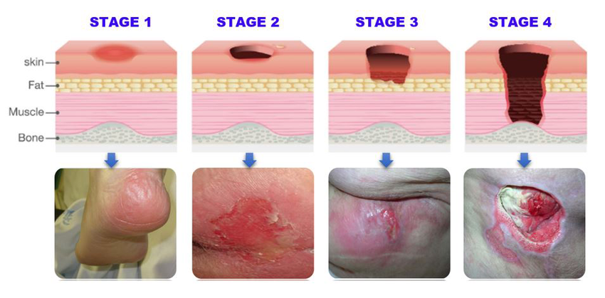
Problem Statement
Bedsores are a critical issue for bedridden patients due to prolonged pressure on the skin, leading to tissue damage and infection. Existing beds and care systems fail to provide real-time monitoring, pressure redistribution, and timely intervention, resulting in poor patient outcomes and increased caregiver burden.

Slide 3
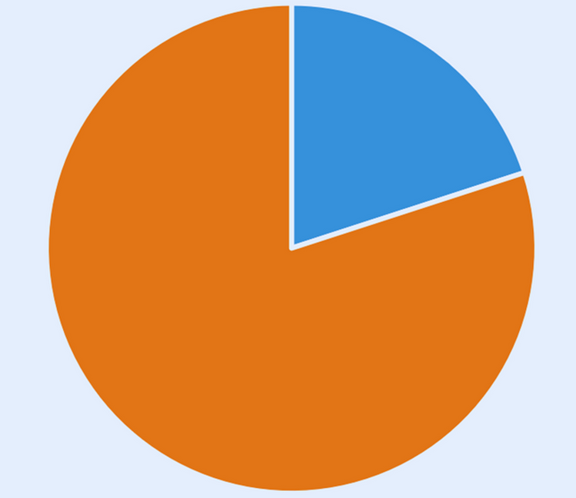
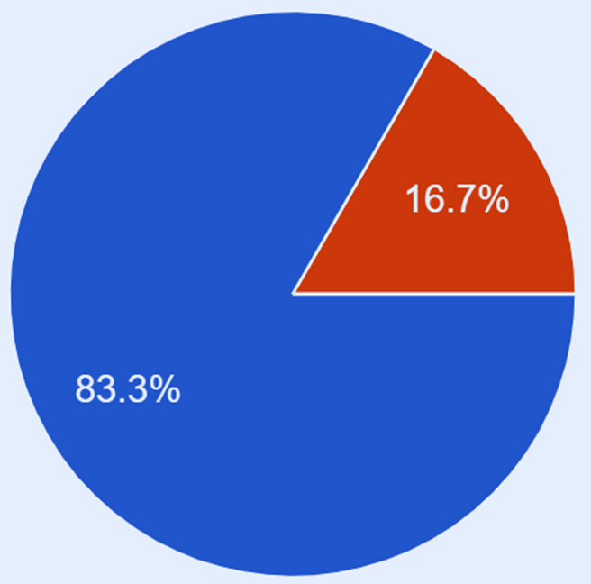
Severity of the problem (Survey)
Sample size: 12 individuals
Question: Have you encountered bedsores during the time of hospitalisation?
Question: Time taken to heal the bed sores.
Upto 7 days
(2 people)
No
(2 people)
More than 7 days
(8 people)
Yes
(10 people)
More than 7 days: 8 individuals
Upto 7 days: 2 individuals
Yes: 10 individuals; No: 2 individuals

Slide 4
Severity of the problem (Doctor’s Input)
Bedsores are a major concern for patients and play a vital role in patient care and management.
Various methods have been developed to address this issue, but they are only applied after bedsores have already formed.
Currently, multiple beds and mattresses are available that claim to prevent bedsores.
However, all of these solutions require manual intervention, making them challenging to manage.
Eliminating the need for manual intervention is essential, as it saves time, labor, and costs while enhancing patient care.
Incorporating features that improve blood circulation can further help in preventing bedsores.
Dr. Rakesh Salunkhe
Dr. Shrinivas Vidhmvar
(Govt Medical College, Latur, Maharastra)

Slide 5

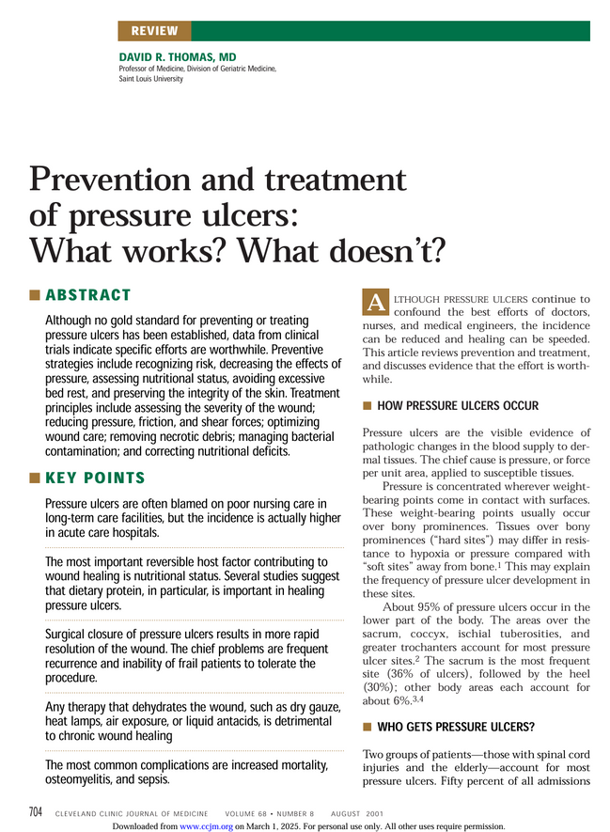
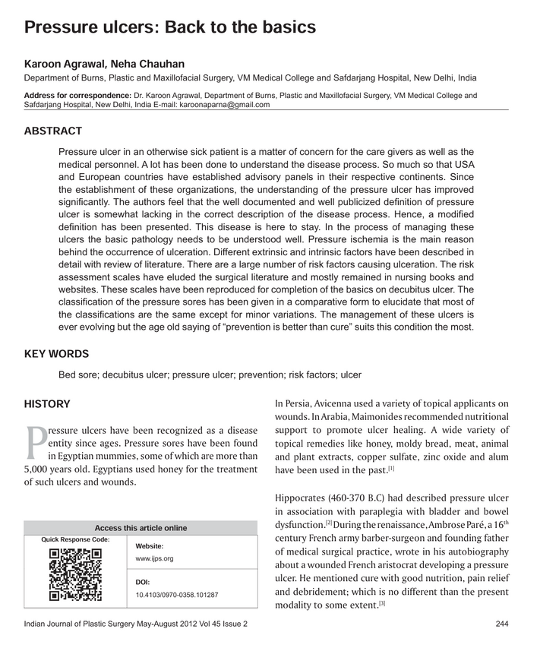
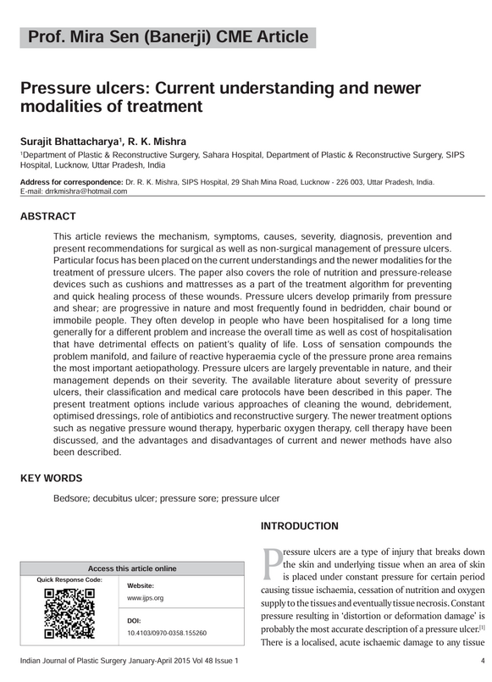
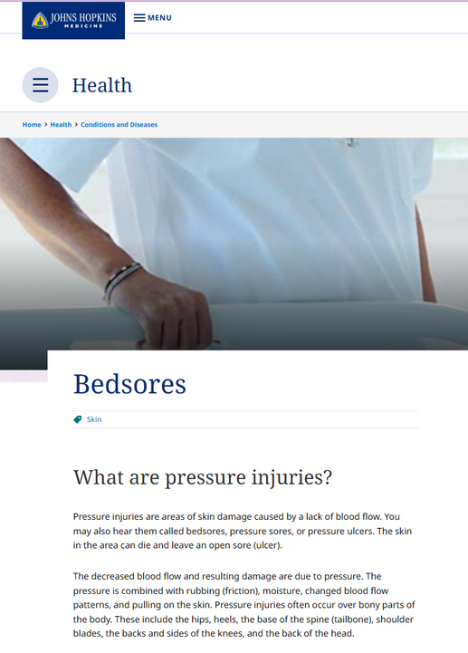
Literature Review
Reasons for pressure ulcers:
Prolonged and uneven pressure distribution
Changes in blood supply to the dermal tissue (The normal capillary pressure ranges from 16 to 33 mm Hg in different segments. External pressure of more than 33 mm Hg occludes the blood vessel so that the underlying tissues become anoxic and if the pressure continues for a critical duration, cell death and eventual result in ulceration.)
Shearing
Friction
Moisture
Malnutrition
Position
What happens if not treated?
Mortality
Sepsis
Osteomyelitis
Amputation
Statistics!
Incidence rates differ from ward to ward.
50% patients with spinal cord injuries suffer from pressure ulcers, which causes death of almost 10% of the patients.
70% of patients older than 70 years experience pressure ulcers.

Slide 6
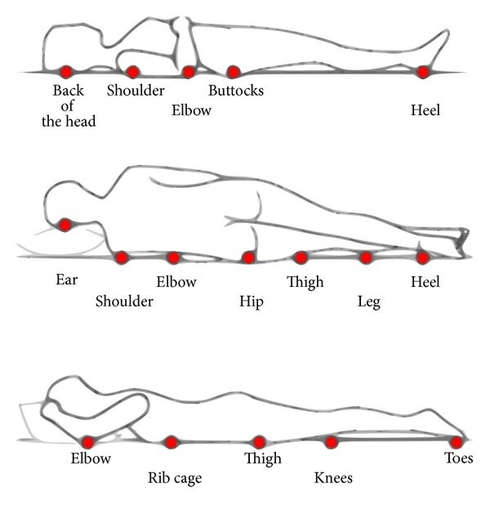
Diagram showing the areas of the body at risk of pressure sores when lying down.
Source: https://www.researchgate.net/figure/Diagram-showing-the-areas-of-the-body-at-risk-of-pressure-sores-when-lying-down_fig7_258029663

Slide 7
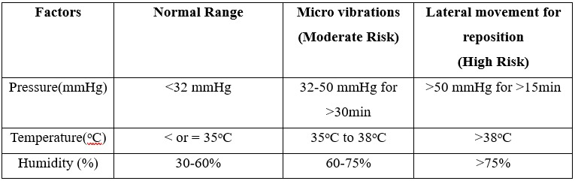
Literature Review
Table: Overview of existing technologies for pressure sores management
S No. | Title | Year | Advantages | Disadvantages
1. | Evaluation of commodity force sensor for building low-cost bed sore prevention mat. | 2021 | Pressure monitoring for every 30 seconds. | Can’t decide the movements of patient. Requires manual intervention.
2. | Wearable Preventive Pressure Ulcer System Using Embroidered Textile Electrodes | 2023 | Non-invasive & wearable. Activates muscles to relieve pressure | Not effective for existing severe ulcers.
3. | IoT-Based Healthcare Monitoring System: Bedsores Prevention | 2020 | Real-time pressure detection | Requires constant monitoring. Dependent on internet connectivity
4. | Medical Robotic Bed to Prevent Pressure Sores | 2021 | Fully automated repositioning | Expensive due to robotic implementation
Table: Threshold values with respect to pressure, temperature and humidity

Slide 8

Proposed Solution
To develop a smart bed with integrated sensors, automated pressure redistribution, and caregiver-friendly interfaces to prevent bedsores, improve patient care, and reduce healthcare costs.
The proposed smart bed has features like:
Integrated sensors and motors: These are equipped with sensors to monitor pressure, temperature, and moisture in real-time, identifying conditions contributing to bedsores.
No manual intervention: The algorithm ensures that the patient's position is changed occasionally based on the requirement without requiring any manual intervention.
This bed tries to detect the pressure load by utilizing the in-built pressure sensors, thereby instructing the algorithm to alter the bed direction and create micro-vibrations, which facilitates the change in the position of the patient and ensures proper blood flow.
The moisture detection sensors help in keeping the bed surfaces dry, thereby preventing microbial colonization which could lead to further infections.

Slide 9


Block Diagram
Bed
ESP 32
Actuators
(Microvibrations
lateral Movement)
BME 280
Mux
SD Card
Real Time
Power Source

Slide 10
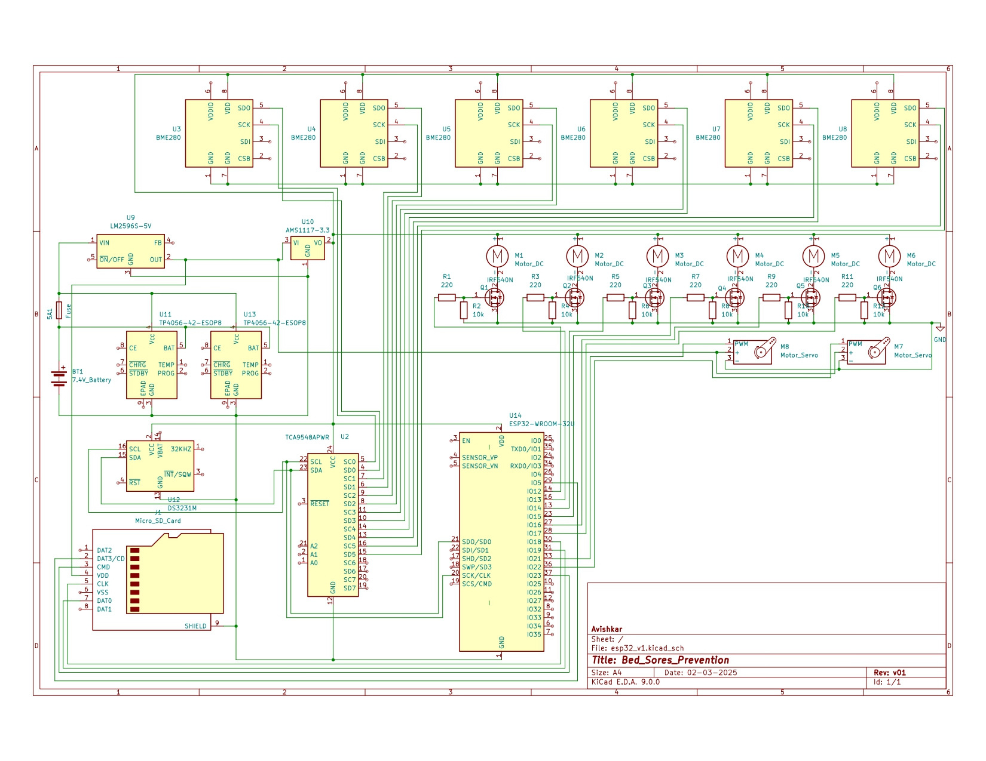
C
I
R
C
U
I
T
D
I
A
G
R
A
M

Slide 11
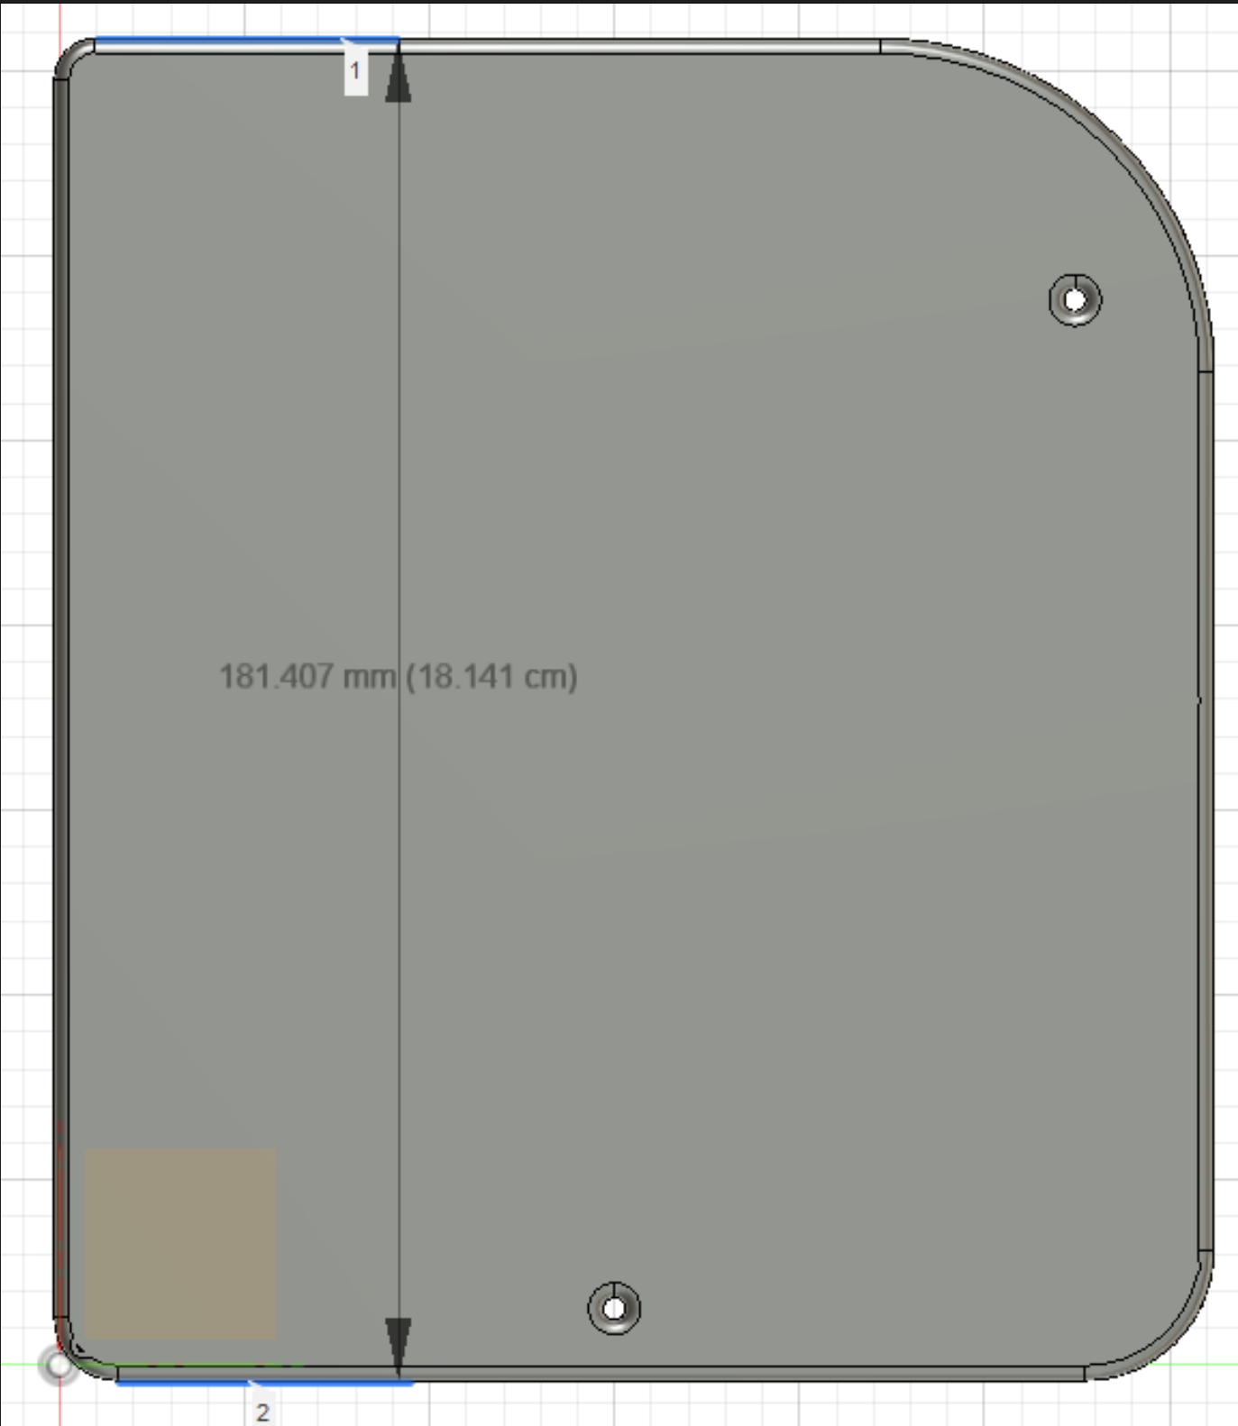
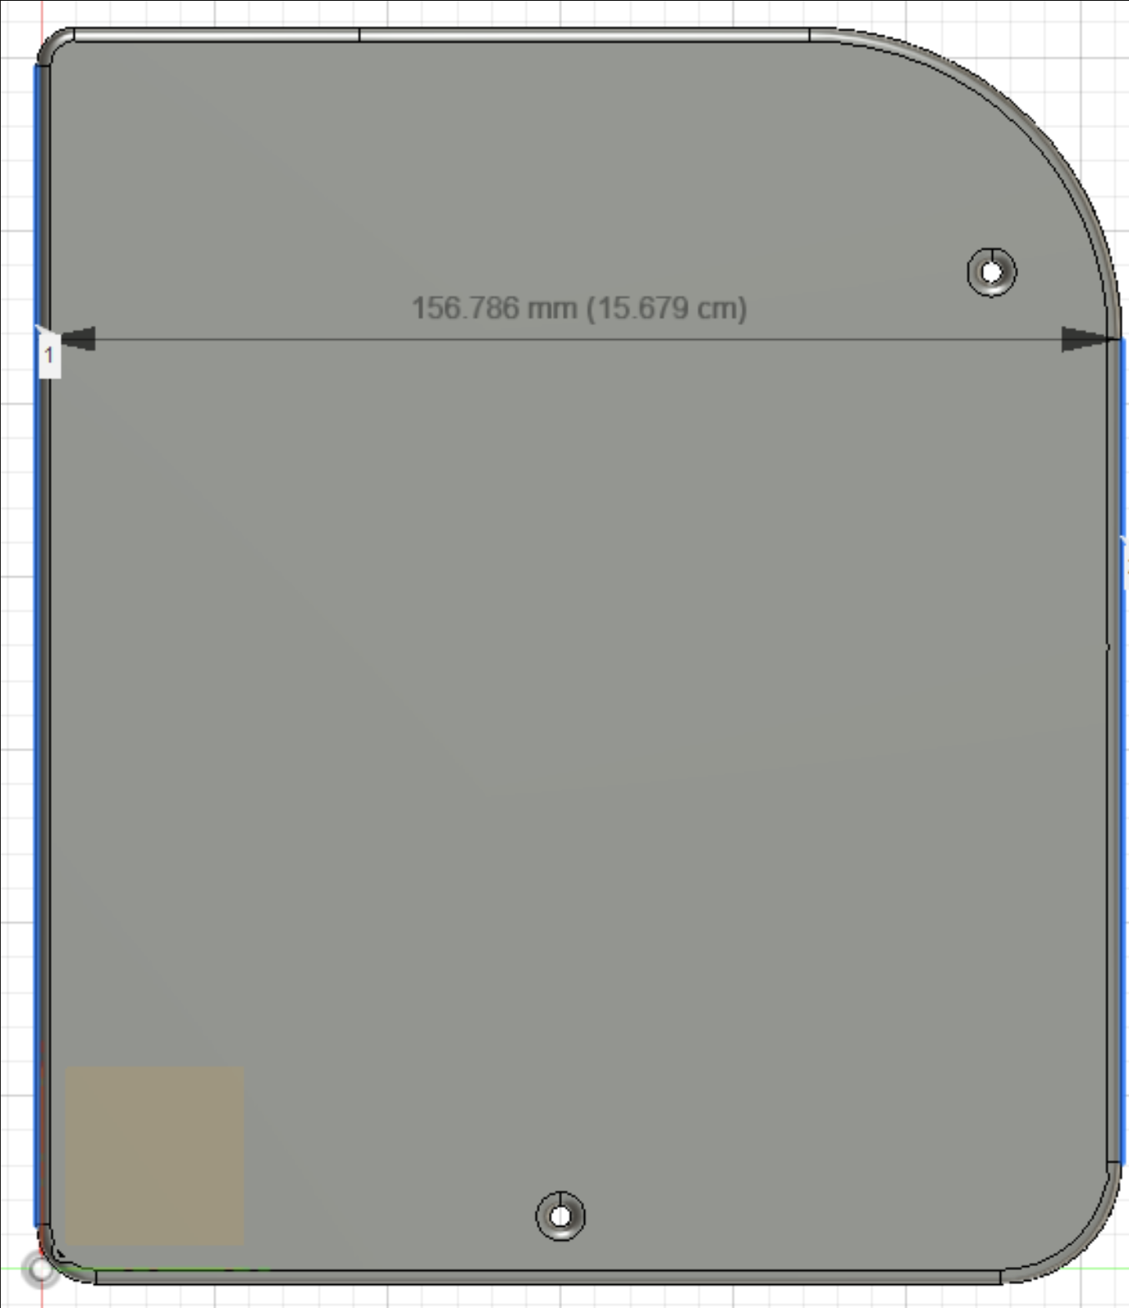
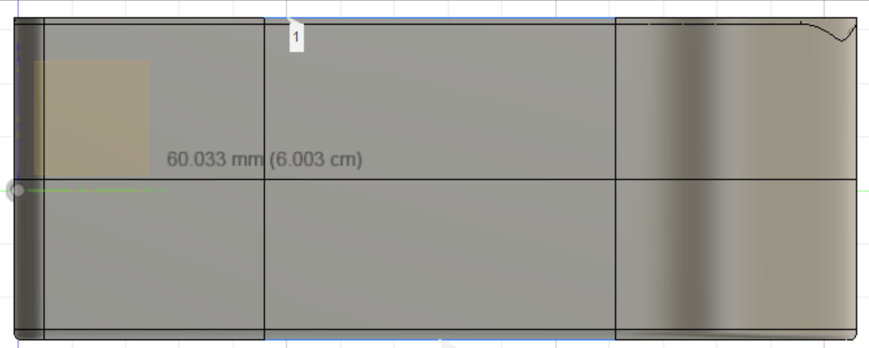
Casing design (Fusion360)
Fig: Bottom and side view of the casing
(Length = 18.141cm, Width = 15.679cm, Height = 6.003cm)

Slide 12
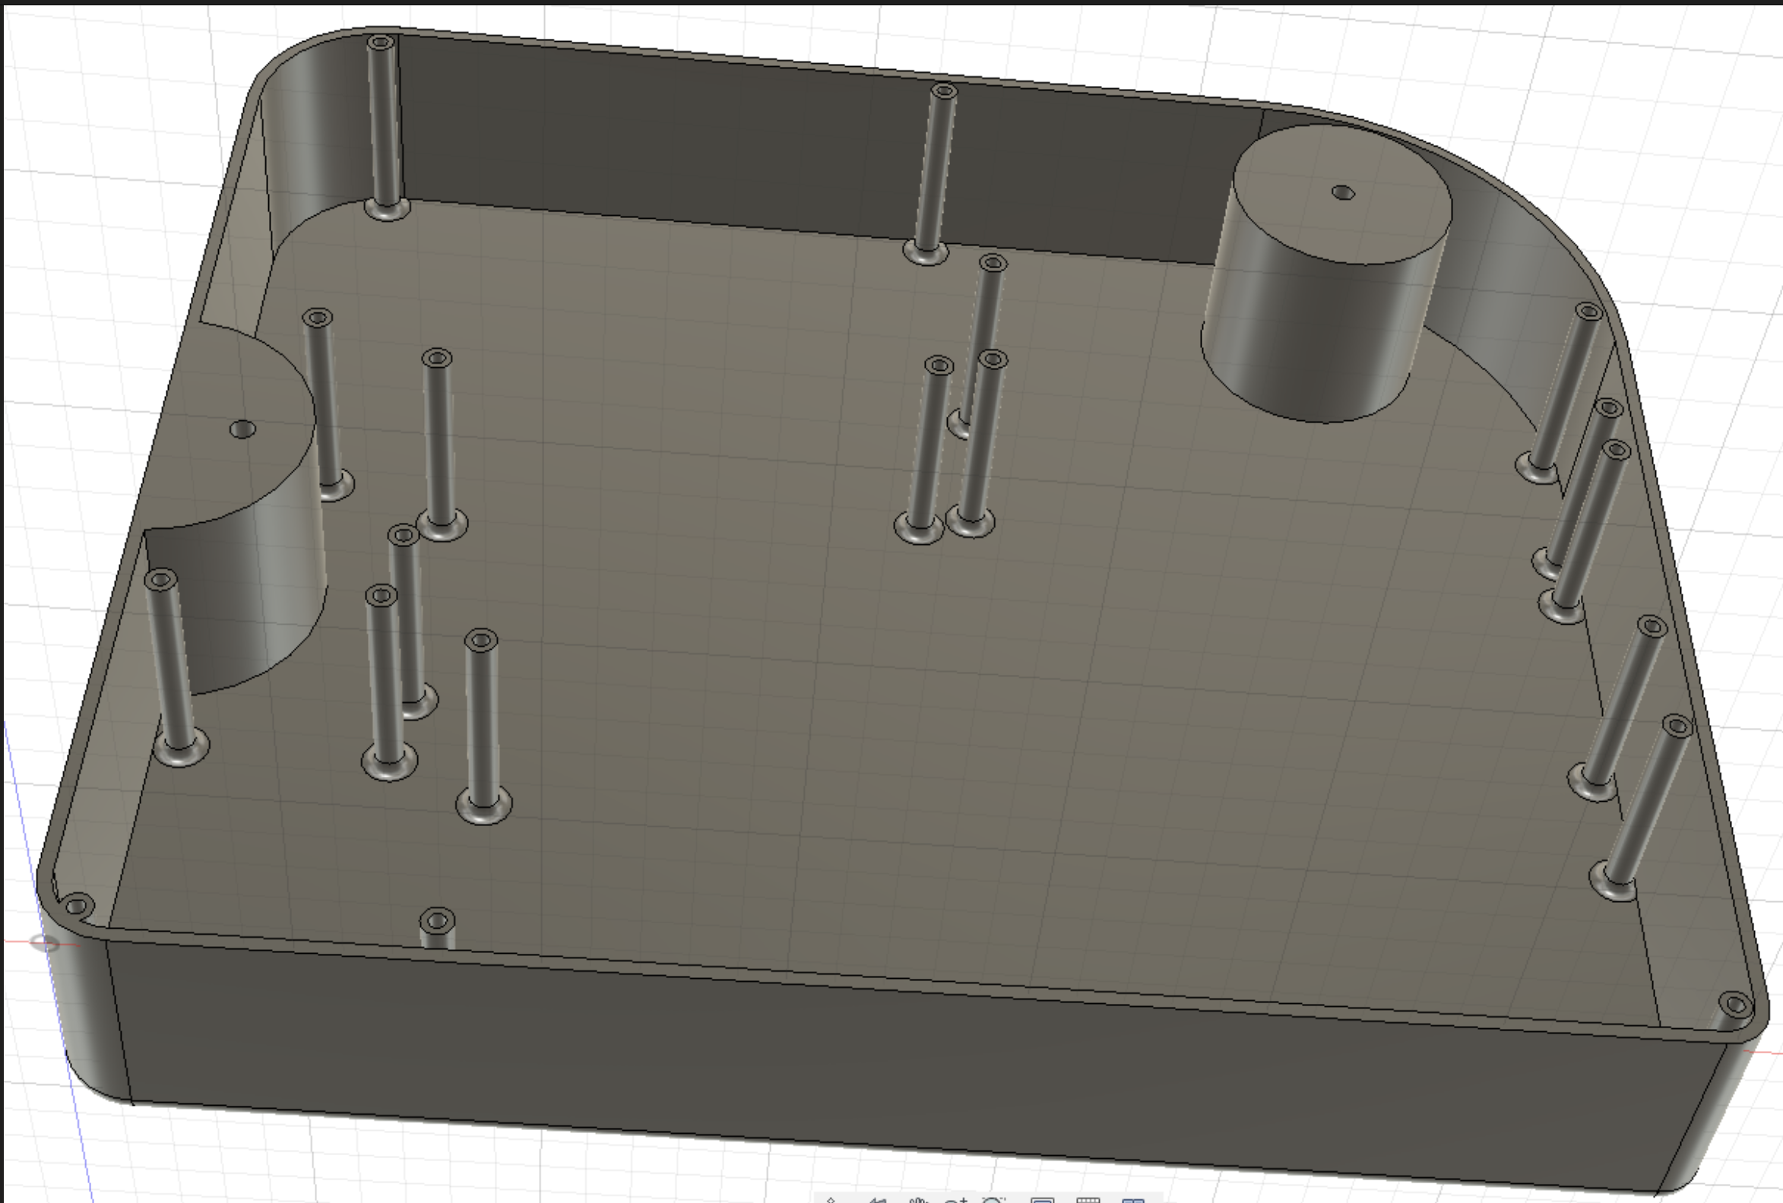
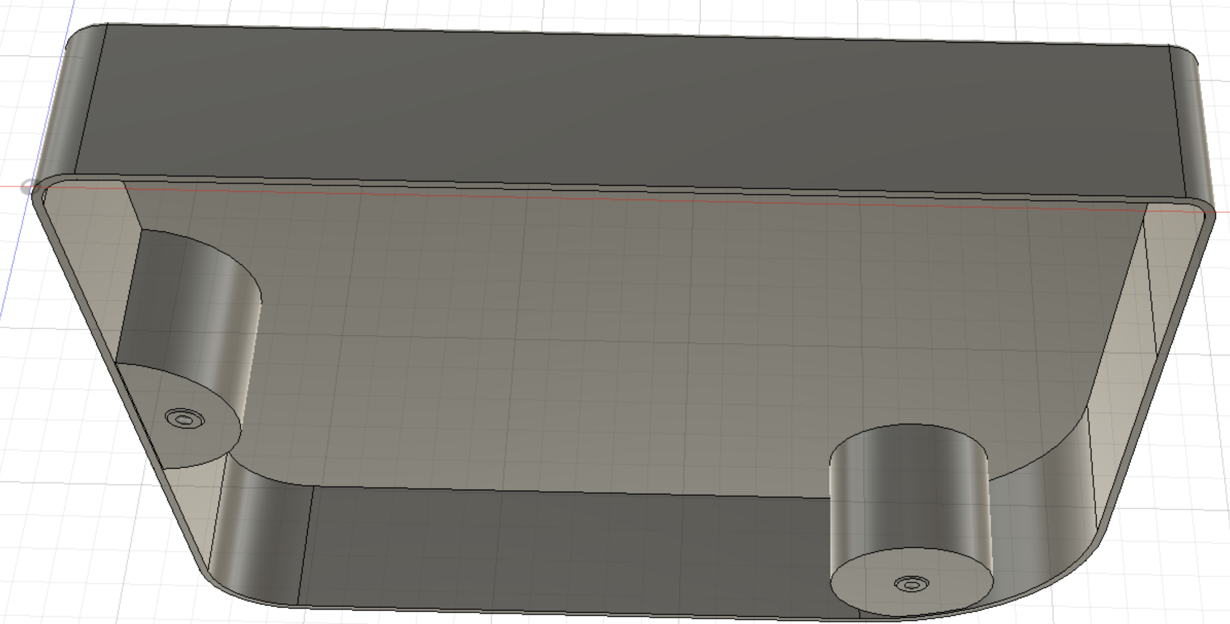
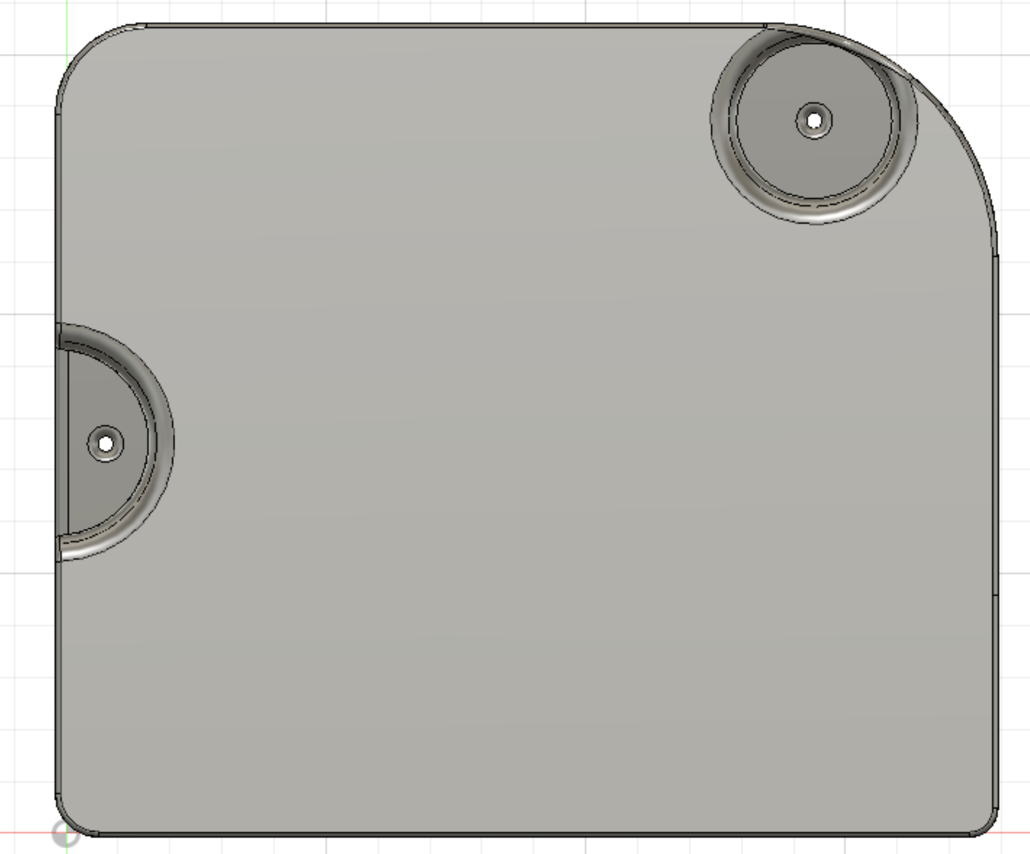
Casing design (Fusion360)
(a)
(b)
Fig: (a) Bottom inside (b) top inside (c) top outside
(c)

Slide 13

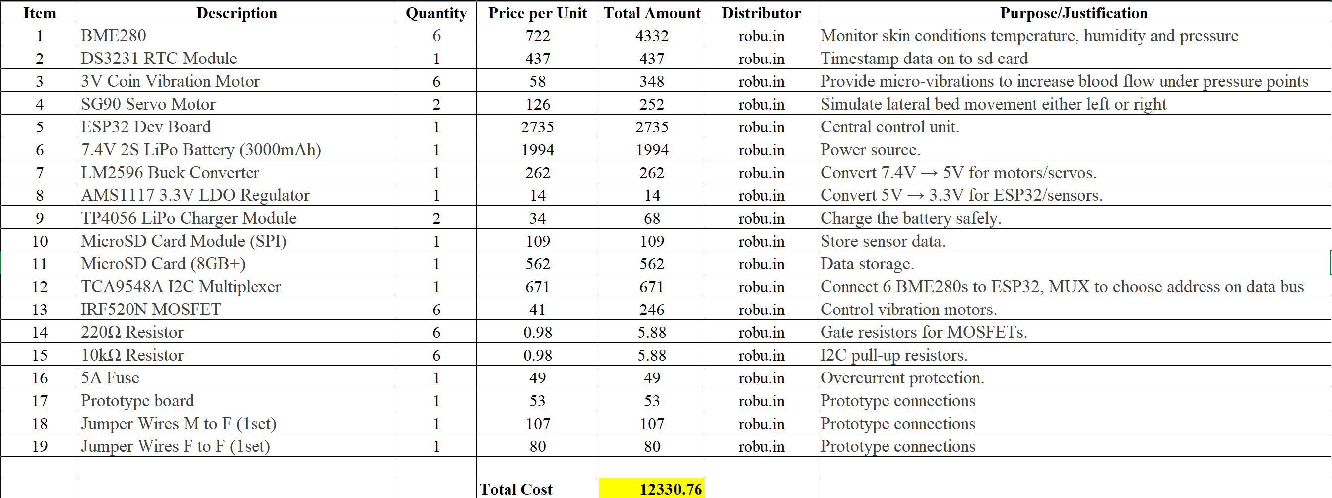
Components List (Robu.in)

Slide 14
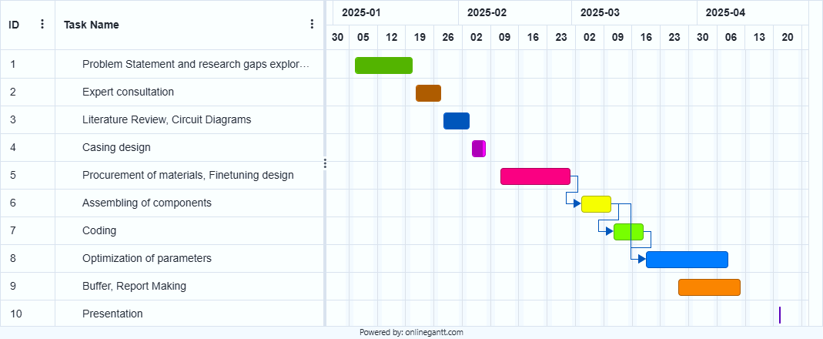
Gantt Chart
Completed
Completed
Completed
Completed
0% Completed
Finish-Start
0% Completed
Finish-Start
0% Completed
Finish-Start
0% Completed
0% Completed

Slide 15
Thank You

