Slide 1

Java Jive JUNCTION Coffee is a language in itself --- Jackie chan!!
"Exploring the World of Coffee”
Team : Bryson Wersonke, Madhavi Pandey, Pallavi Tripathi, Ranjini Rao, Reetu Jakhar & Vinaya Kusuma

Slide 2
Fun facts about coffee
Coffee is actually a “Fruit.”
Bees love coffee.
You can drink coffee in space [How cool is that!!]
The world’s largest cup of coffee was 20,000 liters – made it to Guinness Book of World Records
There is a coffee made from POO...
Coffee helps you live longer!!!!!!
The word "coffee" entered the English language in the 1600s

Slide 3
Introduction
Our coffee project seeks to provide an insight into the coffee industry in the United States and around the World.
We aim to provide the analysis and visualization on global coffee consumption, production, import, export.
We analyze the price, sales and profit data for various coffee and their roasts types available in our source dataset.

Slide 4
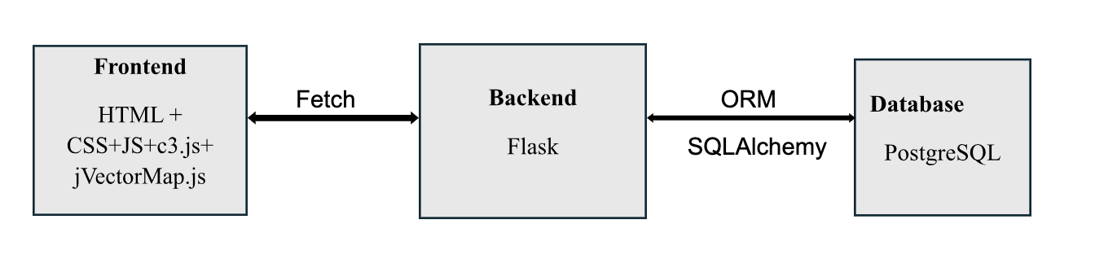
Project Architecture

Slide 5
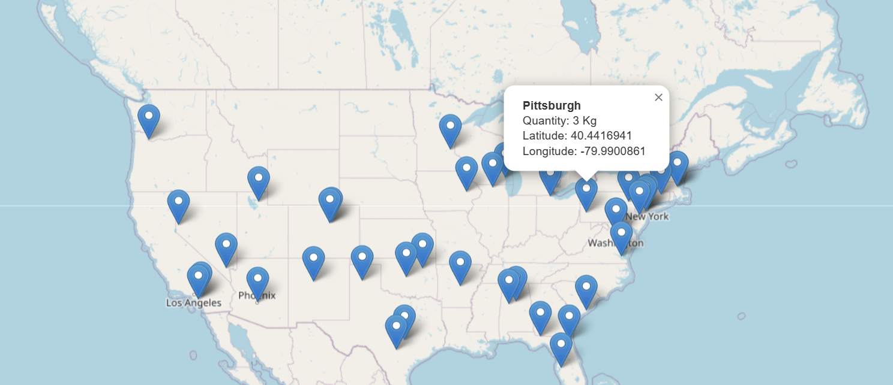
Coffee consumption

Slide 6
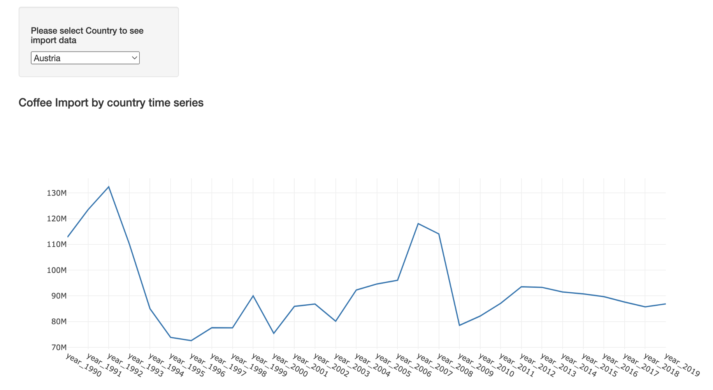
Coffee import

Slide 7
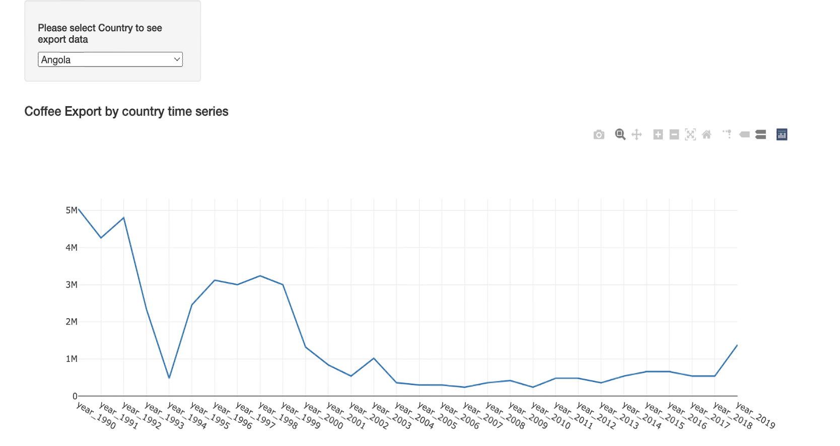
Coffee export

Slide 8
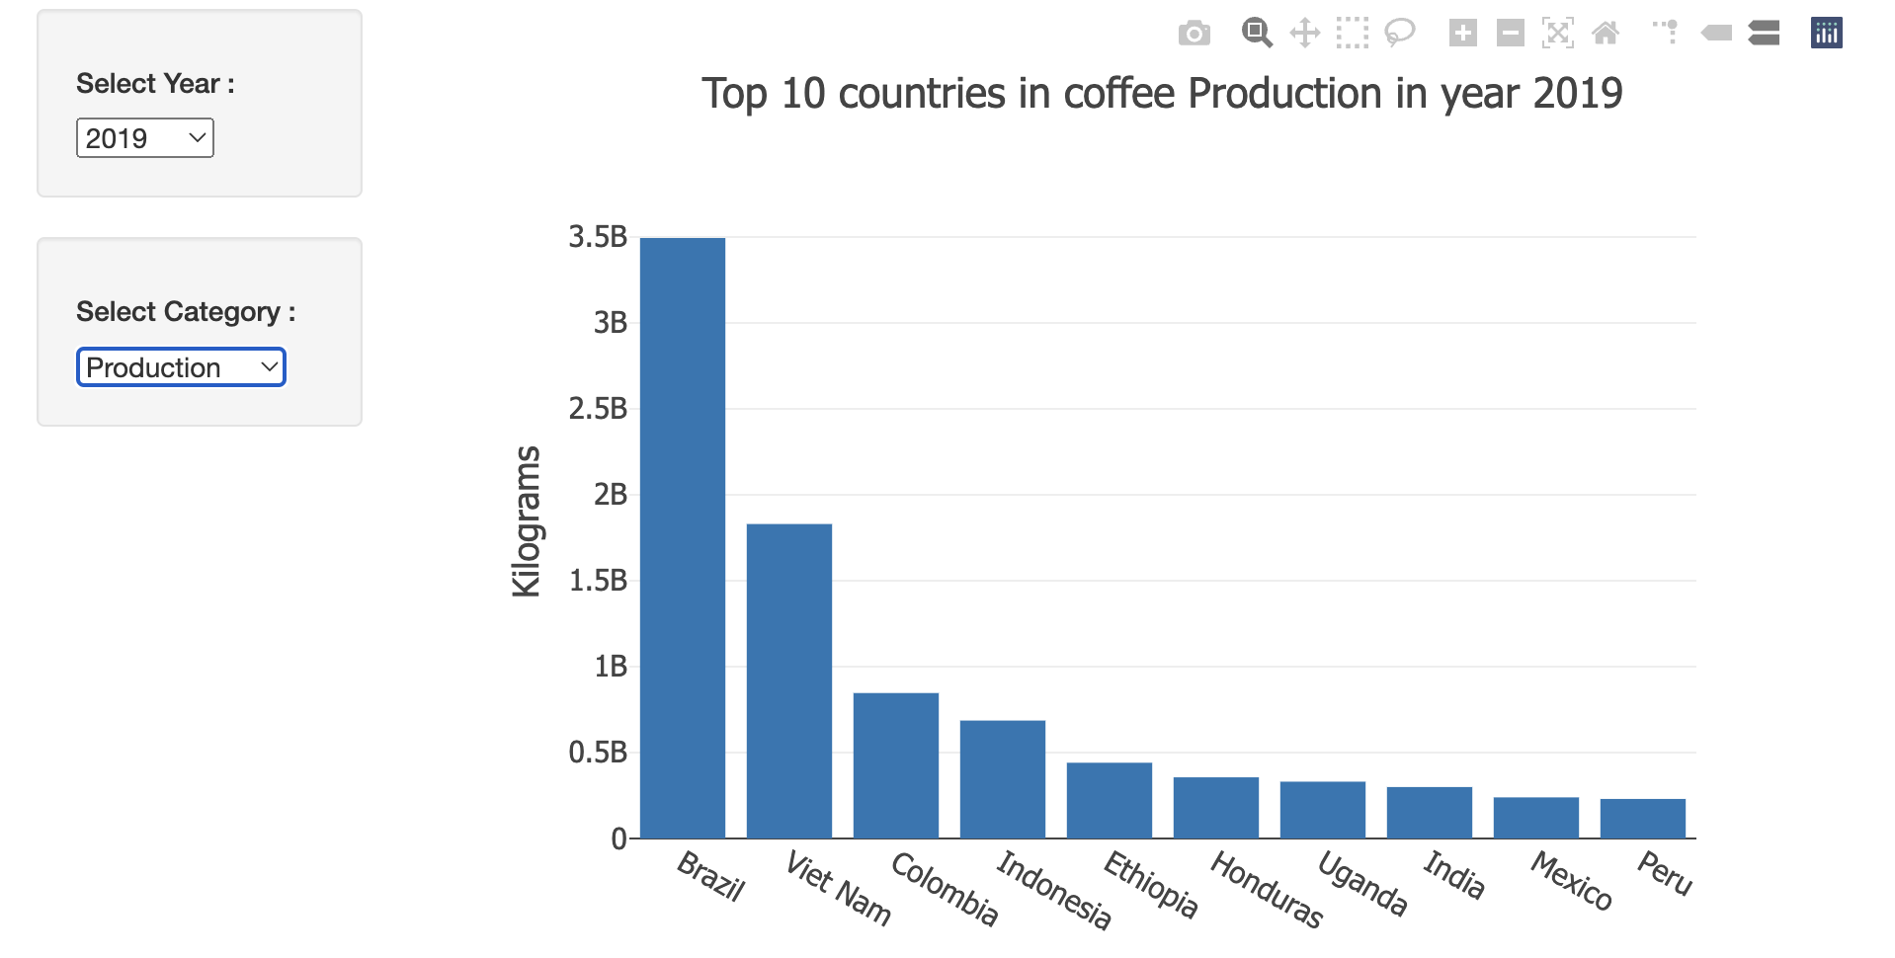
Coffee trade and usage statistics

Slide 9
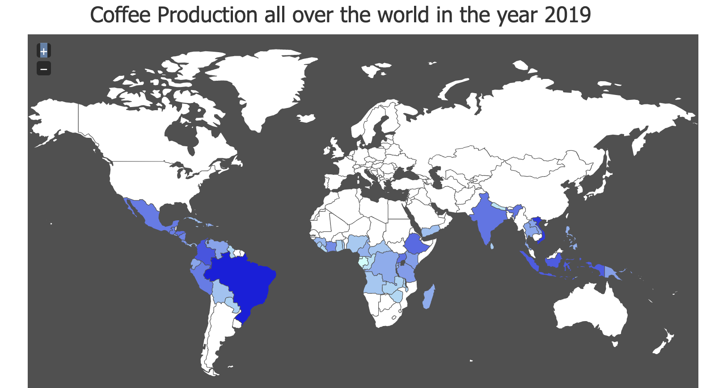
World coffee production

Slide 10
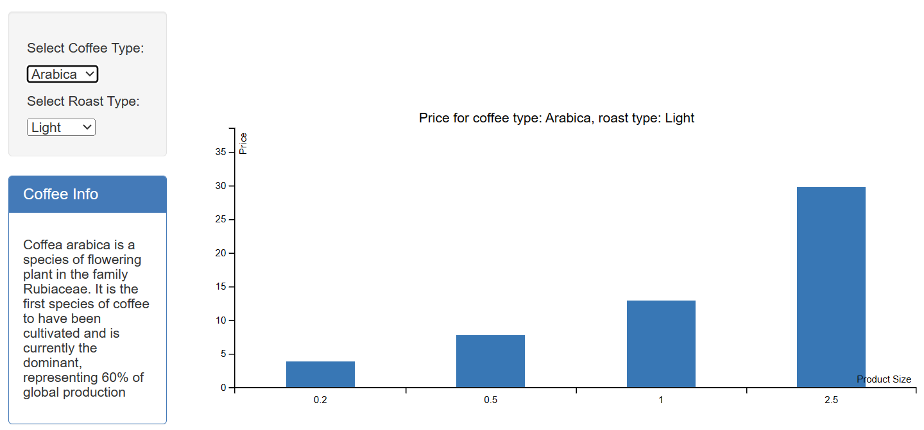
Coffee Bean Price Canvas

Slide 11
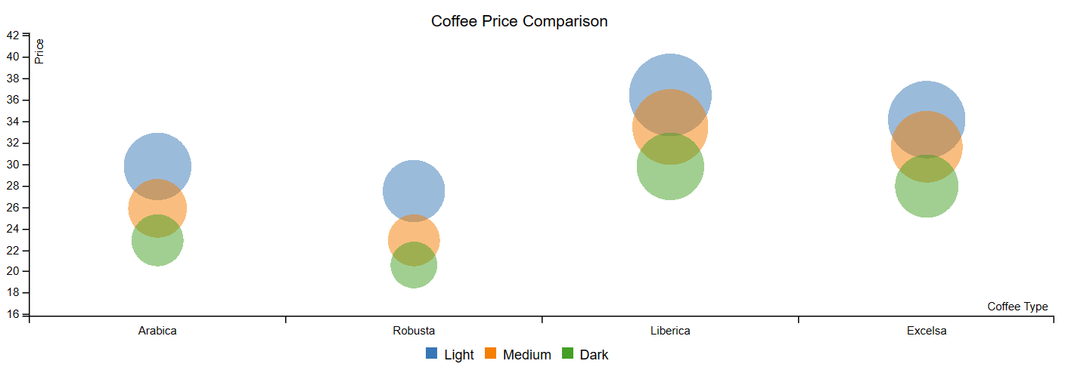
Coffee Bean Price Comparison

Slide 12
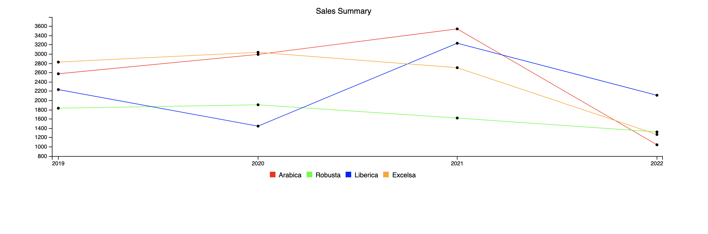
coffee bean Sales Summary

Slide 13

coffee bean profit summary

Slide 14
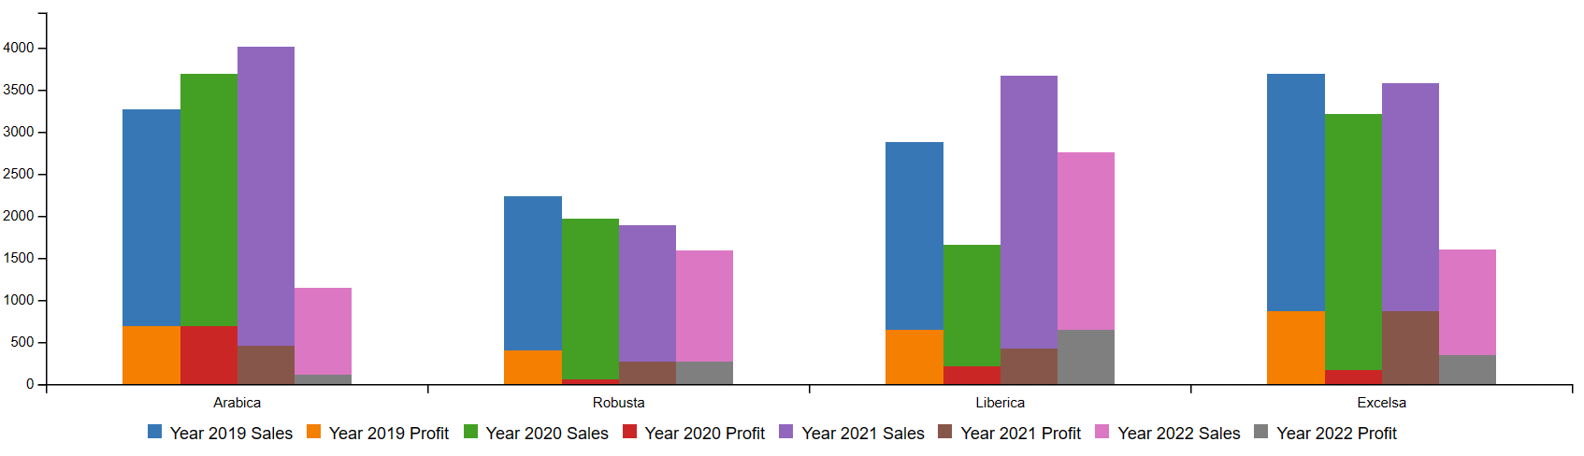
Coffee BEAN PROFIT SALES SUMMARY

Slide 15
conclusion

Slide 16

Q&A

