Slide 1
Neural Network Pharma Probe
Vinaya Kusuma, Madhavi Pandey, Ranjini Rao, Pallavi Tripathi, Bryson Wersonske

Slide 2
Introduction to the Data
Kaggle Dataset: https://www.kaggle.com/datasets/jessicali9530/kuc-hackathon-winter-2018
The dataset was focused on user reviews about drugs currently being taken and how many other people found those reviews useful.

Slide 3
Introduction to the Data - Features
1. Unique ID - Unique for each Review
2. Drug Name - Currently taken Drug
3. Condition - Condition being treated by the drug
4. Review - The user generated review about their experience with the medication
5. Rating - The 1 to 10 user generated rating based on their experience with the medication
6. Date - Not used in any model
7. Useful Count - The count of how many people found the user generated review useful and liked the comment

Slide 4
New Features Created by Our Team
Length of the Review - Important to determine a substantial review with useful information.
Embedded Review - LDA of the Review column to discover latent topics.
Condition Cluster - Conditions Grouped into Ten Distinct Categories
Drug Name Cluster - Drug Names Grouped into Ten Distinct Categories using the word2vec model from Google
Review Sentiment Analysis - Using NLP to assign the review a classification of Positive, Negative or Neutral, also used word2vec

Slide 5
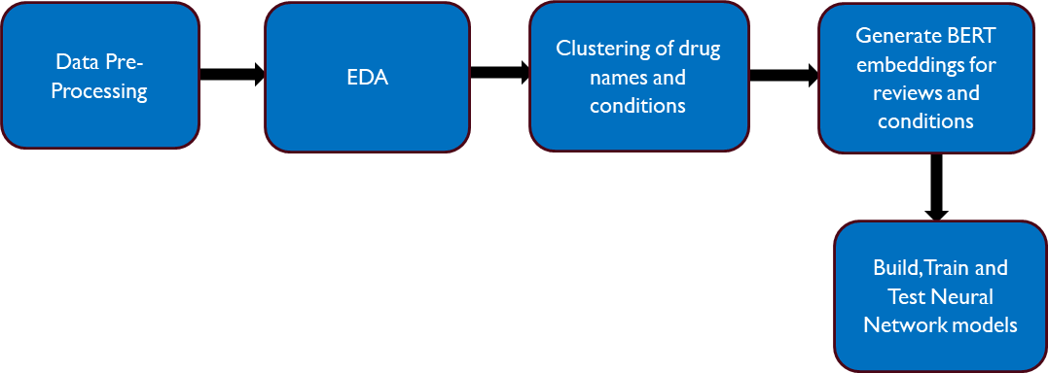
Project Outline

Slide 6
Our Three Models
Condition Cluster Classification
Drug Cluster Classification
Sentiment Analysis

Slide 7
EDA

Slide 8
Main Pre-Processing steps - Python and Pandas
Load the data and check for NAN values, removing any found.
Standardize language in the review text by changing text to numbers. Example: change “five” and “four” to “5” and “4”.
Change all the uppercase characters to lowercase
Remove special character codes and punctuations using punkt library
Create the Review Length Variable using pandas.

Slide 9
EDA For Numerical Columns
Review Length, Useful Count and Rating histograms to observe outliers.
For Review Length outliers were determined to be under 100 characters and over 1200.
For useful count we removed anything with a value less than 10
Rating was user generated from 1-10 so we did not consider any values outliers
Each pair of numerical values was then tested with scatter plots and correlations to check for covariance, no covariance existed between any two features.

Slide 10
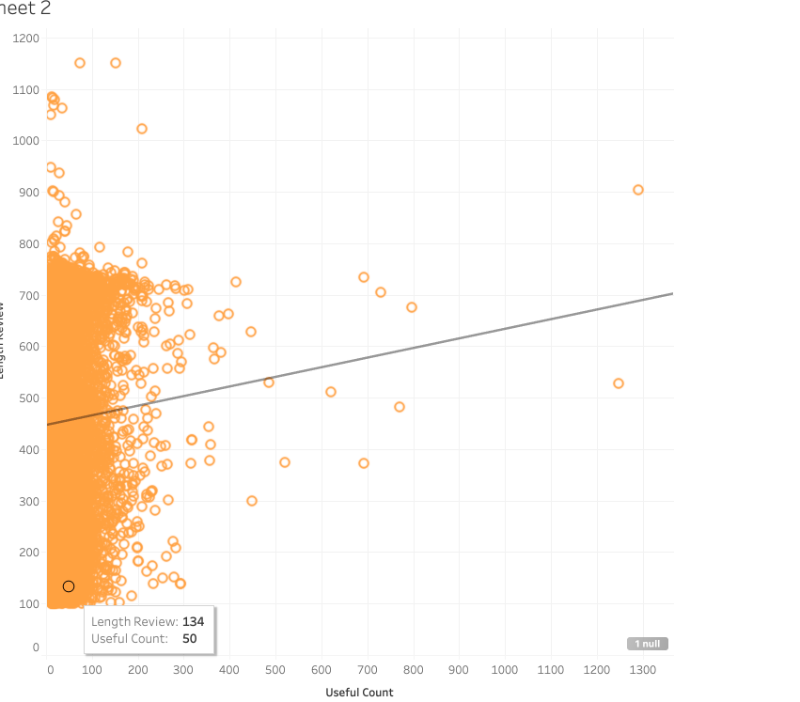
Useful Count and Length Review Histogram

Slide 11
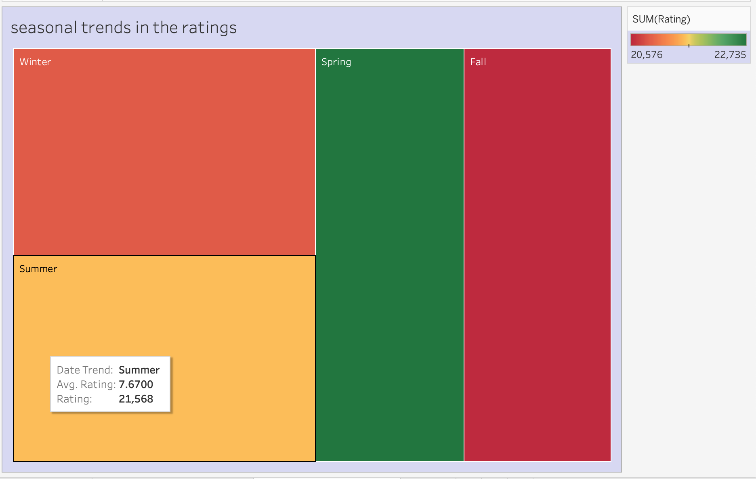
Seasonal trend of user ratings

Slide 12
EDA For Categorical Columns
Condition originally had 691 categories, after filtering out conditions seen 14 or less times the final data had 269 unique conditions to group.
Drug Name originally had 2477 categories, after filtering out conditions seen 4 or less times the final data had 1179 unique drugs to group.
Analysis indicated that most conditions were being treated by multiple unique drugs, some drugs were treating different conditions.

Slide 13
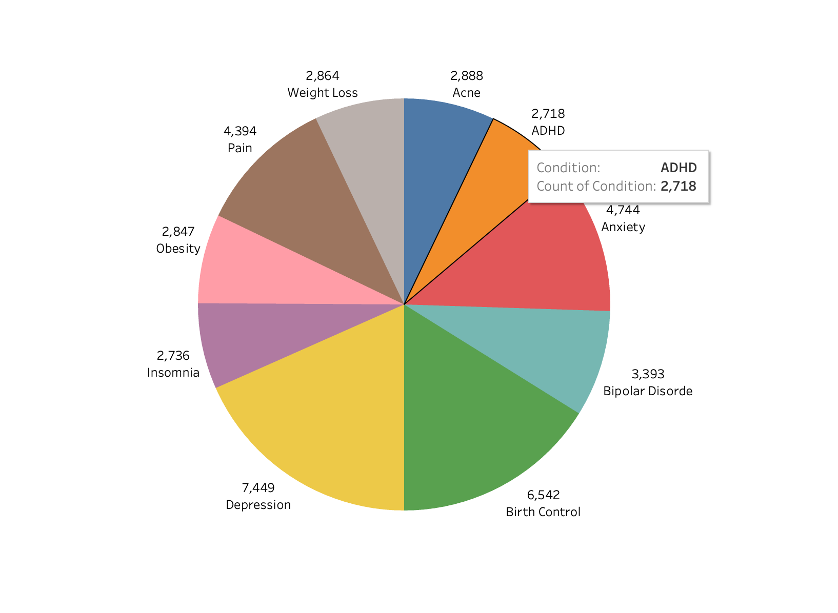
10 Most Common Conditions

Slide 14
Neural Network Target:
Condition Cluster - LDA

Slide 15
Strategy
Our team goal was to build up the model by slowly adding new features and seeing what features made improvements to the models performance.

Slide 16
Analysis Of Condition Clusters - Part 1
It was necessary to group similar conditions in order to give the Neural Net a limited number of classification options.
After multiple attempts at clustering using word2vec, trained by Google, led to by far the best results, even if not entirely accurate.

Slide 17
Analysis Of Condition Clusters - Part 2
Highly Accurate Groups (4): Cluster 1 included: Pain, Chronic Pain, Headache, Backache and 12 other types of pain.
Groups with only 1 or 2 Conditions (4) : Cluster 8 was comprised solely of Acne, cluster 5 contained depression and postpartum depression.
Catch All Groups (2) : Group 0 and 7 were comprised of relatively non-related conditions that seemed not to fit elsewhere.

Slide 18
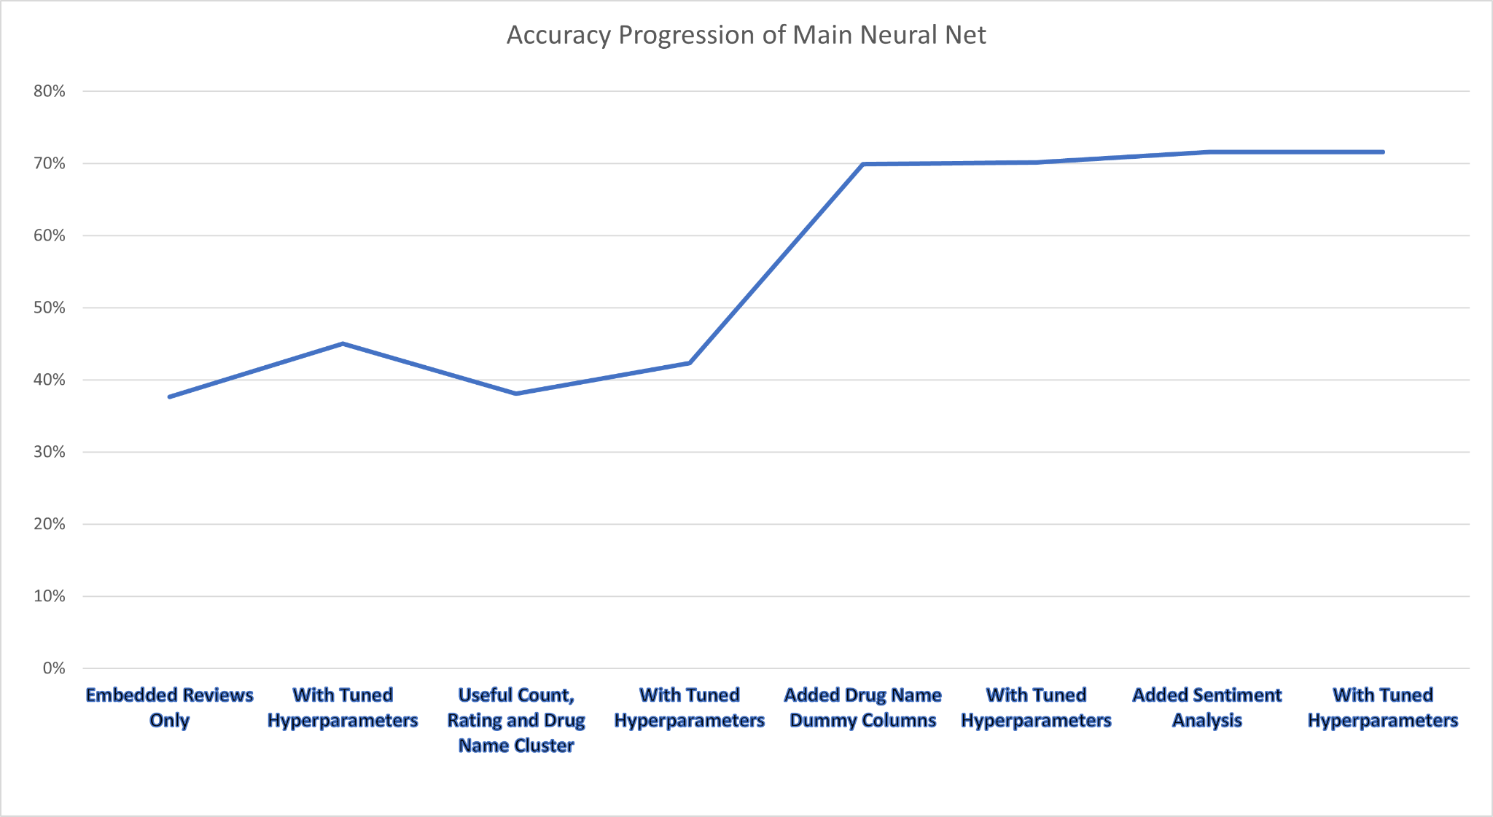

Slide 19
Interesting Results
Decreasing the learning rate and increasing epochs increased the model’s accuracy, but by ignoring the smaller condition clusters.
Many customers would include the name of the drug they were taking in the review, but also include multiple drugs they used to take, plus other drugs they are currently taking.
The three condition clusters for Acne, Insomnia and Depression were generally the most accurate.
The two condition clusters for Pain and Anxiety were the always the least accurate.

Slide 20
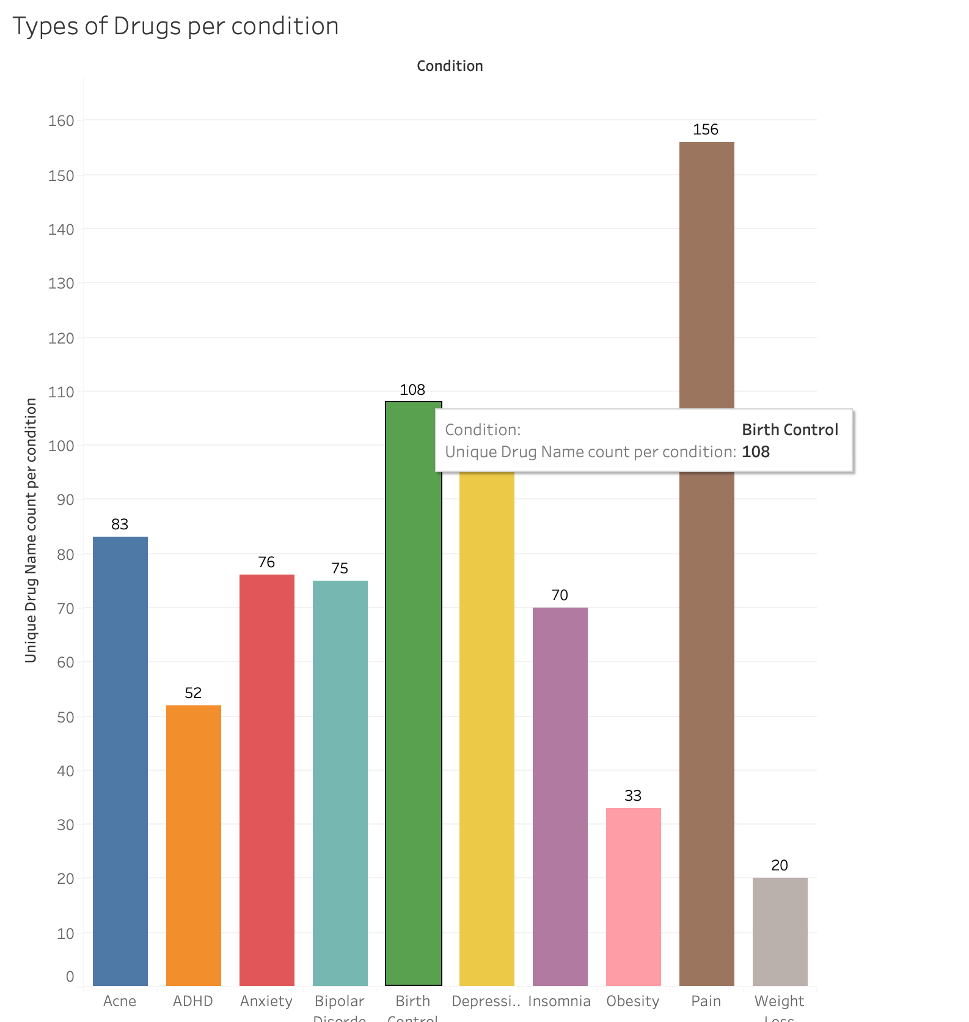

Slide 21
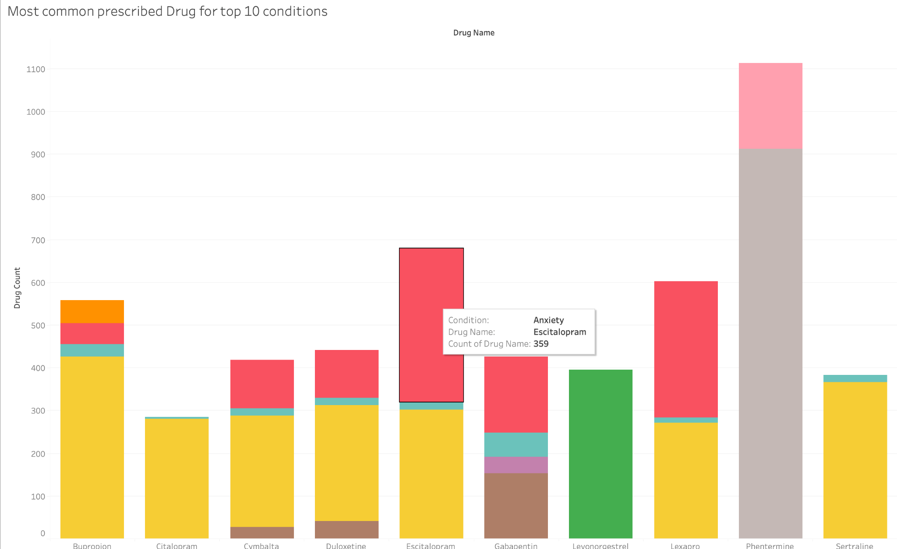
Most Commonly Prescribed Drugs for top 10 Conditions

Slide 22
Some Techniques Used
L2 Regularization - prevent overfitting by penalizing large weights in the model, encouraging simpler and more generalizable representations.
Keras Tuner - enables the automatic search for the optimal hyperparameters of a neural network model using techniques such as random search, hyperband, or Bayesian optimization.
Cross-Validation - A resampling technique used in machine learning to assess how well a predictive model will generalize data by estimating the performance of a model by splitting the available data into multiple subsets, called folds.

Slide 23
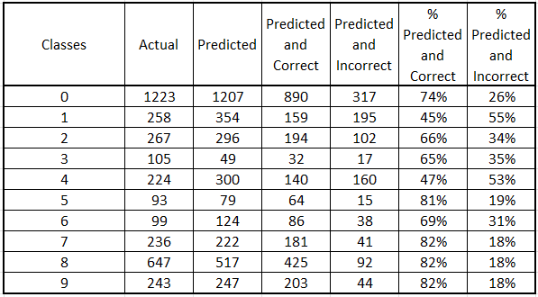
Most Accurate Model: Test Data Classification

Slide 24
Sentiment Analysis

Slide 25
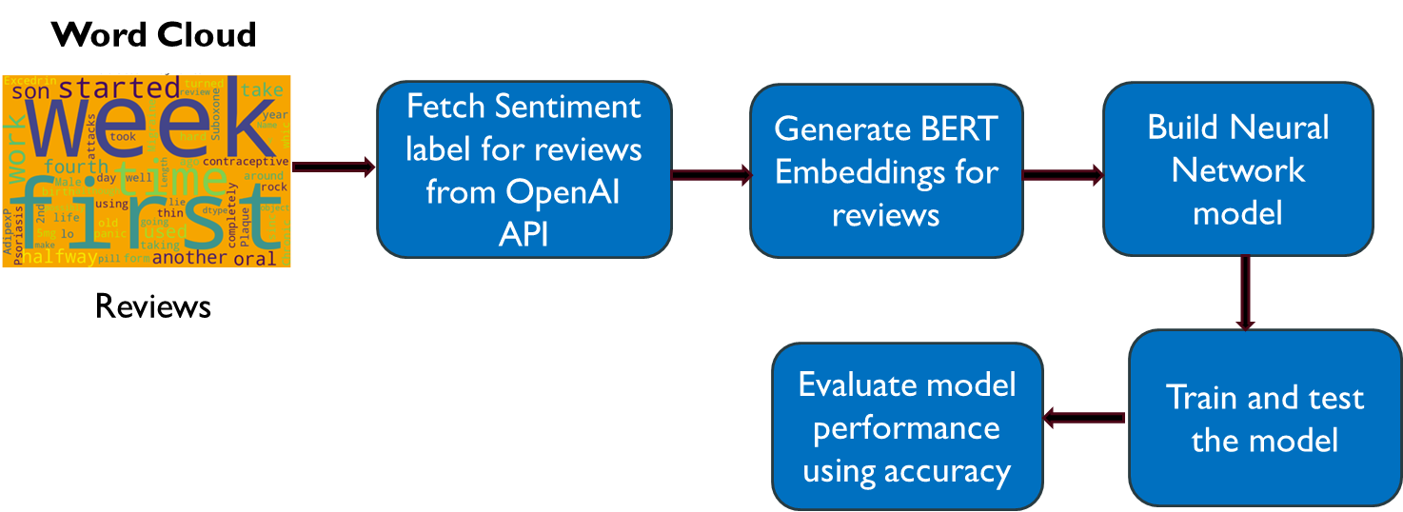
Decoding Reviews: Steps to Sentiment Analysis

Slide 26
Data Preparation : Labeling the reviews
•OpenAI API chat completion
•Prompt - sentiment labels: Positive, Negative and Neutral
Input features - Review Embeddings (768 components)
Target feature - Sentiment

Slide 27
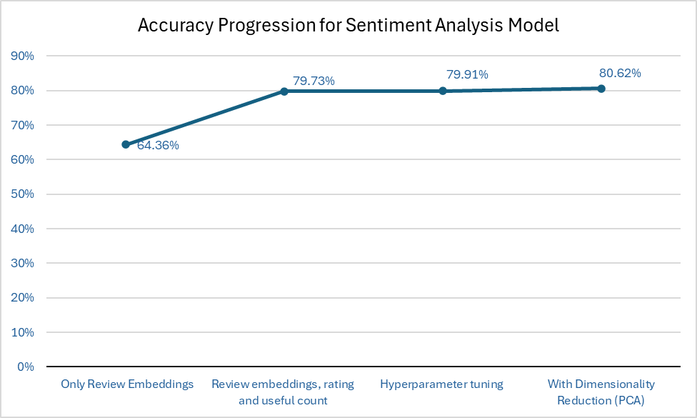

Slide 28
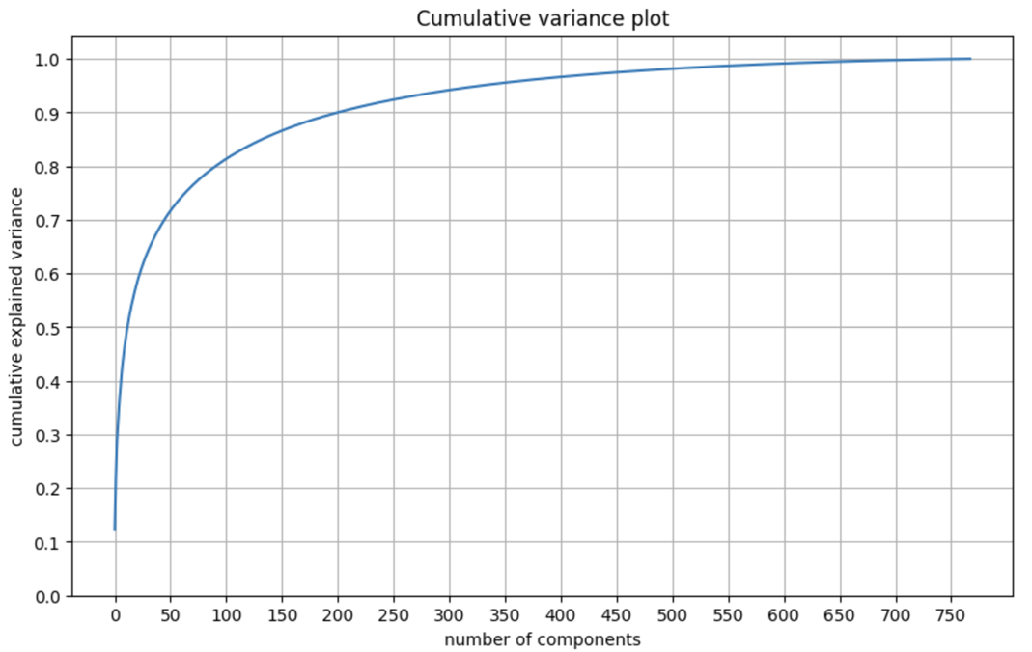

Slide 29
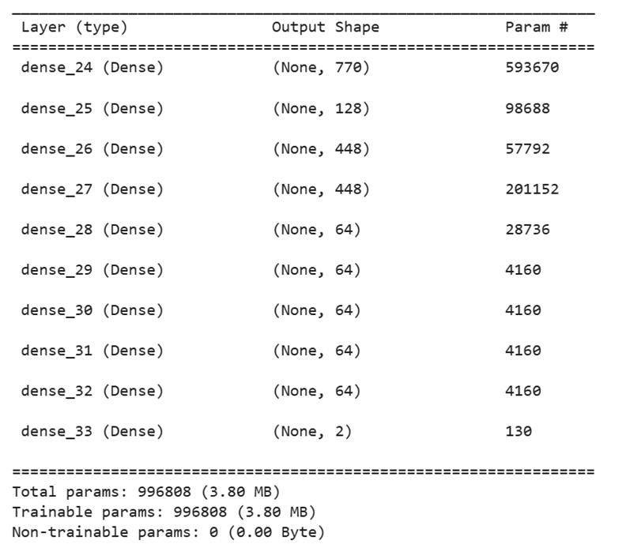
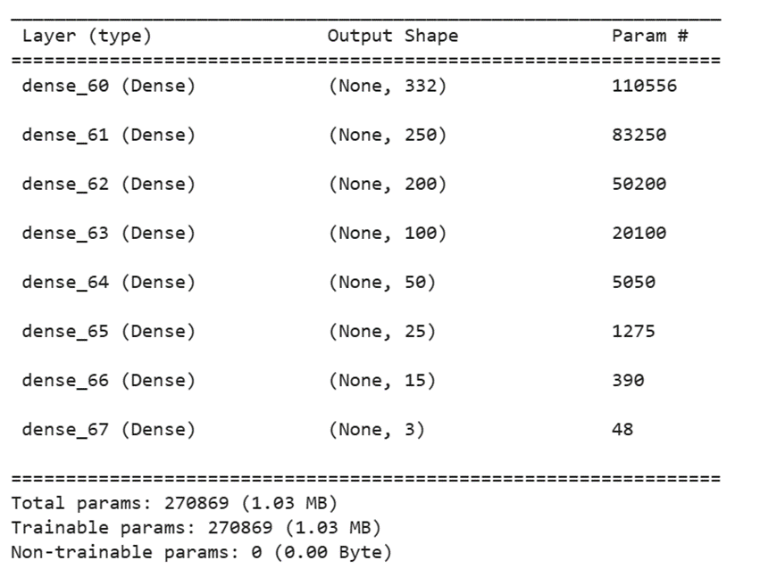
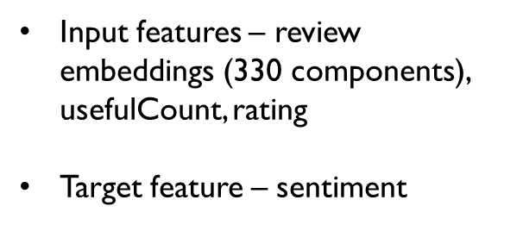
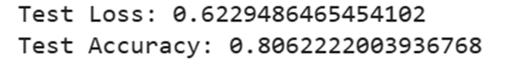
Neural Network Model

Slide 30
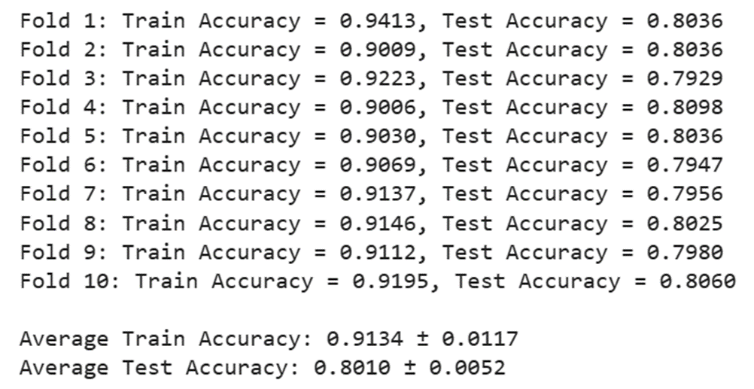
Model Evaluation: Stratified k-fold Cross-Validation

Slide 31
Neural Net Target:
Drug Cluster

Slide 32
Predicting Drug Cluster
Problem: To check if we can predict the drug cluster for a drug with high confidence using features such as 1) embedded review, 2) ratings, 3) useful_count and 4) drug name dummy variable.

Slide 33
Predicting Drug Cluster - Experiment
We used word2vec google library to embed drug name.This library organizes words based on their meanings, grouping similar words together closely in a geometric space. Then we used K-Means to group these words into clusters.
By using all available features (including drug name) and a similar Neural Net structure, our team was able to classify the Drug Name cluster with 95.41% accuracy.
Such a high prediction accuracy asserts that clustering was done appropriately and if a prediction is made for a new Drug, it is highly likely for it to be placed in correct cluster.

Slide 34
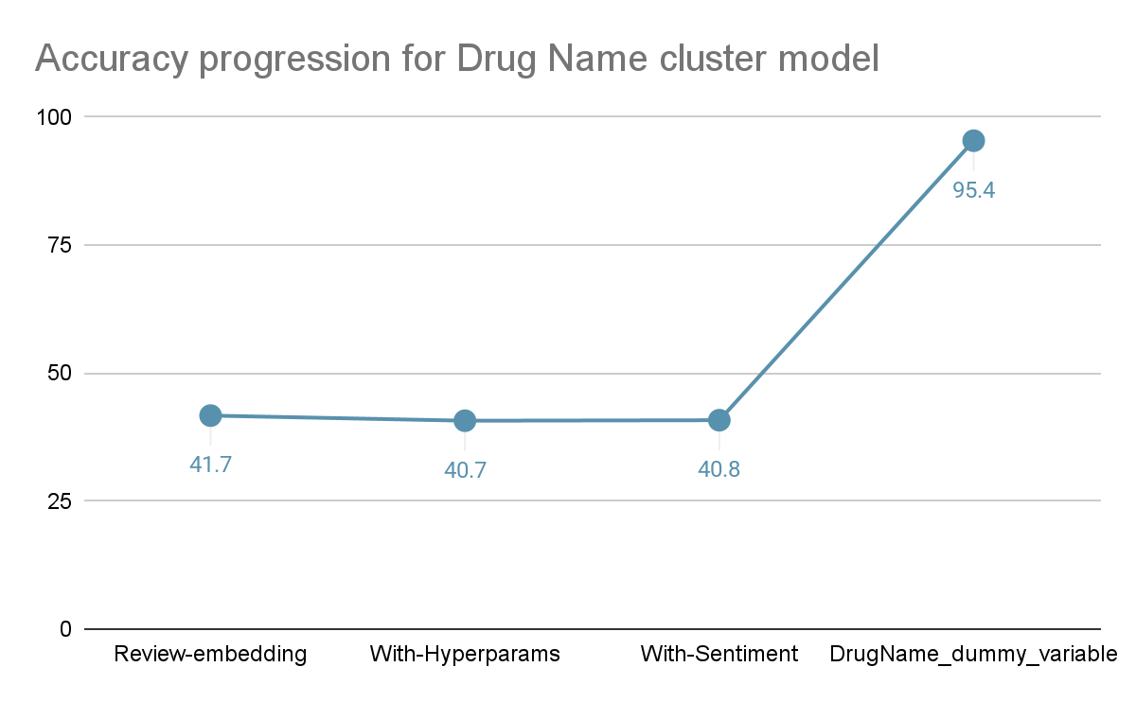

Slide 35
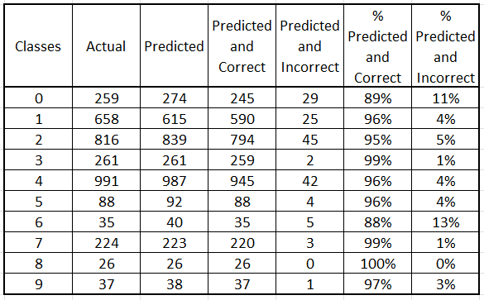
Test Data Classification

Slide 36
Usefulness of the model
For Pharma Companies
For Drug online seller Companies

