Slide 1

Customer Segmentation Predectation Using Python
Team name : Chasers
Team Member:
Smruti Ranjan Pradhan
Shisir kumar Rout
Bhagyashree Sahoo
Sangram Pradhan
Ranjit Kumar Nayak

Slide 2
Contents
Introduction
Advantages of Customer Segmentation
How to Implement Customer Segmentation in Python?
What Is K Means Clustering?
The mathematics of clustering
Deciding on the optimum number of clusters ‘K’
Understanding the K-Means Algorithm
Broad steps of the k-means algorithm
Conculsions

Slide 3
Introduction
What is Customer Segmentation?
Customer Segmentation is the process of division of customer base into several groups of individuals that share a similarity in different ways that are relevant to marketing such as gender, age, interests, and miscellaneous spending habits.

Slide 4
Advantages of Customer Segmentation
Determine appropriate product pricing.
Develop customized marketing campaigns.
Design an optimal distribution strategy.
Choose specific product features for deployment.
Prioritize new product development efforts.

Slide 5
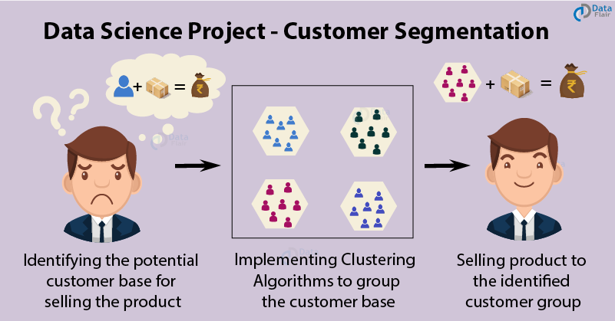
How to Implement Customer Segmentation in Python?
In this project, we will make use of K-means clustering which is the essential algorithm for clustering unlabeled dataset.

Slide 6
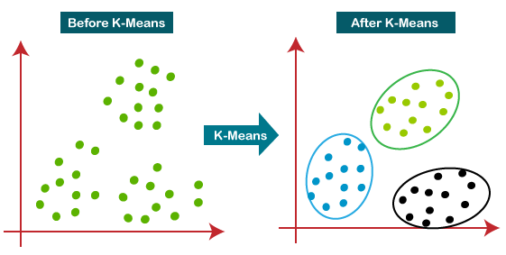
What Is K Means Clustering?
K means is one of the most popular Unsupervised Machine Learning Algorithms Used for Solving Classification Problems. K Means segregates the unlabeled data into various groups, called clusters, based on having similar features, common patterns.

Slide 7
The mathematics of clustering
The mathematics behind clustering, in very simple terms involves minimizing the sum of square of distances between the cluster centroid and its associated data points:
K = number of clusters
N= number of data points
C=centroid of cluster j
(xij — cj)– Distance between data point and centroid to which it is assigned

Slide 8
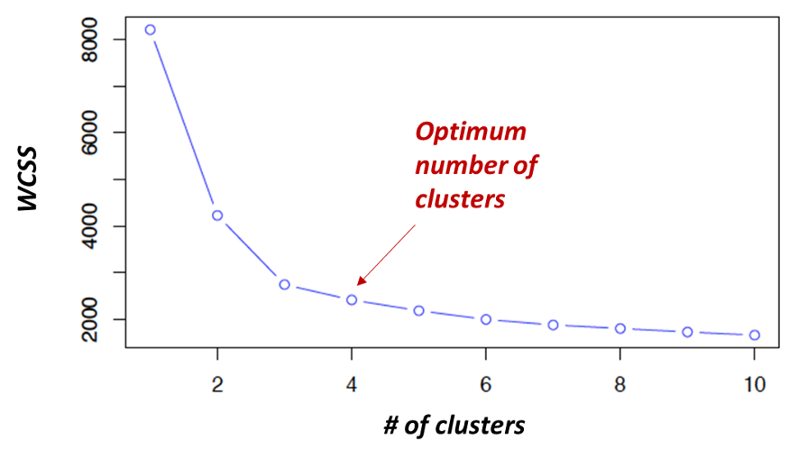
Deciding on the optimum number of clusters ‘K’
The main input for k-means clustering is the number of clusters. This is derived using the concept of minimizing within cluster sum of square (WCSS). A scree plot is created which plots the number of clusters in the X axis and the WCSS for each cluster number in the y-axis.

Slide 9
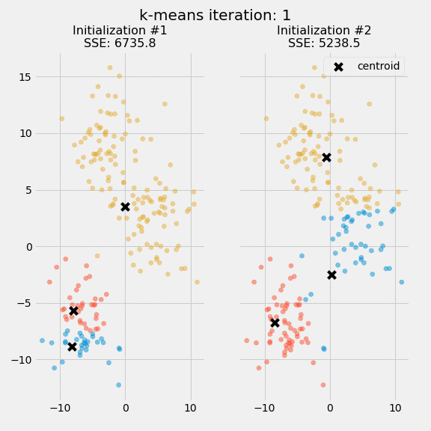
Understanding the K-Means Algorithm
The main element of the algorithm works by a two-step process called expectation-maximization. The expectation step assigns each data point to its nearest centroid. Then, the maximization step computes the mean of all the points for each cluster and sets the new centroid.
The figure shows the centroids and SSE updating through the first five iterations from two different runs of the k-means algorithm on the same dataset.

Slide 10
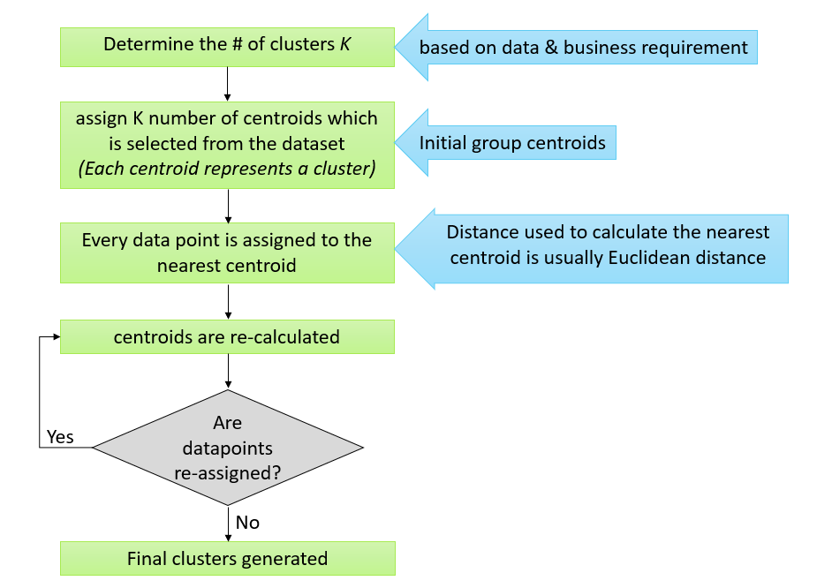
Broad steps of the k-means algorithm
K-means clustering is an iterative clustering algorithm where the number of clusters K is predetermined and the algorithm iteratively assigns each data point to one of the K clusters based on the feature similarity.

Slide 11
Conclusions
K means clustering is one of the most popular clustering algorithms and usually the first thing practitioners apply when solving clustering tasks to get an idea of the structure of the dataset.
The goal of K means is to group data points into distinct non-overlapping subgroups.
One of the major application of K means clustering is segmentation of customers to get a better understanding of them which in turn could be used to increase the revenue of the company.

Slide 12
Reference
https://www.kaggle.com/vjchoudhary7/customer-segmentation-tutorial-in-python

Slide 13
Thank You

