Slide 1
Data Analysis of Historical spot price data for Crude Oil and Petroleum products February 2019
Ranjita Rajeeva Shetty
LinkedIn: https://www.linkedin.com/in/ranjitashetty/
Email: rrs462@nyu.edu
Phone: +1 (201) 744-5227

Slide 2
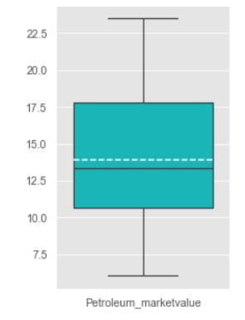
Quick Insights: 1. Insights/observations from the data
Average market value for Crude Oil and Petroleum Products is $13.9 per gallon
Crude Oil and Petroleum Products Market Value (Dollars Per Gallon)
Mean | $13.9
Standard Deviation | $4.0
Median | $13.4
Metric Definition:
Crude Oil and Petroleum Products Market Value in any month is sum of the spot prices of crude oil and all the petroleum products in that month
Note: Months considered for this analysis is from June 2006 to January 2019

Slide 3
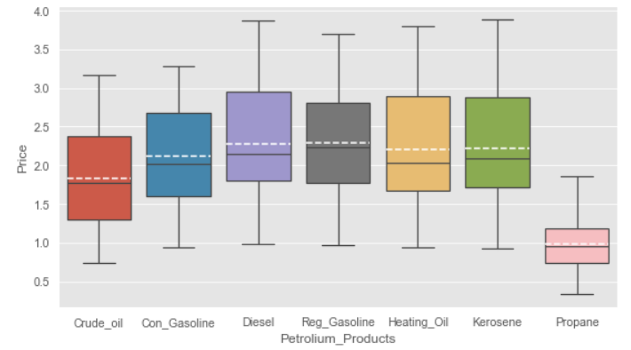
Quick Insights: 1. Insights/observations from the data
Diesel and Regular Gasoline are on an average more expensive than other fuel types
 | Mean | Standard Deviation | Median
Crude oil | $ 1.83 | $ 0.57 | $ 1.77
Con Gasoline | $ 2.12 | $ 0.59 | $ 2.02
Diesel | $ 2.28 | $ 0.67 | $ 2.14
Reg Gasoline | $ 2.29 | $ 0.59 | $ 2.23
Heating Oil | $ 2.20 | $ 0.67 | $ 2.04
Kerosene | $ 2.23 | $ 0.69 | $ 2.09
Propane | $ 0.98 | $ 0.34 | $ 0.96
Diesel and Regular gasoline with $2.28 per gallon are the most expensive fuel type on an average
Propane is the cheapest among all the fuel types at $0.98 per gallon on an average
From above box plot we can see that spot prices for Crude oil and Petroleum products are right skewed, where mean is greater than median
Note: Months considered for this analysis is from June 2006 to January 2019

Slide 4
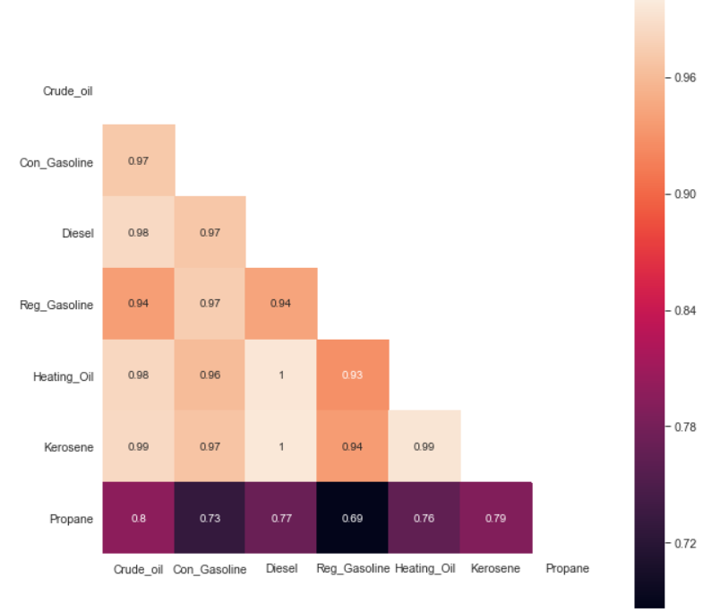
Quick Insights: 1. Insights/observations from the data
There is high correlation between Crude Oil and Petroleum Products prices except Propane
Note: Months considered for this analysis is from June 2006 to January 2019

Slide 5
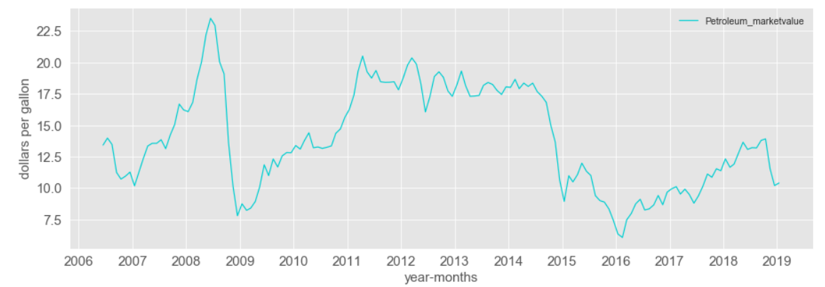
Quick Insights: 2. Possible link between the price of the petroleum products and external factors.
There is high correlation between Crude Oil and Petroleum Products prices except Propane
Mid 2000s: Asia drives rising demand as production stagnates
2011: Arab spring
2008: Global Financial Crisis
2014-15: Global oversupply -OIL GLUT - and reduce demand from emerging countries
Sources: Wikipedia, Business Insider, Forbes, World Economic Forum
Note: Months considered for this analysis is from June 2006 to January 2019

Slide 6
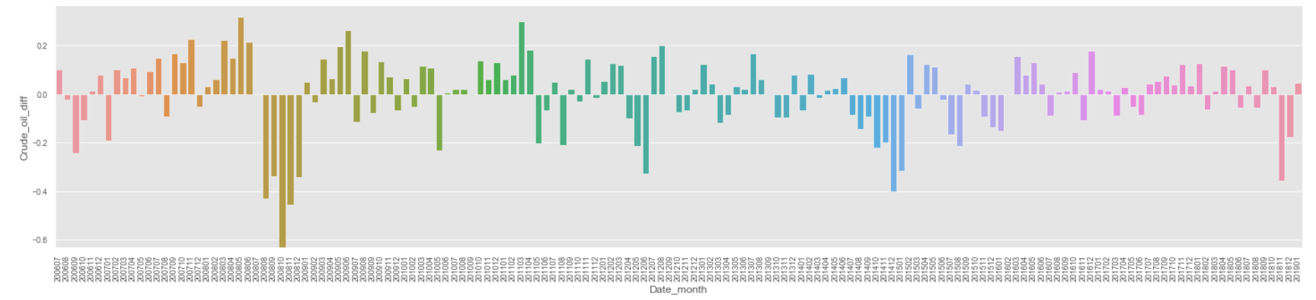
Quick Insights: 3. Create column to find price changes month over month
Crude oil price changes month over month was highest in October 2008
Note: Months considered for this analysis is from June 2006 to January 2019

Slide 7
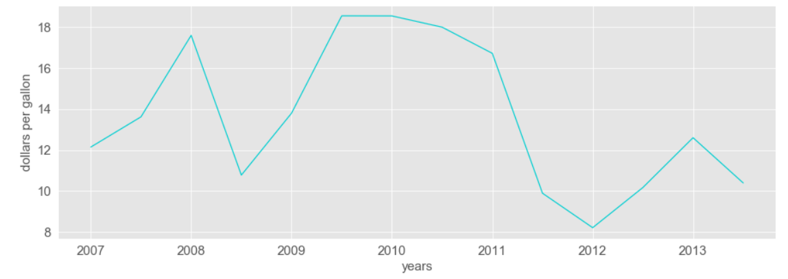
Quick Insights: 4. Summarized price and price movement by year
Summarized price
Summarized price is sum of spot prices of Crude oil and petroleum products for each month
The summarized price is rolled up by taking mean at year level
Note: Months considered for this analysis is from June 2006 to January 2019

Slide 8
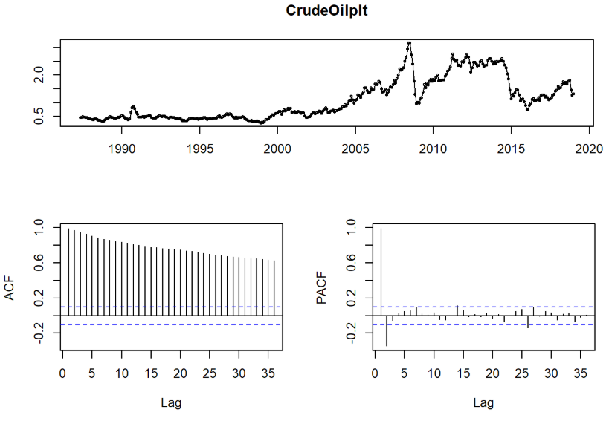
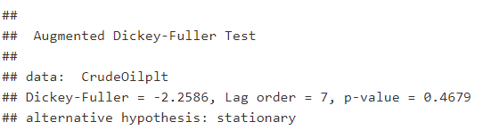
Deep Dive Analysis: 5. Crude oil price for next 6 months
Crude oil price is a non stationary process
From Augmented Dickey-Fuller test shows that the Crude Oil price is not stationary process
ACF and PACF plots are showing that the Crude oil spot price time series has both AR and MA components

Slide 9
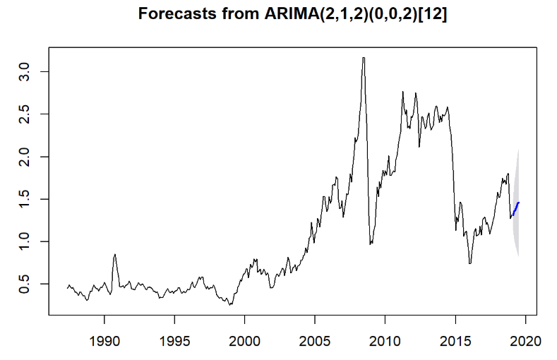
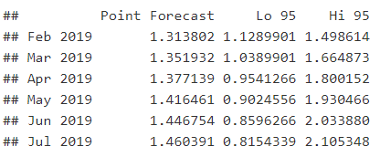
Deep Dive Analysis: 5. Predict the crude oil price for next 6 months
So our forecasting model is ARIMA(2,1,2)SARIMA(0,0,2)[12]
Forecasts for next 6 months (Dollars per gallon)

Slide 10
Deep Dive Analysis: 6. Identify the correlation between Conventional Gasoline prices between New York Harbor and U.S. Gulf Coast
Correlation of Conventional Gasoline spot price is very high (0.998) between New York Harbor and U.S. Gulf Coast
 | New York Harbor Conventional Gasoline Regular Spot Price FOB (Dollars per Gallon) | U.S. Gulf Coast Conventional Gasoline Regular Spot Price FOB (Dollars per Gallon)
New York Harbor Conventional Gasoline Regular Spot Price FOB (Dollars per Gallon) | 1 | 0.998
U.S. Gulf Coast Conventional Gasoline Regular Spot Price FOB (Dollars per Gallon) | 0.998 | 1
Note: Months considered for this analysis is from June 2006 to January 2019

Slide 11
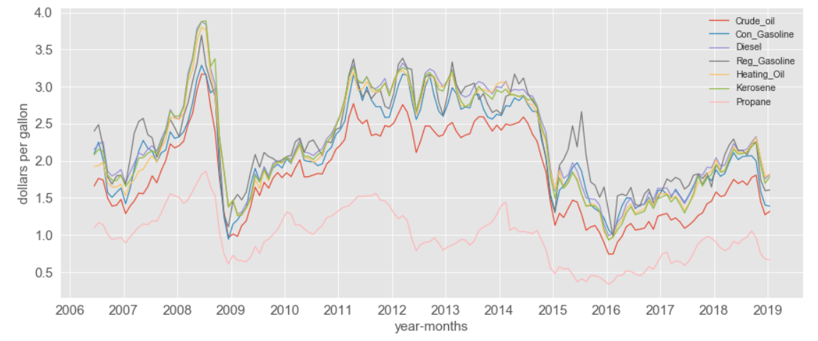
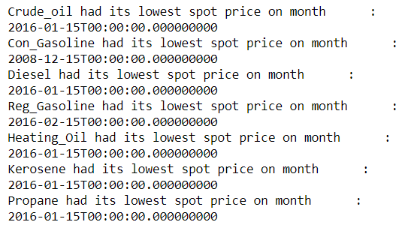
Deep Dive Analysis: 7. Is there a month/quarter/year where prices of all Products were lower than prior data points
Crude oil and all petroleum products except Conventional Gasoline had their lowest spot prices on Jan and Feb of 2016
Lowest spot price months for all products
Note: Months considered for this analysis is from June 2006 to January 2019

